Slide 1
How to Harvest Web Data Efficiently and Ethically
November 18, 2020
Notes:
Welcome. We are so happy you’re here.

Slide 2
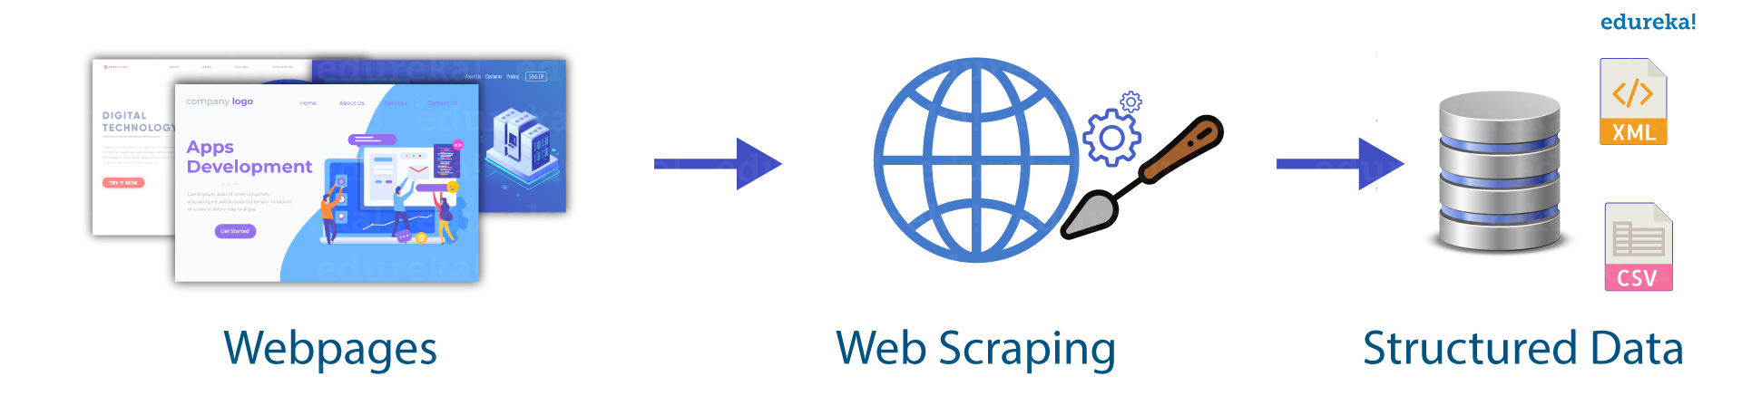
What is Web Harvesting?
Web harvesting or scraping is an automated process of extracting data from websites.
Step 1 Harvesting - Accesses website contents through hypertext transfer protocol (HTTP) or a web browser.
Step 2 Parsing - Extracts, copies, and stores data from a webpage in a local database or spreadsheet.
Step 1
Step 2
Image taken from: https://www.edureka.co/blog/web-scraping-with-python/

Slide 3

Goals for Today
Learning Objectives
Scraping Etiquette
Harvest – GET Methods
wget
curl
requests
Parse – Python Tools
Selenium
Beautiful Soup
Your thoughts – Should I scrape this?

Slide 4
Web Scraping Etiquette

Slide 5
Web Scraping Etiquette
Follow the guidelines of robots.txt and Terms of Service

Slide 6
Web Scraping Etiquette
Follow the guidelines of robots.txt and Terms of Service
Allowed
Blocked
User-Agent: *
Disallow: /...
Allow: /…
Crawl-delay: 20
User-Agent: *
Disallow: / …

Slide 7
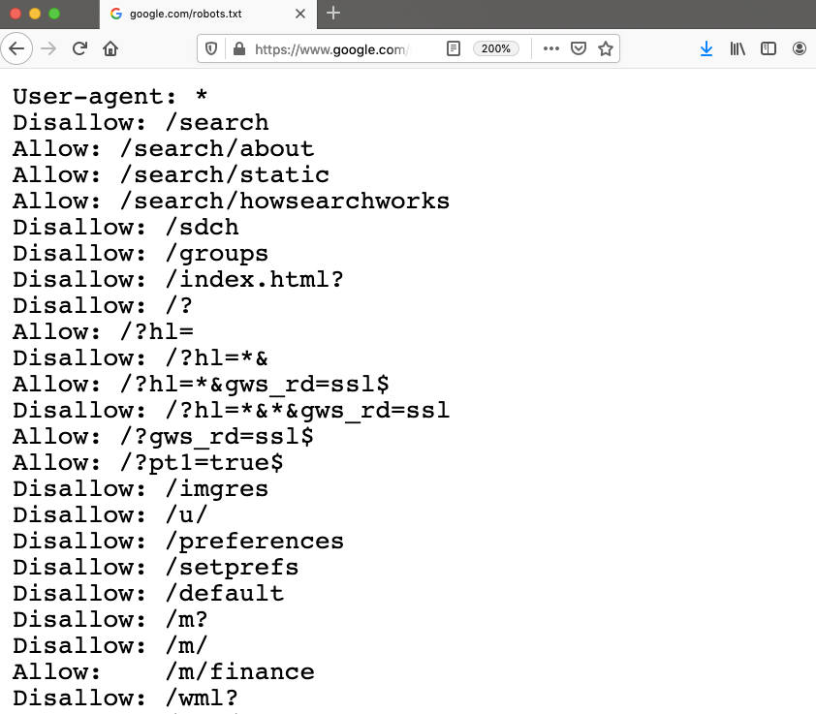
Web Scraping Etiquette – robots.txt Ex. 1

Slide 8
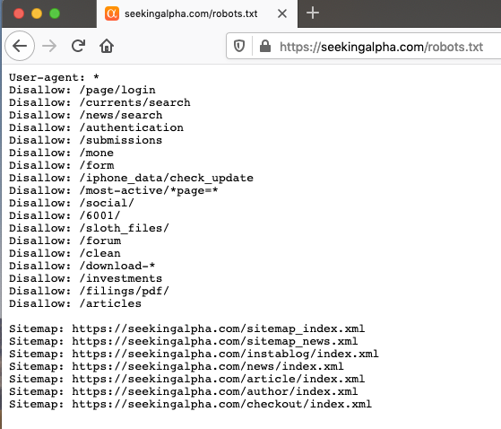
Web Scraping Etiquette – robots.txt Ex. 2

Slide 9
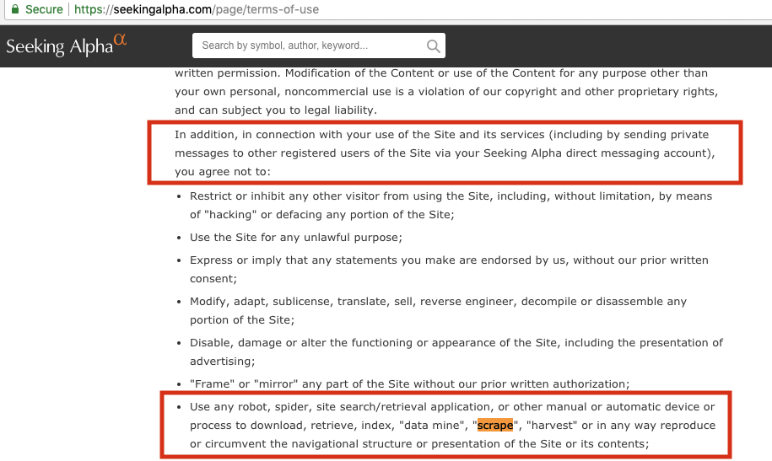
Web Scraping Etiquette –TOS Ex. 2

Slide 10
Web Scraping Etiquette
Follow the guidelines of robots.txt and Terms of Service
Use your own IP address (Don’t Lie)
Allowed
Blocked
User-Agent: *
Disallow: /
Allow: /
Crawl-delay: 20
User-Agent: *
Disallow: /

Slide 11
Web Scraping Etiquette
Follow the guidelines of robots.txt and Terms of Service
Use your own IP address (Don’t Lie)
Throttle your requests -- Sleep Times
Allowed
Blocked
User-Agent: *
Disallow: /
Allow: /
Crawl-delay: 20
User-Agent: *
Disallow: /

Slide 12
Web Scraping Etiquette
Follow the guidelines of robots.txt and Terms of Service
Use your own IP address (Don’t Lie)
Throttle your requests -- Sleep Times
When in doubt, ask for permission
Allowed
Blocked
User-Agent: *
Disallow: /
Allow: /
Crawl-delay: 20
User-Agent: *
Disallow: /

Slide 13
Harvesting – GET Methods
GET requests are an HTTP method a client (your computer) can call
wget (World Wide Web + get) – A command line utility used to retrieve files via HTTP, HTTPS, and FTP
curl (Client for URLs) – A command line tool used to retrieve files via many protocols
requests – The de facto library for making HTTP requests in Python

Slide 14
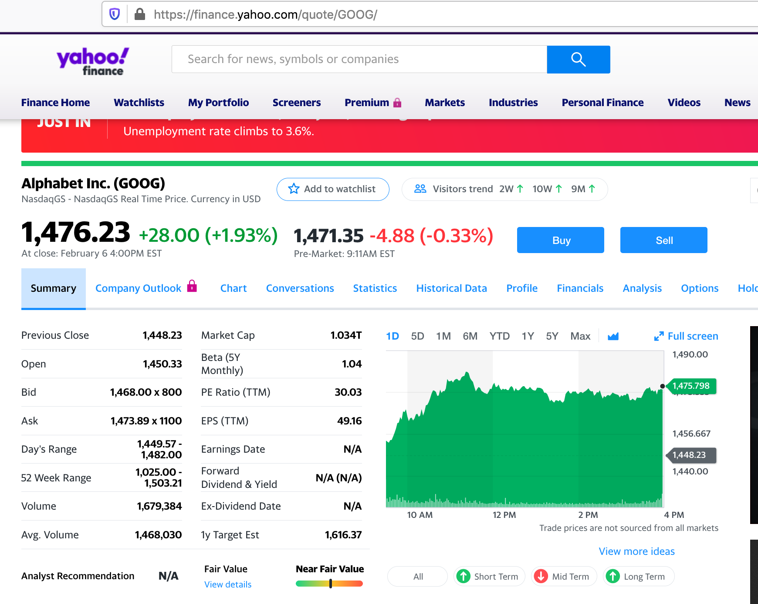
Harvesting – Task 1

Slide 15
GET Methods – wget
Download a single file wget https://finance.yahoo.com/quote/GOOG
Download contents of an FTP site
wget --user=NAME --password='PASSWORD' ftp://url/path/file.name
Mirror a site:
wget –m --user=dlpuser@dlptest.com --password= ‘SzMf7rTE4pCrf9dV286GuNe4N’ ftp://ftp.dlptest.com/
Download the contents of a website recursively (Max Depth=5)
wget --recursive --level 4 --wait 10 --limit-rate 250K https://finance.yahoo.com/quote/GOOG
Help Menu
wget -h

Slide 16
GET Methods – curl
Download a single file in a different format curl https://finance.yahoo.com/quote/GOOG > goog.html
Download contents of an FTP or SFTP site
curl -u dlpuser@dlptest.com:SzMf7rTE4pCrf9dV286GuNe4N -0 ftp://ftp.dlptest.com/
Upload files to an FTP or SFTP site
curl -u dlpuser@dlptest.com:SzMf7rTE4pCrf9dV286GuNe4N -T myfile.txt ftp://ftp.dlptest.com/
Help Menu
curl -h

Slide 17
GET Methods – requests
Let’s use the requests library to download the Yahoo Finance Summary Page for a few companies!
Copy the contents of the github repository for scraping
cd $HOME
git clone https://github.com/rs-kellogg/
fellows_workshop
Load appropriate modules, run python file
cd fellows_workshop/2-harvest
ls
module load python/anaconda3.6
python sleeper.py

Slide 18
GET Methods – Summary
Recursive
downloads:
Quick
Use
Upload and
send files
Integrate
with
library
Retrieve
data from:
Available
from:
HTTP,
HTTPS,
FTP
command
line
✓
✓
wget
HTTP, HTTPS, FTP, DICT, FILE,, FTPS, GOPHER, IMAP,IMAPS, LDAP, LDAPS, POP3, POP3S, RTMP, RTSP, SCP, SFTP, SMB, SMBS, SMTP, SMTPS, TELNET, TFTP
curl
command
line
✓
libcurl
requests
HTTP,
HTTPS
python
✓

Slide 19

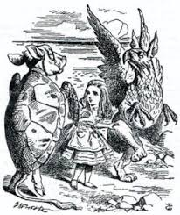
Parsing – Python Packages
Selenium - A python package, Selenium, allows you to extract data from JavaScript links on a website.
Beautiful Soup – Another python package, BeautifulSoup, allows you to parse the HTML code from a website

Slide 20
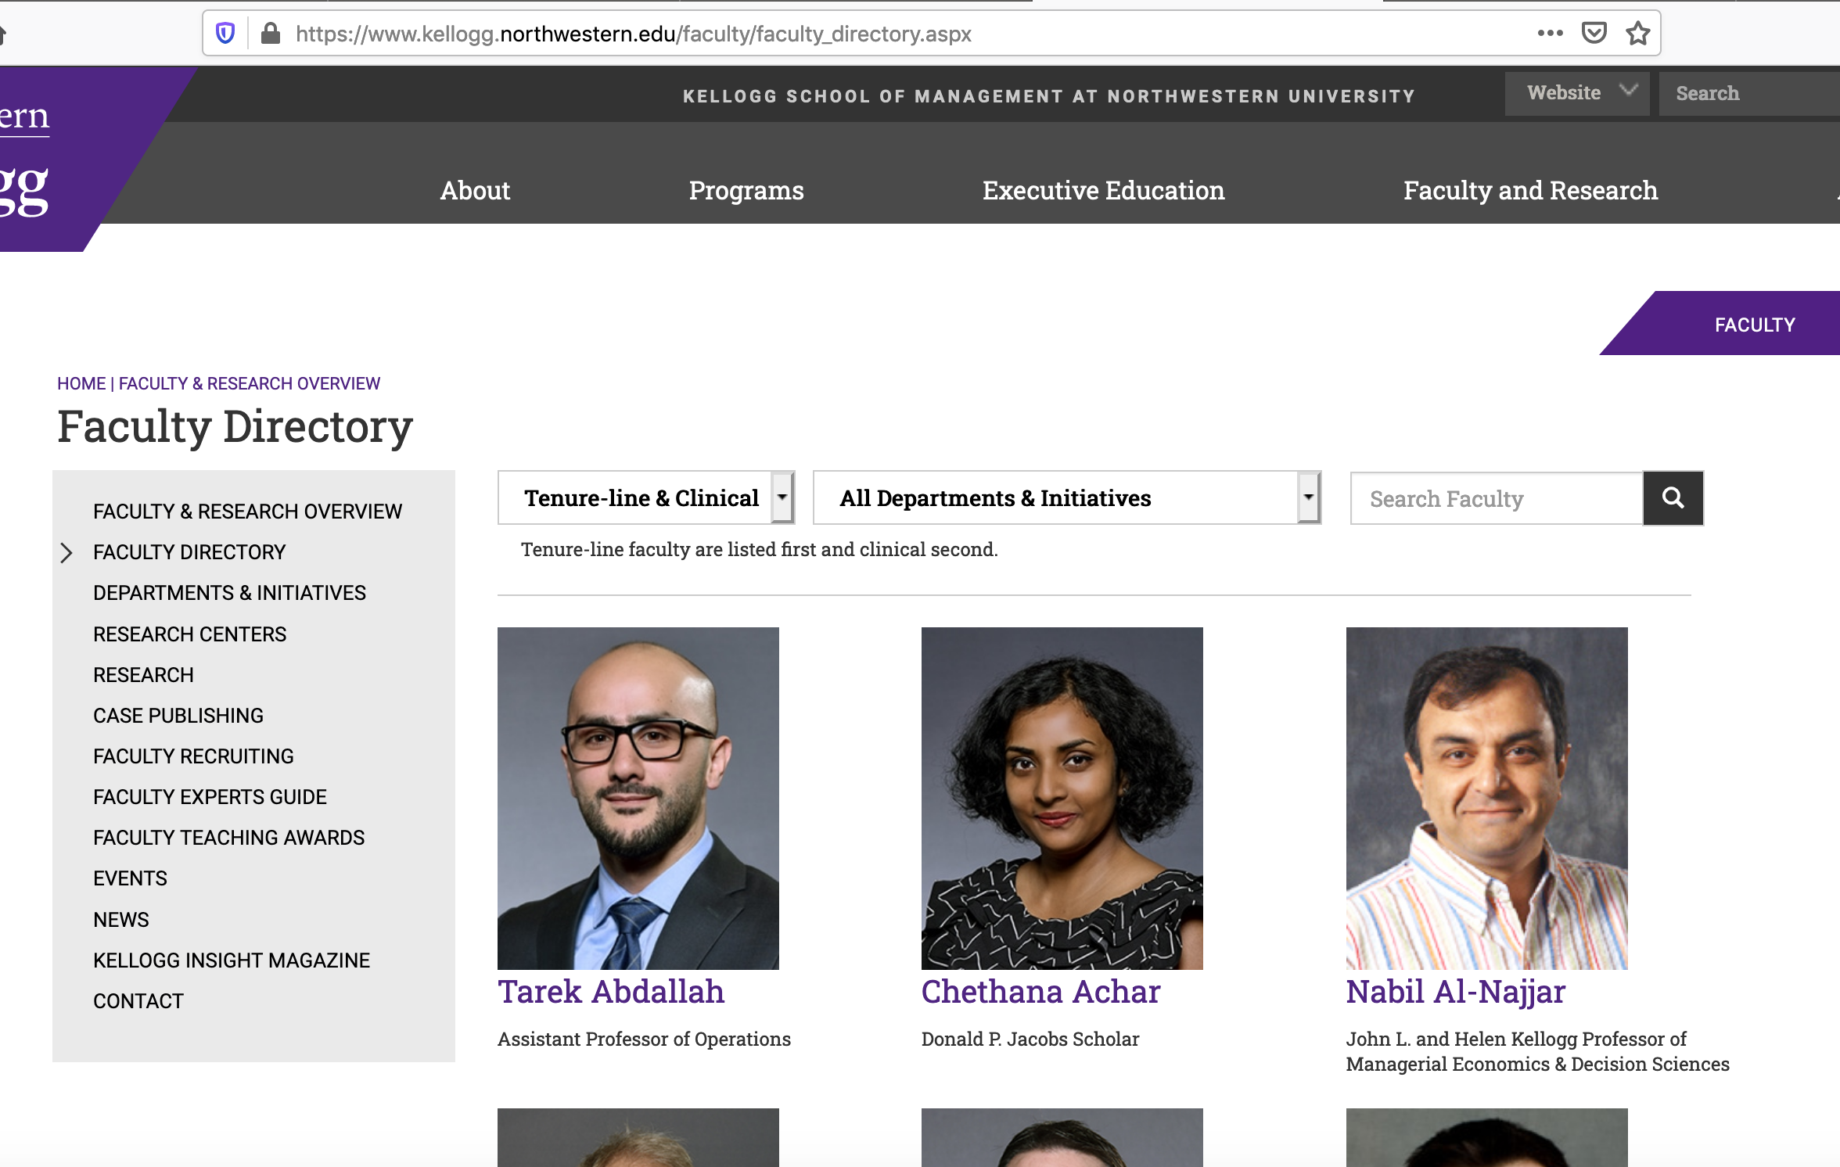
Parsing – Task 2

Slide 21
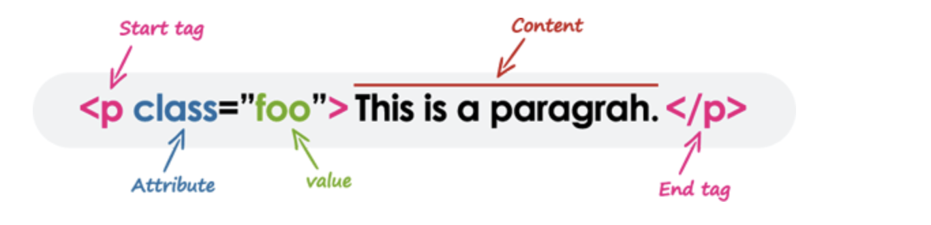
HTML Elements – Tag, Attribute, Value
Source: https://www.tutorialrepublic.com/html-tutorial/html-elements.php

Slide 22
HTML Elements
< div id = “bindFaculty” …………………….>
<h2 id = “facName”>
<a href = “/faculty/directory/abdallah_tarek”
target = “_blank”>Tarek Abdallah </a>
<div id= “Faculty-Guide-content”>
Assistant Professor of Operations </div>
</h2>
</div>

Slide 23
Run Python Scraping Libraries on KLC
Open a GNOME Terminal Session in FastX and type the
following:
module load python/anaconda3.6
module load firefox/62
﻿#export PATH=/kellogg/bin:$PATH
#export PYTHONNOUSERSITE=True
source activate harvestNov2020_env
jupyter notebook --browser=firefox

Slide 24
Should you scrape?
Sure
..﻿
﻿
﻿
No way!
..

Slide 25
Should you scrape?
Sure
Data is publicly available
Everyone else is scraping it --Code available online
Why is it any different than manually downloading or copying the data?
No way!
Isn’t this what hackers do?

Slide 26
Should you scrape?
It Depends….
Does it violate the terms of service or robots.txt?
Are you pretending to be someone else? Lying?
Are you getting your computer/Northwestern blocked?
Others have faced legal action:
Facebook vs. Pete Warden
LinkedIn vs. Doe Defendants
Can you lose net ID privileges? other university sanctions?
Will a journal publish your data/findings?

Slide 27
Takeaways
Check if a website has an API
Respect the Terms of Service (TOS) and robots.txt
Use sleep times
Identify yourself with a legitimate user agent string
When in doubt, ask….
Research Support
Contact the website directly

