Slide 1
Research Fellows - Session Three Version Control – Git, Github, Conda Environments
Summer 2022

Slide 2

Version Control without Git
Image taken from: http://phdcomics.com/comics/archive_print.php?comicid=1531

Slide 3
Today we will Cover
The difference between Git and Github
Using Git locally as a version control tool on KLC
Syncing your local Git directory to a Github repository
Discussion: Using Git and Github Smartly
Creating conda environments on KLC

Slide 4
Git vs. Github

Slide 5
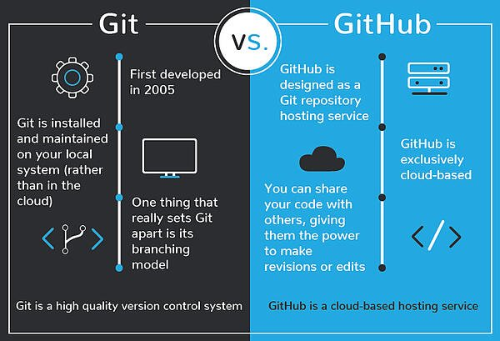
Git vs. GitHub
Image taken from: https://blog.devmountain.com/git-vs-github-whats-the-difference/

Slide 6
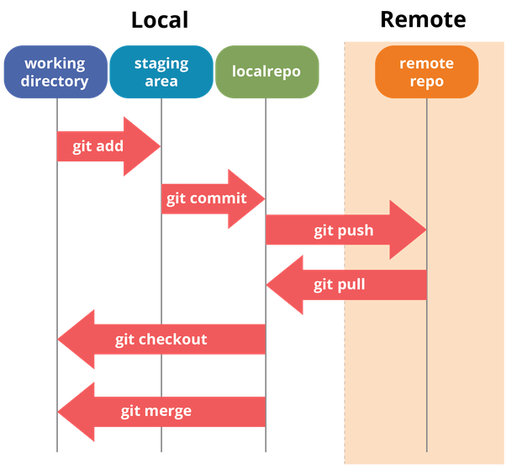
Git and Github Overview
Image taken from: https://dev.to/mollynem/git-github--workflow-fundamentals-5496

Slide 7
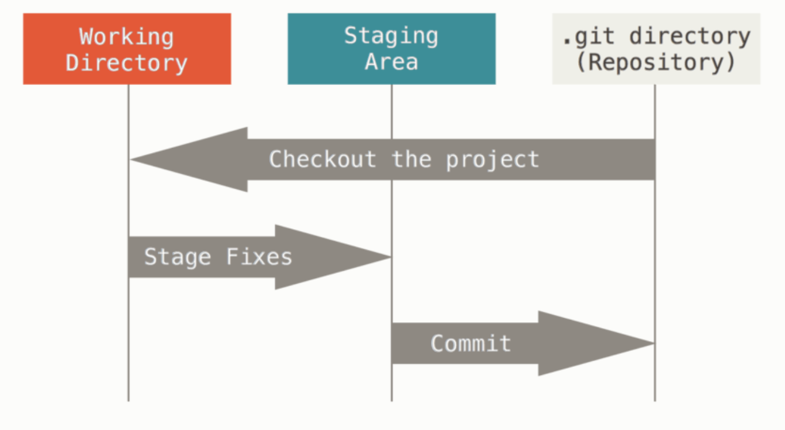
Committing Changes
Image taken from: https://git-scm.com/book/en/v2/Getting-Started-What-is-Git%3F

Slide 8
Using Git on KLC

Slide 9
Loading git on KLC
Recall that no modules are preloaded in a new KLC session. You will need to load everything you use.
To see what version of a software package are available type:
module load git
The first time you load git on KLC, you need to set the username and email it will use when it records your commits. Note that this will have no bearing on your Github login later on.
git config --global user.name "John Doe"
git config --global user.email johndoe@northwestern.edu
git config --list
Resources:
NU IT page: https://kb.northwestern.edu/page.php?id=78598
NU IT github: https://github.com/nuitrcs/intermediate-git-workshop

Slide 10
Cloning a repo and initializing a local repo
A Git repository (”repo”) is essentially a container for your Git code.
You can create a Git repo on KLC from scratch or you can download an existing public Github repo and work on the code locally on KLC.
Let’s first clone a public Github repo to your home directory:
git clone https://github.com/rs-kellogg/fellows_workshop_2022
It should download a directory called: fellows_workshop_2022.
Create a subfolder called practice within the Week 3 directory
cd fellows_workshop_2022/Session3_Version_Control/
mkdir practice
cd practice
The first step to start version control with Git is to initialize your (empty) directory:
git init

Slide 11
Make Changes to your repo
Note that when you initialize a repo a new hidden folder will be saved here:
ls -a
If you type the following, you notice there is no activity in your Git repo:
git status
Let’s make some basic changes to the Git repo we initialized. For instance, let’s start by moving in all the FEC files we cloned from Github.
mv ~/fellows_workshop_2022/Session3_Version_Control/fec* ~/fellows_workshop_2022/Session3_Version_Control/practice/
Now running git status will show untracked changes.

Slide 12
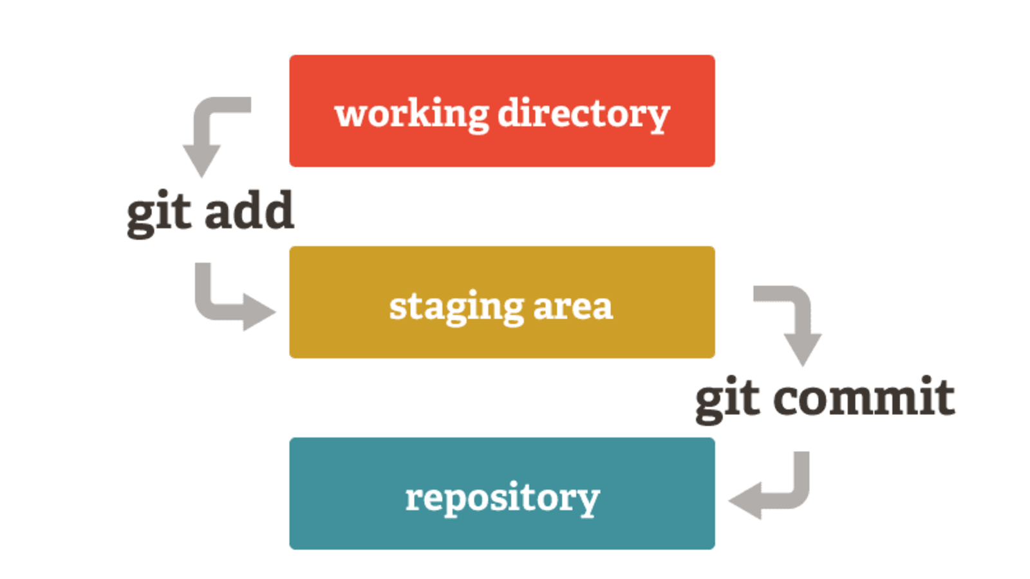
Saving Changes to a local git repo
Since a Git repo consists of two spaces: a “staging area” and the actual “repository”, saving changes requires two steps:
1.) an “add” and 2.) a “commit”.
Image taken from:
https://medium.com/tech-and-the-city/changing-a-super-old-git-commit-history-20346f709ca9

Slide 13
Saving Changes to a local git repo
We can add the files we moved to the staging area with the following:
﻿git add fec_all.sh fec_cron.sh fec_extract.py fec_process.R
OR
git add .
We can move the files from staging area to the local Git practice repo with:
﻿git commit -m "Add all FEC files to repo”
After making these changes, we can retrieve a log:
git log

Slide 14
Retrieving a Previous Version
If we go back to our git log, there is an alpha-numeric sequence associated with each commit. These are commit-hashes.
To retrieve a previous version of a document or set of documents, use the commit-hash:
﻿git checkout <commit hash>
Files in a git repo are saved in branches. Branches are essentially timelines on Git. For now, we have been working in the main branch called “master”. You can return to the main timeline with:
﻿git checkout master

Slide 15
Syncing local Git directory to Github repo

Slide 16
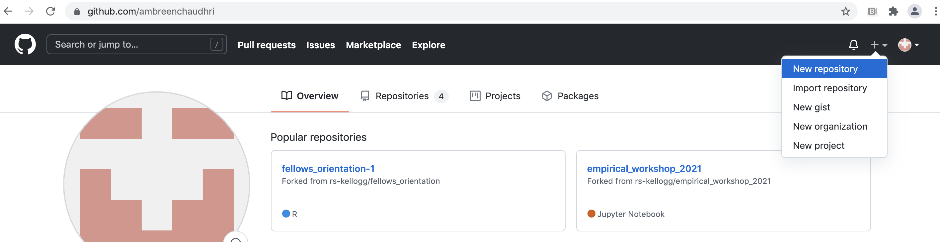
Creating and accessing a Github Repo
We can go to a Github account to create a new private repo to save our local changes.
Follow the steps to create a repo and you will receive a page with instructions to access it.

Slide 17
Accessing a github repo on KLC
The instructions should list how to add a ”remote” to your Github repo, which is equivalent to a label for your Github url.
﻿git remote add origin https://github.com/<user>/git_practice.git
Note that “origin” is just a generic name. You can use any name you like. The following command will show you the remote that is set.
﻿git remote -v

Slide 18
Saving Changes to a Github repo

Slide 19
Saving local Git repo to Github
To push the changes in your local repo to Github, do the following:
﻿git branch –M main
git push –u origin main
The push request will require you to sign into your Github account on KLC. In order to do so you will need a personal access token. You can acquire one by going to:
Settings → Developer Settings → Personal Access Token → Generate New Token
The steps are described here: https://docs.github.com/en/github/authenticating-to-github/keeping-your-account-and-data-secure/creating-a-personal-access-token

Slide 20
Saving Github changes to local repo
If you manually add files or make other changes on Github, you can sync those changes to your local git repo on KLC by doing the following:
git pull origin main

Slide 21
Discussion: Using Git Smartly

Slide 22
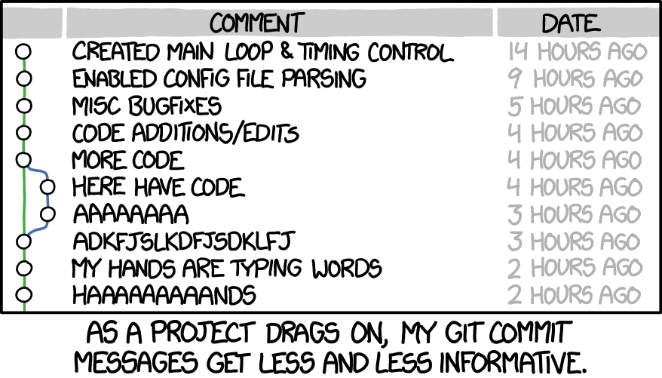
Discussion: Using Git and Github Smartly

Slide 23
Discussion: Using Git and Github Smartly
Git tools are not a substitute for good documentation. You are still responsible for making decisions about whether the code is tested, what version is saved, how descriptive the comments are. Placing bad code in Git/Github is still bad code!

Slide 24
Creating Conda Environments on KLC

Slide 25
Creating a Conda Environment
Instead of loading each module you would like to use in your shell script separately, you can also create conda environment. Follow the steps below only once to create the environment:
module load python-miniconda3/4.12.0
conda create -n automate_env r-essentials r-base
source activate automate_env
conda install r-fs
conda install pandas
To leave the environment:
source deactivate automate_env
In the future, you will only need to activate the environment to load all modules and libraries.
source activate automate_env

Slide 26
Conda Environments Using a yaml file
The basic commands for creating a conda environment only allow you to install one package at a time. A yaml file allows you to install multiple packages while accounting for dependencies between libraries. Using a text editor, create the following file on KLC called automate_env.yml.
To run this file from the command line, type:
conda env create -f automate_env.yml
To save a conda environment to a yaml file:
conda env export > automate_env.yml
# Create automate_env.yml file
# begin automate_env.yml
name: automate_env
channels:
- defaults
dependencies:
- pandas=1.4.3
- r-base=3.6.1
- r-essentials=3.6.0
# end automate_env.yml

Slide 27
Appendix

Slide 28
Appendix – Branching on Git
A branch is an independent line of development. You could think of a branch as a timeline of a project that could be created in parallel with the main branch. To see a list of branches a project contains, type:
git branch
If you’d like to make an experimental branch of a project and start working on it, type the following:
git branch experimental
git checkout experimental
The changes you make in a new branch will remain independent of the master branch you are working on. Once you are comfortable with these changes, you can merge them back to the master branch by doing the following:
git checkout master
git merge experimental

Slide 29
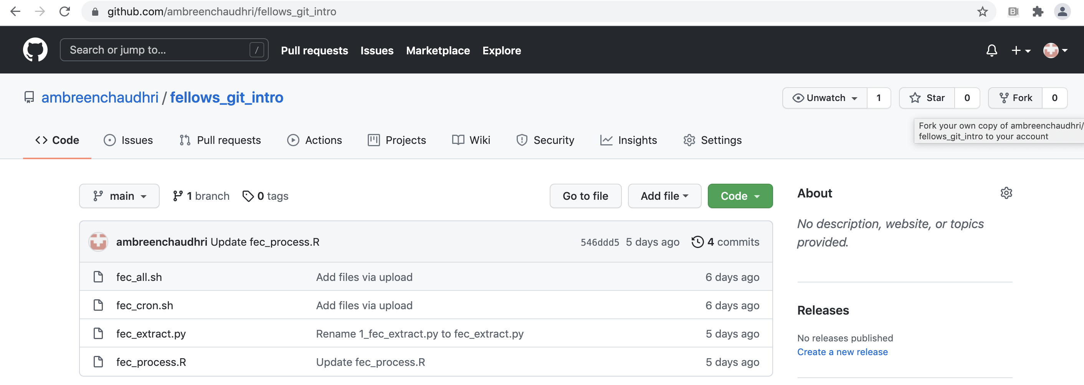
Appendix – Forking a Github Repo
Much like cloning, forking enables a user to copy all the contents of a Github repository. However, forking a repo also enables a user to suggest and possibly implement changes to the original repository with the creator’s approval. Forking is a useful tool to collaborate with others to improve open-source code.
There is no command line tool in the Git module on KLC to fork a repository. Instead, navigate to the main page of a repository. On the right side, select the “Fork” button. The selected repository will be copied to your list of Github repos.

