Slide 1
Research Fellows - Session Two Automating Research Work
Summer 2022

Slide 2

Automating and Scripting on KLC

Slide 3
Today we will Cover
Automation Advice in your Code
Running the Code from a Terminal on KLC
Scripting Multiple Tasks at Once
Scheduling processes in cron

Slide 4
Automate Checks/Changes in Code

Slide 5
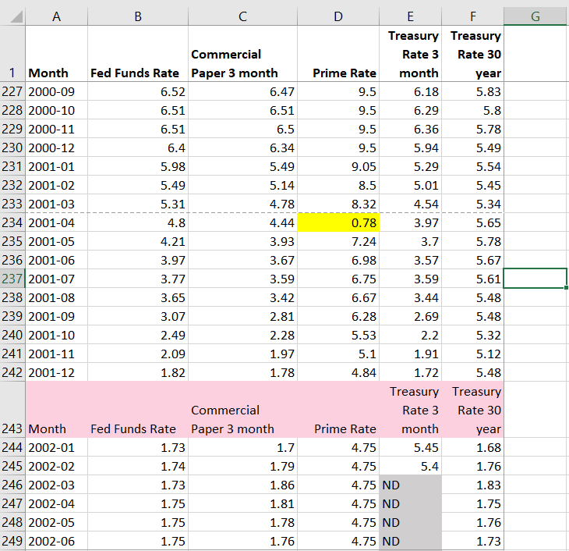
Automating Changes to Data
Change out of Range data points
Remove repeated header rows
Fix missing value notation: NDs to NAs

Slide 6
Opening a GUI on KLC
Recall that no modules are preloaded in a new KLC session. You will need to load everything you use.
To see what version of a software package are available type:
module avail <software name>
module avail R
module avail stata
module avail python
To load something type:
module load <software version>
module avail R/4.0.3
module load stata/17
module load python/anaconda3.6
To launch a GUI:
rstudio
xstata-mp
spyder

Slide 7
Launching Code from Command Line

Slide 8
Launching Code from Terminal
To launch an R file:
Rscript <file_name.R>
To launch a python file:
python <file_name.py>
To launch a stata do file:
stata-mp -b do <file_name.do>
For the FEC example:
python 1_fec_extract.py --start=2018 --end=2020

Slide 9
Scripting Multiple Tasks at Once

Slide 10
Creating a Shell Script
If you’d like to run multiple files in sequence, you can create a shell script on KLC using the nano editor.
nano <file_name.sh>
Here is a simple example file:
#!/bin/bash
clear
# load modules
module load python/anaconda3.6
module load R/4.0.3
# run scripts
python file.py
Rscript file.R
To make the file executable:
chmod +x <file_name.sh>

Slide 11
Running a Shell Script
To make the file executable:
chmod +x <file_name.sh>
To run the script:
./<file_name.sh>
or
source <file_name.sh>
For the FEC example:
source fec_all.sh

Slide 12
Cron Jobs

Slide 13
Creating a Cron Job
To create a cron job type the following from any node:
crontab -e
Note that you will need to enter your job in a vi editor.
To insert text type “i”
To exit text type “esc”
To save changes type “:wq”
To exit the file without saving changes type “:q!
To enter a cron job for the cron_example.sh shell script and print the results to a file:
15 12 * * * sh ~/cron_example.sh > ~/cron_output.txt
45 12 * * * sh ~/fellows_workshop_2022/
Session2_Automation/FEC/fec_cron.sh > ~/fellows_workshop_2022/Session2_Automation/
FEC/fec_cron_output.txt

Slide 14
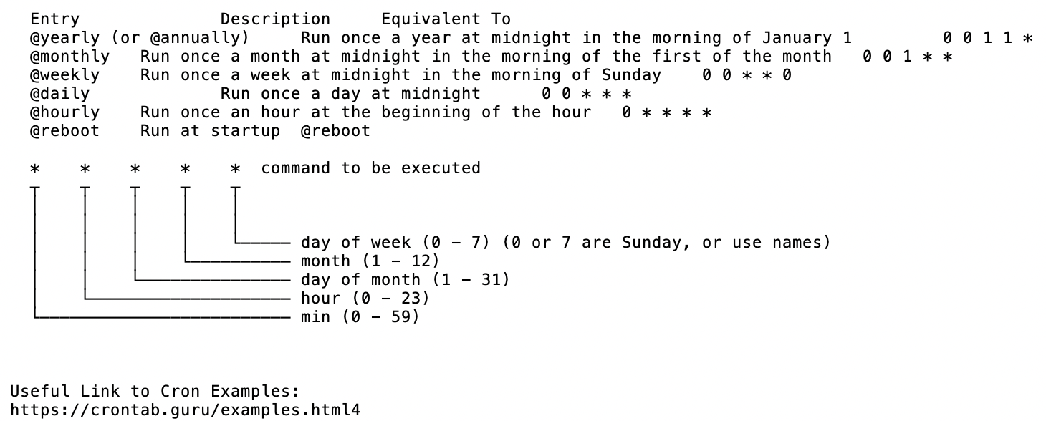
Crontab Guide

Slide 15
Crontab Examples
The following example will run every 10 minutes
*/10 * * * * /usr/bin/somedirectory/somecommand
The following example will run every 3 hours and 30 minutes
*/30 */3 * * * /usr/bin/somedirectory/somecommand
The following example will run every day at 8am
0 8 * * * /usr/bin/somedirectory/somecommand
The following example will run every Friday at 2pm
0 14 * * FRI /usr/bin/somedirectory/somecommand
0 14 * * 6 /usr/bin/somedirectory/somecommand
The following example will run every month
0 0 1 * * /usr/bin/somedirectory/somecommand
The following example will run every quarter (4 times a year)
0 0 1 */3 * /usr/bin/somedirectory/somecommand
The following example will run the specified months only.
0 0 10 Jan,Apr,Jul,Oct * /usr/bin/somedirectory/somecommand

Slide 16
Creating a Shell Script for Cron
Create a sample shell script for a cron job in the nano editor and follow the previous steps to make it executable:
nano cron_example.sh
In the nano editor, enter the following:
#!/bin/bash -l
source ~/.bash_profile
# load modules
module load python/anaconda3.6
# run scripts
python file.py
# print message
echo “Cron Job is Running on KLC Node 5”

Slide 17
Appendix

Slide 18
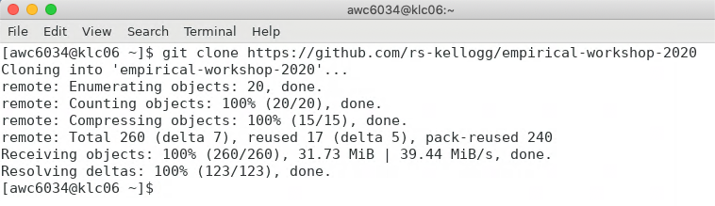
Appendix: Git Clone Workshop to KLC
Recall that we’ll first copy the contents of this week’s github lecture notes/materials to our KLC home directories.
Launch a Terminal window on KLC
Type the following into the command line:
git clone https://github.com/rs-kellogg/fellows_workshop_2022/
To update the contents of an existing cloned directory, navigate to the folder and type:
cd ~/fellows_workshop_2022
git pull

Slide 19
Appendix - Creating a Conda Environment
Instead of loading each module you would like to use in your shell script separately, you can also create conda environment. Follow the steps below only once to create the environment:
module load python-miniconda3/4.12.0
conda create -n automate_env r-essentials r-base
source activate automate_env
conda install r-fs
conda install pandas
To leave the environment:
source deactivate automate_env
In the future, you will only need to activate the environment to load all modules and libraries.
source activate automate_env

