Slide 1
Session Four Automating your Workflows, Scripting, Audit Trails Kellogg Research Support
Summer 2022
Notes:
Welcome. We are so happy you’re here.
What you are about to hear next is about the closest you will get to a lecture in this workshop series. Most of the rest of this will be pretty interactive.
There will be discussions and you follow along with a demonstration, and maybe try to solve a few problems yourself.
But before we get into demonstrations of tools and how to apply them to your research work, I want to talk a bit about the reproducibility of that work you are about to start.
It is a very important topic, and I believe there are a few general principles that, if kept in mind, can help you quite a lot when you go to reproduce your work in the future.

Slide 2
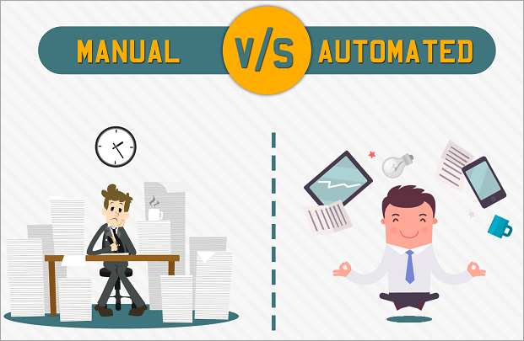
Automating and Scripting on KLC
Notes:
You should care about reproducibility because it matters to so many different people.
<CLICK>
When you publish your work, many stakeholders will need to be able to reproduce your results. It will be a problem for you when they cannot.
<CLICK>
Even before publication time, your collaborators will thank you – or curse you – depending on how easy or difficult it is to follow what you have done and replicate results consistently.
Even if you do not expect to work with others or do not value their comfort, there is one very important collaborator you will always have:
<CLICK>
Your future self. That person will always be responsible for everything your younger self does. Be kind to the future version of you.

Slide 3
Today we will Cover
Automation Advice in your Code
Running the Code from a Terminal on KLC
Scripting Multiple Tasks at Once
Scheduling processes in cron
Notes:
Here is one last cautionary example about manual work.
This is real source file with historical information about different interest rates, and it is a messy file.
Highlighted in yellow is a cell that contains a clerical error. The prime rate in April, 2001, should be 7.8 -- not 0.78
The file also has some inconvenient flaws. The header row keeps repeating throughout the data, what you see highlighted in pink.
Also, the source file uses “ND” to indicate null. You probably would want those values in the CSV file to be blank before reading these into Stata.
<CLICK>
So the dilemma is, you could fix these issues in a few seconds in Excel.
Just overwrite cell D234. Manually delete the extra headers. Do a global search and replace on “ND.”
But should you?
If your future self had to recreate your analysis from scratch in the year 2025, would you remember to do all those things exactly as you had before?

Slide 4
Automate Checks/Changes in Code

Slide 5
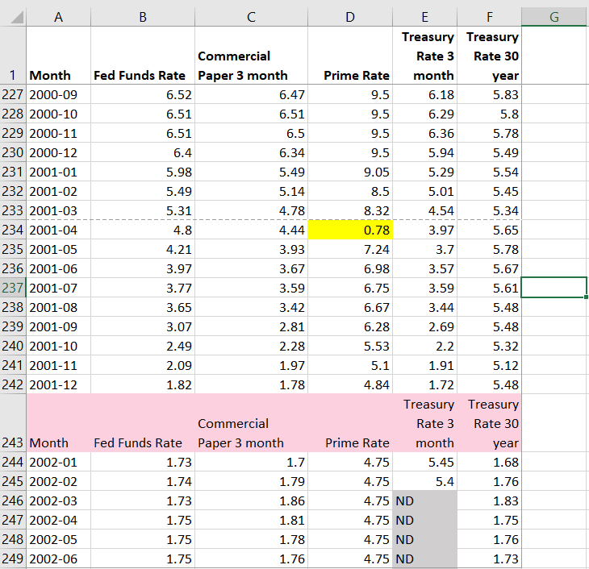
Automating Changes to Data
Change out of Range data points
Remove repeated header rows
Fix missing value notation: NDs to NAs
Notes:
Here is one last cautionary example about manual work.
This is real source file with historical information about different interest rates, and it is a messy file.
Highlighted in yellow is a cell that contains a clerical error. The prime rate in April, 2001, should be 7.8 -- not 0.78
The file also has some inconvenient flaws. The header row keeps repeating throughout the data, what you see highlighted in pink.
Also, the source file uses “ND” to indicate null. You probably would want those values in the CSV file to be blank before reading these into Stata.
<CLICK>
So the dilemma is, you could fix these issues in a few seconds in Excel.
Just overwrite cell D234. Manually delete the extra headers. Do a global search and replace on “ND.”
But should you?
If your future self had to recreate your analysis from scratch in the year 2025, would you remember to do all those things exactly as you had before?

Slide 6
Opening a GUI on KLC
Recall that no modules are preloaded in a new KLC session. You will need to load everything you use.
To see what version of a software package are available type:
module avail <software name>
module avail R
module avail stata
module avail python
To load something type:
module load <software version>
module avail R/4.1.1
module load stata/17
module load python/anaconda3.6
To launch a GUI:
rstudio
xstata-mp
spyder
Notes:
One final thought about repdocudibility…
To reproduce results implies that you were able to produce them correctly in the first place.
So throughout the workshops, we will try to emphasize the virtue of breaking your problems into smaller pieces
And then testing them relentlessly to convince yourself they are doing what you expect them to do.
Near the end of the series, one of our hours will be dedicated to helping you make your code “bulletproof.”

Slide 7
Launching Code from Command Line

Slide 8
Launching Code from Terminal
To launch an R file:
Rscript <file_name.R>
To launch a python file:
python <file_name.py>
To launch a stata do file:
stata-mp -b do <file_name.do>
Notes:
One final thought about repdocudibility…
To reproduce results implies that you were able to produce them correctly in the first place.
So throughout the workshops, we will try to emphasize the virtue of breaking your problems into smaller pieces
And then testing them relentlessly to convince yourself they are doing what you expect them to do.
Near the end of the series, one of our hours will be dedicated to helping you make your code “bulletproof.”

Slide 9
Scripting Multiple Tasks at Once

Slide 10
Creating a Shell Script
If you’d like to run multiple files in sequence, you can create a shell script on KLC using the nano editor.
nano <file_name.sh>
Here is a simple example file:
#!/bin/bash
clear
# load modules
module load python/anaconda3.6
module load R/4.1.1
# run scripts
python file.py
Rscript file.R
To make the file executable:
chmod +x <file_name.sh>
Notes:
One final thought about repdocudibility…
To reproduce results implies that you were able to produce them correctly in the first place.
So throughout the workshops, we will try to emphasize the virtue of breaking your problems into smaller pieces
And then testing them relentlessly to convince yourself they are doing what you expect them to do.
Near the end of the series, one of our hours will be dedicated to helping you make your code “bulletproof.”

Slide 11
Running a Shell Script
To make the file executable:
chmod +x <file_name.sh>
To run the script:
./<file_name.sh>
or
source <file_name.sh>
Notes:
One final thought about repdocudibility…
To reproduce results implies that you were able to produce them correctly in the first place.
So throughout the workshops, we will try to emphasize the virtue of breaking your problems into smaller pieces
And then testing them relentlessly to convince yourself they are doing what you expect them to do.
Near the end of the series, one of our hours will be dedicated to helping you make your code “bulletproof.”

Slide 12
Cron Jobs

Slide 13
Creating a Cron Job
To create a cron job type the following from any node:
crontab -e
Note that you will need to enter your job in a vi editor.
To insert text type “i”
To exit text type “esc”
To save changes type “:wq”
To exit the file without saving changes type “:q!
To enter a cron job for the cron_example.sh shell script and print the results to a file:
15 12 * * * sh ~/cron_example.sh > ~/cron_output.txt
Notes:
One final thought about repdocudibility…
To reproduce results implies that you were able to produce them correctly in the first place.
So throughout the workshops, we will try to emphasize the virtue of breaking your problems into smaller pieces
And then testing them relentlessly to convince yourself they are doing what you expect them to do.
Near the end of the series, one of our hours will be dedicated to helping you make your code “bulletproof.”

Slide 14
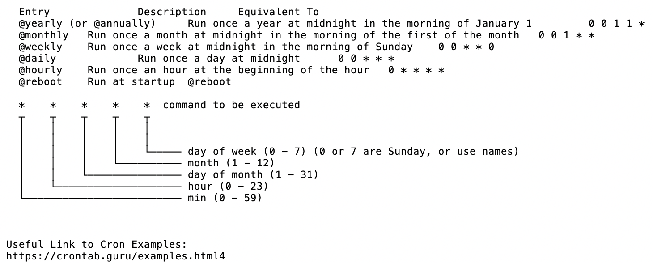
Crontab Guide
Notes:
One final thought about repdocudibility…
To reproduce results implies that you were able to produce them correctly in the first place.
So throughout the workshops, we will try to emphasize the virtue of breaking your problems into smaller pieces
And then testing them relentlessly to convince yourself they are doing what you expect them to do.
Near the end of the series, one of our hours will be dedicated to helping you make your code “bulletproof.”

Slide 15
Crontab Examples
The following example will run every 10 minutes
*/10 * * * * /usr/bin/somedirectory/somecommand
The following example will run every 3 hours and 30 minutes
*/30 */3 * * * /usr/bin/somedirectory/somecommand
The following example will run every day at 8am
0 8 * * * /usr/bin/somedirectory/somecommand
The following example will run every Friday at 2pm
0 14 * * FRI /usr/bin/somedirectory/somecommand
0 14 * * 6 /usr/bin/somedirectory/somecommand
The following example will run every month
0 0 1 * * /usr/bin/somedirectory/somecommand
The following example will run every quarter (4 times a year)
0 0 1 */3 * /usr/bin/somedirectory/somecommand
The following example will run the specified months only.
0 0 10 Jan,Apr,Jul,Oct * /usr/bin/somedirectory/somecommand
Notes:
One final thought about repdocudibility…
To reproduce results implies that you were able to produce them correctly in the first place.
So throughout the workshops, we will try to emphasize the virtue of breaking your problems into smaller pieces
And then testing them relentlessly to convince yourself they are doing what you expect them to do.
Near the end of the series, one of our hours will be dedicated to helping you make your code “bulletproof.”

Slide 16
Creating a Shell Script for Cron
Create a sample shell script for a cron job in the nano editor and follow the previous steps to make it executable:
nano cron_example.sh
In the nano editor, enter the following:
#!/bin/bash -l
source ~/.bash_profile
# load modules
module load python/anaconda3.6
# run scripts
python file.py
# print message
echo “Cron Job is Running on KLC Node 5”
Notes:
One final thought about repdocudibility…
To reproduce results implies that you were able to produce them correctly in the first place.
So throughout the workshops, we will try to emphasize the virtue of breaking your problems into smaller pieces
And then testing them relentlessly to convince yourself they are doing what you expect them to do.
Near the end of the series, one of our hours will be dedicated to helping you make your code “bulletproof.”

Slide 17
Appendix

Slide 18
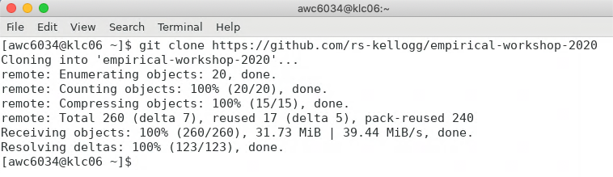
Appendix: Git Clone Workshop to KLC
Recall that we’ll first copy the contents of this week’s github lecture notes/materials to our KLC home directories.
Launch a Terminal window on KLC
Type the following into the command line:
git clone https://github.com/rs-kellogg/workshop_2022/
To update the contents of an existing cloned directory, navigate to the folder and type:
cd ~/workshop-2022
git pull
Notes:
One final thought about repdocudibility…
To reproduce results implies that you were able to produce them correctly in the first place.
So throughout the workshops, we will try to emphasize the virtue of breaking your problems into smaller pieces
And then testing them relentlessly to convince yourself they are doing what you expect them to do.
Near the end of the series, one of our hours will be dedicated to helping you make your code “bulletproof.”

Slide 19
Appendix - Creating a Conda Environment
Instead of loading each module you would like to use in your shell script separately, you can also create conda environment. The environment below will include R and install the tidyverse package. Follow the steps below only once to create the environment:
module load python/anaconda3.6
conda create -n <environment_name> r-essentials r-base
source activate <environment_name>
conda install <any R or python package>
conda install r-tidyverse
To leave the environment:
source deactivate <environment_name>
In the future, you will only need to activate the environment to load all modules and libraries.
source activate <environment_name>
Notes:
One final thought about repdocudibility…
To reproduce results implies that you were able to produce them correctly in the first place.
So throughout the workshops, we will try to emphasize the virtue of breaking your problems into smaller pieces
And then testing them relentlessly to convince yourself they are doing what you expect them to do.
Near the end of the series, one of our hours will be dedicated to helping you make your code “bulletproof.”

