Slide 1
Session Four Automating your Workflows, Scripting, Audit Trails Kellogg Research Support
Summer 2022

Slide 2
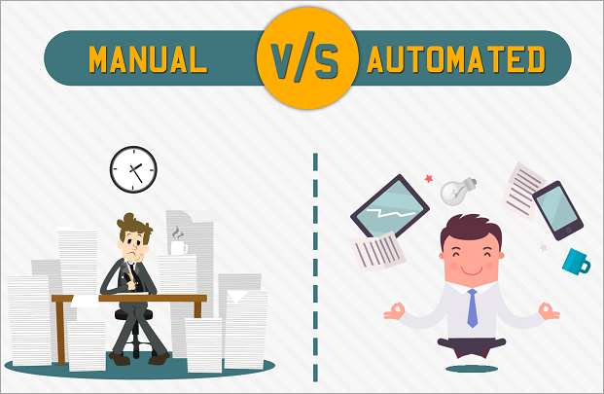
Automating and Scripting on KLC

Slide 3
Today we will Cover
Automation Advice in your Code
Running the Code from a Terminal on KLC
Scripting Multiple Tasks at Once
Scheduling processes in cron

Slide 4
Automate Checks/Changes in Code

Slide 5
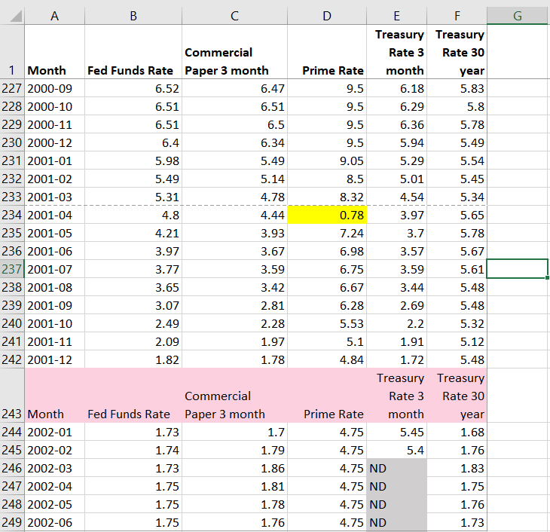
Automating Changes to Data
Change out of Range data points
Remove repeated header rows
Fix missing value notation: NDs to NAs

Slide 6
Opening a GUI on KLC
Recall that no modules are preloaded in a new KLC session. You will need to load everything you use.
To see what version of a software package are available type:
module avail <software name>
module avail R
module avail stata
module avail python
To load something type:
module load <software version>
module avail R/4.0.3
module load stata/17
module load python/anaconda3.6
To launch a GUI:
rstudio
xstata-mp
spyder

Slide 7
Exercise 1 – Using Regex
In the Interest Rate dataset, use Regular Expressions to separate the Month and Year from the “Month” variable.

Slide 8
Launching Code from Command Line

Slide 9
Launching Code from Terminal
To launch an R file:
Rscript <file_name.R>
To launch a python file:
python <file_name.py>
To launch a stata do file:
stata-mp -b do <file_name.do>

Slide 10
Scripting Multiple Tasks at Once

Slide 11
Creating a Shell Script
If you’d like to run multiple files in sequence, you can create a shell script on KLC using the nano editor.
nano <file_name.sh>
Here is a simple example file:
#!/bin/bash
clear
# load modules
module load python/anaconda3.6
module load R/4.0.3
# run scripts
python file.py
Rscript file.R
To make the file executable:
chmod +x <file_name.sh>

Slide 12
Running a Shell Script
To make the file executable:
chmod +x <file_name.sh>
To run the script:
./<file_name.sh>
or
source <file_name.sh>

Slide 13
Exercise 2 – Shell Script Practice
Write a shell script that uses any existing code you have on KLC. Feel free to use the interest rate code in the programming language of your choice.

Slide 14
Cron Jobs

Slide 15
Creating a Cron Job
To create a cron job type the following from any node:
crontab -e
Note that you will need to enter your job in a vi editor.
To insert text type “i”
To exit text type “esc”
To save changes type “:wq”
To exit the file without saving changes type “:q!
To enter a cron job for the cron_example.sh shell script and print the results to a file:
15 12 * * * sh ~/cron_example.sh > ~/cron_output.txt

Slide 16
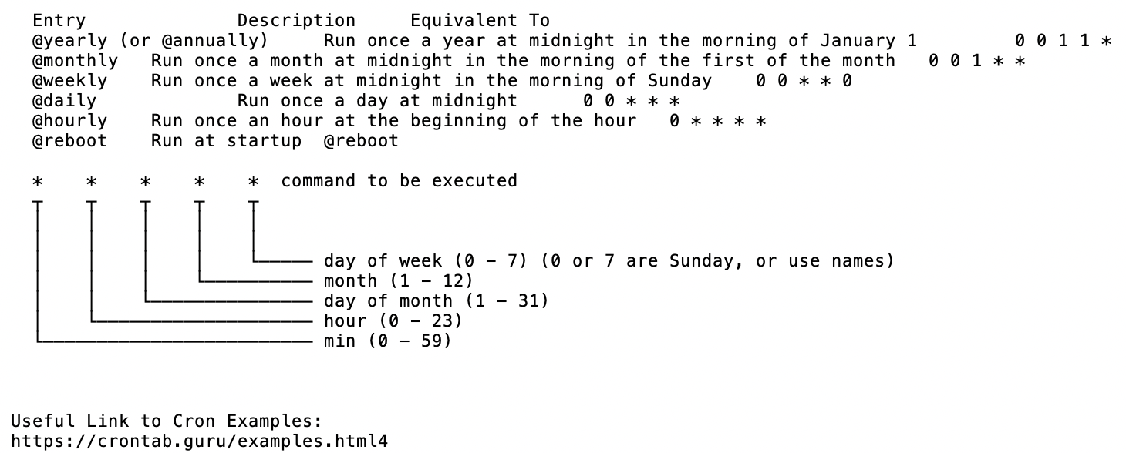
Crontab Guide

Slide 17
Crontab Examples
The following example will run every 10 minutes
*/10 * * * * /usr/bin/somedirectory/somecommand
The following example will run every 3 hours and 30 minutes
*/30 */3 * * * /usr/bin/somedirectory/somecommand
The following example will run every day at 8am
0 8 * * * /usr/bin/somedirectory/somecommand
The following example will run every Friday at 2pm
0 14 * * FRI /usr/bin/somedirectory/somecommand
0 14 * * 6 /usr/bin/somedirectory/somecommand
The following example will run every month
0 0 1 * * /usr/bin/somedirectory/somecommand
The following example will run every quarter (4 times a year)
0 0 1 */3 * /usr/bin/somedirectory/somecommand
The following example will run the specified months only.
0 0 10 Jan,Apr,Jul,Oct * /usr/bin/somedirectory/somecommand

Slide 18
Creating a Shell Script for Cron
Create a sample shell script for a cron job in the nano editor and follow the previous steps to make it executable:
nano cron_example.sh
In the nano editor, enter the following:
#!/bin/bash -l
source ~/.bash_profile
# load modules
module load python/anaconda3.6
# run scripts
python file.py
# print message
echo “Cron Job is Running on KLC Node 5”

Slide 19
Exercise 3 – Cron Job Practice
Setup a cron tab with an email notification on KLC. If needed, setup the cron job to run the interest rate code in your preferred programming language.

Slide 20
Appendix

Slide 21
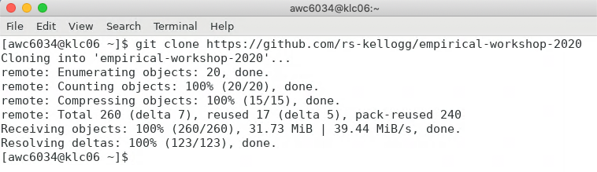
Appendix: Git Clone Workshop to KLC
Recall that we’ll first copy the contents of this week’s github lecture notes/materials to our KLC home directories.
Launch a Terminal window on KLC
Type the following into the command line:
git clone https://github.com/rs-kellogg/workshop_2022/
To update the contents of an existing cloned directory, navigate to the folder and type:
cd ~/workshop-2022
git pull

Slide 22
Appendix - Creating a Conda Environment
Instead of loading each module you would like to use in your shell script separately, you can also create conda environment. The environment below will include R and install the tidyverse package. Follow the steps below only once to create the environment:
module load python-miniconda3/4.12.0
conda create -n automate_env r-essentials r-base
source activate automate_env
conda install r-fs
conda install pandas
To leave the environment:
source deactivate automate_env
In the future, you will only need to activate the environment to load all modules and libraries.
source activate automate_env

