Slide 1
Session Six Exporting Results to LaTeX, Markdown Kellogg Research Support
Summer 2022

Slide 2

Automating Papers

Slide 3
Today we will Cover
Discussion: Using LaTex vs. Markdown
Generating Results within R, Python, Stata
LaTex – Populating Results in a KLC LaTeX doc
Markdown –
Juypter Notebooks for Python
‘Knitting’ R Markdown Files
Stata Markdown

Slide 4
Discussion: LaTeX vs. Markdown

Slide 5
LaTeX and Markdown Comparison
Markdown
LaTeX
\documentclass{article}
\usepackage{amsmath}
\usepackage{amssymb}
\usepackage{amsfonts}
\title{Sample Article} \author{Your Name}
\date{July 2022}
\begin{document}
\maketitle
Hello world!
\end{document}
---
title: Sample Problem Set
author: Your Name
date: July 2022
--- Hello world!
Preamble
Body

Slide 6
Markdown
What is it?
Markdown is a text-to-HTML conversion tool. It allows you to write using a plain text format, then convert it to structurally valid HTML. A Markdown document could contain source code and LaTeX formulas.
Use
distraction-free focus-on-what-you-want-to-say writing.

Slide 7
LaTeX
What is it?
LaTeX or Tex/Markup is a high-quality typesetting system; it includes features designed for technical and scientific documentation.
Use
high-quality typesetting for articles, research papers, manuals, books, etc.

Slide 8
Discussion – Use Cases
When would you use LaTeX?
Journal articles, working papers, class papers
Beamer for your job talk presentation
When would you use Markdown?
Class problem sets
Exploratory work
Teaching materials

Slide 9
Automating Results Generation in Code

Slide 10
Generating Results Files in Programs
What we’ll Cover:
Creating Descriptive Statistics Tables
Formatting Regression Results
Exporting Plots and Graphs
For Tables
Python & R – stargazer package
Python – estout and outreg2

Slide 11
Recall - Opening a GUI on KLC
Again, no modules are preloaded in a new KLC session. You will need to load everything you use.
To see what version of a software package are available type:
module avail <software name>
module avail R
module avail stata
module avail python
To load something type:
module load <software version>
module avail R/4.1.1
module load stata/17
python-miniconda3/4.12.0
To launch a GUI:
rstudio
xstata-mp
spyder

Slide 12
Running LaTeX

Slide 13
Running LaTeX on KLC: TexLive
Open a Terminal Session in FastX.
To load packages, type:
module load texlive/2020
module load ghostscript
To create a pdf of the tex file, run:
pdflatex <file_name_here.tex>
pdflatex sample.tex

Slide 14
Exercise 1 – Automate Papers with Bash
Now that we know how to output results tables and graphs from code and pipe those results into a LaTeX document to compile on KLC, please write a shell script to automate the process for Python, R or Stata results.

Slide 15
Using Markdown on KLC

Slide 16
Juypter Notebooks in Python
Open a GNOME Terminal Session in FastX.
To load packages, type:
To create and launch a conda environment, type:
To install libraries, type:
To launch a jupyter notebook, type:
module load python/anaconda3.6
module load chrome
conda create -n taxi_env python=3.6
source activate taxi_env
conda install -c conda-forge <library>
jupyter notebook --browser=chrome
Access from a Quest Analytics Node: https://jupyter.questanalytics.northwestern.edu/hub/login

Slide 17
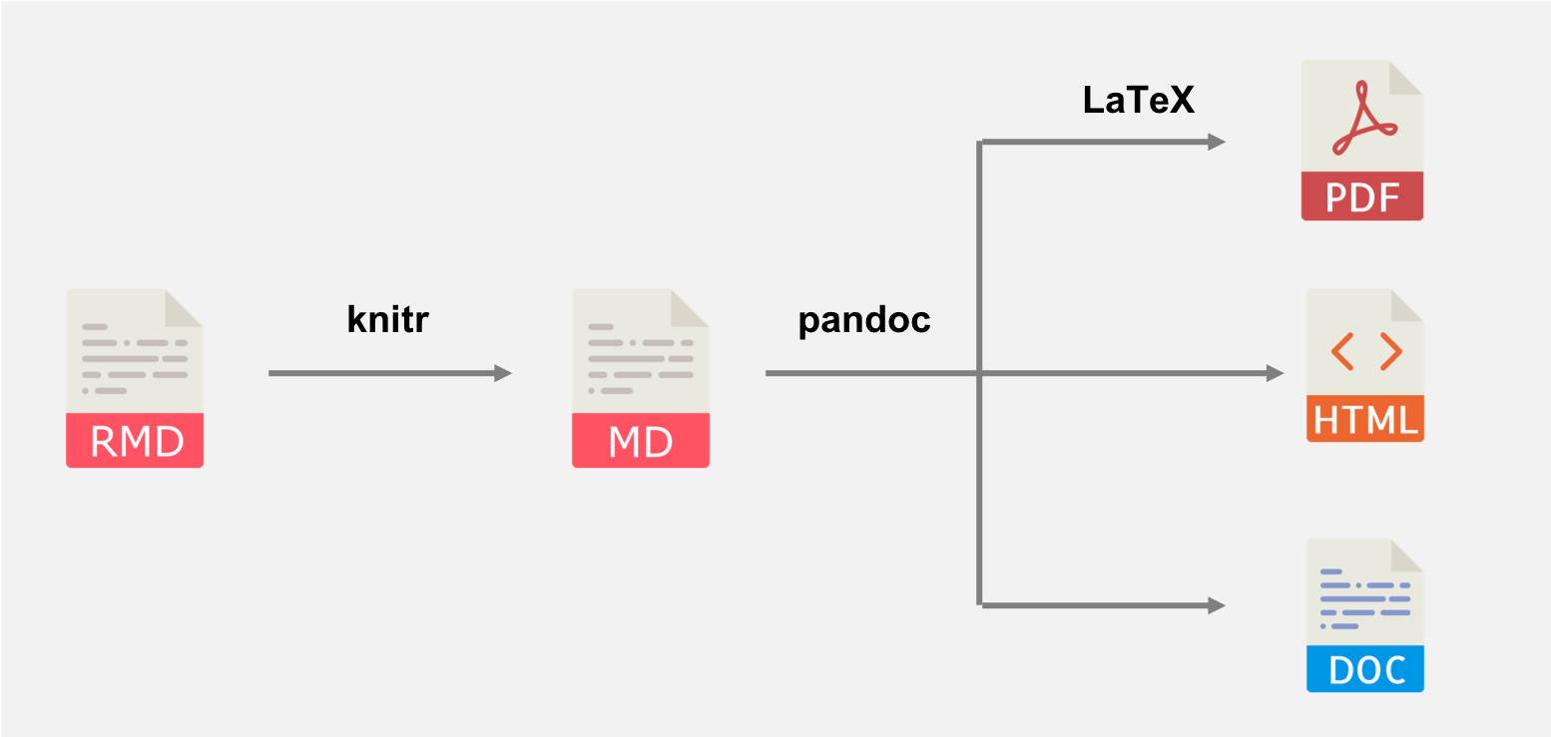
Knitting an R Markdown File

Slide 18
R Markdown within Rstudio
Open a GNOME Terminal Session in FastX.
To load packages and launch Rstudio, type:
module load texlive/2020
module load R/4.1.1
rstudio
Within R, install and load the following
install.packages(‘rmarkdown’)
library(rmarkdown)
To generate a pdf file in R, “Knit to pdf” from the “Knit” dropdown.

Slide 19
R Markdown from the command line
Open a GNOME Terminal Session in FastX.
To load packages and launch Rstudio, type:
module load texlive/2020
module load pandoc/2.2.1
module load R/4.1.1
To generate a pdf file from the command line:
Rscript -e "rmarkdown::render('samplex.Rmd’,
params=list('myarg'))"
Access from a Quest Analytics Node: https://jupyter.questanalytics.northwestern.edu/hub/login

Slide 20
Creating a Stata Markdown File
Open a GNOME Terminal Session in FastX.
To load packages, type:
module load texlive/2020
module load pandoc/2.2.1
module load stata/17
xstata-mp
Within Stata, type the following
ssc install markstat
ssc install whereis
whereis pandoc /software/pandoc/2.2.1/bin/pandoc
whereis pdflatex /software/texlive/2020/bin/
x86_64-linux/pdflatex
cd <directory>
markstat using <filename>, mathjax

Slide 21
Exercise 2 – Teaching with Markdown
Please share something you learned how to code during this workshop by describing it in a Markdown file in Python, R, or Stata.

Slide 22
Appendix

Slide 23
Appendix – LaTeX/Markdown Resources
Getting Started with Latex:
https://www.latex-project.org/get/#tex-distributions
Online Latex Editor: https://www.tutorialspoint.com/online_latex_editor.php
Texlive on a Linux Server:
https://www.tug.org/texlive/
https://www.linuxfordevices.com/tutorials/ubuntu/install-tex-live-texmaker
R Markdown and Knitr
https://www.r-bloggers.com/2015/12/r-markdown-and-knitr-tutorial-part-1/
Python with Latex: https://github.com/gpoore/pythontex
https://www.geeksforgeeks.org/pylatex-module-in-python/?ref=lbp
Stata Markdown
https://data.princeton.edu/stata/markdown

Slide 24
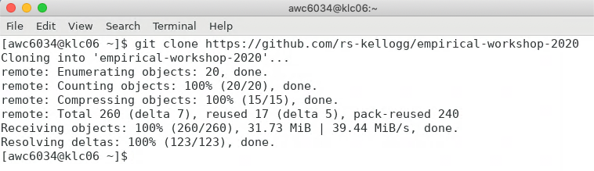
Appendix: Git Clone Workshop to KLC
Recall that we’ll first copy the contents of this week’s github lecture notes/materials to our KLC home directories.
Launch a Terminal window on KLC
Type the following into the command line:
git clone https://github.com/rs-kellogg/workshop_2022/
To update the contents of an existing cloned directory, navigate to the folder and type:
cd ~/workshop-2022
git pull

