Slide 1
Using Git and Github on KLC Fellows Workshop
Summer 2021
Notes:
Welcome. We are so happy you’re here.
What you are about to hear next is about the closest you will get to a lecture in this workshop series. Most of the rest of this will be pretty interactive.
Later we will have discussions, demonstrations where you can follow along, and maybe try to solve a few problems yourself.
But before we start showing you tools and how to apply them to your research work, first let me want talk a bit about reproducibility of your work.
It is a very important topic, and I believe there are a few general principles that, if kept in mind, can help you quite a lot in the future.

Slide 2

Version Control without Git
Image taken from: http://phdcomics.com/comics/archive_print.php?comicid=1531

Slide 3
Today we will Cover
The difference between Git and Github
Using Git locally as a version control tool on KLC
Syncing your local Git directory to a Github repository
Discussion: Using Git and Github Smartly

Slide 4
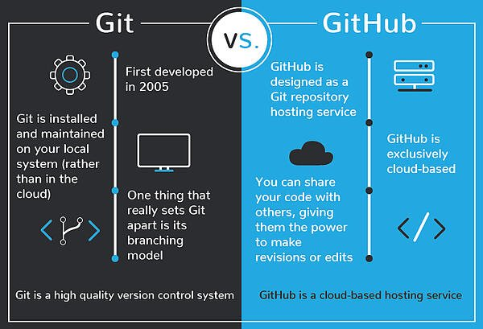
Git vs. GitHub
Image taken from: https://blog.devmountain.com/git-vs-github-whats-the-difference/

Slide 5
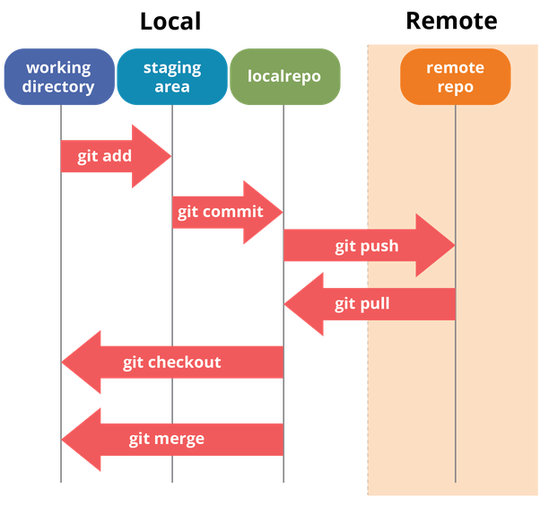
Git and Github Overview
Image taken from: https://dev.to/mollynem/git-github--workflow-fundamentals-5496
Notes:
One final thought about repdocudibility…
To reproduce results implies that you were able to produce them correctly in the first place.
So throughout the workshops, we will try to emphasize the virtue of breaking your problems into smaller pieces
And then testing them relentlessly to convince yourself they are doing what you expect them to do.
Near the end of the series, one of our hours will be dedicated to helping you make your code “bulletproof.”

Slide 6
Loading git on KLC
Recall that no modules are preloaded in a new KLC session. You will need to load everything you use.
To see what version of a software package are available type:
module load git
The first time you load git on KLC, you need to set the username and email it will use when it records your commits. Note that this will have no bearing on your Github login later on.
git config --global user.name "John Doe"
git config --global user.email johndoe@northwestern.edu
git config --list
Resources:
NU IT page: https://kb.northwestern.edu/page.php?id=78598
NU IT github: https://github.com/nuitrcs/gitworkshop
Notes:
One final thought about repdocudibility…
To reproduce results implies that you were able to produce them correctly in the first place.
So throughout the workshops, we will try to emphasize the virtue of breaking your problems into smaller pieces
And then testing them relentlessly to convince yourself they are doing what you expect them to do.
Near the end of the series, one of our hours will be dedicated to helping you make your code “bulletproof.”

Slide 7
Cloning a repo and initializing a local repo
A Git repository (”repo”) is essentially a container for your Git code.
You can create a Git repo on KLC from scratch or you can download an existing public Github repo and work on the code locally on KLC.
Let’s first clone a public Github repo to your home directory:
git clone https://github.com/ambreenchaudhri/fellows_git_intro
It should download a directory called: fellows_git_intro.
Let’s create a subfolder in this directory called practice.
cd fellows_git_intro
mkdir practice
cd practice
The first step to start version control with Git is to initialize your (empty) directory:
git_init
Notes:
One final thought about repdocudibility…
To reproduce results implies that you were able to produce them correctly in the first place.
So throughout the workshops, we will try to emphasize the virtue of breaking your problems into smaller pieces
And then testing them relentlessly to convince yourself they are doing what you expect them to do.
Near the end of the series, one of our hours will be dedicated to helping you make your code “bulletproof.”

Slide 8
Make Changes to your repo
Note that when you initialize a repo a new hidden folder will be saved here:
ls -a
If you type the following, you notice there is no activity in your Git repo:
git status
Let’s make some basic changes to the Git repo we initialized. For instance, let’s start by moving in all the FEC files we cloned from Github.
mv ~/fellows_git_intro/fec* ~/fellows_git_intro/practice/
Now running git status will show untracked changes.
Notes:
One final thought about repdocudibility…
To reproduce results implies that you were able to produce them correctly in the first place.
So throughout the workshops, we will try to emphasize the virtue of breaking your problems into smaller pieces
And then testing them relentlessly to convince yourself they are doing what you expect them to do.
Near the end of the series, one of our hours will be dedicated to helping you make your code “bulletproof.”

Slide 9
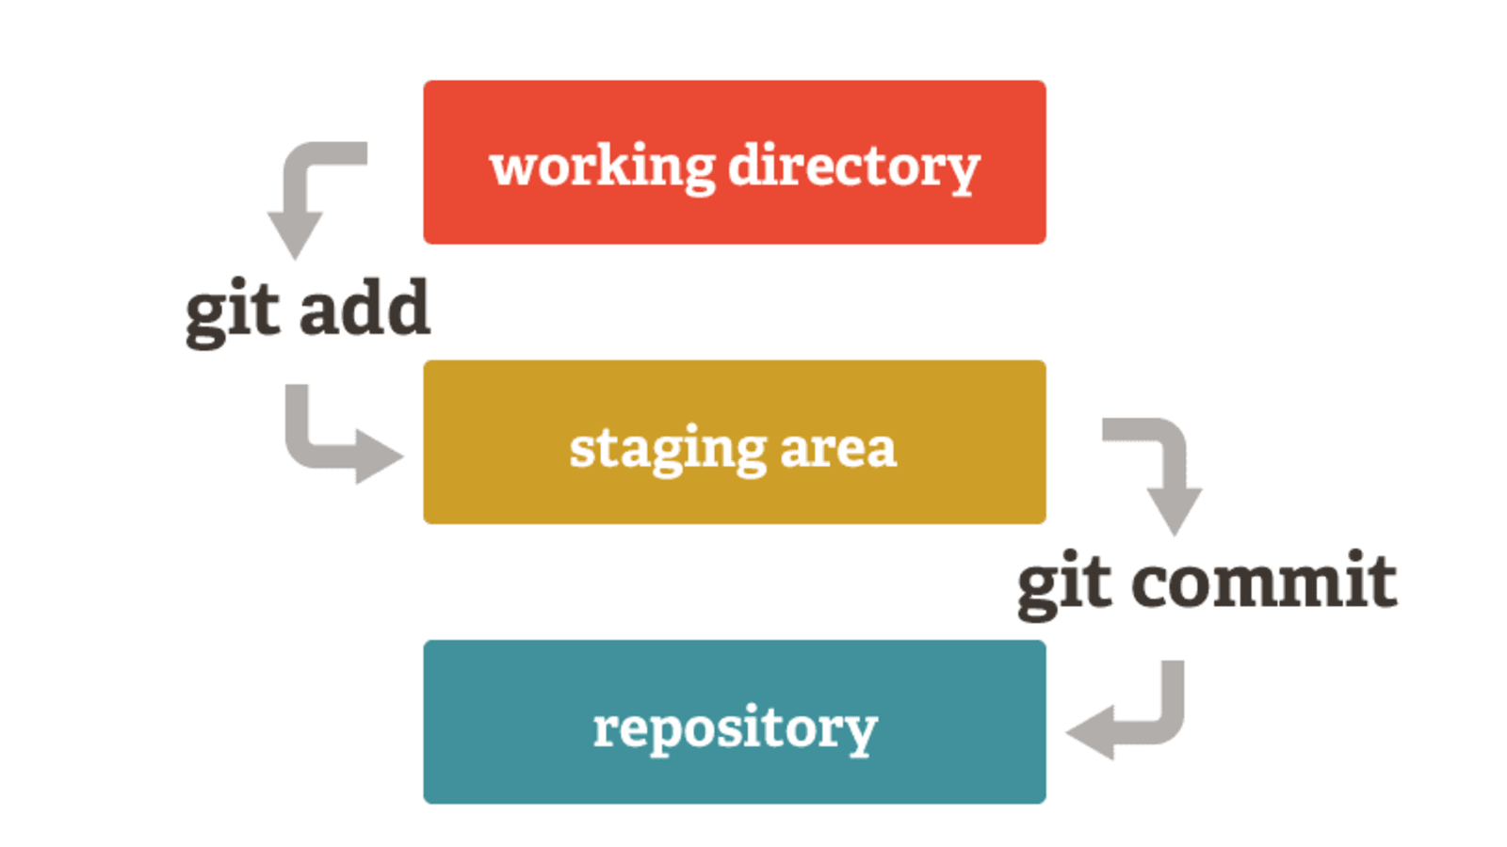
Saving Changes to a local git repo
Since a Git repo consists of two spaces: a “staging area” and the actual “repository”, saving changes requies two steps:
1.) an “add” and 2.) a “commit”.
Image taken from:
https://medium.com/tech-and-the-city/changing-a-super-old-git-commit-history-20346f709ca9
Notes:
One final thought about repdocudibility…
To reproduce results implies that you were able to produce them correctly in the first place.
So throughout the workshops, we will try to emphasize the virtue of breaking your problems into smaller pieces
And then testing them relentlessly to convince yourself they are doing what you expect them to do.
Near the end of the series, one of our hours will be dedicated to helping you make your code “bulletproof.”

Slide 10
Saving Changes to a local git repo
We can add the files we moved to the staging area with the following:
﻿git add fec_all.sh fec_cron.sh fec_extract.py fec_process.R
OR
git add .
We can move the files from staging area to the local Git practice repo with:
﻿git commit -m "Add all FEC files to repo”
After making these changes, we can retrieve a log:
git log
Notes:
One final thought about repdocudibility…
To reproduce results implies that you were able to produce them correctly in the first place.
So throughout the workshops, we will try to emphasize the virtue of breaking your problems into smaller pieces
And then testing them relentlessly to convince yourself they are doing what you expect them to do.
Near the end of the series, one of our hours will be dedicated to helping you make your code “bulletproof.”

Slide 11
Retrieving a Previous Version
If we go back to our git log, there is an alpha-numeric sequence associated with each commit. These are commit-hashes.
To retrieve a previous version of a document or set of documents, use the commit-hash:
﻿git checkout <commit hash>
Files in a git repo are saved in branches. Branches are essentially timelines on Git. For now, we have been working in the main branch called “master”. You can return to the main timeline with:
﻿git checkout master
Notes:
One final thought about repdocudibility…
To reproduce results implies that you were able to produce them correctly in the first place.
So throughout the workshops, we will try to emphasize the virtue of breaking your problems into smaller pieces
And then testing them relentlessly to convince yourself they are doing what you expect them to do.
Near the end of the series, one of our hours will be dedicated to helping you make your code “bulletproof.”

Slide 12
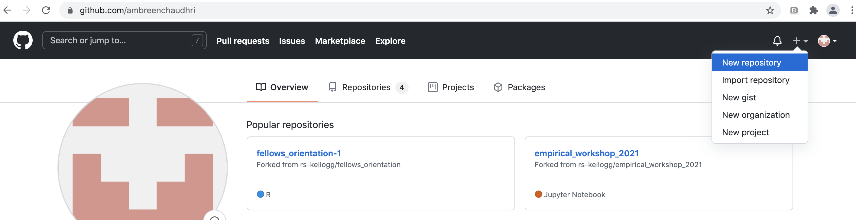
Creating and accessing a Github Repo
We can go to a Github account to create a new private repo to save our local changes.
Follow the steps to create a repo and you will receive a page with instructions to access it.
Notes:
One final thought about repdocudibility…
To reproduce results implies that you were able to produce them correctly in the first place.
So throughout the workshops, we will try to emphasize the virtue of breaking your problems into smaller pieces
And then testing them relentlessly to convince yourself they are doing what you expect them to do.
Near the end of the series, one of our hours will be dedicated to helping you make your code “bulletproof.”

Slide 13
Accessing a github repo on KLC
The instructions should list how to add a ”remote” to your Github repo, which is equivalent to a label for your Github url.
﻿git remote add origin https://github.com/<user>/git_practice.git
Note that “origin” is just a generic name. You can use any name you like. The following command will show you the remote that is set.
﻿git remote -v

Slide 14
Saving Changes to a Github repo
Notes:
One final thought about repdocudibility…
To reproduce results implies that you were able to produce them correctly in the first place.
So throughout the workshops, we will try to emphasize the virtue of breaking your problems into smaller pieces
And then testing them relentlessly to convince yourself they are doing what you expect them to do.
Near the end of the series, one of our hours will be dedicated to helping you make your code “bulletproof.”

Slide 15
Saving local Git repo to Github
To push the changes in your local repo to Github, do the following:
﻿git branch –M main
git push –u origin main
The push request will require you to sign into your Github account on KLC. In order to do so you will need a personal access token. You can acquire one by going to:
Settings → Developer Settings → Personal Access Token → Generate New Token
The steps are described here: https://docs.github.com/en/github/authenticating-to-github/keeping-your-account-and-data-secure/creating-a-personal-access-token
Notes:
One final thought about repdocudibility…
To reproduce results implies that you were able to produce them correctly in the first place.
So throughout the workshops, we will try to emphasize the virtue of breaking your problems into smaller pieces
And then testing them relentlessly to convince yourself they are doing what you expect them to do.
Near the end of the series, one of our hours will be dedicated to helping you make your code “bulletproof.”

Slide 16
Saving Github changes to local repo
If you manually add files or make other changes on Github, you can sync those changes to your local git repo on KLC by doing the following:
git pull origin main
Notes:
One final thought about repdocudibility…
To reproduce results implies that you were able to produce them correctly in the first place.
So throughout the workshops, we will try to emphasize the virtue of breaking your problems into smaller pieces
And then testing them relentlessly to convince yourself they are doing what you expect them to do.
Near the end of the series, one of our hours will be dedicated to helping you make your code “bulletproof.”

Slide 17
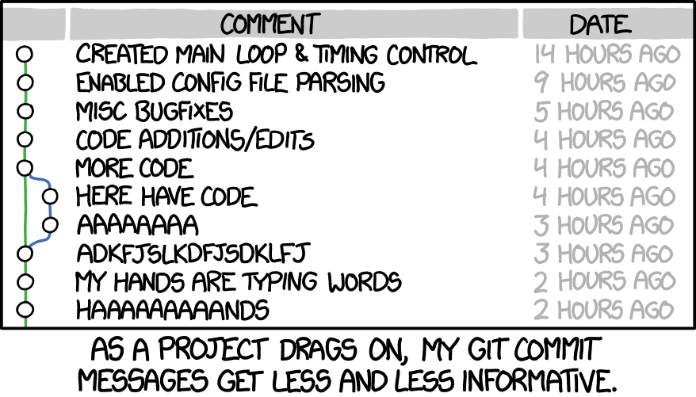
Discussion: Using Git and Github Smartly
Notes:
One final thought about repdocudibility…
To reproduce results implies that you were able to produce them correctly in the first place.
So throughout the workshops, we will try to emphasize the virtue of breaking your problems into smaller pieces
And then testing them relentlessly to convince yourself they are doing what you expect them to do.
Near the end of the series, one of our hours will be dedicated to helping you make your code “bulletproof.”

Slide 18
Discussion: Using Git and Github Smartly
Git tools are not a substitute for good documentation. You are still responsible for making decisions about whether the code is tested, what version is saved, how descriptive the comments are. Placing bad code in Git/Github is still bad code!
Notes:
One final thought about repdocudibility…
To reproduce results implies that you were able to produce them correctly in the first place.
So throughout the workshops, we will try to emphasize the virtue of breaking your problems into smaller pieces
And then testing them relentlessly to convince yourself they are doing what you expect them to do.
Near the end of the series, one of our hours will be dedicated to helping you make your code “bulletproof.”

Slide 19
Appendix – Text Editors on KLC
KLC/Quest has a number of text editors available for you to use. The links below provide the basic syntax for other text editors available to you:
Nano: From any terminal session on KLC, type:
nano <file_name>
https://www.redhat.com/sysadmin/getting-started-nano
Emacs: From any terminal session on KLC, type:
emacs <file_name>
https://www.redhat.com/sysadmin/beginners-guide-emacs
Vi: From any terminal session on KLC, type:
vi <file_name>
https://www.redhat.com/sysadmin/introduction-vi-editor
Gedit: From a terminal session with graphics enabled, type:
gedit <file_name>
https://www.lifewire.com/gedit-linux-command-unix-command-4097153
Notes:
One final thought about repdocudibility…
To reproduce results implies that you were able to produce them correctly in the first place.
So throughout the workshops, we will try to emphasize the virtue of breaking your problems into smaller pieces
And then testing them relentlessly to convince yourself they are doing what you expect them to do.
Near the end of the series, one of our hours will be dedicated to helping you make your code “bulletproof.”

Slide 20
Appendix – Branching on Git
A branch is an independent line of development. You could think of a branch as a timeline of a project that could be created in parallel with the main branch. To see a list of branches a project contains, type:
git branch
If you’d like to make an experimental branch of a project and start working on it, type the following:
git branch experimental
git checkout experimental
The changes you make in a new branch will remain independent of the master branch you are working on. Once you are comfortable with these changes, you can merge them back to the master branch by doing the following:
git checkout master
git merge experimental
Notes:
One final thought about repdocudibility…
To reproduce results implies that you were able to produce them correctly in the first place.
So throughout the workshops, we will try to emphasize the virtue of breaking your problems into smaller pieces
And then testing them relentlessly to convince yourself they are doing what you expect them to do.
Near the end of the series, one of our hours will be dedicated to helping you make your code “bulletproof.”

Slide 21
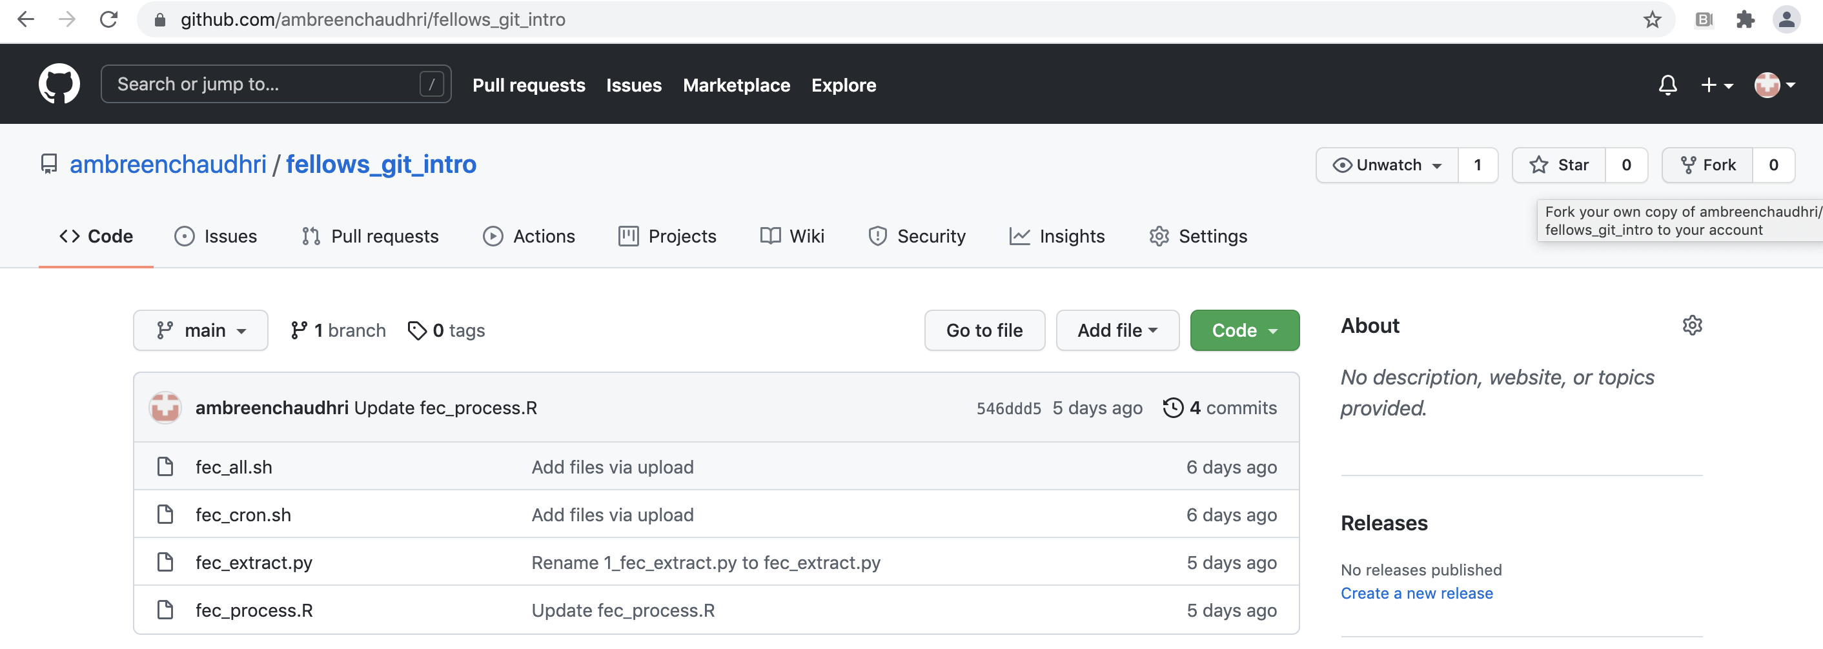
Appendix – Forking a Github Repo
Much like cloning, forking enables a user to copy all the contents of a Github repository. However, forking a repo also enables a user to suggest and possibly implement changes to the original repository with the creator’s approval. Forking is a useful tool to collaborate with others to improve open-source code.
There is no command line tool in the Git module on KLC to fork a repository. Instead, navigate to the main page of a repository. On the right side, select the “Fork” button. The selected repository will be copied to your list of Github repos.
Notes:
One final thought about repdocudibility…
To reproduce results implies that you were able to produce them correctly in the first place.
So throughout the workshops, we will try to emphasize the virtue of breaking your problems into smaller pieces
And then testing them relentlessly to convince yourself they are doing what you expect them to do.
Near the end of the series, one of our hours will be dedicated to helping you make your code “bulletproof.”

