Slide 1
Session Four Automating your Workflows, Scripting, Audit Trails Kellogg Research Support
Summer 2022

Slide 2

Automating and Scripting on KLC

Slide 3
Today we will Cover
Automation Advice in your Code
Running the Code from a Terminal on KLC
Scripting Multiple Tasks at Once
Scheduling processes in cron

Slide 4
Automate Checks/Changes in Code

Slide 5
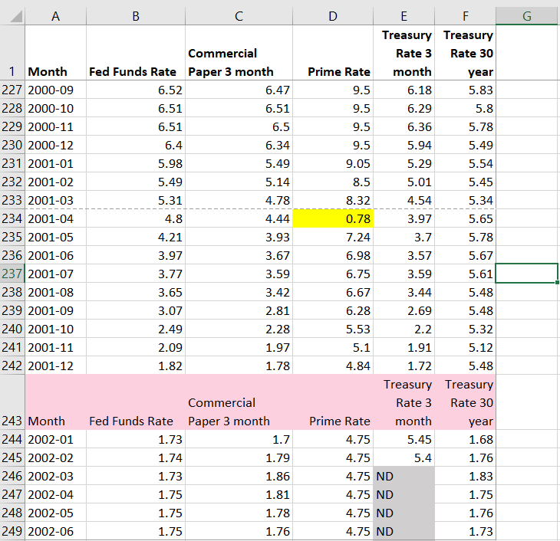
Automating Changes to Data
Change out of Range data points
Remove repeated header rows
Fix missing value notation: NDs to NAs

Slide 6
Opening a GUI on KLC
Recall that no modules are preloaded in a new KLC session. You will need to load everything you use.
To see what version of a software package are available type:
module avail <software name>
module avail R
module avail stata
module avail python
To load something type:
module load <software version>
module avail R/4.0.3
module load stata/17
module load python/anaconda3.6
To launch a GUI:
rstudio
xstata-mp
spyder

Slide 7
Launching Code from Command Line

Slide 8
Launching Code from Terminal
To launch an R file:
Rscript <file_name.R>
To launch a python file:
python <file_name.py>
To launch a stata do file:
stata-mp -b do <file_name.do>

Slide 9
Scripting Multiple Tasks at Once

Slide 10
Creating a Shell Script
If you’d like to run multiple files in sequence, you can create a shell script on KLC using the nano editor.
nano <file_name.sh>
Here is a simple example file:
#!/bin/bash
clear
# load modules
module load python/anaconda3.6
module load R/4.0.3
# run scripts
python file.py
Rscript file.R
To make the file executable:
chmod +x <file_name.sh>

Slide 11
Running a Shell Script
To make the file executable:
chmod +x <file_name.sh>
To run the script:
./<file_name.sh>
or
source <file_name.sh>

Slide 12
Cron Jobs

Slide 13
Creating a Cron Job
To create a cron job type the following from any node:
crontab -e
Note that you will need to enter your job in a vi editor.
To insert text type “i”
To exit text type “esc”
To save changes type “:wq”
To exit the file without saving changes type “:q!
To enter a cron job for the cron_example.sh shell script and print the results to a file:
15 12 * * * sh ~/cron_example.sh > ~/cron_output.txt

Slide 14
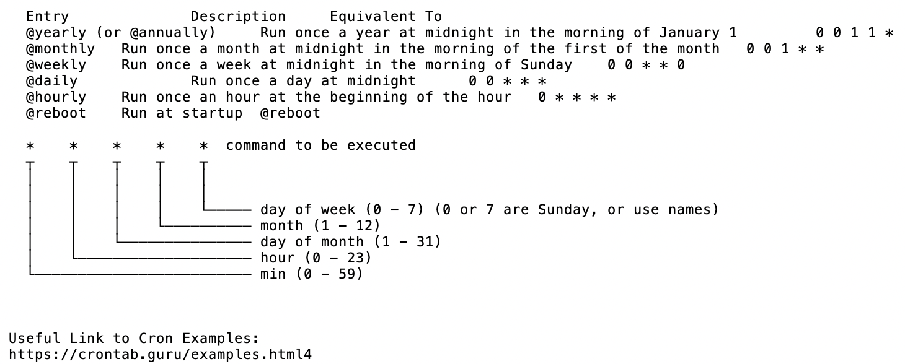
Crontab Guide

Slide 15
Crontab Examples
The following example will run every 10 minutes
*/10 * * * * /usr/bin/somedirectory/somecommand
The following example will run every 3 hours and 30 minutes
*/30 */3 * * * /usr/bin/somedirectory/somecommand
The following example will run every day at 8am
0 8 * * * /usr/bin/somedirectory/somecommand
The following example will run every Friday at 2pm
0 14 * * FRI /usr/bin/somedirectory/somecommand
0 14 * * 6 /usr/bin/somedirectory/somecommand
The following example will run every month
0 0 1 * * /usr/bin/somedirectory/somecommand
The following example will run every quarter (4 times a year)
0 0 1 */3 * /usr/bin/somedirectory/somecommand
The following example will run the specified months only.
0 0 10 Jan,Apr,Jul,Oct * /usr/bin/somedirectory/somecommand

Slide 16
Creating a Shell Script for Cron
Create a sample shell script for a cron job in the nano editor and follow the previous steps to make it executable:
nano cron_example.sh
In the nano editor, enter the following:
#!/bin/bash -l
source ~/.bash_profile
# load modules
module load python/anaconda3.6
# run scripts
python file.py
# print message
echo “Cron Job is Running on KLC Node 5”

Slide 17
Appendix

Slide 18
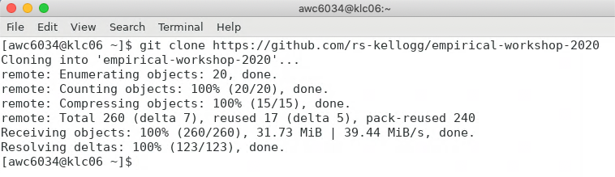
Appendix: Git Clone Workshop to KLC
Recall that we’ll first copy the contents of this week’s github lecture notes/materials to our KLC home directories.
Launch a Terminal window on KLC
Type the following into the command line:
git clone https://github.com/rs-kellogg/workshop_2022/
To update the contents of an existing cloned directory, navigate to the folder and type:
cd ~/workshop-2022
git pull

Slide 19
Appendix - Creating a Conda Environment
Instead of loading each module you would like to use in your shell script separately, you can also create conda environment. The environment below will include R and install the tidyverse package. Follow the steps below only once to create the environment:
module load python/anaconda3.6
conda create -n automate_env r-essentials r-base
source activate automate_env
conda install r-fs
conda install argparse
To leave the environment:
source deactivate automate_env
In the future, you will only need to activate the environment to load all modules and libraries.
source activate automate_env

