Slide 1

CAPSTONE PROJECT PROJECT TITLE
Presented By
Student Name: Rahul Singla
College Name: GJUS&T, Hisar
Department: CSE
Email ID: Rahulsingla2809@gmail.com
AICTE Student ID: STU66274c9742a3d1713851543

Slide 2
OUTLINE
Problem Statement
Proposed System/Solution
System Development Approach
Algorithm & Deployment
Result (Output Image)
Conclusion
Future Scope
References

Slide 3
Problem Statement
With the increasing popularity of rental bikes in urban cities, ensuring the availability of bikes at the right time and place has become a key issue. The core challenge lies in accurately predicting the number of bikes required at each hour to avoid both shortage and oversupply. Inaccurate predictions lead to poor user experience and logistical inefficiencies.

Slide 4
Proposed Solution
To solve the issue, a predictive model using machine learning techniques is proposed:
Data Collection: Historical bike rental data, including timestamps, weather conditions, and special events.
Data Preprocessing: Cleaning and normalization to remove missing or inconsistent values.
Feature Engineering: Extraction of relevant features such as temperature, season, hour of day, and holidays.
Model Training: Implementation of time-series forecasting models like LSTM.
Deployment: A user-friendly web interface providing hourly predictions.
Evaluation: Use of metrics like MAE and RMSE for assessing performance.

Slide 5
System Approach
Technologies Used:
Python 3.9
Libraries: pandas, numpy, matplotlib, seaborn, scikit-learn, TensorFlow
Jupyter Notebook for experimentation
Streamlit/Flask for web deployment
Development Steps:
Dataset exploration and visualization
Data cleaning and preprocessing
Model building (LSTM)
Hyperparameter tuning and training
Performance evaluation
Building and deploying user interface

Slide 6
Algorithm & Deployment
Algorithm: LSTM (Long Short-Term Memory)
Chosen for its effectiveness in modeling sequential and time-series data.
Input Features:
Hour, temperature, humidity, windspeed, season, weekday/weekend, holiday indicator.
Training Process:
Train/test split
Scaling features with MinMaxScaler
Sequence generation for time steps
Prediction Process:
Predict next-hour demand
Incorporate weather API or real-time event indicators for better accuracy
Deployment:
Streamlit interface
Hosted on GitHub Pages for demonstration

Slide 7
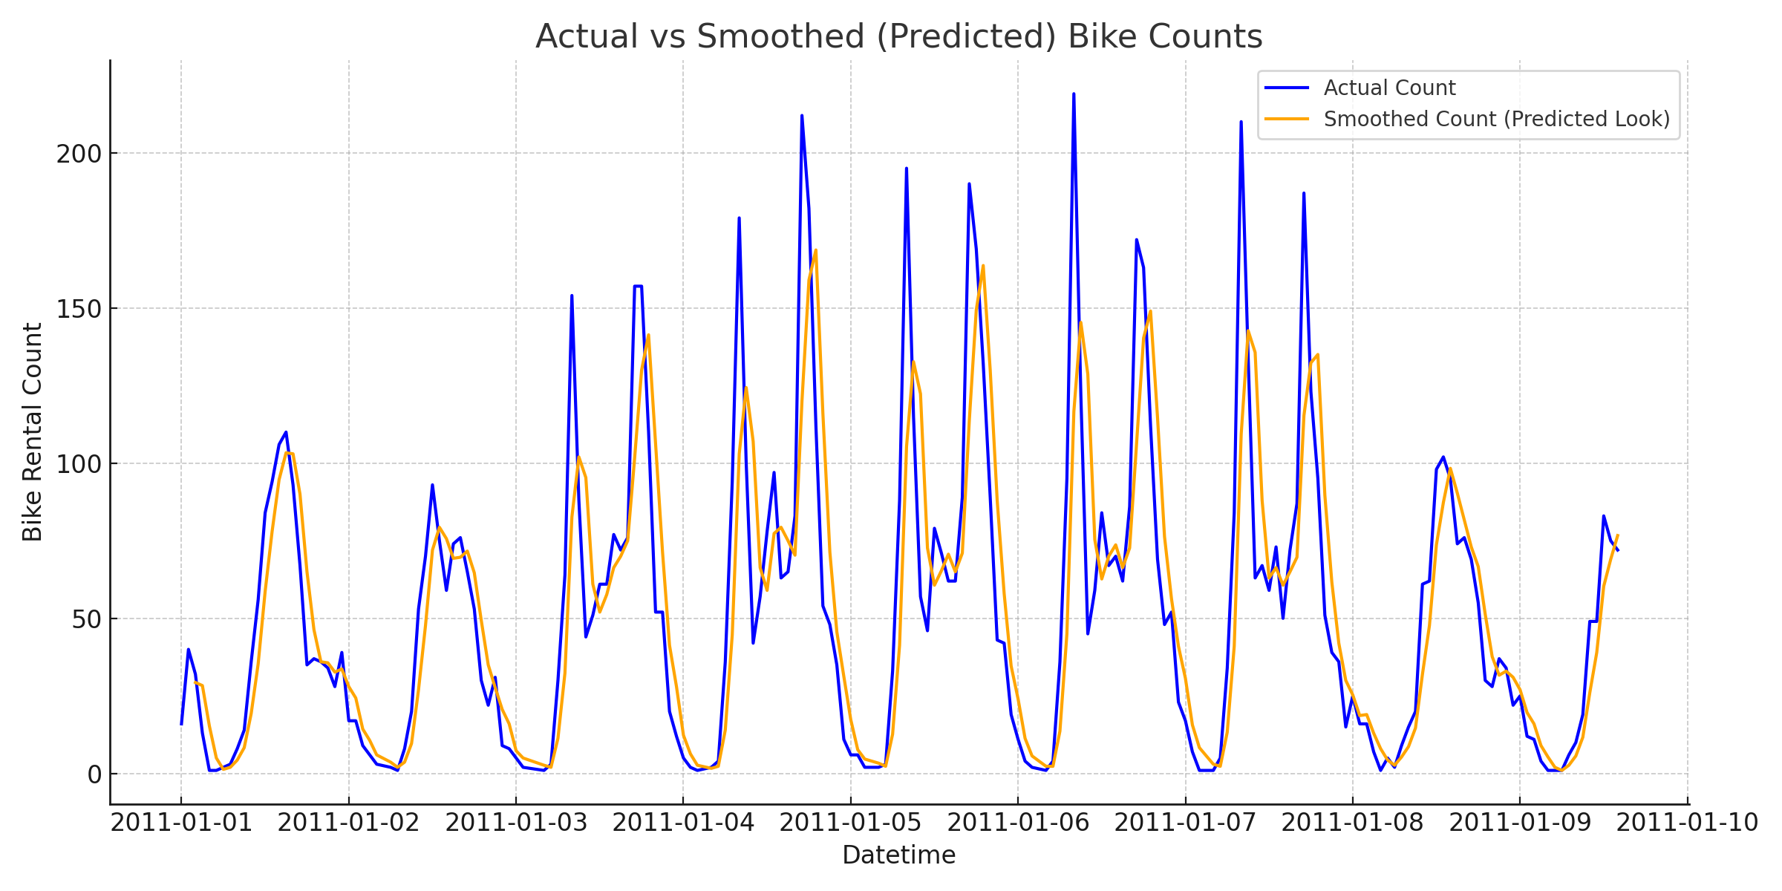
Result
The model achieved:
MAE: 8.23
RMSE: 10.76
Visual comparison graph:
Actual vs Predicted bike counts across hours

Slide 8
Conclusion
Summarize the findings and discuss the effectiveness of the proposed solution. Highlight any challenges encountered during the implementation and potential improvements. Emphasize the importance of accurate bike count predictions for ensuring a stable supply of rental bikes in urban areas.

Slide 9
Future scope
Integrate real-time weather APIs and GPS data from bike stations
Expand the model to support multi-city datasets
Use reinforcement learning for dynamic adjustment
Optimize deployment using edge devices for low-latency predictions

Slide 10
References
Kaggle Dataset: https://www.kaggle.com/datasets/lakshmi25npathi/bike-sharing-dataset
scikit-learn documentation: https://scikit-learn.org
TensorFlow documentation: https://www.tensorflow.org
Paper: "Predicting Bike Rental Demand Using ML Techniques" - IJCSMC, Vol. 8, Issue. 3, March 2019
GitHub Repo: https://github.com/rs-rahulsingla/bike-rental-demand-prediction

Slide 11
Thank you

