Slide 1
Machine Learning: Capstone Project
By: Rebecca Brink
Under Username: ornl_water
Format for PowerPoint borrowed from PowerPoint Templates.

Slide 2
Data Exploration: By the Numbers
To start exploring the data, I looked at what type of data was available for things people did everyday. Using the “value_counts()” method the tables to the right were printed. These categories were not quite usable the way they were so I decided to map them with numerical values and save those in new columns.
Drinks | Number
not at all | 3267
rarely | 5957
socially | 41780
often | 5164
very often | 471
desperately | 322
Diet | Number
mostly anything | 16585
anything | 6183
strictly anything | 5113
mostly vegetarian | 3444
mostly other | 1007
strictly vegetarian | 875
vegetarian | 667
strictly other | 452
mostly vegan | 338
other | 331
strictly vegan | 228
vegan | 136
mostly kosher | 86
mostly halal | 48
strictly kosher | 18
strictly halal | 18
Drugs | Number
never | 37724
sometimes | 7732
often | 410
Smokes | Number
no | 43896
sometimes | 3787
when drinking | 3040
yes | 2231
trying to quit | 1480

Slide 3
Mapping Data to New Columns
The new columns were saved as “parameter_codes” except for one column diets_binary which differed from the rest because it only used 0 and 1. Because all of this data is on the same order of magnitude, no normalization was needed. Now it was time to do some visualization of the data.
Drinks | Mapped Code
not at all | 0
rarely | 1
socially | 2
often | 3
very often | 4
desperately | 5
Diet | Mapped Code | Binary Code
mostly anything | 0 | 1
anything | 0 | 1
strictly anything | 0 | 1
mostly vegetarian | 2 | 0
mostly other | 1 | 0
strictly vegetarian | 2 | 0
vegetarian | 2 | 0
strictly other | 1 | 0
mostly vegan | 3 | 0
other | 1 | 0
strictly vegan | 3 | 0
vegan | 3 | 0
mostly kosher | 3 | 0
mostly halal | 3 | 0
strictly kosher | 3 | 0
strictly halal | 3 | 0
Drugs | Mapped Code
never | 0
sometimes | 1
often | 2
Smokes | Mapped Code
no | 0
sometimes | 1
when drinking | 2
yes | 3
trying to quit | 4

Slide 4
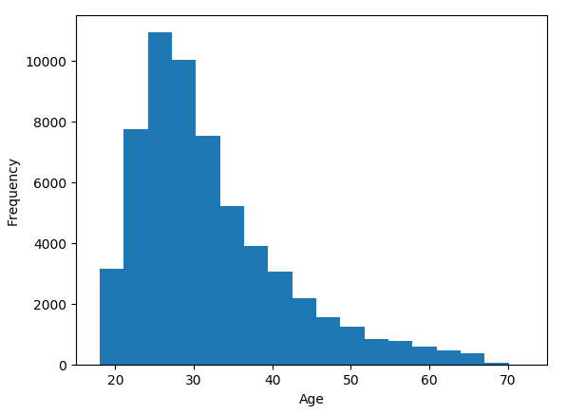
Data Exploration: Graph 1
Reasoning: Seeing the age dispersion of people on the site seemed to be a good starting point to formulate a question. A histogram seemed to be the best way to display this.

Slide 5
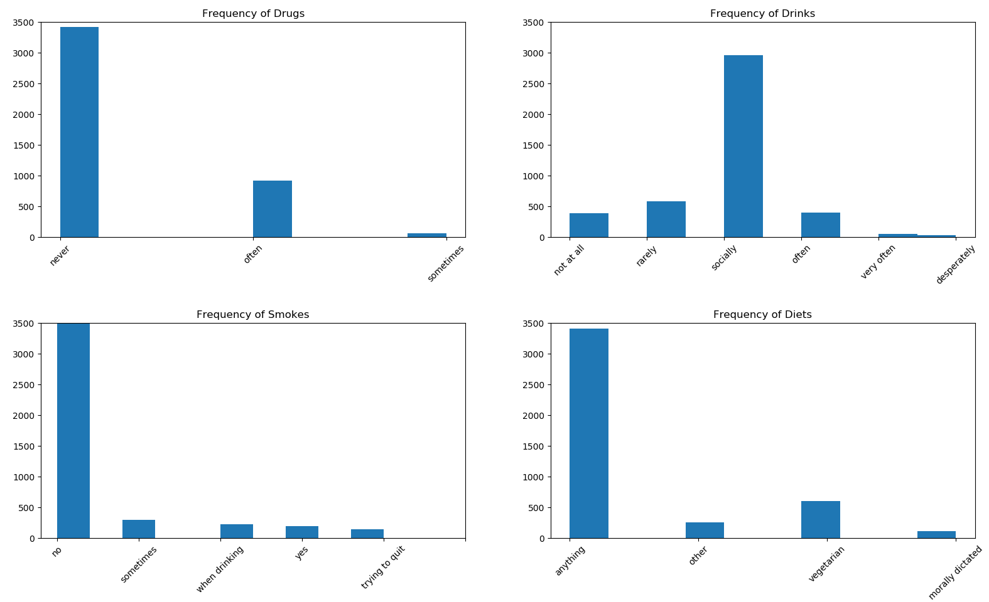
Data Exploration: Graph 2
Reasoning: After adding the columns of data, it made sense to also look at the frequency of the different categories. Interestingly, the number of people who do not smoke and do not do drugs are nearly identical as is the frequency of the anything diet.

Slide 6
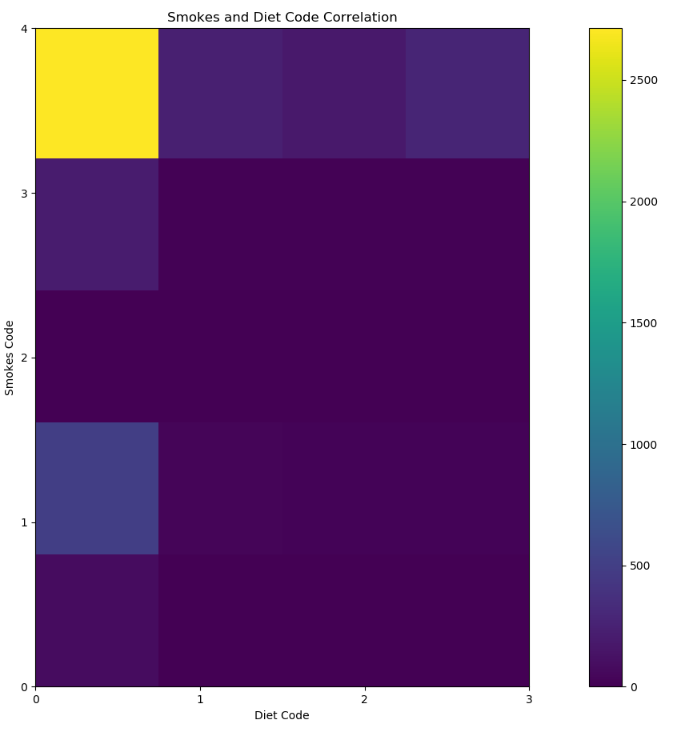
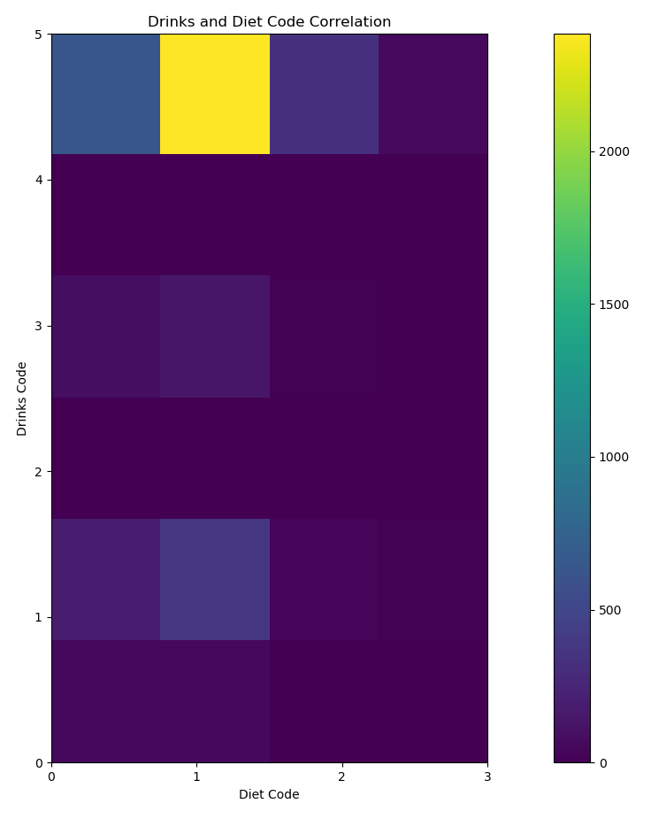
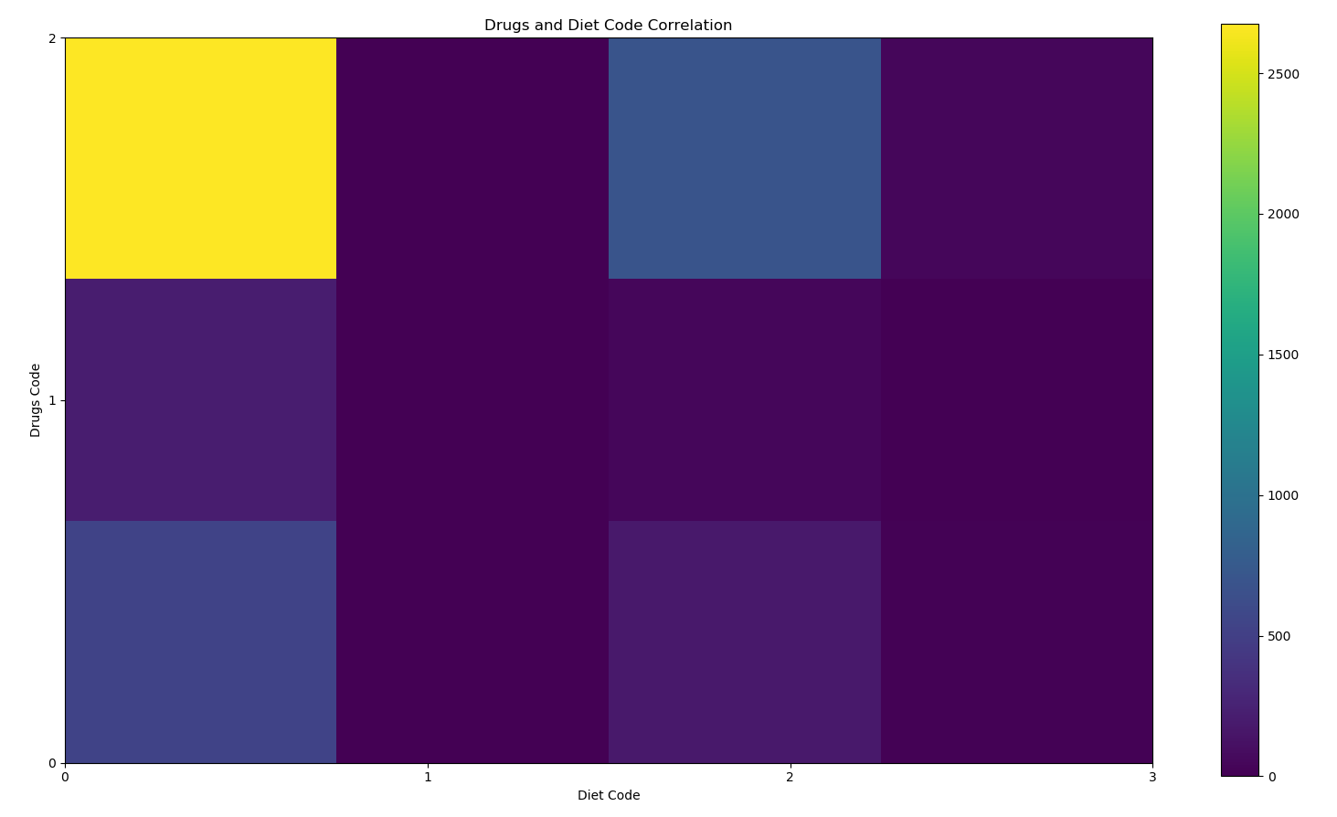
Data Exploration: Graph 3
Reasoning: From the second graph, the correlation between different diets, drugs, and smokes, came into question. Here three 2D histograms were plotted to see the correlations. Some diets have very strong correlations to not smoking, drinking, or doing drugs. This will lead to the formation of a question.

Slide 7
Question:
Can we predict what diet a person will have based on drug use, drinking frequency, and smoking frequency?

Slide 8
Regression:
Single Linear Regression
Multiple Linear Regressing
K-Nearest Neighbor Regression
Please note that for the regression models, we attempted to predict a diet code value (between 0 and 4 inclusive). This did not lend itself to using the recall, f1, accuracy, or precision as when explained in the lesson, these required a 0/1 type classification scheme.

Slide 9
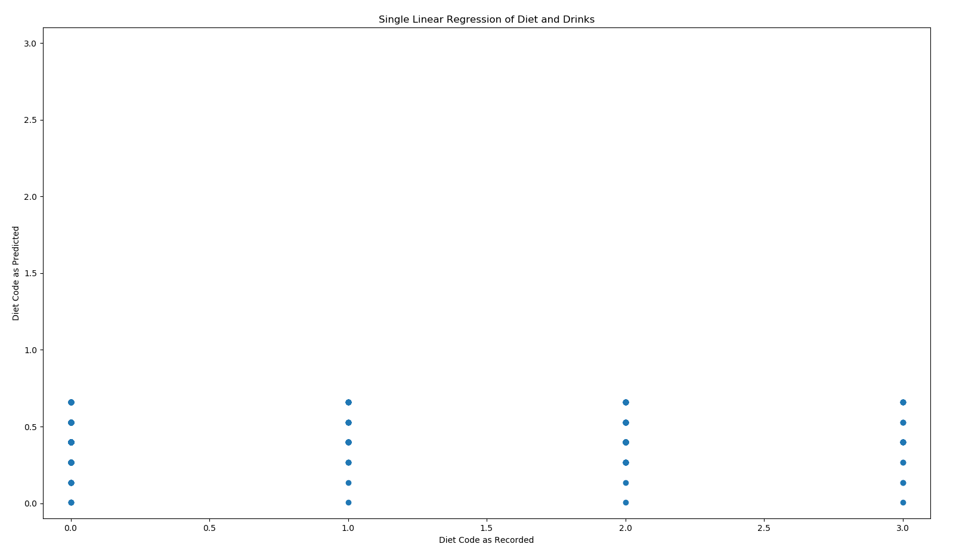
Single Linear Regression
Method: Use a single linear regression model on drinks to predict diet and see if this provides accurate results.
Simplicity: This model was extremely simple to set up and run. It is also easy to understand how the model performs.
Time: ~0.0630ms
Score: ~0.0022
Conclusion: This runs quickly. However, the graph is not what we would expect to see. Hopefully we would see the predicted and recorded diet codes form a line upward to the right of the graph. The predicted values form a plateau instead. The score and the graph indicate that the correlation this method generates is very weak and ineffective at predicting diet off of drinks. In earlier versions of the model, drugs and smokes were also tried but the results were similar.

Slide 10
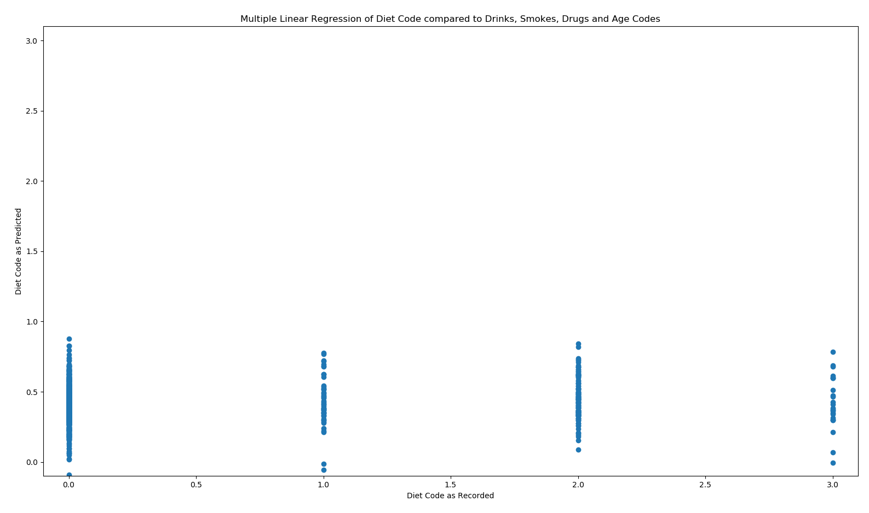
Multiple Linear Regression
Method: Use drugs, drinks, and smokes to form a predictor of diet. When setting up the model, it was found that adding age as a parameter significantly increased the score and did not significantly affect the time so this parameter was added as well.
Simplicity: Multiple Linear Regression is a little more complicated to understand, but it was the same number of steps to set up as the single linear regression model so no noticeable change in simplicity was noticed.
Time: ~ 0.0470ms
Score: ~0.0049
Conclusion: This method, for whatever reason, ran even faster than the single linear regression method. The score for the method is also twice as high, and we can see in the graph that the data is starting to shift upward as we move right along the x-axis. While these are big improvements, the score for the model is still too low to be effective. Time to look for other models.

Slide 11
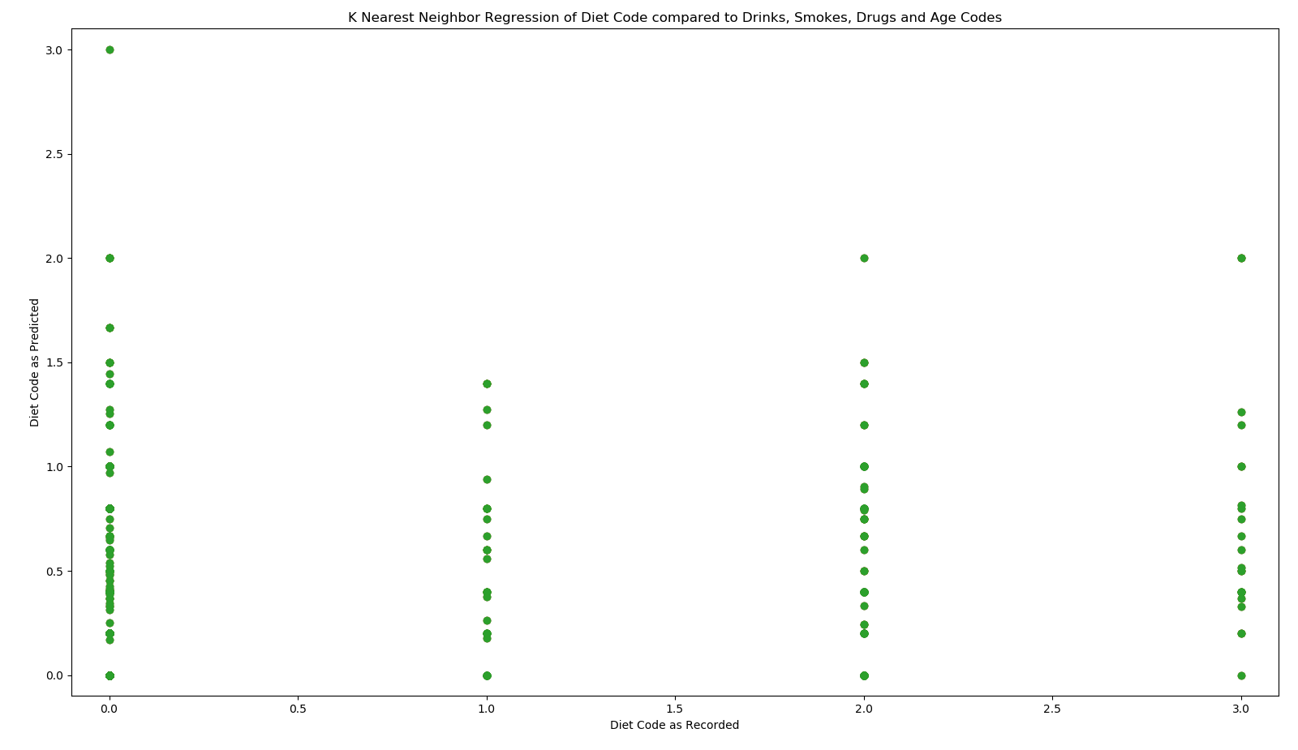
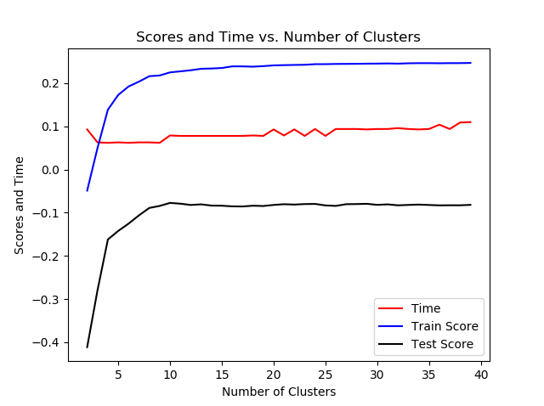
K-Nearest Neighbor Regression
Method: K Nearest Neighbors regression was set up with age, drinks, drugs, and smokes as parameters to predict diet.
Simplicity: K nearest Neighbors regression has an additional step in increasing the set-up which is that the optimal number of neighbors should be chosen.
Time: 0.08< time <0.1ms
Score: -0.4 < score < 0.28
Conclusion: In the graph to the right we can see that this optimal number of neighbors is about 9 for this data set. At 9 neighbors the scores begin to level out and the time steps up at about 10. The time to run this for each step was about twice that of the multiple linear regression model, but still well within reasonable bounds. The score however is still far below what we would want to have a reliable model.

Slide 12
Classification Methods:
Support Vector Classifier (SVC)
K-Nearest Neighbors Classifier

Slide 13
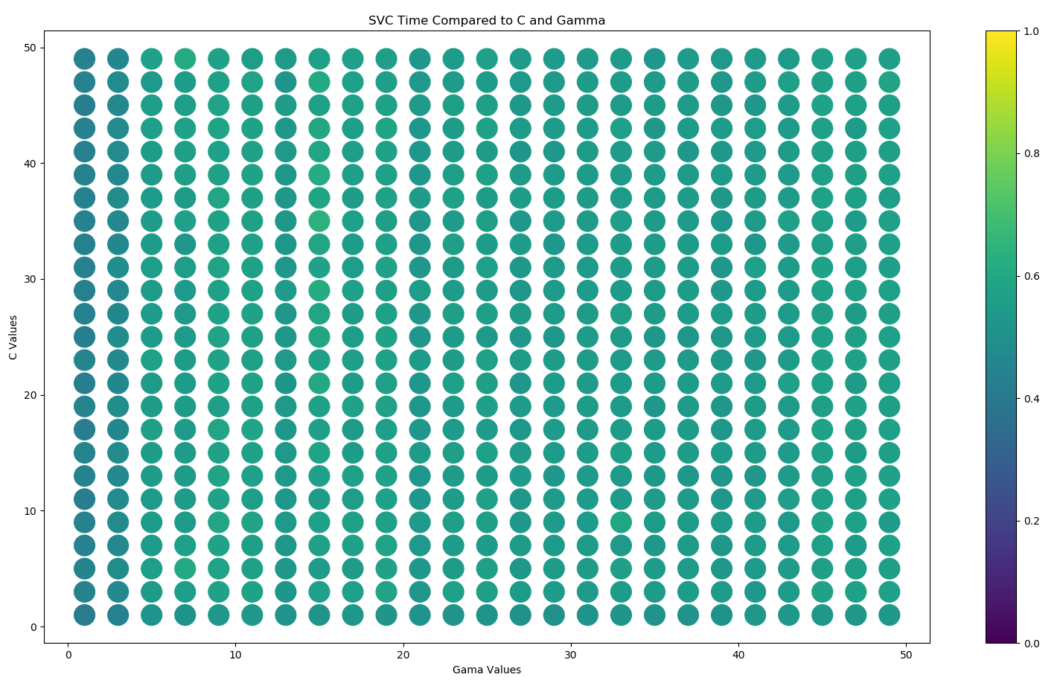
Support Vector Classifier (SVC)
Method: Use the SVC method with drugs, drinks, smokes, and age to predict a binary “anything” or “restricted” diet.
Simplicity: This method was the most complex method to set up as both a C and gamma parameter needed to be optimized for the model.
Time: ~ 0.5481ms (as indicated by color in the graph below)
Accuracy: ~0.80 (see next slide)
Recall: ~0.05 (see next slide)
Precision: ~0.40 (see next slide)
F1 Score: ~0.15 (see next slide)
Conclusion: The accuracy and the precision of
this model are good. The recall score is very low
which pushes the f1 score down with it. The SVC
method takes five times to run as the other methods
tried so far, but the results are worth it. A gamma
and a C should be taken less than 10 as the models
do not significantly benefit but the time it takes does
increase as the values get larger.

Slide 14
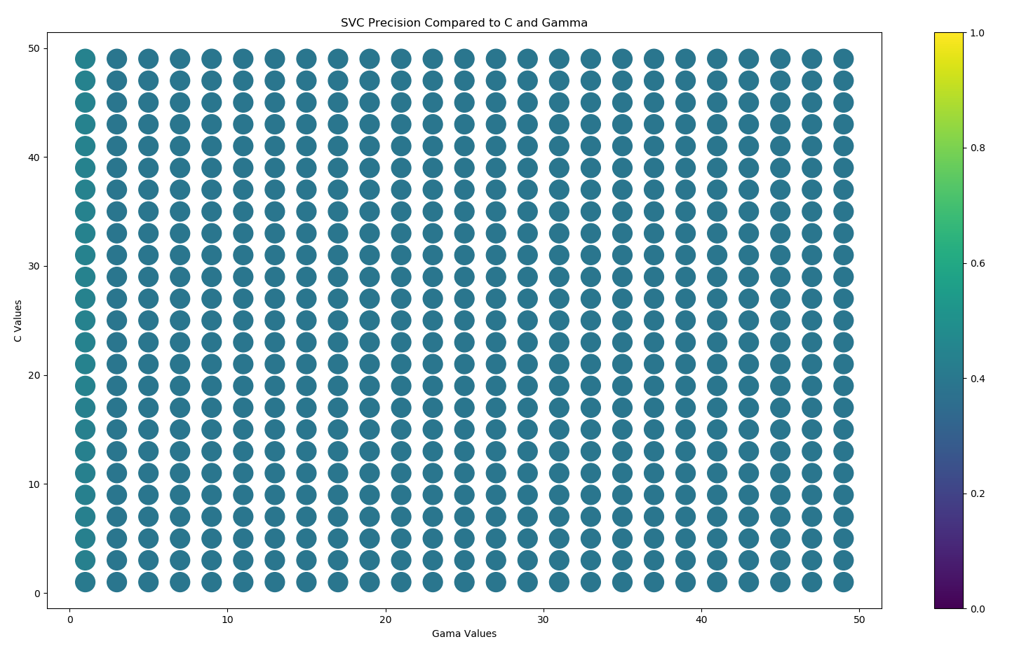
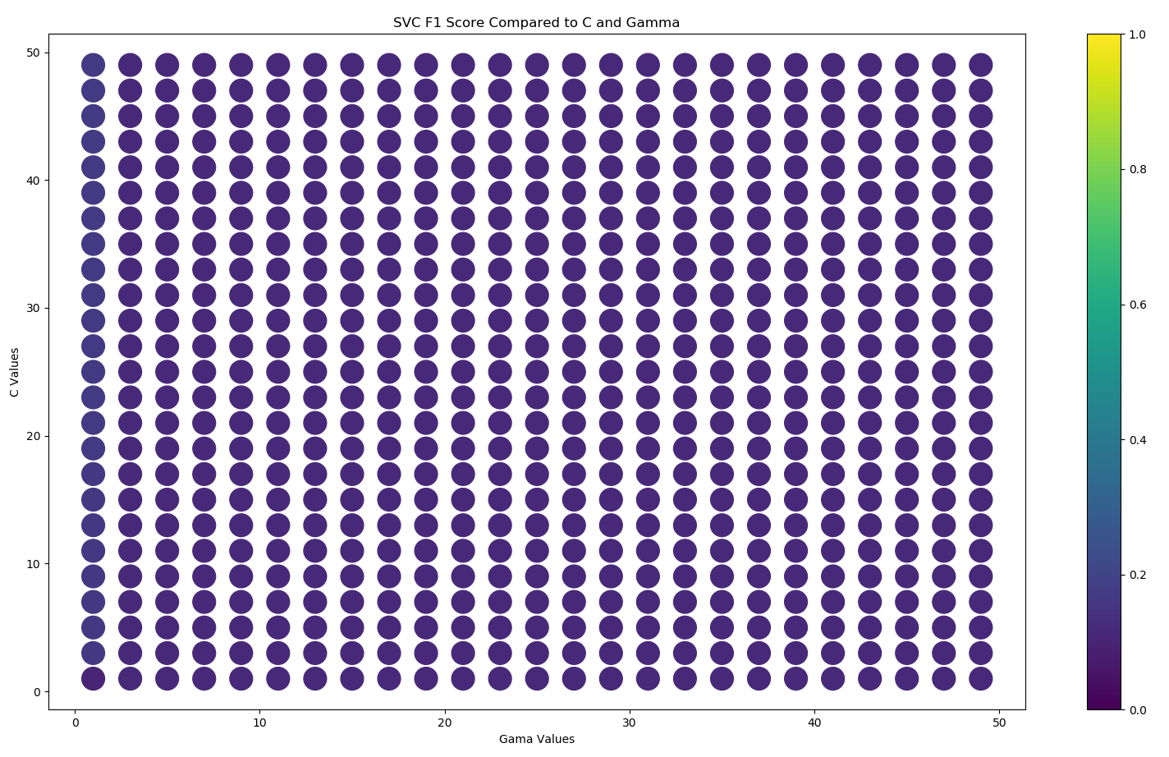
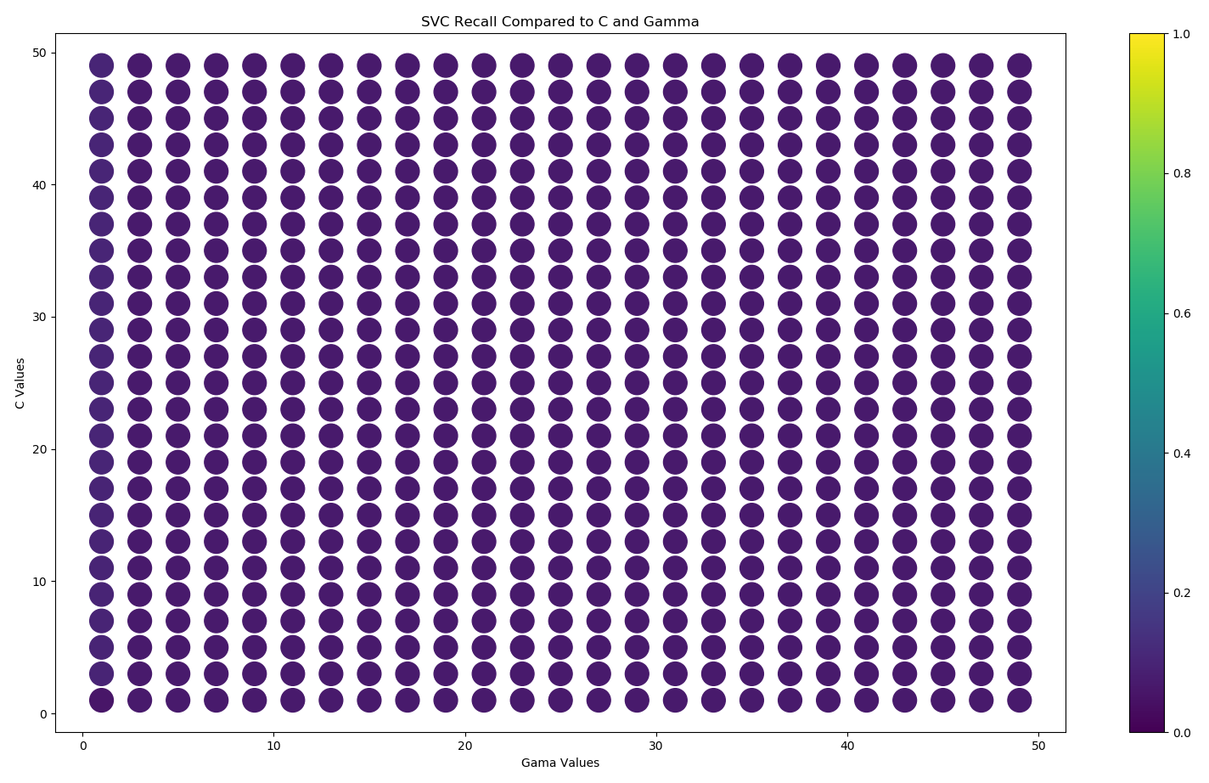
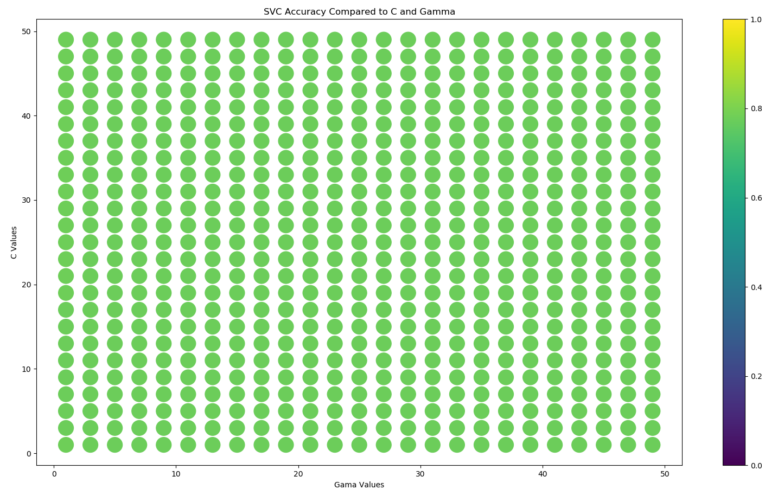
Support Vector Classifier (SVC)

Slide 15
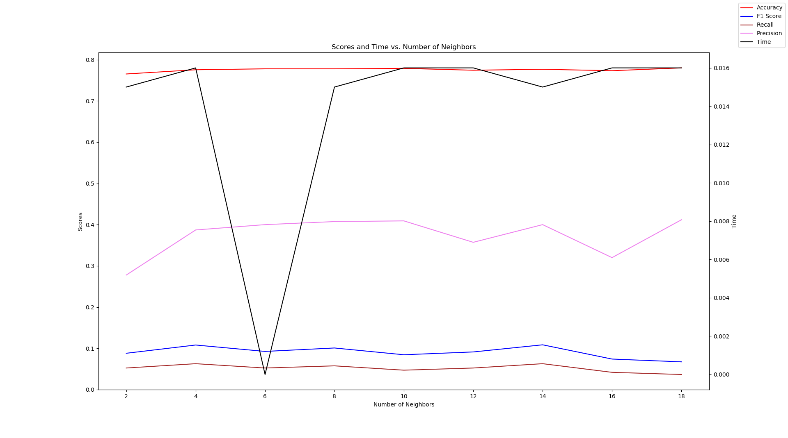
K-Nearest Neighbors Classifier
Method: Use the K-Nearest neighbor Classifier with drugs, drinks, smokes, and age to predict diet.
Simplicity: This method was simpler than the SVC method as only one parameter had to be optimized. Very similar to the K-Nearest Neighbor Regression scheme in complexity.
Time: ~ 0.0139ms
Accuracy: ~0.80
Recall: ~0.10
Precision: ~0.40
F1 Score: ~0.05
Conclusion: The optimal number of neighbors used should be about 6. This number of neighbors drops the time it takes to run significantly putting this model at a runtime of 0.001ms. This is incredibly fast and puts it on the order with single linear regression. The accuracy of this model is high along with the precision. The recall is a bit low, but an additional parameter may help to increase this. Overall, this model had the best results.

Slide 16
Conclusions:
Diet has some correlations to smoking, drinking, and drugs. However, it is not a strong enough correlation to predict diet with a regression model. This could be because a large part of the population in the data do not smoke and never do drugs. Also a large majority of the population eat the “anything” category. If a large enough majority fall into these categories just by numbers, then it would seem to be a correlation at first glance, however, other factors must affect their diet choice. However, if we shift to a binary system with “anything” and “stricter” being the only two options, a classification system can predict diet with 80% accuracy. As the K-Nearest Neighbor at 6 neighbors had a high accuracy and ran quickly, this model should be selected to answer this question. Also, perhaps more factors should be added to boost the accuracy and find a balance between recall and precision.

