Slide 1
System Modelling
System modeling refers to the process of developing simplified, abstract representations of a system's components, their interactions, and behaviors.
These models serve as tools for visualizing, specifying, and validating system requirements and design.

Slide 2
System Modelling - Purpose
Understanding and Analysis: System models help stakeholders comprehend the structure and behavior of the system, breaking down complexity into manageable parts.
Communication: They provide a common language that facilitates discussions among developers, clients, and other stakeholders, ensuring everyone has a shared understanding of the system.
Specification: Models capture essential requirements and functionalities, guiding the development process.
Validation: They enable testing of the system's design against requirements to ensure it meets stakeholder expectations.

Slide 3
System Modelling - Models
System Models
Context
Models
Interaction
Models
Structural
Models
Behavioural
Models
Data
Models

Slide 4
System Modelling - Models
Context Models: Illustrate the system's environment and its interactions with
external entities to define system boundaries.
Interaction Models: Focus on how components within the system communicate
and interact with each other.
Structural Models: Represent the organization of the system’s components and their relationships, often using class diagrams or entity-relationship diagrams.
Behavioral Models: Capture how the system behaves in response to various
inputs or events, using state machine diagrams or sequence diagrams.
Data Models: Represents the structure and organization of data within the system

Slide 5
System Modelling – Modelling Techniques
Techniques
Entity- Relationship Model
State Diagram Models
Unified Modelling Language
Data Flow Models

Slide 6
System Modelling - Techniques
Context Models – UML & DFD
Interaction Model – UML
Structural Model – UML & ERD
Behavioral Model – UML
Data Model – ERD & UML

Slide 7
System Modelling – Data Flow Diagram Model
A Data Flow Diagram (DFD) is a graphical representation that
illustrates the flow of data within a system.
It serves as a powerful tool for visualizing and understanding how information is processed, stored, and communicated, making it essential in system analysis and design.

Slide 8
System Modelling – Data Flow Diagram Model
Purpose and Benefits
Visualization: DFDs provide a clear and concise visual representation of how data flows through a system, making it easier to understand complex processes.
Identification of Bottlenecks: By mapping out the flow of information, DFDs help
identify potential inefficiencies or bottlenecks in data processing.
Documentation: DFDs serve as documentation tools that communicate system designs to various stakeholders, from technical teams to non-technical audiences.
System Analysis: They can be used to analyze existing systems or model new ones, facilitating discussions around improvements or redesigns.

Slide 9
System Modelling – Data Flow Diagram Model
DFDs consist of four primary components:
Processes: Represented by rounded rectangles, processes transform input data into output data. Each process is typically labeled with a verb phrase that describes its function.
Data Flows: Illustrated as arrows, data flows indicate the movement of data between
processes, data stores, and external entities. They are labeled with descriptions of the data being transferred.
Data Stores (Warehouses): Depicted as open-ended rectangles, these represent locations where data is stored for later use. Data can flow into and out of these stores as needed.
External Entities (Terminators): Shown as squares or rectangles, external entities are sources or destinations of data outside the system being modeled. They interact with the system by providing inputs or receiving outputs.

Slide 10
System Modelling – Data Flow Diagram Model
When creating a DFD, several rules should be followed:
Identify the key processes and external entities involved.
Determine the input and output data for each process.
Use standardized symbols to represent components clearly.
Label all arrows with the type of data being transferred.
Keep the diagram simple to enhance understanding and avoid complexity.

Slide 11
System Modelling – Data Flow Diagram Model
Advantages:
Provides a clear overview of data flow within a system.
Helps in identifying potential issues in data handling.
Facilitates communication among stakeholders regarding system design.
Disadvantages:
Can become complex if too many elements are included.
May require significant time to create and maintain.
Might not capture dynamic aspects of system behavior effectively.

Slide 12
System Modelling – Data Flow Diagram Model
Levels of DFDs
Context Diagram (Level 0): The highest-level DFD, showing the system as a single process with external entities.
Level 1 DFD: Decomposes the context diagram into major processes and data flows.
Level 2 DFD: Further decomposes Level 1 processes into more detailed
processes and data flows.
Level 3 DFD: Decomposes Level 2 processes into even more detailed processes and data flows.

Slide 13
System Modelling – Data Flow Diagram Model
Visualization of Data Flow: DFDs provide a graphical representation of how data moves through a system, illustrating processes, data stores, and external entities. This visualization helps stakeholders understand how information is processed and transferred, which is essential for accurately capturing requirements16.
Clarification of System Boundaries: By defining what is inside and outside the system,
DFDs help delineate the scope of the project. This clarity is vital during requirement elicitation to ensure that all necessary functionalities are identified and documented34.
Facilitation of Communication: DFDs serve as a communication stakeholders, including developers, clients, and users. They provide
tool among a common
framework for discussing system processes, ensuring that everyone has a shared understanding of how data flows within the system

Slide 14
System Modelling – Data Flow Diagram Model
Example - Lemonade System
The Lemonade System involves the following processes:
Customer Orders: A customer places an order for lemonade.
Make Lemonade: The lemonade stand owner makes the lemonade according
to the customer's request.
Payment: The customer pays for the lemonade.
Serve Lemonade: The lemonade stand owner serves the lemonade to the
customer.

Slide 15
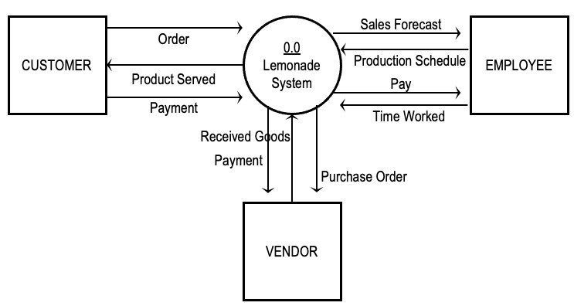
System Modelling – Data Flow Diagram Model
Context Model – Level 0

Slide 16
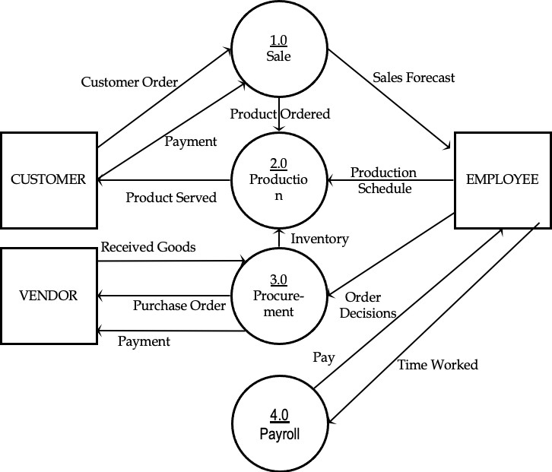
System Modelling – Data Flow Diagram Model
Level 0 DFD – Identifying manageable sub processes

Slide 17
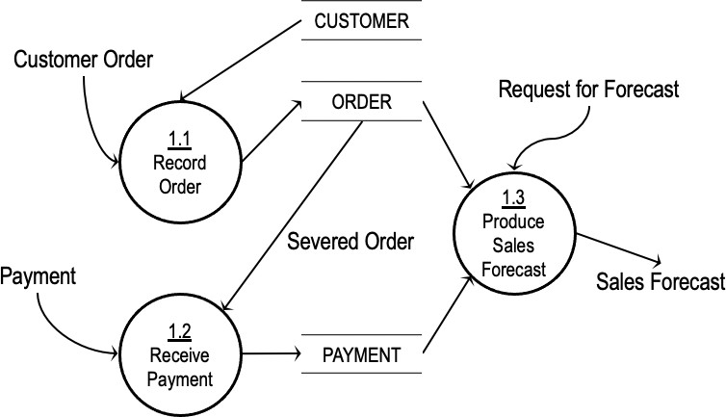
System Modelling – Data Flow Diagram Model
Level 1 DFD
Customer Order
Serve Product
Collect Payment
Produce Product
Store Product
Order Raw Materials
Pay for Raw Materials
Pay for Labor

Slide 18
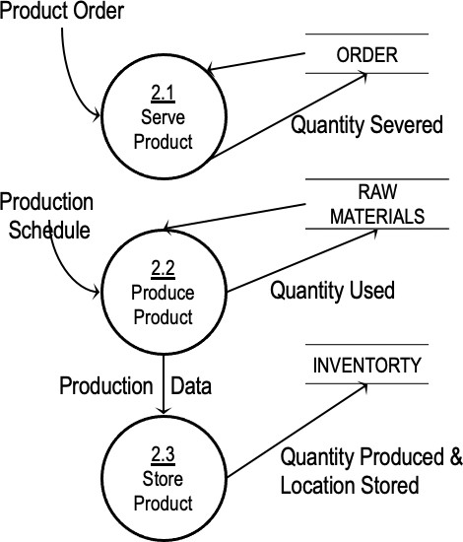
System Modelling – Data Flow Diagram Model
Level 1 DFD
Customer Order
Serve Product
Collect Payment
Produce Product
Store Product
Order Raw Materials
Pay for Raw Materials
Pay for Labor

Slide 19
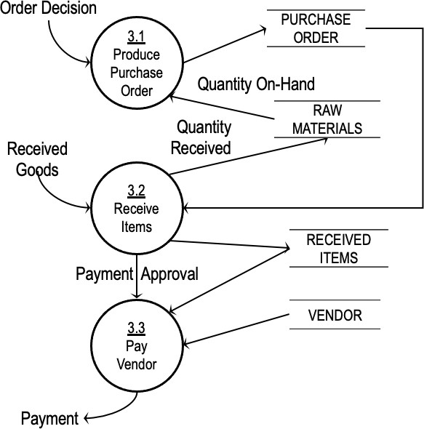
System Modelling – Data Flow Diagram Model
Level 1 DFD
Customer Order
Serve Product
Collect Payment
Produce Product
Store Product
Order Raw Materials
Pay for Raw Materials
Pay for Labor

Slide 20
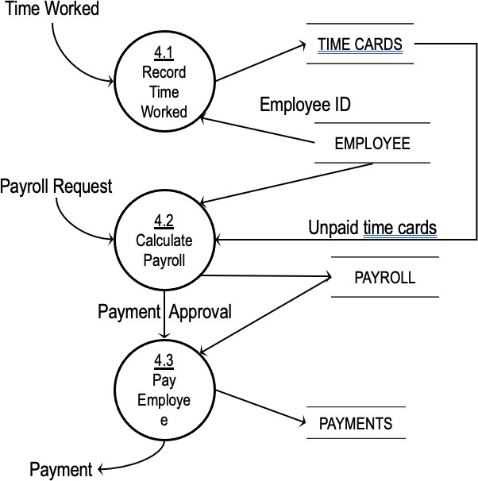
System Modelling – Data Flow Diagram Model
Level 1 DFD –
Customer Order
Serve Product
Collect Payment
Produce Product
Store Product
Order Raw Materials
Pay for Raw Materials
Pay for Labor

Slide 21
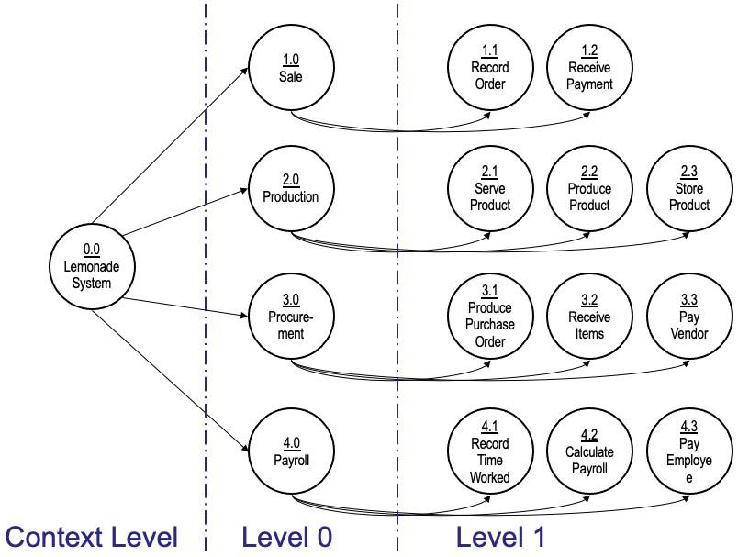
System Modelling – Data Flow Diagram Model
Process Decomposition

Slide 22
System Modelling – Entity Relationship Model
Represents the logical design of a database by abstracting real-world objects as entities and their associations as relationships.
Example: Entities "Student" and "School" with the relationship "Studies in.”

Slide 23
System Modelling – Entity Relationship Model
Entity Set & Relationship Set:
Entity Set: A collection of similar entities (e.g., "Student" entity set). Individual instances are entities (e.g., "Ram").
Relationship Set: A collection of similar relationships between entities.
Attributes: Characteristics describing an entity (e.g., Student attributes: name, age, address, roll number, grade).

Slide 24
System Modelling – Entity Relationship Model
Keys:
Super Key: One or more attributes that uniquely identify an entity (e.g., grade + roll number in a school).
Candidate Key: A minimal subset of a super key (super key without extraneous attributes).
Primary Key: A chosen candidate key for database implementation.
Prime Attribute: Any attribute part of a super key.

Slide 25
System Modelling – Entity Relationship Model
Weak Entity: An entity dependent on another entity for its identification (doesn't have its own super key).
Example: "Family" (weak entity) dependent on "Employee" (owning entity) for identification.
Entity Generalization/Specialization: Represents hierarchical relationships between entity sets. A generalized entity (e.g., "Person") can have specialized subtypes (e.g., "Customer," "Employee"). Uses "ISA" hierarchy.

Slide 26
System Modelling – Entity Relationship Model
Mapping Cardinalities (Relationships between Entity Sets E1 and E2):
One-to-One: One entity in E1 relates to at most one entity in E2, and vice versa.
One-to-Many: One entity in E1 relates to zero or more entities in E2. One
entity in E2 relates to at most one entity in E1.
Many-to-One: Many entities in E1 relate to one entity in E2. One entity in E2 relates to at most one entity in E1.
Many-to-Many: Many entities in E1 relate to many entities in E2.

Slide 27
System Modelling – Entity Relationship Model
ER Diagram
From a given problem statement, we identify the possible entity sets, their
attributes, and relationships among different entity sets.
Once we have these information, we represent them pictorially, called an entity-relationship (ER) diagram.

Slide 28
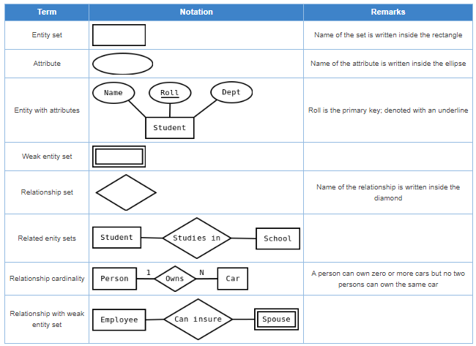
System Modelling – Entity Relationship Notations

Slide 29
System Modelling – Entity Relationship Importance
Foundation for Database Design: ER modeling is the crucial first step in designing a relational database. It provides a clear blueprint for translating real- world concepts into database structures.
Identifies Key Elements: ER modeling helps pinpoint the essential components of a database: entities (objects), attributes (properties), and relationships (associations).
Visual Representation: ER diagrams offer a visual representation of the database structure, making it easier to understand and communicate the design.

Slide 30
System Modelling – Entity Relationship Importance
Facilitates Table Creation: The ER diagram directly informs the creation of database tables, including columns (attributes) and connections (relationships).
Supports Constraint Definition: ER modeling aids in defining constraints (rules) on the data, ensuring data integrity and consistency.
Enables Database Normalization: A well-defined ER model is essential for effective database normalization, which reduces data redundancy and improves data management.
Detailed and Accurate Design: The importance of ER modeling lies in its ability to capture a detailed and accurate representation of the data requirements, which is crucial for efficient data storage and retrieval. A good ER diagram leads to a good database.

Slide 31
System Modelling – Entity Relationship Example
Problem 1
A manufacturing company produces products. The following product information is stored: product name, product ID and quantity on hand. These products are made up of many components. Each component can be supplied by one or more suppliers. The following component information is kept: component ID, name, description, suppliers who supply them, and products in which they are used.
Create an ERD to show how you would track this information.

Slide 32
System Modelling – Entity Relationship Example
Assumptions
A supplier can exist without providing components.
A component does not have to be associated with a supplier.
A component does not have to be associated with a product. Not all components are used in products.
A product cannot exist without components.

Slide 33
System Modelling – Entity Relationship Example
Component(CompID, CompName, Description) PK=CompID
Product(ProdID, ProdName, QtyOnHand) PK=ProdID
Supplier(SuppID, SuppName) PK = SuppID
CompSupp(CompID, SuppID) PK = CompID, SuppID
Build(CompID, ProdID, QtyOfComp) PK= CompID, ProdID

Slide 34
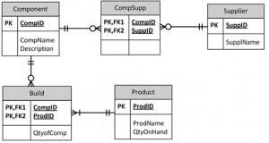
System Modelling – Entity Relationship Example

Slide 35
System Modelling – Unified Modelling Language (UML)
A standardized modeling language used in software engineering for visualizing, specifying, constructing, and documenting the artifacts of software systems.

Slide 36
System Modelling – Unified Modelling Language (UML)
Visualization:
UML provides a way to represent software systems graphically, making complex designs easier to understand.
Instead of just lines of code, developers can use diagrams to see the structure and behavior of their software.

Slide 37
System Modelling – Unified Modelling Language (UML)
Specification:
UML can be used to specify the components of a software system in a precise
and unambiguous way.
This helps ensure that everyone on the development team has a shared understanding of the system's design

Slide 38
System Modelling – Unified Modelling Language (UML)
Construction: While UML itself isn't code, it can be used to generate code in various programming languages. This can speed up the development process and reduce errors.
Documentation: UML diagrams serve as excellent documentation for software systems. They provide a clear and concise overview of the system's design, which is helpful for maintenance and future development.

Slide 39
System Modelling – UML - Perspectives
Structural Model (Static View) - Class Diagram, Diagram, Deployment Diagram, Object Diagram
Component
Behavioral Model (Dynamic View) – Sequence Diagram, Collaboration Diagram, State Chart Diagram, Activity Diagram
User Interaction View – Usecase Diagram

Slide 40

















System Modelling – UML - Perspectives
UML
Diagrams/ Models
Structural
Models
Behavioural
Models
Class
Object
Component
Deployment
Use Case
Activity
State Transition
Sequence
Communicat ion
Timing

Slide 41
System Modelling – UML – Usecase Model
Provide a shared understanding of system functionality among end- users, developers, and domain experts.
Capture system functionality (use cases) and users (actors) from a problem statement.
Behavioral UML diagram showing a graphical overview of system functionality.
Consist of use cases (actions), actors (users/external systems), and their relationships.

Slide 42
System Modelling – UML – Usecase Model
Actor
External entity (human, device, or system) interacting with the system for a purpose.
Primary Actor: Principal user achieving goals through system services (e.g., customer withdrawing cash).
Supporting Actor: Provides services to the system (e.g., bank representative restocking ATM). Primary actors typically on the top left of the diagram.

Slide 43
System Modelling – UML – Usecase Model
Use Case:
A specific functionality provided by the system (e.g., withdraw cash, check balance).
Includes both successful and unsuccessful interaction scenarios.

Slide 44
System Modelling – UML – Usecase Model
Subject:
The system under consideration (e.g., ATM).
Use cases apply to the subject.

Slide 45
System Modelling – UML – Usecase Model
Association (Actor-Use Case):
Connection between actors and use cases, showing interaction (message passing).
Actors must be associated with at least one use case, and vice versa.
Actor associations are not usually shown, but class hierarchies can be depicted.

Slide 46
System Modelling – UML – Usecase Model
Use Case Relationships:
Include: Represents shared behavior among use cases (like a function call). Dashed arrow with «include» stereotype from including to included use case. Example: "Login" included by "Send Email," "Reply," and "Forward."
Extend: Represents variations or optional behaviors of a use case. Dashed arrow with
«extend» stereotype from extending to extended use case. Example: "Add Shipping Instructions" extends "Place Order.”
Generalization: Represents inheritance between use cases (specialization). Solid arrow from specialized to generalized use case. Example: "Draw Rectangle" generalizes "Draw Polygon."

Slide 47
System Modelling – UML – Usecase Model
Identifying Actors:
Who benefits most from the system? (Primary actors)
Who keeps the system working?
What other software/hardware interacts with the system?
Any interface with other systems?
Identifying Use Cases:
Determine actor goals (functionality they want).
Use case names start with a verb (e.g., "Check Balance").

Slide 48
System Modelling – UML – Usecase Model
Guidelines for Drawing Use Case Diagrams:
Define the system boundary.
Actors should have well-defined purposes.
Use cases should represent meaningful work for actors.
Connect all actors and use cases.
Use "include" relationships for shared behavior.

Slide 49
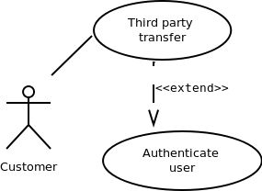
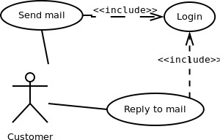
System Modelling – UML – Usecase Model
Example

Slide 50
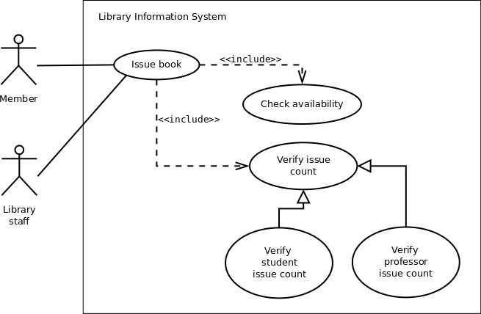
System Modelling – UML – Usecase Model
Example

Slide 51
System Modelling – UML – Activity Model
Activity diagrams are behavioral diagrams that visually represent the flow of control in a system.
They are like flowcharts but can represent concurrent activities.
They can't depict message passing among objects and thus can't be directly translated into code.
Activity diagrams are suitable for confirming logic with business users, especially when the business logic is complex.

Slide 52
System Modelling – UML – Activity Model
Components:
Activity: Represents an action (rounded rectangle). Special types: initial (filled circle) and final (filled circle with a border) nodes.
Flow: Directed arrow showing the transfer of control. May include guard conditions.
Decision: Diamond shape with one incoming flow and multiple outgoing
flows, based on conditions.
Merge: Diamond shape with multiple incoming flows and one outgoing flow; processing continues when at least one control reaches the node.

Slide 53
System Modelling – UML – Activity Model
Components:
Fork: Black bar with one incoming flow and multiple outgoing flows, indicating parallel activities.
Join: Black bar with multiple incoming flows and one outgoing flow,
synchronizing concurrent activities (all incoming controls must be completed).
Note: Used to attach textual information (comments, constraints) to components.
Partition (Swimlane): Logically groups components into areas, often corresponding to organizational units or actors (not mandatory).

Slide 54
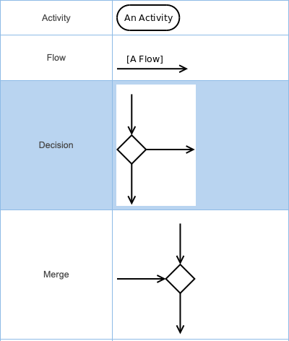
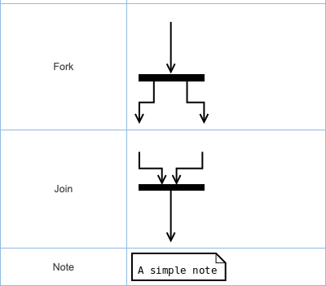
System Modelling – UML – Activity Model

Slide 55
System Modelling – UML – Activity Model
Guidelines
Identify tiny pieces of work being performed by the system
Identify the next logical activity that should be performed
Think about all those conditions that should be made, and all those constraints that should be satisfied, before one can move to the next activity
Put non-trivial guard conditions on the edges to avoid confusion

Slide 56
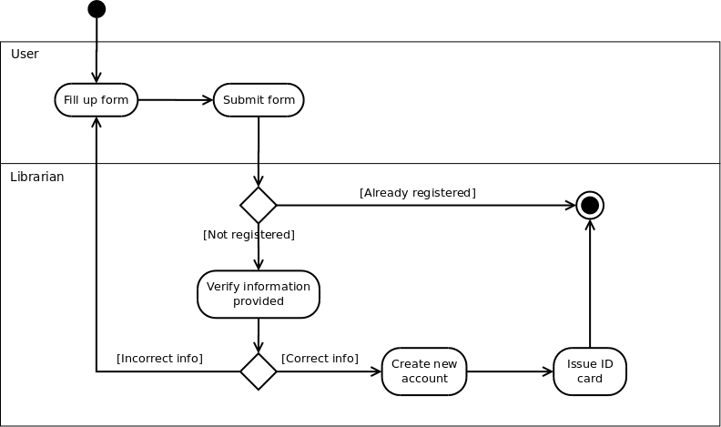
System Modelling – UML – Activity Model - Example

Slide 57
System Modelling – UML – State Chart Model
A statechart diagram is a visual representation of a system, showing its states and the events that cause transitions between them.
It models the behavior of a system with well-defined states.
Statechart diagrams are typically used to model complex systems.

Slide 58
System Modelling – UML – State Chart Model
Components
State: A distinct stage an object/system passes through.
Initial: The state an object is in when created (represented by a filled black
circle).
Final: A state from which the object does not move to another state
(represented by an unfilled circle with an inner black-filled circle);
Intermediate: Any state that is not initial or final (represented by a rounded
rectangle).

Slide 59
System Modelling – UML – State Chart Model
Components
Name compartment: Contains the name of the state.
Internal transitions compartment: Lists internal activities performed while in
the state, using the syntax: action-label / action-expression.
Special action labels include:
Entry: Activity performed upon entering the state.
Exit: Activity performed upon exiting the state.
Do: Activity performed while in the state.
Include: Invocation of a sub-machine.

Slide 60
System Modelling – UML – State Chart Model
Components
Transition: Movement from one state to another in response to an external stimulus or internal event (represented by a solid arrow). Labeled as: event [guard-condition] / [action-expression].
Event: What causes the transition (mandatory, written in past tense).
Guard-condition: Precondition(s) that must be true for the transition to
happen (optional).
Action-expression: Action(s) performed as a result of the transition (optional).

Slide 61
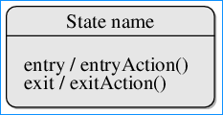

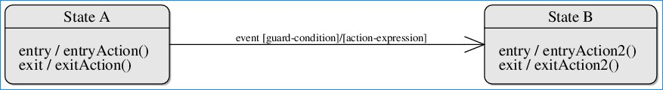
System Modelling – UML – State Chart Model
Components

Slide 62
System Modelling – UML – State Chart Model
Guidelines
Identify the distinct states the system passes through.
Identify the events (and preconditions) that cause state transitions.
Identify what activities are performed while the system remains in a given state.

Slide 63
System Modelling – UML – Structural Aspect - Sequence
Sequence Diagram: Shows object interactions and message passing over time.
Elements: Objects, lifelines, and messages.
Object: Instance of a class. Represented by a box at the top with object name : class name (underlined).
Lifeline: Vertical line representing an object's existence.
Activation box on lifeline shows when the object is active.

Slide 64
System Modelling – UML – Structural Aspect - Sequence
Messages: Communication between objects. Arrows labeled with message name.
Synchronous: Sender waits for receiver to finish. Filled arrowhead.
Asynchronous: Sender doesn't wait. Open arrowhead.
Return: Value returned from a message. Dashed arrow with open arrowhead.
Self-Message: Object sending a message to itself.

Slide 65
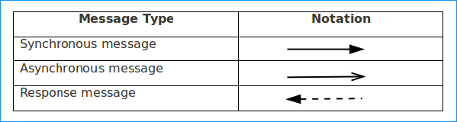
System Modelling – UML – Structural Aspect - Sequence
Messages:

Slide 66
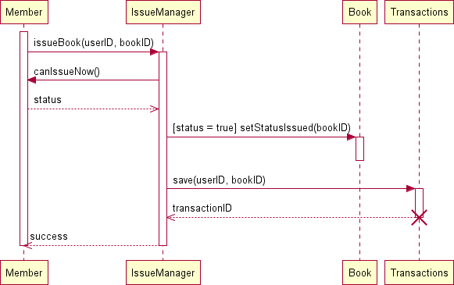
System Modelling – UML – Structural Aspect - Sequence
Example Issue Book:

Slide 67
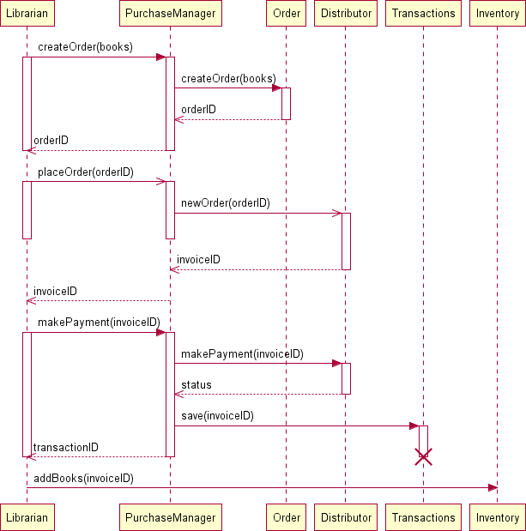
System Modelling – UML – Structural Aspect - Sequence
Example Purchase Book:

Slide 68
System Modelling – UML – Structural Aspect - Class
Class Diagram: Graphical representation of a system's structure.
Elements: Classes, attributes, operations, and relationships.
static
Class: Blueprint for objects with similar data and Represented by a rectangle with three compartments:
Class Name: Unique identifier.
Attributes: Properties of the class (data members).
Operations: Actions the class can perform (member functions).
behavior.

Slide 69
System Modelling – UML – Structural Aspect - Class
Generalization/Specialization: Describes inheritance relationships. Derived classes inherit properties from parent classes. "ISA" relationship.
Relationships: Connections between classes.
Association: Instance-level connection allowing message exchange. Line connecting classes. Can have name, role names, and multiplicity. Can be unidirectional.
Aggregation: "Part-whole" relationship where the whole contains the parts. Weaker ownership than composition. Represented by a hollow diamond on the whole side.
Composition: Strong "part-whole" relationship where the whole owns the parts. Part lifecycle
depends on the whole. Represented by a filled diamond on the whole side.
Multiplicity: Specifies the number of instances of one class related to another. (e.g., 1, 0..1, , 1.., n).

Slide 70
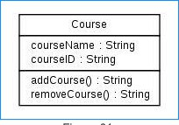
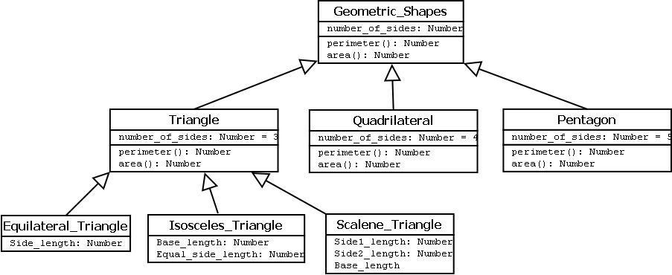
System Modelling – UML – Structural Aspect - Class

Slide 71
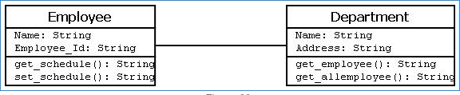
System Modelling – UML – Structural Aspect - Class
Association Example

Slide 72
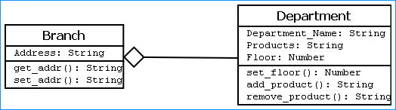
System Modelling – UML – Structural Aspect - Class
Aggregation Example

Slide 73
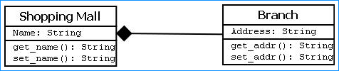
System Modelling – UML – Structural Aspect - Class
Composition Example

Slide 74
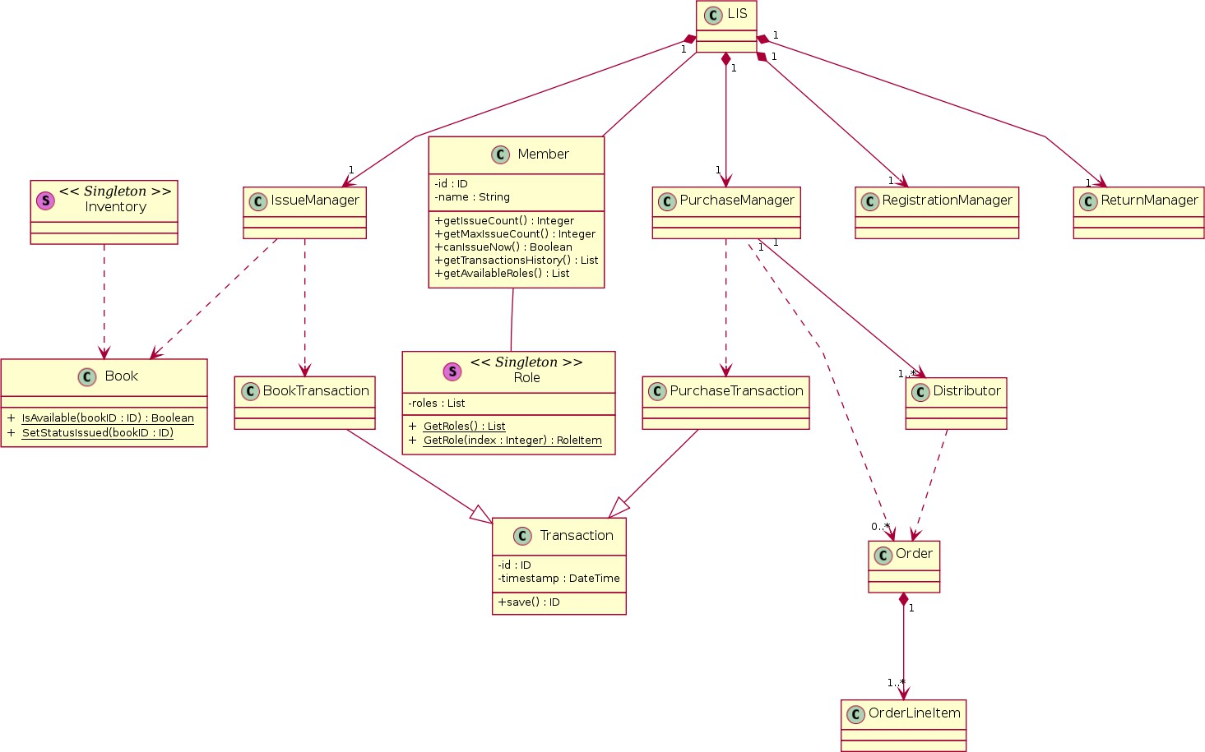
System Modelling – UML – Structural Aspect - Class
Example

Slide 75
System Modelling – UML – Component Model
Model breaks down a large system into smaller, manageable components, modeling the physical parts of the system like files, executables, and libraries.
It provides a visual representation of the components and their relationships, helping to form an executable system.
Each component is a single, replaceable unit with hidden implementation details, communicating through interfaces

Slide 76
System Modelling – UML – Component Model
To depict the functionality and behavior of components within a system at a specific time
Components: Represented as rectangles with the <<component>> stereotype or a component icon. They can be basic building blocks or larger subsystems.
Interfaces: Define how components interact with each other, with components providing and requiring interfaces

Slide 77
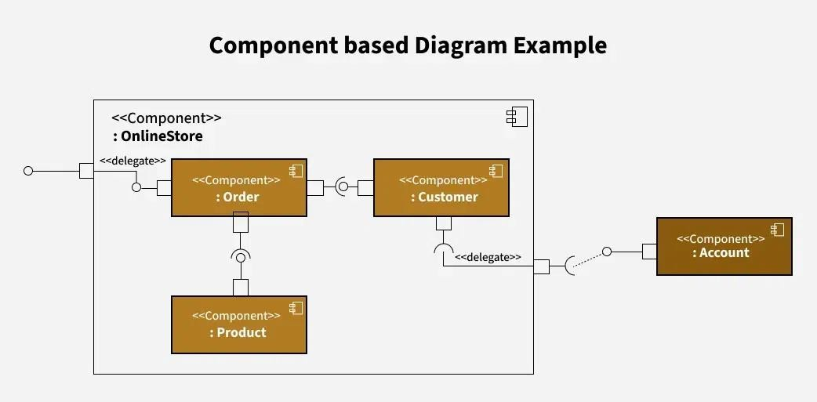
System Modelling – UML – Component Model
Connectors: Illustrate the relationships between components4. Assembly connectors link provided interfaces to required interfaces

Slide 78
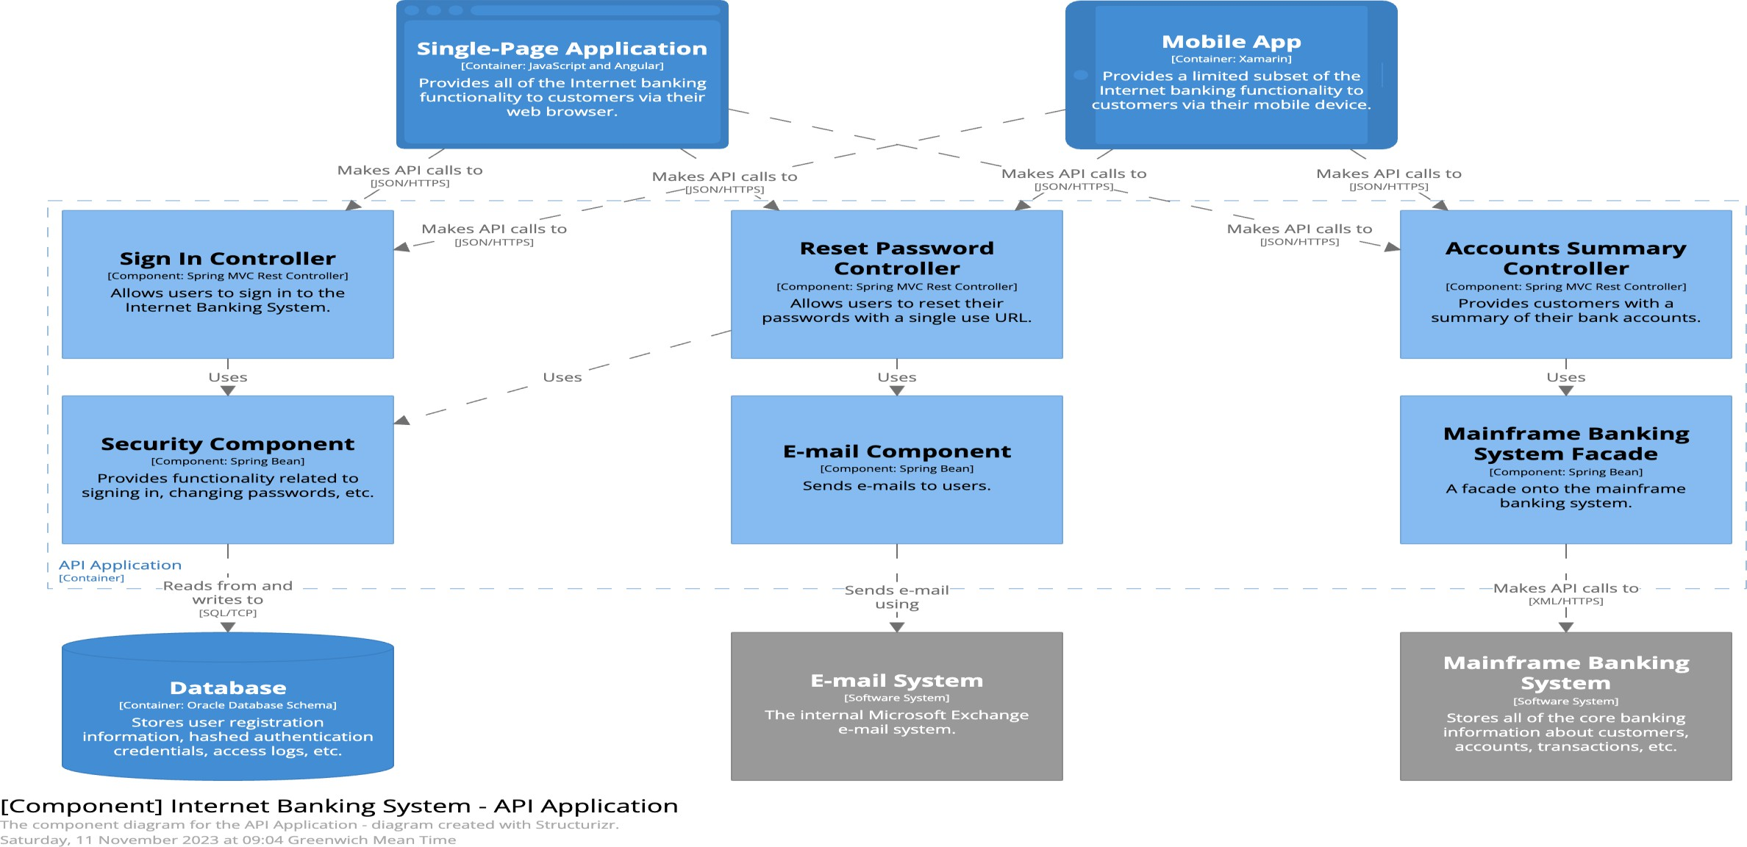
System Modelling – UML – Component Model

Slide 79
System Modelling – UML – Deployment Model
Visualizes the physical hardware and software deployment in a system.
Shows how software components are deployed on hardware.
Depicts the relationships between software and hardware components

Slide 80
System Modelling – UML – Deployment Model
Key Elements
Nodes: Represent hardware devices (e.g., servers, PCs, mobile phones) or software execution environments (e.g., operating systems, JVMs). They are the most important part of the diagram.
Artifacts: Represent concrete software elements like executable files, libraries,
configuration files, etc.
Communication Paths: Solid lines that show the communication links
between nodes. These can be labeled with communication protocols (e.g.,
HTTP, TCP/IP)7.

Slide 81
System Modelling – UML – Deployment Model
Nodes
Device Nodes: Computing resources with processing capabilities4.
Execution Environment Nodes (EEN): Computer systems residing within a
device node, like operating systems or JVMs.
Nodes can be nested to show more detail, like a disk inside a PC.
Node instances can be shown to represent specific instances

Slide 82
System Modelling – UML – Deployment Model
Artifacts in Detail:
Represent software that runs on hardware.
Examples: databases, configuration files, executable files
Relationships:
Association: Represents a structural connection.
Dependency: Indicates that one element depends on another.
Deployment: Shows how artifacts are deployed to nodes. Artifacts can be deployed to nodes by nesting or using a dashed line arrow labeled "deploy"

Slide 83
System Modelling – UML – Deployment Model
Guidelines
Identify the nodes (hardware and software)
Outline the software artifacts
Establish relationships between nodes
Configure artifacts on nodes
Detail the environment (e.g., OS, cloud platform)
Annotate the diagram with notes and constraints.

Slide 84
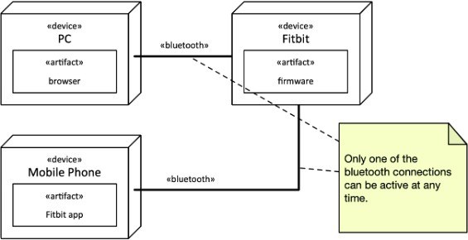
System Modelling – UML – Deployment Model

Slide 85
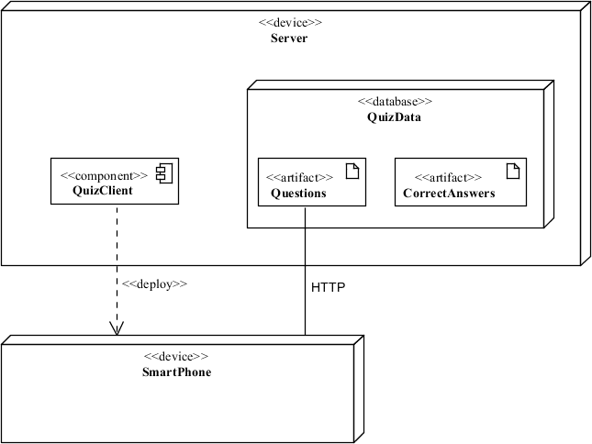
System Modelling – UML – Deployment Model

Slide 86
System Modelling – UML – Summary
Class Diagram: It visualizes a system's classes, their properties, and the relationships between them. It is the foundation for component and deployment diagrams
Component Diagram: It verifies that the required functionalities are implemented by components and is a communication tool to discuss and improve system design. It breaks down complex systems into
smaller components and visualizes the relationships between these components.

Slide 87
System Modelling – UML – Summary
Use Case Diagram: Used during the analysis phase of a project to identify system functionality by describing the interaction of people or external devices with the system. It provides a high-level overview of the relationships between actors and systems, making it suitable for explaining a system to a non-technical audience
Sequence Diagram: Describes how operations are carried out. It
depicts the chronologically structured event flow through a use case and presents the communication relationships between objects

Slide 88
System Modelling – UML – Summary
Communication Diagram: Visualizes the relationship between objects collaborating to perform a particular task and models the logic of the implementation for a complex operation. It focuses on messages passed between objects and can represent the same information as a sequence diagram using different objects
Deployment Diagram: Describes the hardware components used in system implementations, the execution environments, and the artifacts deployed on the hardware1. It helps visualize the hardware topology
system, model physical hardware elements, and the communication
relationships between them, as well as plan the architecture of the system.

Slide 89
System Modelling – UML – Summary
State Diagram: Models the dynamic nature of a system by describing all possible states of an object as events occur, from creation to termination.
Activity Diagram: Graphically represents business or operational workflows to show the activity of any part or component in the system.

Slide 90
System Modelling – UML – Summary
Object Diagram: Shows the relationship between objects using real- world examples and illustrates how a system will look at any given time

