Slide 1
Credit Fraud Detection
PBA Coursework Group 10
Abubakar Jauro Sani (6769836)
Adarsh Manoj (6532510)
Piyush Patel (6760850)
Ramandeep Singh (6730378)

Slide 2
Content
Introduction
Data Exploration and Processing
Machine Learning Modelling
Results
Evaluation
Conclusion

Slide 3
Introduction
Credit Card Fraud Detection is a method of detecting fraud by implementing complex algorithms and machine learning knowledge to identify patterns in data that can protect customer’s money from falling into the wrong hands.

Slide 4
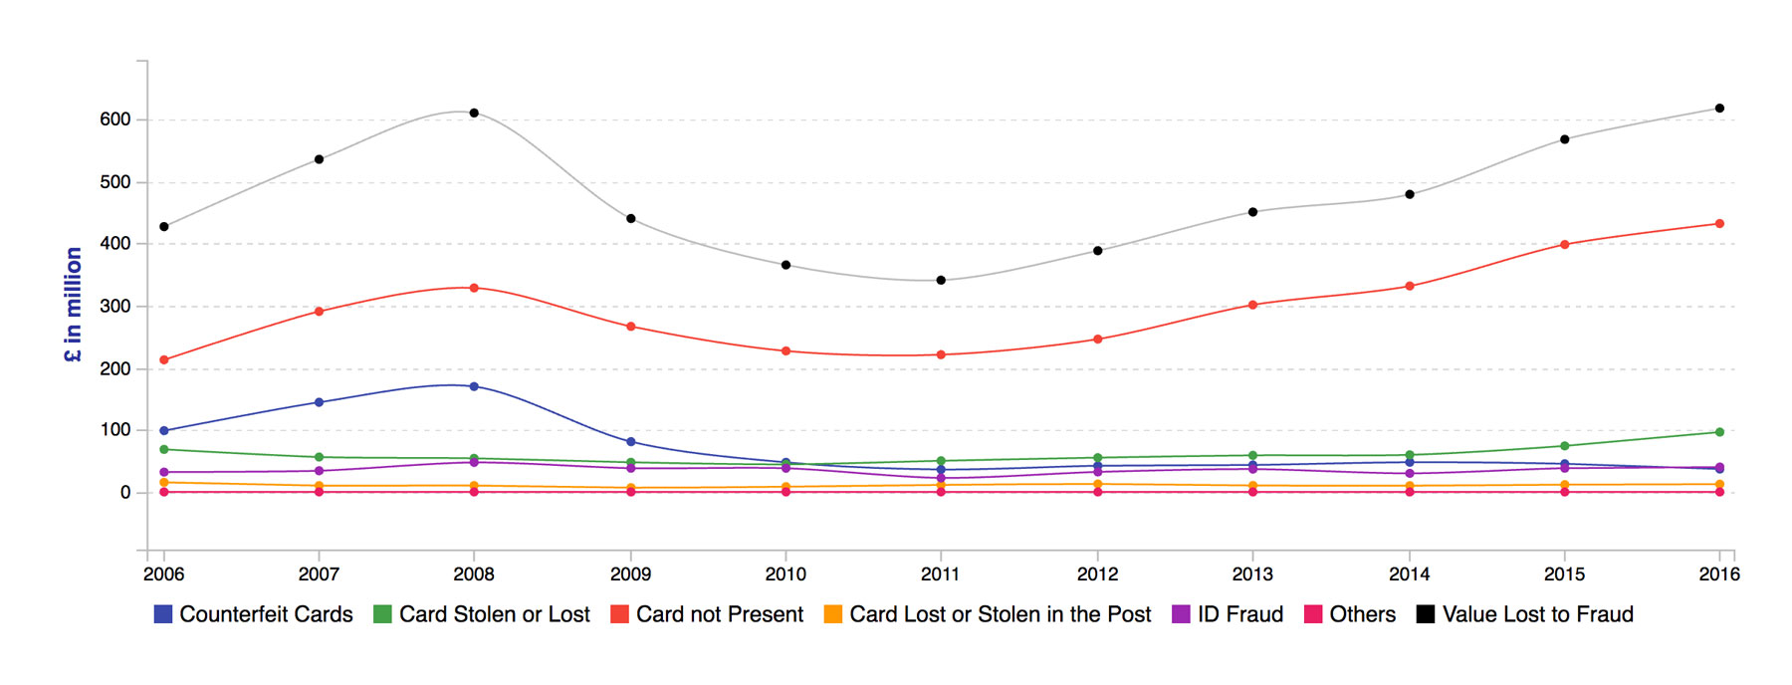
Problem Definition
The aim is to determine an efficient way to detect whether a particular transaction is a fraud or not by choosing various strategies to maximize the efficiency and accuracy of our models.

Slide 5
Existing Works
ARTICLE TITLE | PUBLISHER | DATA SIZE (ENTRIES) | MODELS | FINDINGS
CREDIT CARD FRAUD DETECTION WITH MACHINE LEARNING (link) | Cardiff University | 284,807 | LR, K-NN, SVM, DT and Catboost | Best performing model was the LR model with 97.92% accuracy, this was achieved with the implementation of oversampling.
CREDIT CARD FRAUD DETECTION - MACHINE LEARNING METHODS (LINK) | IEEE 2019 |  | LR, RF, Naive Bayes and Multilayer Perceptron | Results indicate that each algorithm can accurately detect credit card fraud. Also utilised SMOTE as a means of oversampling.
FRAUD DETECTION IN CREDIT CARDS USING LOGISTIC REGRESSION (link) | International Journal of Advanced Computer Science and Applications | 284,807 | LR, SVM | Didn’t utilise oversampling, and also implemented voting classifiers to boost model performance.

Slide 6
Exploratory Data Analysis
Columns | Description | Type | Number of columns
Time | Time elapsed between each successive transaction (in seconds) | Integer | 1
V1-V28 | PCA components | Double | 28
Amount | Amount spent by cardholder(in euros) | Double | 1
Class | Contains two values 0 –non-fraud and 1-fraud transaction. | Integer | 1
Dataset overview

Slide 7
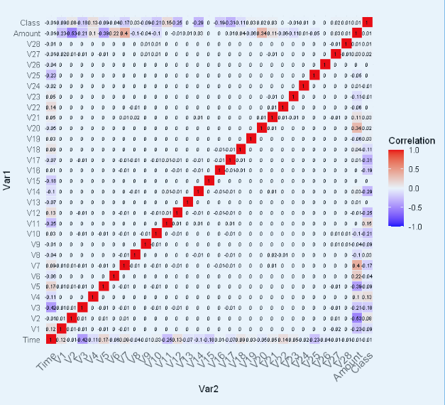
EDA
Correlation matrix showing the Correlation in data
-0.53 against V2 Amount
0.4 for V7 and Amount

Slide 8
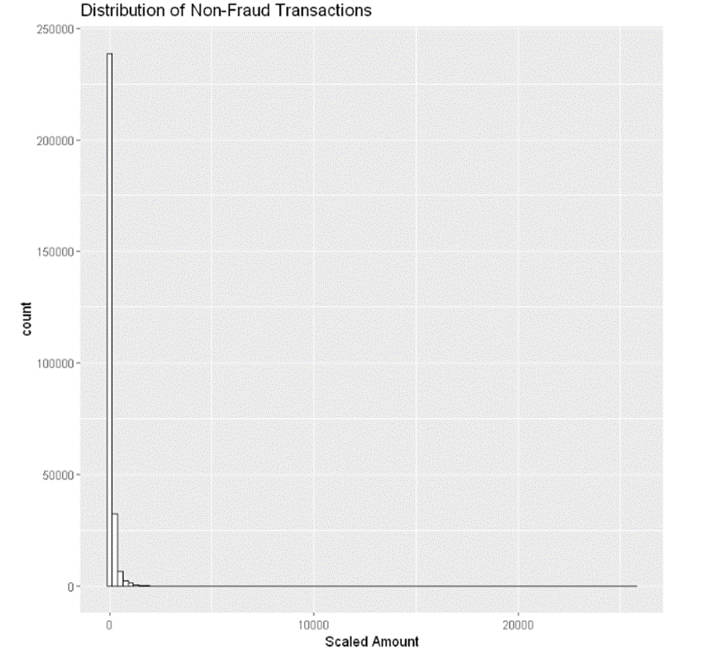
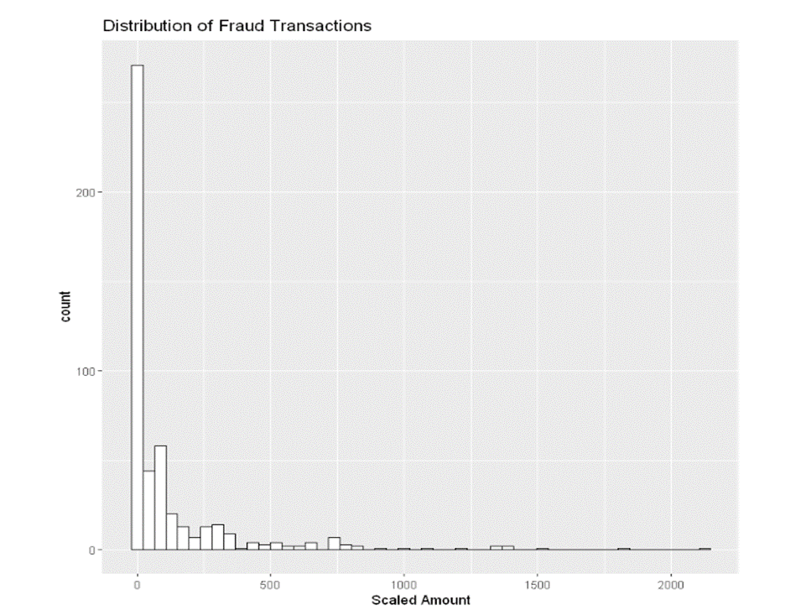
EDA
Distribution of Non-Fraud
Distribution of Fraud

Slide 9
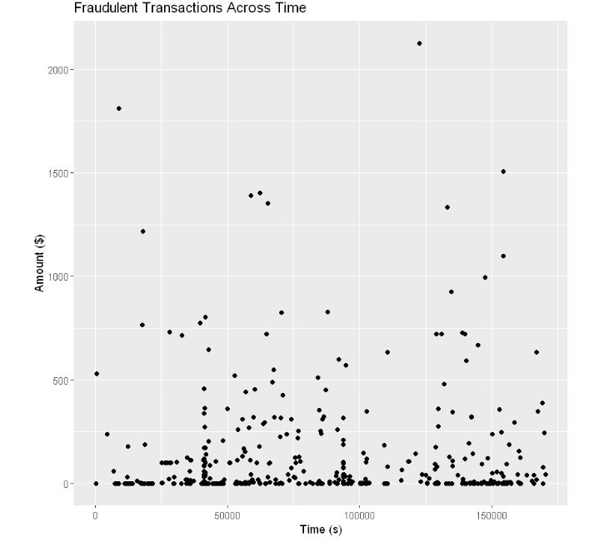
EDA

Slide 10
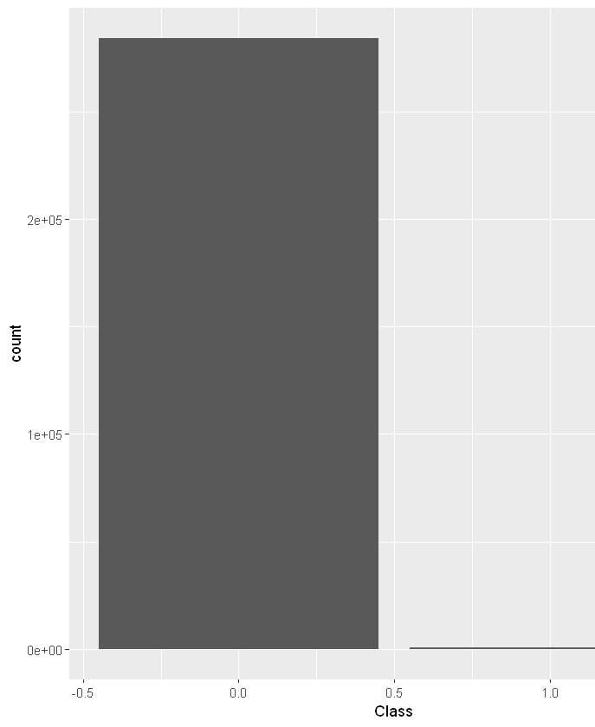
Data Processing
Check for missing values
No missing or null values were found
Check for duplicate
1084 duplicates were found and cleared
Class Balancing
Over Sampling
Under Sampling
Hybrid Sampling
Dimensionality Reduction

Slide 11
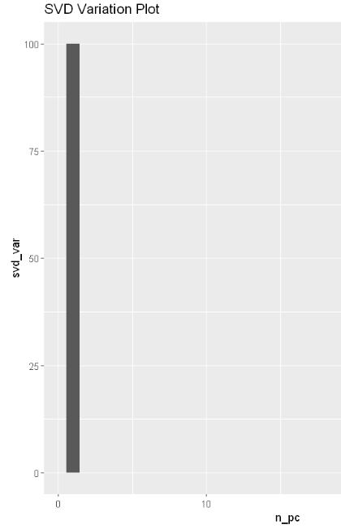
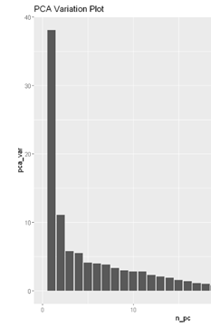
Data Processing
Dimensionality Reduction
Dimensionality reduction refers to methods for lowering the input variables in our training data.
In doing so, we seek to achieve a more simplistic but effective machine learning model structure while avoiding overfitting.
We will evaluate three different Linear Algebra methods: PCA, SVD, and choose the best.

Slide 12
Data processing
Data splitting
to ensure that there is both enough data for the model to learn, and enough data to ensure if the model had identified patterns.
Typically, datasets can be split into – training, testing and validation, however, for this project only training and testing sets were instantiated.
The reason a validation set was deemed redundant was due to the availability of an explicit testing data. The split is 70:30, training to testing.

Slide 13
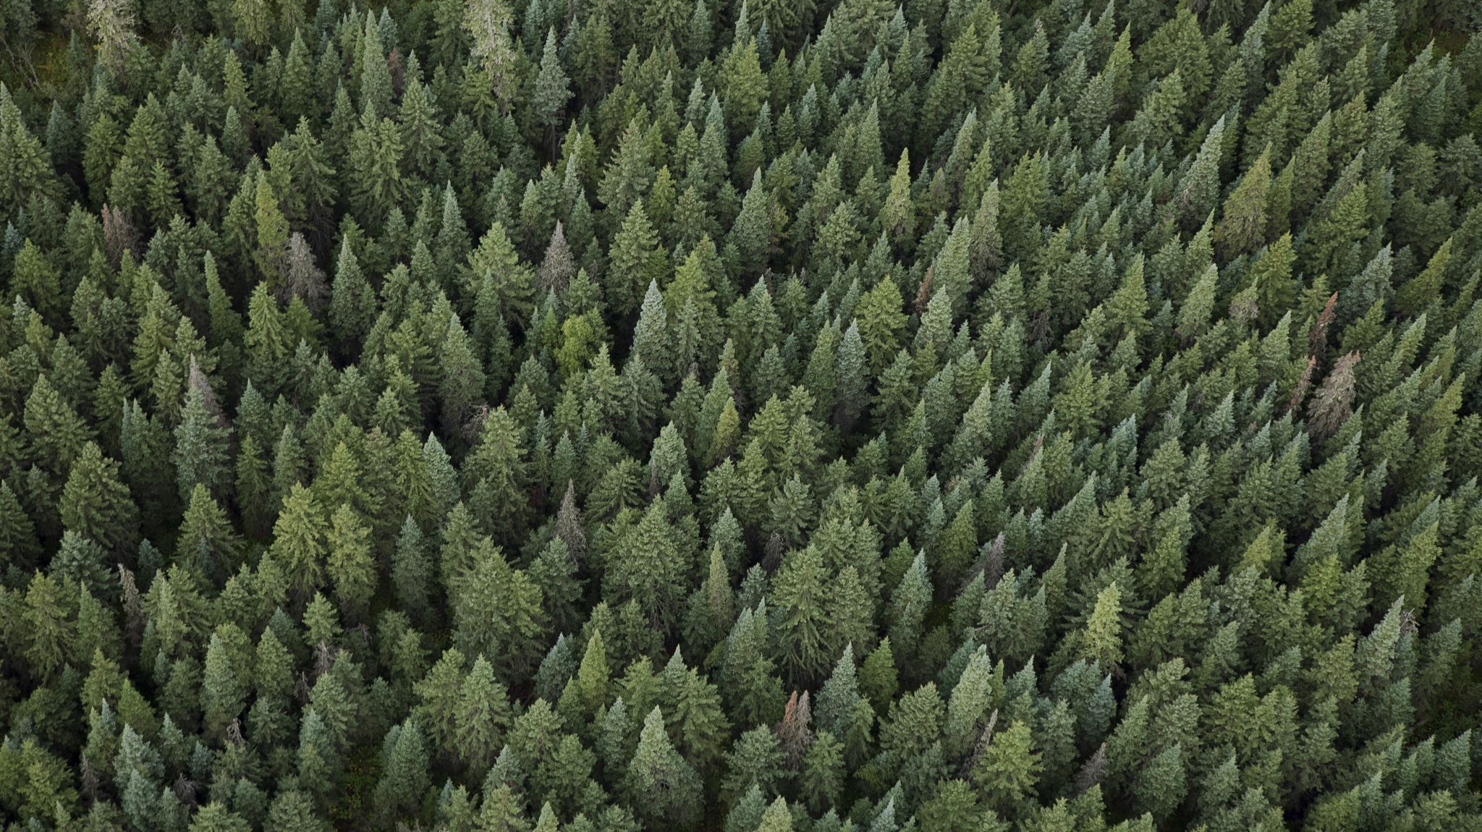
Machine learning models
Since the task at hand is of a classification nature this narrows down the potential models that can be implemented to those suited for classification.
Logistic regression
Decision tree
Random forest

Slide 14
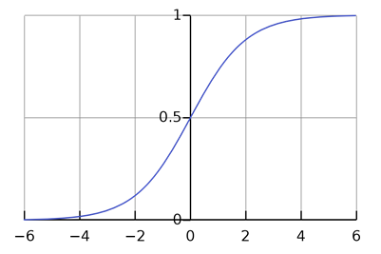
Logistic Regression
This estimates the probability of an event based on the given data set of estimated variables.
The reason for using logistic regression to develop the classifier is due to its effectiveness in detecting fraud based on its ability to segregate data from different binary classifications.

Slide 15
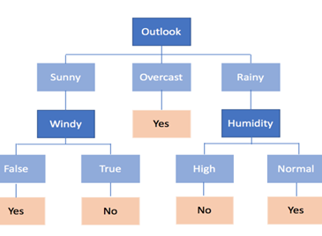
Decision Tree
This is a machine-learning model used for classification problems. It is composed of several internal nodes where each node represents a test in an attribute.

Slide 16
Logistic Regression Results
LR - Over Sampling | Reference
Prediction | 0 | 1
0 | 84523 | 13696
1 | 771 | 71691
LR - Under Sampling | Reference
Prediction | 0 | 1
0 | 141 | 30
1 | 1 | 117
Logistic Regression | Accuracy | Precision | K-Value | F1 Score | AUC
Under Sampling | 0.91 | 0.99 | 0.78 | 0.88 | 0.94
Over Sampling | 0.89 | 0.98 | 0.83 | 0.908 | 0.96
Hybrid Sampling | 0.91 | 0.989 | 0.83 | 0.908 | 0.96
LR - Hybrid Sampling | Reference
Prediction | 0 | 1
0 | 42244 | 6807
1 | 400 | 35990

Slide 17
Decision Tree Results
Decision Tree | Accuracy | Precision | K-Value | F1 Score | AUC
Under Sampling | 0.88 | 0.98 | 0.77 | 0.879 | 0.92
Over Sampling | 0.91 | 0.969 | 0.83 | 0.86 | 0.92
Hybrid Sampling | 0.92 | 0.97 | 0.84 | 0.91 | 0.93
DT - Under Sampling | Reference
Prediction | 0 | 1
0 | 140 | 30
1 | 2 | 117
DT - Over Sampling | Reference
Prediction | 0 | 1
0 | 82933 | 11415
1 | 2361 | 73972
DT - hybrid Sampling | Reference
Prediction | 0 | 1
0 | 41528 | 5602
1 | 1116 | 37195

Slide 18
Conclusion
Model | Resampling Method | Precision | K Value | F1 Score | AUC
Logical Regression | Under Sampling | 0.99 | 0.78 | 0.88 | 0.94
 | Over Sampling | 0.98 | 0.83 | 0.908 | 0.96
 | Hybrid Sampling | 0.989 | 0.83 | 0.908 | 0.96
Decision Tree | Under Sampling | 0.98 | 0.77 | 0.879 | 0.92
 | Over Sampling | 0.969 | 0.83 | 0.91 | 0.92
 | Hybrid Sampling | 0.97 | 0.84 | 0.91 | 0.93
Notes:
What didn’t work

Slide 19
Future Works Short Term
Complete Random Forest
Alternative Models
Alternative Pre-processing Methods

Slide 20
Future Works Long Term
Extend to solve forecasting problems
Look at Cloud based solutions

