Slide 1
Introduction to Operating Systems
Chapter 1

Slide 2
Key concepts in chapter 1
Multilevel implementation
  also called layered
Resources
  Hardware: provided to the OS
  Logical (a.k.a. virtual): created by the OS
Resource management
  transformation
  multiplexing
    time and space

Slide 3
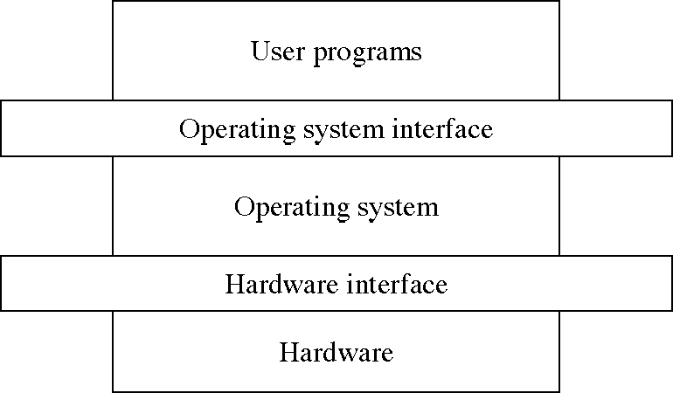
Levels in a computer system

Slide 4
Design: Two-level implementation
Two-level implementation
  Lower level is a problem-specific language
  Upper level solves the problem at hand
  Lower level is reusable
In operating systems
  mechanism: lower level of basic functions, does not change
  policy: upper level policy decisions, easy to change and experiment

Slide 5
Operating system functions
Resource manager
  manage hardware and software resources
Virtual machine manager
  implement a virtual machine for processes to run in
  a nicer environment than the bare hardware

Slide 6
Hardware resources
Processor: execute instructions
Memory: store programs and data
Input/output (I/O)controllers: transfer to and from devices
Disk devices: long-term storage
Other devices: conversion between internal and external data representations

Slide 7
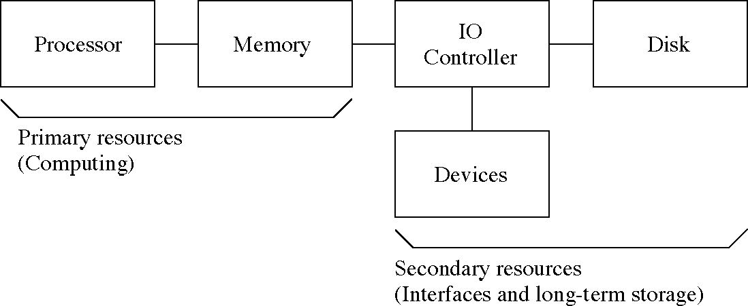
Hardware resources

Slide 8
Resource management functions
Transforming physical resources to logical resources
  Making the resources easier to use
Multiplexing one physical resource to several logical resources
  Creating multiple, logical copies of resources
Scheduling physical and logical resources
  Deciding who gets to use the resources

Slide 9
Types of multiplexing
Time multiplexing
  time-sharing
  scheduling a serially-reusable resource among several users
Space multiplexing
  space-sharing
  dividing a multiple-use resource up among several users

Slide 10
Virtual computers
Processor virtualized to processes
  mainly time-multiplexing
Memory virtualized to address spaces
  space and time multiplexing
Disks virtualized to files
  space-multiplexing
  transforming

Slide 11
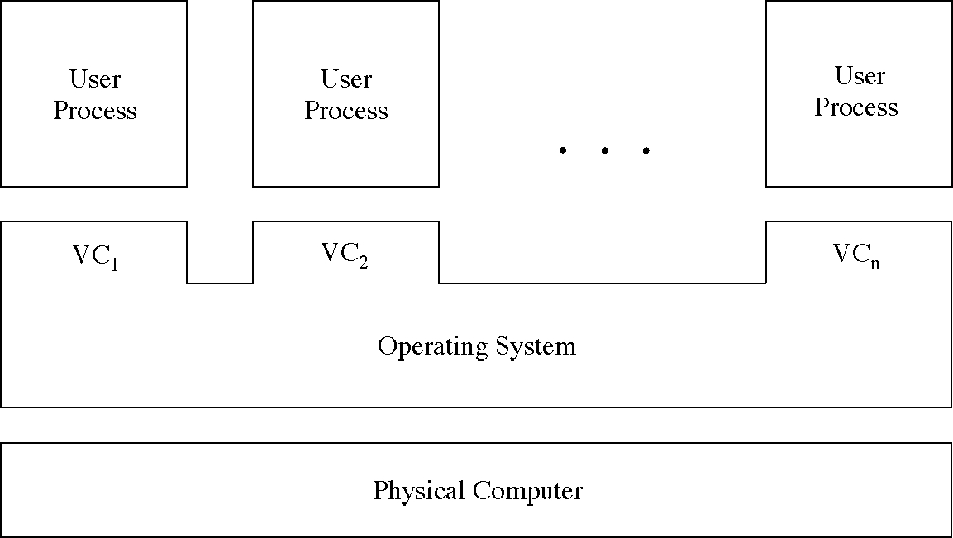
Multiple virtual computers

Slide 12
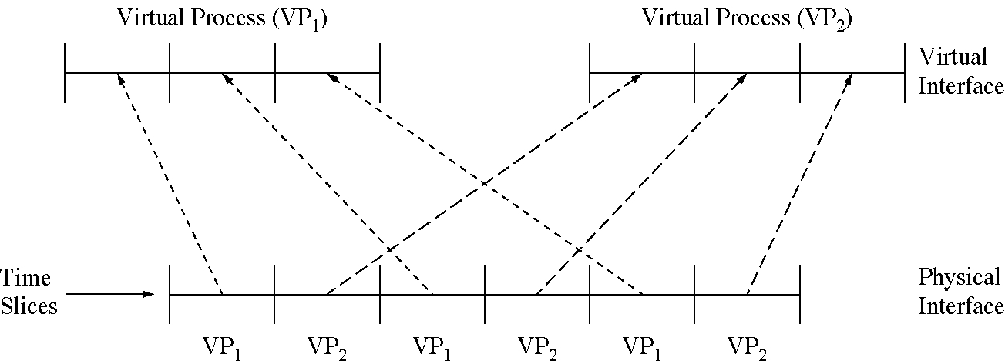
Time-multiplexing the processor

Slide 13
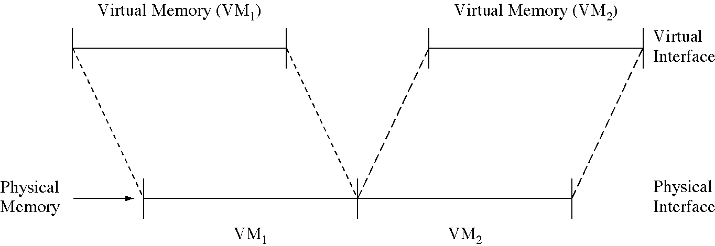
Space-multiplexing memory

Slide 14
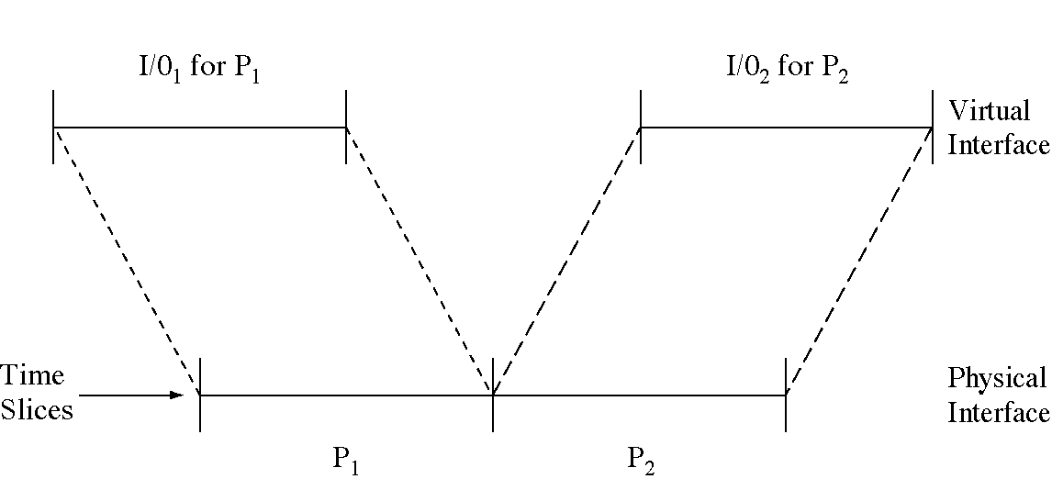
Time-multiplexing I/O devices

Slide 15
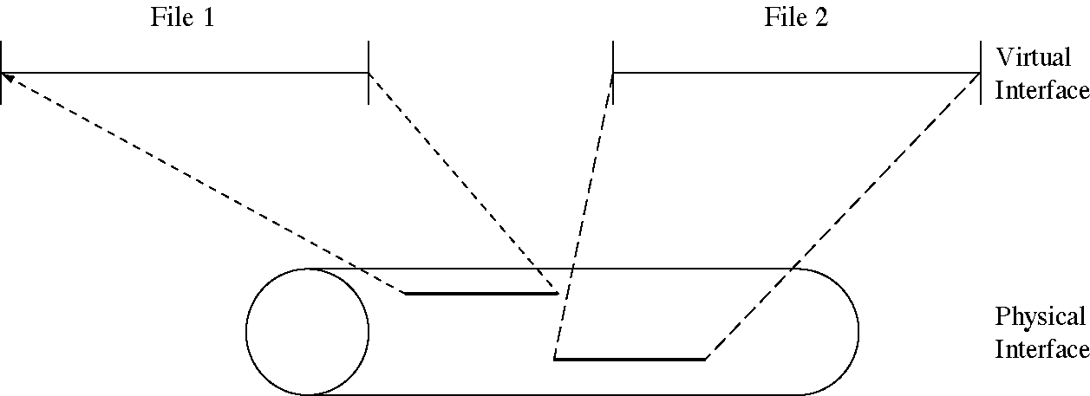
Space-multiplexing the disk

Slide 16
Do we need an OS?
Not always
  Some programs run “stand-alone”
But they are very useful
  Reusable functions
  Easier to use than the bare hardware

Slide 17
Metric prefixes
decisecond: 10⁻¹ sec.
centiecond: 10⁻² sec.
millisecond: 10⁻³ sec.
microsecond: 10⁻⁶ sec.
nanosecond: 10⁻⁹ sec.
picosecond: 10⁻¹² sec.
femptosecond: 10⁻¹⁵ sec.
attoseond: 10⁻¹⁸ sec.
dekabyte: 10¹ bytes
hectobyte: 10² bytes
kilobyte: 10³ bytes
megabyte: 10⁶ bytes
gigabyte: 10⁹ bytes
terabyte: 10¹² bytes
petabyte: 10¹⁵ bytes
exabyte: 10¹⁸ bytes

