Slide 1
The Hardware Interface
Chapter 2

Slide 2
Key concepts in chapter 2
General and special-purpose registers
Processor modes: user and system
Memory addressing
  physical (or absolute) addresses and address space
  logical addresses and address space
  I/O address space
Interrupts
I/O devices and memory-mapped I/O

Slide 3
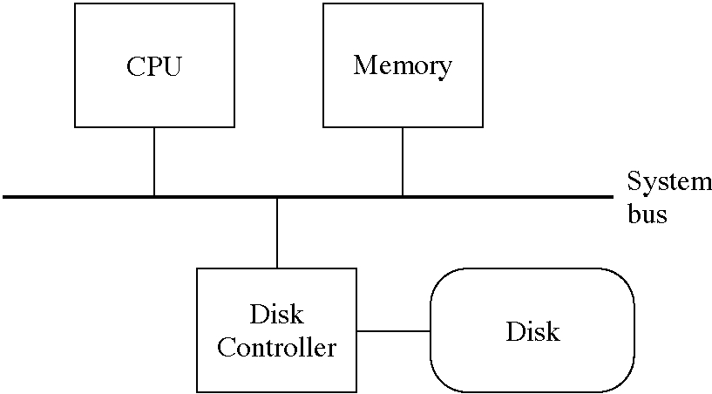
CRA-1 organization

Slide 4
General-purpose registers
32 general registers, each 32 bits long
  r0: always 0
  r1: return values of functions
  r8, r9, r10, r11: function parameters
  r29: frame pointer
  r30: stack pointer
  r31: return address for function call instruction

Slide 5
Special-purpose registers
ia: address of the next instruction to execute
psw: program status word, processor state
base: memory-mapping base register
bound: memory-mapping bound register
iia: saves ia during an interrupt
ipsw: saves psw during an interrupt
ip: saves interrupt-specific data
iva: address of the interrupt vector area
timer: interval timer

Slide 6
Processor modes
psw bit 0: 1 if system mode, 0 if user mode
User mode
  a user program is running
  certain instructions are not allowed
  memory mapping (base and bound) is enabled
System mode
  the operating system is running
  all instructions are allowed
  memory mapping (base and bound) is disabled

Slide 7
Instruction set of the CRA-1
Load and store register (including control registers when in system mode)
Load and store all register (for saving state)
Move register to register
System call
Return from interrupt
Plus many others not relevant here

Slide 8
CRA-1 memory and addressing
32-bit physical (a.k.a. absolute) addresses
  8-bit bytes
  physical address space: 0 to 0xFFFFFFFF
  memory address space: 0 to 0xEFFFFFFF
  I/O address space: 0xF0000000-0xFFFFFFFF
32-bit logical addresses
  mapped by base and bound registers
  defines a logical address space

Slide 9
Interrupts
System call: program executed a syscall
Timer: timer register went from 1 to 0
  a non-zero timer counts down every microsecond
Disk: a disk operation completed
Program error
  ip=0: undefined instruction
  ip=1: illegal instruction in user mode
  ip=2: logical address >= bound register

Slide 10
Interrupt processing
Steps in handling an interrupt
  psw saved in ipsw, psw set to 0
  interrupt parameter (if any) placed in ip register
  ia saved in iia
  new is taken from interrupt vector area (offset depends on which interrupt it is)
timer and disk interrupt can be masked (recorded but delayed) by setting psw bit 0

Slide 11
CRA-1 I/O devices
Memory-mapped I/O
  device registers are in the physical address space
Disk controller and disk
  4 Kbyte disk blocks
  20 bit disk block numbers

Slide 12
Disk controller information
const int BlockSize = 4096;
enum disk_command {LoadBlock=0, StoreBlock=1};
struct disk_control_reg {
unsigned int command : 1;
unsigned int interrupt_enabled : 1;
unsigned int disk_block : 20;
unsigned int padding : 10;
};
volatile disk_control_reg *Disk_control
= (disk_control_reg *)0xF0000000;
void **Disk_memory_addr = (void **)0xF0000004;
enum disk_status { DiskIdle=0, DiskBusy=1 };
struct disk_status_reg {
unsigned int busy : 1;
unsigned int padding : 31;
};
disk_status_reg *Disk_status
= (disk_status_reg *)0xF0000008;

Slide 13
Simple OS code and simulators
CRA-1 Simple OS
  code in the book, but there is no simulator
MIPS Simple OS
  code in distribution, runs on UNIX systems
  a number of changes in the low-level code that interfaces to the hardware
Java Simple OS
  code in distribution, runs on Java 1.1 systems and Java 1.1 browsers
  a number of changes in the low-level code that interfaces to the hardware

Slide 14
MIPS Hardware Interface
TBD

Slide 15
Java Hardware Interface
TBD

