Slide 1
The Operating System Interface
Chapter 3

Slide 2
Key concepts in chapter 3
System calls
File and I/O system
  hierarchical file naming
  file interface: open, read, write, lseek, close
  file versus open file
  devices as files (in naming and in interface)
Process
  operations: create, exit, wait
Shell

Slide 3
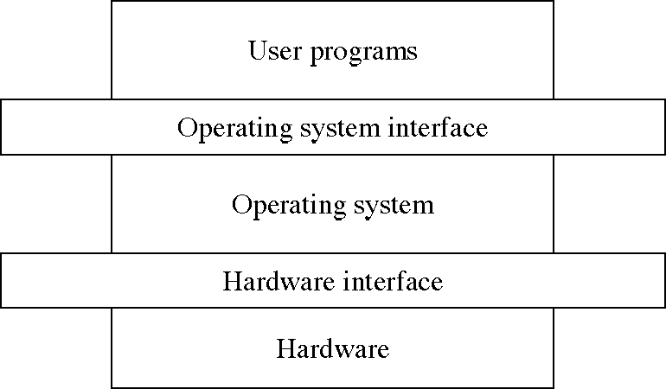
The OS Level Structure
(chapter 3)
(chapters 5-20)
(chapter 2)

Slide 4
System calls
A special machine instruction
  that causes an interrupt
  various names: syscall, trap, svc
Usually not generated by HLLs
  but in assembly language functions

Slide 5
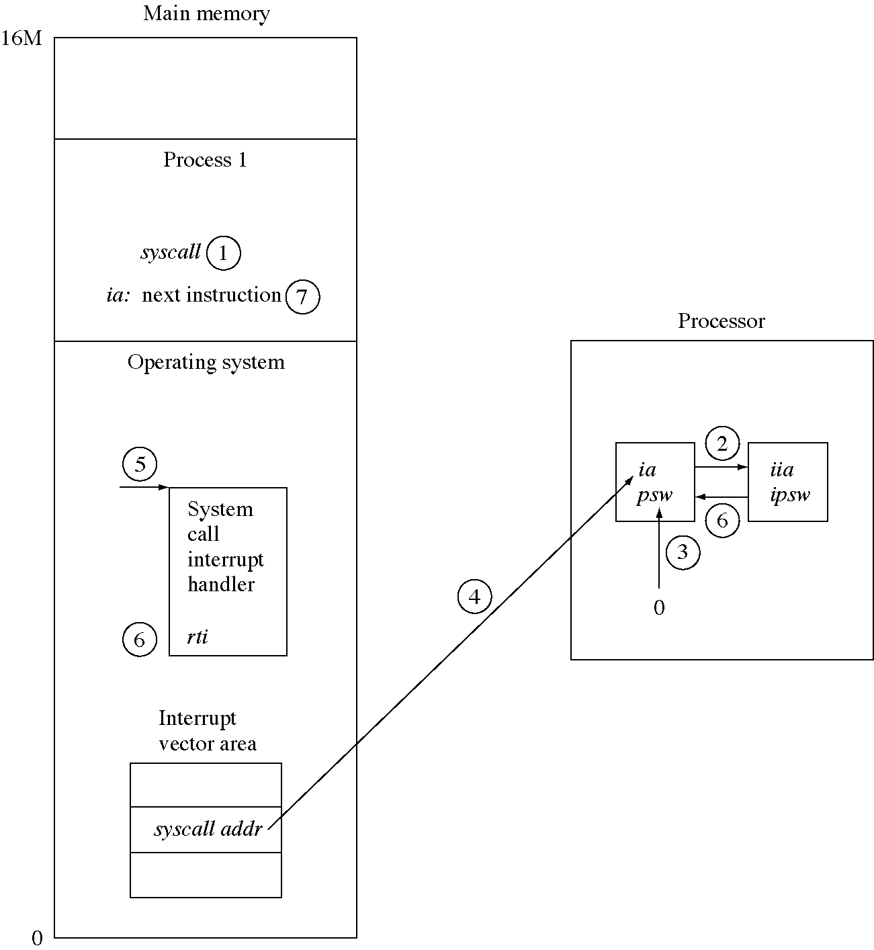
System call flow of control

Slide 6
Hierarchical file naming systems
A tree of directories and files
  directory: contains file and directory names
Objects (files and directories) are named with path names
  later: other kinds of objects (e.g. devices)
Path names contains a component name for each directory in the path

Slide 7
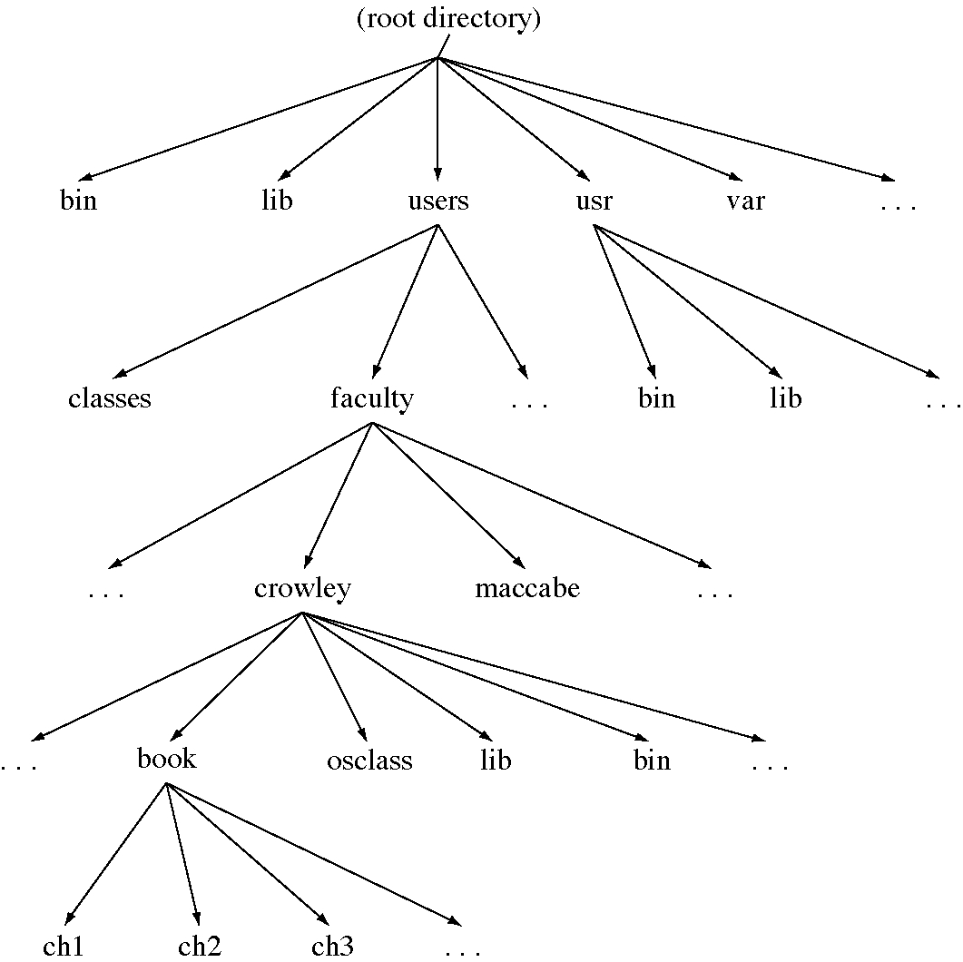
A file naming system

Slide 8
File and I/O system calls
int open(char *name, int flags)
int read(int fid, char *buffer, int count)
int write(int fid, char *buffer, int count)
int lseek(int fid, int offset, int from)
int close(int fid)
int unlink(char *name)

Slide 9
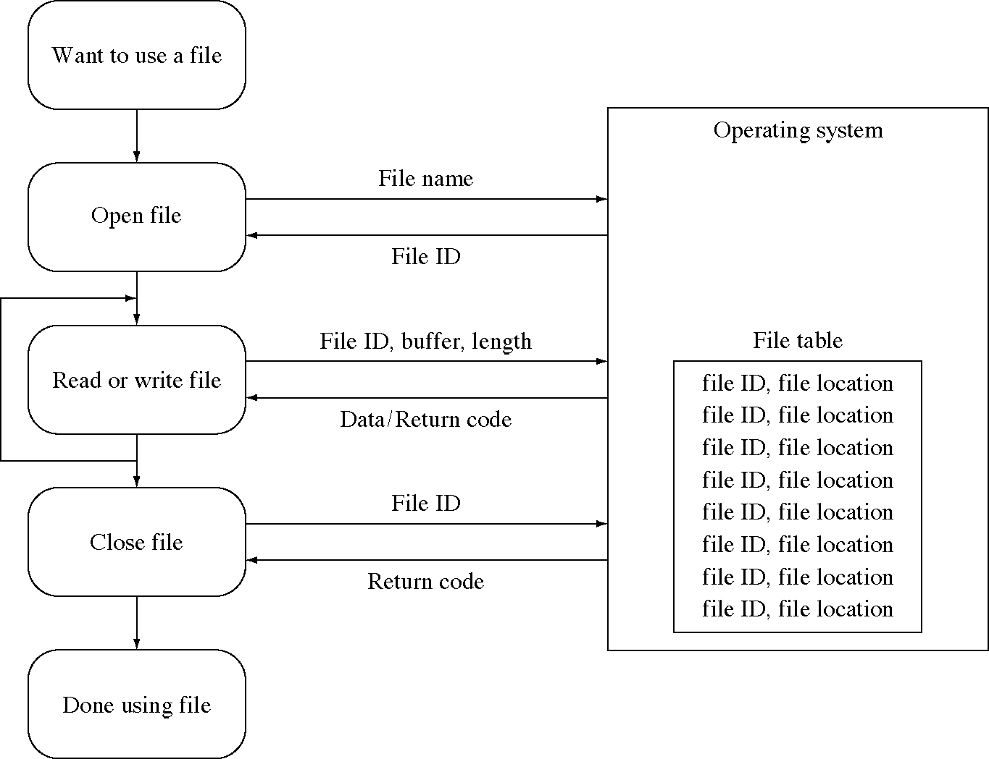
Steps in using a file

Slide 10
Files versus open files
File: passive container of bytes on disk
Open file: active source (or sink) of bytes in a running program
  usually connected to a file
  but can be connected to a device or another process

Slide 11
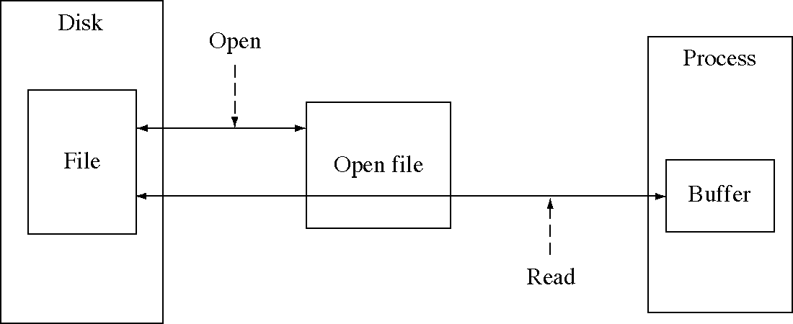
Files and open files

Slide 12
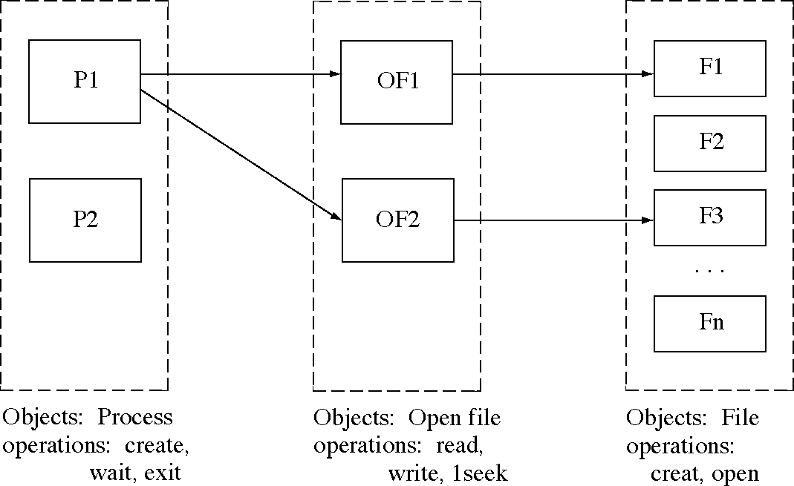
OS objects and operations

Slide 13
File copy
enum { Reading=0, Writing=1, ReadAndWrite=2,
ReadWriteFile=0644 };
void FileCopy( char * fromFile, char * toFile ) {
int fromFD = open( fromFile, Reading );
if( fromFD < 0 ) {
cerr << "Error opening " << fromFile << endl;
return; }
int toFD = creat( toFile, ReadWriteFile );
if( toFD < 0 ) {
cerr << "Error opening " << toFile << endl;
close( fromFD ); return; }
while( 1 ) {
char ch; int n = read( fromFD, &ch, 1 );
if( n <= 0 ) break;
n = write( toFD, &ch, 1 );
if( n < 0 ) {
cerr << "Error writing " << toFile << endl;
return; }
}
close( fromFD ); close( toFD );
}

Slide 14
File reverse (1 of 2)
enum { Reading=0, Writing=1, ReadAndWrite=2 };
enum {SeekFromBeginning=0,SeekFromCurrent=1,SeekFromEnd=2};
void Reverse( char * fromFile, char * revFile ) {
int fromFD = open( fromFile, Reading );
if( fromFD < 0 ) {
cerr << "Error opening " << fromFile << endl;
return;
}
// move the internal file pointer so the next character
// read will be the last character of the file
int ret lseek( fromFD, -1, SeekFromEnd );
if( ret < 0 ) {
cerr << "Error seeking on " << fromFile << endl;
close( fromFD );
return;
}
int revFD = creat( revFile, 0 );
if( revFD < 0 ) {
cerr << "Error creating " << revFile << endl;
close( fromFD );
return;
}

Slide 15
File reverse (2 of 2)
while( 1 ) {
char ch;
int n = read( fromFD, &ch, 1 );
if( n < 0 ) {
cerr << "Error reading " << fromFile << endl;
return;
}
n = write( revFD, &ch, 1 );
if( n < 0 ) {
cerr << "Error writing " << revFile << endl;
return;
}
// exit the loop if lseek returns an error.
// The expected error is that the computed offset will
// be negative.
if( lseek(fromFD, -2, SeekFromCurrent) < 0 )
break;
}
close( fromFD );
close( revFD );
}

Slide 16
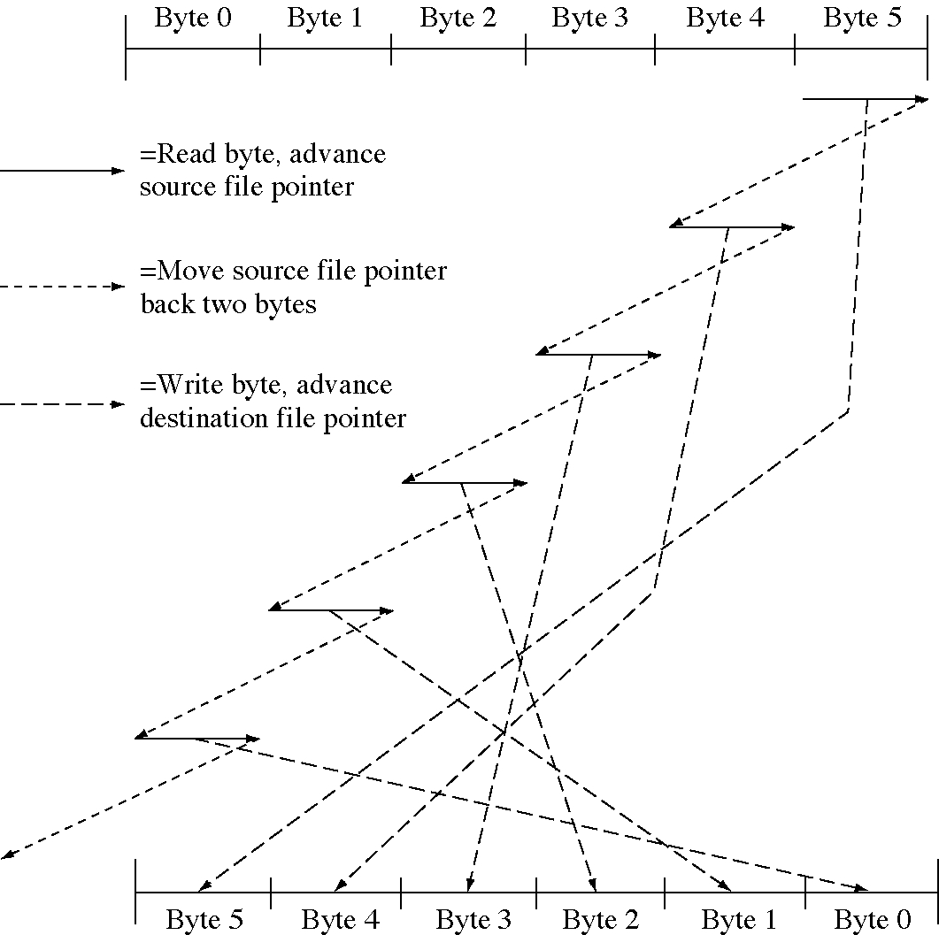
Reversing a file

Slide 17
Design technique: Interface design
There are many different sets of system calls with the same functionality
  which one is best depends on how they will be used
  we try to make them easy to use and efficient (minimize the number of system calls necessary to get the job done)
One should always consider several design alternatives and evaluate them

Slide 18
Meta-data
Meta-data describes the file rather than being the data in file itself
  also called meta-information
Examples of meta-data
  Who owns the file
  Who can use the file and how
  When the file was created, last used, last modified
int stat(char * name, StatInfo *statInfo)
  this calls returns the file meta-data

Slide 19
Naming OS objects
File naming system names files (and directories)
  but why limit it to that
Other OS objects need names:
  processes
  devices
  IPC: message queues, pipes, semaphores

Slide 20
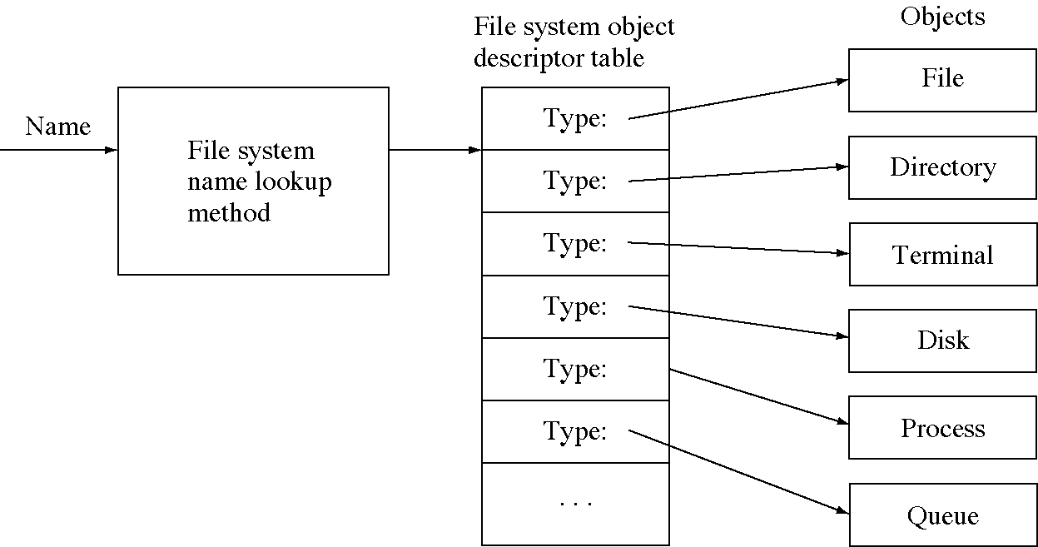
Mapping names to objects

Slide 21
Devices as files
Devices are named as files
  they can be opened as files, to create open files
  they can be used as byte streams: sources of bytes and sinks for bytes
Examples
  copy someFile /dev/tty17
  copy aFile /dev/tape01

Slide 22
The process concept
Program: a static, algorithmic description, consists of instructions
  int main() {
  int i, prod=1;
  for(i=0; i<100; ++i)
  prod = prod*i;
  }
Process: dynamic, consists of instruction executions

Slide 23
Simple create process
void CreateProcess1( void ) {
int pid1 = SimpleCreateProcess( "compiler" );
if( pid1 < 0 ) {
cerr << "Could not create process \"compiler\"”
<< endl;
return; }
int pid2 = SimpleCreateProcess( "editor" );
if( pid2 < 0 ) {
cerr << "Could not create process \"editor\"”
<< endl;
return; }
// Wait until they are both completed.
SimpleWait( pid1 );
SimpleWait( pid2 );
// "compiler" and "editor" also end by making
// SimpleExit system calls
SimpleExit();
}

Slide 24
Process system calls
int CreateProcess(
char *progName, int argc, char *argv[ ])
  progName is the program to run in the process
  returns a process identifier (pid)
void Exit(int returnCode)
  exits the process that executes the exit system calls
int Wait(int pid)
  waits for a child process to exit

Slide 25
Create process
void CreateProcess2( void ) {
static char * argb[3]
= { "compiler", "fileToCompile", (char *) 0 };
int pid1 = CreateProcess( "compiler", 3, argb );
if( pid1 < 0 ) {
cerr << "Could not create process \"compiler\"”
<< endl;
return;
}
char * argv[3];
argv[0] = "editor";
argv[1] = "fileToEdit";
argv[2] = (char *) 0;
int pid2 = CreateProcess( "editor", 3, argv );
if( pid2 < 0 ) {
cerr << "Could not create process \"compiler\"”
<< endl;
return;
}
(void) Wait( pid1 );
(void) Wait( pid2 );
Exit( 0 );
}

Slide 26
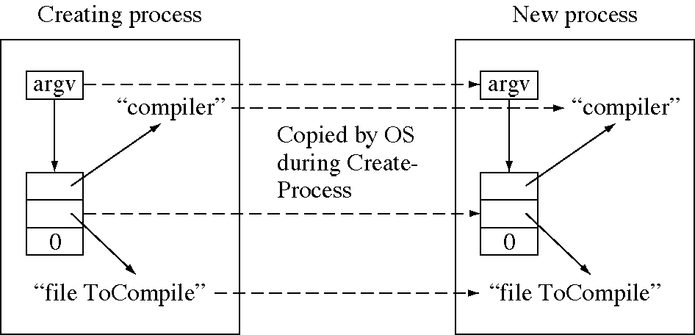
How arguments are passed

Slide 27
Print arguments
// This program writes out it arguments.
#include <iostream.h>
void main( int argc, char * argv[ ] ) {
int i;
for( i = 0; i < argc; ++i ) {
cout << argv[i] << " ";
}
cout << "\n";
}

Slide 28
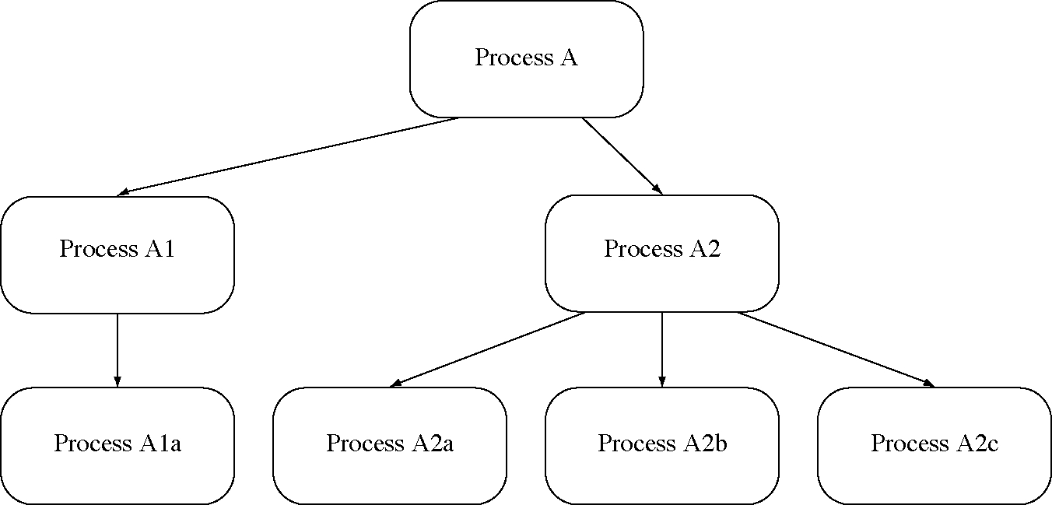
A process hierarchy

Slide 29
Interprocess communication (IPC)
Many methods have been used: messages, pipes, sockets, remote procedure call, etc.
Messages and message queues:
  The most common method
  Send messages to message queues
  Receive messages from message queues

Slide 30
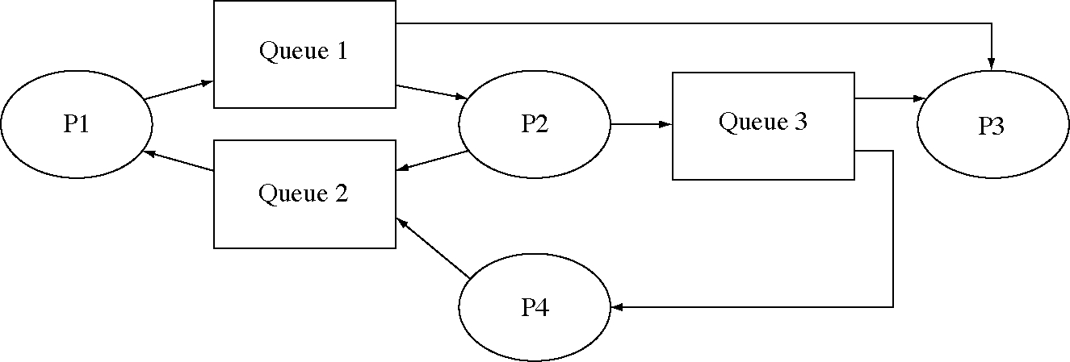
Example of message passing paths

Slide 31
Message passing system calls
int CreateMessageQueue( void )
  returns a message queue identifier (mqid)
int SendMessage(int mqid, int *msg)
  send to a message queue (no waiting)
int ReceiveMessage(int mqid, int *msg)
  receive from a message queue
  wait for a message if the queue is empty
int DestroyMessageQueue(int mqid)

Slide 32
Message: file sender (1 of 2)
void SendMsgTo( int msg_q_id, int msg0=0, int msg1=0, int msg2=0 ) {
int msg[8];
msg[0] = msg0; msg[1] = msg1; msg[2] = msg2;
(void)SendMessage( msg_q_id, msg );
}
enum { Reading=0, Writing=1, ReadAndWrite=2 };
enum{ FileToOpen=1, SendQueue=2, ReceiveQueue=3 };
void main( int argc, char * argv[ ] ) {
int fromFD = open( argv[FileToOpen], Reading );
if( fromFD < 0 ) {
cerr << "Could not open file ”
<< argv[FileToOpen] << endl;
exit( 1 );
}
int to_q = atoi(argv[SendQueue]);

Slide 33
Message: file sender (2 of 2)
while( 1 ) {
char ch;
int n = read( fromFD, &ch, 1 );
if( n <= 0 )
break;
SendMsgTo( to_q, ch );
}
close( fromFD );
SendMsgTo( to_q, 0 );
int msg[8];
int from_q = atoi(argv[ReceiveQueue]);
ReceiveMessage( from_q, msg );
cout << msg[0] << " characters\n";
exit( 0 );
}

Slide 34
Message: file receiver
enum{ SendQueue=1, ReceiveQueue=2 };
void main( int argc, char * argv[ ] ) {
// start the count at zero.
int count = 0;
int msg[8];
int from_q = atoi(argv[SendQueue]);
while( 1 ) {
ReceiveMessage( from_q, msg );
if( msg[0] == 0 )
break;
// Any message with nonzero content
// is a character to count.
++count;
}
// Send the count back to the sender.
int to_q = atoi(argv[ReceiveQueue]);
(void) SendMsgTo( to_q, count );
exit( 0 );
}

Slide 35
Message: start processes (1 of 2)
int CreateProcessWithArgs(char * prog_name,
char * arg1=0, char * arg2=0, char * arg3=0) {
char *args[5];
args[0] = prog_name;
args[1] = arg1;
args[2] = arg2;
args[3] = arg3;
args[4] = 0;
int argc = 4;
if( arg3 == 0) --argc;
if( arg2 == 0) --argc;
if( arg1 == 0) --argc;
return CreateProcess( prog_name, argc, args );
}
char * itoa( int n ) {
char * result = new char[8];
sprintf( result, "%d", n );
return result;
}

Slide 36
Message: start processes (2 of 2)
void main( int argc, char * argv[ ] ) {
//Create the message queues the processes will use.
int q1 = CreateMessageQueue();
int q2 = CreateMessageQueue();
// Create the two processes, sending each the
// identifier for the message queues it will use.
int pid1 = CreateProcessWithArgs( "FileSend",
"FileToSend", itoa(q1), itoa(q2) );
int pid2 = CreateProcessWithArgs( "FileReceive",
itoa(q1), itoa(q2) );
// Wait for the two processes to complete.
int ret1 = wait( pid1 );
int ret2 = wait( pid2 );
// We do not use the return code ret1 and ret2
// in this example.
// Destroy the message queues.
DestroyMessageQueue( q1 );
DestroyMessageQueue( q2 );
Exit( 0 );
}

Slide 37
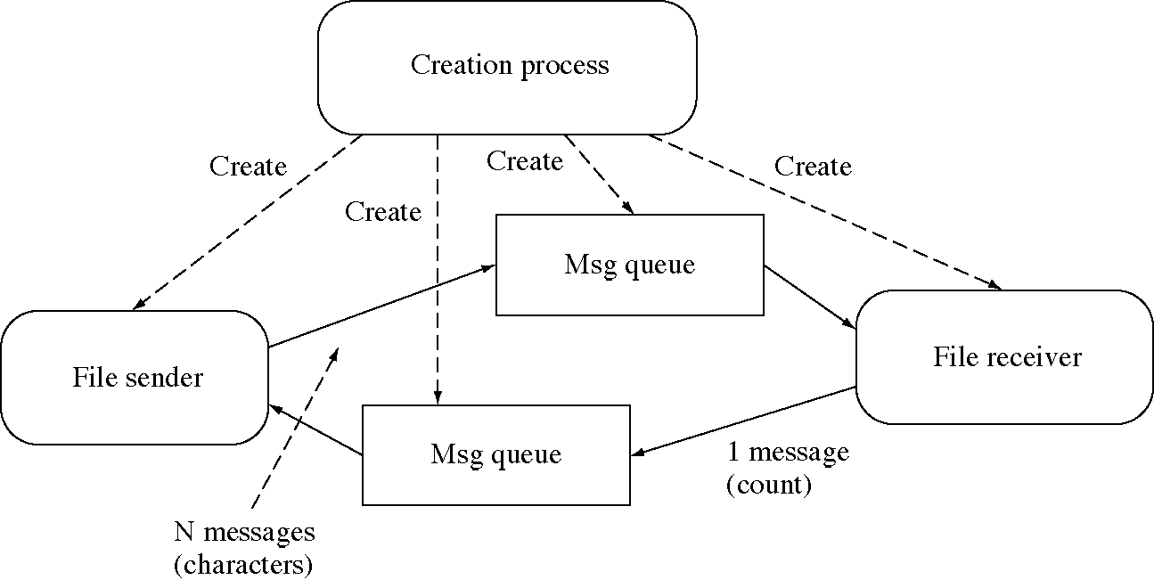
Objects for sending a file with messages

Slide 38
UNIX-style process creation
int fork()
  creates an exact copy of the calling process
int execv(char *progName, char *argv[ ])
  runs a new program in the calling process
  destroying the old program
int exit(int retCode)
  exits the calling process
int wait(int *retCode)
  waits for any exited child, returns its pid

Slide 39
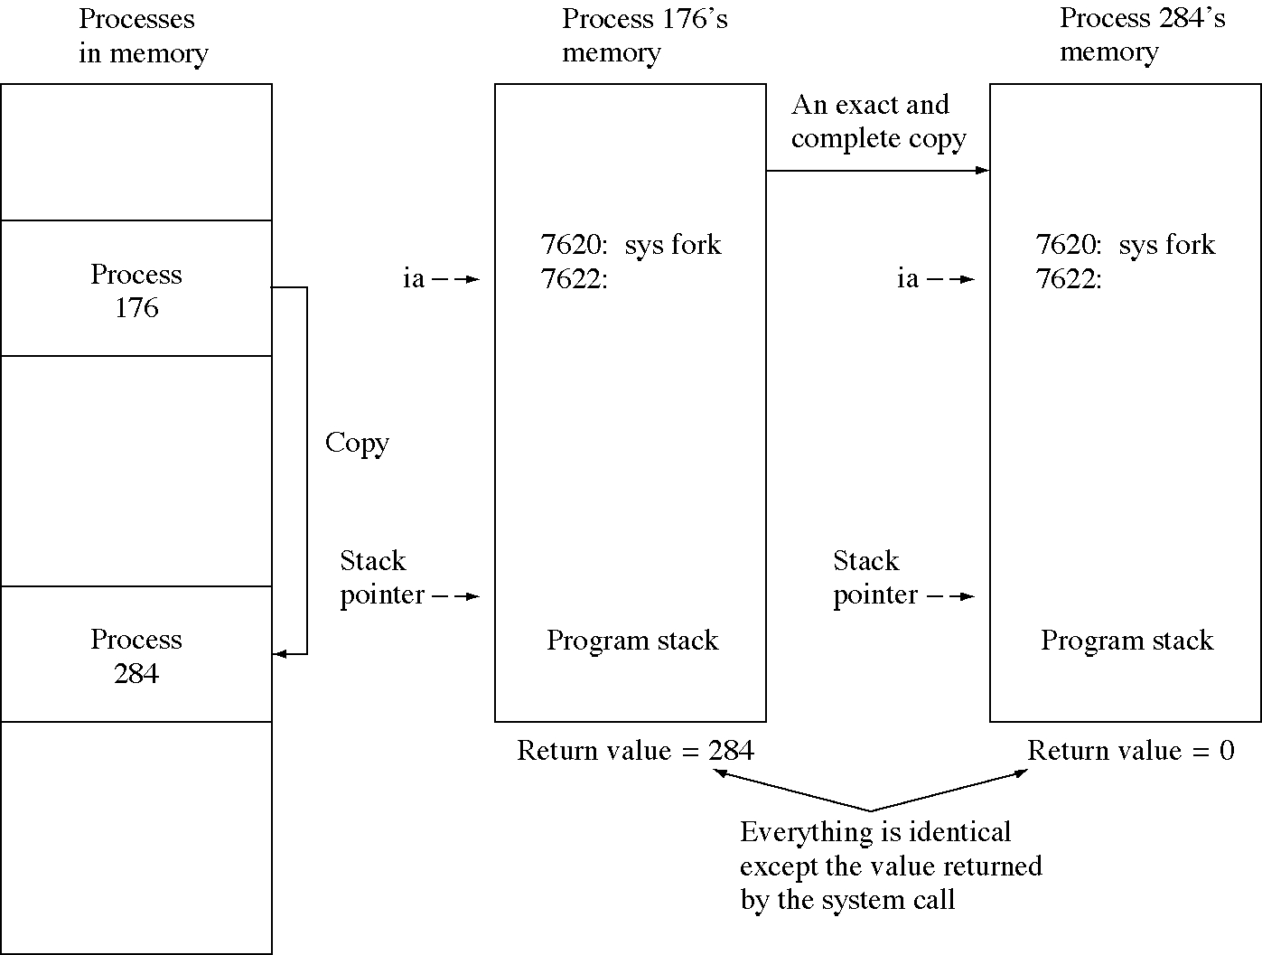
UNIX fork

Slide 40
Create process (UNIX-style)
void CreateProcess3( void ) {
int pid1, pid2;
char *argv[3] = {"compiler", "fileToCompile", 0};
pid1 = fork();
if( pid1 == 0 ) {// Child process code begins here
execv( "compiler", argv ); // execute compiler
// Child process code ends here.
// execv does not return
}
// Parent executes here because pid1 != 0
argv[0] = "editor";
argv[1] = "fileToEdit";
argv[2] = 0;
if( (pid2 = fork()) == 0 )
execv( "editor", argv );
int reta, retb;
int pida = wait( &reta );
int pidb = wait( &retb );
}

Slide 41
Standard input and output
Most programs are filters:
  one input stream (standard input)
  some processing
  one output stream (standard output)
So the OS starts a program out with two open files, standard input and standard output
grep helvetica <fontList >helvList

Slide 42
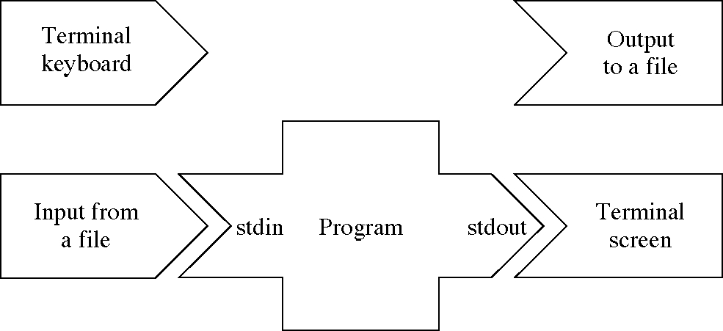
Redirection of standard input and output

Slide 43
Pipes
Pipe: another IPC mechanism
  uses the familiar file interface
  not a special interface (like messages)
Connects an open file of one process to an open file of another process
  Often used to connect the standard output of one process to the standard input of another process

Slide 44
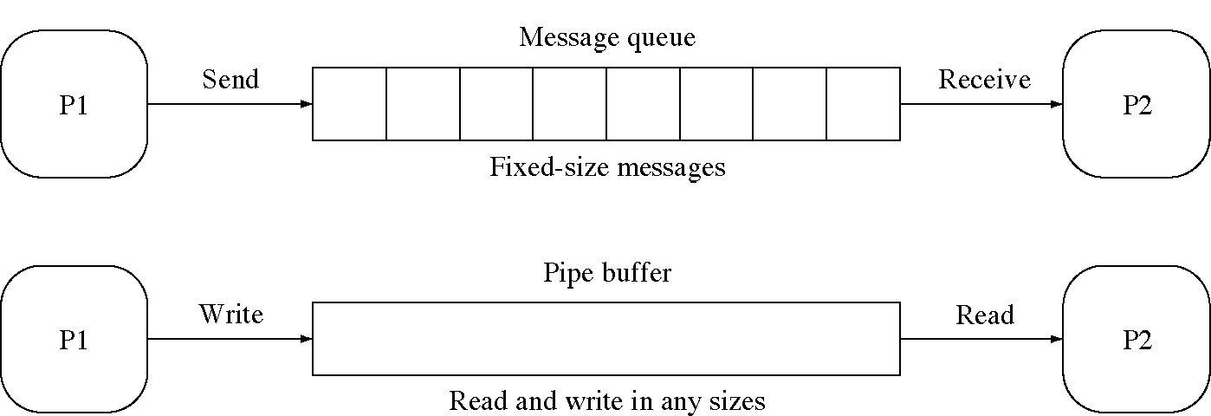
Messages and pipes compared

Slide 45
Pipe: file sender
enum { Reading=0, Writing=1, ReadAndWrite=2 };
void main( int argc, char * argv[ ] ) {
int fromFD = open( argv[1], Reading );
int to_pipe = open( argv[2], Writing );
while( 1 ) {
char ch;
int n = read( fromFD, &ch, 1 );
if( n == 0 ) break;
write( to_pipe, &ch, 1 );
}
close( fromFD );
close( to_pipe );
int n, from_pipe = open( argv[3], Reading );
// int n is four bytes long, so we read four bytes
read( from_pipe, &n, 4 );
close( from_pipe );
cout << n << " characters\n";
exit( 0 );
}

Slide 46
Pipe: file receiver
enum { Reading=0, Writing=1, ReadAndWrite=2 };
void main( int argc, char * argv[ ] ) {
int count = 0;
// The first argument is the pipe to read from.
int from_pipe = open( argv[1], Reading );
while( 1 ) {
char ch;
int n = read( from_pipe, &ch, 1 );
if( n == 0 )
break;
++count;
}
close( from_pipe );
// send the count back to the sender.
int to_pipe = open( argv[2], Writing );
write( to_pipe, &count, 4 );
close( to_pipe );
exit( 0 );
}

Slide 47
Pipe: create processes
void main( int argc, char * argv[ ] ) {
int pid1 = CreateProcessWithArgs("FileSend",
"FileToSend", "PipeToReceiver", "PipeToSender");
int pid2 = CreateProcessWithArgs( "FileReceive",
"PipeToReceiver", "PipeToSender" );
int ret1 = wait( pid1 );
int ret2 = wait( pid2 );
exit( 0 );
}

Slide 48
More on naming
We have seen three naming systems
  Global character names in the file system: named pipes
  Process-local names (file identifiers): anonymous pipes
  Global integer names picked by the OS: message queues
We can use any of the systems to name objects

Slide 49
Design technique:
Connection in protocols
File interface is a connection protocol
  open (setup), use, close
  Best for tightly-coupled, predictable connections
WWW interface is a connection-less protocol
  Each interaction is independent
  For loose, unpredictable connections

Slide 50
OS examples
UNIX (ATT, Bell Labs)
  Basis of most modern OSes
Mach (CMU)
  Microkernel
  Research system, now widely used
MS/DOS (Microsoft)
  Not a full OS

Slide 51
More OS examples
Windows NT (Microsoft)
  Successor to MS/DOS
OS/2 (IBM)
Macintosh OS (Apple)
  Innovations in the GUI
  To be replaced by Rhapsody (Mach)

Slide 52
Shell: an OS interface
Interactive access to the OS system calls
  copy fromFile toFile
Contains a simple programming language
Popularized by UNIX
  Before UNIX: JCL, OS CLs (command languages)
  Bourne shell, C shell (csh), Korn shell (ksh), Bourne-again shell (bash), etc.

Slide 53
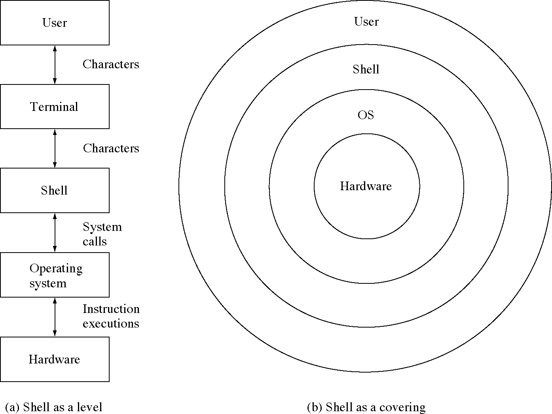
Two views of a shell

Slide 54
Shell: globals
#include <iostream.h>
// some constants
// maximum size of any one argument
const int ARGSIZE 50
// maximum number of arguments
const int NARGS 20
// token types returned by getWord()
const int STRING 1
const int INREDIR 2
const int OUTREDIR 3
const int NEWLINE 4
// define the argv structure
char *argv[NARGS]; // space for argv vector
char args[NARGS][ARGSIZE]; // space for arguments

Slide 55
Shell (1 of 3)
void main( int argcount, char *arguments[ ] ) {
int wasInRedir, wasOutRedir;
char inRedir[ARGSIZE], outRedir[ARGSIZE];
// each iteration will parse one command
while( 1 ) {
// display the prompt
cout << "@ ";
// So far we have not seen any redirections
wasInRedir = 0;
wasOutRedir = 0;
// Set up some other variables.
int argc = 0;
int done = 0;
char word[ARGSIZE];
// Read one line from the user.
while( !done ) {
// getWord gets one word from the line.
int argType = getWord(word);
// getWord returns the type of the word it read

Slide 56
Shell (2 of 3)
switch( argType ) {
case INREDIR:
wasInRedir = 1;
(void)getWord(inRedir);
break;
case OUTREDIR:
wasOutRedir = 1;
(void)getWord(outRedir);
break;
case STRING:
strcpy(args[argc], word);
argv[argc] = &args[argc][0];
++argc;
break;
case NEWLINE:
done = 1;
break;
}
}
argv[argc] = NULL;
if( strcmp(args[0], "logout") == 0 )
break;

Slide 57
Shell (3 of 3)
if( fork() == 0 ) {
if( wasInRedir ) {
close(0); // close standard input
open(inRedir, 0); //reopen as redirect file }
if( wasOutRedir ) {
close(1); // close standard output
enum { UserWrite=0755 };
creat(outRedir, UserWrite); }
char cmd[60];
strcpy(cmd, "./"); strcat(cmd, args[0]);
execv(cmd, &argv[0]);
strcpy(cmd, "/bin/"); strcat(cmd, args[0]);
execv(cmd, &argv[0]);
cout << "Child: could not exec \"" << args[0]
<< "\"\n";
exit(1);
}
int status; (void) wait(&status);
}
cout << "Shell exiting.\n";
}

Slide 58
Design technique: Interactive and programming interfaces
Interactive interfaces have advantages:
  for exploration
  for interactive use
Programming interfaces have advantages :
  for detailed interactions
  Inter-application programming
  Scripting, COM, CORBA
It is useful for a program to have both

