Slide 1
Design Techniques I
Chapter 4

Slide 2
Key concepts in chapter 4
The design process
Design skills
Two-level implementation
Interface design
Connection in protocols
Interactive and programming interfaces
Decomposition patterns

Slide 3
The design process
System analysis and requirements analysis
  define the problem
System specification
  define a solution
Architectural design
  define the structure of an implementation
Module (a.k.a detailed) design
  design each module
  recursively invoke the design process

Slide 4
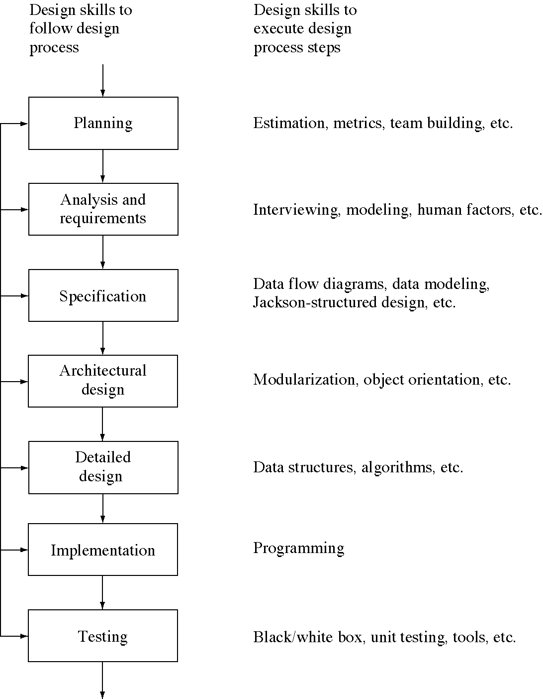
Design skills

Slide 5
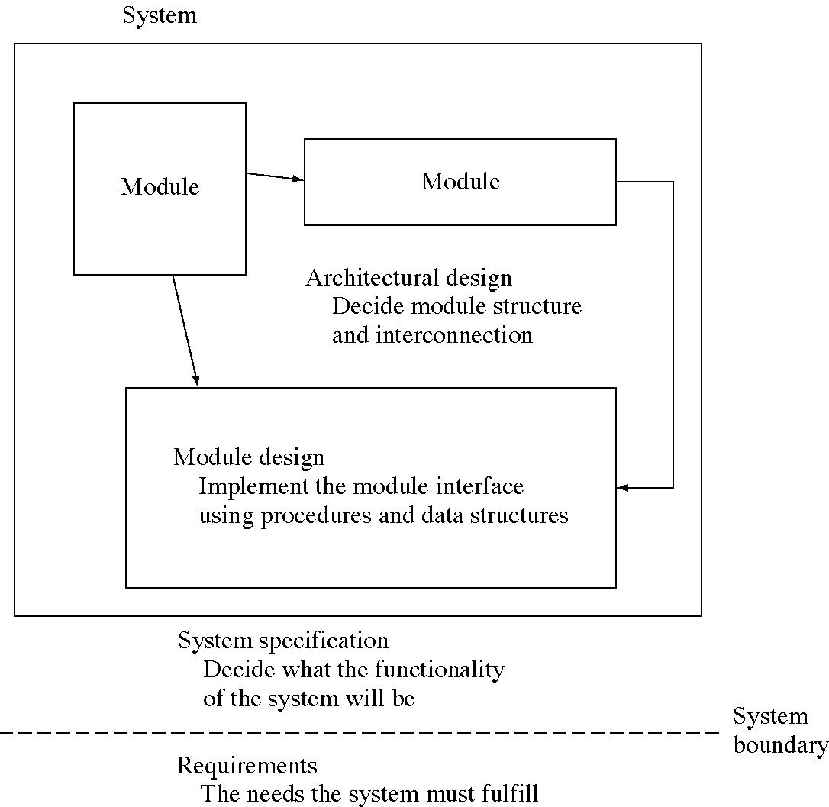
Levels of design

Slide 6
Learning design through OS
We cover many OS design problems
  and give the standard solutions
We generalize them to archtypical design problems
  and give the standard solutions
You probably won’t design on OS
  but you will encounter these design problems

Slide 7
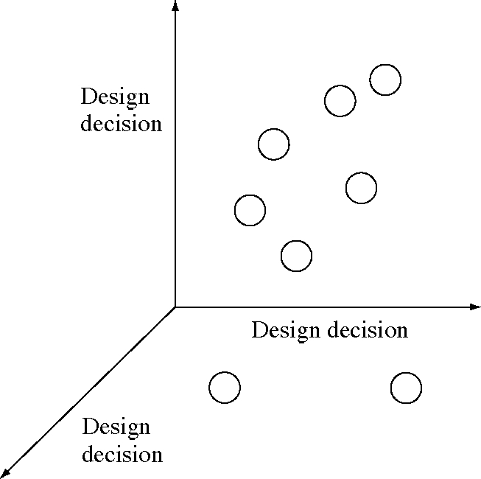
A design space

Slide 8
Design skills
Learning to formulate a design problem in a general way
Knowing the typical design problems and their solutions
Knowing how to evaluate potential design solution in a particular design situation
In general, knowing how to explore the design space.

Slide 9
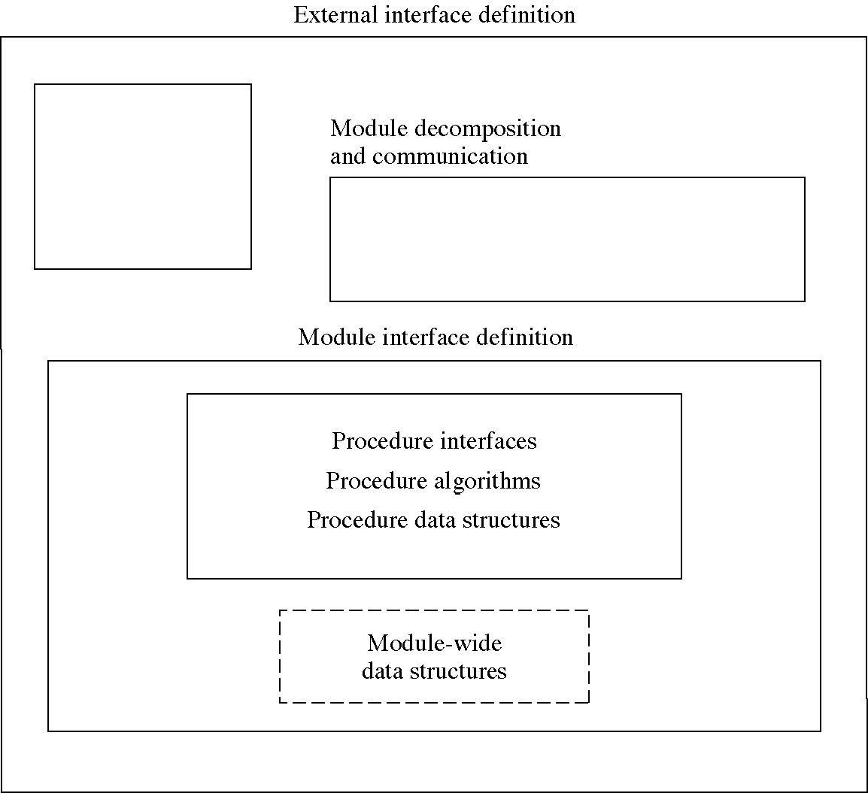
Design levels

Slide 10
Design techniques
General design problems
  with a standard solution (or solutions)
Sections
  Motivation: usually from OS
  Examples: from OS and other CS areas
  Applicability: when to use this solution
  Consequences: good and bad
  Implementation issues and variations
    other things related to the technique
  Related design techniques
    to help you decide which to use

Slide 11
Two-level implementation
Implement a system on two levels
  lower level: a language for solving problems of this type
  upper level: a specific solution for this problem
A special case of:
  modularity
  multiple-level implementations

Slide 12
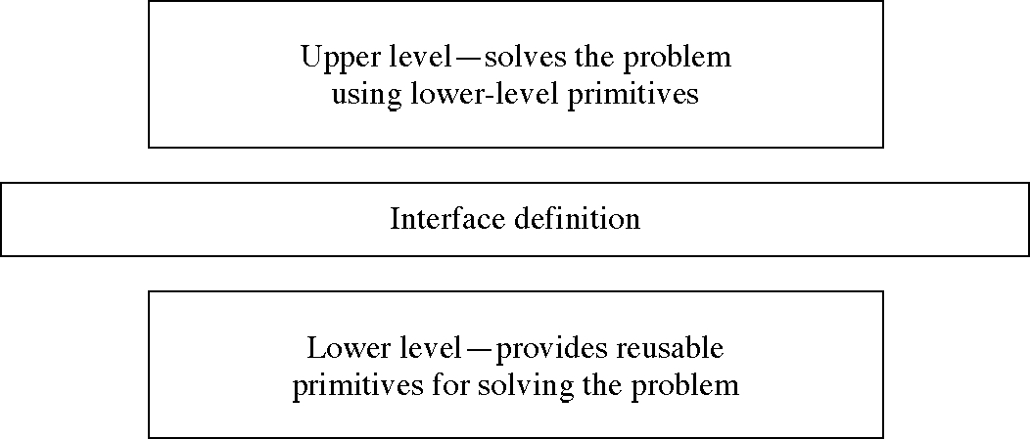
Two-level implementation

Slide 13
OS examples
OS (lower) and user processes (upper)
Memory management: OS (lower) and per process (upper)
Virtual (upper) and physical (lower) terminals
Device drivers
  upper level interfaces with the OS, lower level interfaces with the device
I/O (lower) and file system (upper)

Slide 14
CS examples
File system (lower) and database system (upper)
Compiler or interpreter (lower) and programs in the language (upper)
Little languages (lower)
Scripting languages (lower)
Class/subroutine library (lower)

Slide 15
Applicability
There must be a natural intermediate level
You want to separate policy from mechanism
You want to provide user programmability and customizability
You want to separate the fixed parts from the changeable parts

Slide 16
Consequences
Easier to experiment with the upper level
Lower level may be reusable
Program is easier to change
Communication costs are higher
The level division may be artificial

Slide 17
Two-level design issues
Little languages
  the lower level implements it
  the upper level is written in it
  examples: printf strings, title line formats
Separation of policy and mechanism
  isolate what changes: the upper level
User-level programming

Slide 18
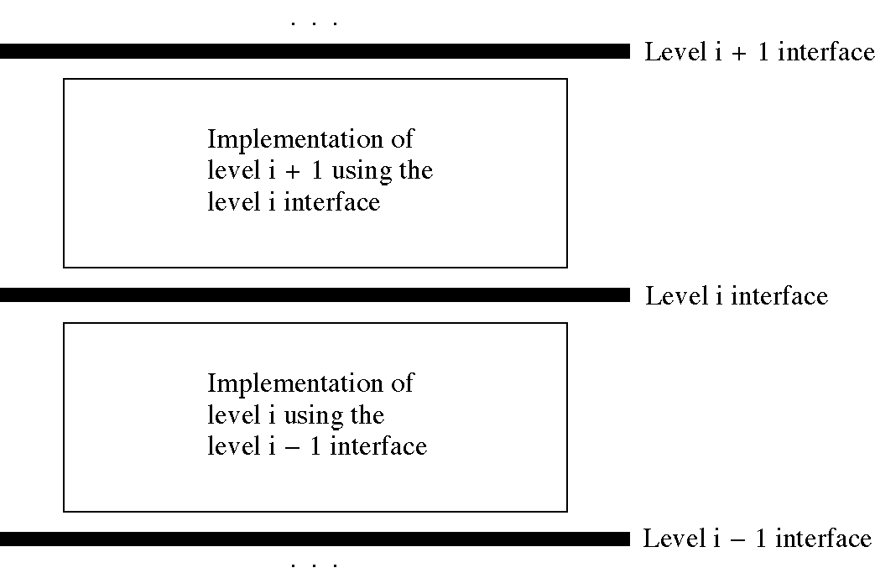
Multiple levels of implementation

Slide 19
Interface design
Two level of module design
  the interface of the module
  the implementation of the module
Experiment with different interfaces
  the first one you think of may not be the best

Slide 20
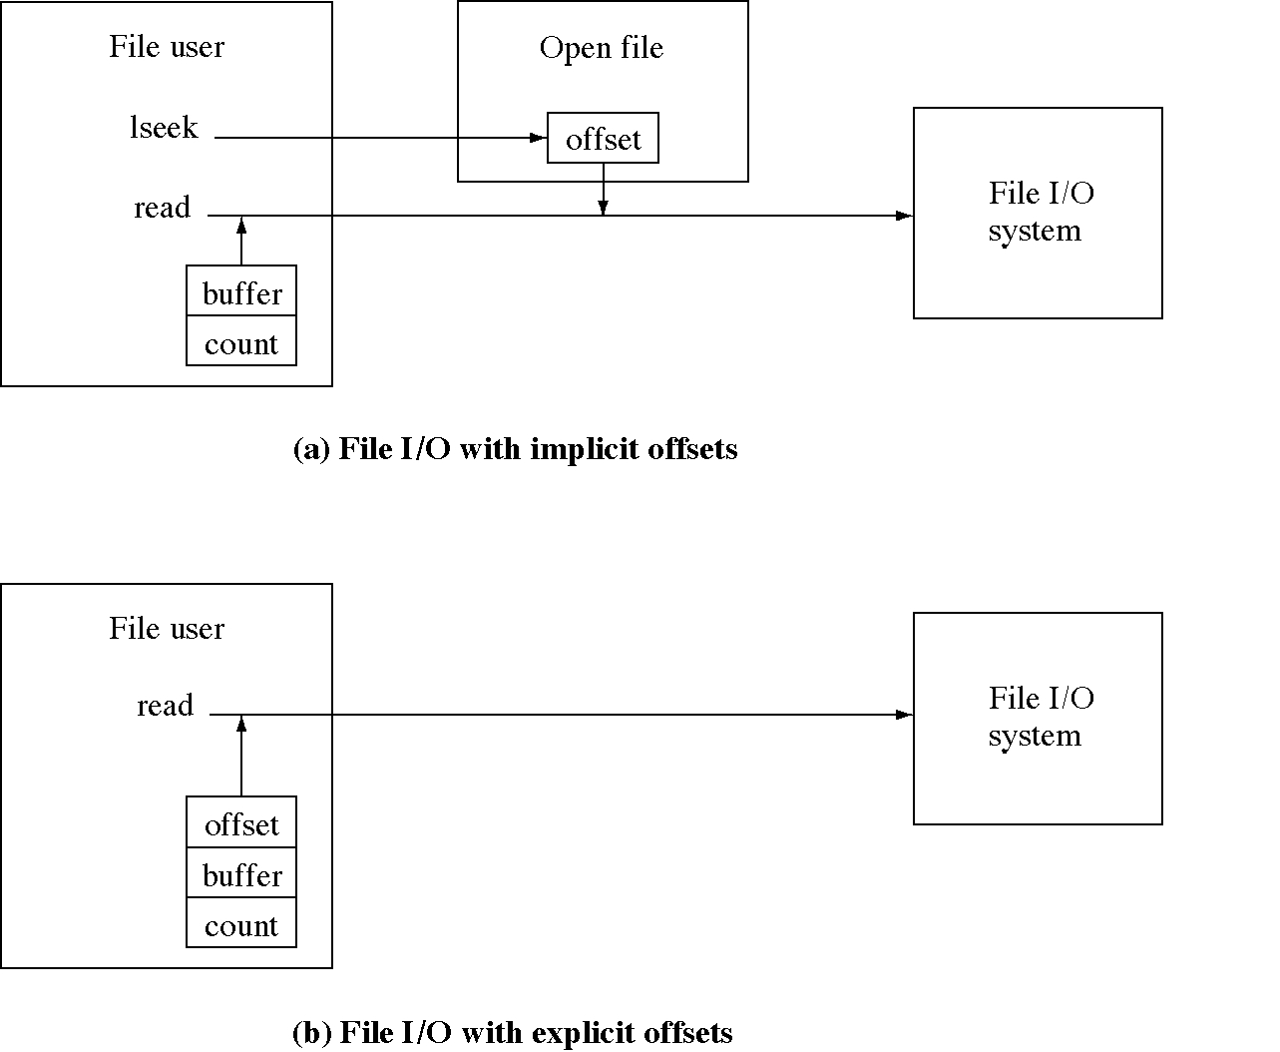
Two models of I/O calls

Slide 21
Reverse (with explicit offsets)
void Reverse(char * fromFile, char * revFile) {
int fromFD = open( fromFile, 0 );
int fromPosition = fileSize( fromFD); // NEW
int revFD = creat( revFile, 0 );
int newPosition = 0; // NEW
int n;
char ch;
while( fromPosition >= 0 ) {
n = read(fromFD, --fromPosition, &ch, 1);
(void)write(revFD, toPosition++, &ch, 1);
}
close( fromFD );
close( revFD );
}

Slide 22
Two connection models
Persistent connection: the telephone model
  for multiple interactions
  with a reliable server
  and significant setup cost
No connection: the postal model
  for unpredictable communication
  with a possibly unreliable servers

Slide 23
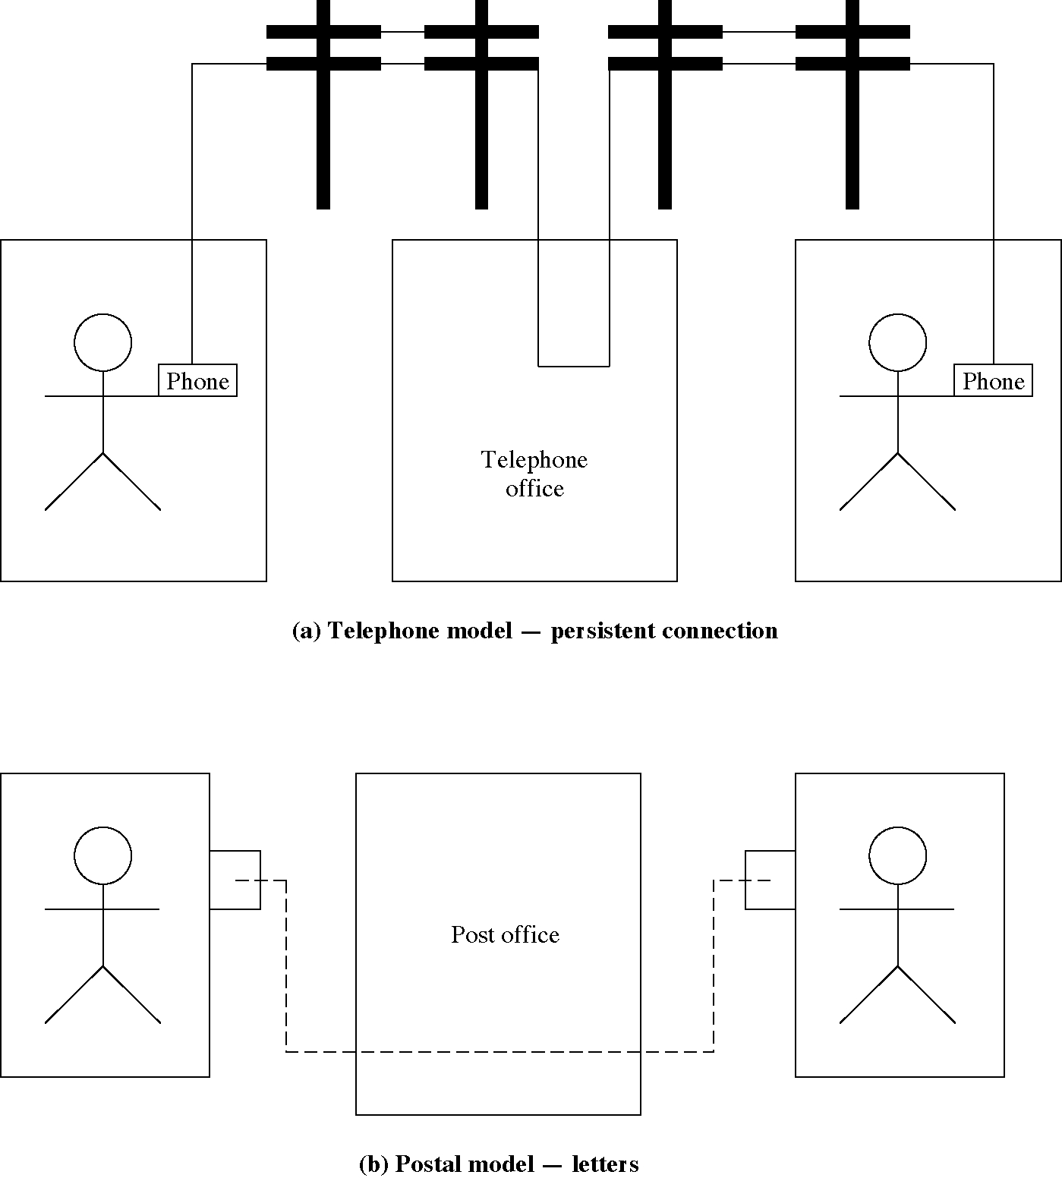
Message sending models

Slide 24
OS examples
File I/O: connection
Message passing IPC: connectionless
Pipe IPC: connection
Using an OS: connection (login)
OS types
  Network OS: connectionless log on to each OS)
  Distributed OS: connection (log on once)

Slide 25
CS examples
World Wide Web: connectionless
FTP: connection
Electronic mail: connectionless

Slide 26
Connectionless file access
Use in the NFS network file system
int read (char *name, int fileOffset, char *buffer, int count)

Slide 27
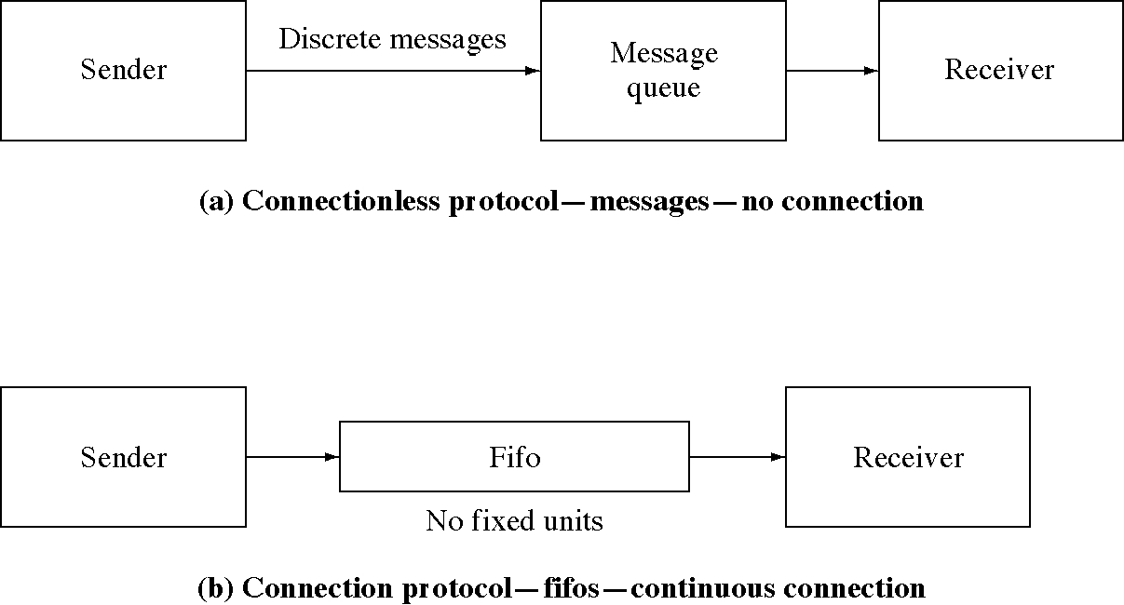
Connection in IPC

Slide 28
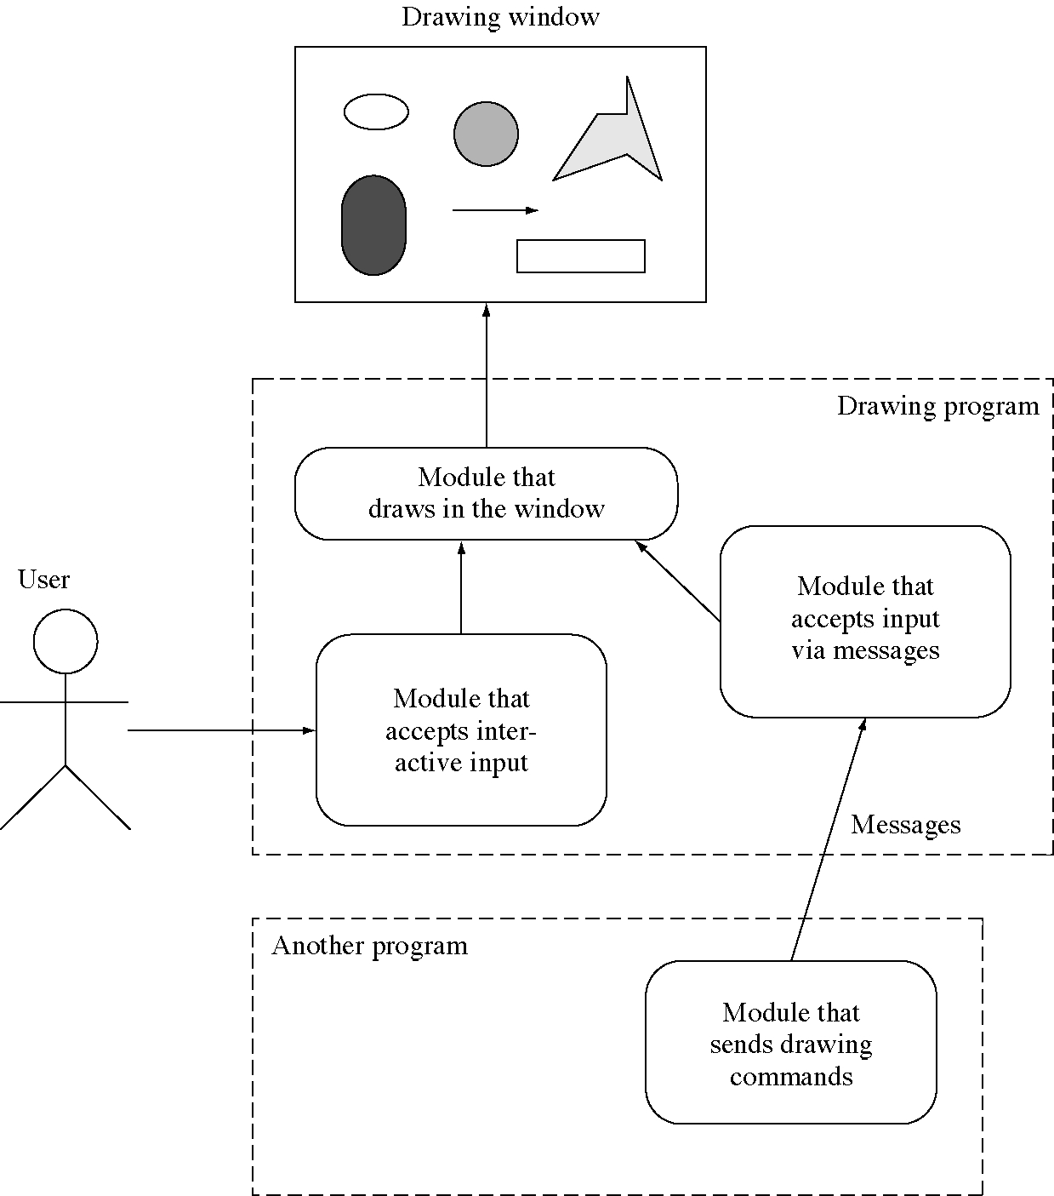
Interactive and programming interfaces

Slide 29
Examples
OS shells: interactive interface to OS
System-level scripting: programming interface to multiple applications
Tcl: programming interface to multiple programs
Programs that listen on sockets: programming interface to these programs

Slide 30
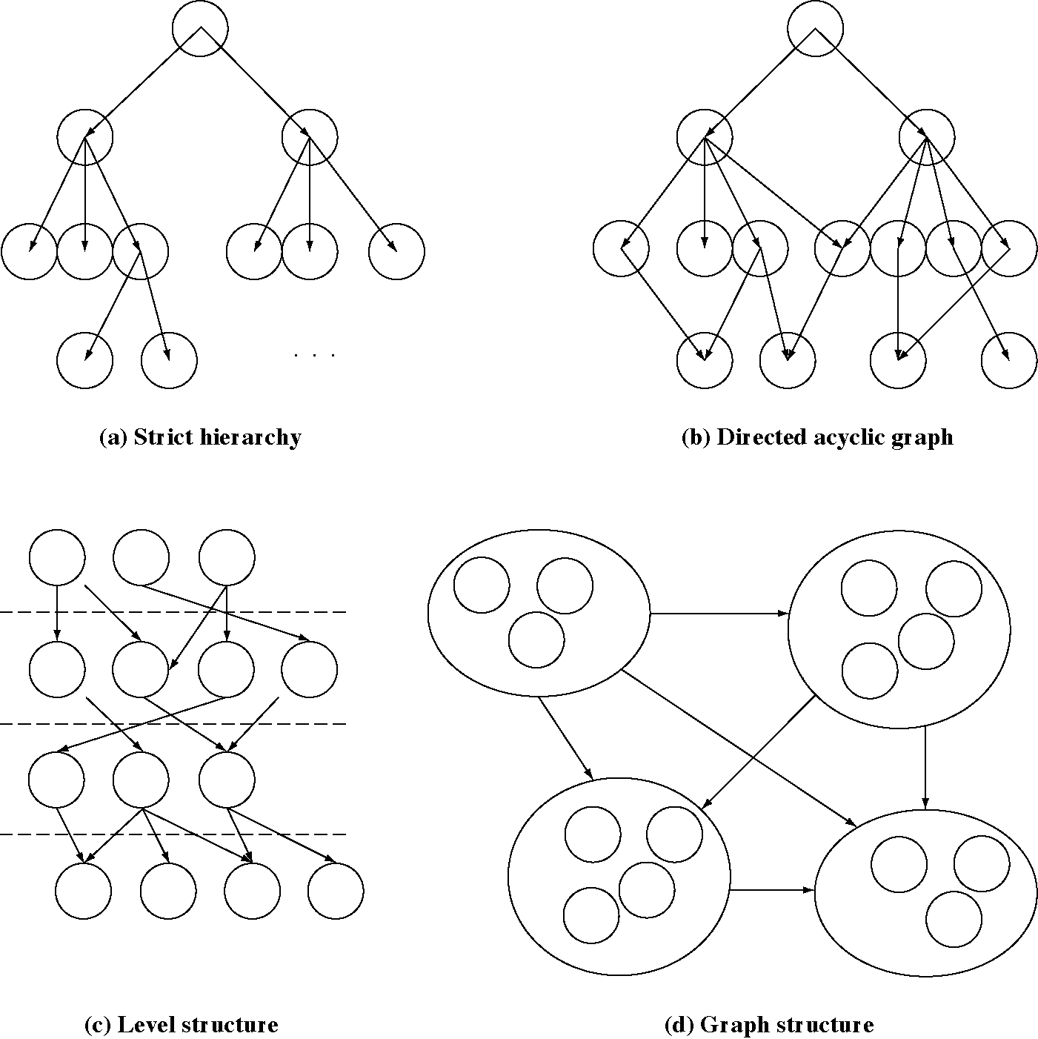
Decomposition patterns

Slide 31
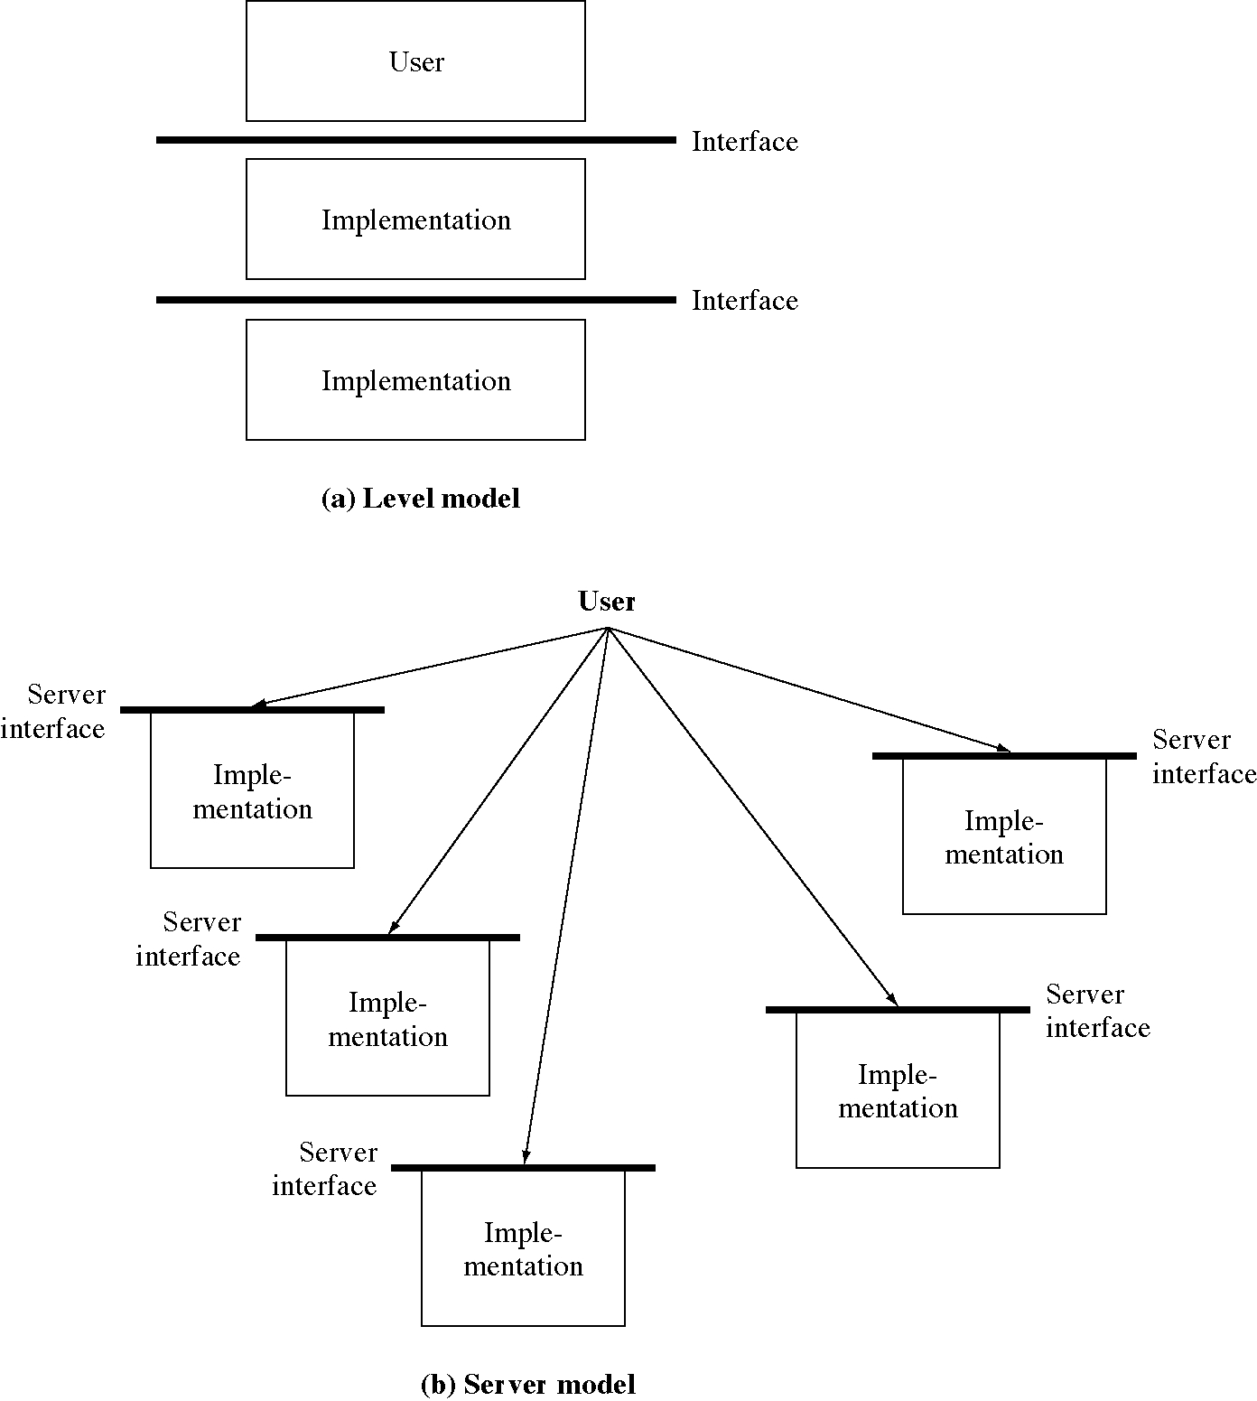
Level and server models

