Slide 1
Parallel Systems
Chapter 6

Slide 2
Key concepts in chapter 6
Parallelism
  physical (a.k.a. true) parallelism
  logical (a.k.a. pseudo-) parallelism
Multiprocessor OS (MPOS)
  race conditions
  atomic actions
  spin locks
Threads
Kernel-mode processes
Implementation of mutual exclusion

Slide 3
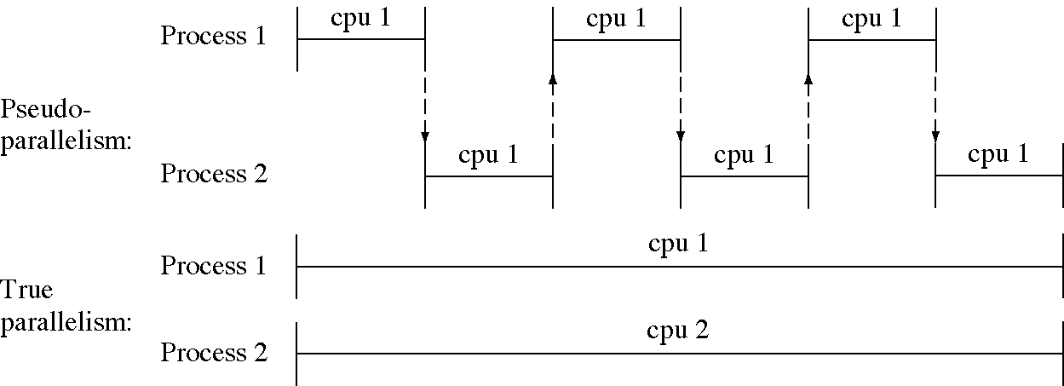
Parallel actions in a program

Slide 4
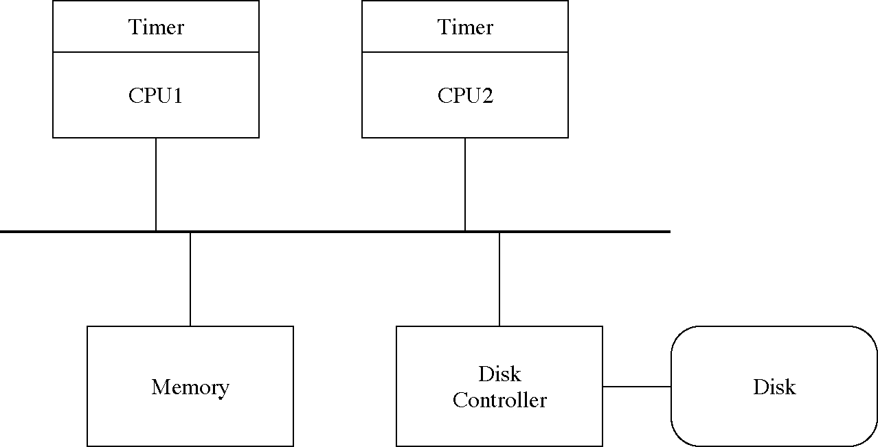
Parallel hardware

Slide 5
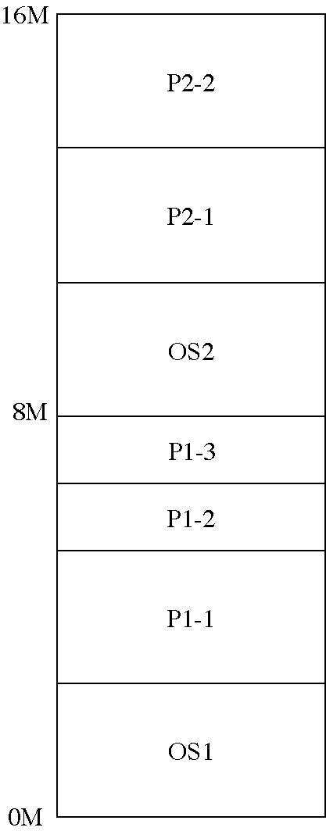
Two operating systems

Slide 6
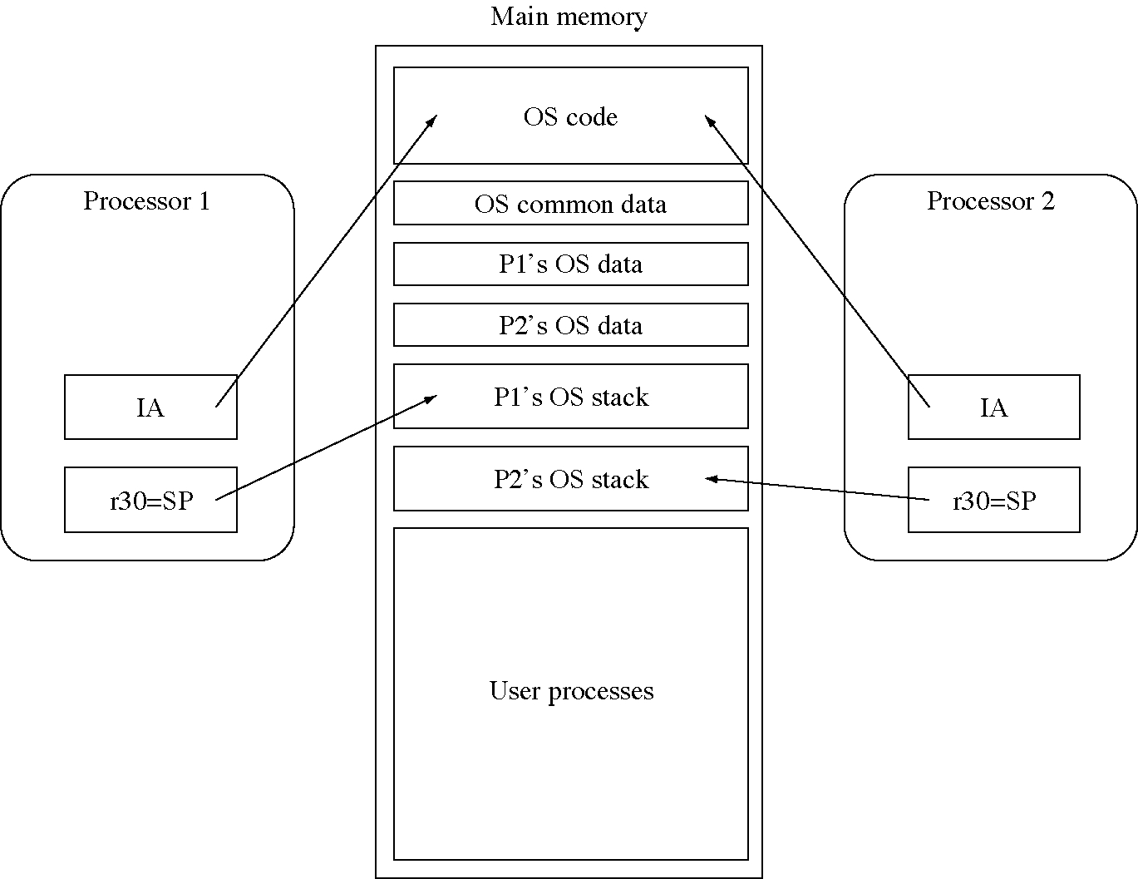
Sharing the OS between processors

Slide 7
Global data
Shared (between the processors)
  process_using_disk
  disk queue
  process table (pd)
  message queues
Duplicated (one for each processor)
  stack
  current_process

Slide 8
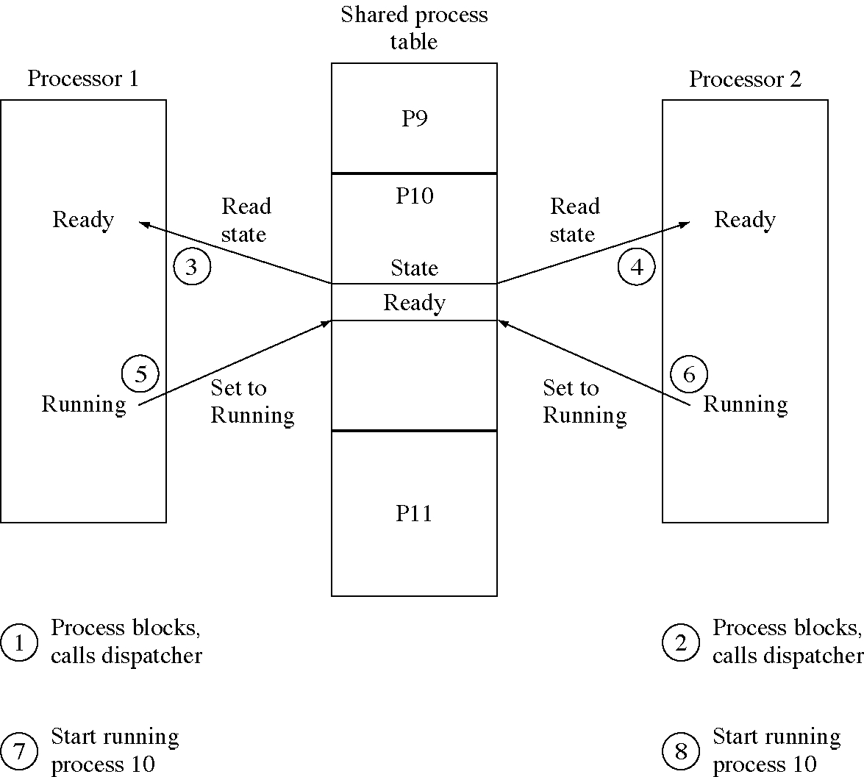
Race condition with a shared process table

Slide 9
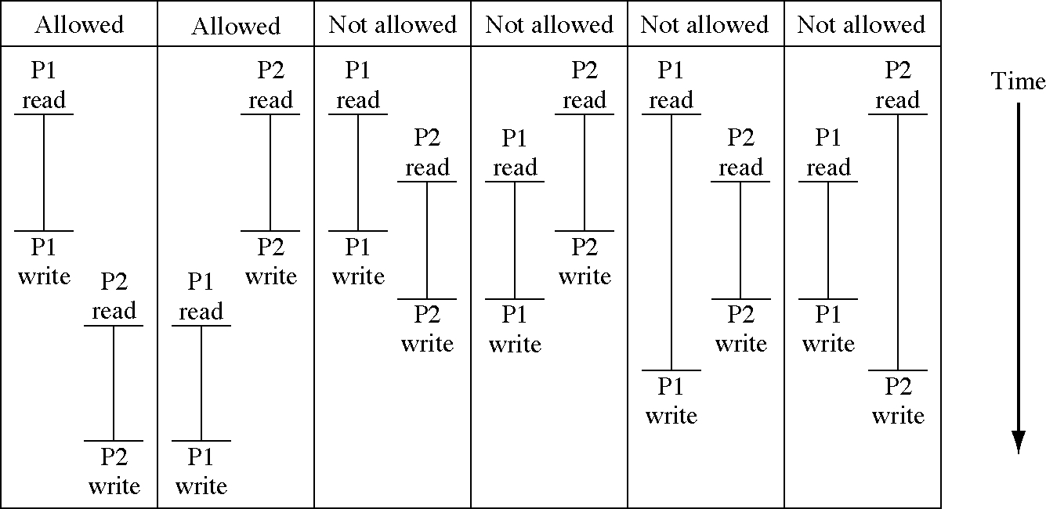
Atomic actions with the ExchangeWord instruction

Slide 10
Hardware implementation of atomic actions
Only the “bus master” can access memory
Solution
  allow one processor to be the bus master for two bus cycles
  one to read the word
  one to write the word
  Presto! An atomic read/write action

Slide 11
MPOS: global data
// Each processor has a stack and a current process
int p1_current_process;
int p2_current_process;
int p1_SystemStack[SystemStackSize];
int p2_SystemStack[SystemStackSize];
// Shared process table
ProcessDescriptor pd[NumberOfProcesses];
// Shared message queues
MessageBuffer message_buffer[NumberOfMessageBuffers];
int free_message_buffer;
int message_queue_allocated[NumberOfMessageQueues];
Queue<MessageBuffer *>
* message_queue[NumberOfMessageQueues];
Queue<WaitQueueItem *>
* wait_queue[NumberOfMessageQueues];
// Shared disk data
int process_using_disk;
Queue<DiskRequest *> disk_queue;

Slide 12
MPOS: system initialization
int main( void ) { // Proc. 1 system initialization
// Set up the system's stack
asm{ load p1_SystemStack+SystemStackSize,r30 }
// set up the interrupt vectors ... as before
// set up the pds ... as before
// process 1 is the initialization process
// ... as before
// set up the pool of free message buffers
// ... as before
process_using_disk = 0;
p1_current_process = 0;
// start processor 2
Dispatcher();
}
int main( void ) { // Proc. 2 system initialization
// Set up the system's stack
asm{ load p2_SystemStack+SystemStackSize,r30 }
p2_current_process = 0;
Dispatcher();
}

Slide 13
Protecting the process table
// A global variable to restricts access to the
// process table
int ProcessTableFreeFlag = 1;
void StartUsingProcessTable( void ) {
int flag;
while( 1 ) {
asm{
move r0,r1
exchangeword r1,ProcessTableFreeFlag
store r1,flag
}
// Busy wait until we get a 1 from the flag.
if( flag == 1 )
break;
}
}
void FinishUsingProcessTable( void ) {
ProcessTableFreeFlag = 1;
}

Slide 14
MPOS: dispatcher
int SelectProcessToRun( void ) {
static int next_proc = NumberOfProcesses;
int i, return_value = -1; int current_process;
StartUsingProcessTable(); // <-------- NEW CODE
if( ProcessorExecutingThisCode() == 1 )
current_process = p1_current_process;
else current_process = p2_current_process;
if(current_process>0 && pd[current_process].state==Ready
&& pd[current_process].timeLeft>0) {
pd[current_proc].state = Running;
return_value = current_process;
} else {
for( i = 1; i < NumberOfProcesses; ++i ) {
if( ++next_proc >= NumberOfProcesses ) next_proc = 1;
if( pd[next_proc].slotAllocated
&& pd[next_proc].state == Ready ) {
pd[next_proc].state = Running;
pd[next_proc].timeLeft = TimeQuantum;
return_value = next_proc;
break;
}
}
}
FinishUsingProcessTable(); // <-------- NEW CODE
return return_value;
}

Slide 15
Busy waiting
Processes wait by being suspended and resumed when the desired event occurs
Processors wait by continually checking the lock word
  this is called busy waiting
  the lock is called a spin lock

Slide 16
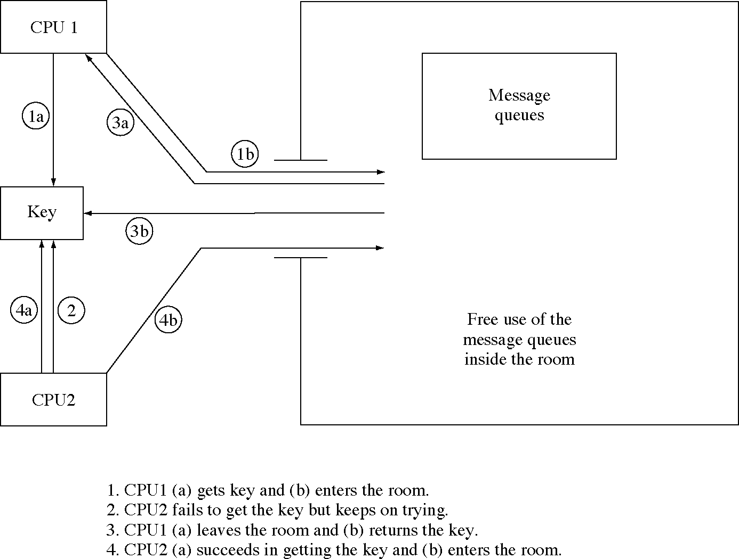
Protecting all the message queues with one lock

Slide 17
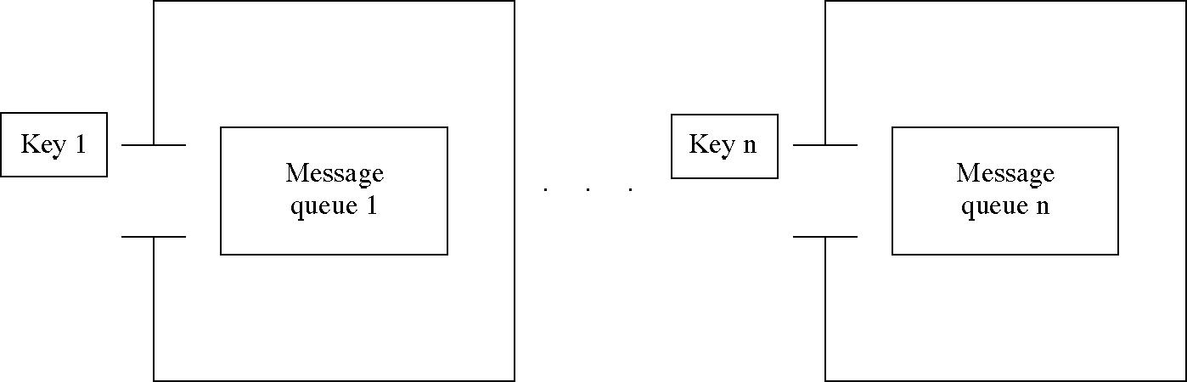
Protecting each message queue with a separate lock

Slide 18
Protecting access to shared data
void StartUsingSharedMemory(
int * shared_memory_flag ) {
int flag;
while( 1 ) {
// check first to see if we have a chance
while( * shared_memory_flag == 0 )
;
asm{
move r0,r1
exchangeword r1,* shared_memory_flag
store r1,flag
}
// Busy wait until we get a 1 from the flag.
if( flag == 1 ) break;
}
}
void FinishUsingSharedMemory(
int * shared_memory_flag ) {
*shared_memory_flag = 1;
}

Slide 19
Protecting the message queues
int message_queue_flag[NumberOfMessageQueues]
= {1,1,1,...,1};
case SendMessageSystemCall:
int * user_msg; asm { store r9,user_msg }
int to_q; asm { store r10,to_q }
if( !message_queue_allocated[to_q] ) {
pd[current_process].sa.reg[1] = -1; break;
}
int msg_no = GetMessageBuffer();
if( msg_no == EndOfFreeList ) {
pd[current_process].sa.reg[1] = -2; break;
}
CopyToSystemSpace( current_process, user_msg,
message_buffer[msg_no], MessageSize )
StartUsingSharedMemory(&message_queue_flag[to_q]);
if( !wait_queue[to_q].Empty() ) {
WaitQueueItem item = wait_queue.Remove();
TransferMessage( msg_no, item.buffer );
pd[item.pid].state = Ready;
} else { message_queue[to_q].Insert( msg_no ); }
FinishUsingSharedMemory(&message_queue_flag[to_q]);
pd[current_process].sa.reg[1] = 0;
break;

Slide 20
Protecting the message buffers
int message_buffer_flag = 1; //
int GetMessageBuffer( void ) {
// get the head of the free list
StartUsingSharedMemory( &message_buffer_flag );
int msg_no = free_msg_buffer;
if( msg_no != EndOfFreeList ) {
// follow the link to the next buffer
free_msg_buffer = message_buffer[msg_no][0];
}
FinishUsingSharedMemory( &message_buffer_flag );
return msg_no;
}
void FreeMessageBuffer( int msg_no ) {
StartUsingSharedMemory( &message_buffer_flag );
message_buffer[msg_no][0] = free_msg_buffer;
free_msg_buffer = msg_no;
FinishUsingSharedMemory( &message_buffer_flag );
}

Slide 21
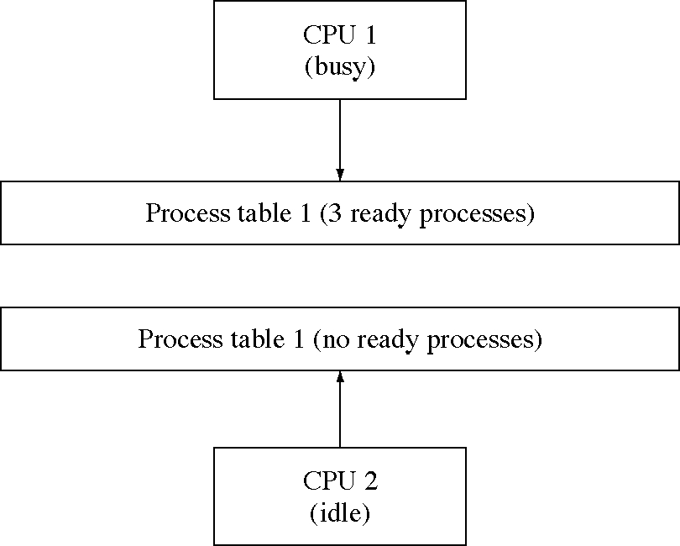
Using two process tables

Slide 22
Threads
A process has two characteristics
  resources: a process can hold resources such as an address space and open files.
  dispatchability: a process can be scheduled by the dispatcher and execute instructions.
We can split these two characteristics into:
  a (new) process which holds resources
  a thread which can be dispatched and execute instructions.
  several threads can exist in the same process, that is, in the same address space.

Slide 23
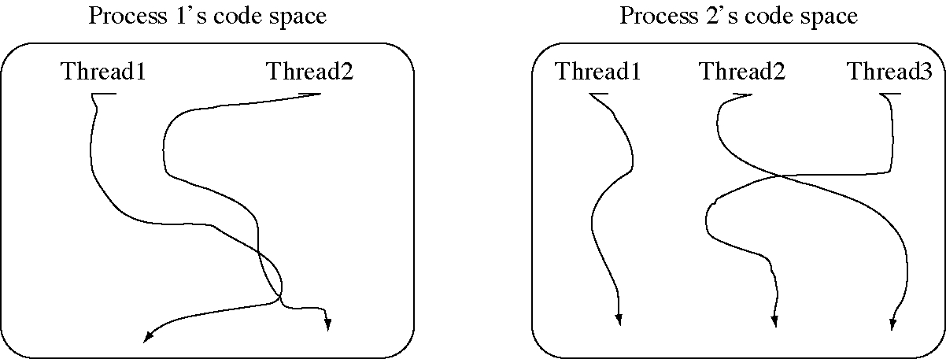
Threads executing in two processes

Slide 24
Process and thread analogies
A process is the software version of a standalone computer
  One processor (for each computer or process), no shared memory
  Communicate (between computers or processes) with messages
A thread is the software version of a processor in a multiple-processor, shared-memory computer
  Multiple processors (threads), shared memory
  Communicate (between processors or threads) through shared memory

Slide 25
Thread-related system calls
int CreateThread(
char *startAddress, char *stackAddress)
int ExitThread(int returnCode)
WaitThread(int tid)
Basically the same as for processes

Slide 26
Advantages of threads
Threads allows parallel activity inside a single address space
  Inter-thread communication and synchronization is very fast
Threads are cheap to create
  mainly because we do not need another address space
  They are also called lightweight processes (LWPs)

Slide 27
Uses of threads
Partition process activities
  each part of the process has its own thread
Waiting
  threads can wait for events without holding up other threads
Replicate activities
  servers can allocate a thread for each request

Slide 28
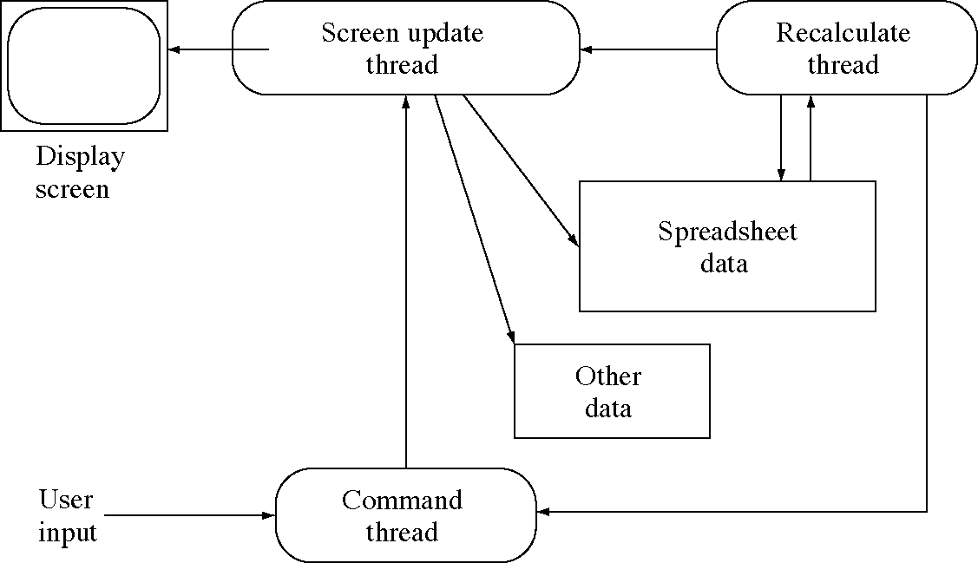
Threads in a spreadsheet program

Slide 29
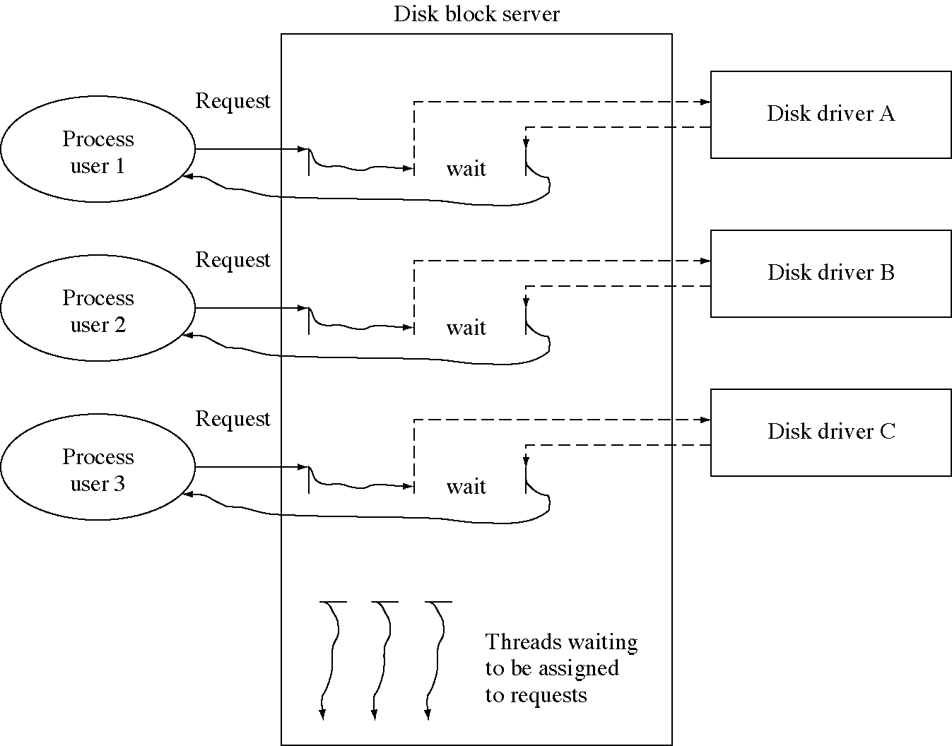
Disk server using threads

Slide 30
Threads: global data
enum ThreadState { Ready, Running, Blocked };
struct ThreadDescriptor {
int slotAllocated;
int timeLeft;
int nextThread, prevThread;
int pid;
ThreadState state;
SaveArea sa;
};
struct ProcessDescriptor {
int slotAllocated;
int threads; void * base, bound;
};
// This is the thread currently running.
int current_thread;
// We need a process table and a thread table.
ProcessDescriptor pd[NumberOfProcesses];
// pd[0] is the systemThreadDescriptor td[NumberOfThreads];
int thread_using_disk;

Slide 31
Threads: system initialization
int main( void ) {
// Other initialization is the same …
// The thread slots start out free.
for( i = 1; i < NumberOfThreads; ++i )
td[i].slotAllocated = False;
// Other initialization is the same …
}

Slide 32
Threads: create process
int CreateProcess( int first_block, int n_blocks ) {
int pid;
for( pid = 1; pid < NumberOfProcesses; ++pid )
if( !(pd[pid].slotAllocated) ) break;
if( pid >= NumberOfProcesses ) return -1;
pd[pid].slotAllocated = True;
pd[pid].base = pid * ProcessSize;
pd[pid].bound = ProcessSize;
char * addr = (char *)(pd[pid].sa.base);
for( i = 0; i < n_blocks; ++i ) {
while( DiskBusy() ) ; // Busy wait for I/O.
IssueDiskRead( first_block + i, addr, 0 );
addr += DiskBlockSize;
}
int tid = CreateThread( pid, 0, ProcessSize );
pd[pid].threads = tid;
if( tid == -1 ) return -1;
td[tid].nextThread = td[tid].prevThread = tid;
return pid;
}

Slide 33
Threads: create thread
int CreateThread(
int pid, char * startAddress, char *stackBegin ) {
// startAddress = address in the process
// address space to begin execution.
// stackBegin = initial value of r30
int tid;
for( tid = 1; tid < NumberOfThreads; ++tid )
if( !(td[tid].slotAllocated) ) break;
if( tid >= NumberOfThreads ) {
return -1; }
td[tid].slotAllocated = True;
td[tid].pid = pid;
td[tid].state = Ready;
td[tid].sa.base = pd[pid].base;
td[tid].sa.bound = pd[pid].bound;
td[tid].sa.psw = 3;
td[tid].sa.ia = startAddress;
td[tid].sa.r30 = stackBegin;
return tid;
}

Slide 34
Threads: dispatcher
void Dispatcher( void ) {
current_thread = SelectThreadToRun();
RunThread( current_thread ); }
int SelectThreadToRun( void ) {
static int next_thread = NumberOfThreads;
if( current_thread > 0 && td[current_thread].slotAllocated
&& td[current_thread].state == Ready
&& td[current_thread].timeLeft > 0 ) {
td[current_thread].state = Running;
return current_thread; }
for( int i = 0; i < NumberOfThreads; ++i ) {
if( ++next_thread >= NumberOfThreads ) next_thread = 0;
if( td[next_thread].slotAllocated
&& td[next_thread].state == Ready ) {
td[next_thread].state = Running;
return next_thread;
}
}
return -1; // No thread is ready to run
}
void RunThread( int tid ) {
/* ... same except it uses tid instead of pid */}

Slide 35
Threads: system calls (1 of 2)
void SystemCallInterruptHandler( void ) {
// The Exit system call is eliminated. You exit a
// process by exiting from all its threads.
case CreateProcessSystemCall:
int block_number; asm { store r9,block_number }
int number_of_blocks;
asm { store r10, number_of_blocks }
td[current_thread].sa.reg[1]
= CreateProcess( block_number, number_of_blocks);
break;
case CreateThreadSystemCall:
int start_addr; asm { store r9,start_addr }
int stack_begin; asm { store r10,stack_begin }
int pid = td[current_thread].pid;
int new_thread
= CreateThread( pid, start_addr, stack_begin );
td[current_thread].sa.reg[1] = new_thread;
int next_thread = td[current_thread].nextThread;
td[new_thread].nextThread = next_thread;
td[new_thread].prevThread = current_thread;
td[current_thread].nextThread = new_thread;
td[next_thread].prevThread = new_thread;
break;

Slide 36
Threads: system calls (2 of 2)
case ExitThreadSystemCall:
td[current_thread].slotAllocated = False;
int next_thread = td[current_thread].nextThread;
int pid = td[current_thread].pid;
if( next_thread == current_thread ) {
pd[pid].slotAllocated = False;
// No other exit process processing. In a real OS
// we might free memory, close unclosed files,etc.
} else {
// Unlink it from the list and make sure pd[pid]
// is not pointing to the deleted thread.
int prev_thread = td[current_thread].prevThread;
td[next_thread].prevThread = prev_thread;
td[prev_thread].nextThread = next_thread;
pd[pid].threads = next_thread;
}
break;
}
Dispatcher();
}

Slide 37
Kinds of threads
We have described lightweight processes
  threads implemented by the OS
A process can implement user threads
  threads implemented (solely) by the user
  these are more efficient
  but if the OS blocks one of them, they are all blocked
Kernel threads are threads that run inside the OS (a.k.a. the kernel)

Slide 38
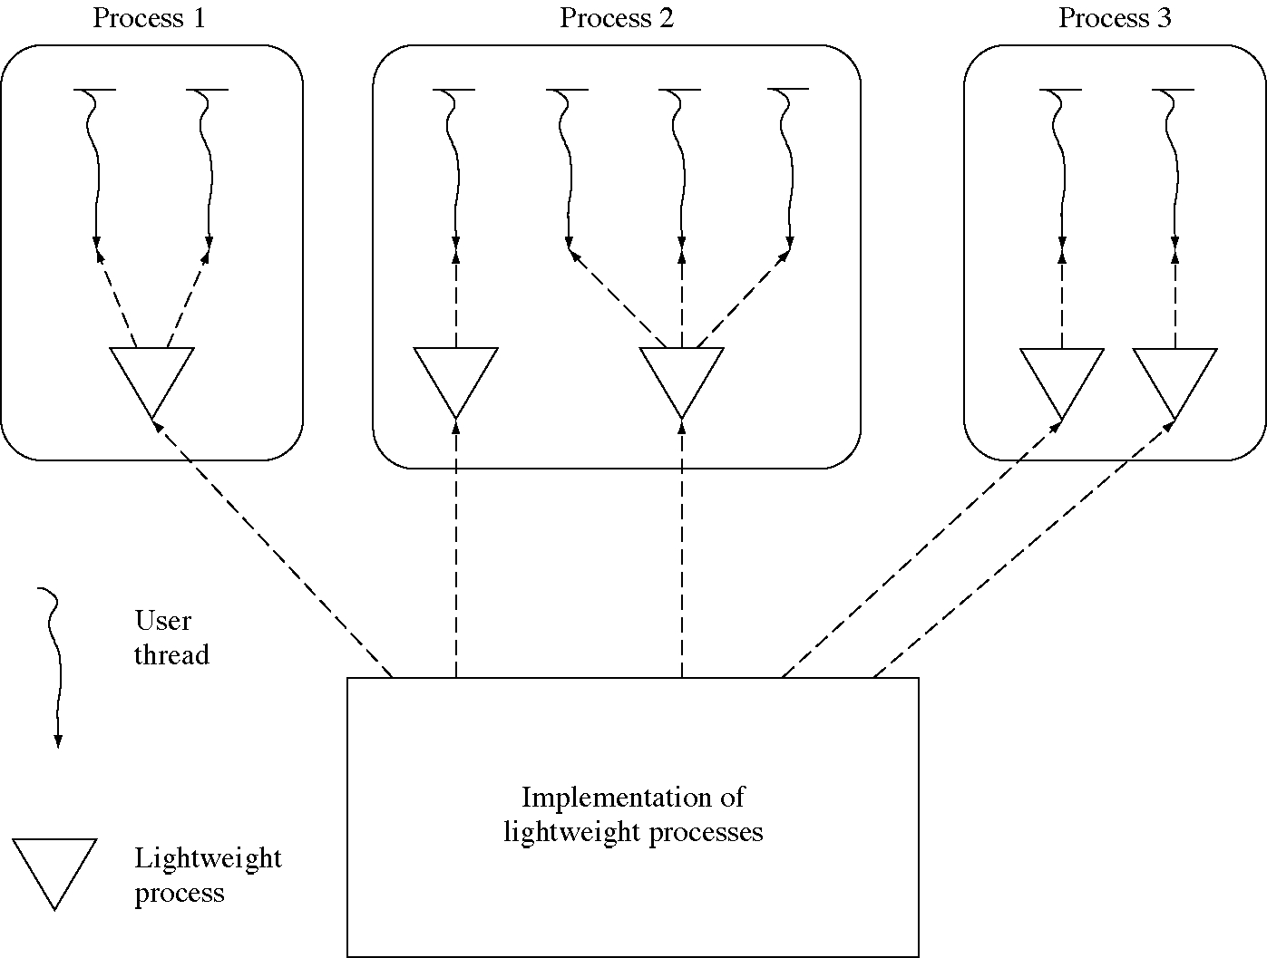
Combining user threads and lightweight processes

Slide 39
Threads in real OSs
Almost all modern OSs implement threads
Plan 9 has a very flexible form of process creation instead of threads
Several user thread packages are available
Some programming languages implement threads in the language
  Ada, Modula 3, Java

Slide 40
Design technique:
Separation of concepts
We separated resource holding and dispatchability into separate concepts: process and thread
  This allowed us to have several threads inside a single process
If two concepts can be used separately it is often useful to separate them in the software

Slide 41
Design technique:
Reentrant programs
Threads allow two threads of control to be executing in the same code at the same time
This leads to sharing problems
  such code must be reentrant
  this is the same problem we had with two processor sharing OS global data

Slide 42
Kernel-mode processes
Many UNIX implementations have long allowed processes to execute inside the kernel (the OS) during system calls
  this is actually an example of kernel threads
  it neatly solves the problem of suspending a system call

Slide 43
Kernel-mode: globals
struct ProcessDescriptor {
int slotAllocated;
int timeLeft; // time left from the last time slice
ProcessState state;
// SaveArea sa; <---- ELIMINATED
int inSystem; // set to 0 in CreateProcess <--- NEW
int * lastsa; // most recent save area on the stack
// <-- NEW
char sstack[SystemStackSize]; // system mode stack
//<---- NEW};
// We don't need a common system stack any more
// int SystemStack[SystemStackSize]; <---- ELIMINATED
// CHANGED: this is now a queue of ints.
Queue<int> * wait_queue[NumberOfMessageQueues];

Slide 44
Kernel-mode: create process
int CreateProcessSysProc(
int first_block, int n_blocks ) {
// ... the beginning part is the same as it was
// before except this is added:
pd[pid].inSystem = 0;
// Read in the image of the process.
char * addr = (char *)(pd[pid].sa.base);
for( i = 0; i < n_blocks; ++i ) {
DiskIO(DiskReadSystemCall, first_block+i, addr);
addr += DiskBlockSize;
}
return pid;
}

Slide 45
System calls (1 of 5)
void SystemCallInterruptHandler( void ) {
// *** BEGIN NEW CODE ***
// All this initial interrupt handling is new.
int * savearea;
int saveTimer;
if( pd[current_process].inSystem == 0 ) {
// This is the first entry into system mode
savearea = &(pd[current_process].sstack
+SystemStackSize-sizeof(SaveArea)-4);
} else {
// we were already in system mode so the system
// stack already has some things on it.
asm { store r30,savearea }
// allocate space on the stack for the save area
savearea -= sizeof(SaveArea)+4;
}

Slide 46
System calls (2 of 5)
asm {
store timer,saveTimer
load #0,timer
store iia,savearea+4
store ipsw,savearea+8
store base,savearea+12
store bound,savearea+16
storeall savearea+20
load savearea,r30
}
pd[current_process].timeLeft = saveTimer;
pd[current_process].state = Ready;
*savearea = pd[current_process].lastsa;
// link to previous save area
pd[current_process].lastsa = savearea;
++(pd[current_process].inSystem);
// state saved, so enable interrupts
asm { load #2,psw }
// *** END NEW CODE *** for interrupt handling code

Slide 47
System calls (3 of 5)
// fetch the system call number and switch on it
int system_call_number;
asm { store r8,system_call_number }
switch( system_call_number ) {
case CreateProcessSystemCall:
// ... the same
case ExitProcessSystemCall:
// ... the same
case CreateMessageQueueSystemCall:
// ... the same
case SendMessageSystemCall:
// get the arguments
int * user_msg; asm { store r9,user_msg }
int to_q; asm { store r10,to_q }
// check for an invalid queue identifier
if( !message_queue_allocated[to_q] ) {
pd[current_process].sa.reg[1] = -1;
break;
}

Slide 48
System calls (4 of 5)
int msg_no = GetMessageBuffer();
// make sure we are not out of message buffers
if( msg_no == EndOfFreeList ) {
pd[current_process].sa.reg[1] = -2;
break;
}
// copy message vector from the system caller's
// memory into the system's message buffer
CopyToSystemSpace( current_process, user_msg,
message_buffer[msg_no], MessageSize );
if( !wait_queue[to_q].Empty() ) {
// process is waiting for a message, unblock it
int pid = wait_queue.Remove();
pd[pid].state = Ready;
}
// put it on the queue
message_queue[to_q].Insert( msg_no );
pd[current_process].sa.reg[1] = 0;
break;

Slide 49
System calls (5 of 5)
case ReceiveMessageSystemCall:
int * user_msg; asm { store r9,user_msg }
int from_q; asm { store r10,from_q }
if( !message_queue_allocated[from_q] ) {
pd[current_process].sa.reg[1] = -1;
break; }
if( message_queue[from_q].Empty() ) {
pd[current_process].state = Blocked;
wait_queue[from_q].Insert( current_process );
SwitchProcess(); }
int msg_no = message_queue[from_q].Remove();
TransferMessage( msg_no, user_msg );
pd[current_process].sa.reg[1] = 0;
break;
case DiskReadSystemCall:
case DiskWriteSystemCall:
// ... the same
}
Dispatcher();
}}

Slide 50
Kernel-mode: SwitchProcess
void SwitchProcess() {
// Called when a system mode process wants
// to wait for something
int * savearea; asm { store r30,savearea }
savearea -= sizeof(SaveArea)+4;
asm {
// save the registers.
// arrange to return from the procedure call
// when we return.
store r31,savearea+4
store psw,savearea+8
store base,savearea+12
store bound,savearea+16
storeall savearea+20
}
pd[current_process].state = Blocked;
Dispatcher();
}

Slide 51
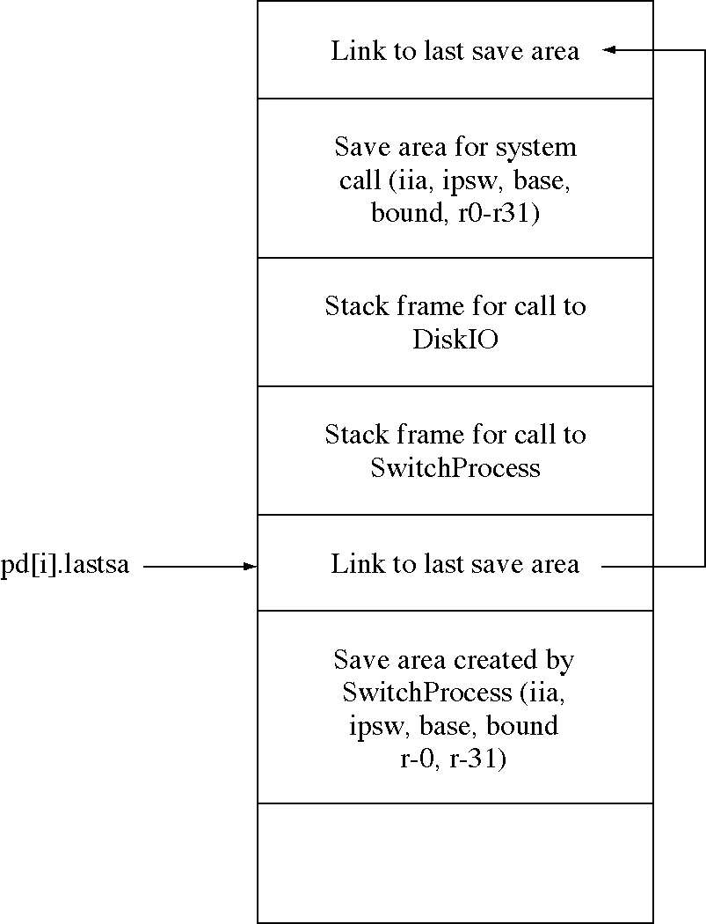
Kernel-mode process system stack

Slide 52
Kernel-mode: DiskIO
void DiskIO(int command, int disk_block,
char * buffer ) {
// Create a new disk request
// and fill in the fields.
DiskRequest * req = new DiskRequest;
req->command = command;
req->disk_block = disk_block;
req->buffer = buffer;
req->pid = current_process;
// Then insert it on the queue.
disk_queue.Insert( (void *)req );
pd[current_process].state = Blocked;
// Wake up the disk scheduler if it is idle.
ScheduleDisk();
SwitchProcess(); // NEW CODE
}

Slide 53
Kernel-mode: dispatcher
void RunProcess( int pid ) {
if( pid >= 0 ) {
asm { move #0,psw } // Disable interrupts
int * savearea = pd[pid].lastsa;
pd[pid].lastsa = *savearea;
--(pd[pid].inSystem);
int quantum = pd[pid].timeLeft
asm {
load savearea+4,iia
load savearea+8,ipsw
load savearea+12,base
load savearea+16,bound
loadall savearea+20
load quantum,timer
rti
}
} else {
waitLoop: goto waitLoop;
}
}

Slide 54
Kernel-mode: schedule disk
void ScheduleDisk( void ) {
StartUsingProcessTable();
if( pd[scheduleDiskPid].state == Blocked )
pd[scheduleDiskPid].state = Ready;
FinishUsingProcessTable();
}

Slide 55
Kernel-mode: real schedule disk
void RealScheduleDisk( void ) {
while( 1 ) { // NEW CODE
// If the disk is already busy, wait for it.
if( DiskBusy() )
SwitchProcess(); // NEW CODE
// Get the first disk request
// from the disk request queue.
DiskRequest * req = disk_queue.Remove();
// Wait, if there is no disk request to service.
if( req == 0 )
SwitchProcess(); // NEW CODE
// record which process is waiting for the disk
process_using_disk = req->pid;
// issue read or write, with interrupt enabled
if( req->command == DiskReadSystemCall )
IssueDiskRead(req->disk_block,req->buffer,1);
else
IssueDiskWrite(req->disk_block,req->buffer,1);
}
}

Slide 56
Kernel-mode process tradeoffs
Waiting inside the kernel is easy
Interrupts inside the kernel are easy
But every process needs a kernel-mode stack
  this adds up to a lot of memory allocated to stacks
UNIX implementations have used kernel-mode processes from the beginning
  but newer versions are getting away from it to save memory

Slide 57
Implementation of mutual exclusion in the OS
Three low-level solutions
  disable interrupts
    easy but only possible for single processor systems
  special hardware instruction (exchangeword)
    the preferred solution
  software mutual exclusion
    no special hardware required

Slide 58
Using mutual exclusion
void Process1( void ) {
while( 1 ) {
DoSomeStuff();
EnterCriticalSection( 0 );
DoCriticalSectionStuff();
LeaveCriticalSection( 0 );
}
}
void Process2( void ) {
while( 1 ) {
DoSomeStuff();
EnterCriticalSection( 1 );
DoCriticalSectionStuff();
LeaveCriticalSection( 1 );
}
}

Slide 59
Implementing mutual exclusion
enum{ False = 0, True = 1 };
// This is global data available to both processes
int interested[2] = {False, False};
int turn = 0;
void EnterCriticalSection( int this_process ) {
int other_process = 1 - this_process;
interested[this_process] = True;
turn = this_process;
while( turn == this_process
&& interested[other_process] ) {
// do nothing, just wait for this loop to exit
}
}
void LeaveCriticalSection( int this_process ) {
interested[this_process] = False;
}

Slide 60
Comparing the three solutions
Disabling interrupts
  is fast and does not involve busy waiting
  is the best solution for a single processor
Using ExchangeWord
  requires hardware assistance and busy waiting
  is the best solution for multiprocessors which share memory
Peterson’s solution
  requires busy waiting but no special hardware
  is the best solution for distributed systems with no central control

Slide 61
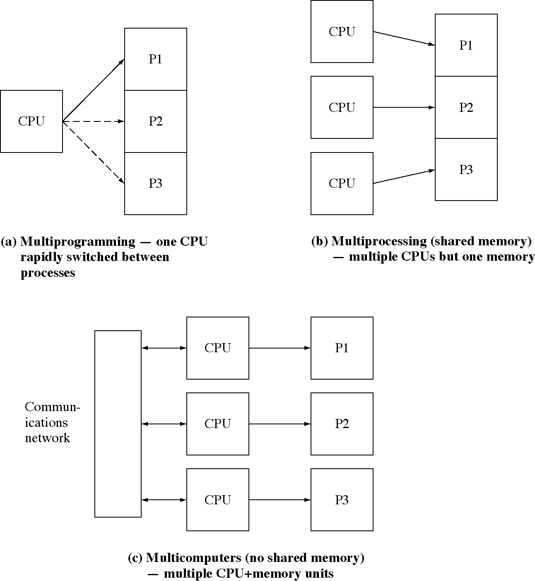
Varieties of multiple processors

Slide 62
Mutual exclusion (Dekker’s)
// This is global data available to both processes
int interested[2] = {False, False};
int turn = 0;
void EnterCriticalSection( int this_process ) {
int other_process = 1 - this_process;
interested[this_process] = True;
while( interested[other_process] ) {
if( turn == other_process ) {
interested[this_process] = False;
while( turn == other_process )
/* do nothing*/ ;
interested[this_process] = True;
}
}
}
void LeaveCriticalSection( int this_process ) {
int other_process = 1 - this_process;
turn = other_process;
interested[this_process] = False;
}

