Slide 1
Interprocess Communication Patterns
Chapter 7

Slide 2
Key concepts in chapter 7
Process competition and cooperation
Mutual exclusion
Signaling
Rendezvous
Producer-consumer
  with limited buffers
Client-server
Database access and update

Slide 3
Using IPC
This chapter is not about OSs
  it is about the communication patterns of user processes running in parallel
  but the same problems come up as came up in chapter 6
    and some new problems

Slide 4
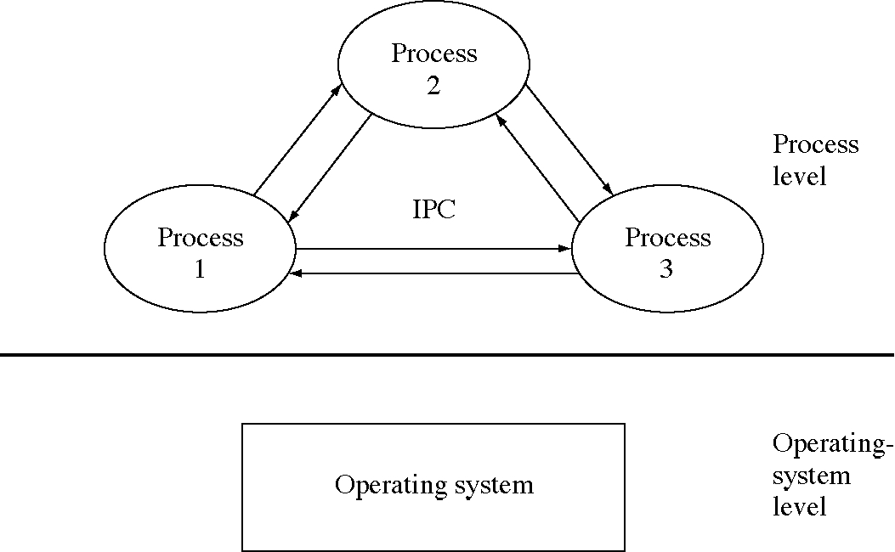
IPC at the user process level

Slide 5
Ways that processes interact
Competition
  for use of resources
  because we are multiplexing resources
  the mutual exclusion IPC pattern
Cooperation
  each process solves part of a problem
  many IPC patterns

Slide 6
Process competition for resources
Context: the use of shared resources
  physical and logical resources
  serially reusable resources
Problem: race conditions
Where the problem occurs: critical sections
Abstract solution: atomic actions
Concrete solution: mutual exclusion (of critical sections)

Slide 7
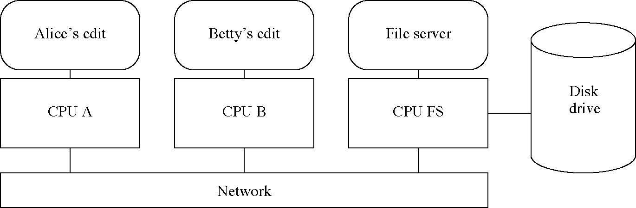
Simultaneous editing of a file

Slide 8
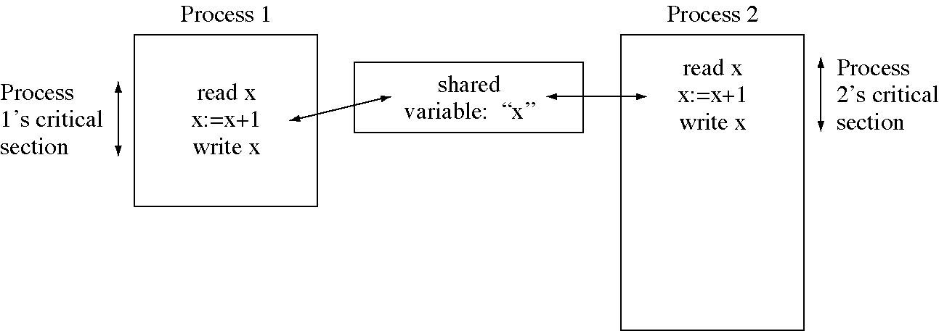
Race condition updating a variable

Slide 9
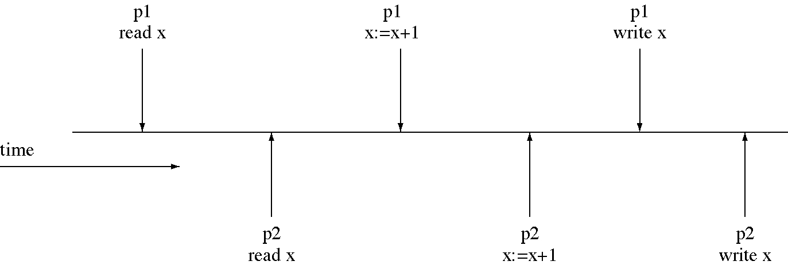
Race condition timing chart

Slide 10
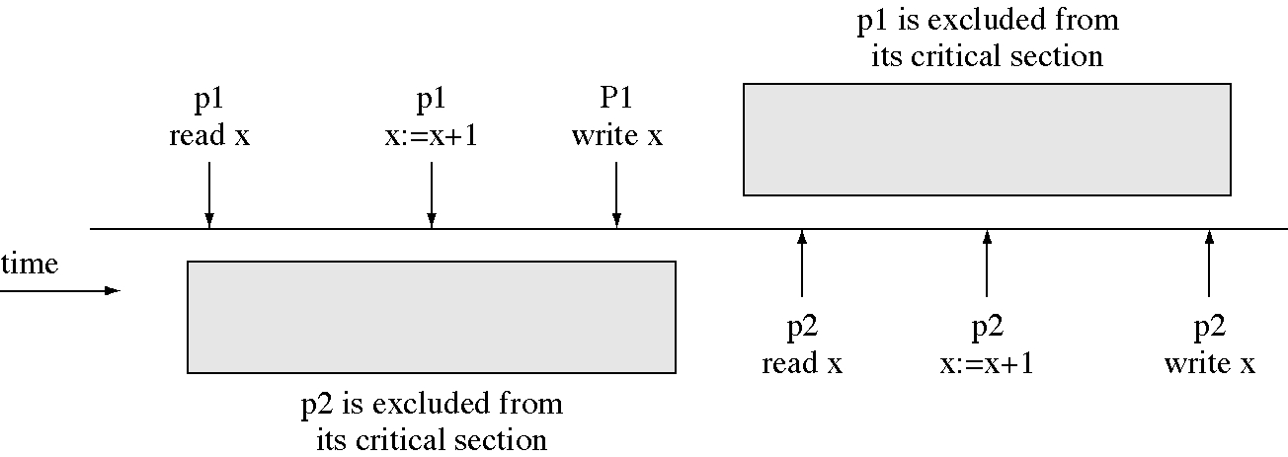
Critical section to prevent a race condition

Slide 11
Design technique:
Win big, then give some back
Multiprogramming is a big win
  it allows logical parallelism
  it uses devices efficiently
  but we lose correctness when there is a race condition
So we forbid logical parallelism inside critical section
  we lose a little bit of logical parallelism
  but we regain correctness

Slide 12
New message-passing system calls for the IPC patterns
int AttachMessageQueue(char *qname)
  returns queue identifier (qid)
int DetachMessageQueue(int qid)

Slide 13
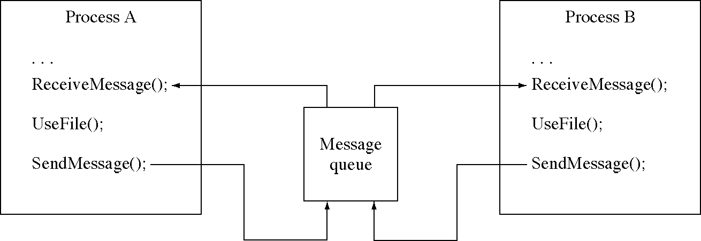
Mutual exclusion pattern

Slide 14
Two-process mutual exclusion
// Convenience procedure
void WaitForEmptyMsg( int msg_queue ) {
int msg[MsgSize];
ReceiveMessage( msg_queue, msg );
}
void main(int argc,char * argv[]) { //Process A or B
int mutex_queue
= AttachMessageQueue("/usr/queue/FMutex");
// Start with one message in the queue (the ticket)
if( IAmProcessA() )
SendMsgTo( mutex_queue );
while( 1 ) {
DoOtherThings(); // Not using file F
// Enter critical section by getting message
WaitForEmptyMsg( mutex_queue );
UseFileF();
SendMsgTo( mutex_queue );
// Leave critical section by returning message
}
}

Slide 15
Mutual exclusion issues
The solution is simple
The solution generalizes to N processes
Processes must follow the protocol or the solution does not work

Slide 16
Design technique: Reducing a problem to a special case
Messages can solve the mutual exclusion problem (at the user level)
  but we needed mutual exclusion (at the OS level) to implement messages
  we reduced the general user-level problem to a specific OS-level problem
Users find it hard to remember how to use all the commands
  but if they can remember how to use the help command they can get help on the others

Slide 17
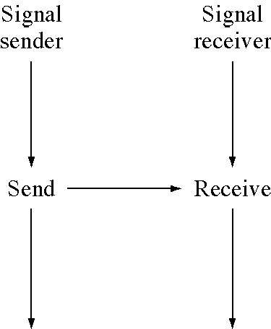
Process signaling

Slide 18
Signaling print completions
void main() {
// Printer Daemon
while( 1 ) {
PrintJob();
SendMsgTo( informer_queue[i], PrintingDone );
}
}
void main() {
// Informer Process
int msg[MsgSize];
while( 1 ) {
// wait for a message to display
ReceiveMessage( my_queue, msg );
// inform the person the printing is done.
}
}

Slide 19
Signaling IPC pattern
void main() {
// Signal Sender
int signal_queue
= AttachMessageQueue( "/usr/queue/receiver" );
// Do what you need to do, then signal completion
SendMsgTo( signal_queue );
}
void main() {
// Signal Receiver
int signal_queue
= AttachMessageQueue( "/usr/queue/receiver" );
int msg[MsgSize];
// wait for the sender process to send the signal
ReceiveMessage( signal_queue, msg );
// Do something in response to the signal
}

Slide 20
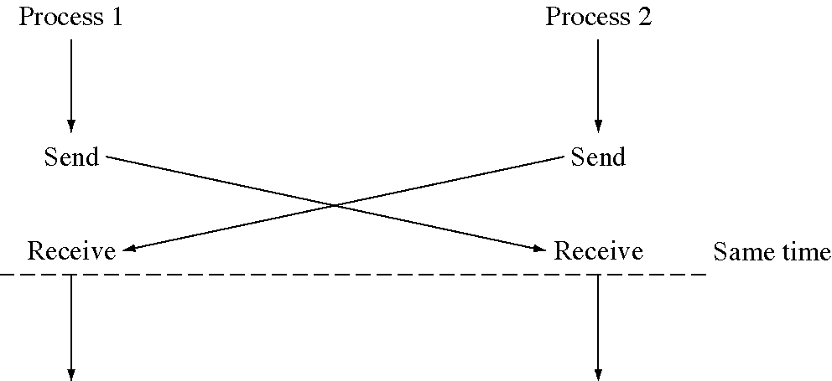
Two-process rendezvous

Slide 21
Two-process rendezvous
void main( int argc, char *argv[ ] ) {
// Game Player A
int b_queue = AttachMessageQueue("/usr/queue/gpb");
SendMsgTo( b_queue, ReadyToStart );
int a_queue = AttachMessageQueue("/usr/queue/gpa");
WaitForEmptyMsg( a_queue );
}
void main( int argc, char *argv[ ] ) {
// Game Player B
int a_queue = AttachMessageQueue("/usr/queue/gpa");
SendMsgTo( a_queue, ReadyToStart );
int b_queue = AttachMessageQueue("/usr/queue/gpb");
WaitForEmptyMsg( b_queue );
}

Slide 22
Many-process rendezvous
void main(int argc, char *argv[ ]) { // Coordinator
int msg[MsgSize];
int player[NumberOfPlayers], coordinator_queue
= AttachMessageQueue( "/usr/queue/coordq" );
for( i = 0; i < NumberOfPlayers; ++i ) {
ReceiveMessage( coordinator_queue, msg );
player[i] = msg[1];
}
for( i = 0; i < NumberOfPlayers; ++i )
SendMsgTo( player[i], BeginPlaying );
}
void main( int argc, char *argv[ ] ) { // Player I
int coordinator_queue
= AttachMessageQueue( "/usr/queue/coordq" );
char qname[32];
sprintf( qname, "/usr/queue/%s", argv[1] );
int my_queue = AttachMessageQueue( qname );
SendMsgTo(coordinator_queue,ReadyToStart,my_queue);
WaitForEmptyMsg( my_queue );
}

Slide 23
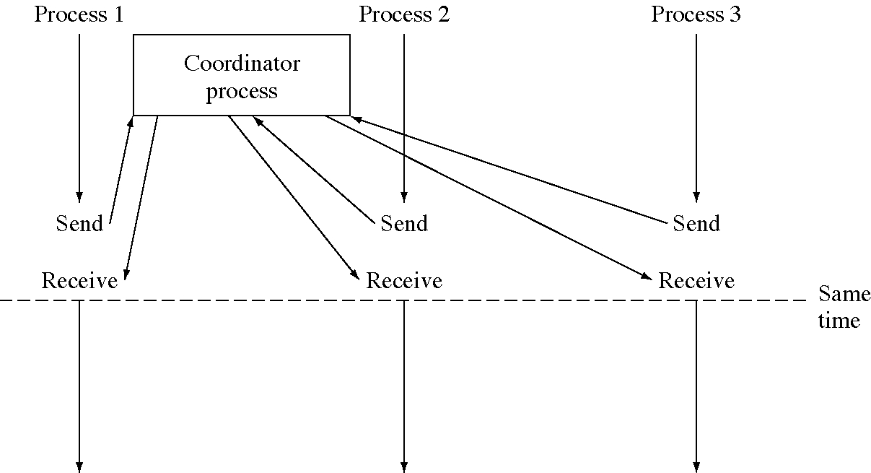
Three-process rendezvous

Slide 24
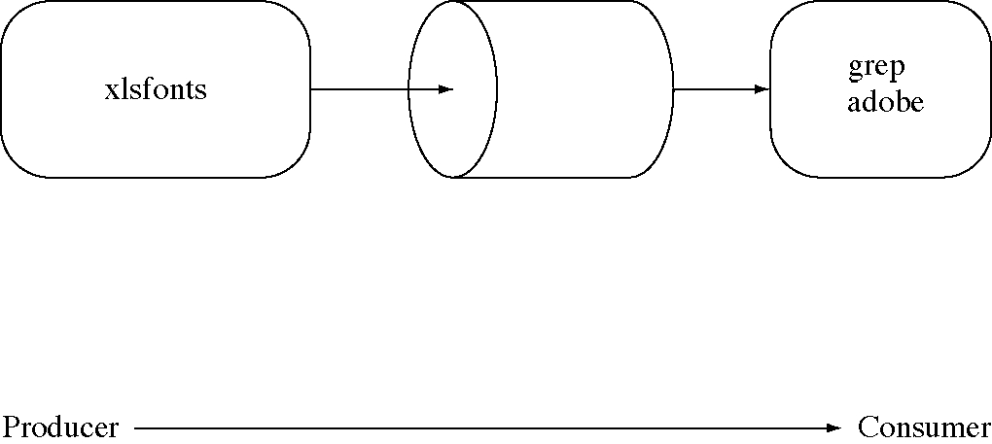
IPC pattern: Producer-consumer

Slide 25
Implementing a pipeline
void main() {
// xlsfonts (the producer)
int grep_queue=AttachMessageQueue("/usr/queue/grep");
while( 1 ) {
// find the next font name
SendMsgTo( grep_queue, fontName );
}
}
void main() {
// grep (the consumer)
int msg[MsgSize];
int grep_queue=AttachMessageQueue("/usr/queue/grep");
while( 1 ) {
ReceiveMessage( grep_queue, msg );
if( end_of_font_names )
break;
if( font_name_matched_pattern ) {
// print font name
}
}
}

Slide 26
Producer-consumer IPC pattern
void main() { // The Producer
int consumer_queue
= AttachMessageQueue( "/usr/queue/consumer_q" );
while( 1 ) {
// Produce a message
SendMsgTo( consumer_queue, msg );
}
}
void main() { // The Consumer
int msg[MsgSize];
int consumer_queue
= AttachMessageQueue( "/usr/queue/consumer_q" );
while( 1 ) {
ReceiveMessage( consumer_queue, msg );
// consume the message
}
}

Slide 27
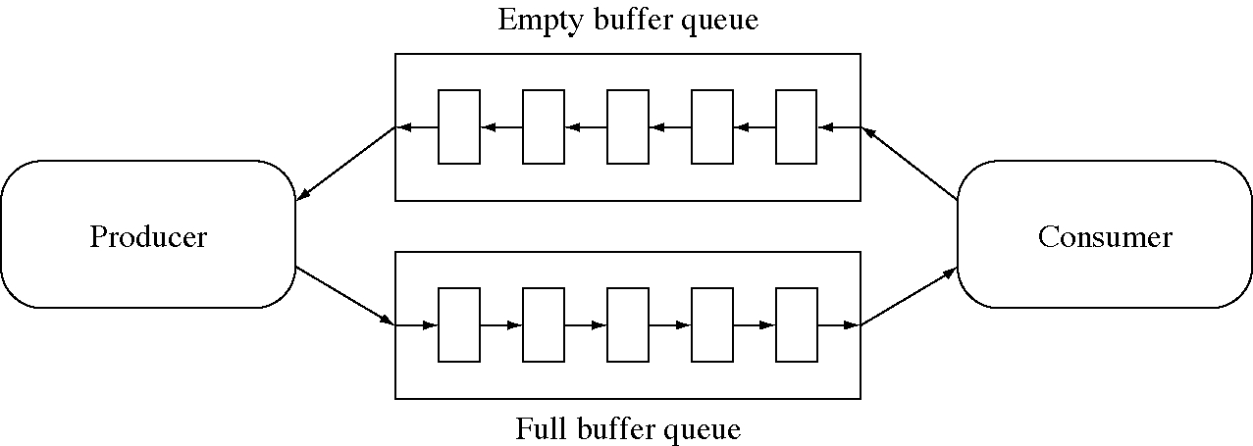
Producer-consumer with limited buffers

Slide 28
N-buffer producer-consumer
void main() { // The Producer
int buffer_queue
= AttachMessageQueue("/usr/queue/buffer_q");
int producer_queue
= AttachMessageQueue("/usr/queue/producer_q");
int msg[MsgSize];
while( 1 ) {
WaitForEmptyMsg( producer_queue );
SendMsgTo( buffer_queue, msg );
}
}
void main() { // The Consumer
int buffer_queue
= AttachMessageQueue("/usr/queue/buffer_q");
int producer_queue
= AttachMessageQueue("/usr/queue/producer_q");
int msg[MsgSize], i;
for( i = 0; i < BufferLimit; ++i )
SendMsgTo( producer_queue );
while( 1 ) {
ReceiveMessage( buffer_queue, msg );
// consume the message
SendMsgTo( producer_queue, EmptyBuffer );
}
}

Slide 29
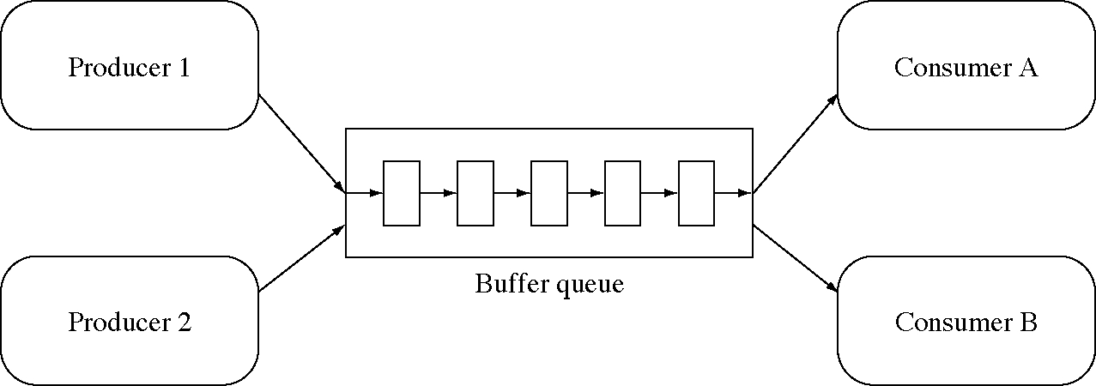
Multiple producers and consumers

Slide 30
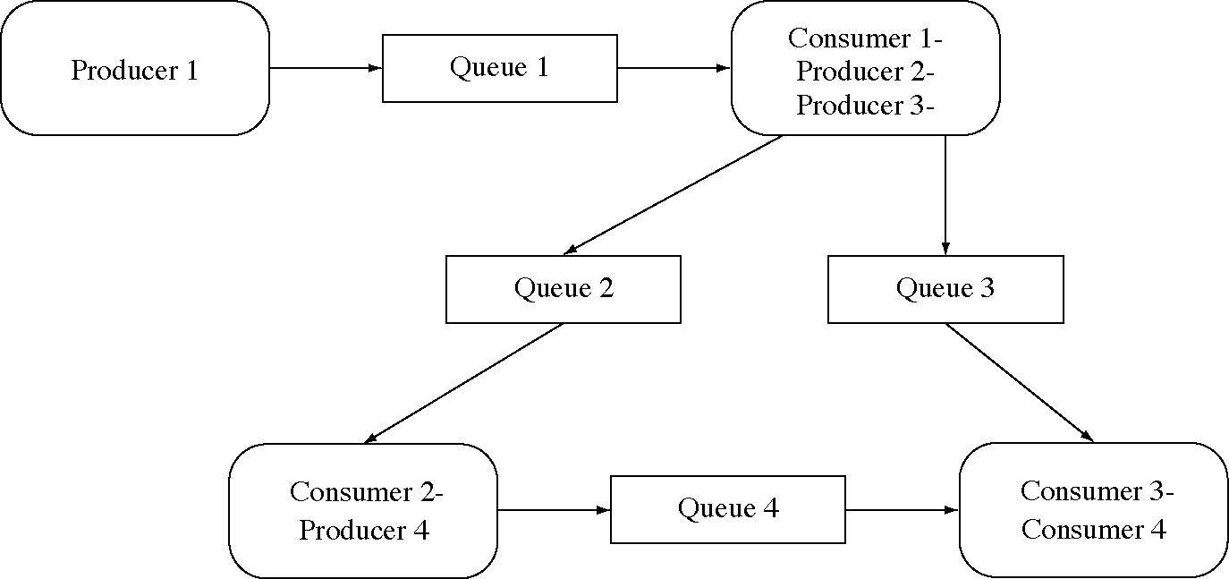
A complex network of producers and consumers

Slide 31
Squaring server
void main() { // Squaring Client
int msg[MsgSize];
int my_queue
= AttachMessageQueue( "client_queue" );
int server_queue
= AttachMessageQueue( "/usr/queue/squarer" );
SendMsgTo( server_queue, 23 ); // square 23
ReceiveMsg( my_queue, msg, my_queue );
// get response or verification
// msg[0] will contain 23*23
}
void main() { // Squaring Server
int server_queue
= AttachMessageQueue( "/usr/queue/squarer" );
int msg[MsgSize];
while( 1 ) { // Main server loop
ReceiveMessage( server_queue, msg );
SendMsgTo( msg[1], msg[0]*msg[0] );
}
}

Slide 32
Client-server IPC pattern
void main() { int msg[MsgSize]; // Client
int my_queue = AttachMessageQueue("client_queue");
int server_queue
= AttachMessageQueue("/usr/queue/server17");
SendMsgTo(server_queue, Service43, my_queue, otherData);
ReceiveMsg( my_queue, msg );
}
void main() { int msg[MsgSize]; // Server
int server_queue
= AttachMessageQueue("/usr/queue/server17");
while( 1 ) { // Main server loop
ReceiveMessage( server_queue, msg );
switch( msg[0] ) { // switch on the service requested
case Service43:
// get parameters and serve request
SendMsgTo( msg[1], responseData );
break;
// ... other cases are structured similarly
}
}
}

Slide 33
The Client-Server Model
Server
  exports an interface for clients to use
    only interaction is through the interface
  provides services to clients
Client
  requests services
Basically two modules
The basic of most network services
  file server, print server, name server, authentication server

Slide 34
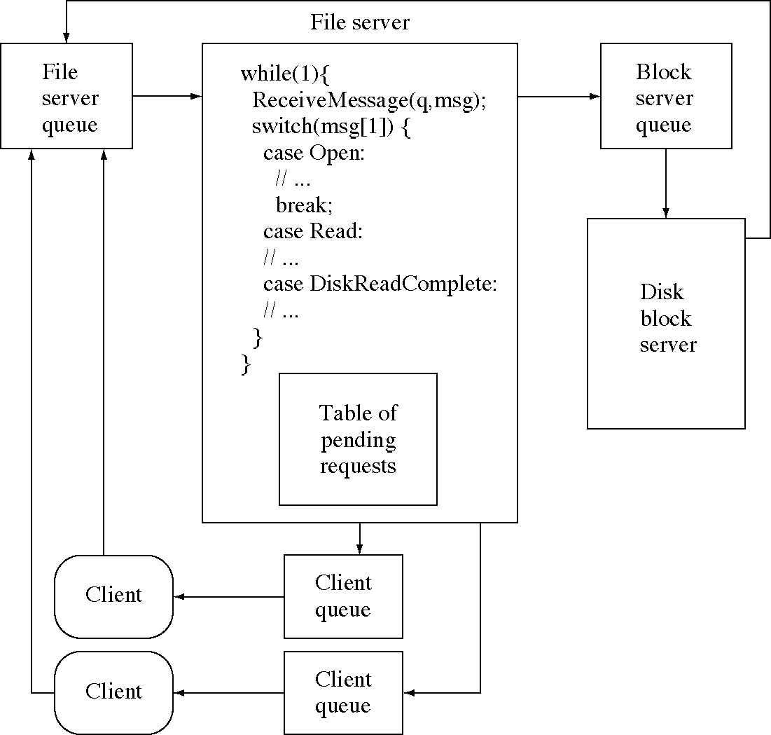
File server and clients

Slide 35
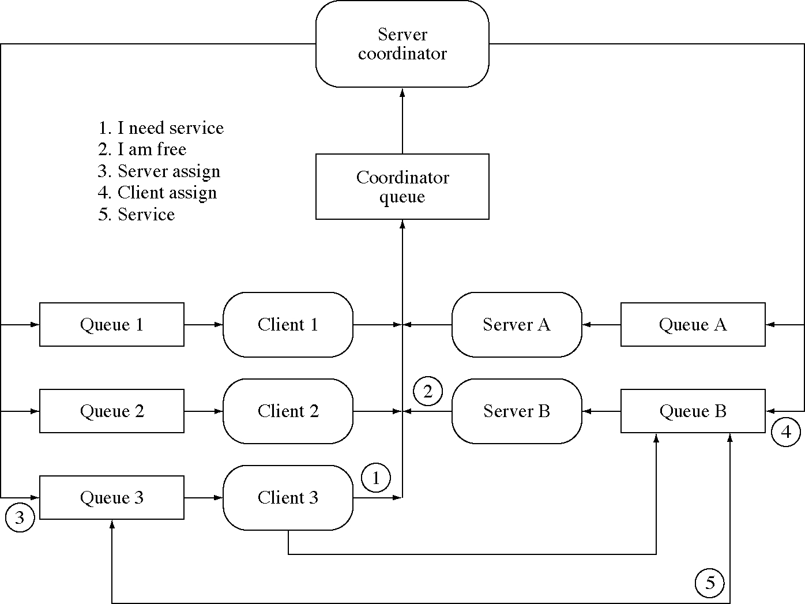
Multiple servers and clients

Slide 36
Multiple servers: client
// This is the code for a client process.
void main( int argc, char *argv[ ] ) {
int msg[MsgSize];
int coordinator_queue
= AttachMessageQueue("/usr/queue/coord");
char qname[32];
// Figure out the name of my message queue
// and get its identifier.
sprintf( qname, "/usr/queue/%s", GetPid() );
int my_queue = AttachMessageQueue( qname );
// Tell coordinator I need to be assigned a server.
SendMsgTo(coordinator_queue,INeedService,my_queue);
ReceiveMessage( my_queue, msg );
// Communicate with server whose pid is in msg[1].
// Then leave the system.
}

Slide 37
Multiple servers: server
void main( int argc, char *argv[ ] ) {
int msg[MsgSize];
int coordinator_queue
= AttachMessageQueue( "/usr/queue/coord" );
char qname[32];
// Figure out the name of my message queue
sprintf( qname, "/usr/queue/%s", GetPid() );
int my_queue = AttachMessageQueue( qname );
// Servers do not ever leave the system but continue
// to serve clients as they are assigned to them.
while( 1 ) {
// Tell the coordinator I am free.
SendMsgTo( coordinator_queue, ImFree, my_queue );
// Wait for an assignment to a client process.
ReceiveMessage( my_queue, msg );
// Serve the client whose pid is in msg[1].
}
}

Slide 38
Multiple servers: coordinator (1/2)
void main() {
int msg[MsgSize];
int coordinator_queue
= AttachMessageQueue( "/usr/queue/coord" );
while( 1 ) {
ReceiveMessage( coordinator_queue, msg );
switch( msg[0] ) {
case INeedService:
if( ServerQueue.Empty() ) {
// If no servers are available then put the
// request on the client queue for later
// assignment when a server becomes free.
ClientQueue.Insert( msg[1] );
} else { // Assign free servers to the client.
queue = ServerQueue.Remove();
// Inform server and the client of assignment
SendMsgTo( msg[1], YourServerIs, queue );
SendMsgTo( queue, YourClientIs, msg[1] );
}
break;

Slide 39
Multiple servers: coordinator (2/2)
case ImFree:
// This is a request from a server,
// to be assigned a client.
if( ClientQueue.Empty() ) {
// If no clients are waiting for a server
// then put the server on the server queue
// for later assignment.
ServerQueue.Insert( msg[1] );
} else {
// If there are clients waiting for a server
// then assign this server to one of them.
queue = ClientQueue.Remove();
// Inform both the server and the client
// of the assignment.
SendMsgTo( msg[1], YourClientIs, queue );
SendMsgTo( queue, YourServerIs, msg[1] );
}
}
}
}

Slide 40
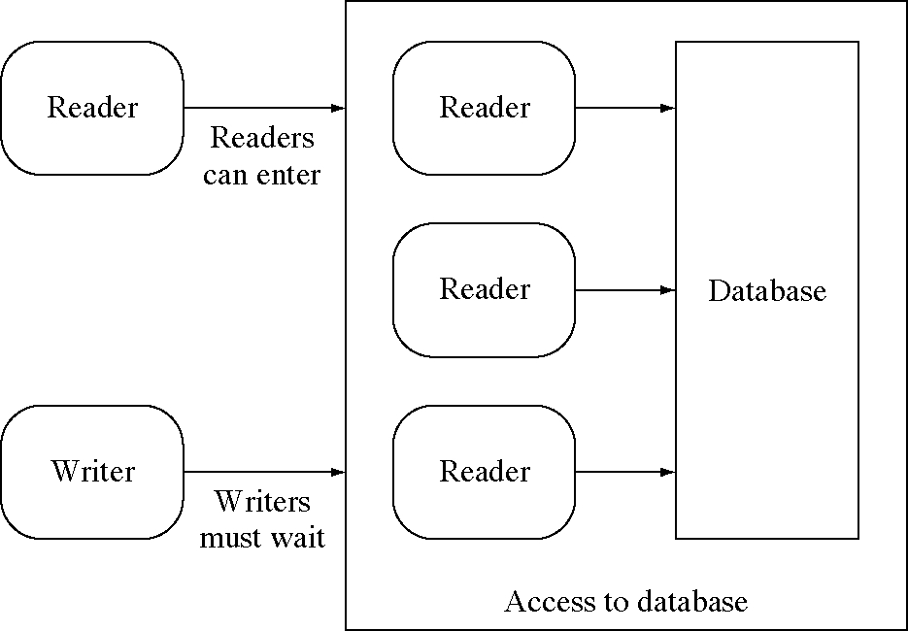
Readers-writers with active readers

Slide 41
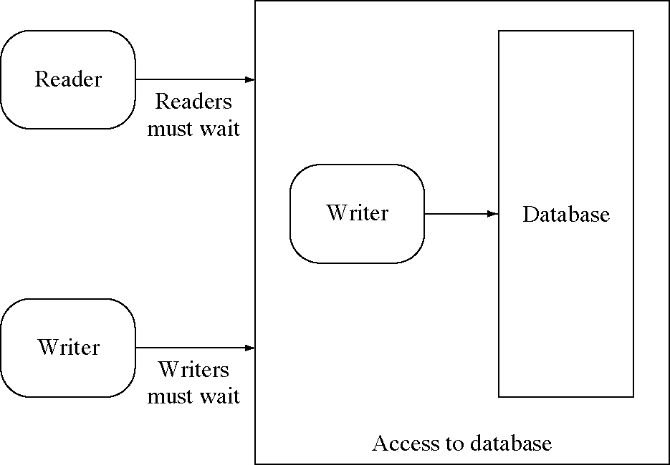
Readers-writers with an active writer

Slide 42
Reader
void main( int argc; char * argv[ ] ) {
// Get the id of the coordinator's message queue
int coordinator_queue
= AttachMessageQueue("/usr/queue/coord");
char qname[32];
// Figure out the name of my input queue
sprintf( qname, "/usr/queue/%s", GetPid() );
int my_queue = AttachMessageQueue( qname );
while( 1 ) {
DoOtherThings();
// Request permission to read the database.
SendMsgTo(coordinator_queue,
RequestToStartReading, my_queue);
// Wait for permission to begin reading.
WaitForEmptyMsg( my_queue );
ReadTheDatabase();
SendMsgTo( coordinator_queue, EndRead );
}
}

Slide 43
Writer
void main( int argc; char * argv[ ] ) { // A Writer
// Get the id of the coordinator's message queue.
int coordinator_queue
= AttachMessageQueue("/usr/queue/coord");
char qname[32];
sprintf( qname, "/usr/queue/%s", GetPid() );
// Get the name of my input queue and gets its id.
int my_queue = AttachMessageQueue( qname );
while( 1 ) {
DoOtherThings();
// Request permission to write the database.
SendMsgTo(coordinator_queue,
RequestToStartWriting,my_queue);
// Wait for permission to begin writing.
WaitForEmptyMsg( my_queue );
WriteTheDatabase();
SendMsgTo( coordinator_queue, EndWrite );
}
}

Slide 44
Database coordinator (1 of 3)
void main() { // only one coordinator in the system
int coordinator_queue
= AttachMessageQueue("/usr/queue/coord");
int NReaders = 0; Queue ReaderQueue;
int NWriters = 0; Queue WriterQueue;
int msg[MsgSize];
while( 1 ) { // server loop, handle requests
ReceiveMessage( coordinator_queue, msg );
switch( msg[0] ) {
case RequestToStartReading:
if( NWriters==0 && WriterQueue.Empty() ) {
// If there are no writers waiting or writing
// then this reader can start reading
++NReaders; // maintain reader count
SendMsgTo( msg[1], OkayToStartReading );
} else {
// otherewise, the reader has to wait.
ReaderQueue.Insert( msg[1] );
}
break;

Slide 45
Database coordinator (2 of 3)
case EndRead:
--NReaders; // maintain reader count
if( NReaders == 0 && !WriterQueue.Empty() ) {
// If there are no more readers and a writer
// is waiting then it gets to go.
++NWriters;
queue = WriterQueue.Remove();
SendMsgTo( queue, OkayToStartWriting );
}
break;
case RequestToStartWriting:
if( NReaders == 0 && NWriters == 0 ) {
// if there are no other readers or writers
// then this writer can proceed
++NWriters; // maintain writer count
SendMsgTo( msg[1], OkayToStartWriting );
} else {
// Otherwise it must wait
WritersQueue.Insert( msg[1] );
}
break;

Slide 46
Database coordinator (3 of 3)
case EndWrite:
--NWriters; // maintin writer count
if( !ReaderQueue.Empty() ) {
// A writer just went so now release all
// the readers to share the database
while( !ReaderQueue.Empty() ) {
queue = ReaderQueue.Remove();
SendMsgTo( queue, OkayToStartReading );
}
} else if( !WriterQueue.Empty() ) {
// If there are no readers then we can let
// a second writer go after the writer than
// just completed.
queue = WriterQueue.Remove();
SendMsgTo( queue, OkayToStartWriting );
}
break;
}
}
}

Slide 47
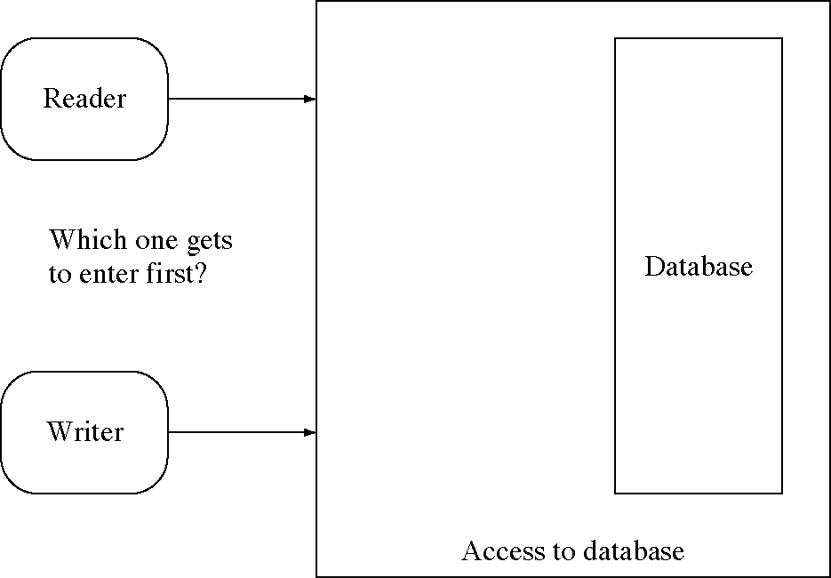
Reader or writer priority?

Slide 48
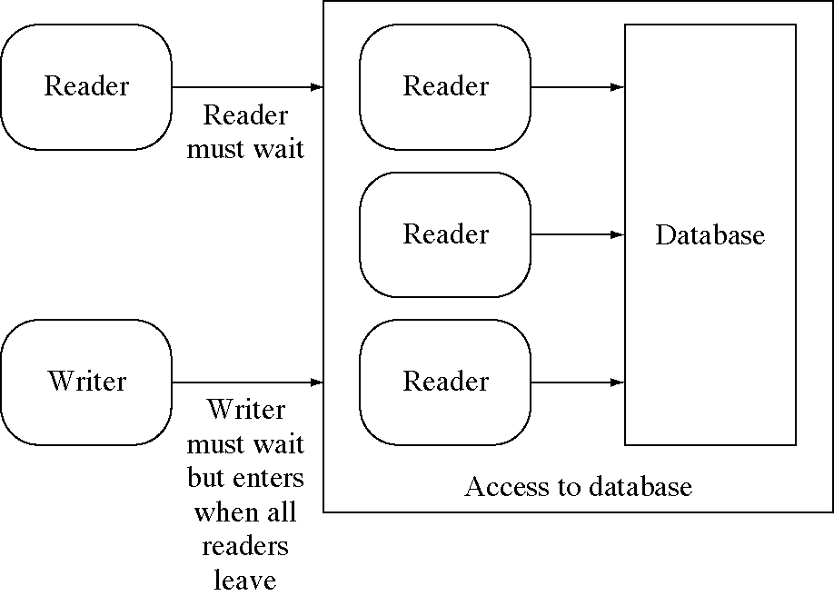
Should readers wait for waiting writer?

Slide 49
Design technique: Reusable patterns
Pattern: a typical problem with a solution
  a general problem that occurs more than once
  a solution that has been shown to work well
Examples
  IPC patterns: typical ways to use IPC
  Design patterns: typical arrangements of objects to solve common problems
  Frameworks: skeleton code to solve a class of problems

Slide 50
Failure of processes
All IPC patterns assume that processes do not fail at critical times
  but processes do fail, especially in networks
Complete solutions are hard
  but we can reduce the probability that a single process failure will cause the entire system to fail

Slide 51
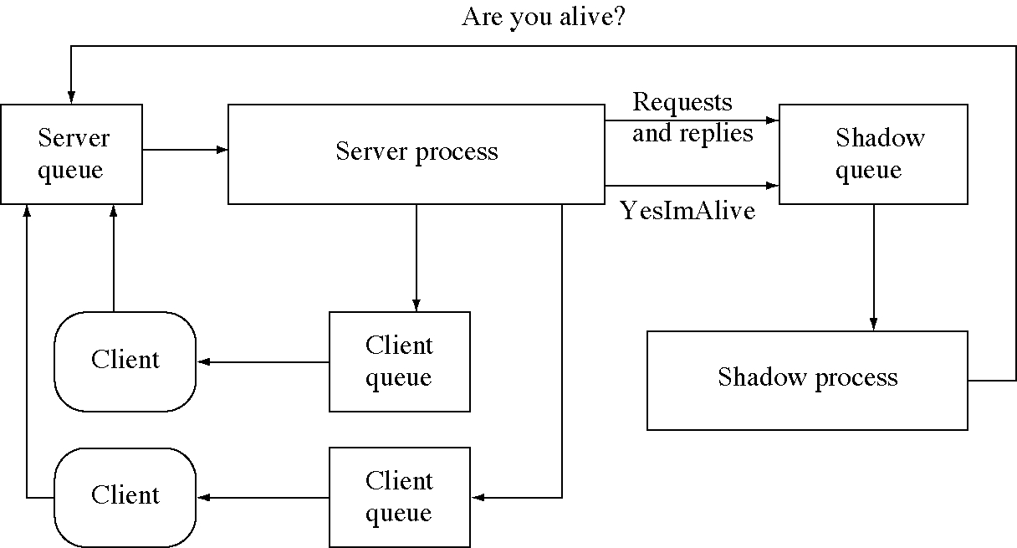
Fault-tolerant server system

Slide 52
Fault-tolerant server
void main() { // Client ... same as before }
void main() { // Server
int msg[MsgSize]; int server_queue
= AttachMessageQueue( "/usr/queue/server17" );
int shadow_queue
= AttachMessageQueue( "/usr/queue/shadow17" );
while( 1 ) { // Main server loop
ReceiveMessage( server_queue, msg );
// Forward a copy of requests to shadow process.
SendMsgTo( shadow_queue, msg );
switch( msg[0] ) {
case AreYouAlive:
SendMsgTo( shadow_queue, YesImAlive );
break;
case Service43:
// Get parameters, serve request
SendMsgTo( msg[1], responseData );
// Tell shadow process request is completed.
SendMsgTo( shadow_queue, msg[1] );
break;
// other cases are structured similarly
}
} }

Slide 53
Server’s shadow process (1 of 2)
void main() {
int msg[MsgSize]; int server_queue
= AttachMessageQueue( "/usr/queue/server17" );
int shadow_queue
= AttachMessageQueue( "/usr/queue/shadow17" );
int timer_queue
= AttachMessageQueue( "/usr/queue/timer" );
int timeout_pending = 0;
// Start the timer for the first watch interval.
SendMsgTo( timer_queue, shadow_queue,
CheckServer, WatchInterval );
while( 1 ) { // Main server loop
ReceiveMessage( shadow_queue, msg );
switch( msg[0] ) {
case CheckServer:
// see if the server is still alive.
SendMsgTo( server_queue, AreYouAlive );
// Wait TimoutInterval for a response.
SendMsgTo( timer_queue, TimeoutServer,
TimoutInterval );
timeout_pending = 1;
break;

Slide 54
Server’s shadow process (2 of 2)
case YesImAlive:
timeout_pending = 0;
break;
case TimeoutServer:
if( timeout_pending ) {
// We assume that the server had died and
// start another server and forward to it all
// the requests in the pending request table.
}
// Start another watch interval time out.
SendMsgTo(timer_queue, CheckServer, WatchInterval);
break;
default: // Otherwise it is about a request.
if( RequestFromClient() ) {
// Record request in pending request table.
} else if( ReplyByServer ) {
// Request was serviced so remove it from
// the pending request table.
}
break;
}
}}

