Slide 1
Processes
Chapter 8

Slide 2
Key concepts in chapter 8
Non-preemptive scheduling: first-come-first-served (or first-in-first-out), shortest-job-first, priority
Preemptive scheduling: round-robin, multiple round-robin queues
Policy versus mechanism
Deadlock and starvation
Remote procedure calls
Synchronization
Semaphores
Monitors

Slide 3
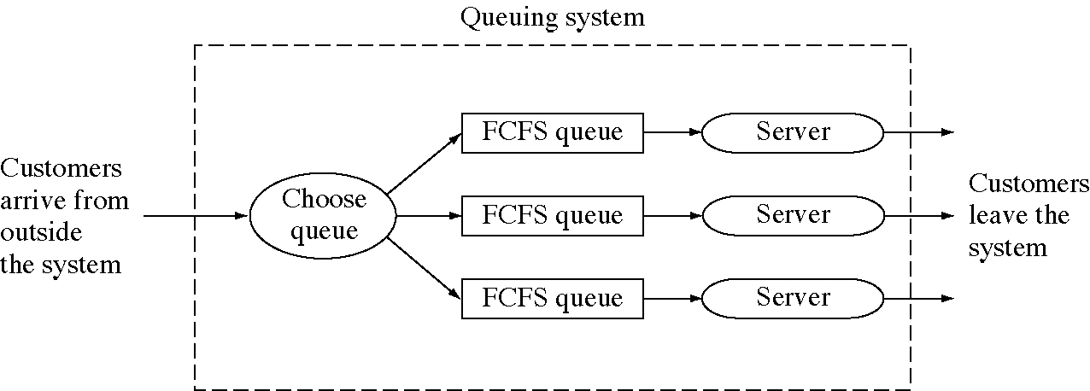
FCFS at the supermarket

Slide 4
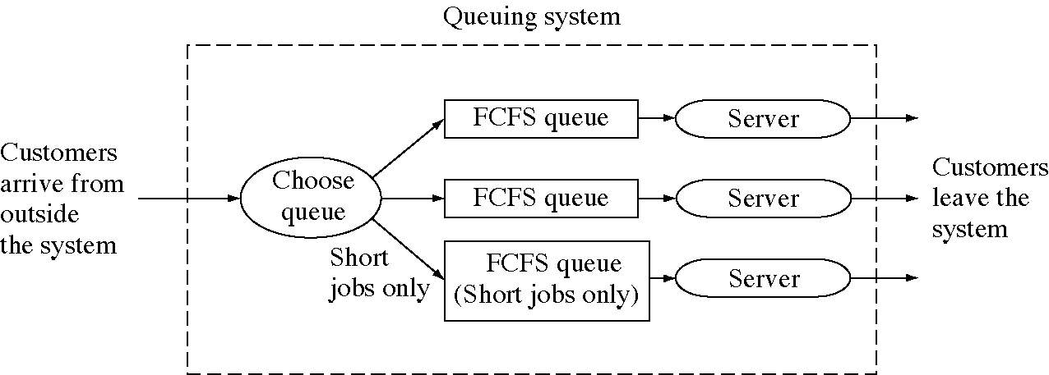
SJF at the supermarket

Slide 5
Everyday scheduling methods
First-come, first served
Shorter jobs first
Higher priority jobs first
Job with the closest deadline first
Round-robin

Slide 6
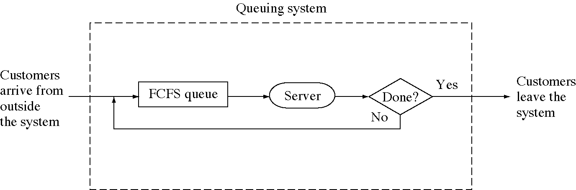
Round-robin scheduling

Slide 7
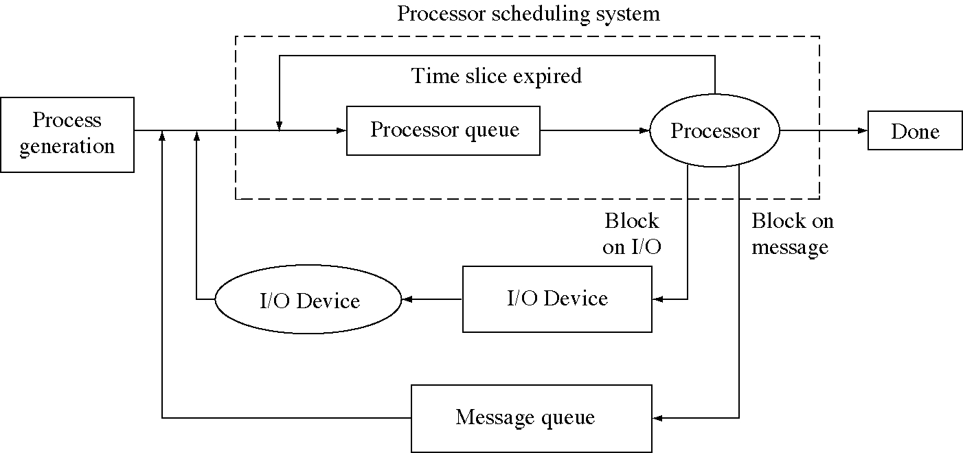
Process flow in an OS

Slide 8
Round-robin scheduling
Preemptive: processes lose the processor before they are finished using it
Time-slice or quantum: time of each turn
  5 to 100 milliseconds
  could be adaptive and change with the load
Performs poorly if the load is heavy

Slide 9
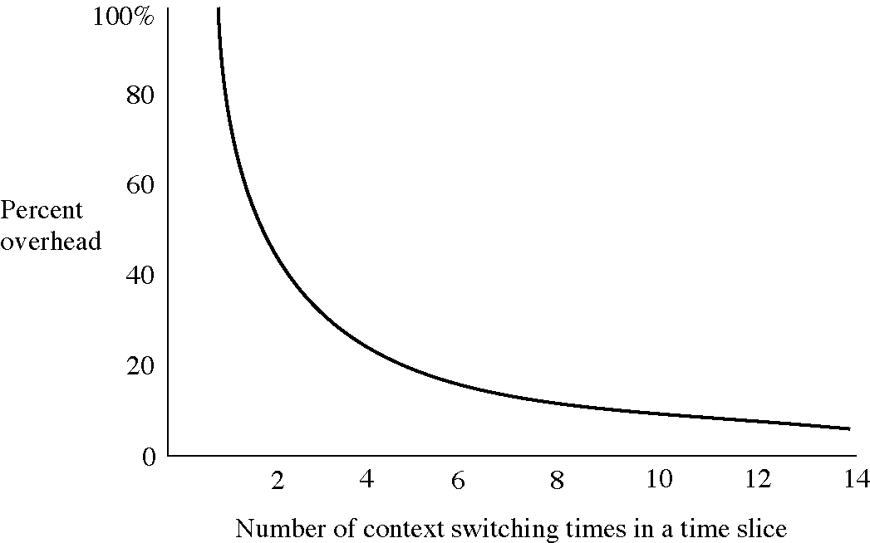
Round-robin time slice

Slide 10
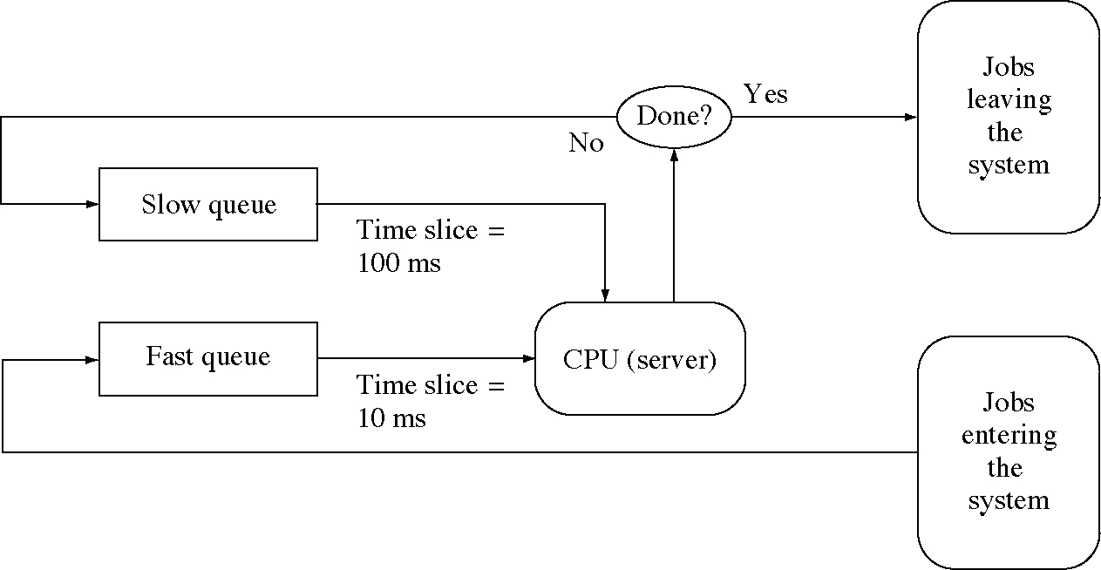
Two-queue scheduling

Slide 11
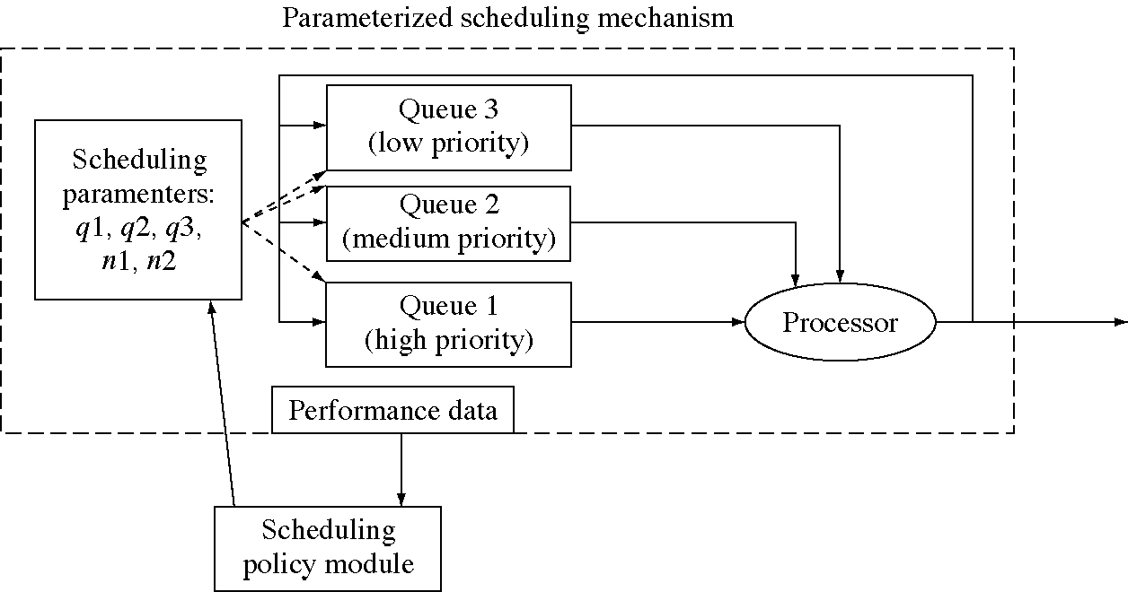
Three-queue scheduling

Slide 12
Policy and mechanism in scheduling
We can parameterize the three-queue scheduler
  and make it into a range of scheduling algorithms
Scheduling policy shifts through the day
  so schedulers should have settable parameters
  the scheduler is the mechanism

Slide 13
A scheduling example
Job 1, 10 seconds, priority 3
Job 2, 2 seconds, priority 2
Job 3, 5 seconds, priority 1
Job 4, 3 seconds, priority 4

Slide 14
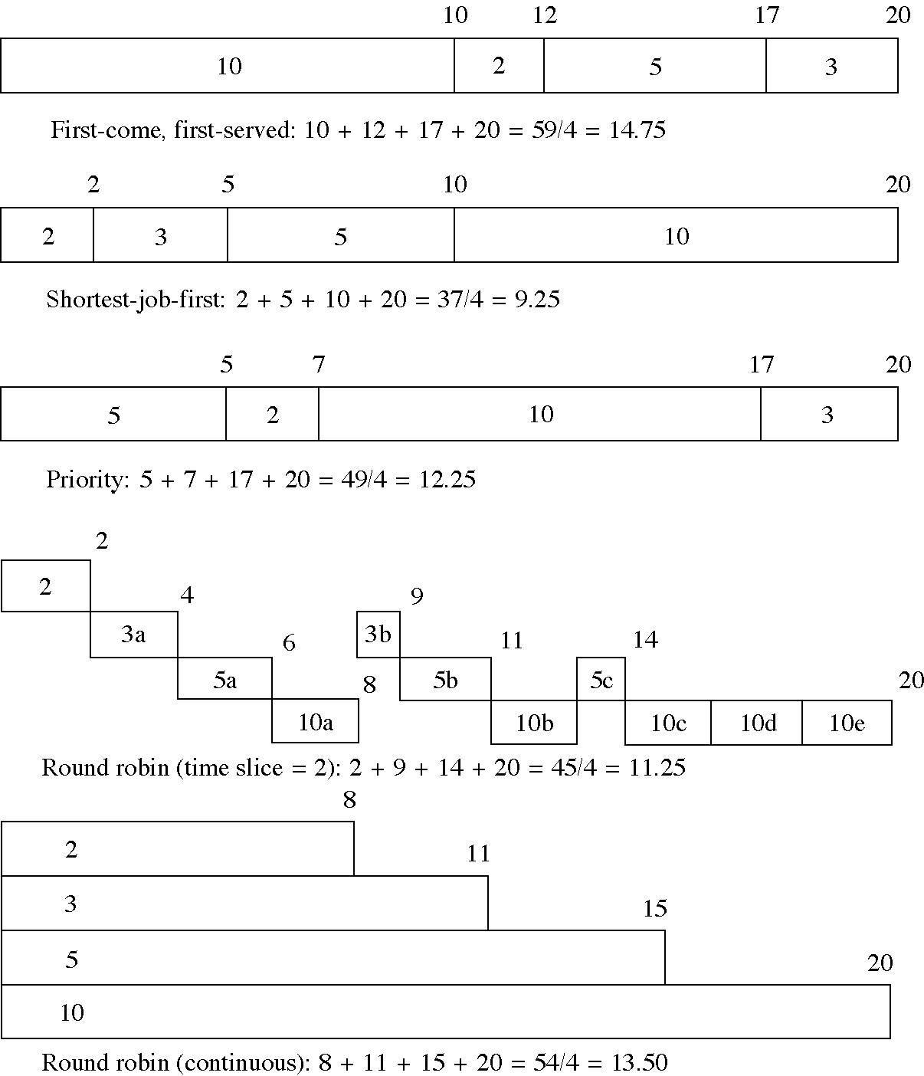
A scheduling example

Slide 15
Scheduling in real OSs
All use a multiple-queue system
UNIX SVR4: 160 levels, three classes
  time-sharing, system, real-time
Solaris: 170 levels, four classes
  time-sharing, system, real-time, interupt
OS/2 2.0: 128 level, four classes
  background, normal, server, real-time
Windows NT 3.51: 32 levels, two classes
  regular and real-time
Mach uses “hand-off scheduling”

Slide 16
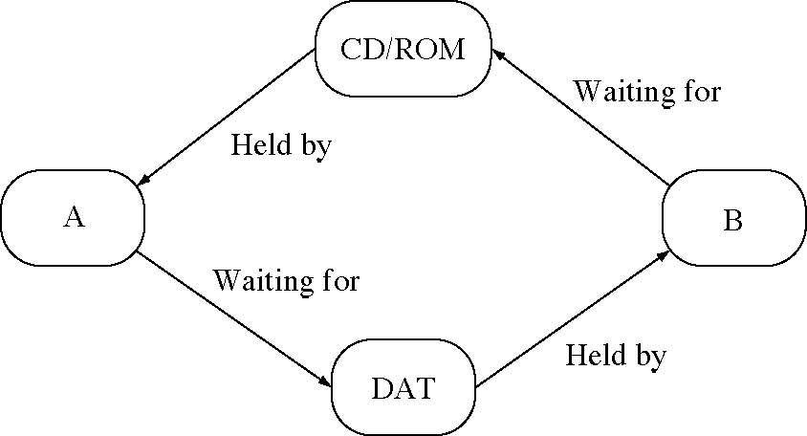
Two-process deadlock

Slide 17
Deadlock
When two or more processes are waiting for each other to finish using resources
This causes the system to come to a halt
Deadlock is a problem if you don’t take steps to prevent or detect it.
Message deadlock:
  ProcessA { receive(B, msg); send(B, msg): }
  ProcessB { receive(A, msg); send(A, msg): }
  Could result from a message being lost

Slide 18
Conditions for deadlock
Resources cannot be preempted.
Resources cannot be shared.
A process is holding one resource and requesting another.
Circular waits are possible.

Slide 19
Dealing with deadlock
Three solutions
  Prevention: place restrictions on resource request to make deadlock impossible
  Avoidance: plan ahead to avoid deadlock.
  Recovery: detect when deadlock occurs and recover from it

Slide 20
Deadlock prevention
Allow preemption
  this is not easy
Allow sharing
  sometimes you can create multiple, virtual copies of the resource
Avoid hold-and-wait
  require all resources to be acquired in one request
Avoid circular wait
  require resource to be acquired in a fixed order

Slide 21
Deadlock avoidance
There are algorithms for this
  e.g. the Banker’s algorithm
But the have problems
  they are slow
  they do not account for resource failure or loss

Slide 22
Deadlock recovery
The usual solution
There are algorithms to detect deadlock
  but they are slow
  timeouts are another solution

Slide 23
Two-phase locking
Each process has two stages
  Stage 1
    acquire all resources you will need
    if a resource is locked, then release all resources you are holding and start over
  Stage 2
    Use the resources
Deadlock is prevented (no hold-and-wait)

Slide 24
Starvation
When a process is unlucky and cannot get a resource it needs
  for example, in a random queue
  calling in to a number that is usually busy
Most common when you are requesting two resources together

Slide 25
Variations in message-passing
Using PIDs as message addresses
  less flexible than indirection through queues
Non-blocking receives
  if there is no message, receive returns an error
  more flexible but require busy waiting for a message
Blocking sends
  send, receive, reply model
  less flexible but avoids OS message buffering

Slide 26
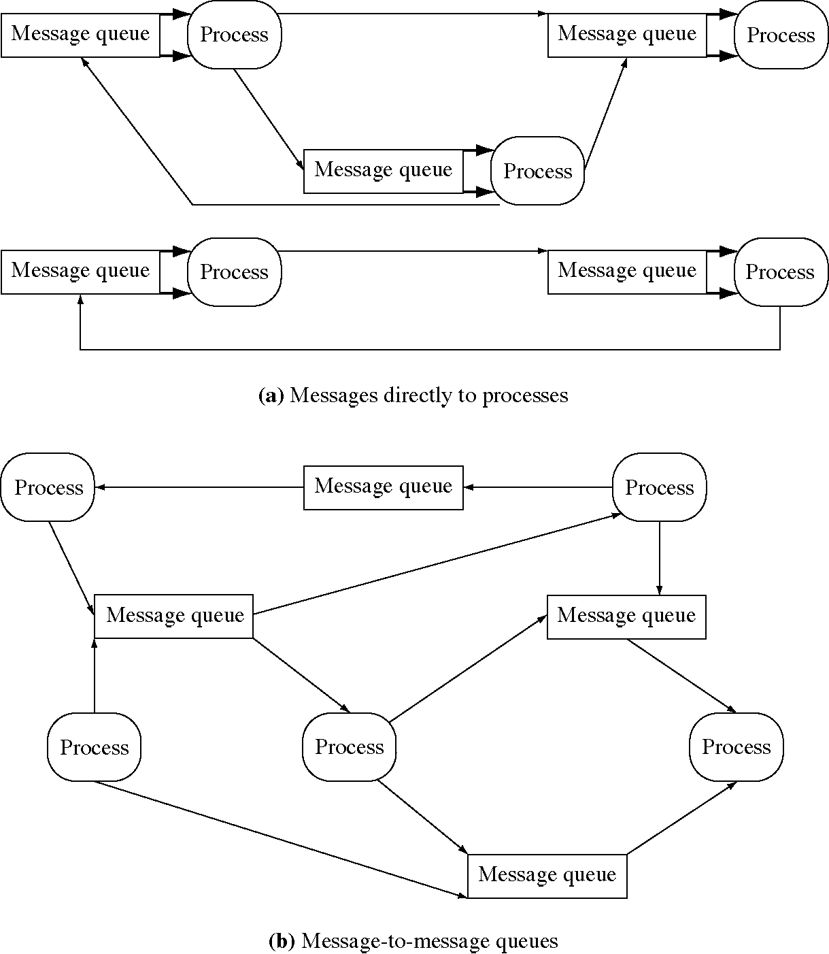
Addressing messages to processes

Slide 27
Design technique: Indirection
Indirection: going through an intermediate object to get to an object
Examples
  sending a message to a queue then another processes receives it from the queue
  access a private variable in an object using set and get functions
Advantage: you get control just before the object is accessed

Slide 28
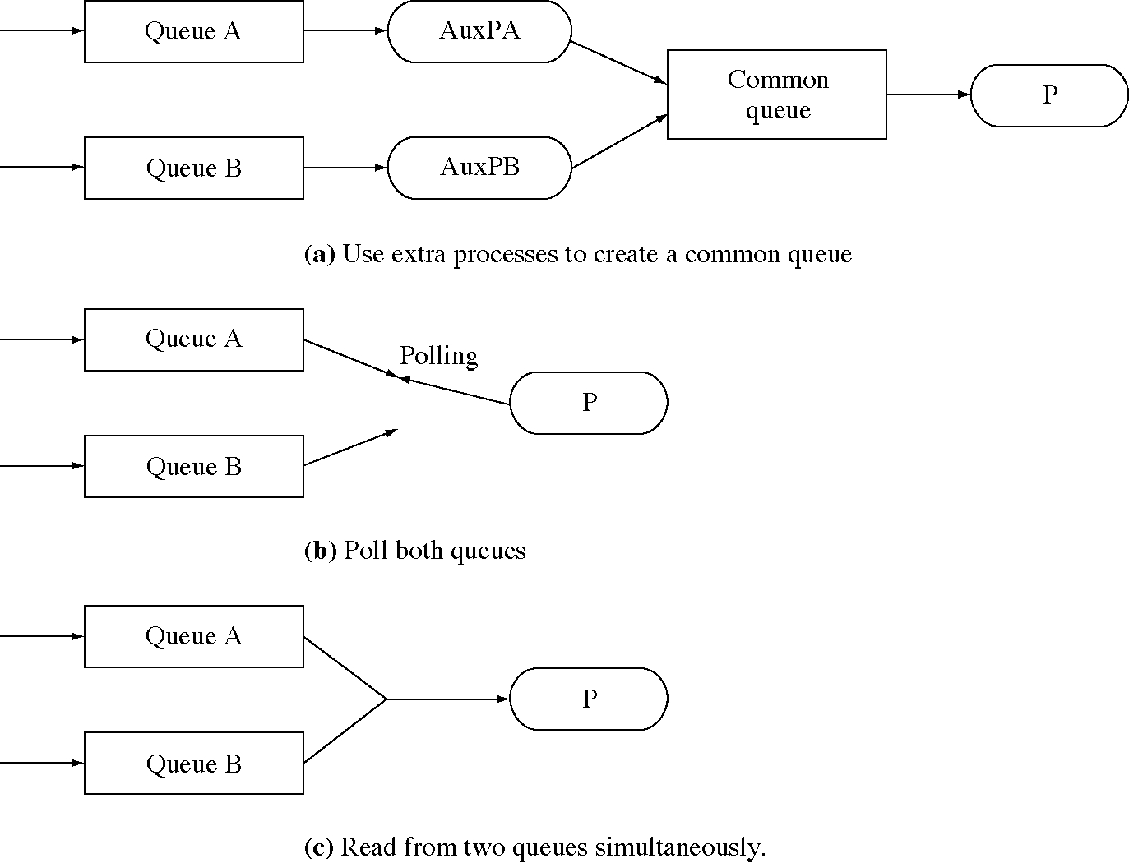
Monitoring two message queues simultaneously

Slide 29
Design technique: Adding a new facility
Three ways to do it
    Example: receiving from two messages queues
  1. use an existing facility
    create threads to listen on each queue
  2. create a new low-level primitive and use it
    add a non-blocking receive and poll with it
  3. create a new high-level primitive to do the job
    add a system call to receive from two queues

Slide 30
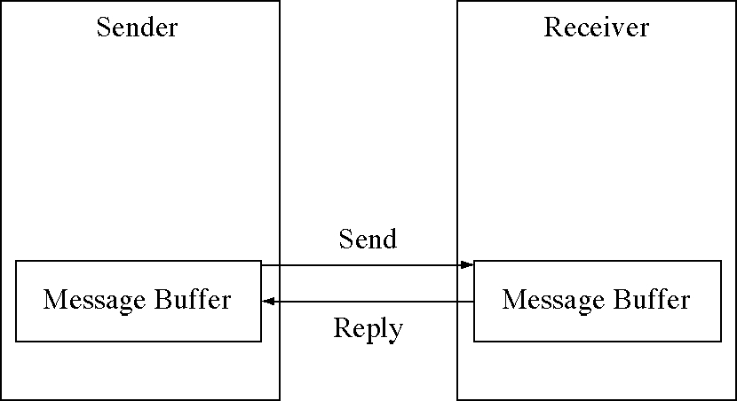
Send-receive-reply model

Slide 31
Remote procedure calls (RPCs)
Remote procedure call (or RPC)
  another IPC technique
  RPC uses the familiar procedure call model
Calling a procedure in another address space looks the same as calling a local procedure
Implemented with stubs

Slide 32
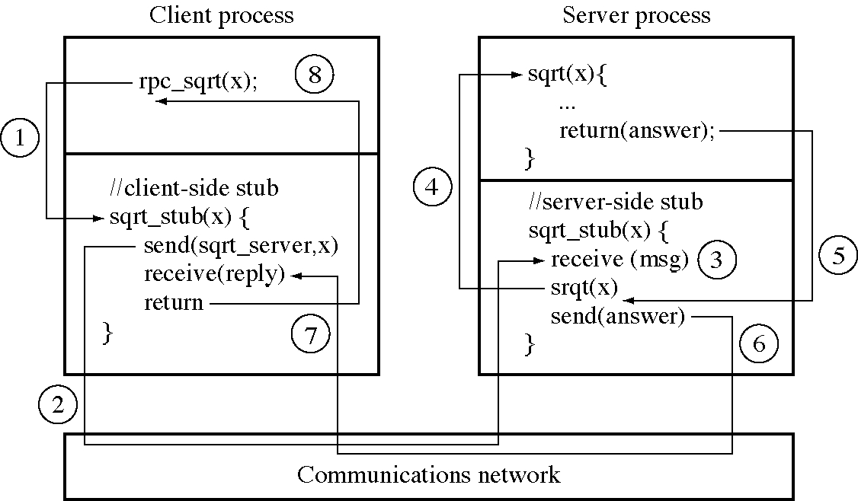
Remote procedure call flow of control

Slide 33
Implementing RPCs:
Client-side stub
retValue = RemoteService( arg1, arg2, arg3 );
// client-side "stub" procedure
int RemoteService( int arg1, int arg2, int arg3 ) {
MessageBuffer msg;
msg[0] = RemoteServiceCode;
msg[1] = arg1;
msg[2] = arg2;
msg[3] = arg3;
SendMessage( RemoteServer, msg );
ReceiveMessage( RemoteServer, msg );
return msg[1];
}

Slide 34
RPC implementation issues
An RPC is not really procedure call
  arguments must be by value (no pointers)
  server must be found
  server can fail
  messages can be lost
RPC libraries are provided to allow reuse of most of the RPC mechanism

Slide 35
Synchronization
Synchronization is processes (or threads) waiting for each other, basically signaling
In the OS we used various methods: disabling interrupts, spin locks, kernel-mode processes
In user processes we have seen only messages, which combine data transfer with synchronization, but they can be separated

Slide 36
Semaphores
Basic synchronization problems:
  mutual exclusion
  signaling
Semaphores are a shared-memory synchronization primitive that solves these two problems

Slide 37
Semaphore operations
int AttachSemaphore( int global_id)
  a global, numerical ID (global_id)
  it returns a local identifier for the semaphore
int Wait(int local_id)
  local_id from the AttachSemaphore
int Signal(int local_id)
int DetachSemaphore(int local_id)
  local_id from the AttachSemphore

Slide 38
Binary semaphore implementation
void Wait( int sema_id ) {
Semaphore * sema = GetSemaphoreFromId( sema_id );
Lock( sema->lock );
if( !sema->busy ) {
sema->busy = True;
} else {
sema->queue->Insert( current_process );
Block( current_process );
}
Unlock( sema->lock );
}
void Signal( int sema_id ) {
Semaphore * sema = GetSemaphoreFromId( sema_id );
Lock( sema->lock );
if( sema->queue->Empty() ) {
sema->busy = False;
} else {
process = sema->queue->Remove();
Unblock( process );
}
Unlock( sema->lock );
}

Slide 39
Two-process mutual exclusion
// This is the code for process A or B
void main( int argc, char * argv[ ] ) {
int mutex_sema = AttachSemaphore( FMutexID );
if( ThisIsProcessA() )
Signal( mutex_sema );
// Initialize the semaphore to not busy
while( 1 ) {
DoOtherThings();
// The critical section
Wait( mutex_sema );
UseFileF();
Signal( mutex_sema );
}
DetachSemaphore( mutex_sema );
}

Slide 40
Two-process rendezvous
void main(int argc,char *argv[]){ // Game player A
int a_sema = AttachSemaphore( GPAID );
int b_sema = AttachSemaphore( GPBID );
// Tell B that A is ready to go.
Signal( b_sema );
// Wait until B is ready to go.
Wait( a_sema );
DetachSemaphore( a_sema );
DetachSemaphore( b_sema );
}
void main(int argc,char *argv[]){ // Game player B
int b_sema = AttachSemaphore( GPBID );
int a_sema = AttachSemaphore( GPAID );
// Tell A that B is ready to go.
Signal( a_sema );
// Wait until A is ready to go.
Wait( b_sema );
DetachSemaphore( a_sema );
DetachSemaphore( b_sema );
}

Slide 41
Producer-consumer
Buffer buffer;
void main() { // The Producer
int empty_buffer = AttachSemaphore(EmptyBufferID);
int full_buffer = AttachSemaphore(FullBufferID);
while( 1 ) {
Wait( empty_buffer );
FillBuffer( buffer );
Signal( full_buffer );
}
DetachSemaphore(empty_buffer);
DetachSemaphore(full_buffer);
}
void main() { // The Consumer
int empty_buffer = AttachSemaphore(EmptyBufferID);
int full_buffer = AttachSemaphore(FullBufferID);
Signal( empty_buffer );
while( 1 ) {
Wait( full_buffer );
ConsumeBuffer( buffer );
Signal( empty_buffer );
}
DetachSemaphore( empty_buffer );
DetachSemaphore( full_buffer );
}

Slide 42
Counting semaphore implementation
void Wait( int sema_id ) {
Semaphore * sema = GetSemaphoreFromId( sema_id );
Lock( sema->lock );
if( sema->count > 0 ) --sema->count;
else {
sema->queue->Insert( current_process );
Block( current_process );
}
Unlock( sema->lock );
}
void Signal( int sema_id ) {
Semaphore * sema = GetSemaphoreFromId( sema_id );
Lock( sema->lock );
if( sema->queue->Empty() ) ++sema->busy;
else {
process = sema->queue->Remove();
Unblock( process );
}
Unlock( sema->lock );
}

Slide 43
N-buffer producer
Const int MaxBuffers = 20;
Queue<Buffer> buffer_queue;
void main() { // The Producer
int use_buffer_queue
= AttachSemaphore(UseBufferQueueID);
int empty_buffer = AttachSemaphore(EmptyBufferID);
int full_buffer = AttachSemaphore(FullBufferID);
Buffer buffer;
while( 1 ) {
FillBuffer( buffer );
Wait( empty_buffer );
Wait( use_buffer_queue );
buffer_queue.Insert( buffer );
Signal( use_buffer_queue );
Signal( full_buffer );
}
DetachSemaphore( use_buffer_queue );
DetachSemaphore( empty_buffer );
DetachSemaphore( full_buffer );
}

Slide 44
N-buffer consumer
void main() { // The Consumer
int use_buffer_queue
= AttachSemaphore( UseBufferQueueID );
int empty_buffer = AttachSemaphore(EmptyBufferID);
int full_buffer = AttachSemaphore(FullBufferID);
Buffer buffer;
Signal( use_buffer_queue ); // Buffer queue free
for( int i = 0; i < MaxBuffers; ++i )
Signal( empty_buffer );
while( 1 ) {
Wait( full_buffer );
Wait( use_buffer_queue );
buffer = buffer_queue.Remove();
Signal( use_buffer_queue );
Signal( empty_buffer );
ConsumeBuffer( buffer );
}
DetachSemaphore( use_buffer_queue );
DetachSemaphore( empty_buffer );
DetachSemaphore( full_buffer );
}

Slide 45
Semaphores and messages
Semaphores
  are basically messages with no content
  they handle synchronization only
  data are transferred in shared memory
Messages
  are more appropriate when there is no shared memory

Slide 46
System constants and globals
// system limits (we can change these)
const int NumberOfSemaphores = 50;
// system call numbers
const int AttachSemaphoreSystemCall = 8;
const int DetachSemaphoreSystemCall = 9;
const int SignalSemaphoreSystemCall = 10;
const int WaitSemaphoreSystemCall = 11;
// semaphore data structures
struct Semaphore {
int allocated;
int count;
int use_count;
int id;
Queue<Pid> queue;
};
Semaphore sema[NumberOfSemaphores];

Slide 47
System initialization
int main( void ) {
// ... all what we had before, plus
// initialize all semaphores to "not allocated”
for( i = 0; i < NumberOfSemaphores; ++i ) {
sema.allocated[i] = False;
}

Slide 48
System call handler (1 of 3)
case AttachSemaphoreSystemCall:
int sema_id; asm { store r9,sema_id }
pd[current_process].sa.reg[1]
= AttachSemaphore( sema_id );
break;
case DetachSemaphoreSystemCall:
int sid; asm { store r9,sid }
pd[current_process].sa.reg[1]
= DetachSemaphore( sid );
break;
case SignalSemaphoreSystemCall:
int sid; asm { store r9,sid }
pd[current_process].sa.reg[1]
= SignalSemaphore( sid );
break;
case WaitSemaphoreSystemCall:
int sid; asm { store r9,sid }
pd[current_process].sa.reg[1]
= WaitSemaphore( sid );
break;

Slide 49
System call handler (2 of 3)
case SendMessageSystemCall:
// get the arguments
int * user_msg; asm { store r9,user_msg }
int to_q; asm { store r10,to_q }
// check for an invalid queue identifier
if( !message_queue_allocated[to_q] ) {
pd[current_process].sa.reg[1] = -1;
break;
}
int msg_no = GetMessageBuffer();
// make sure we have not run out of message buffers
if( msg_no == EndOfFreeList ) {
pd[current_process].sa.reg[1] = -2;
break;
}
// copy the message vector from the system caller's
// memory into the system's message buffer
CopyToSystemSpace( current_process, user_msg,
message_buffer[msg_no], MessageSize );

Slide 50
System call handler (3 of 3)
// put it on the queue
message_queue[to_q].Insert( msg_no );
// notify any waiters that it is there
SignalSemaphore( message_semaphore[to_q] ); // NEW
pd[current_process].sa.reg[1] = 0;
break;
case ReceiveMessageSystemCall:
int * user_msg; asm { store r9,user_msg }
int from_q; asm { store r10,from_q }
// check for an invalid queue identifier
if( !message_queue_allocated[from_q] ) {
pd[current_process].sa.reg[1] = -1;
break;
}
WaitSemaphore( message_semaphore[from_q] ); // NEW
int msg_no = message_queue[from_q].Remove();
TransferMessage( msg_no, user_msg );
pd[current_process].sa.reg[1] = 0;
break;

Slide 51
Attach semaphore
int AttachSemaphore( int sema_id ) {
int i, free_slot = -1;
for( i = 0; i < NumberOfSemaphores; ++i )
if( sema[i].allocated ) {
if( sema[i].id == sema_id ) break;
else free_slot = I
}
if( i >= NumberOfSemaphores ) { // found sema_id?
if( free_slot == -1 ) // found free slot?
return -1; // No, so return an error code.
i = free_slot;
sema[i].allocated = True;
sema[i].count = 0;
sema[i].use_count = 0;
sema[i].id = sema_id;
sema[i].queue = new Queue<Pid>;
}
++sema[i].use_count;
return i;
}

Slide 52
Detach semaphore
int DetachSemaphore( int sid ) {
if( !sema[sid].allocated ) {
pd[current_process].sa.reg[1] = -1;
break;
}
if( --sema[sid].use_count == 0 ) {
sema[sid].allocated = False;
delete sema[sid].queue;
}
return 0;
}

Slide 53
Signal semaphore
int SignalSemaphore( int sid ) {
if( !sema[sid].allocated ) {
pd[current_process].sa.reg[1] = -1;
break;
}
if( sema[sid].queue->Empty() )
++sema[sid].count;
else {
int pid = sema[sid].queue->Remove();
pd[pid].state = Ready;
}
return 0;
}

Slide 54
Wait semaphore
int WaitSemaphore( int sid ) {
if( !sema[sid].allocated ) {
pd[current_process].sa.reg[1] = -1;
break;
}
if( sema[sid].count > 0 )
--sema[sid].count;
else {
sema[sid].queue->Insert(current_process);
pd[current_process].state = Blocked;
}
return 0;
}

Slide 55
System initialization
processTableSemaphore
= AttachSemaphore( ProcessTableID );
disk_queue = AttachSemaphore( DiskQueueID);
disk_free = AttachSemaphore( DiskFreeID );

Slide 56
Dispatcher
int SelectProcessToRun( void ) {
static int next_proc = NumberOfProcesses;
int i, return_value = -1;
// Get exclusive access to the process table.
WaitSemaphore(processTableSemaphore); // NEW
// ... use process table as before
SignalSemaphore(processTableSemaphore); // NEW
return return_value;
}

Slide 57
Disk I/O
void DiskIO( int command, int disk_block,
char * buffer ) {
// Create a new disk request
// and fill in the fields.
DiskRequest * req = new DiskRequest;
req->command = command;
req->disk_block = disk_block;
req->buffer = buffer;
req->semaphore = pd[current_process].semaphore;
// Then insert it on the queue.
disk_queue.Insert( req );
// Wake up the disk scheduler if it is idle.
SignalSemaphore( disk_queue );
WaitSemaphore( pd[current_process].semaphore );
}

Slide 58
Disk scheduling
void RealScheduleDisk( void ) {
while( 1 ) { // NEW CODE
WaitSemaphore( disk_free ); // NEW CODE
WaitSemaphore( disk_queue ); // NEW CODE
// Get the first disk request
// from the disk request queue.
DiskRequest * req = disk_queue.RemoveFirst();
// remember which process is waiting
// for the disk operation
disk_completion_semaphore = req->semaphore;
// issue the read or write,
// with disk interrupt enabled
if( req->command == DiskReadSystemCall )
IssueDiskRead(req->disk_block,req->buffer,1);
else
IssueDiskWrite(req->disk_block,req->buffer,1);
}
}

Slide 59
Disk interrupt handler
void DiskInterruptHandler( void ) {
if( current_process > 0 ) {
// was there a running process?
// Save the processor state of the system caller.
// ... as before
}
// Notify the waiting process that
// the disk transfer is complete
SignalSemaphore( disk_completion_semaphore );
// Notify any waiters that the disk is free
SignalSemaphore( disk_free );
// now run a process
Dispatcher();
}

Slide 60
Monitors
Another synchronization primitive
  more structured, monitors are modules
Components of a monitor module
  variables: of any kind
  condition variables: for monitor signaling
  procedures: can be called from outside the monitor, they comprise the monitor’s interface

Slide 61
Counter monitor
monitor Counter {
private:
int count = 0;
public:
void Increment( void ) { count = count + 1; }
int GetCount( void ) { return count; }
}
int main() { // one process
while( 1 ) {
// ... Do other things
Counter.Increment();
// ... continue on
int n = Counter.GetCount();
}
}
int main() { // another process
while( 1 ) {
// ... Do other things
Counter.Increment();
}
}

Slide 62
Signal monitor
monitor Signal {
private:
int IsSignaled = 0;
condition SendSignal;
public:
void SendSignal( void ) {
IsSignaled = 1;
signal( SendSignal );
}
void WaitForSignal( void ) {
if( !IsSignaled )
wait( SendSignal );
}
}
}

Slide 63
Using the signal monitor
int main() { // the Signal Sender
// ... Do things up to the signal point
Signal.SendSignal();
// ... continue on
}
int main() { // the Signal Receiver
// ... Do things up to the signal point
Signal.WaitForSignal();
// ... continue on when the signal is receive
}

Slide 64
Bounded buffer monitor (1 of 2)
monitor BoundedBufferType {
private:
BufferItem * buffer;
int NumberOfBuffers;
int next_in, nextout;
int current_size;
condition NotEmpty, NotFull;
public:
BoundedBufferType( int size ) {
buffers = new BufferItem[size];
NumberOfBuffers = size;
next_in = 0; next_out = 0; current_size = 0;
}

Slide 65
Bounded buffer monitor (2 of 2)
void Put( BufferItem item ) {
if( current_size == NumberOfBuffers )
wait( NotFull );
buffer[next_in] = item;
next_in = (next_in+1) % NumberOfBuffers;
if( ++current_size == 1 )
signal( NotEmpty );
}
BufferItem Get( void ) {
if( current_size == 0 )
wait( NotEmpty );
BufferItem item = buffer[next_out];
next_out = (next_out+1) % NumberOfBuffers;
if( --current_size == NumberOfBuffers-1 )
signal( NotFull );
return item;
}
}

Slide 66
Using a bounded buffer monitor
BoundedBufferType BoundedBuffer;
int main() { // the Producer
while( 1 ) {
BufferItem item = ProduceItem();
BoundedBuffer.Put( item );
}
}
int main() { // the Consumer
while( 1 ) {
BufferItem item = BoundedBuffer.Get();
ConsumeItem( item );
}
}

Slide 67
Counting semaphore monitor
monitor Semaphore {
private:
int count = 0;
condition NotBusy;
public:
void Signal( void ) {
if( ++count > 0 )
signal( NotBusy );
}
void Wait( void ) {
while( count <= 0 )
wait( NotBusy );
--count;
}
}

Slide 68
Using a semaphore monitor
int main() { // one process
while( 1 ) {
// do other stuff
// enter critical section
Semaphore.Wait();
// do critical section
Semaphore.Signal();
}
}
int main() { // another process
while( 1 ) {
// do other stuff
// enter critical section
Semaphore.Wait();
// do critical section
Semaphore.Signal();
}
}

Slide 69
Protected counter in Ada95
-- declare the interface to the task
task Counter is
entry GetCount( count : out integer );
entry Increment;
private
count : integer;
end Counter;
-- the implementation of the protected variable
task body Counter is
loop
select
accept GetCount( count_out : out integer ) do
count_out := count;
end;
or
accept Increment do
count := count + 1;
end;
end select;
end loop;
end Counter;

Slide 70
Using a protected counter
task body OneProcess is begin
loop
-- do other things than incrementing the counter
Counter.Increment;
-- do other things
Counter.GetCount( n );
end loop;
end OneProcess;
task body AnotherProcess is begin
loop
-- do other things than incrementing the counter
Counter.Increment;
-- do other things
end loop;
end AnotherProcess;

Slide 71
Signal in Ada95
task Signal is
entry SendSignal;
entry WaitForSignal;
private
IsSignaled : boolean := False;
end Counter;
task body Signal is
accept SendSignal do
IsSignaled := True;
end;
accept WaitForSignal do
null;
end;
end Signal;

Slide 72
Using signal in Ada95
task body SignalSender is begin
-- get to point where event occurs
Signal.SendSignal;
-- go on to other things
end SignalSender;
task body SignalReceiver is begin
-- get to the point where you need
-- to wait for the event
Signal.WaitForSignal;
-- respond to event
end SignalReceiver;

Slide 73
Bounded buffer in Ada95 (1 of 2)
task BoundedBuffer is
entry Put( x : in Item );
entry Get( x : out Item );
end BoundedBuffer;
task body BoundedBuffer is
NumberOfBuffers : constant integer := 20;
buffers : array(1 .. NumberOfBuffers) of Item;
current_size :
integer range 0 .. NumberOfBuffers := 0;
next_in, next_out
: integer range 1 .. NumberOfBuffers := 1;

Slide 74
Bounded buffer in Ada95 (2 of 2)
begin
loop
select
when current_size < NumberOfBuffers =>
accept Put( x : in item ) do
buffers( next_in ) := x;
end;
next_in := (next_in mod NumberOfBuffers) + 1;
current_size := current_size + 1;
or when current_size > 0 =>
accept Get( x : out Item do
x := buffers(next_out);
end;
next_out := (next_out mod NumberOfBuffers)+1;
current_size := current_size - 1;
or
terminate;
end select;
end loop;
end BoundedBuffer;

Slide 75
Producer-consumer in Ada95
task body Producer is begin
loop
item := ProduceItem;
BounderBuffer.Put( item );
end loop;
end Producer;
task body Consumer is begin
loop
BounderBuffer.Get( item );
ConsumeItem( item );
end loop;
end Consumer;

Slide 76
Semaphore in Ada95
CountingSemaphore( StartCount : Integer := 1 ) is
entry Wait;
entry Signal;
entry Count( count_out : out integer );
private
CurrentCount : Integer := StartCount;
end CountingSemaphore;
task body CountingSemaphore is begin
loop
select
when CurrentCount > 0 =>
accept Wait do
CurrentCount := CurrentCount - 1;
end;
or
accept Signal do
CurrentCount := CurrentCount + 1;
end;
or
accept Count( count_out : out integer ) do
count_out := CurrentCount;
end;
end select;
end loop;
end CountingSemaphore;

Slide 77
Protected counter in Ada95 using protecting variables
-- the interface to the protected variable
protected Counter is
function GetCount return integer;
procedure Increment;
private
count : integer;
end Counter;
-- the implementation of the protected variable
protected body Counter is
function GetCount return integer is begin
return count;
end GetCount;
procedure Increment is begin
count := count + 1;
end Increment;
end Counter;

Slide 78
Using a protected counter
task body OneProcess is begin
loop
-- do other things than incrementing the counter
Counter.Increment;
-- do other things
n := Counter.GetCount;
end loop;
end OneProcess;
task body AnotherProcess is begin
loop
-- do other things than incrementing the counter
Counter.Increment;
-- do other things
end loop;
end AnotherProcess;

Slide 79
Signaling in Ada95 using protected variables
protected Signal is
procedure SendSignal;
entry WaitForSignal;
private
IsSignaled : boolean := False;
end Signal;
protected body Signal is
procedure SendSignal is begin
IsSignaled := True;
end SendSignal;
entry WaitForSignal when IsSignaled is begin
null;
end WaitForSignal;
end Signal;

Slide 80
Using signals in Ada95
task body SignalSender is begin
-- get to point where event occurs
Signal.SendSignal;
-- go on to other things
end SignalSender;
task body SignalReceiver is begin
-- get to the point where you need to wait
-- for the event
Signal.WaitForSignal;
-- respond to event
end SignalReceiver;

Slide 81
Bounder buffer in Ada95
protected type BoundedBuffer is
entry Put( x : in Item );
entry Get( x : out Item );
private
buffers : ItemArray(1..NumberOfBuffers);
next_in, next_out
: integer range 1..NumberOfBuffers := 1;
current_size
: integer range 0..NumberOfBuffers := 0;
end BoundedBuffer;
protected body BoundedBuffer is
entry Put( x : in Item )
when current_size < NumberOfBuffers is begin
buffers(next_in) := x;
next_in := (next_in mod NumberOfBuffers) + 1;
current_size := current_size + 1;
end Put;
entry Get( x : out Item )
when current_size > 0 is begin
x := buffers(next_out);
next_out := (next_out mod NumberOfBuffers) + 1;
current_size := current_size - 1;
end Get;
end BoundedBuffer;

Slide 82
Producter-consumer in Ada95
task body Producer is begin
loop
item := ProduceItem;
BounderBuffer.Put( item );
end loop;
end Producer;
task body Consumer is begin
loop
BounderBuffer.Get( item );
ConsumeItem( item );
end loop;
end Consumer;

Slide 83
Counting semaphore in Ada95 using protected variables
protected type
CountingSemaphore( StartCount : Integer := 1 ) is
entry Wait;
procedure Signal;
function Count return Integer;
private
CurrentCount : Integer := StartCount;
end CountingSemaphore;
protected body CountingSemaphore is
entry Wait when CurrentCount > 0 is begin
CurrentCount := CurrentCount - 1;
end Wait;
procedure Signal is begin
CurrentCount := CurrentCount + 1;
end Signal;
function Count return Integer is begin
return CurrentCount;
end Count;
end CountingSemaphore;

Slide 84
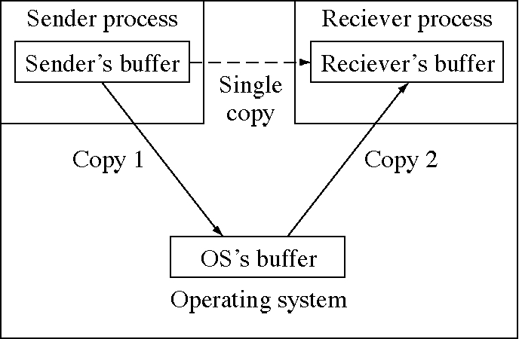
Copying messages in an OS

Slide 85
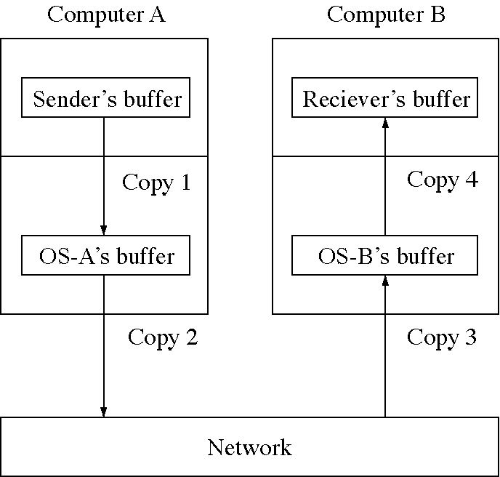
Copying messages in a network

Slide 86
Longer messages
Eight words is too small
Paging (chapter 11) will allow us to pass long messages with no copying

Slide 87
IPC in Mach
Task: Mach terminology for process
Thread: execute in a task
Port: a message queue
  only one receiver
  protected with access rights and capabilities
Message: contains three types of information
  data: any number of bytes, copied
  out-of-line-data: part of the sender’s address space, not copied
  ports

Slide 88
Signals
Used in UNIX system for IPC
An event notification
  30 or so fixed signal (event) types
Basically a software interrupt
  process defines the interrupt handler

