Slide 1
Design Techniques II
Chapter 9

Slide 2
Key concepts in chapter 9
Indirection
State machines
Win big, then give some back
Separation of concepts
Reducing a problem to a special case
Reentrant programs
Using models for inspiration
Adding a facility to a system

Slide 3
Design technique: Indirection
Access an object indirectly, through a third object
This allows you to gain control whenever an access occurs
  access becomes an event to which you can attach actions

Slide 4
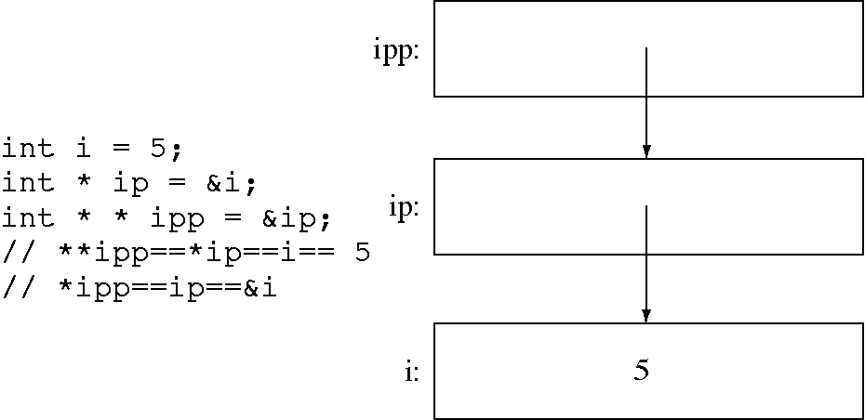
Indirection in C++

Slide 5
Indirection in text formatting
Direct formatting: attach formats (e.g., bold, italics, font, etc.) to the text directly
Indirect formatting: attach a formatting code to each character of the text, then attach formats to each formatting code
  the formatting code is the logical formatting
  the formats attached to the formatting code is the physical formatting.

Slide 6
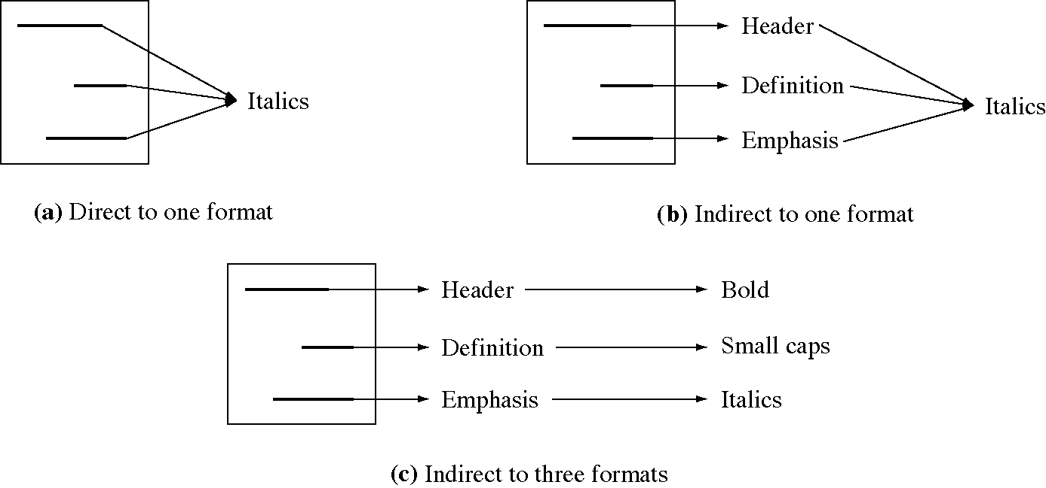
Indirect formatting

Slide 7
Indirection in OSs
Message queues
Initial process
RPC implementation (with stubs)
Implementing “shared memory” with page faults
Dynamic loading
Character generator memory

Slide 8
Indirection in CS
Two-level implementations
Access private data in an object
Memory management
Sorting large objects
Passing parameters by reference
Defined constants

Slide 9
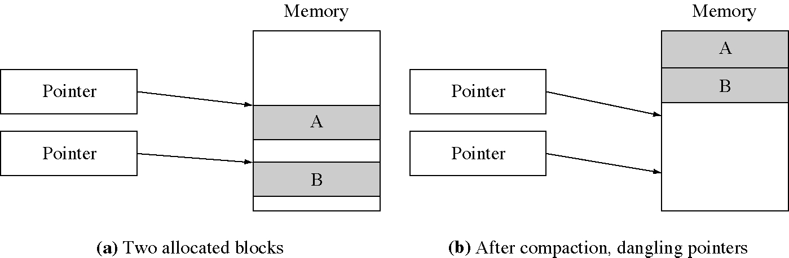
Dangling pointers after compaction

Slide 10
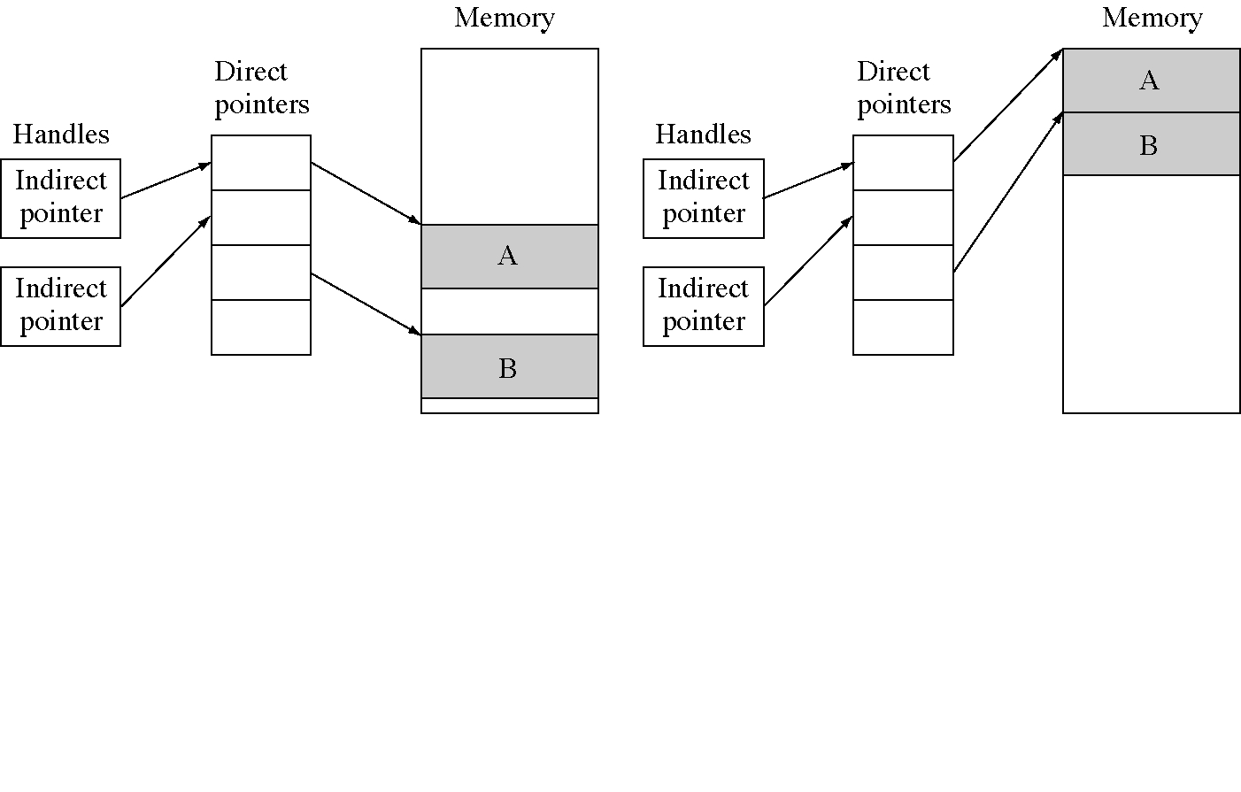
Indirection using memory handles

Slide 11
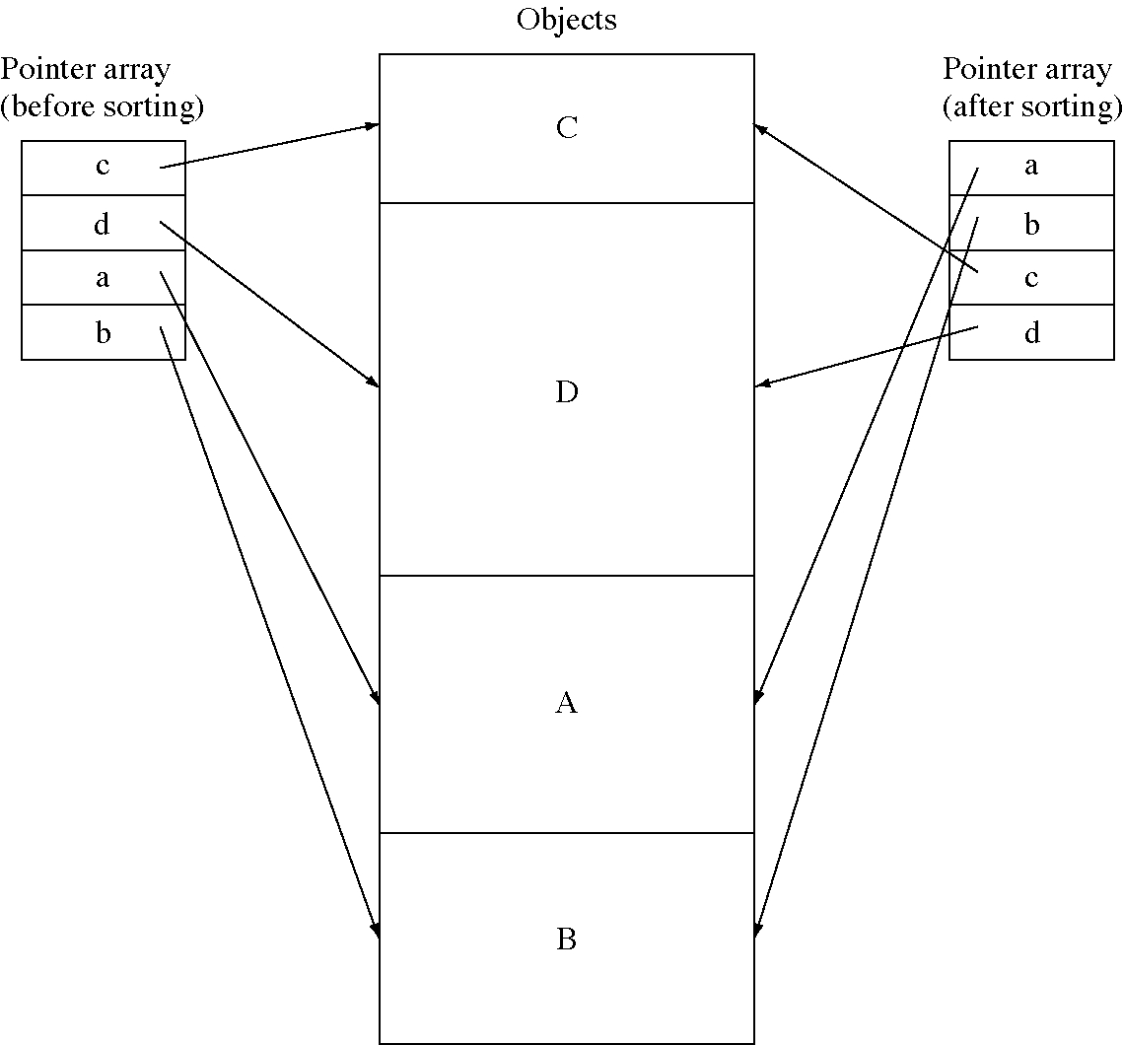
Sorting using indirection

Slide 12
Indirection examples
Source object Reference Indirect object Reference Desired object
  Process Send Message queue Receive Process
  OS Create by hand Initial process Create Processes
  Client process RPC call RPC client stub Server RPC Server process
  Process Memory ref. Indirect pointer Memory ref. Data object
  Statement Name Symbolic constant Table lookup Value
  Characters Name Abstract style Style sheet Concrete format

Slide 13
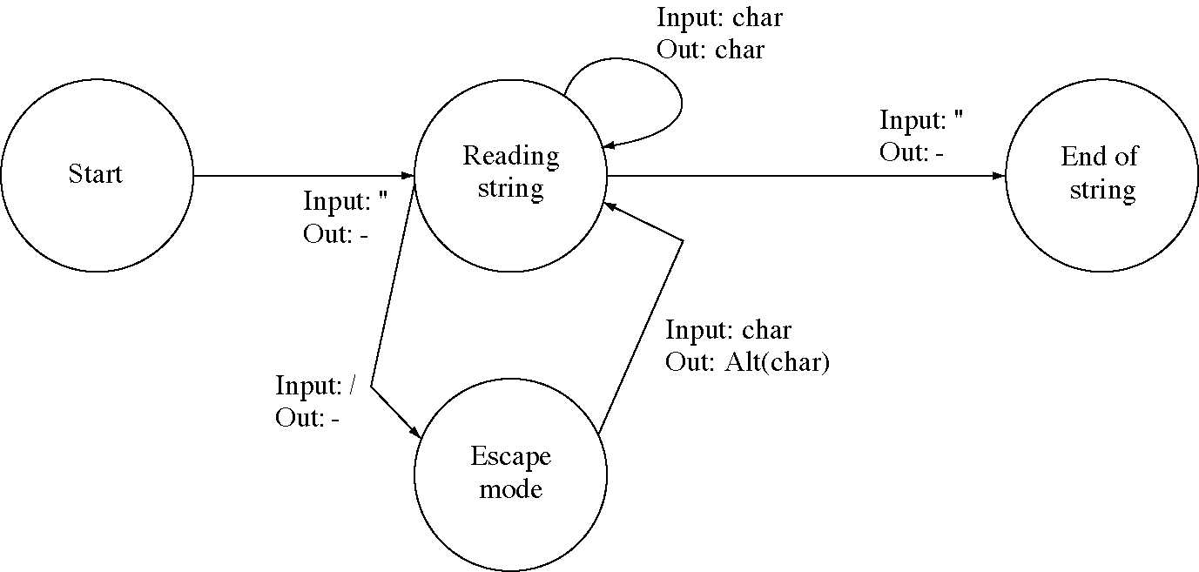
State machine

Slide 14
Design technique: State machines
State machines (a.k.a. state diagrams) are an effective way to represent information
  but they are only good for state-transition oriented systems
Good visual representations are powerful
We have seen process state diagrams

Slide 15
Design technique:
Win big, then give some back
Some techniques produce huge gains in speed or space used
  but the lose some useful property
  Example: video compression
But, often we can give up some of the gains to regain the property

Slide 16
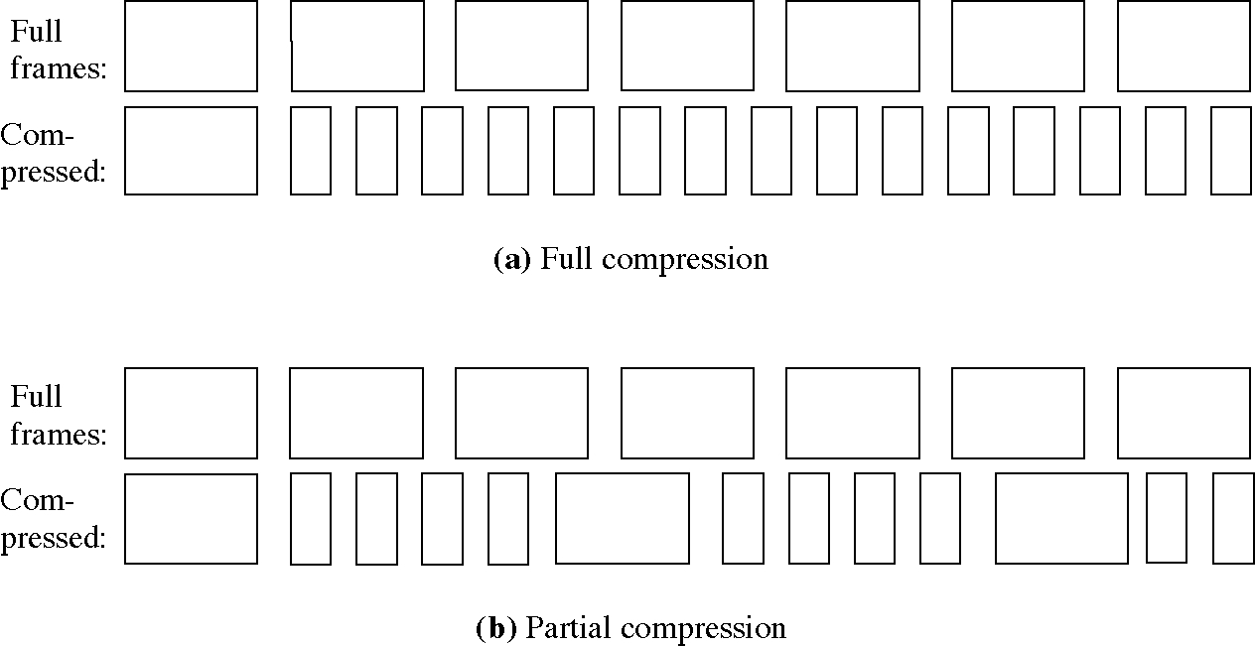
Video compression

Slide 17
OS examples
Shortest-response-ratio-next (SRN) scheduling
  Shortest-job-first minimizes average wait time
    but penalized long jobs too much
  SRN has a very good average wait time (short jobs run quickly) but does not penalize long job so much
Multiprogramming
  increases system efficiency but introduces parallelism and hence race conditions
  Mono-programming in critical section solves that problem
    we lose some parallelism but regain correctness

Slide 18
Design technique:
Separation of concepts
Often the first version of an idea combines two concepts
  e.g. processes = threads + resource holding
Separation of the concepts allows them to be used independently
  smaller building blocks
  so they are more flexible

Slide 19
OS examples
Process = thread + resource holder
Create process = fork + exec
Messages = synchronization + information transfer

Slide 20
Design technique: Reducing a problem to a special case
Motivation
  Implement mutual exclusion with semaphores
    general mutual exclusion for any length of time
  But we need mutual exclusion in the OS to implement semaphores
    special mutual exclusion: only a few machine instructions so busy waiting to acceptable

Slide 21
OS examples
Mutual exclusion
Process blocking: OS does it but then we have to blocking OS system calls
Name servers: expensive to broadcast for names in a network but once we find the name server it can resolve names for us
Unique global names: use hierarchy so we only have to generate locally unique names

Slide 22
CS examples
Help systems: it is hard to remember how to use all the commands but if you can remember how to use the “help” command it can tell you about the others
Text editor data structures:
  sequential characters is time-inefficient
  a linked list of characters is space-inefficient
  but a linked list of line pointers to lines of sequential characters is reasonable efficient

Slide 23
Design technique:
Reentrant programs
Two threads can execute the same code simultaneously
  so the shared global data is a problem
Programs with embedded data are not reentrant, also called not thread-safe
We make them reentrant by removing the embedded data and allocating it for each execution
  data is accessed through a pointer

Slide 24
Non-reentrant and reentrant browsers
// Browser using global variables
WindowID wBrowser;
char *wCurrentDirectory;
void redrawWindow( void ) {
char ** list = GetFileList( wCurrentDirectory );
UpdateListBox( wBrowser, list );
}
// Broswer using a state structure
typedef struct browserStruct {
WindowID browserID;
char *currentDirectory
} Browser;
void redrawWindow( Browser * browser ) {
char ** list
= GetFileList( browser->currentDirectory );
UpdateListBox( browser->browserID, list );
}

Slide 25
Examples
Embedded data in threaded programs
Embedded data in an OS
MS/DOS: most versions are not reentrant
Object-oriented programming languages
  Each object’s data area is allocated from the free store (the heap) so they are automatically thread-safe

Slide 26
Design technique:
Using models for inspiration
A model is a representation of a system: an equation, a clay model, a simulation, etc.
For the model to predict or prove something about the system the model must be validated to give evidence that it is accurate
But a model can also be used to generate ideas about things that might be true in the system or useful
  The ideas are validated in the system
  so there is no necessity to validate the model

Slide 27
Examples
We used computer hardware models to give us ideas about processes and threads
File I/O can be based on the disk model or the tape model
Blackboard architectures are based on the model of experts sharing a blackboard
Some people have used the economic market model for processor scheduling

Slide 28
Design technique:
Adding a new function to a system
Three ways to add a new function
  1. Use an existing facility to build the new function
  2. Add a new low-level primitive function and use it to build the new function
  3. Add a new high-level function that does exactly what you want
All solutions fit into one of these categories
  often there are several solutions in a category

Slide 29
OS Examples
Receiving from two message queues
  1. Use processes or threads to do the waiting
  2. Add a non-blocking receive and poll
  3. Add a receive from two queues
Implementing mutual exclusion
  1. Use the disable interrupts function
  2. Add an exchange-word instruction
  3. Add monitors

Slide 30
Three ways to implement threads
1. Implement user-level threads inside of a process
2. Implement a “scheduler thread” facility
  whenever a process makes a system call that would block, the OS calls a designated scheduler thread instead
3. Implement threads in the kernel

Slide 31
CS example
Iterate over an encapsulated data structure
  1. Get a chunk of memory that will hold all the items in the data structure and return that
  2. Implement an external iterator interface
    void StartInteration()
    void MoveToNextItem()
    Item GetCurrentItem()
    Boolean More Items?()
  3. Implement an internal iterator
    that calls a callback function once for each item in the data structure

Slide 32
Design method
Whenever you are adding a facility
  look for solutions of all three types
  if you are missing a type, think carefully about how you could do it that way
Potential problem
  adding a new low-level primitive can sometimes cause a security problem if it can be used in unexpected ways, or if it interacts with other functionality

Slide 33
Consequences
Using an existing function
  no changes required, nothing new to learn
  often is inefficient
Adding a low-level primitive function
  simpler to implement than a high-level function
  more flexible than a high-level function and can be used for other purposes
Adding a high-level primitive function
  can be the most efficient and easy to use
  not as flexible or general

