Slide 1
Memory Management
Chapter 10

Slide 2
Key concepts in chapter 10
Two levels of memory management
Linking and loading
Dynamic memory allocation
Allocating memory to processes
Memory management system calls

Slide 3
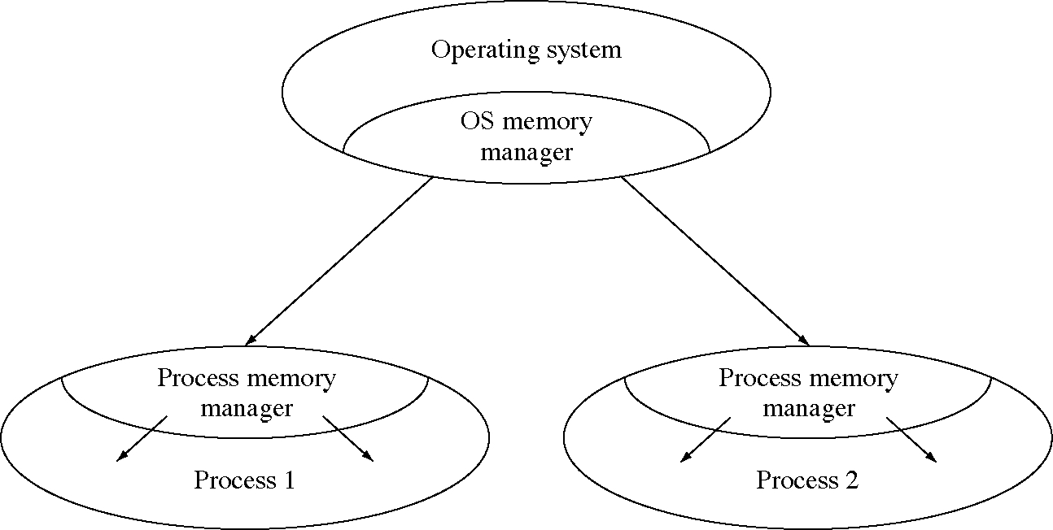
Two levels of memory management

Slide 4
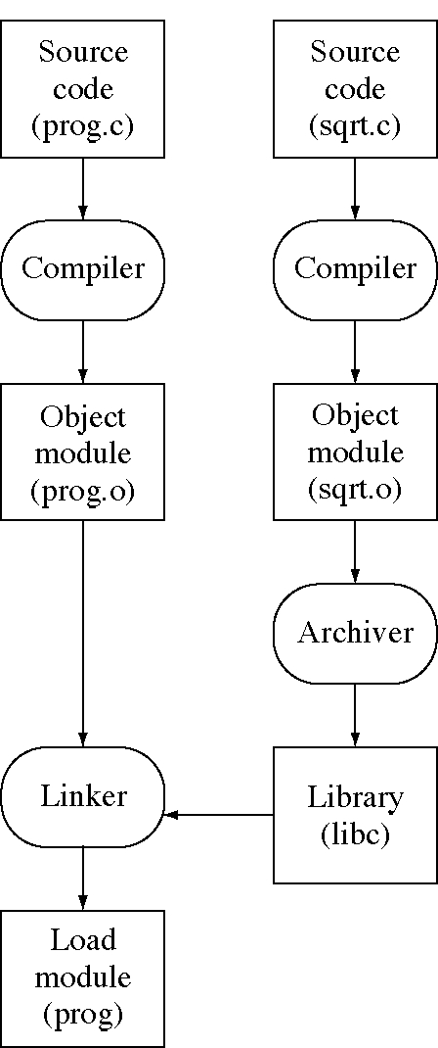
Creating a load module

Slide 5
Object module format
Header information
Machine code
Initialized data
Symbol table
Relocation information

Slide 6
Sample C++ program
#include <iostream.h>
#include <math.h>
float arr[100];
int size = 100;
void main(int argc,char **argv) {
int i; float sum = 0;
for(I=0; I<size; ++i) {
cin >> arr[i];//or “>>”(cin,arr[i])
arr[i] = sqrt(arr[i]);
sum += arr[i];
}
cout << sum;// or “<<“(cout,sum)
}

Slide 7
Linker function
Combine the object modules into a load module
Relocate the object modules as they are being loaded
Link the object modules together as they are being loaded
Search libraries for external references not defined in the object modules

Slide 8
Linker algorithm (1 of 3)
1. Initialize by creating an empty load module and an empty symbol table
2. Read the next object module or library name from the command line

Slide 9
Linker algorithm (2 of 3)
3. If it is an object module then:
  a. Insert it into the load module
  b. Relocate it and its symbols
  c. merge its symbol table into the global symbol table
  d. For each undefined external reference in the object module’s symbol table:
    (1) If the symbol is already in the global symbol table then copy the value to the object module.
    (2) If not then insert it (as undefined) into the global symbol table and make a note to fix up the symbol late
  e. For each defined symbol in the object module, fix up all previous references to the symbol (in object modules loaded earlier).

Slide 10
Linker algorithm (3 of 3)
4. If it is a library then:
  a. Find each undefined symbol in the global symbol table
  b. See if the symbol is defined in a module in this library
  c. If so, the load the object module as described in step 3.
5. Go back to step 2.

Slide 11
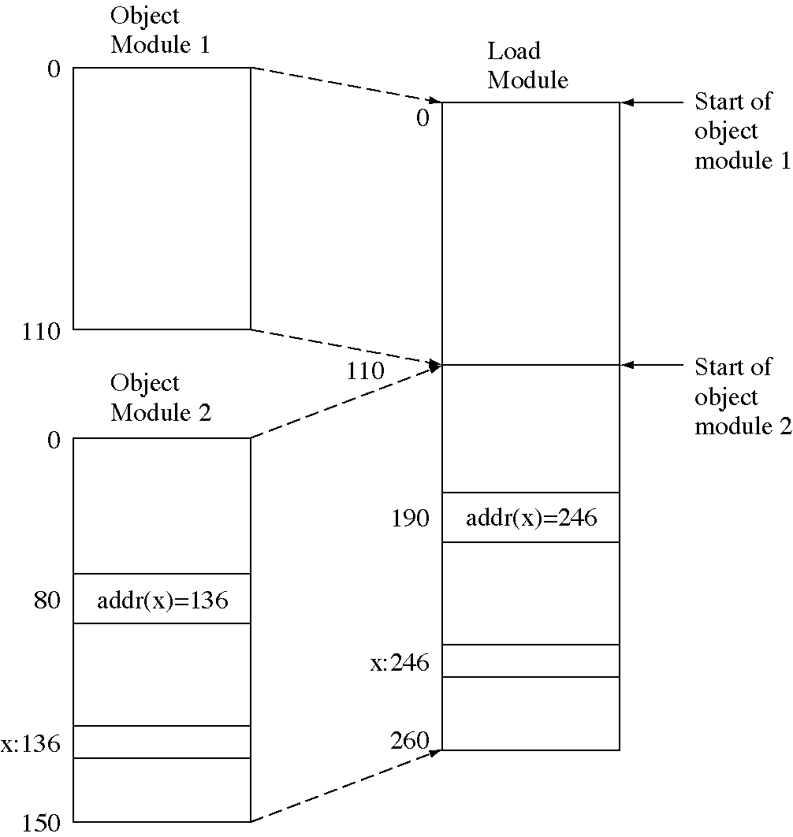
Relocation

Slide 12
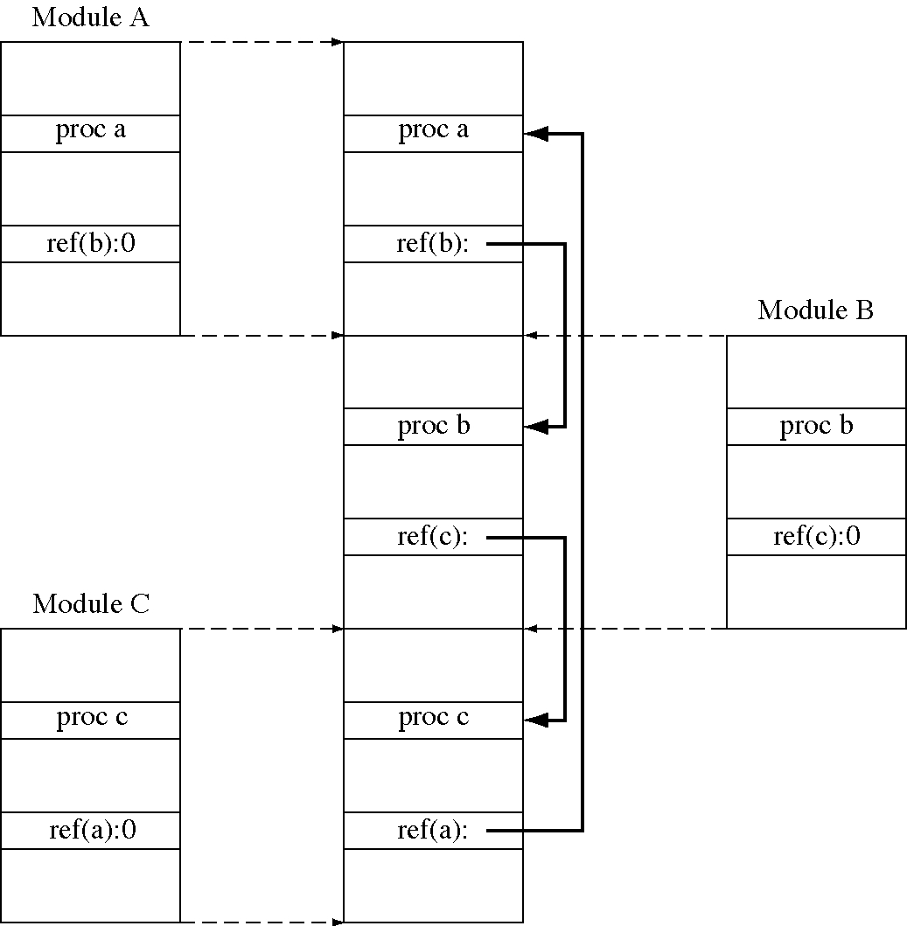
Linking

Slide 13
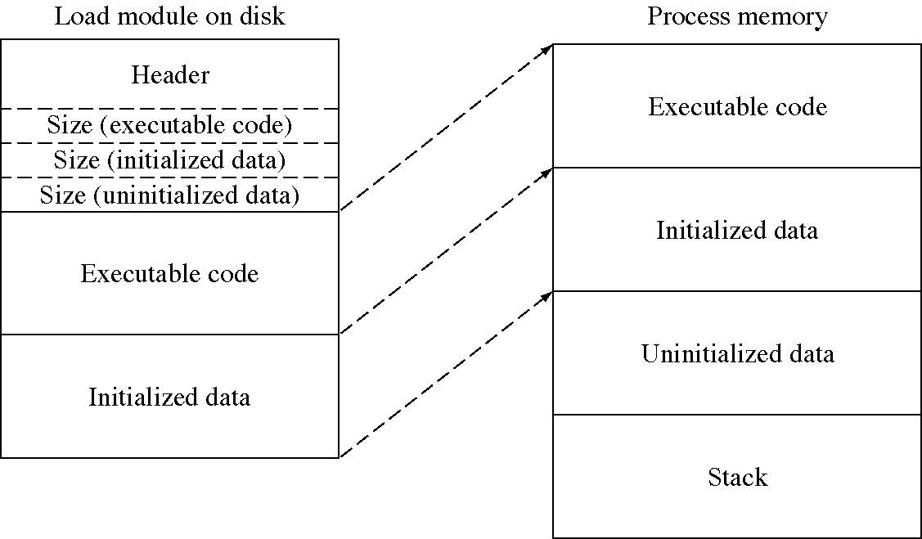
Loading a program into memory

Slide 14
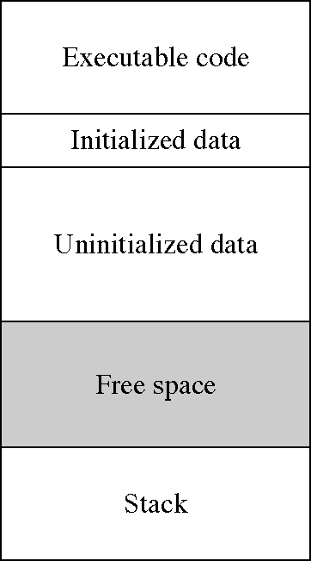
Memory areas in a running process

Slide 15
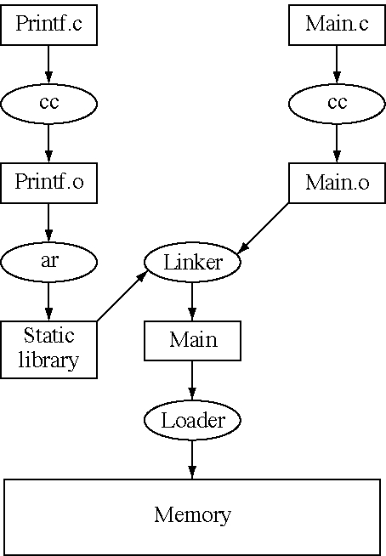
Normal linking and loading

Slide 16
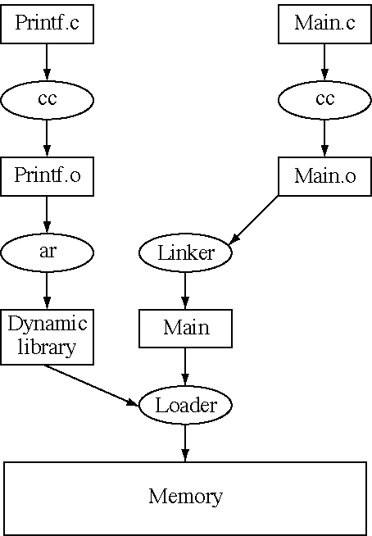
Load-time dynamic linking

Slide 17
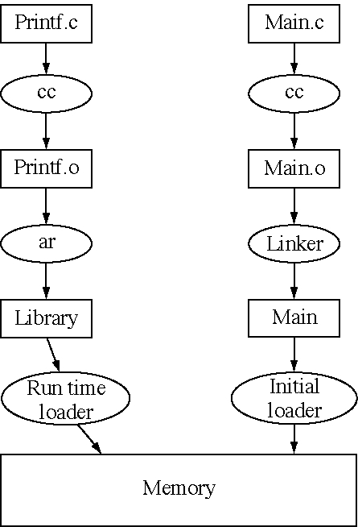
Run-time dynamic linking

Slide 18
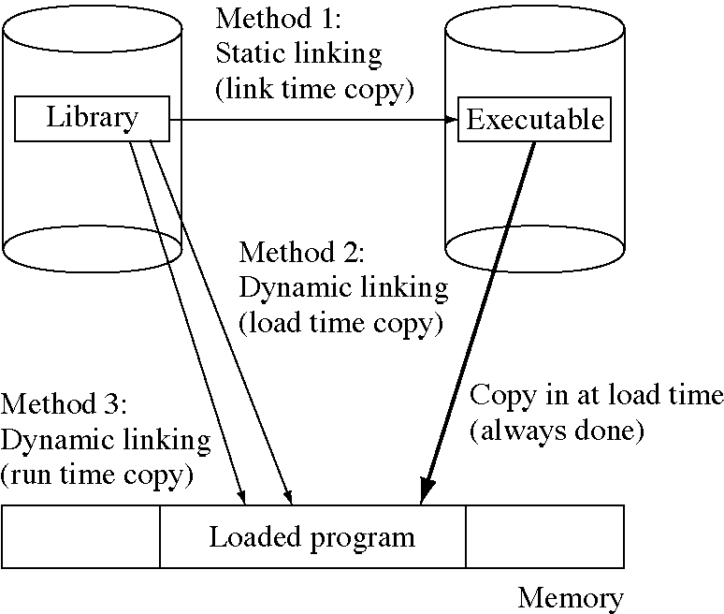
Static and dynamic linking

Slide 19
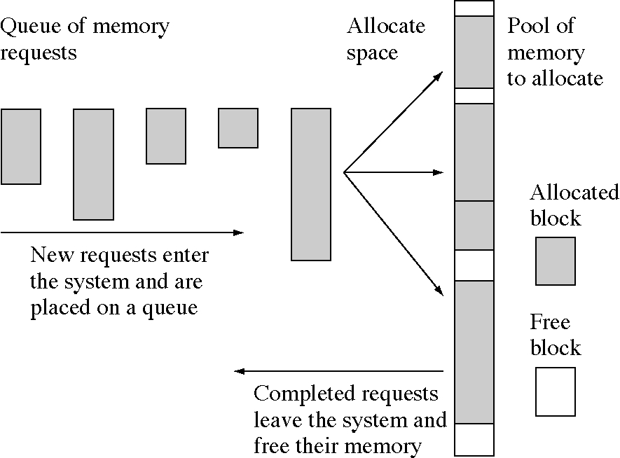
Memory allocation problem

Slide 20
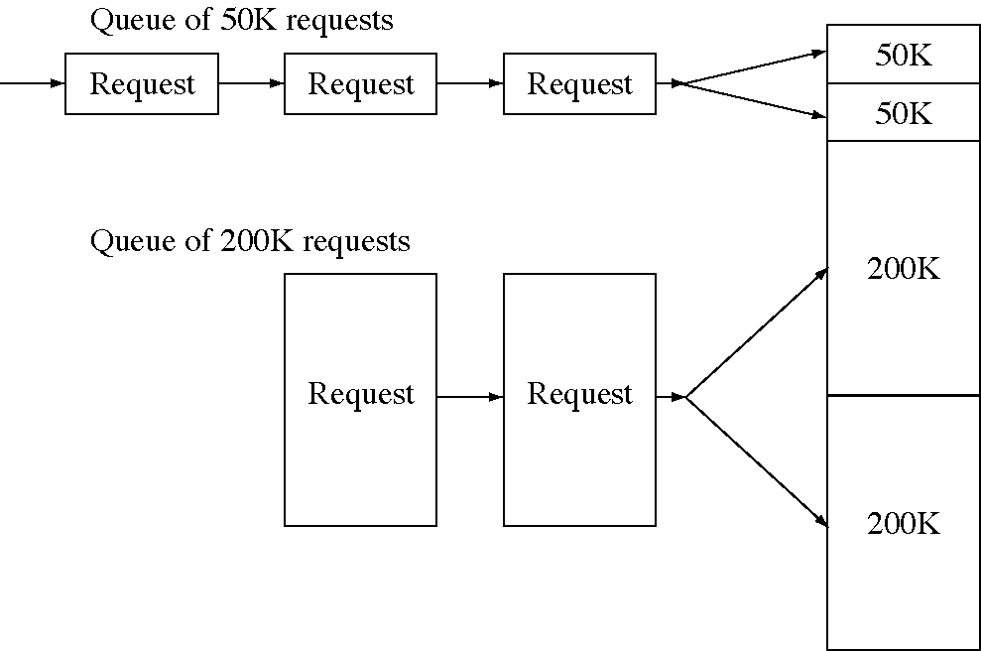
Queue for each block size

Slide 21
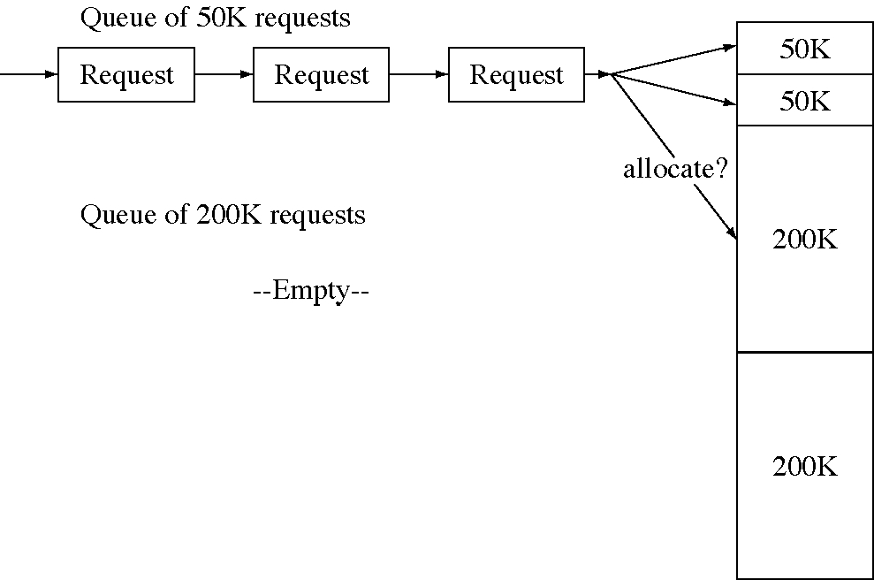
Allocate a large block to a small request?

Slide 22
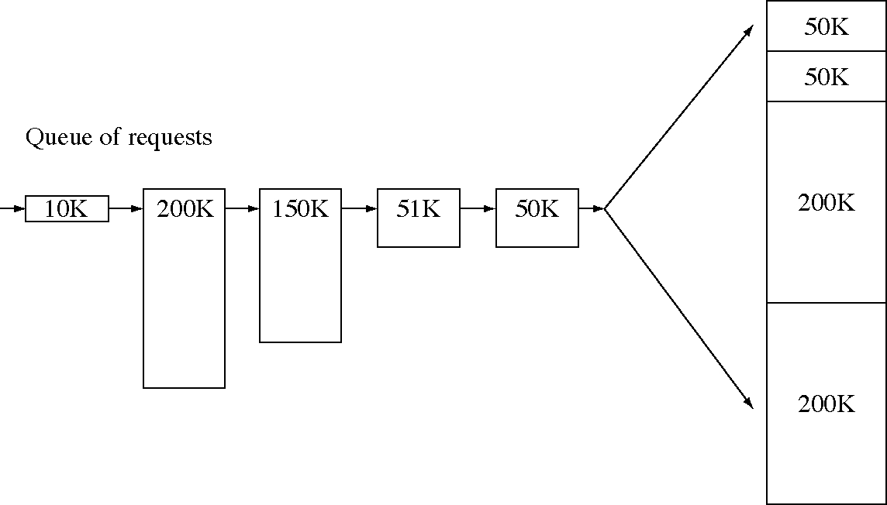
Variably-sized memory requests

Slide 23
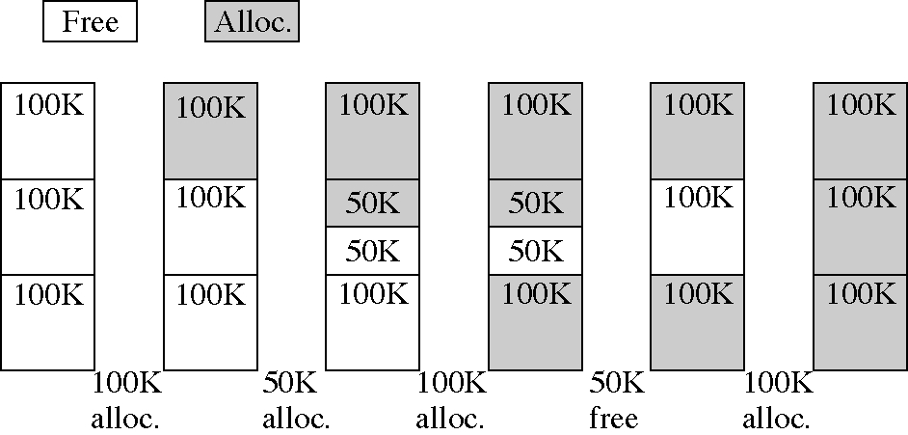
The buddy system

Slide 24
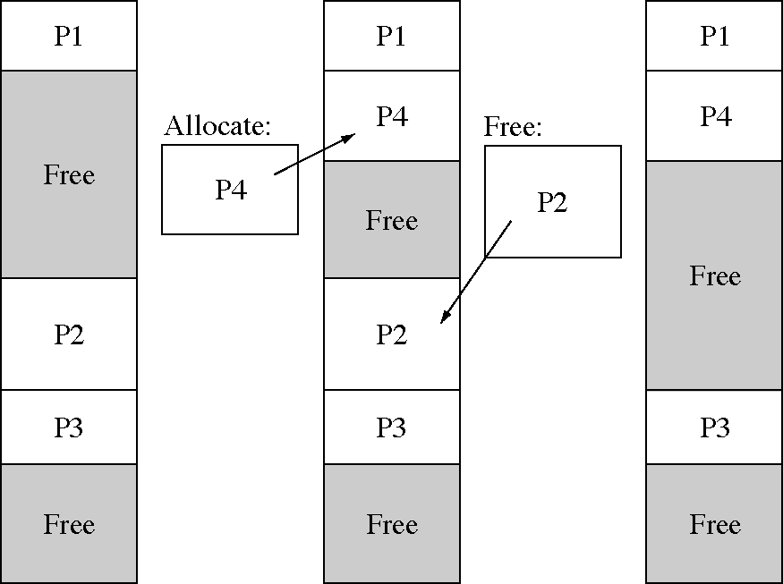
Allocating and freeing blocks

Slide 25
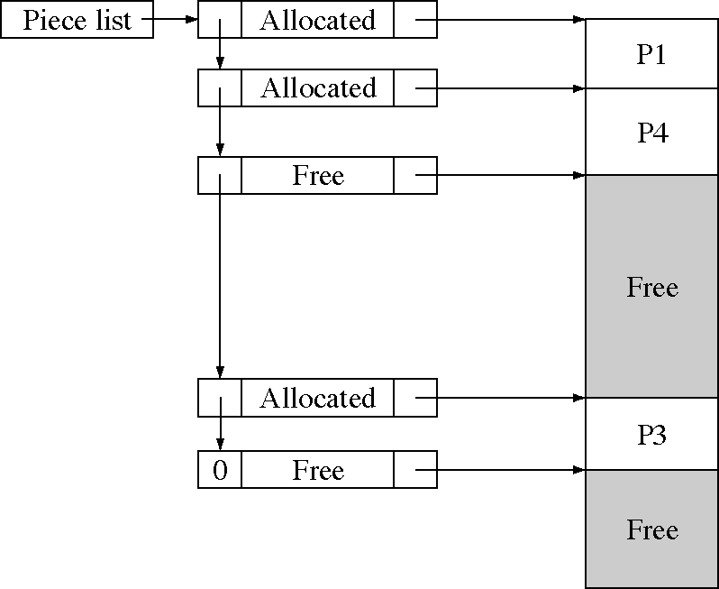
The block list method

Slide 26
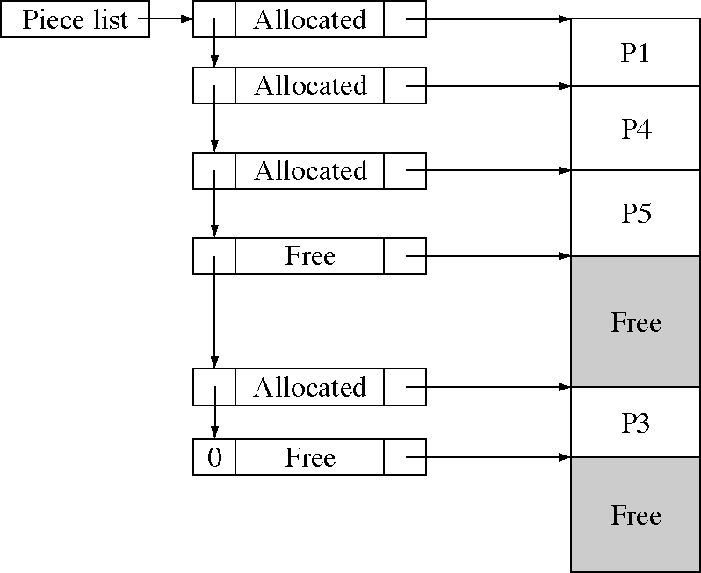
After allocating P5

Slide 27
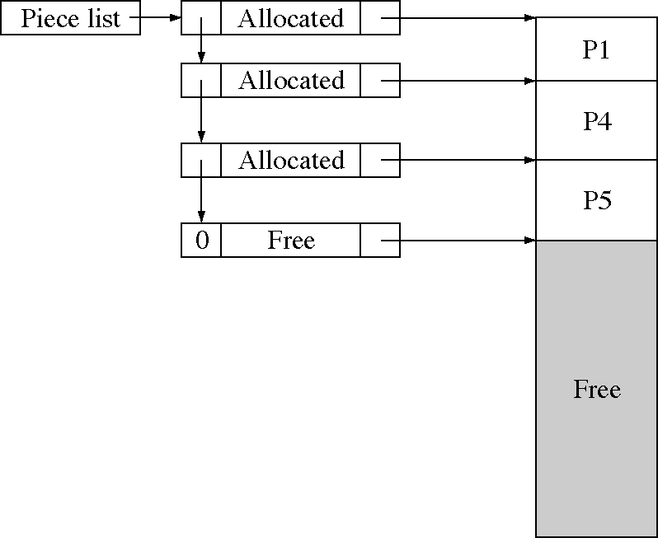
After freeing P3

Slide 28
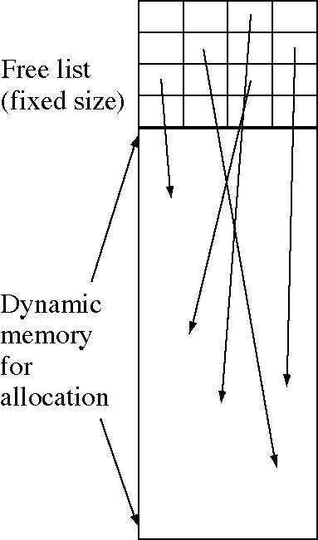
Reserving space for the block list

Slide 29
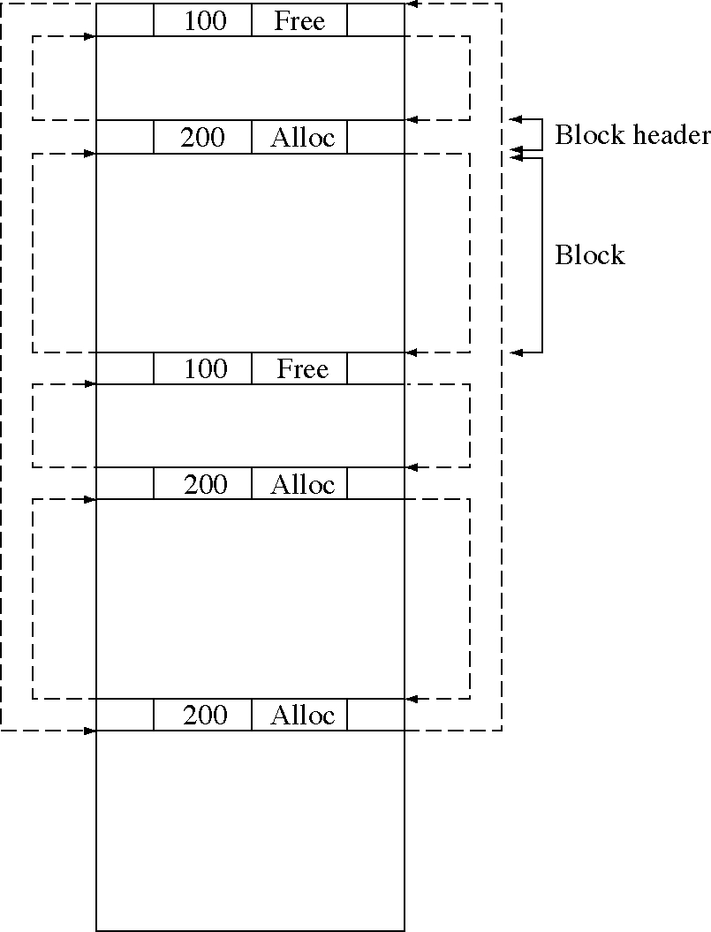
Block list with list headers

Slide 30
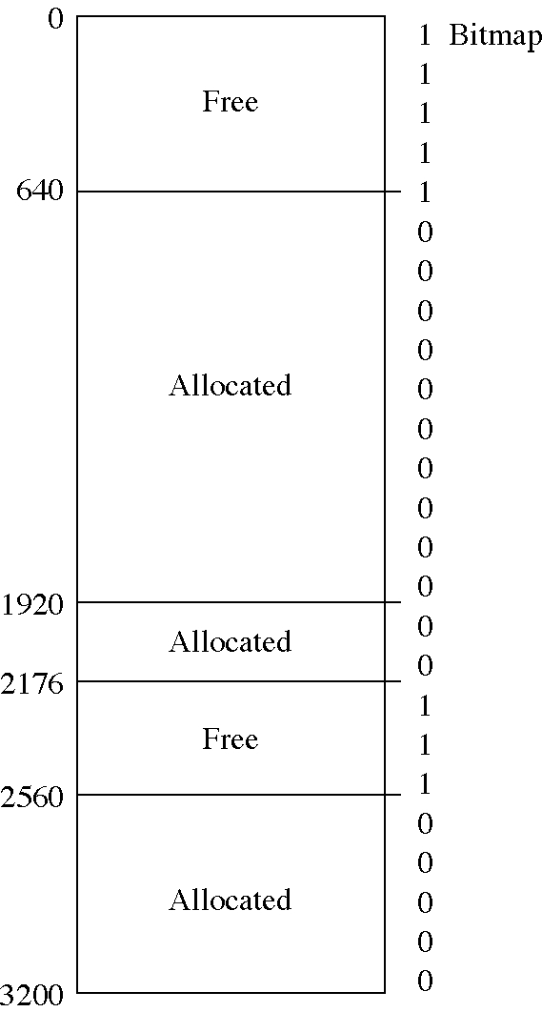
Bitmap method

Slide 31
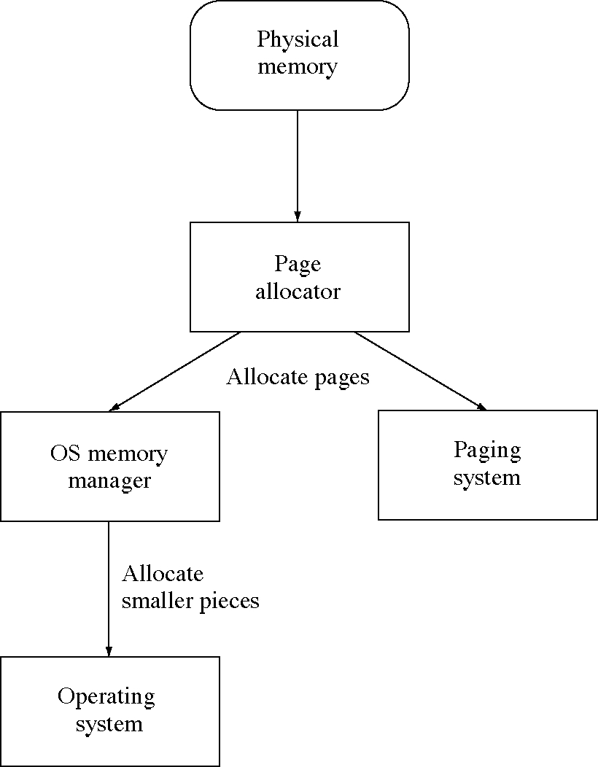
Allocating memory in a paging system

Slide 32
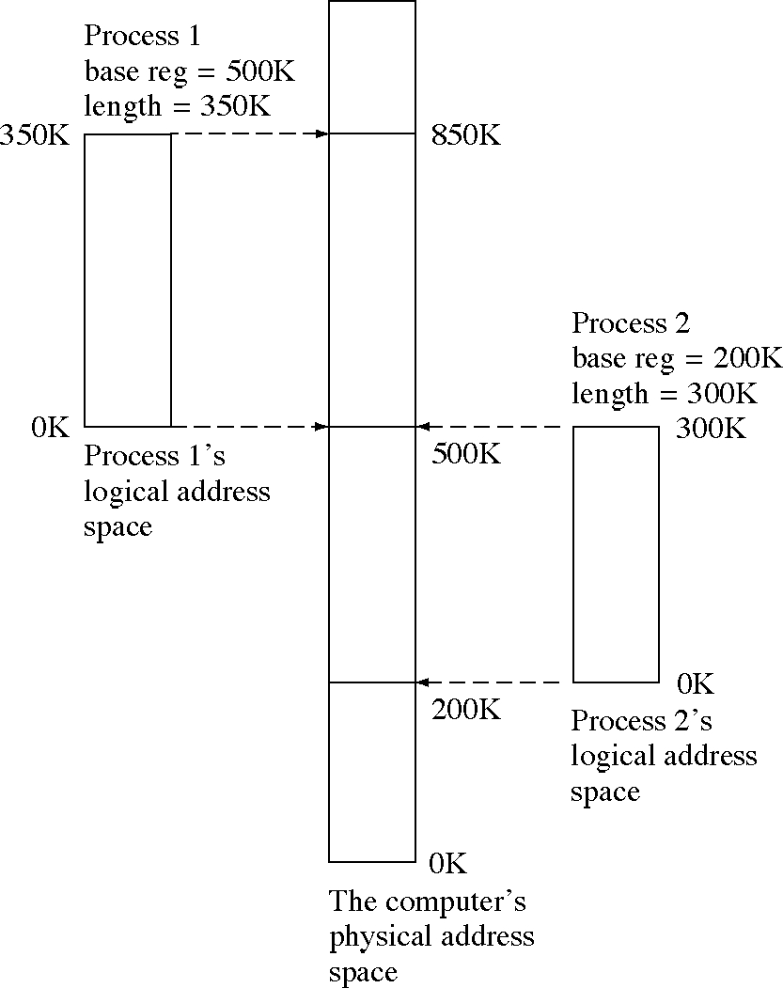
Logical and physical address spaces

Slide 33
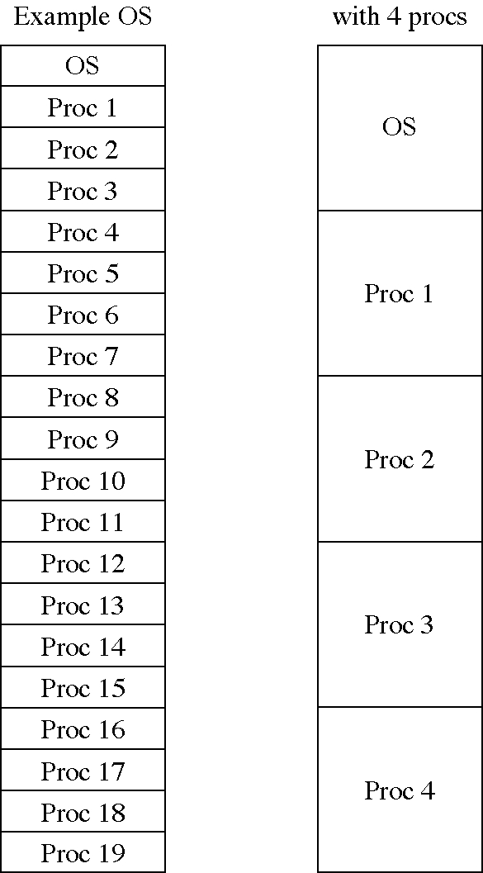
Static allocation of larger blocks

Slide 34
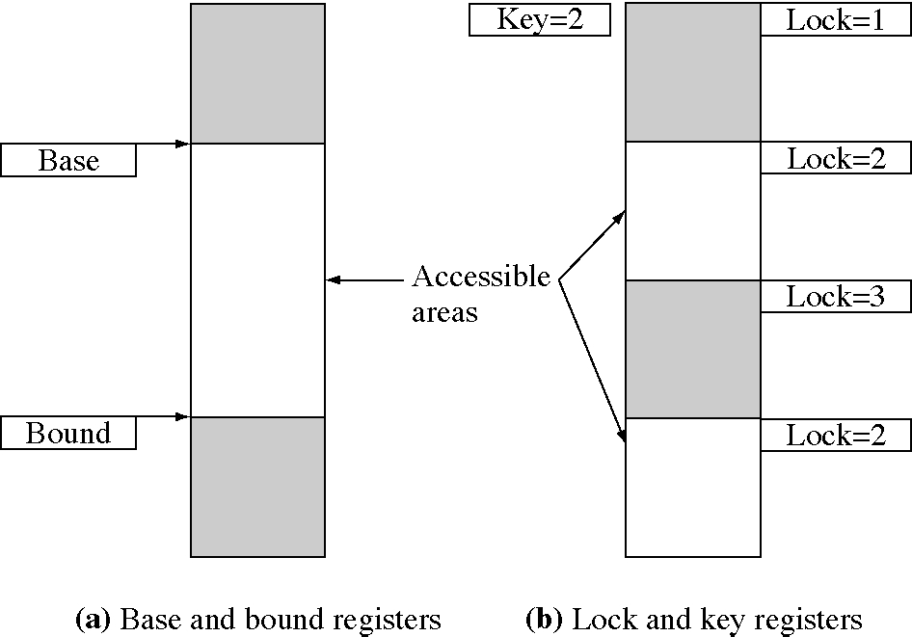
Two forms of memory protection

Slide 35
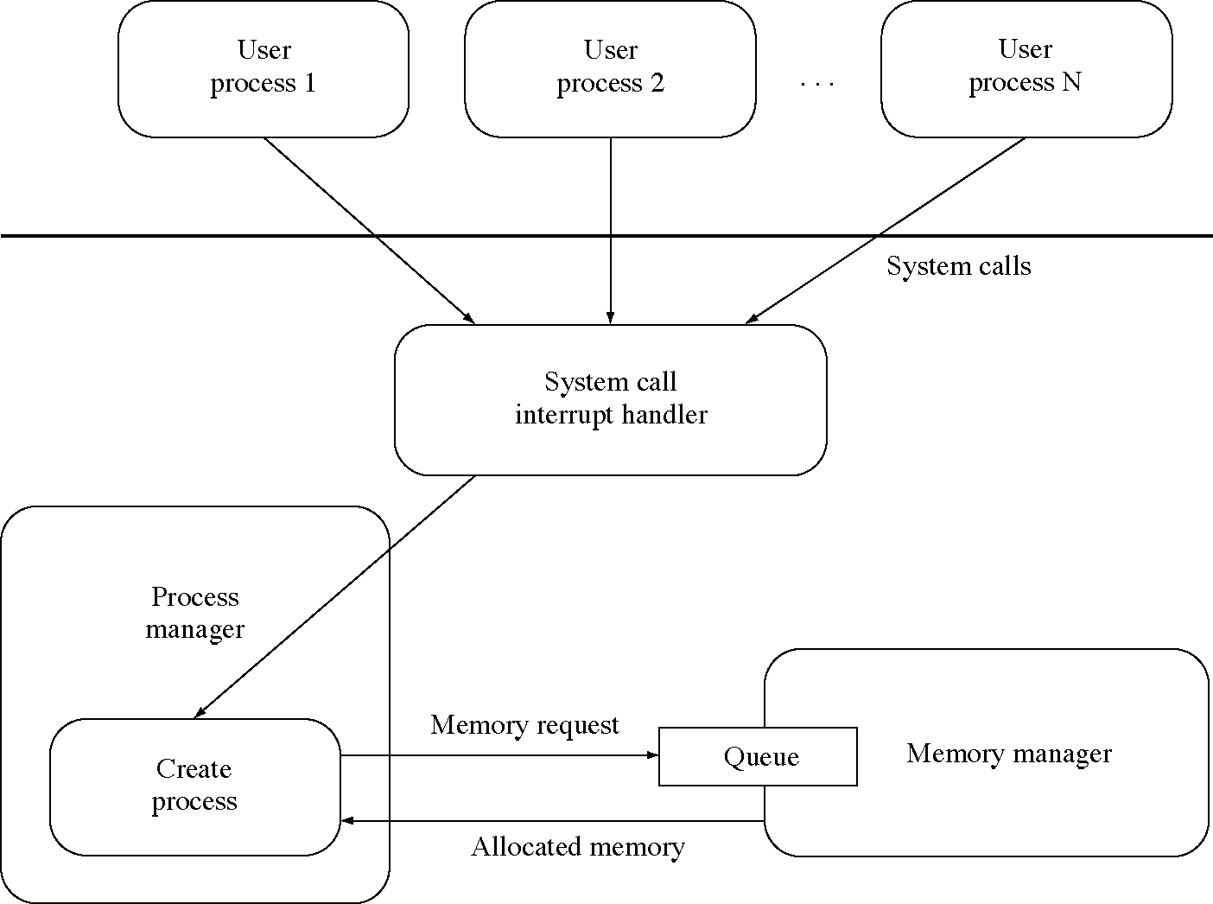
Memory request in the SOS

Slide 36
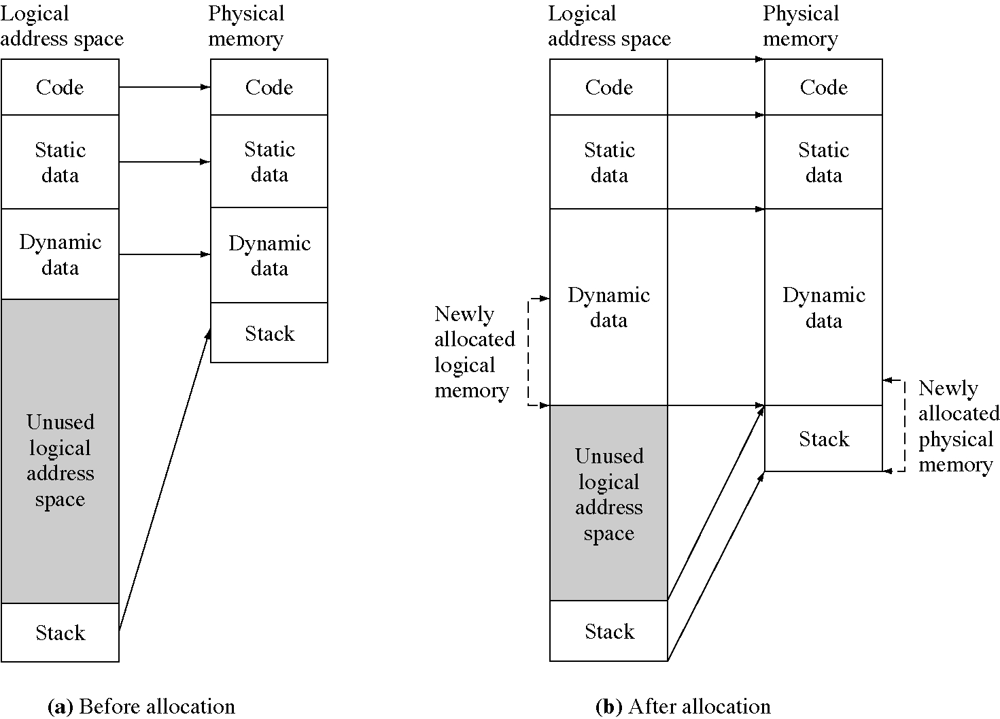
Physical memory allocated to a running process

Slide 37
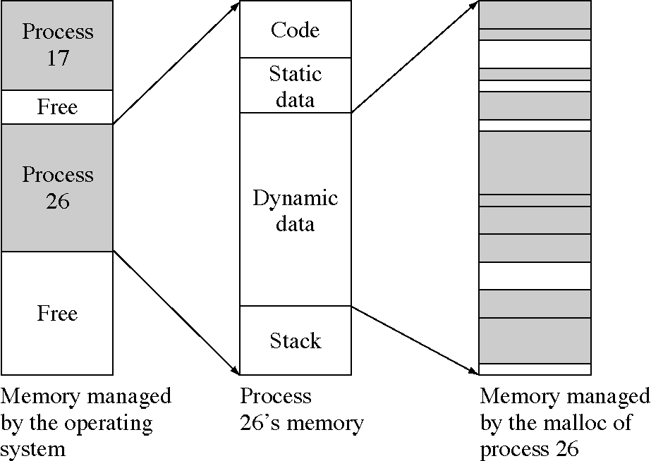
Two levels of memory management

Slide 38
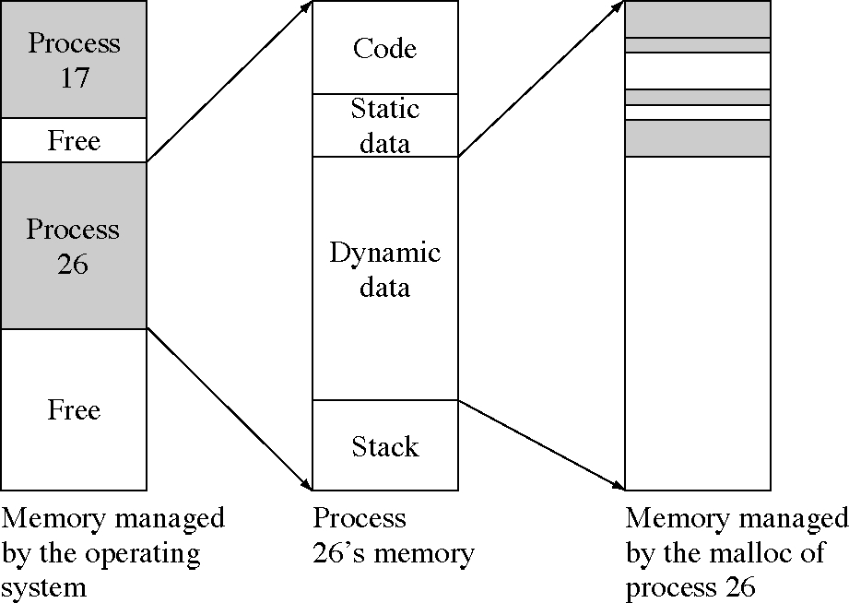
Free memory at the malloc level, but not at the OS level

Slide 39
Memory allocator data (1 of 2)
// The structure for memory requests
struct MemoryRequest {
int size; // in bytes
Semaphore satisfied; // signal when memory is allocated
char ** startAddressSlot; // return block address to the caller here
MemoryRequest *next, *prev; // doubly linked list
};
// The memory request list
// keep a front and back pointer for queue
MemoryRequest * RequestListFront, *RequestListBack;

Slide 40
Memory allocator data (2 of 2)
// The structure for memory requests
// The structure for block list nodes
struct Block {
int size; // in bytes
int isFree; // free or allocated block
char * start; // where the block starts
Block *next, *prev; // doubly linked list
};
// The block list
Block * BlockList;
// The initialization procedure needs to be called
// before any requests are processed.
void Initialize( char * start, int size ) {
RequestListFront = 0;
BlockList = new Block(size, True, start, 0, 0);
}

Slide 41
Make an allocation request
// The request procedure: request a block to be allocated
void RequestABlock( int size, Semaphore * satisfied,
char ** startAddressSlot) {
MemoryRequest * n = new MemoryRequest( size,
satisfied, startAddressSlot, 0 , 0);
if( RequestListFront == 0 ) { // list was empty
RequestListFront = RequestListBack = n;
} else {
RequestListBack->next = n;
RequestListBack = n;
}
TryAllocating();
}

Slide 42
Try to allocate a request (1 of 2)
// The allocation procedure
void TryAllocating( void ) {
MemoryRequest * request = RequestListFront;
// look through the list of request and satisfy
// any ones you can
while( request != 0 ) {
// can we allocate this one?
if( CanAllocate( request ) { // yes we can
// remove from the request list
if( RequestListFront==RequestListBack ) {
// it was the only request on the
// list
// the request list is now empty
RequestListFront = 0;
break; // no more requests

Slide 43
Try to allocate a request (2 of 2)
} else {
// unlink it from the list
request->prev->next = request->next;
request->next->prev = request->prev;
MemoryRequest * oldreq = request;
// save the address
// get link before we delete the node
request = request->next;
delete oldreq;
}
} else {
request = request->next;
}
}
}

Slide 44
Try to allocate a block (1 of 2)
// See if we allocate one request
int CanAllocate( MemoryRequest * request ) {
int size = request->size;
Block * p = BlockList;
// go through the list of blocks
while( p != 0 ) {
if( p->size >= size ) {
// this block is big enough to use,
// see what is left over
int extra = p->size - size;
if( extra != 0 ) {
// split the block into two blocks
Block * np = new Block;
np->size = extra;
np->isFree = True;
np->start = p->start + size;

Slide 45
Try to allocate a block (2 of 2)
np->prev = p;
np->next = p->next;
p->next->prev = np;
p->next = np;
}
p->isFree = False;
*(request->start) = p->start;
SignalSemaphore(
request->satisfied);
return True;
}
p = p->next;
}
return False;
}

Slide 46
Free an allocated block (1 of 2)
// Free a block of memory
void FreeBlock( char * start ) {
Block * p = BlockList;
// go through the list of blocks to find this one
while( p != 0 ) {
if( p->start == start ) {
p->isFree = True;
// merge with the previous block
// if it is free
Block * prevp = p->prev;
if( prevp != 0 && prevp->isFree ) {
prevp->size += p->size;
prevp->next = p->next;
p->next->prev = prevp;
delete p;
}

Slide 47
Free an allocated block (1 of 2)
Block * nextp = p->next;
if( nextp != 0 && nextp->isFree ) {
p->size += nextp->size;
p->next = nextp->next;
nextp->next->prev = p;
delete nextp;
}
return;
}
p = p->next;
}
// ERROR: returned block not found
}

