Slide 1
Virtual Memory
Chapter 11

Slide 2
Key concepts in chapter 11
Fragmentation
Virtual memory
Paging
File mapping

Slide 3
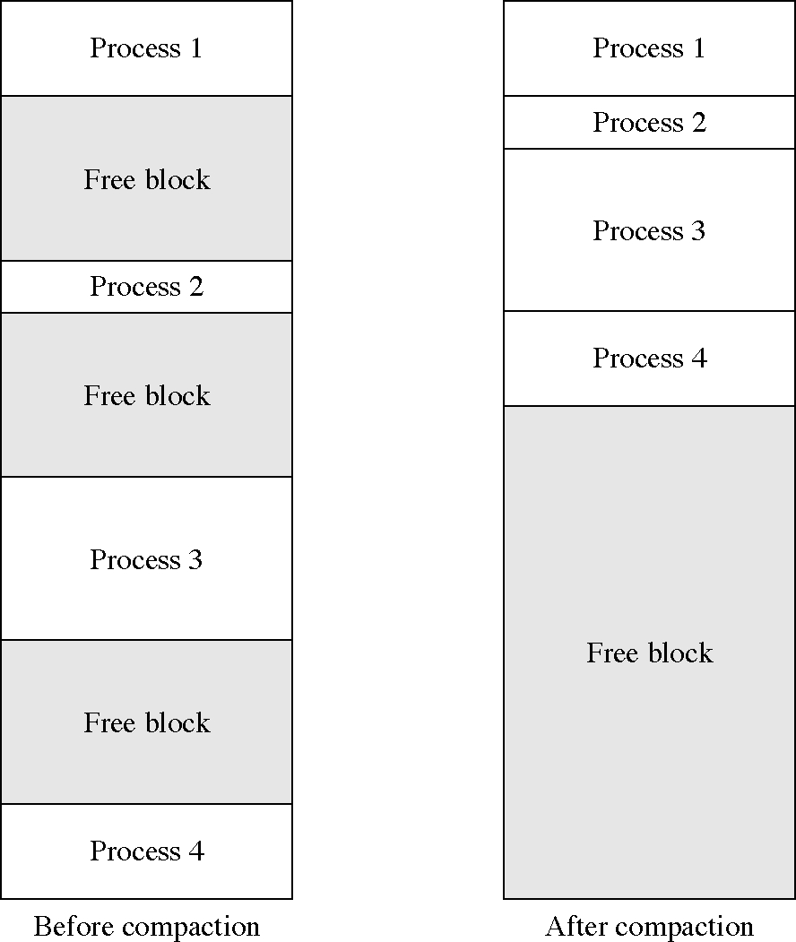
Compacting memory

Slide 4
Fragmentation
Without memory mapping, programs require physically continuous memory
Large blocks mean large fragments
  and wasted memory
We need hardware memory mapping to address this problem
  segments
  pages
We will look at a series of potential solutions

Slide 5
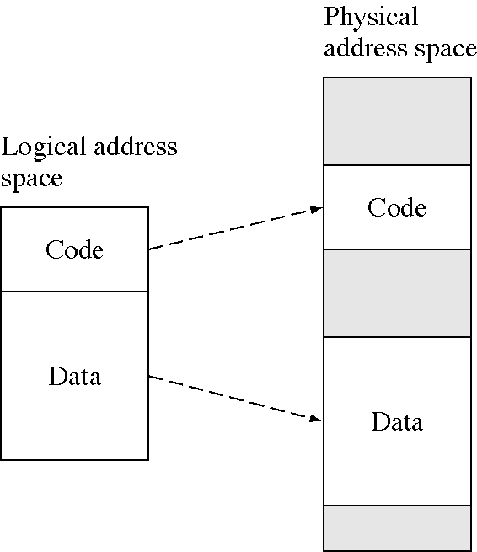
Separate code and data spaces

Slide 6
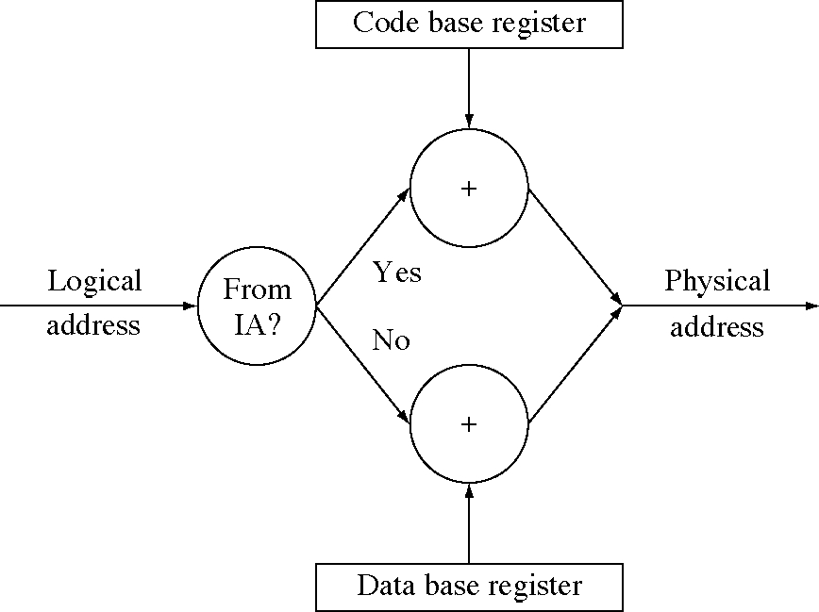
Code/data memory relocation

Slide 7
Segmentation
Divide the logical address space into segments (variable-sized chunks of memory)
Each segment has a base and bound register
  and so segments do not need to be contiguous in the physical address space
  but the logical address space is still contiguous
DEC PDP11
  eight segments
  up to 8K bytes per segment

Slide 8
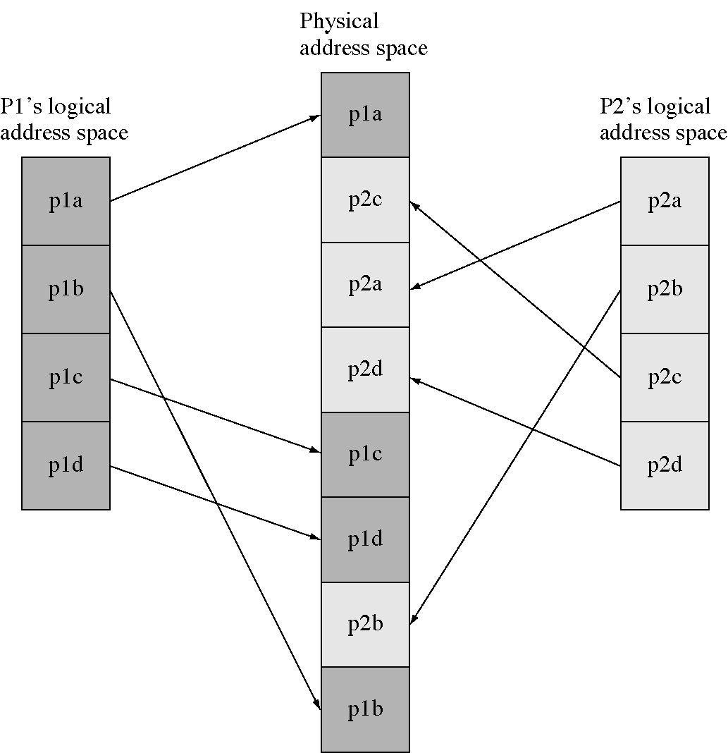
Two segmented address spaces

Slide 9
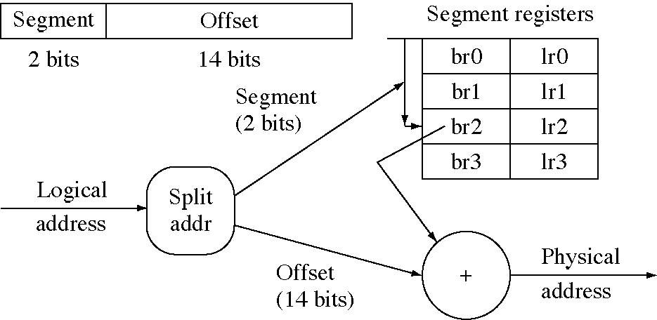
Segmentation memory mapping

Slide 10
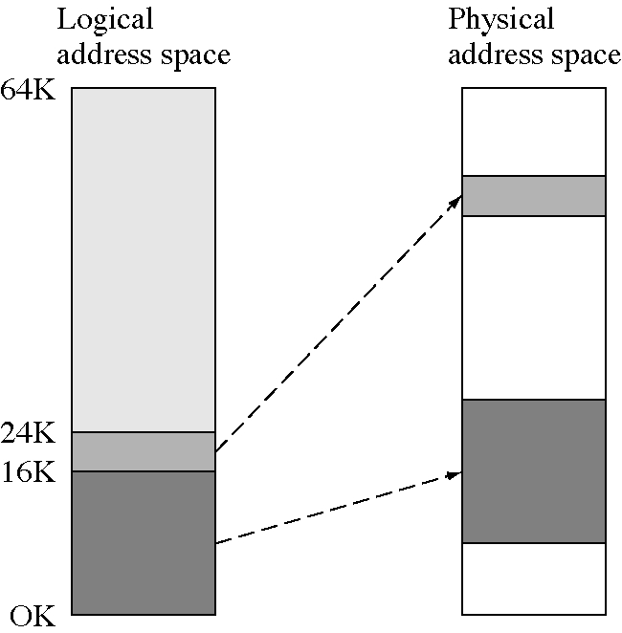
Contiguous 24K logical address space

Slide 11
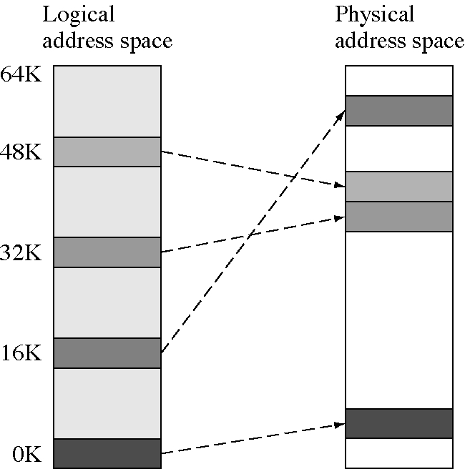
Noncontiguous 24K logical address space

Slide 12
Noncontiguous logical address spaces
This is possible with segmentation hardware
  but is not usually a good idea
Example segmentation map
Segment-Base - Limit - Logical address
  0 100K 6K 0K-6K
  1 194K 6K 16K-22K
  2 132K 6K 32K-38K
  3 240K 6K 48K-54K

Slide 13
Segments to pages
Large segments do not help the fragmentation problem
  so we need small segments
Small segments are usually full
  so we don’t need a length register
  just make them all the same length
Identical length segments are called pages
We use page tables instead of segment tables
  base register but no limit register

Slide 14
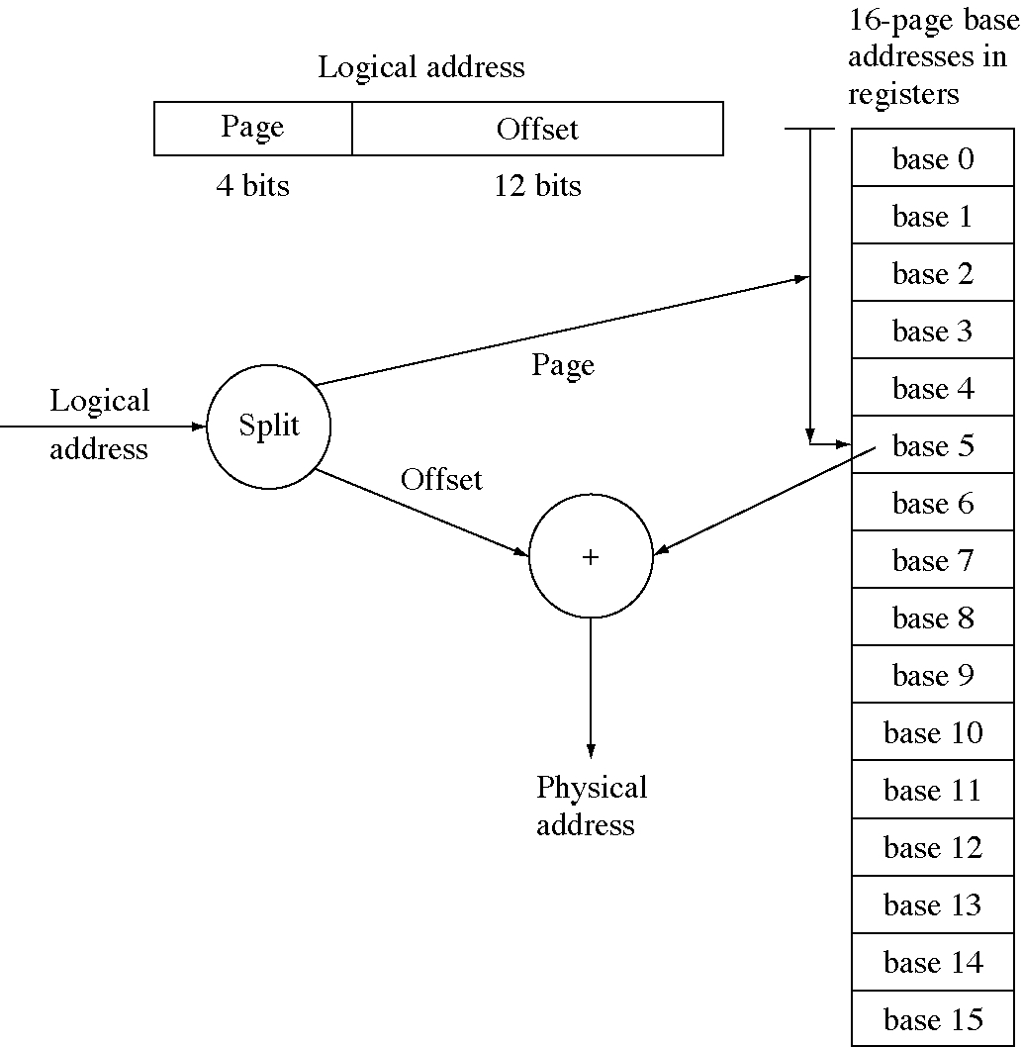
Hardware register page table

Slide 15
Problems with page tables in registers
Practical limit on the number of pages
Time to save and load page registers on context switches
Cost of hardware registers
Solution: put the page table in memory and have a single register that points to it

Slide 16
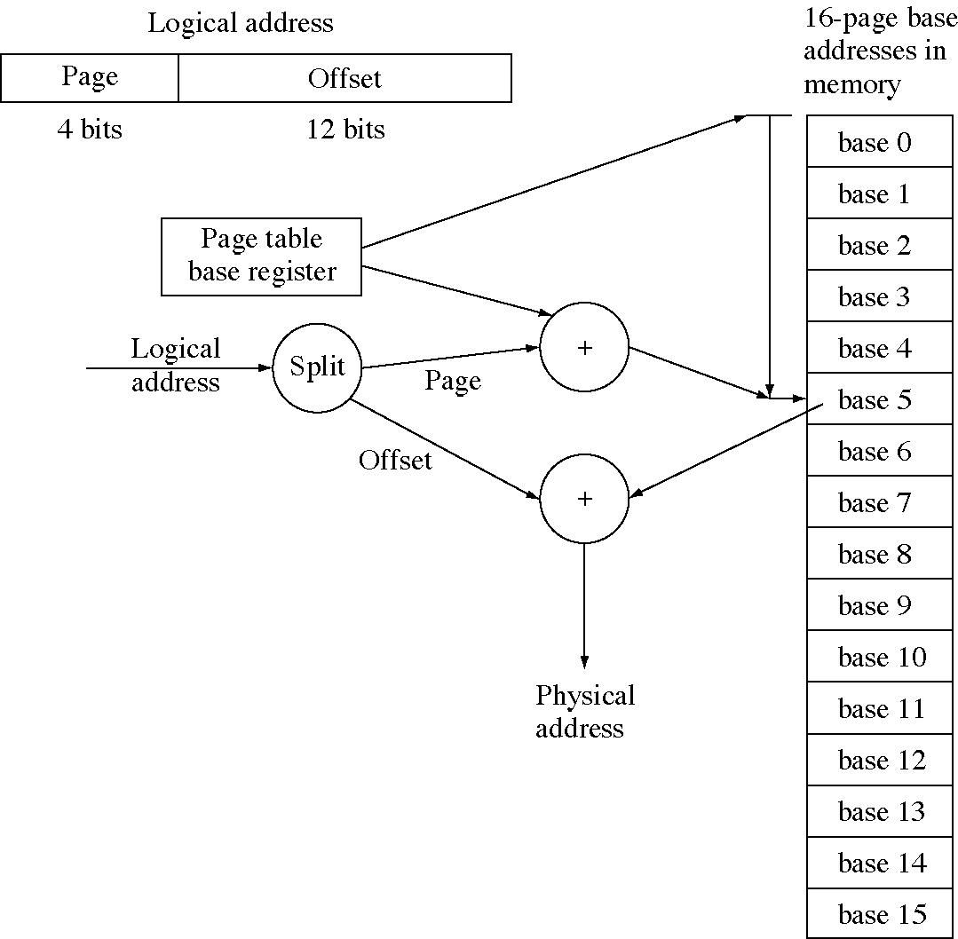
Page tables in memory

Slide 17
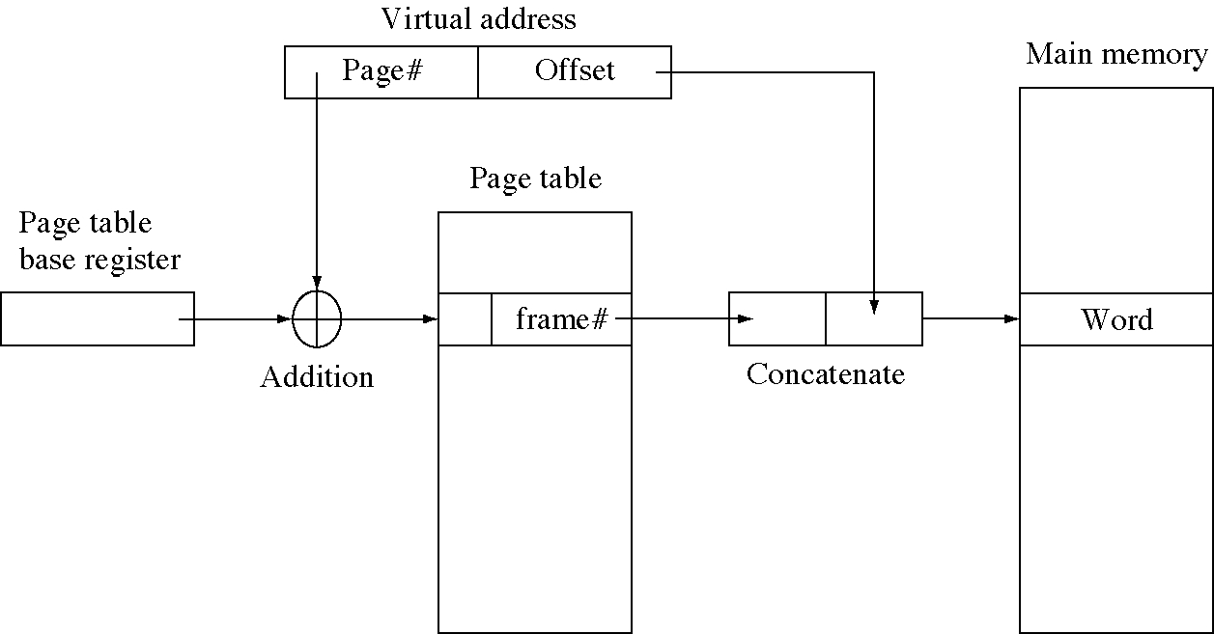
Page table mapping

Slide 18
Problems with page tables in memory
Every data memory access requires a corresponding page table memory access
  the memory usage has doubled
  and program speed is cut in half
Solution: caching page table entries
  called a translation lookaside buffer
  or TLB

Slide 19
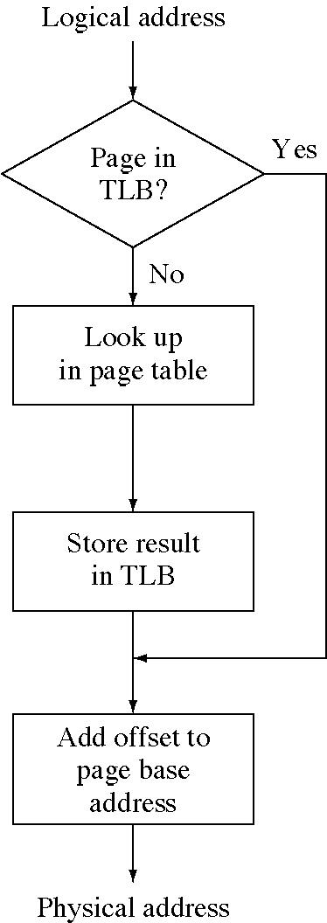
TLB flow chart

Slide 20
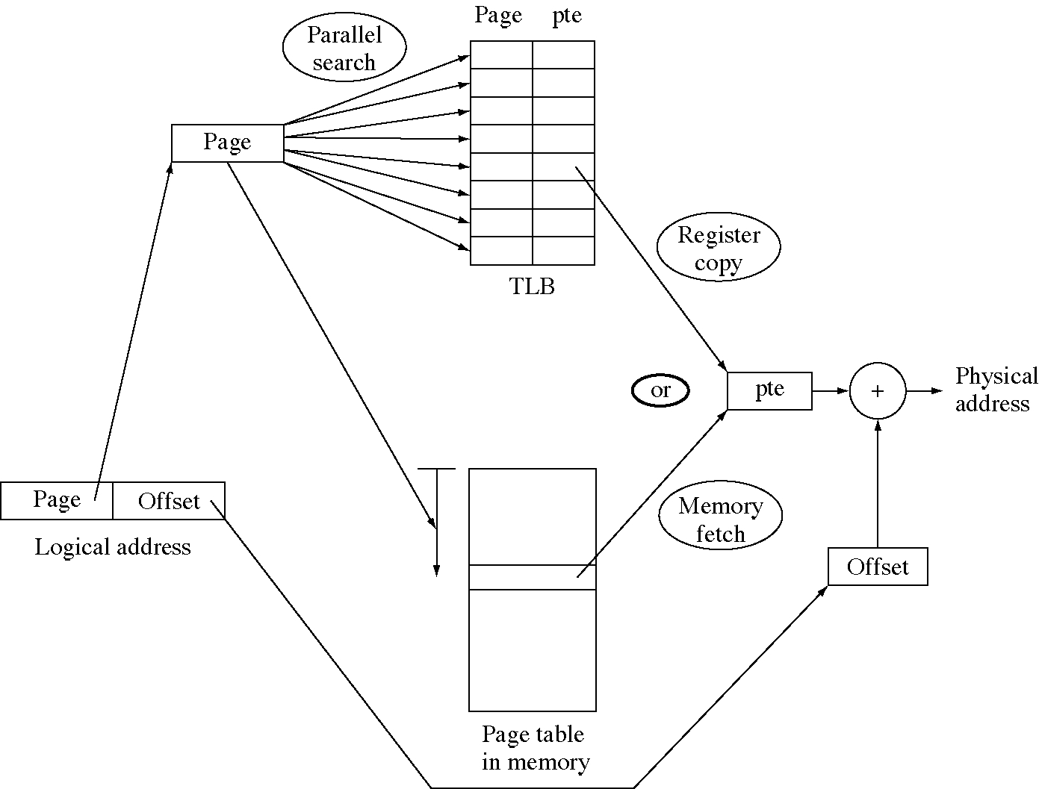
TLB lookup

Slide 21
Caching the page table (1 of 2)
const int PageTableCacheSize = 8;
const int pageSizeShift = 12;
const int pageSizeMask = 0xFFF;
struct CacheEntry {
int logicalPageAddress;
int pageBaseAddress;
} PageTableCache[PageTableCacheSize];
extern int pageTableBaseRegister;
int LeastRecentlyUsedCacheSlot( void );

Slide 22
Caching the page table (2 of 2)
int LogicalToPhysical( int logicalAddress ) {
int logicalPageAddress = logicalAddress & ~pageSizeMask;
for( int i = 0; i < PageTableCacheSize; ++i ) {
// the hardware lookup is done in parallel
if( PageTableCache[i].logicalPageAddress
== logicalPageAddress )
return PageTableCache[i].pageBaseAddress;
}
int pteAddress = pageTableBaseRegister
+ (logicalAddress >> pageSizeShift);
int pageBaseAddress = MemoryFetch( pteAddress );
// now update the cache by replacing the entry that has
// not been used in the longest time (the least recently
// used one) with this new entry
i = LeastRecentlyUsedCacheSlot();
PageTableCache[i].logicalPageAddres=logicalPageAddress;
PageTableCache[i].pageBaseAddress = pageBaseAddress;
return pageBaseAddress;
}

Slide 23
Why TLBs work
Memory access is not random, that is, not all locations in the address space are equally likely to be referenced
References are localized because
  sequential code execution
  loops in code
  groups of data accessed together
  data is accessed many times
This property is called locality
TLB hit rates are 90+% .

Slide 24
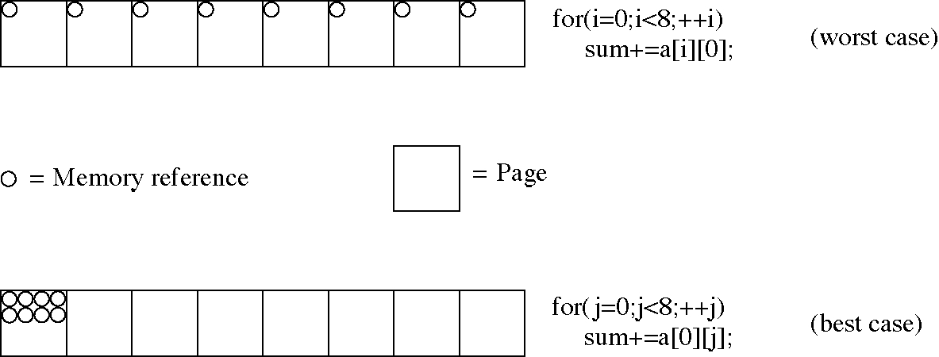
Good and bad cases for paging

Slide 25
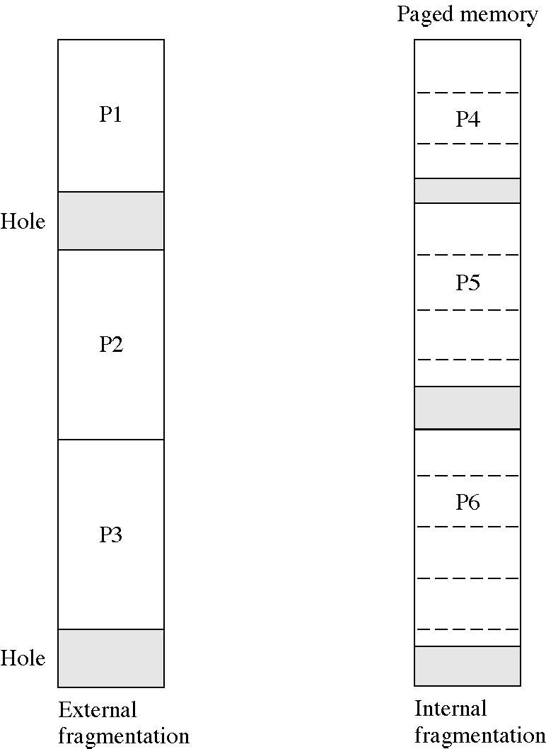
Internal and external fragmentation

Slide 26
Page and page frame
Page
  the information in the page frame
  can be stored in memory (in a page frame)
  can be stored on disk
  multiple copies are possible
Page frame
  the physical memory that holds a page
  a resource to be allocated

Slide 27
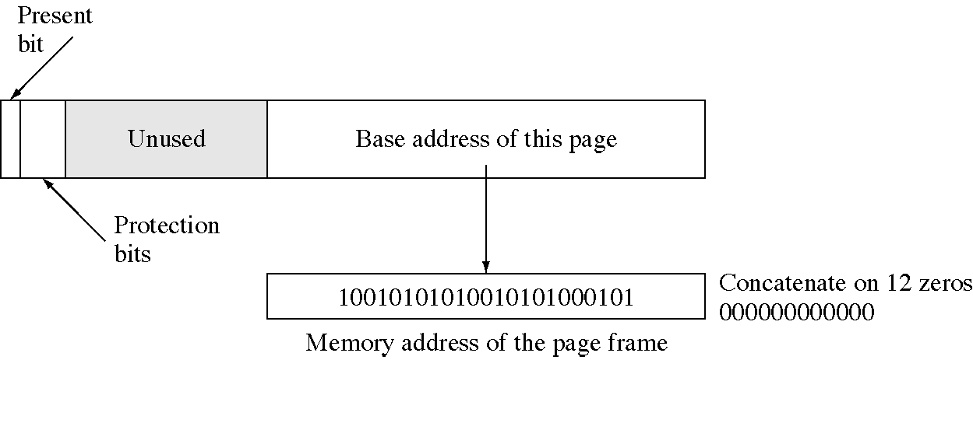
Page table entry

Slide 28
Page table protection
Three bits control: read, write, execute
Possible protection modes:
  000: page cannot be accessed at all
  001: page is read only
  010: page is write only
  100: page is execute only
  011: page can be read or written
  101: page can be read as data or executed
  110: write or execute, unlikely to be used
  111: any access is allowed

Slide 29
Paged memory allocator (1 of 4)
const int PageSize = 4096;
struct MemoryRequest {
int npages;
// size of the request in pages
Semaphore satisfied; // signal when memory allocated
int * pageTableArray; // store page numbers here
MemoryRequest *next, *prev; // doubly linked list
};
// The memory request list
// keep a front and back pointer for queue discipline
MemoryRequest * RequestListFront, *RequestListBack;
// The structure for the free page list
struct FreePage {
int pageNumber;
FreePage *next;
};
// The free page list
FreePage * FreePageList;
int NumberOfFreePages;

Slide 30
Paged memory allocator (2 of 4)
void Initialize( int npages ) {
RequestListFront = 0; FreePageList = 0;
NumberOfFreePages = npages;
for( int i = 0; i < NumberOfFreePages; ++i ) {
FreePageList = new FreePage( i, FreePageList );
}
}
// request procedure: request a piece to be allocated
void RequestBlock( int npages, Semaphore * satisfied,
int * pageTableArray ) {
MemoryRequest * n = new MemoryRequest( npages,
satisfied, pageTableArray, 0 , 0);
if( RequestListFront == 0 ) { // list was empty
RequestListFront = RequestListBack = n;
} else {
RequestListBack->next = n;
RequestListBack = n;
}
TryAllocating();
}

Slide 31
Paged memory allocator (3 of 4)
void TryAllocating( void ) {
MemoryRequest * request = RequestListFront;
while( request != 0 ) {
if( CanAllocate( request ) {
if( RequestListFront == RequestListBack ) {
RequestListFront = 0;
request = 0; // drop out of loop
} else {
request->prev->next = request->next;
request->next->prev = request->prev;
MemoryRequest * oldreq = request;
// save the address
request = request->next;
delete oldreq;
}
} else
request = request->next;
}
}

Slide 32
Paged memory allocator (4 of 4)
void FreePages( int npages, int pageTable[] ) {
for( int i = 0; i < npages; ++i )
FreePageList
= new FreePage( pageTable[i], FreePageList );
}
int CanAllocate( MemoryRequest * request ) {
if( request->npages >= NumberOfFreePages ) {
NumberOfFreePages -= request->npages;
int * p = request->pageTableArray;
for( int i = 0; i < request->npages; ++i ) {
*p++ = FreePageList->pageNumber;
FreePage * fpl = FreePageList;
FreePageList = FreePageList->next;
delete fpl;
}
return True;
}
return False;
}

Slide 33
The design process
Evolution of solutions to the memory problem is a good example of the design process in action
  at each stage the current solution had a problem
  we modified the design to fix the problem
  this created a new problem
  we continued until the solution was good enough
Sometimes we reused previously discarded ideas

Slide 34
Time and space multiplexing
The processor is a time resource
  It can only be time multiplexed
Memory is a space resource
  We have looked at space multiplexing of memory
  Now we will look at time multiplexing of memory

Slide 35
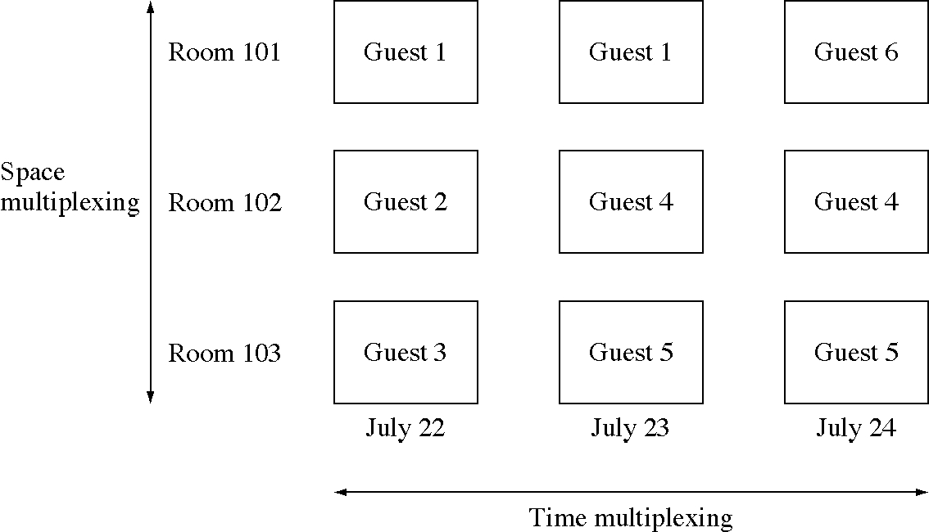
Time and space multiplexing of hotel rooms

Slide 36
Time multiplexing memory
Swapping: move whole programs in and out of memory (to disk or tape)
  allowed time-sharing in early Oss
Overlays: move parts of program in and out of memory (to disk or tape)
  allowed the running of programs that were larger than the physical memory available
  widely used in early PC systems

Slide 37
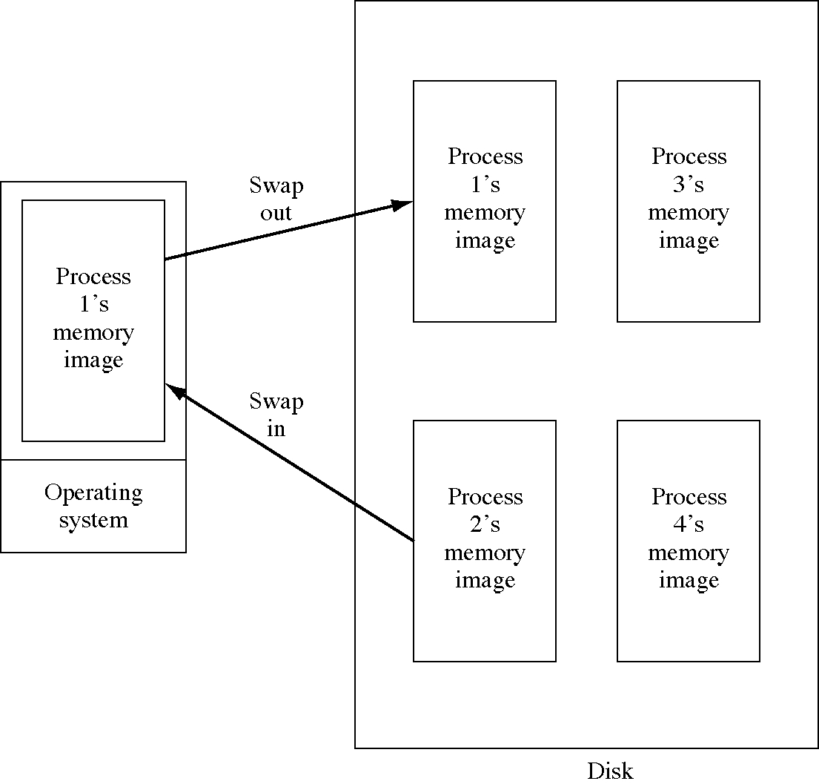
Swapping

Slide 38
Design technique:
Persistent objects
A process was a dynamic entity in the system
  we wanted to write it out to disk
  and read it back in again later
  kind of freeze and unfreeze it
The ability to write an object to disk is called persistence, and it very useful
It allows objects to live beyond the execution of the program that creates them

Slide 39
How to create persistence
Basically simple
  write out a representation of the objects
Problems
  pointers and references: we must encode these in some way in order to write them out
  following references: we also have to write out everything the object refers to.

Slide 40
Design stages:
Design and implementation
First we decide what we want
Then we decide how to implement it
Each stage requires design
Feedback is often required in order to avoid inefficient designs
In operating systems
  we often useful services to the processes
  and try to implement them efficiently

Slide 41
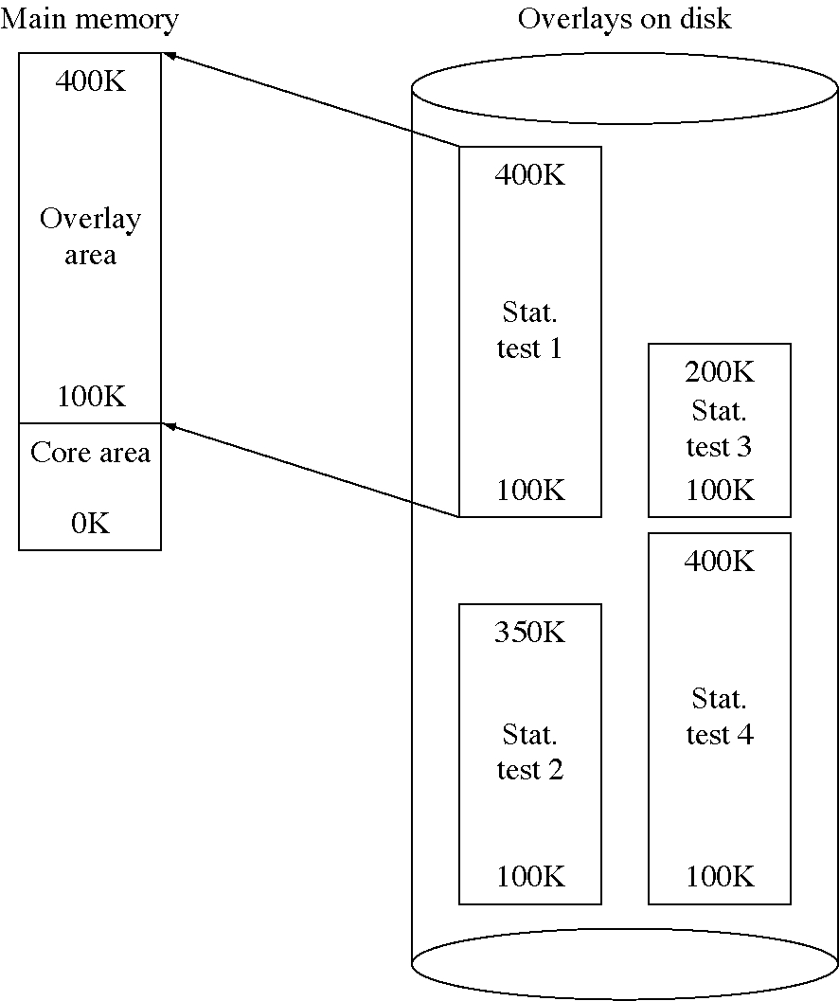
Overlays

Slide 42
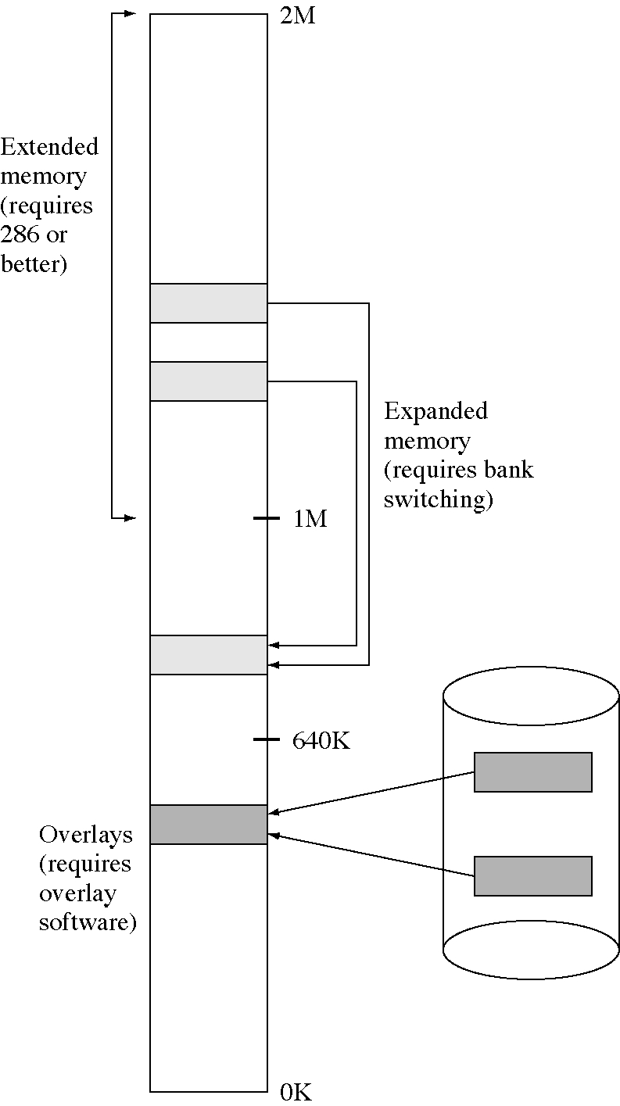
Overlays in PCs

Slide 43
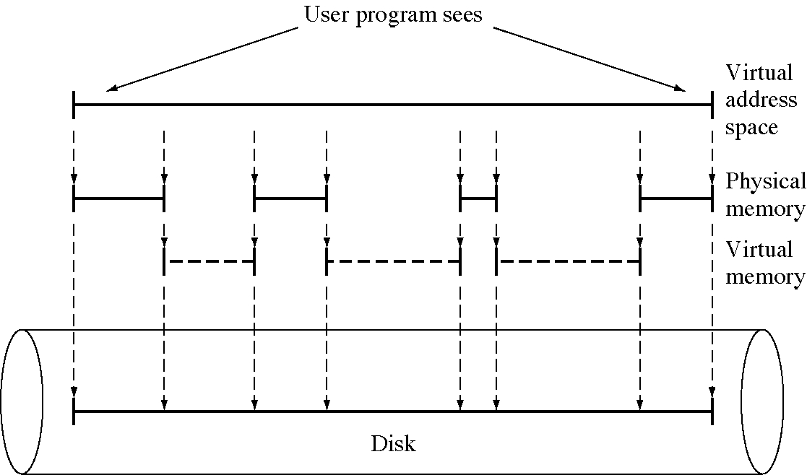
Virtual memory

Slide 44
Implementation of virtual memory
Virtual memory allows
  time multiplexing of memory
  users to see a larger (virtual) address space than the physical address space
  the operating system to split up a process in physical memory
Implementation requires extensive hardware assistance and a lot of OS code and time
  but it is worth it

Slide 45
Virtual memory algorithm (1 of 2)
const int LogicalPages = 1024;
const int ByterPerPage = 4096;
const int OffsetShift = 12;
const int OffsetMask = 0xFFF;
const int PhysicalPages = 512;
enum AccessType { invalid = 0, read = 1, write = 2, execute = 3 };
struct PageTableEntry {
int pageBase : 9;
int present : 1;
AccessType protection : 2;
int fill : 4; // fill to 16 bits
};
PageTableEntry UserPageTable[LogicalPages];

Slide 46
Virtual memory algorithm (2 of 2)
int MemoryAccess( int logicalAddress,
AccessType how, int dataToWrite = 0 ) {
int page = logicalAddress >> OffsetShift;
int offset = logicalAddress & OffsetMask;
PageTableEntry pte = UserPageTable[page];
if( how != pte.protection )
if( !(how = read && ptr.protection = write) ) {
CauseInterrupt( ProtectionViolation );
return 0;}
if( pte.present == 0 ) {
GenerateInterrupt( PageFault, page );
return 0; }
int physicalAddress
= (pte.pageBase << OffsetShift) + offset;
switch( how ) {
case read: case execute:
return PhysicalMemoryFetch(physicalAddress);
case write:
PhysicalMemoryStore(
physicalAddress, dataToWrite );
return 0;
}
}

Slide 47
Virtual memory software
The virtual memory (a.k.a. paging) system in the OS must respond to four events
  process creation
  process exit
  process dispatch
  page fault

Slide 48
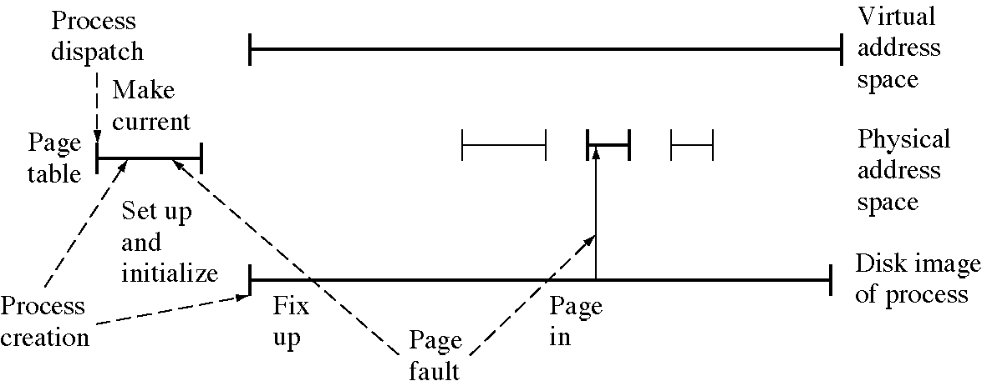
Virtual memory events

Slide 49
Process creation actions
1. Compute program size (say N pages)
2. Allocate N page frames of swap space
3. Allocate a page table (in the OSs memory) for N page table entries.
4. Initialize the swap area
5. Initialize the page table: all pages are marked as not present.
6. Record the location in the swap area and of the page table in the process descriptor

Slide 50
Process exit actions
1. Free the memory used by the page table
2. Free the disk space in the swap area
3. Free the page frames in process was using

Slide 51
Process dispatch actions
1. Invalidate the TLB (since we are changing address spaces)
2. Load the hardware page table base register with the address of the page table for this process

Slide 52
Page fault actions
1. Find the faulting page (say page K)
2. Find an empty page frame. This will involve replacing a page.
3. Read in page K to this page frame
4. Fix up the page table entry for page K. Mark it present and set the base address.
5. Restart the process with the instruction that caused the page fault

Slide 53
Locality
Programs do not access their address space uniformly
  they access the same location over and over
Spatial locality: processes tend to access location near to location they just accessed
  because of sequential program execution
  because data for a function is grouped together
Temporal locality: processes tend to access data over and over again
  because of program loops
  because data is processed over and over again

Slide 54
Design technique: Locality
Locality is almost always present
  and often we can optimize a design by taking advantage of it.
Caching is a common name for systems that take advantage of locality to optimize operations

Slide 55
Practicality of paging
Paging only works because of locality
  at any one point in time programs don’t need most of their pages
Page fault rates must be very, very low for paging to be practical
  like one page fault per 100,000 or more memory references

Slide 56
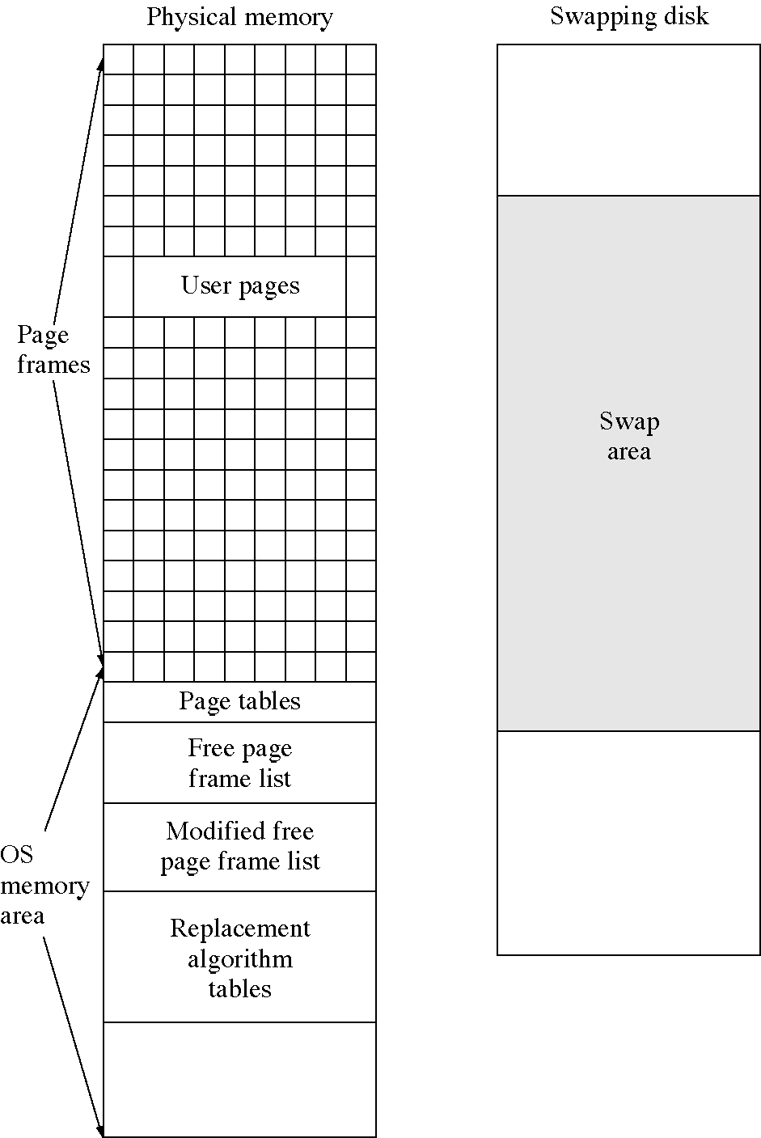
VM data structures

Slide 57
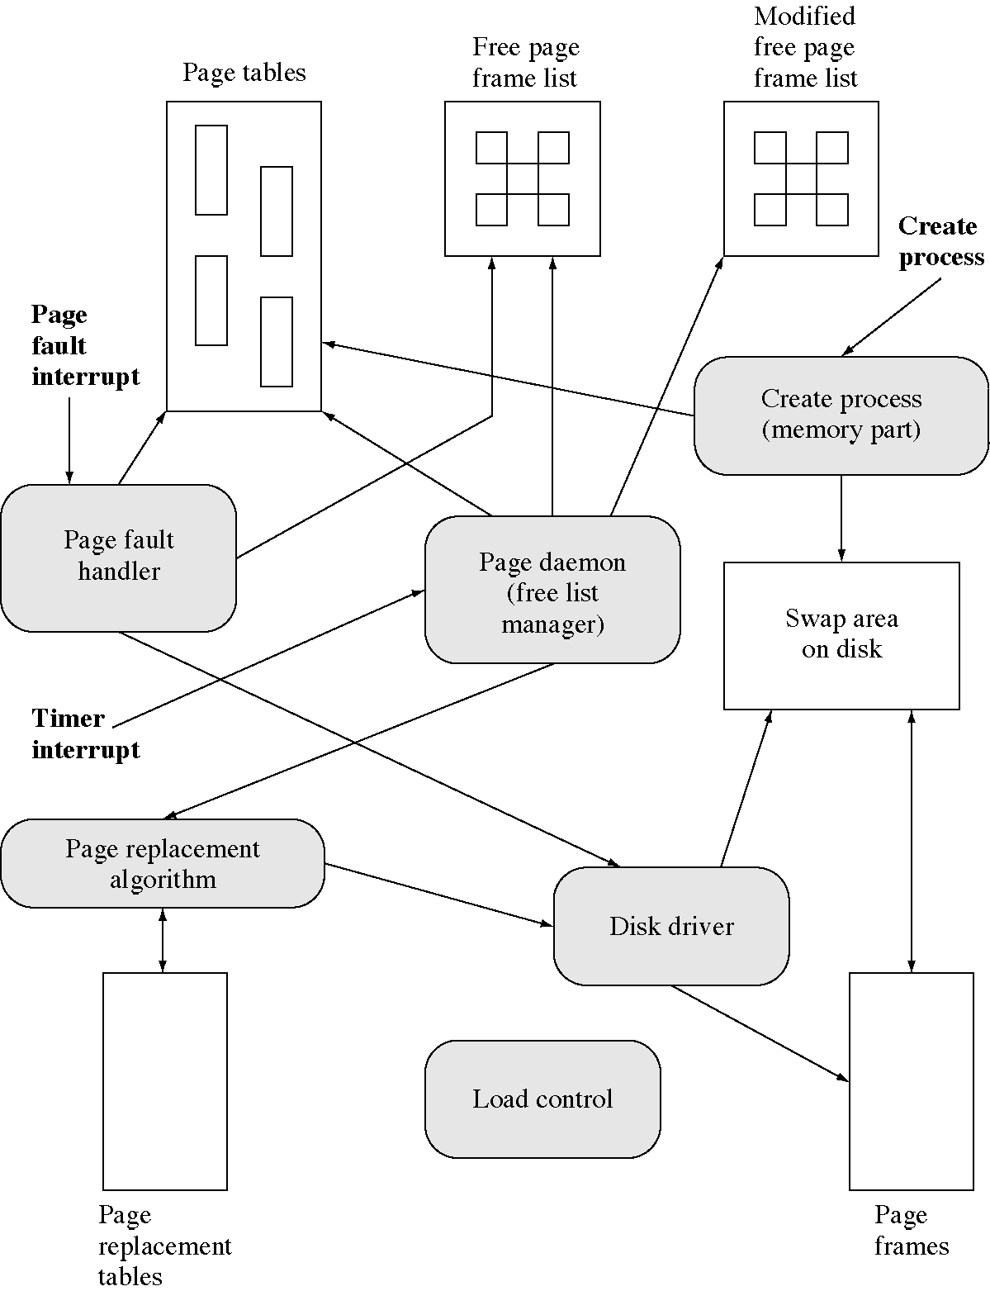
VM events and procedures

Slide 58
Daemons and events
OS usually respond to events
  but sometime they need to be proactive
An OS daemon is a process that wakes up every so often and looks to see if it has any work to do
It is useful to keep a pool of free pages
  so page faults can be handled immediately
A paging daemon wakes up every so often and keeps the free page pool large enough

Slide 59
Design technique:
System models and daemons
Operating systems are essentially reactive
  they react to interrupts
But if we include timer interrupts
  then operating systems are sort of doing things on their own, that is, being proactive
This is what we call a daemon
  a daemon wakes up and checks to see if something needs doing

Slide 60
Reactive and proactive user interfaces
Graphical user interfaces are generally reactive, they wait for user actions
  this is a good model and puts the user in control which is good psychologically
Agents are a new user interface concept
  agents are proactive
  they go out and look for useful things to do

Slide 61
Design technique: Polling, software interrupts and hooks
How can a process know when an event occurs? There are two approaches
polling: it can check periodically
interrupts: it can ask another process to interrupt it when the event occurs
  the other process is usually the one that causes or handles the event
  so it is not much trouble for it to inform the waiting process that the event has ocurred.

Slide 62
Polling versus interrupts
Daemons use polling to discover events
  and then react to the event
Polling is easier to set up but is less efficient than being interrupted
  but interrupts require a process to do the interrupting
  there might be no such process
  or it might not be set up to provide interrupts

Slide 63
Hooks
A hook is the ability to register a procedure to be called when an event occurs
Systems that provide hooks are easy to modify
  emacs provides hooks for many editing events
  widget callback functions are hooks
  a hook is basically a software interrupt

Slide 64
File mapping
File mapping is the mapping of a file on disk into the virtual address space of a process.
File I/O then consists of reading and writing words in the virtual address space
  no system calls are required for read and write
This is also called a memory-mapped file.
The I/O system and the paging system both move data between disk and memory
  so it makes sense to combine them

Slide 65
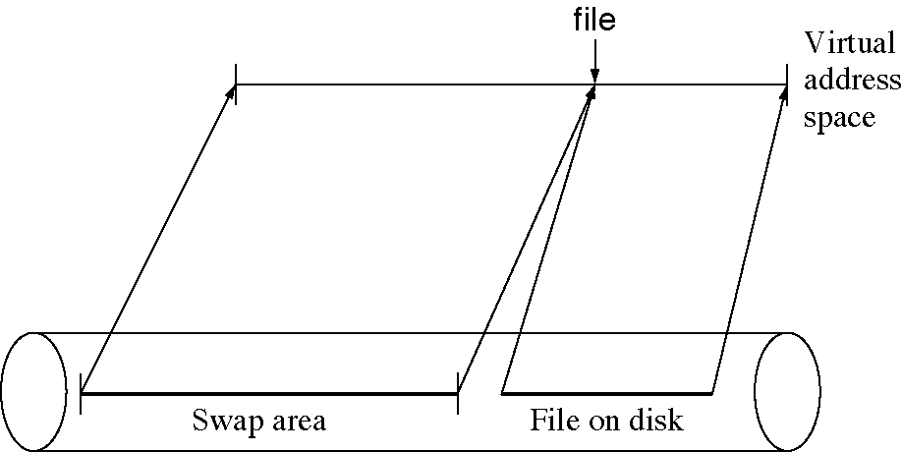
File mapping

Slide 66
File mapping system calls
A system call is required to map the file into the address space (and one to remove it).
char * MapFile(
int openFileId, // file already open
char * startAddress = 0, // 0: OS does it
int startOffset = 0, // into the file
int length = 0 ); // 0: whole file
This call allows you to map a file in pieces
  to save virtual address space

Slide 67
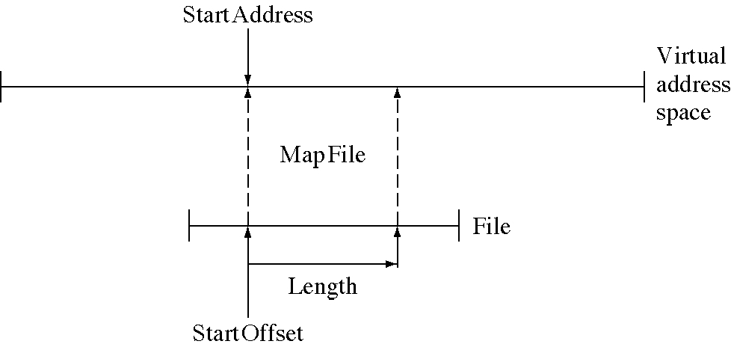
The MapFile system call

Slide 68
File mapping example code
int CountLetter(
char *fileName, char letter) {
int fid = open(fileName, Reading);
char * fileArea = MapFile(fid);
int fileLength = GetFileLength(fid);
int letterCount = 0;
for( int i=0; i < fileLength; ++i) {
if( fileArea[i] == letter )
++letterCount;
}
UnMapFile(fid);
return letterCount;
}

Slide 69
Advantages of file mapping
Simpler OS interface: no explicit I/O
More efficient: system calls are not required for reading and writing files
Reduces the number of copies of file data in memory
Almost all modern operating system use it

Slide 70
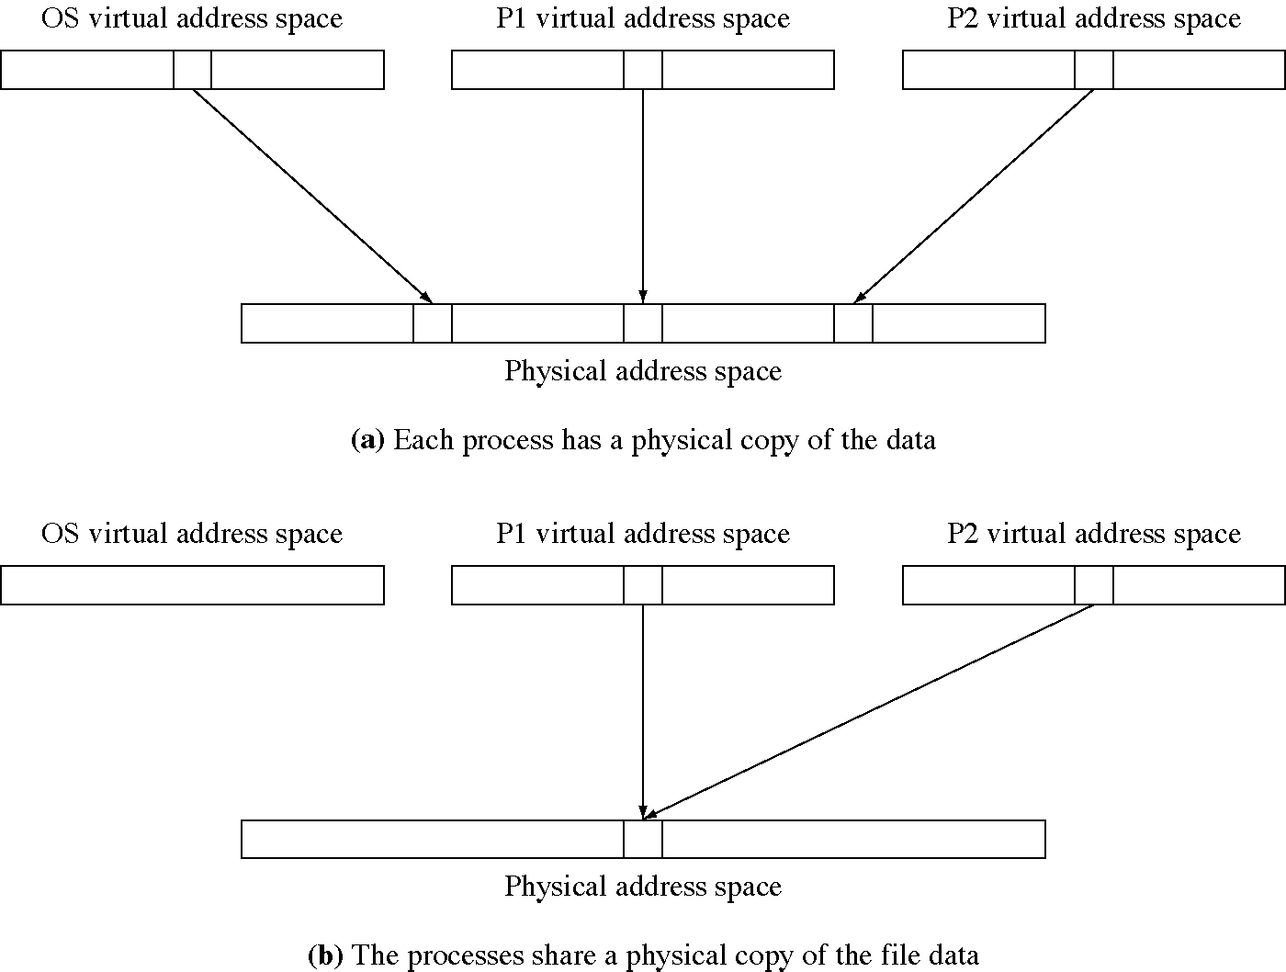
Multiple memory copies of file data

Slide 71
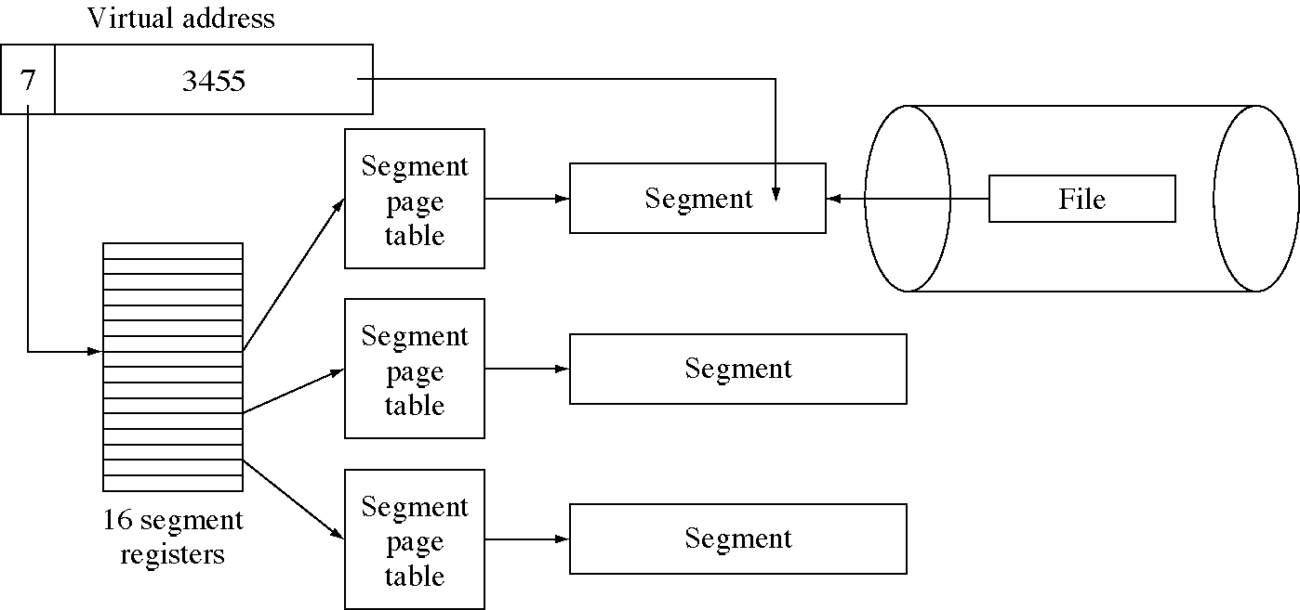
Virtual memory in the IBM 801

