Slide 1
Design III
Chapter 13

Slide 2
Key concepts in chapter 13
Multiplexing
Late binding
  binding time
  lazy creation
Static versus dynamic
  when each is best
Space-time tradeoffs
Using simple analytic models

Slide 3
Design technique: Multiplexing
Multiplexing: sharing a resource between two or more users
  space multiplexing: each user gets a part of the resource (simultaneous use)
    e.g. two processes in memory, two non-overlapping windows on a display screen
  time multiplexing: each user get the whole resource for a limited length of time (serial reuse)
    e.g.processes getting time slices of the processor, switching a window between two documents

Slide 4
Examples of multiplexing
OS examples
  memory: space multiplexed, also time multiplexed with virtual memory
  windows: time and space multiplex a screen
Other examples
  Sharing communication links: time multiplexed and space (by frequency) multiplexed

Slide 5
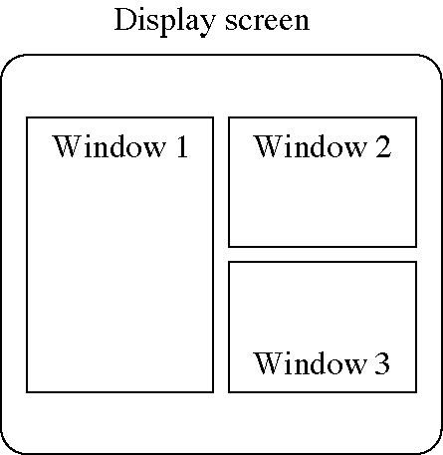
Space-multiplexing a display

Slide 6
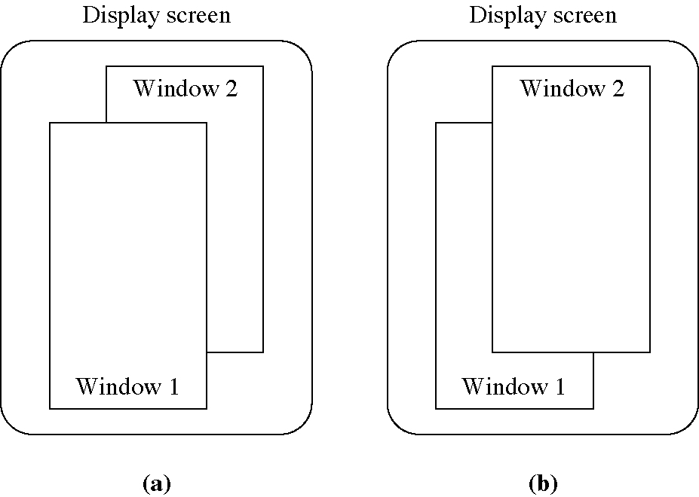
Time-multiplexing a display

Slide 7
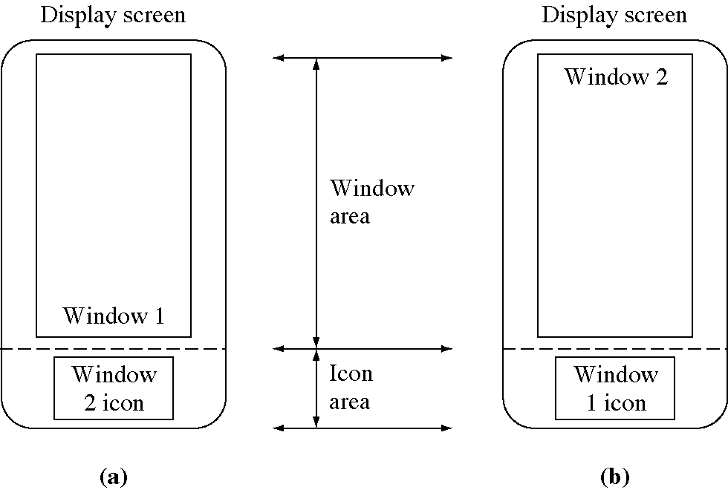
Time- and space-multiplexing

Slide 8
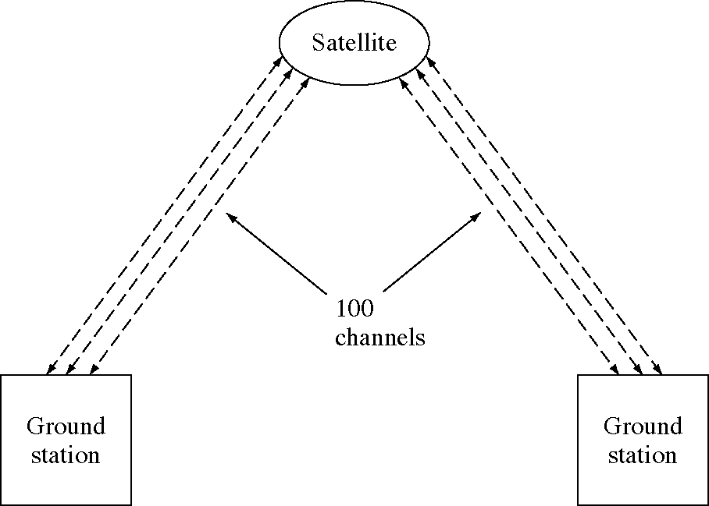
Time-multiplexing satellite channels

Slide 9
Design technique: Late binding
Late binding: delay a computation or resource allocation as long as possible
Motivating example: In virtual memory we delay allocating page frames until the page is accessed for the first time

Slide 10
Late binding examples
OS examples
  Virtual memory
  Network routing: decide route at late moment
CS examples
  Stack allocation: allocate procedure variables when the procedure is called
  Key encoding: send key numbers, bind to ASCII codes later in the processing
  Manufacturing: “just in time” inventory, don’t keep inventory very long

Slide 11
Binding time
A concept taken from programming languages: binding a value to an attribute
  binding a variable to a value: late, assignment time
  binding a local variable to storage: late, at procedure call time
  binding a variable to a type
    early in most languages, compile time
    late in Lisp, Smalltalk, etc., a run time

Slide 12
Lazy creation
Wait to create objects until they are needed
  Fetch web page images only when they are visible
  Create windows only when they are about to become visible
  Copy of a large memory area: use copy-on-write to create the copy as late as possible
Lazy evaluation: of function arguments, only evaluate them when they are used, not at the time of the function call.

Slide 13
Late binding issues
Sometime late bindings do not have to be done at all so we save resources (e.g. the browser never scrolls down to the image)
Resources are not used until they are needed
Late binding is often more expensive than early binding (where you can combine binding as get economies of scale)
Compilers use early binding of source to code and interpreters use late binding

Slide 14
More late binding issues
Reservations: a form of early binding
  used where the cost of waiting for a resource is high
Connectionless protocols use late binding, connection protocols use early binding
Dynamic = late binding
Static = early binding

Slide 15
Design technique:
Static vs. dynamic
Static: done before the computation begins
  static solutions are usually faster
  static solutions use more memory
  static computation are done only once
Dynamic: done after the computation begins
  dynamic solutions are usually more flexible
  dynamic solutions use more computation
  dynamic computation are often done several times

Slide 16
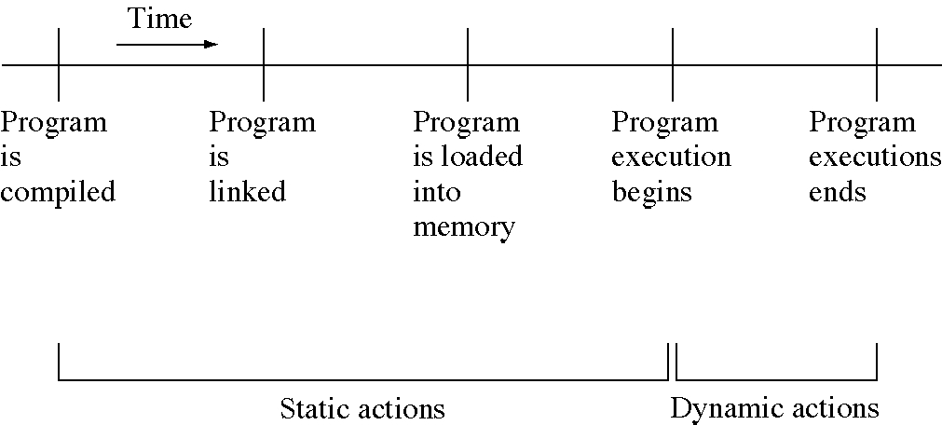
Static and dynamic activities

Slide 17
OS examples
Programs are static, processes are dynamic
Relocation: can be done statically by changing the code or dynamically by changing the addresses
Linking: can be static or dynamic
Process creation: static in a few very specialized OSs
Scheduling: static in many real-time OSs
  static scheduling is more predictable

Slide 18
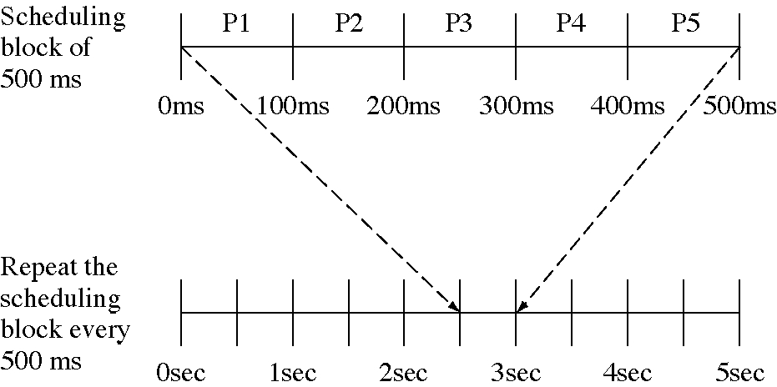
Static scheduling of processes

Slide 19
CS examples
Memory allocation: static or dynamic
Compilers are static, interpreters are dynamic
Type checking: static in strongly typed languages (C++, Ada, etc), dynamic in Smalltalk, Lisp, Tcl, Perl, etc.
Instruction counting: static = count instructions in the code, dynamic = count instruction executions in a process

Slide 20
Design technique:
Space/time tradeoffs
We can almost always trade computation time for memory
  use memory to save the results of previous computations
  compute results again rather than storing them
Example: counting bits in a word
  see the code on the following slides

Slide 21
Bit counting: one at a time
inline int CountBitsInWordByBit( int word );
int CountBitsInArray( int words[ ], int size ) {
int totalBits = 0;
for( int i = 0; i < size; ++i ) {
totalBits += CountBitsInWordByBit(words[i]);
}
return totalBits;
}
enum{ BitsPerWord=32 };
inline int CountBitsInWordByBit( int word ) {
int bitsInWord = 0;
for( int j = 0; j < BitsPerWord; ++j ) {
// Add in the low order bit.
bitsInWord += word & 1;
word >>= 1;
}
return bitsInWord;
}

Slide 22
Bit counting: four at a time
enum{ HalfBytesPerWord=8, ShiftPerHalfByte=4,
MaskHalfByte=0xF };
// Number of 1 bits in the first 16 binary integers
// 0000=0 0001=1 0010=1 0011=2 0100=1 0101=2 0110=2
// 0111=3 1000=1 1001=2 1010=2 1011=3 1100=2 1101=3
// 1110=3 1111=4
int BitsInHalfByte[16] =
{0, 1, 1, 2, 1, 2, 3, 3, 1, 2, 2, 3, 2, 3, 3, 4};
inline int CountBitsInWordByHalfByte( int word ) {
int bitsInWord = 0;
for( int j = 0; j < HalfBytesPerWord; ++j ) {
// Index the table by the low order 4 bits
bitsInWord
+= BitsInHalfByte[word & MaskHalfByte];
word >>= ShiftPerHalfByte;
}
return bitsInWord;
}

Slide 23
Bit counting: eight at a time
inline int CountBitsInWordByByte( int word );
int CountArrayInitialized = 0;
int CountBitsInArray( int words[ ], int size ) {
int totalBits = 0;
if( !CountArrayInitialized ) {
InitializeCountArray();
CountArrayInitialized = 1;
}
for( int i = 0; i < size; ++i ) {
totalBits += CountBitsInWordByByte(words[i]);
}
return totalBits;
}

Slide 24
Bit counting: eight at a time
enum{BytesPerWord=4,ShiftPerByte=8,MaskPerByte=0xFF};
int BitsInByte[256];
void InitializeCountArray( void ) {
for( int i = 0; i < 256; ++i ) {
BitsInByte[i] = CountBitsInWordByBit( i );
}
}
inline int CountBitsInWordByByte( int word ) {
int bitsInWord = 0;
for( int j = 0; j < BytesPerWord; ++j ) {
bitsInWord += BitsInByte[word & MaskPerByte];
word >>= ShiftPerByte;
}
return bitsInWord;
}

Slide 25
Time/space tradeoff examples
Caching: uses space to save time
In-line procedures: use space to save time
Encoded fields: use (decoding) time to save space
Redundant data (e.g., extra links in a data structure): use space to save time
Postscript: uses time to save space
Database indexes: use space to save time
  any index trades of space for time

