Slide 1
I/O Devices
Chapter 14

Slide 2
Key concepts in chapter 14
Devices and controllers
Terminal devices
  terminal capability databases
  graphics terminals
  terminal emulators and PPP
Communication devices
  serial and parallel ports
  Ethernet and other network devices
Disk devices
  RAID, CD, tape, SCSI

Slide 3
Devices and controllers
Input device: transforms externally represented data to internal form
Output device: transforms internal data to some external representation
Device controller: an electronic component that interfaces between the computer system bus and one or more devices
I/O processor or channel: a programmable device controller

Slide 4
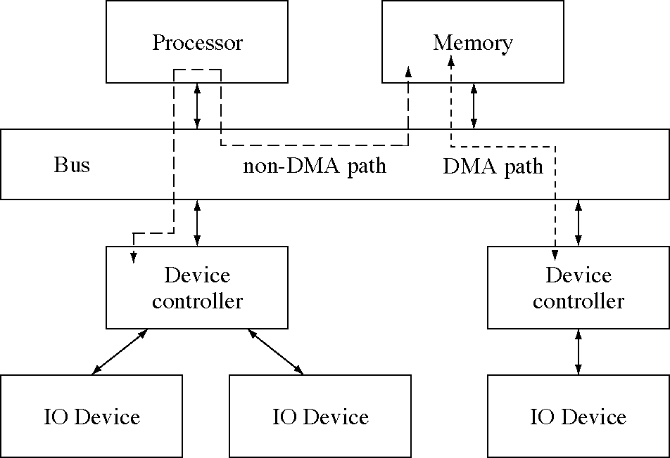
I/O devices and controller

Slide 5
Terminal devices
A keyboard, mouse and display
  connected to the computer by a serial port
A special-purpose computer with a character-display-oriented instruction set
Virtual terminals allow programs to use many types of terminals
  uses a terminal capability database
  uses the curses virtual terminal model

Slide 6
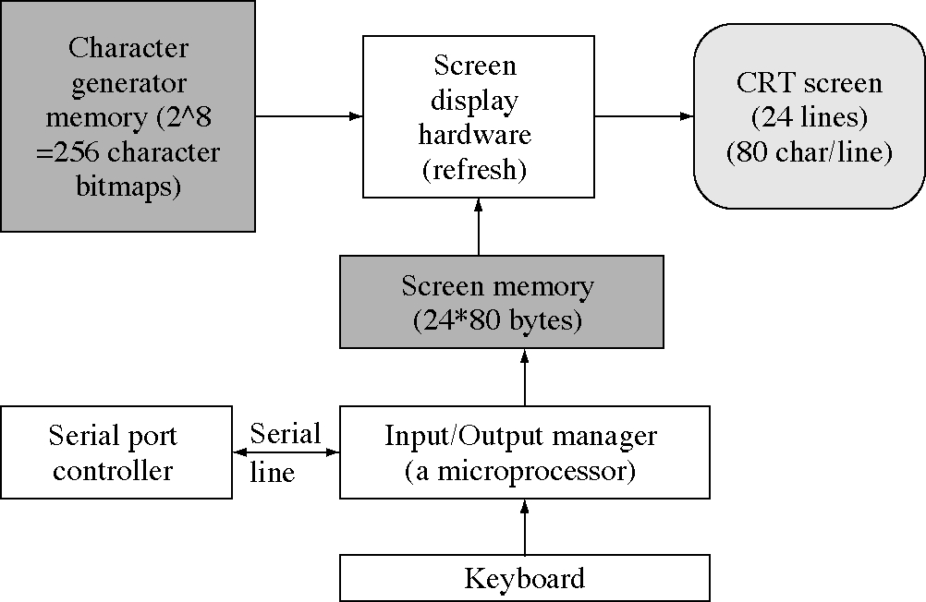
A basic terminal device

Slide 7
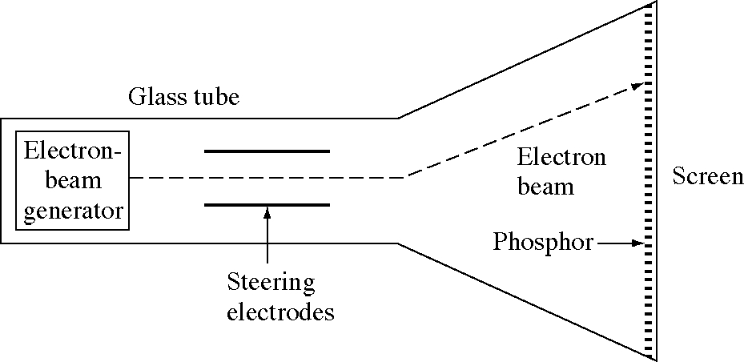
Electron beam drawing on a CRT

Slide 8
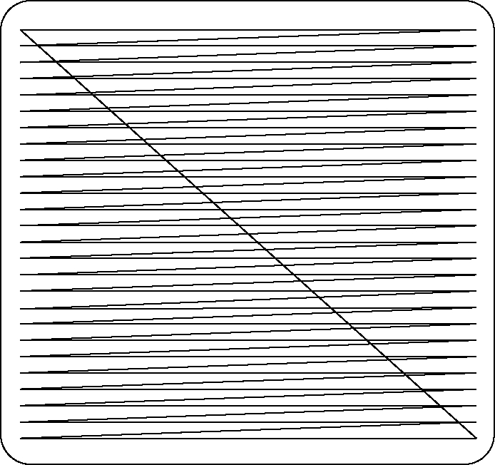
Electron beam trace on a screen

Slide 9
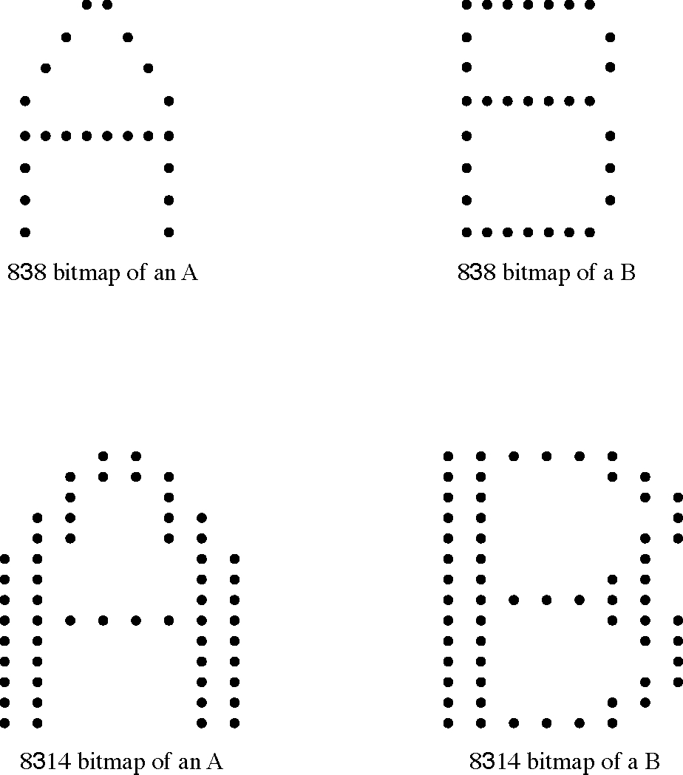
Bitmaps for character display

Slide 10
VT100 display commands
(1) Clear the screen
(2) Go to line 12, character 30
(3) Write "HelloWorld”
(4) Go to line 12, character 35
(5) Insert ", " (changing it to "Hello, World")
(1) <E>[;H<E>[2J (8 bytes -- clear screen and home cursor)
(2) <E>[13;30H (8 bytes -- go to line 12 character 30)
(3) HelloWorld (10 bytes -- ASCII characters)
(4) <E>[13;35H (8 bytes -- go to line 12 character 35)
(5) , World (7 bytes -- ASCII characters -- changing it to "Hello, World")

Slide 11
Televideo 950 display commands
(1) <E>* (2 bytes -- clear screen and home cursor)
(2) <E>=,> (4 bytes -- go to line 12 character 30)
(3) HelloWorld (10 bytes -- ASCII characters)
(4) <E>=,C (4 bytes -- go to line 12 character 35)
(5) <E>q, <E>r (6 bytes -- insert mode, ", ", end insert)

Slide 12
VT100 termcap
d0|vt100|vt100-am|vt100am|dec vt100:\ :do=^J:co#80:li#24:cl=50\E[;H\E[2J:sf=5\ED:\ :le=^H:bs:am:cm=5\E[%i%d;%dH:nd=2\E[C:up=2\E[A:\ :ce=3\E[K:cd=50\E[J:so=2\E[7m:se=2\E[m:us=2\E[4m:ue=2\E[m:\ :md=2\E[1m:mr=2\E[7m:mb=2\E[5m:me=2\E[m:is=\E[1;24r\E[24;1H:\ :rf=/usr/share/lib/tabset/vt100:\ :rs=\E>\E[?3l\E[?4l\E[?5l\E[?7h\E[?8h:ks=\E[?1h\E=:ke=\E[?1l\E>:\ :ku=\EOA:kd=\EOB:kr=\EOC:kl=\EOD:kb=^H:\ :ho=\E[H:k1=\EOP:k2=\EOQ:k3=\EOR:k4=\EOS:pt:sr=5\EM:vt#3:xn:\ :sc=\E7:rc=\E8:cs=\E[%i%d;%dr:

Slide 13
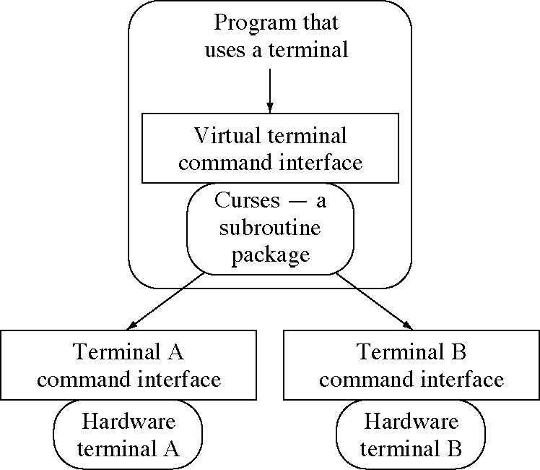
Virtual terminals and curses

Slide 14
Curses display commands
(1) erase();(clear screen and home cursor)
(2) move(12,30);(go to line 12 char 30)
(3) addstr("HelloWorld")(write ASCII chars)
(4) move(12,35);(go to line 12 char 35)
(5) insch(',');insch(' '); (insert ',' then ' ')

Slide 15
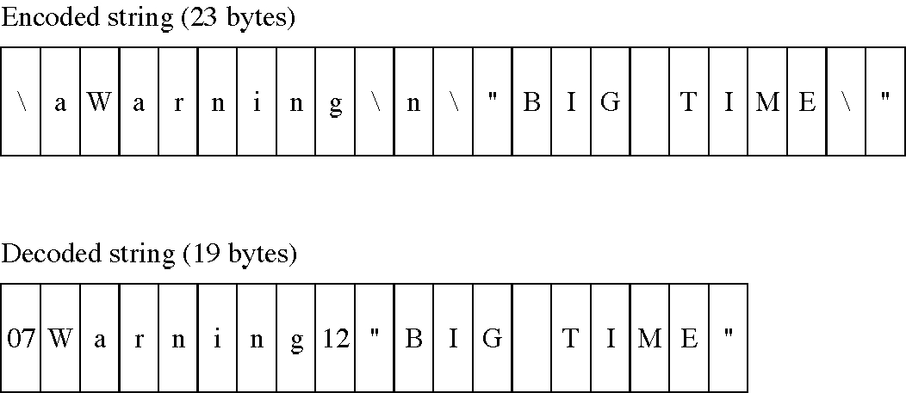
Design technique: escape codes

Slide 16
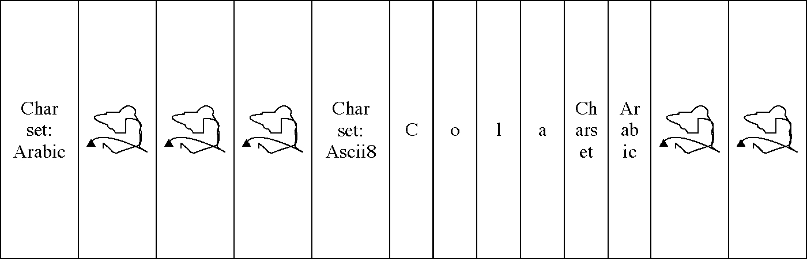
Encoding to save space

Slide 17
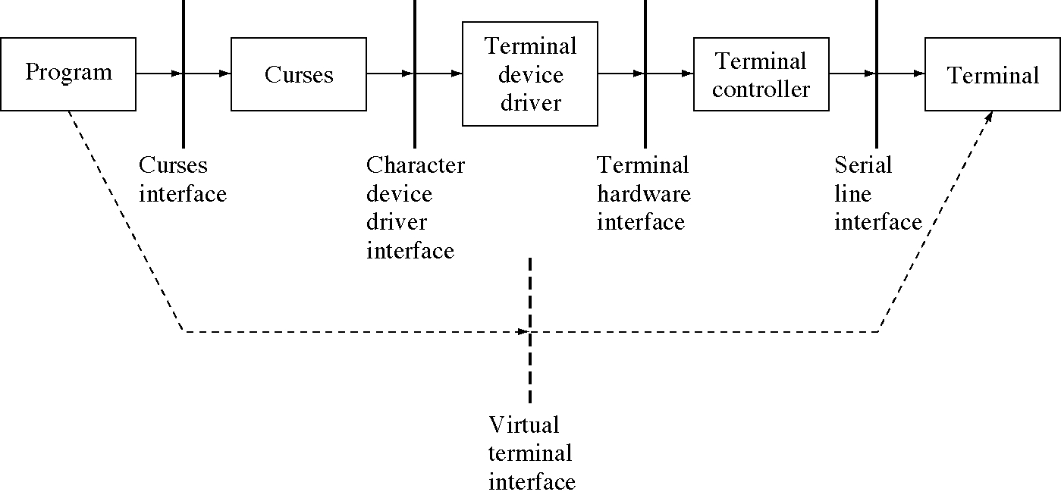
Interfaces to a terminal

Slide 18
Design technique:
Reusing old software
Old software is often a valuable resource
  people know how to use it
  it is already written and debugged
Old software depends on an environment that has gone away (e.g. terminals)
  but we can often use emulation to recreate the old environment and continue using old software

Slide 19
Mouse devices and events
Terminal devices report input events
  keyboard events
    key down
    key up
  mouse event
    mouse button down
    mouse button up
    mouse movement
These are combined into a unified event stream to the process reading the device

Slide 20
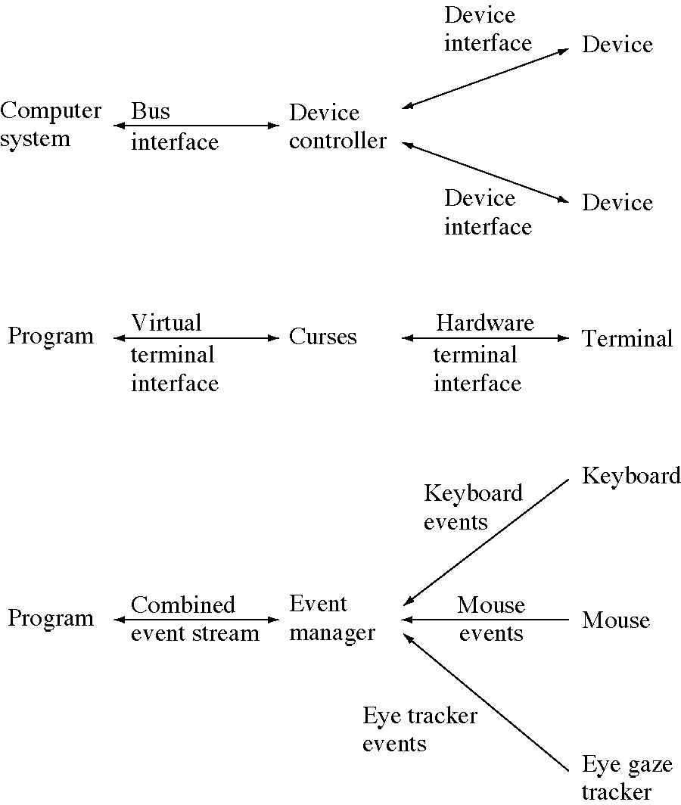
Two-stage communication

Slide 21
Design technique:
Two-level implementation
It is well-known that modularity is an effective design technique
  divide and conquer
The simplest version of modules is two modules, one built on the other
  a two-level implementation
We have seen this before (in chapter 4) but now we have many more examples

Slide 22
Some two-level implementations
Two levels of memory management
Two-level paging
device controllers and devices
Virtual terminals and real terminals
Multiple event streams into a single event stream
Logical and physical disks (later)
Two levels of device drivers (later)

Slide 23
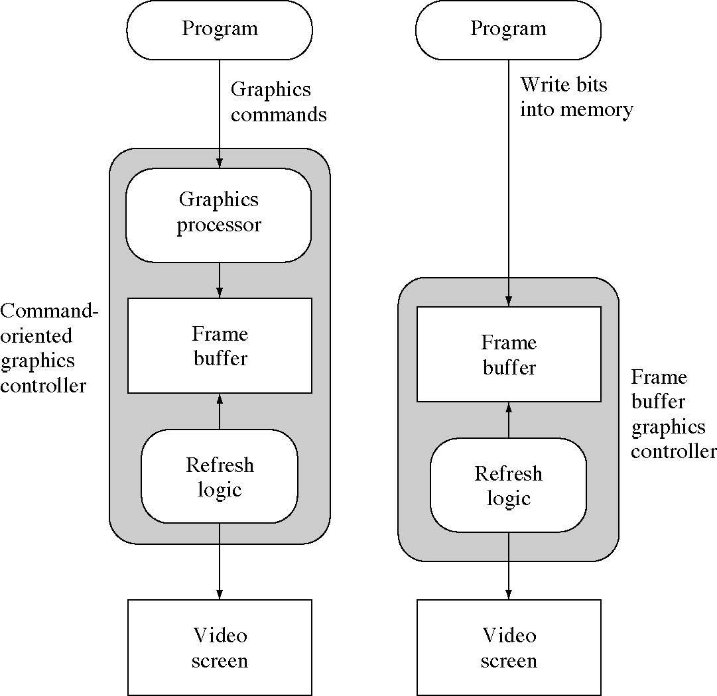
Two graphics controller models

Slide 24
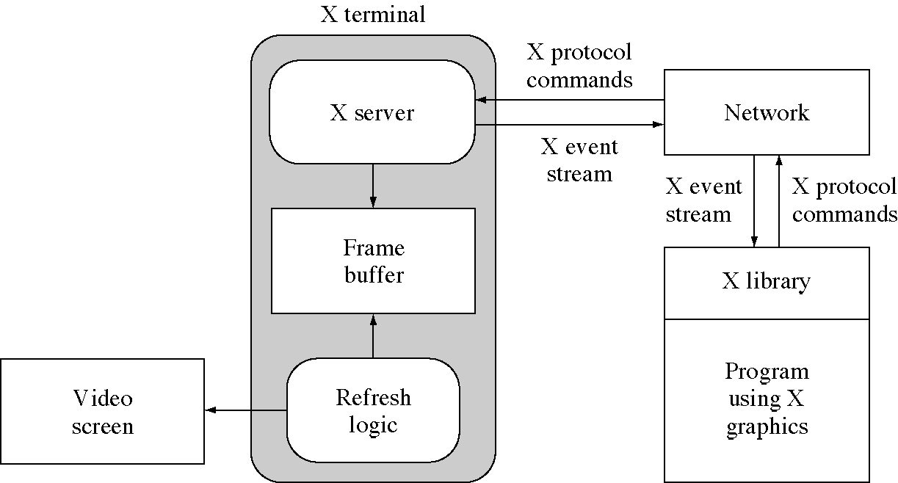
X windows communications

Slide 25
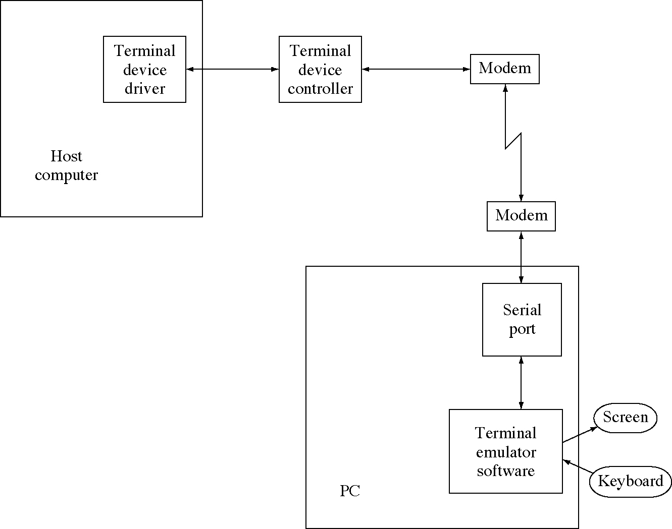
Terminal emulator over a modem

Slide 26
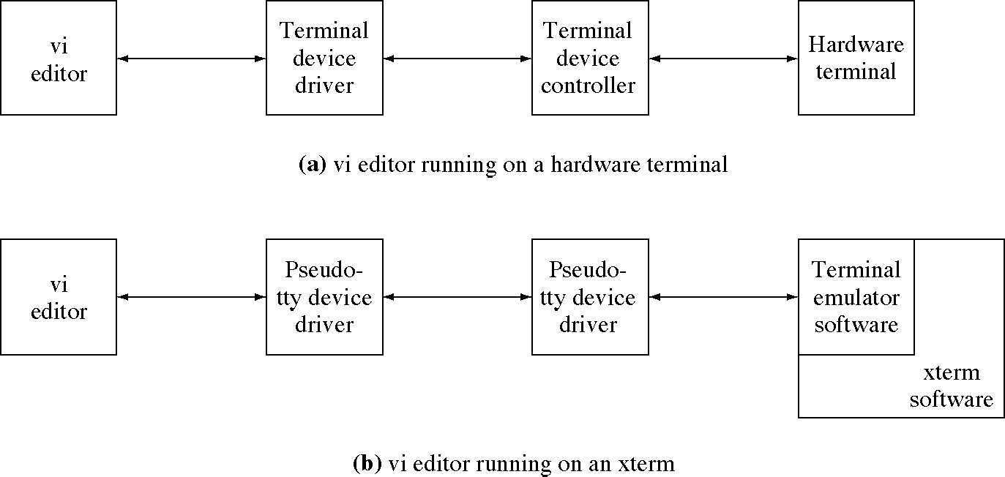
An Xterm is a terminal emulator

Slide 27
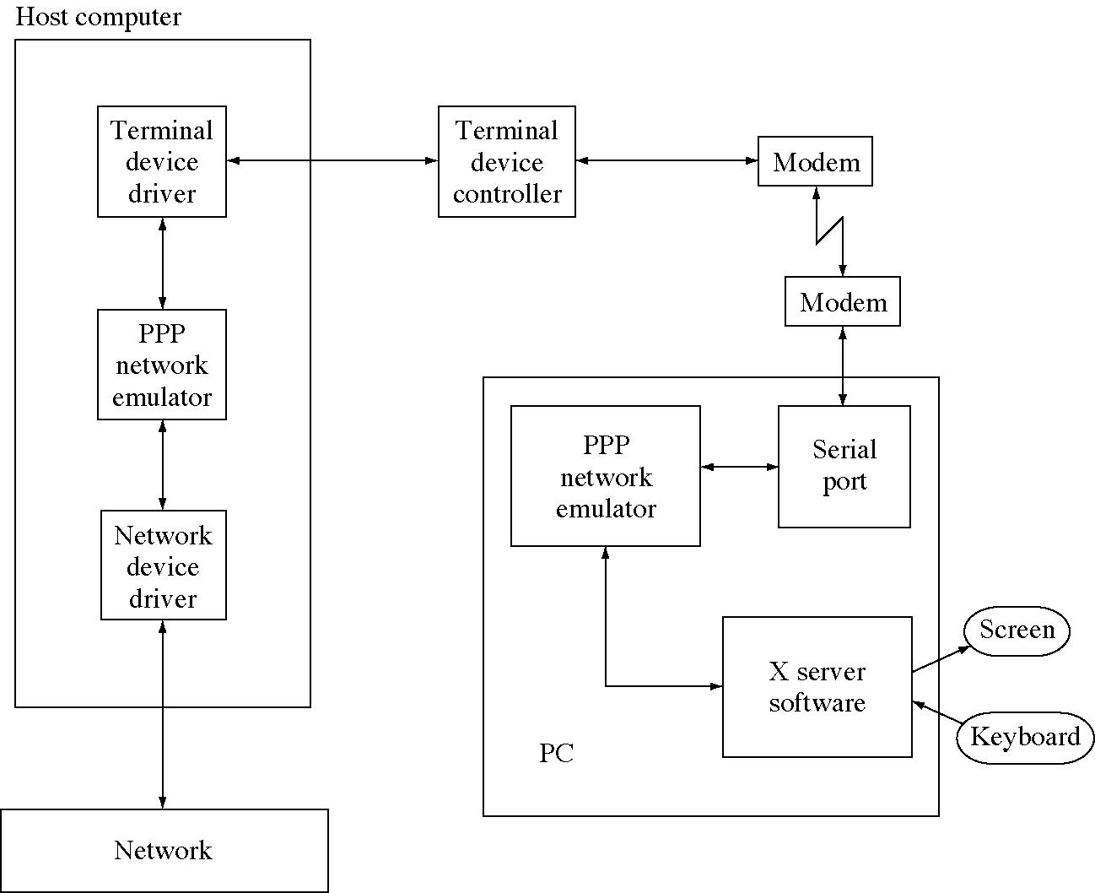
PPP network emulation

Slide 28
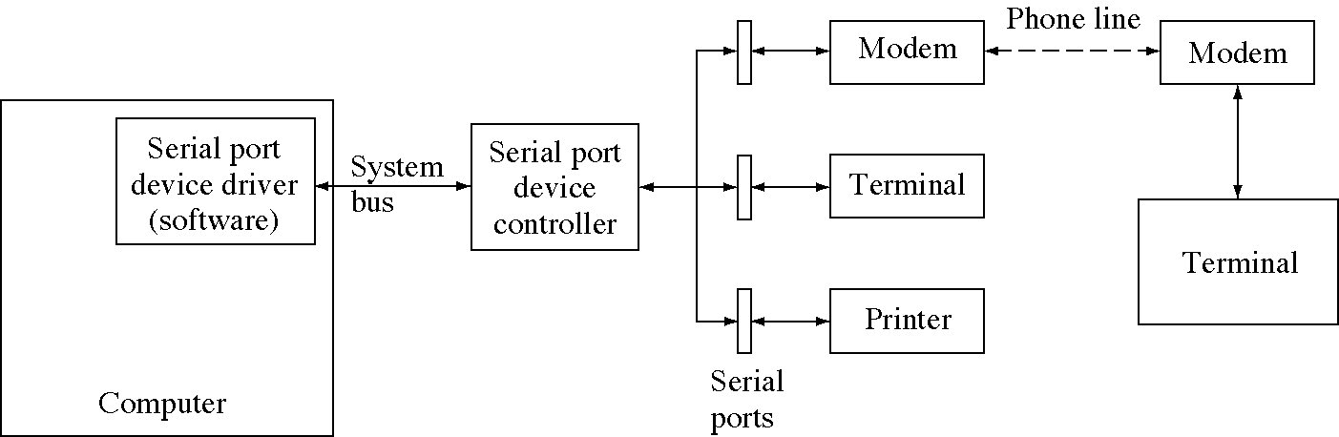
Serial port

Slide 29
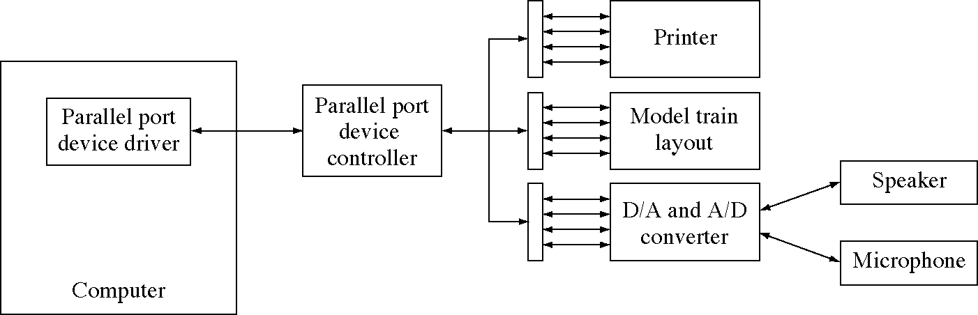
Parallel port

Slide 30
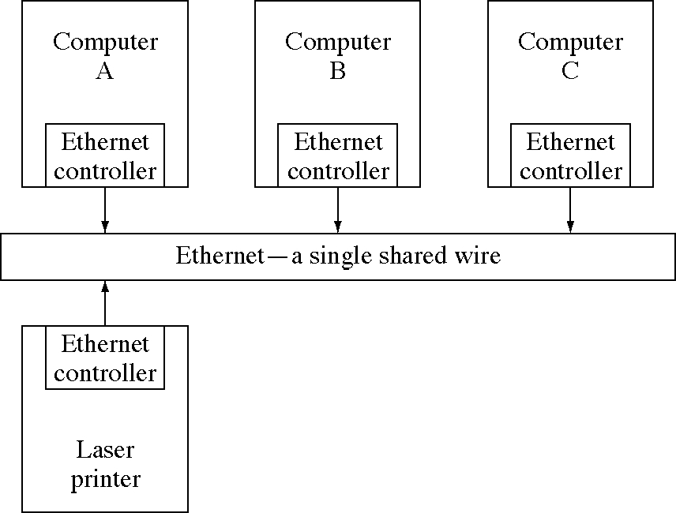
An Ethernet configuration

Slide 31
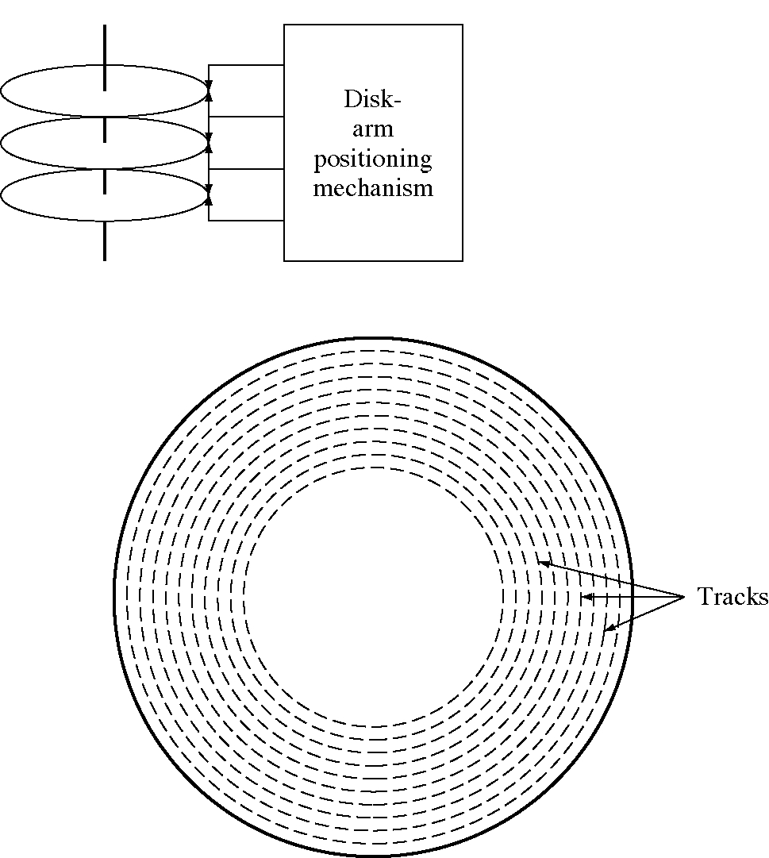
A disk device

Slide 32
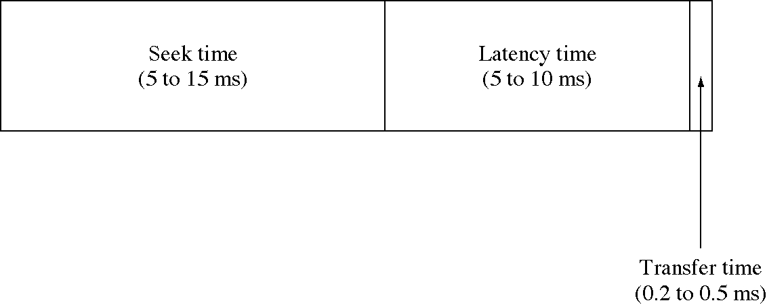
Timing of a disk access

Slide 33
RAID
Disk can only spin so fast
  to increase speed we need to use parallelism
RAID: redundant array of inexpensive disks
  redundant: RAID can be used in increase reliability through redundancy
  array: RAID uses disks in parallel
  inexpensive: RAID uses disks that are manufactured in the highest volume and are therefor have the best performance/cost ratio

Slide 34
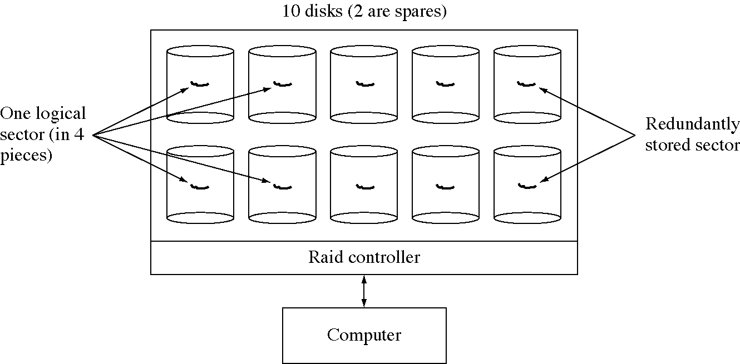
A RAID device

Slide 35
Design technique:
The power of parallelism
It is hard to keep make devices faster and faster
  e.g. processors, disks, printers, etc
You run into the Law of Diminishing Returns
In many situation you can turn to parallelism to gain more speed
  multiprocessors, RAID, multiple printers, etc.

Slide 36
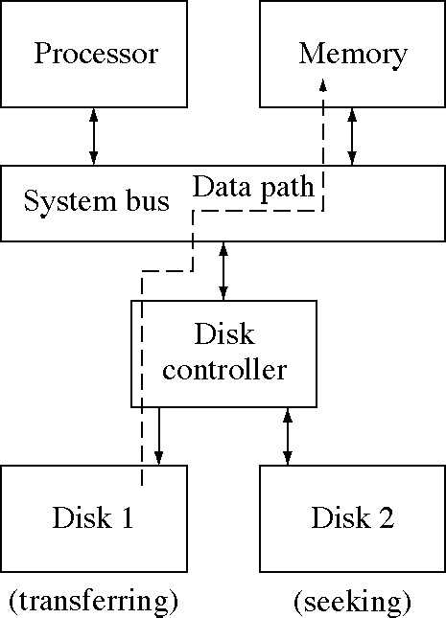
Overlapping transfer and seek

Slide 37
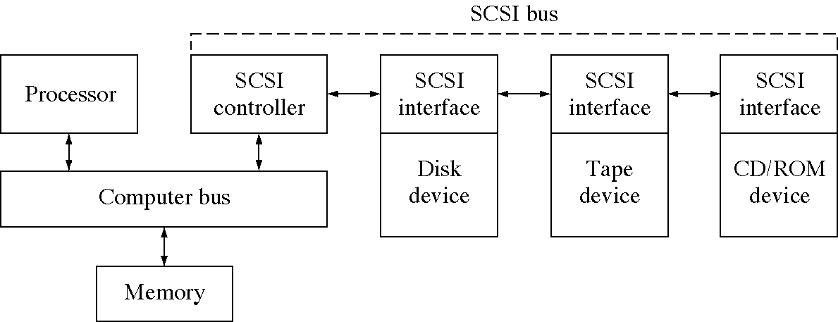
SCSI architecture

Slide 38
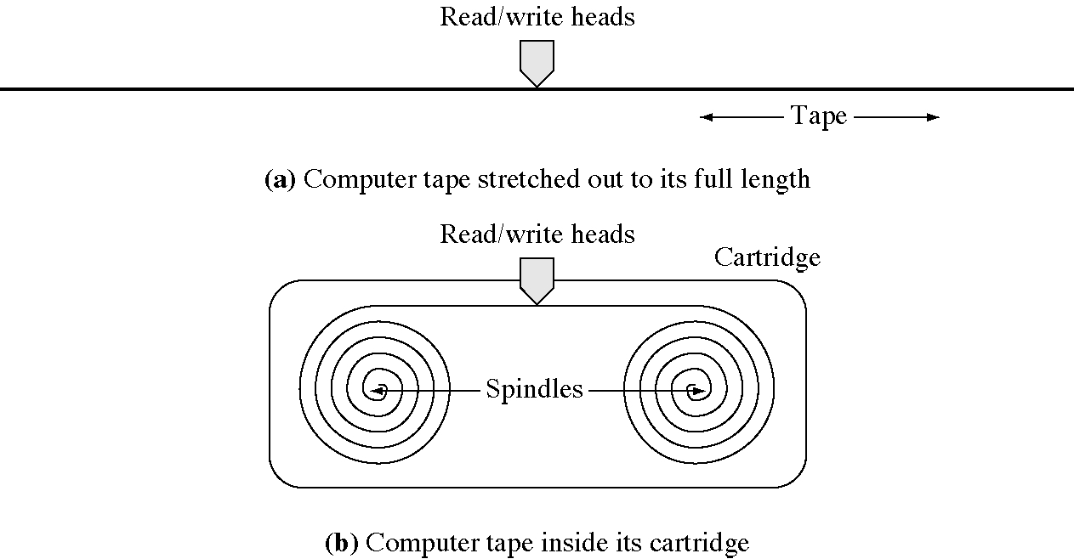
Tape devices

