Slide 1
I/O Systems
Chapter 15

Slide 2
Key concepts in chapter 15
Device drivers
  character and block interfaces
Double buffering
Disk head scheduling
  batching and aging as solutions to starvation
  disk models
Generalized device drivers
  disk parititions, RAM disks, pseudo-ttys, etc.
Disk caching

Slide 3
I/O system architecture
Devices controllers connect to the bus
  and represent the devices
Device drivers talk to device controllers
  and through them to the devices
Device drivers present a common interface to the rest of the OS

Slide 4
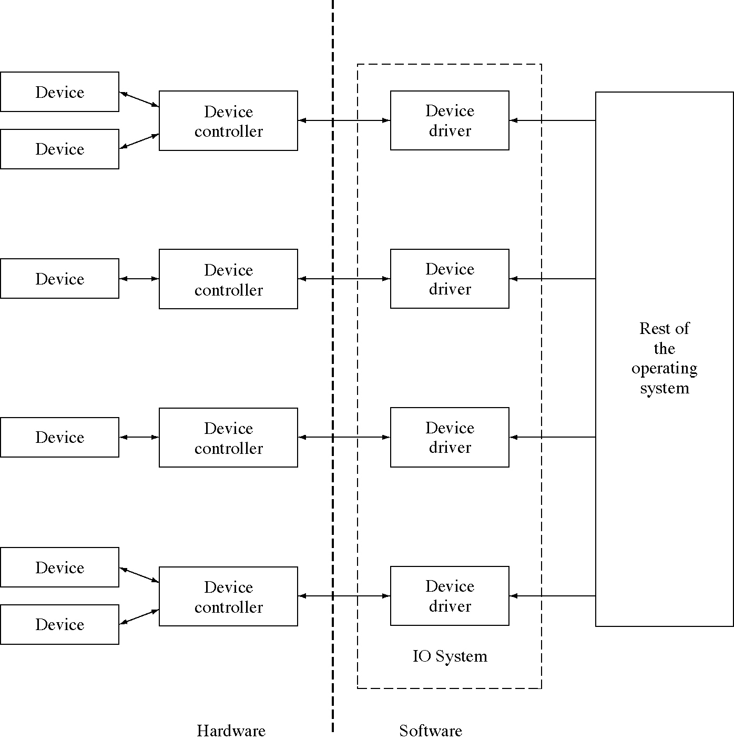
Device drivers

Slide 5
Device driver interface
Open(int deviceNumber): controllers can control more than one device
Close(int deviceNumber)
Read(int deviceNumber, int deviceAddress, void * memoryAddress, int length)
Write(int deviceNumber, int deviceAddress, void * memoryAddress, int length)

Slide 6
Device driver types
Block or disk device drivers
  disks have fixed-size, addressable blocks
  so no length is required, it is always one block
Character device drivers
  these devices deliver a stream of data with no addresses, no no device address is used
  these devices need a “device control” command to handle detailed points (like which paper tray to use)

Slide 7
Device control commands
Device control rather than data transfer
Examples
  which paper tray to use in a printer
  rewind a tape
  turn of echoing on a terminal
  ring the bell on a terminal

Slide 8
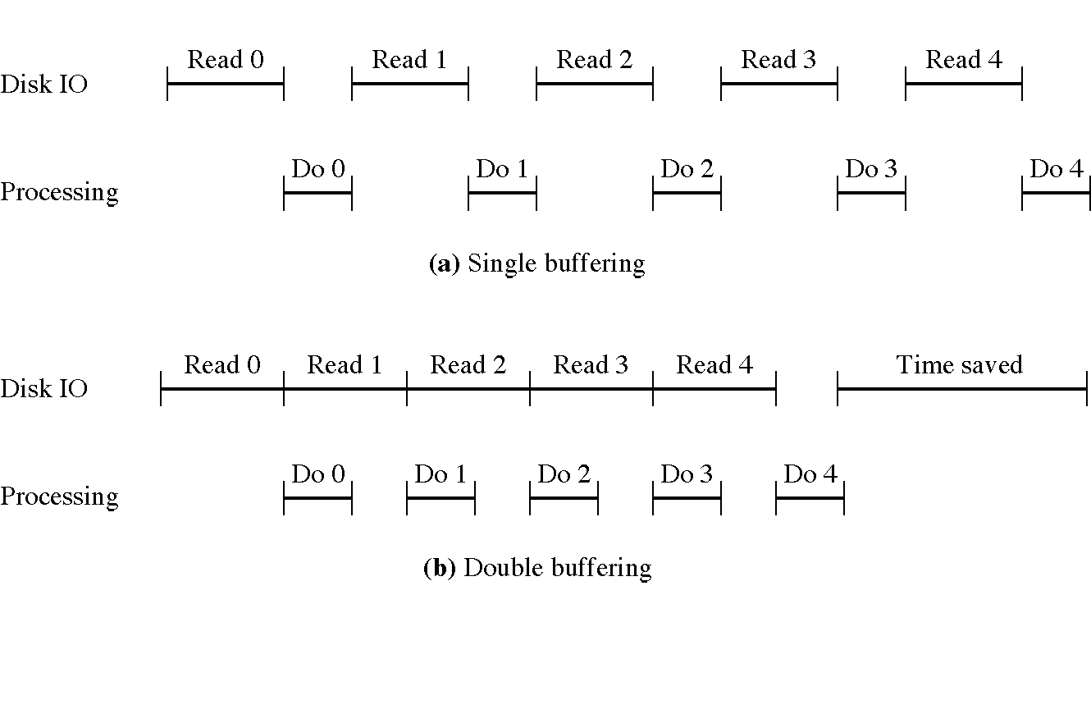
Single and double buffering

Slide 9
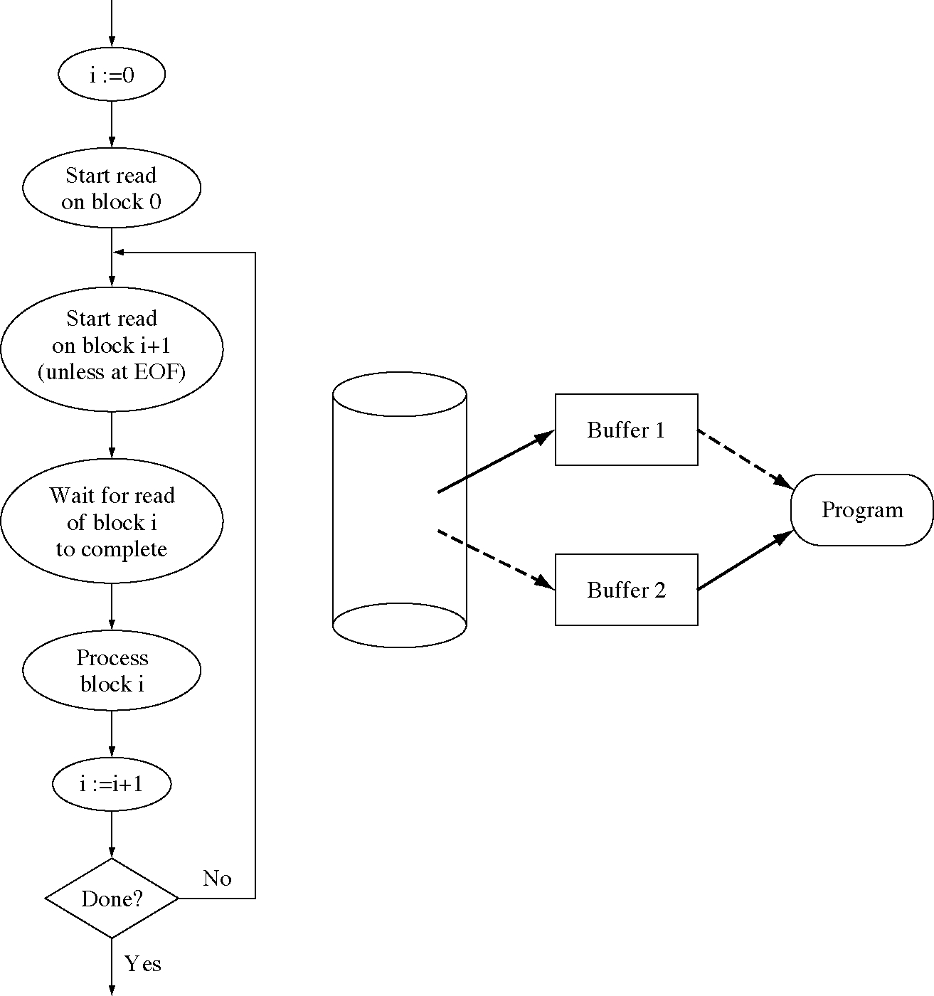
Double buffering flow of control

Slide 10
Disk head scheduling
If we have two or more pending disk requests, which should go first?
Strategies
  First-come, first-served (FCFS)
  Shortest-seek-time-first (SSTF)
    this has problems with starvation
    that can be solved with aging or batching
  Elevator algorithm

Slide 11
Elevator algorithm
1. Start at cylinder 0 with direction “up”.
2. Let N be the current cylinder.
3. If direction is “up”, then choose the closest request for cylinder N or higher else (direction is “down”) choose the closest request for cylinder N or lower.
4. If there are no request in the direction you are going, then switch directions.
5. Go back to step 2.

Slide 12
Device numbers
The main use of device numbers is to name which device to use (among those controlled by a single controller)
But they are often used to convey other information, for example:
  device 0 rewinds when done, device 8 does not
  device 0 uses normal-sized paper, device 8 uses legal-sized paper
  device 0 writes at high density, device 1 at medium density and device 2 at low density

Slide 13
Unification of files and devices
The device driver interface is nearly the same as the file interface
The I/O system has code to translate from the file interface to the device driver interface, so file commands can be used on devices

Slide 14
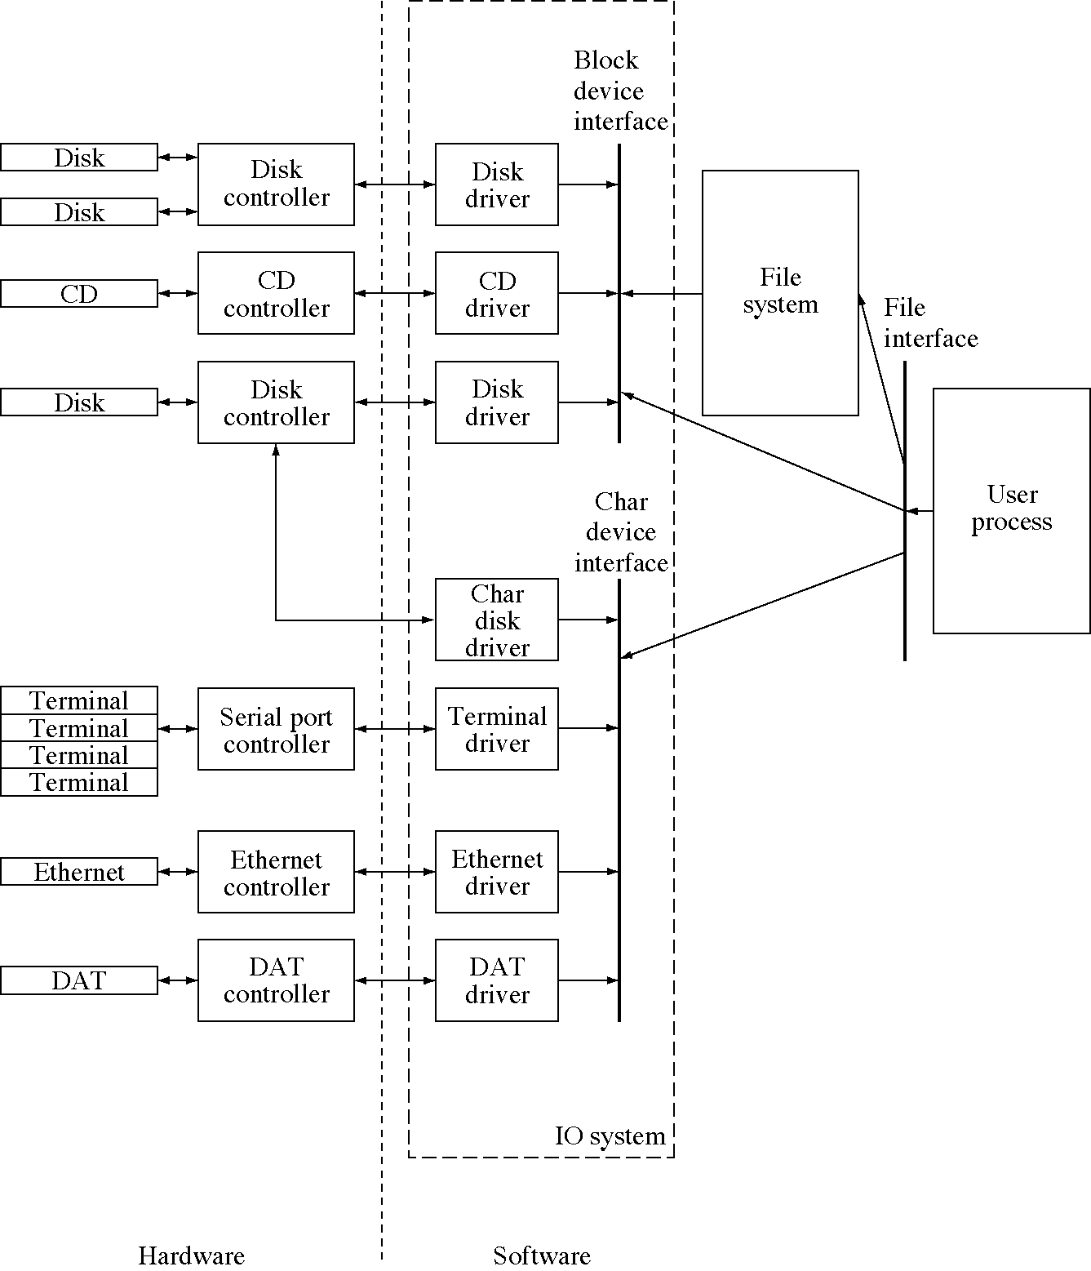
File, block, and character interfaces

Slide 15
Generalized device drivers
Device drivers can create useful effects
  they can partition a physical disk into several logical disks (usually called partitions)
  they can combine several physical disks into a single logical disk
  they can use RAM to simulate a (very fast) disk
  they can allow you to read an address space by making it look like a disk
  they can pretend they are talking to a terminal when they are really talking to a program

Slide 16
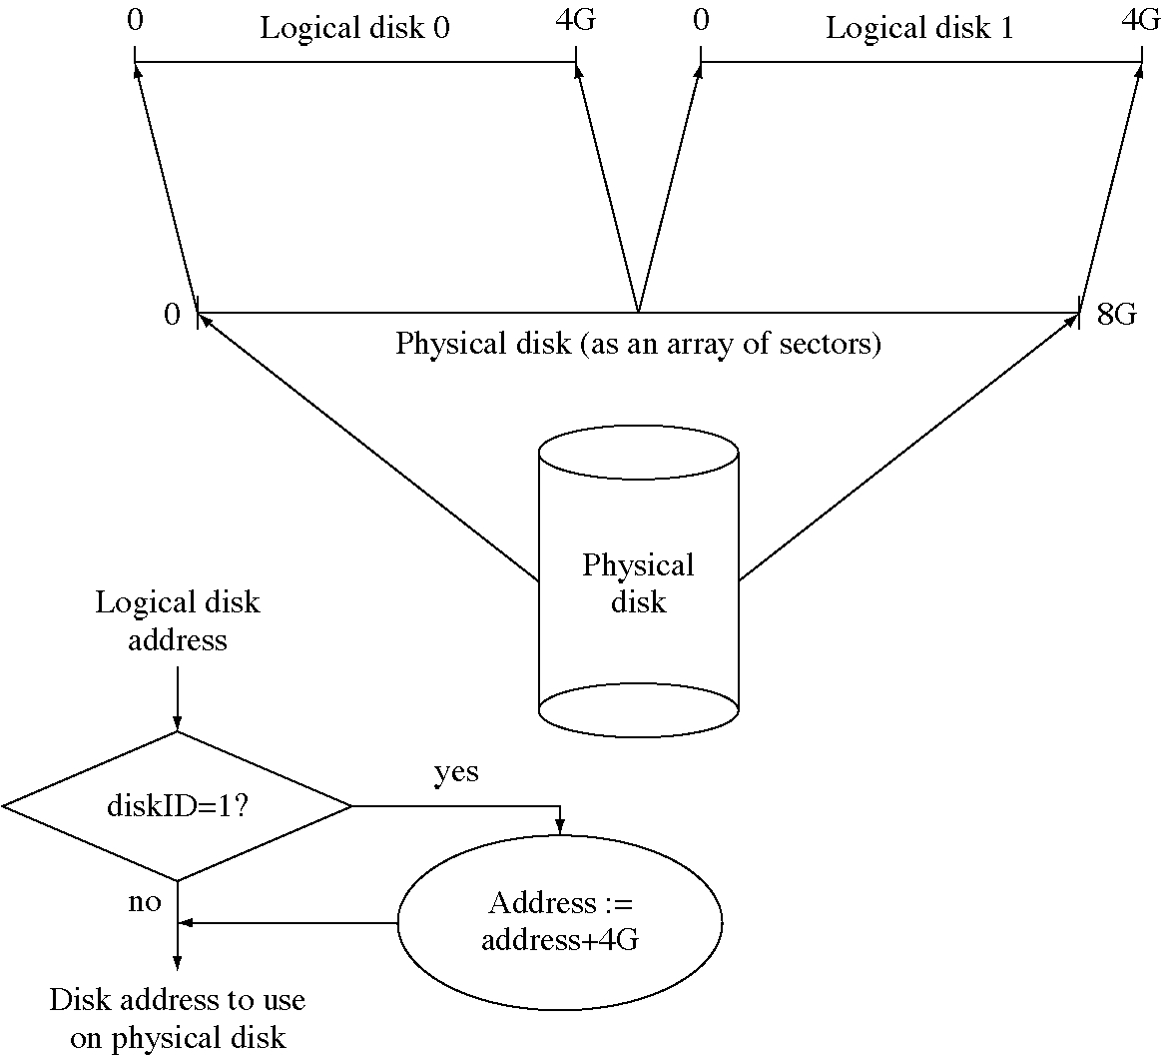
Partitioning a disk

Slide 17
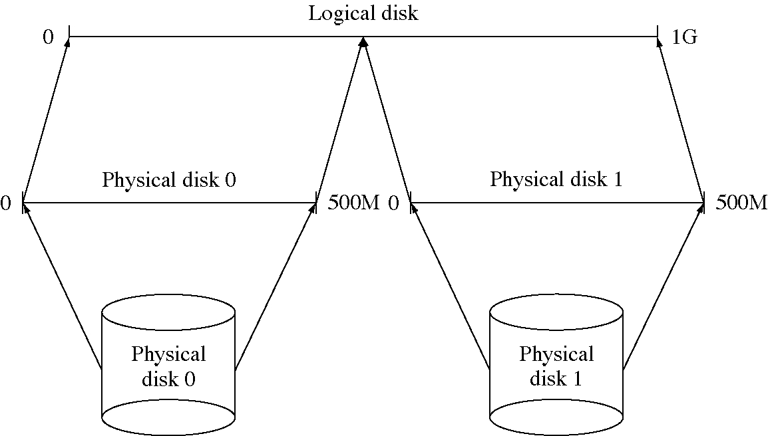
Combining disks

Slide 18
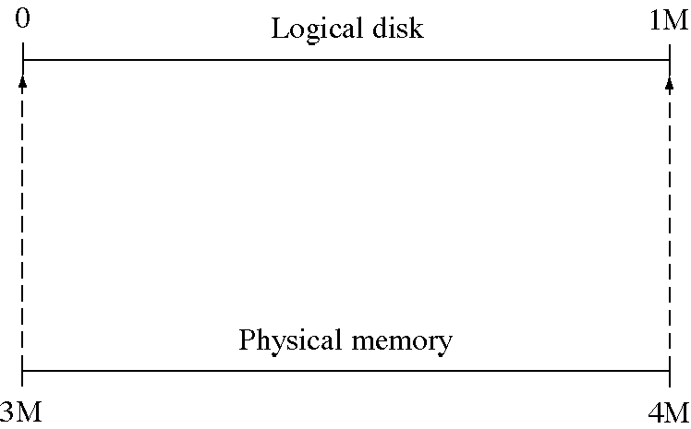
RAM disk

Slide 19
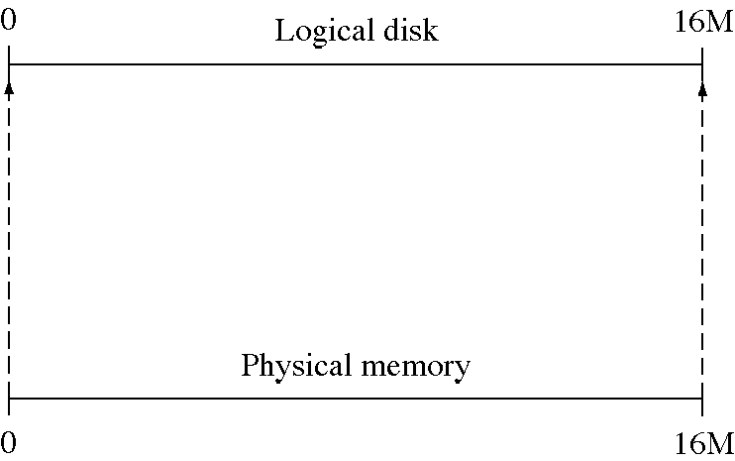
Physical memory as a disk

Slide 20
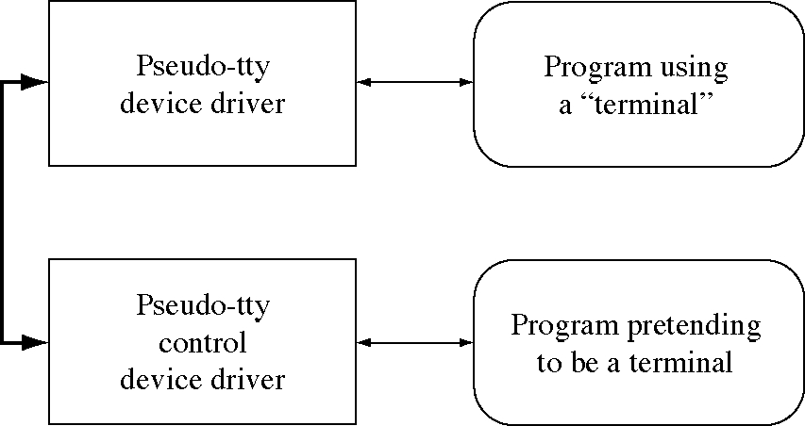
A program simulating a terminal

Slide 21
Disk caching
Memory is about 50,000 times faster than disk, that is the reason for RAM disks
But we can selectively keep parts of the disk in a memory buffer (a disk cache)
  locality makes this work very well
Disk caching is very effective
  we rarely need to read data twice in modern OSs
  but disk caching is not effective for writes

Slide 22
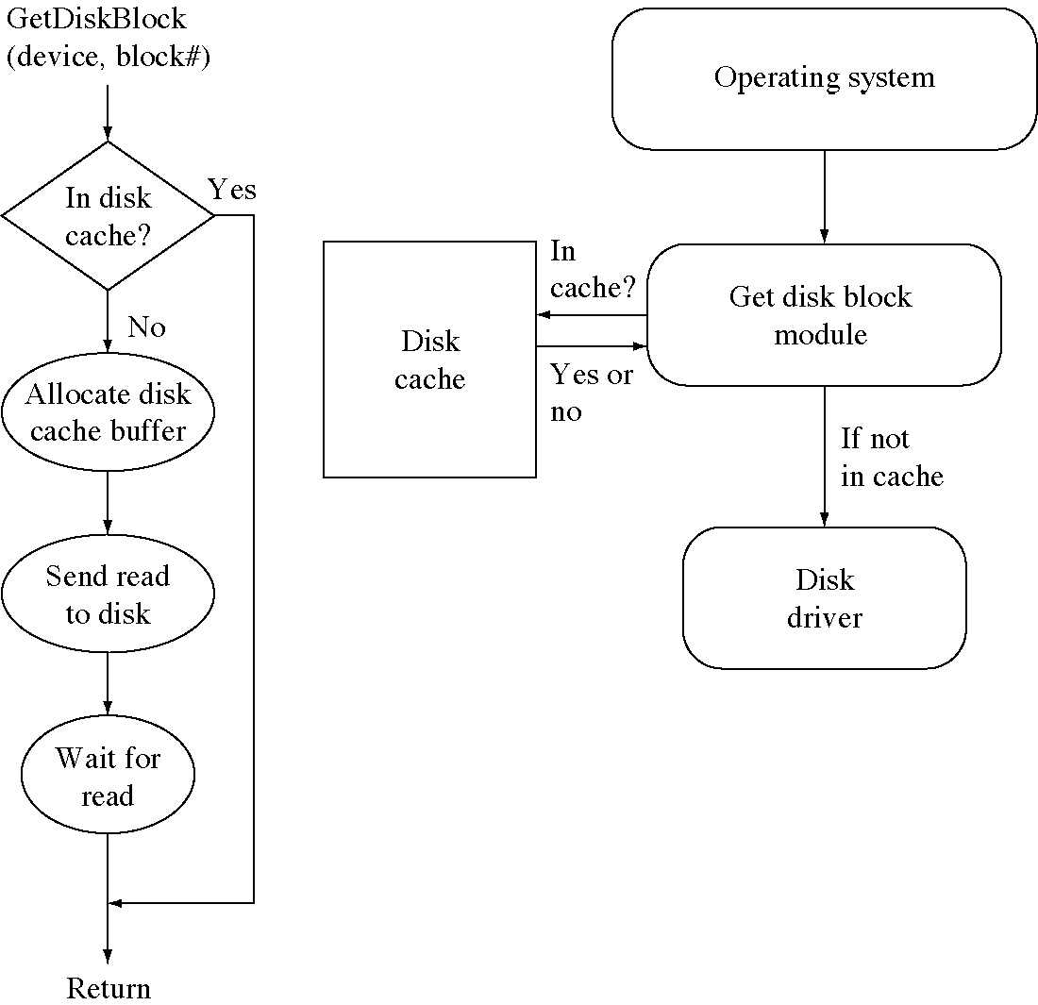
Disk caching flow of control

Slide 23
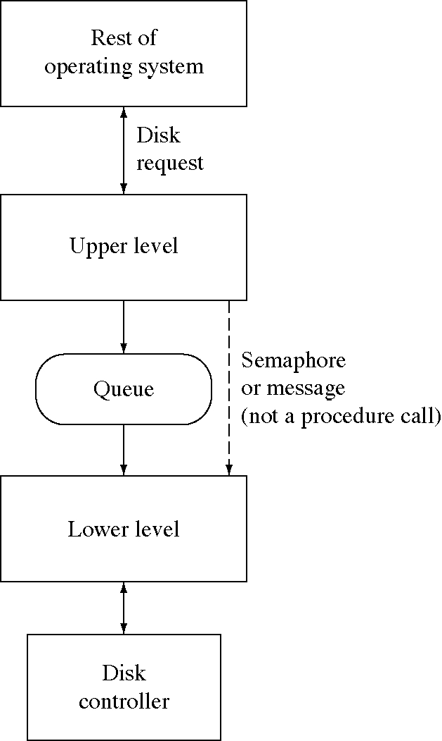
Two-level device driver

Slide 24
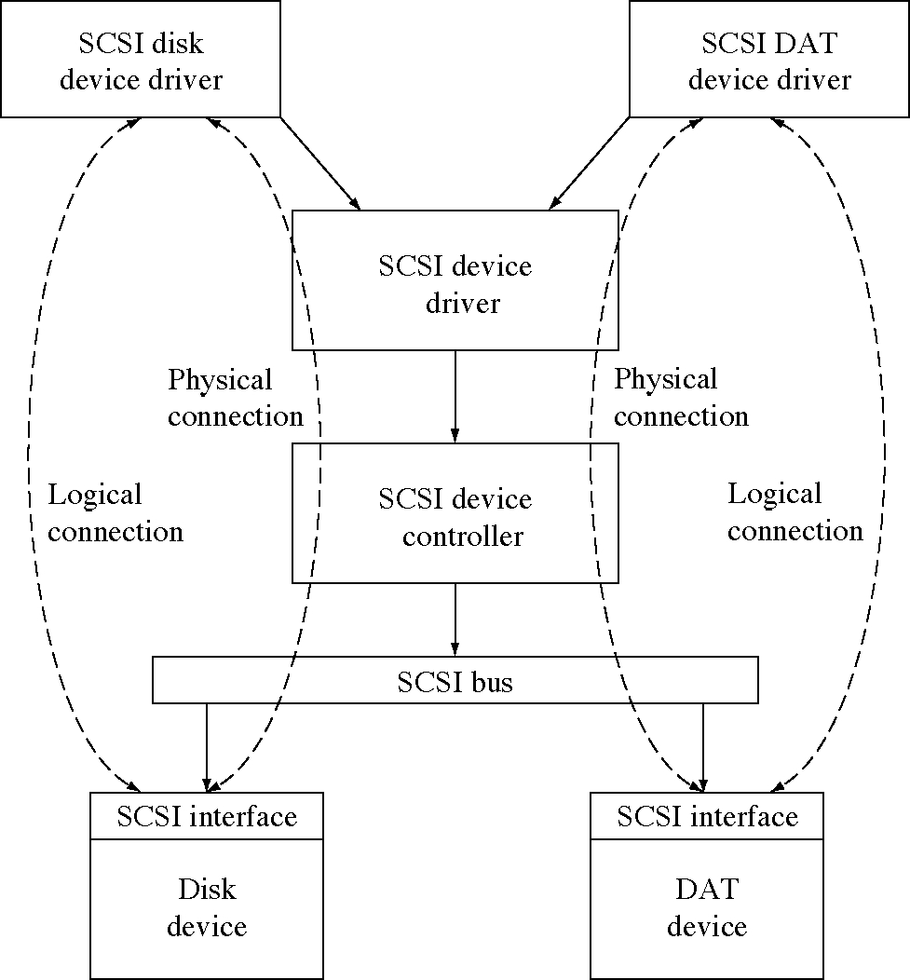
SCSI device drivers

