Slide 1
File Systems
Chapter 16

Slide 2
Key concepts in chapter 16
File
File and I/O system levels
File meta-data
File naming systems
Typical file system operatons
File system implementation
  physical and logical file system
  directory implementation

Slide 3
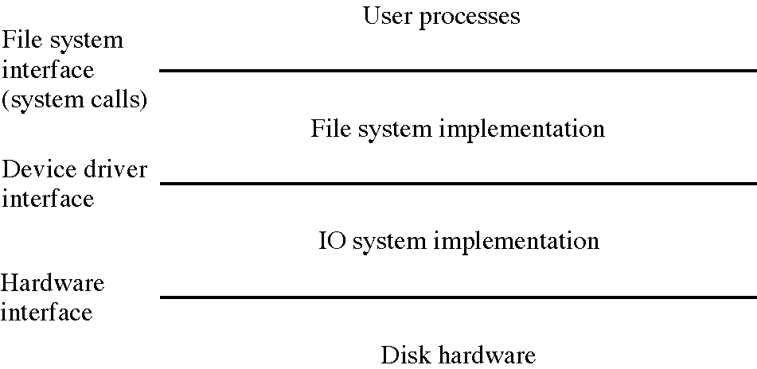
File system context

Slide 4
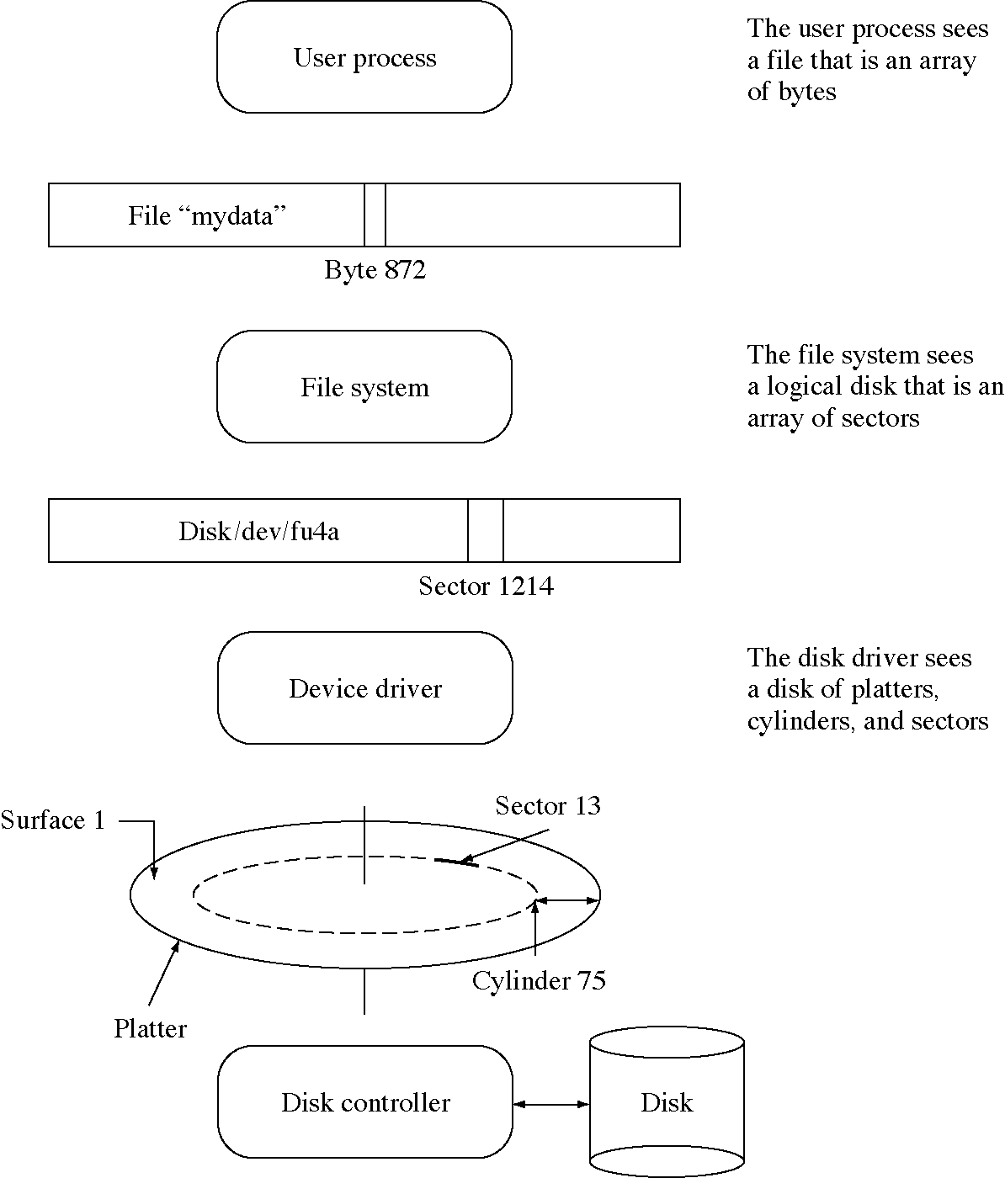
Levels in a file system

Slide 5
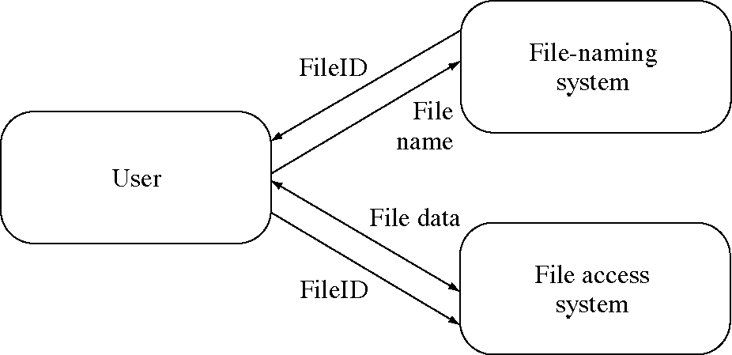
Two major parts of a file system

Slide 6
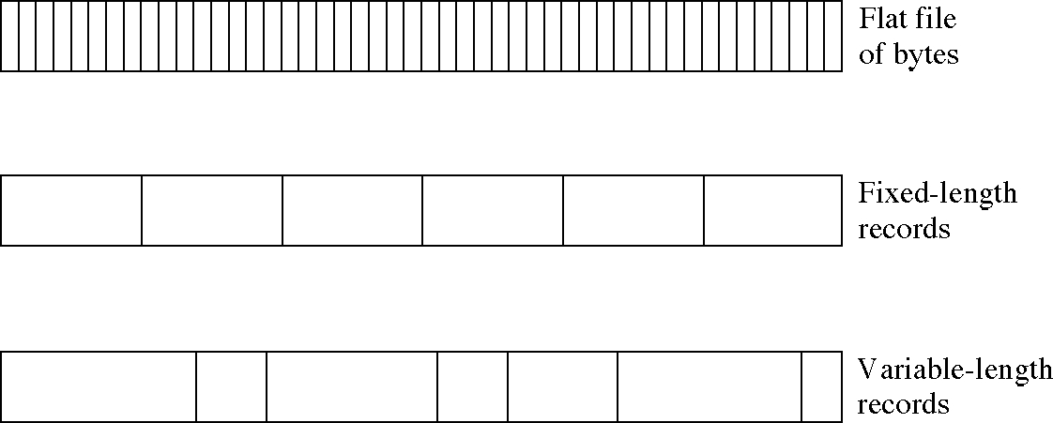
Logical structures in a file

Slide 7
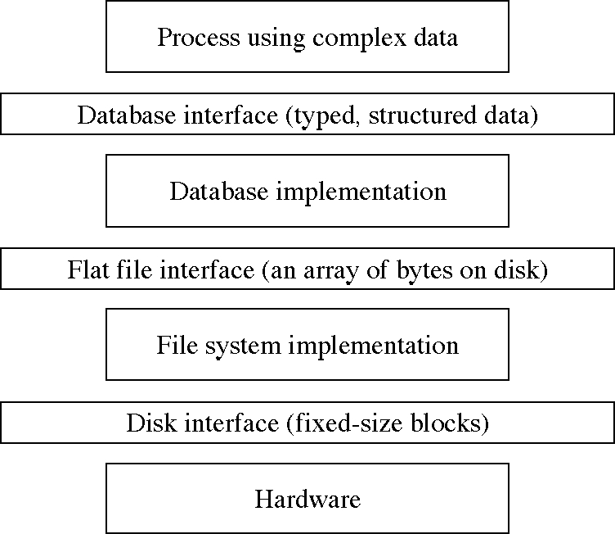
Levels of data abstraction

Slide 8
File meta-data
File contain data plus information about the data, that is, meta-data
Examples
  name
  type of file
  size
  owner, group, and protection data
  time of creation, last modification, last use
  where the file data is stored on disk

Slide 9
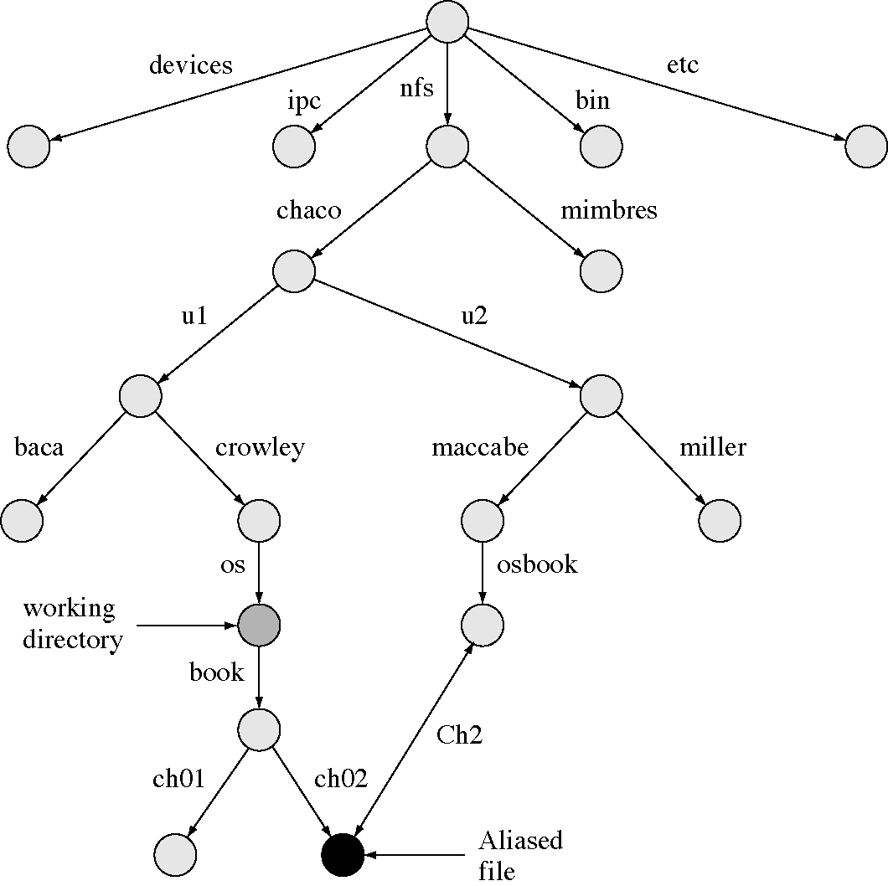
A directory tree

Slide 10
File names
Directory: maps component names into objects (files or directories)
Path name: a sequence of component names specifying a path of directories
  absolute path: starts at the root directory
  relative path: starts at the working directory
File name extension: suffix of a component names that indicate the type of the file
Alias: alternate path names for a file

Slide 11
Some common file extensions
file.c -- a C program file
file.txt -- a text file
file.s -- an assembly language file
file.obj -- an object file (in MS/DOS)
file.o -- an object file (in UNIX)
file.exe -- an executable file (in MS/DOS)
file.wk1 -- spreadsheet worksheet
file.tex -- tex or latex (a text formatter) file
file.mif -- Framemaker interchange file
file.scm -- Scheme program file
file.tmp -- a temporary file

Slide 12
Path name examples
/nfs/chaco/u1/crowley/os/book/ch02 -- UNIX
/nfs/chaco/u2/maccabe/osbook/Cg2 -- UNIX
book/ch02 --UNIX relative path name
E:\u1\crowley\os\book\ch02 -- MS/DOS
Users:u1:crowley:os:book:ch02 -- Macintosh
chaco:[crowley]/os/book]ch02 -- VMS
[book]ch02 -- VMS

Slide 13
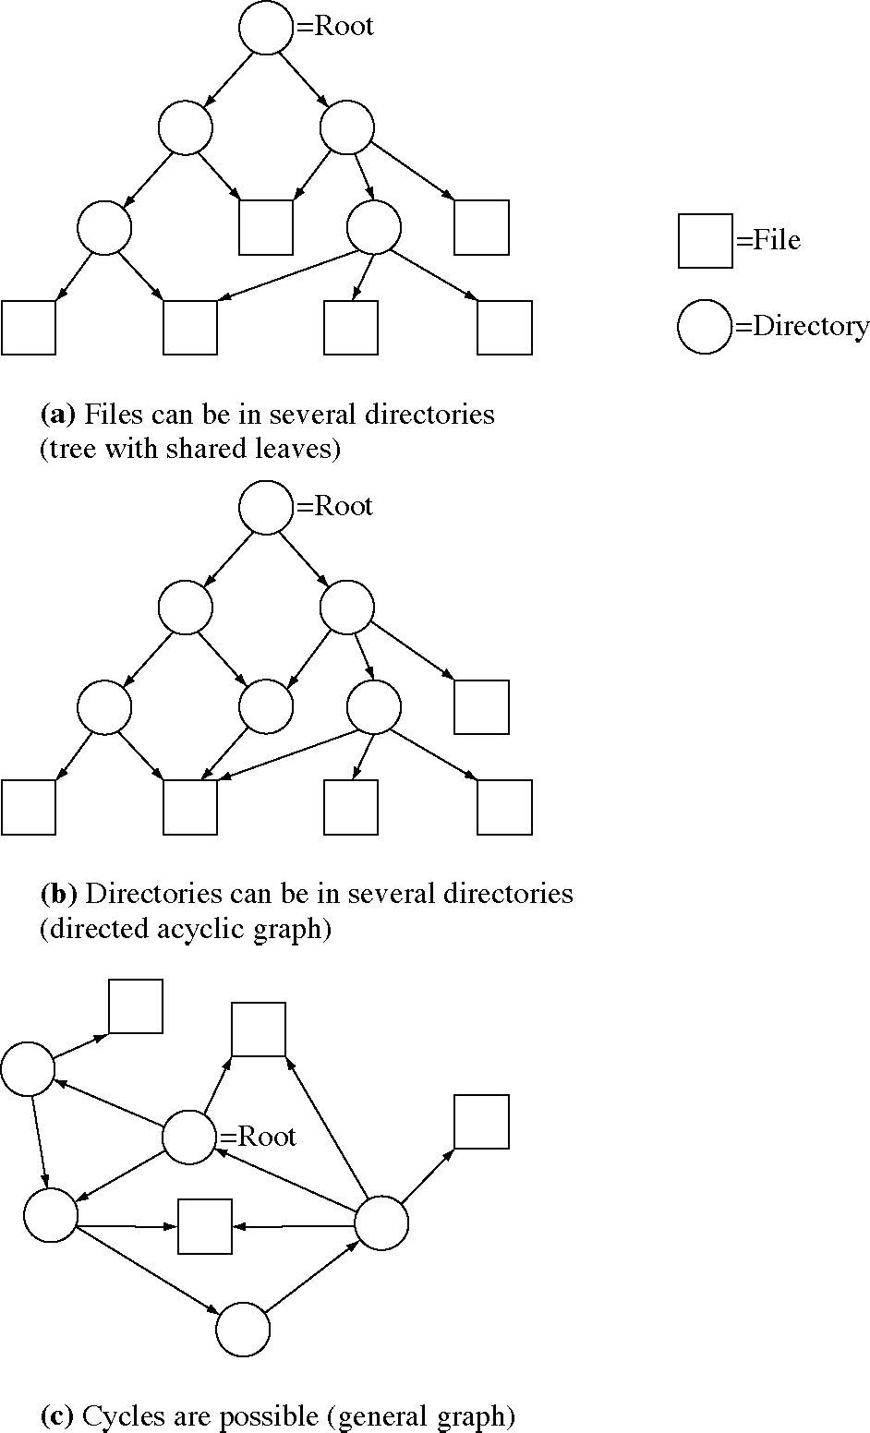
File name space topologies

Slide 14
File operations in UNIX
openFile = open(file name)
openFile = create(file name)
fileMetaData = status(file name)
okay = access(file name, access type)
okay = change mode(file name, new mode)
  changes protection information
okay = change owner(file name,new owner)

Slide 15
Open file operations in UNIX
bytesRead = read(open file)
bytesWritten = write(open file)
newFilePos = seek(open file, how much, how) -- move file position
close(open file)
openFile = duplicate(open file)
fileLock(open file)
fileControl(open file)
twoOpenFiles = pipe()

Slide 16
Directory operations in UNIX
link(file name, alias name)
unlink(file name): delete file
rename(old name, new name)
makeDirectory(directory name)
removeDirectory(directory name)

Slide 17
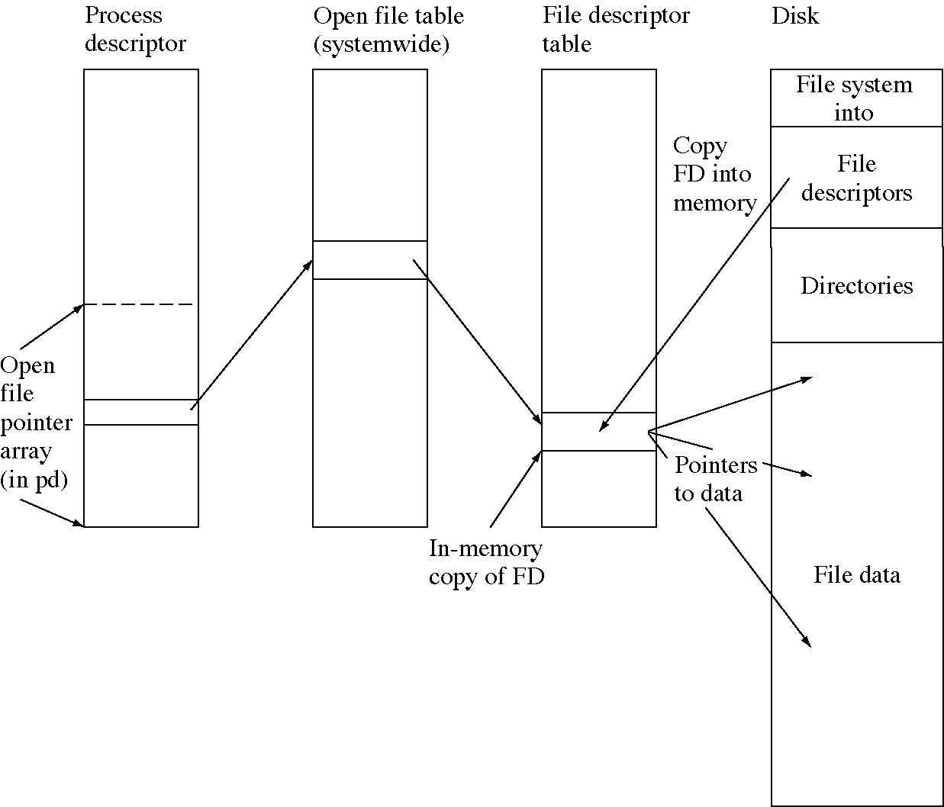
File system data structures

Slide 18
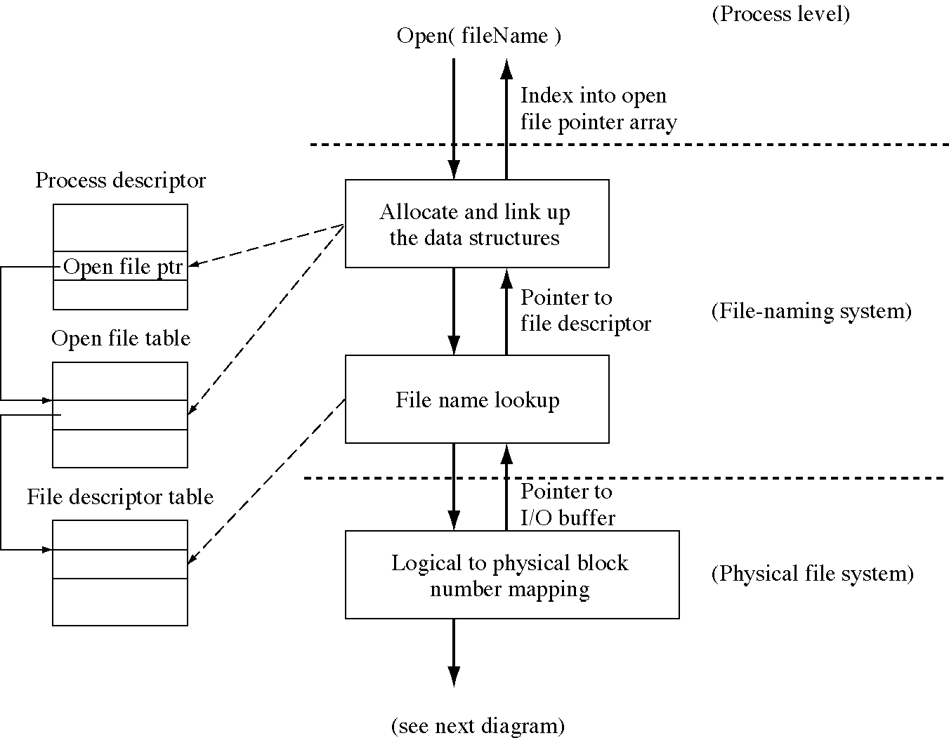
Flow of control for an open

Slide 19
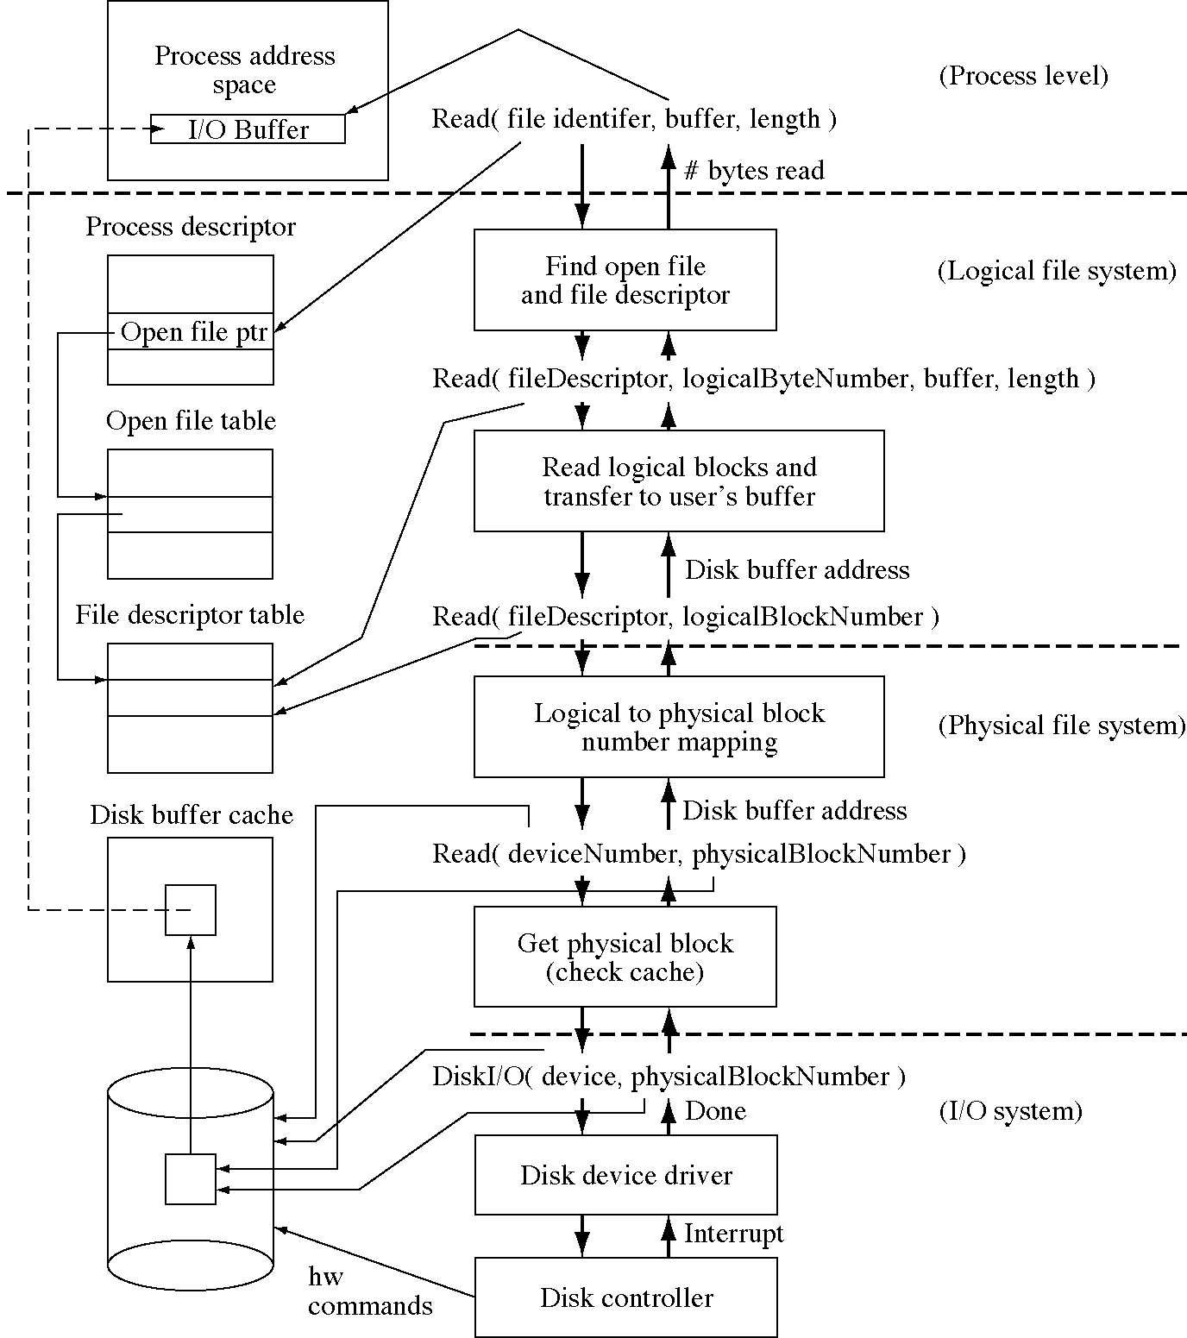
Flow of control for a read

Slide 20
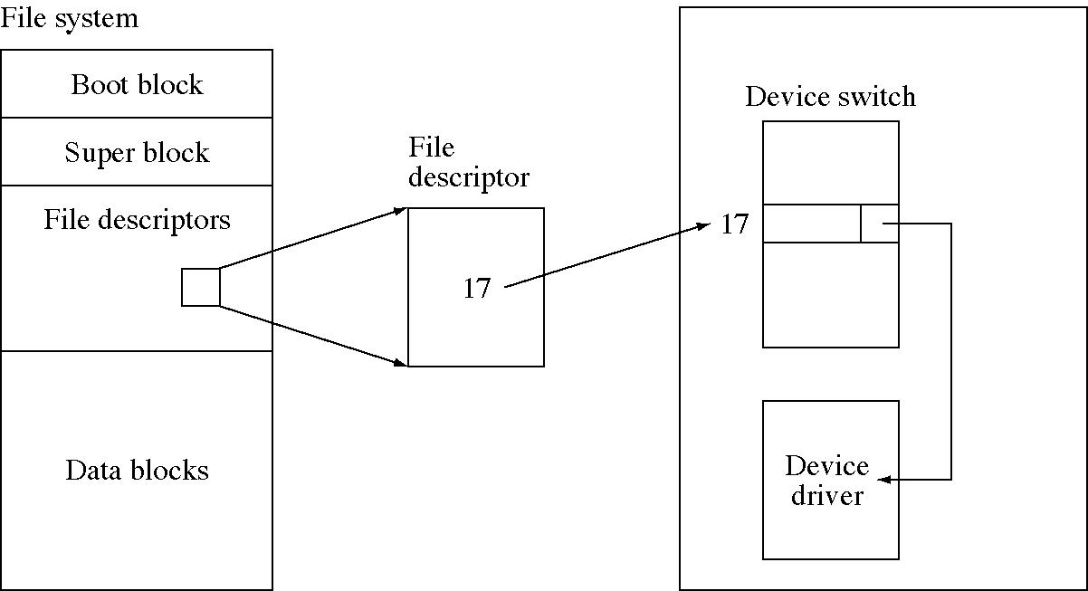
Connecting files and devices

Slide 21
Special files
Special files are not ordinary files
  e.g. directories, devices, pipes, message queues, remote files, mounted directories, etc.
They are marked by flags in the file descriptor
The read and write operations are directed to code for that type of special file
  a case statement determines how to handle a read or write operation

Slide 22
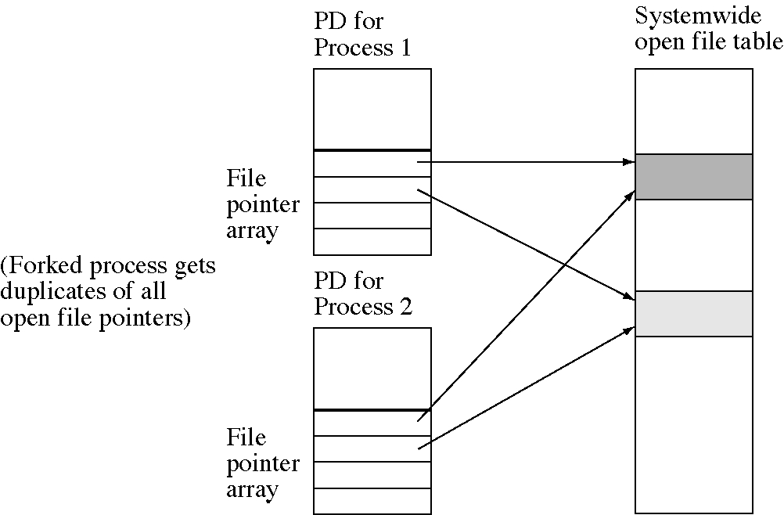
Fork data structure changes

Slide 23
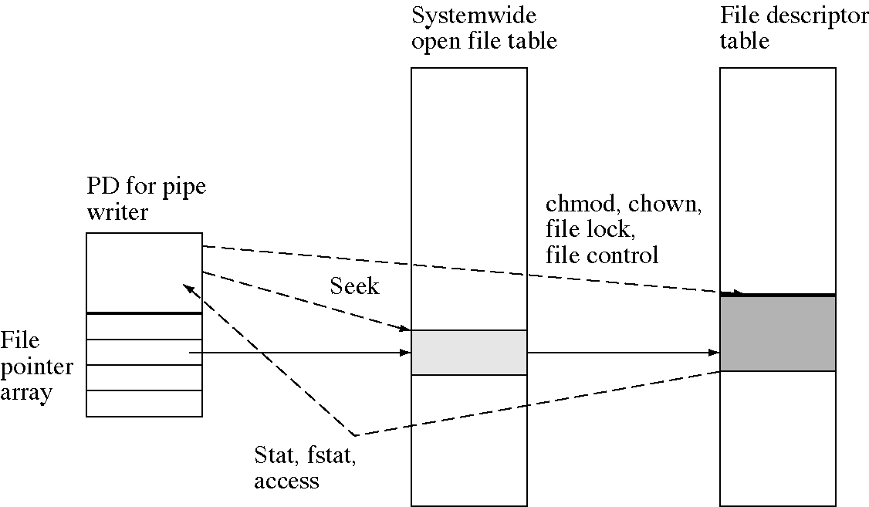
System call data structure changes

Slide 24
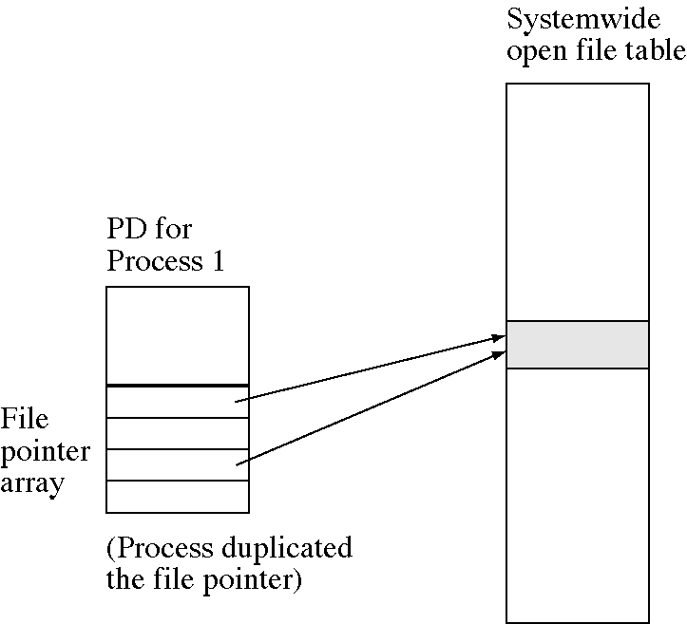
Duplicate data structure changes

Slide 25
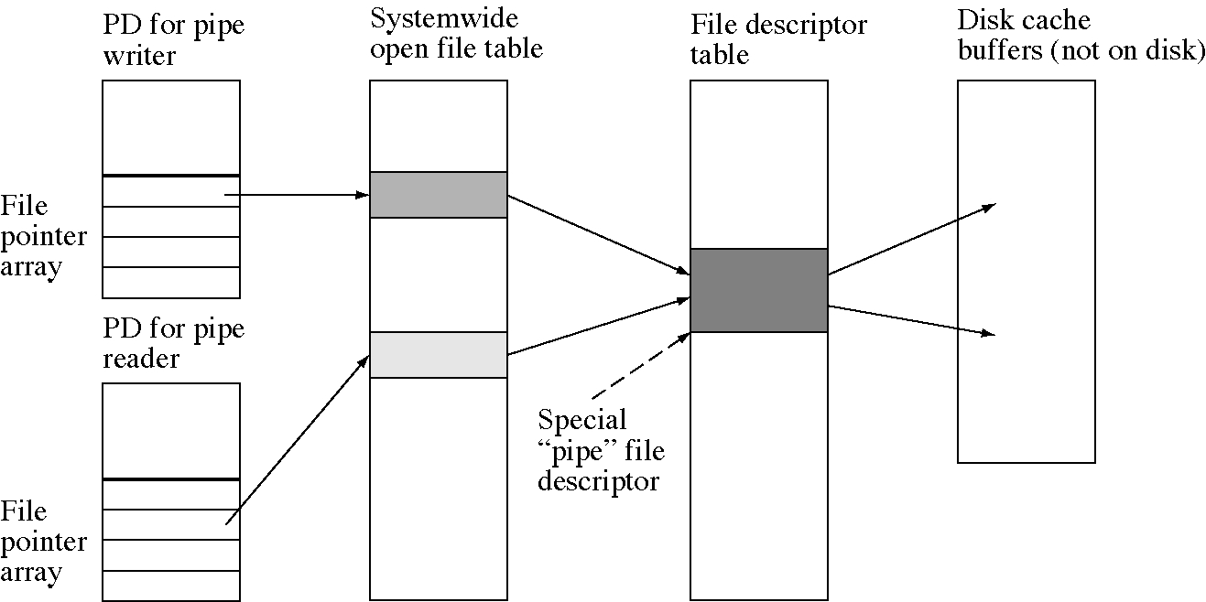
Pipe data structure changes

Slide 26
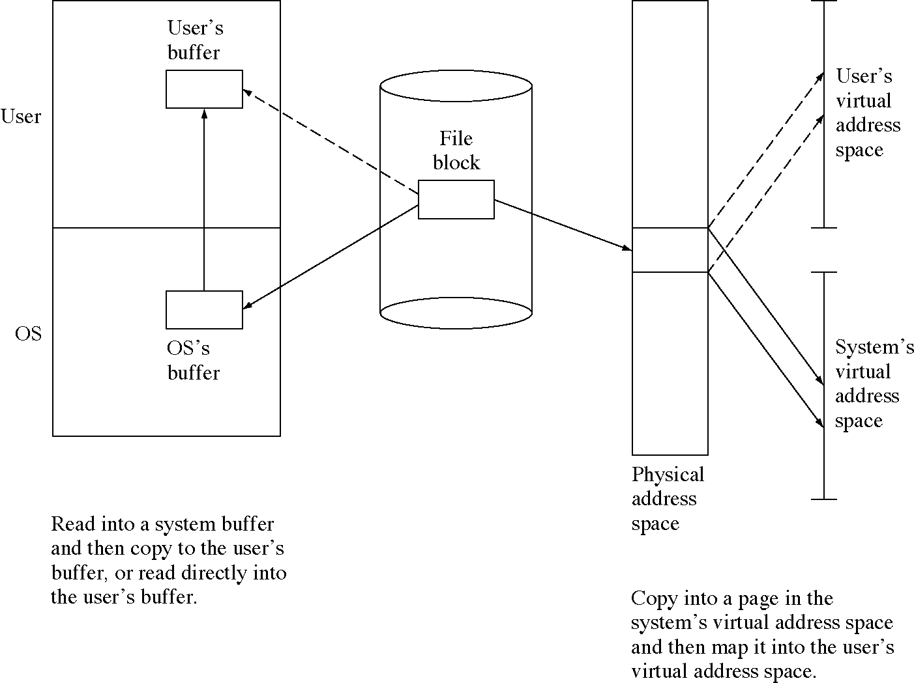
Avoiding data copies

Slide 27
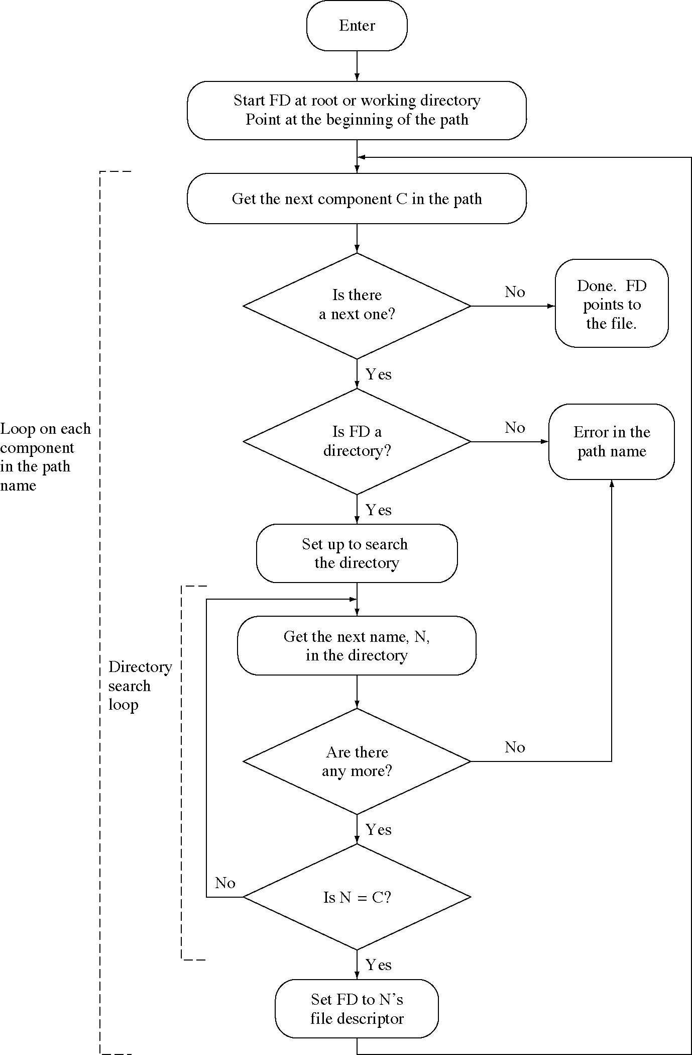
Path name lookup algorithm

Slide 28
Constants and globals
const int BlockSize = 4096;
// only one disk for now
const int DiskNumber = 0;
// type for a disk block in memory
typedef char * BlockBuffer[BlockSize];
// type for block numbers = disk block addresses
typedef int BlockNumber;

Slide 29
Disk cache (1 of 4)
const int DiskCacheSize = 200;
const int BlockBufferHashTableSize = 200;
// type for a disk block header
struct BlockBufferHeader {
int useCount; // processes using this block
int wasModified; // buffer changed since read in
BlockBuffer * block; // the buffer itself
int DiskNumber; // the disk it comes from
BlockNumber blockNumber; // the block number
BlockBufferHeader * next; // the hash table link
};
// the disk cache
BlockBufferHeader diskCache[DiskCacheSize];//buffers
int nextHeaderToReplace; // for FIFO replacement
// the hash table for looking up disk blocks quickly
BlockBufferHeader
*blockBufferHashTable[BlockBufferHashTableSize];

Slide 30
Disk cache (2 of 4)
int HashBlockAddress(DiskNumber dn,BlockNumber pbn){
return (dn + pbn)/BlockBufferHashTableSize;
}
BlockBufferHeader *
LookUpInDiskCache(DiskNumber dn, BlockNumber pbn) {
int hash = HashBlockAddress( db, pbn );
BlockBufferHeader * header
=blockBufferHashTable[hash];
// search the linked list for this hash bucket
while(header != 0
&& (header->bn!=pbn || header->dn!=dn)) {
header = header->nextHeader;
}
return header;
}

Slide 31
Disk cache (3 of 4)
BlockBufferHeader *FindCacheBufferToReuse( void ) {
for( int i = 0; i < DiskCacheSize; ++i ) {
if( ++nextDiskCache >= DiskCacheSize )
nextDiskCache = 0;
if( diskCache[nextDiskCache].useCount == 0 )
break;
}
if( diskCache[nextDiskCache].useCount != 0 )
return 0; // no free cache buffers to reuse
else {
BlockBufferHeader * header
= &(diskCache[nextDiskCache]);
if( header->wasModified )
DiskIO( WriteDisk,
header->blockNumber, header->buffer )
return &(diskCache[nextDiskCache]);
}
}

Slide 32
Disk cache (4 of 4)
BlockBufferHeader *
GetDiskBlock( DiskNumber dn, BlockNumber pbn ) {
// See if disk block is already in the disk cache
BlockBufferHeader * header
= LookUpInDiskCache( dn, pbn );
if( header == 0 ) {
// It's not in the disk cache so read it in.
header = FindCacheBufferToReuse();
header->useCount = 0;
header->dn = dn;
header->pbn = pbn;
DiskIO( ReadDisk, pbn, header->buffer );
}
++header.useCount;
return header;
}
void FreeDiskBlock( BlockBufferHeader * header ) {
--header->useCount;
}

Slide 33
File descriptors (1 of 4)
const int DirectBlocksInFD = 10;
const int NumFileDescriptors = 100;
const int BlockNumberSize = sizeof(BlockNumber);
const int BlocksMappedByIndirectBlock
= BlockSize/BlockNumberSize;
const int BlocksMappedByDouble IndirectBlock
= BlocksMappedByIndirectBlock *
BlocksMappedByIndirectBlock;
typedef BlockNumber
IndirectBlock[BlocksMappedByIndirectBlock];

Slide 34
File descriptors (2 of 4)
// type for a file descriptor in memory
struct FileDescriptor {
int length; // length of the file in bytes
int nlinks; // number of links to the file
BlockNumber direct[DirectBlocksInFD]; // direct
BlockNumber single_indirect; // single indirect
BlockNumber double_indirect; // double indirect
// these fields are typically present but not
// used in this code
int owner;
int group;
int time_created;
int time_last_modified;
int time_last_read;
int pad[13]; // pad out to 128 bytes = 32 words
// These are not part of the file descriptor
// on disk, only the in-memory version.
int useCount; // how many open files point here
int disk; // disk number of the file descriptor
int fd_number; // file descriptor number
};

Slide 35
File descriptors (3 of 4)
const int FileDescriptorSize = 128;
const int FileDescriptorsPerBlock
= BlockSize / FileDescriptorSize;
// the in-memory table of file descriptors
FileDescriptor fileDescriptor[NumFileDescriptors];
FileDescriptor *GetFileDescriptor(
int disk, int fd_number ) {
// find the fd (or a free slot)
free_slot = -1;
for( int i = 0; i < NumFileDescriptors; ++i ) {
if( fileDescriptor[i].disk == disk
&& fileDescriptor[i].fd_number==fd_number ) {
++(fileDescriptor[i].useCount);
return &(fileDescriptor[i]);
}
if(free_slot<0 && fileDescriptor[i].useCount==0 )
free_slot = i;
}
if( free_slot < 0 ) {
return 0;
}

Slide 36
File descriptors (4 of 4)
// find the physical block of the file descriptor
int fd_block=2+(fd_number/FileDescriptorsPerBlock);
int fd_offset = (fd_number%FileDescriptorsPerBlock)
* FileDescriptorSize;
BlockBufferHeader * fd_buffer
= GetDiskBlock(disk, fd_block);
FileDescriptor * fd
=(FileDescriptor *)&(fd_buffer->block+fd_offset;
MemoryCopy( (char *)fd,
(char *)&(fileDescriptor[free_slot]),
FileDescriptorSize);
FreeDiskBlock(fd_buffer);
fd->useCount = 1;
return fd;
}
voidMemoryCopy( char * from, char * to, int count) {
while( count--> 0 ) *to++ = *from++;
}
voidFreeFileDescriptor( FileDescriptor * fd ) {
--(fd->useCount);
}

Slide 37
Open files (1 of 2)
const int NumOpenFiles = 150;
const int OpenFilesPerProcess = 20;
// type for the open file table entries
struct OpenFile {
int useCount;
int openMode;
int filePosition;
FileDescriptor * fd;
};
// openMode is one or more of these ORed together
const int ReadMode = 0x1;
const int WriteMode = 0x2;
// the in-memory table of open files
OpenFile openFile[NumOpenFiles];
// some new fields in the process descriptor
struct ProcessDescriptor {
// ... all the fields we had before plus:
OpenFile * openFile[OpenFilesPerProcess];
// these are all initialized to 0
int currentDirectoryFD;
};

Slide 38
Open files (2 of 2)
int GetProcessOpenFileSlot( int pid ) {
for( int i = 0; i < OpenFilesPerProcess; ++i ) {
if( pd[pid].openFile[i] == 0 ) {
return i;
}
}
return -1;
// no free open file slots left to allocate
}
int GetSystemOpenFileSlot( void ) {
for( int i = 0; i < NumOpenFiles; ++i ) {
if( openFile[i].useCount == 0 ) {
return i;
}
}
return -1;
// no free open file slots left to allocate
}

Slide 39
Directories
const int FileNameSize = 60;
const int MaxPathNameSize = 250;
// type of a directory entry
struct DirectoryEntry {
int FDNumber;
char name[FileNameSize];
};
const int DirectoryEntriesPerBlock
= BlockSize / sizeof(DirectoryEntry);
int rootFD = 0;
// the first FD is always the root directory

Slide 40
File system initialization
voidFileSystemInitialization( void ) {
int i;
// initialize the disk cache
for( i = 0; i < DiskCacheSize; ++i ) {
diskCache[i].block = &(diskBuffer[i]);
diskCache[i].blockNumber = -1;
diskCache[i].useCount = 0;
}
nextHeaderToReplace = DiskCacheSize;
// initialize the file descriptor table
for( i = 0; i < NumFileDescriptors; ++i ) {
fileDescriptor[i].useCount = 0;
fileDescriptor[i].fd_number = -1;
}
// initialize the open file table
for( i = 0; i < NumOpenFiles; ++i ) {
openFile[i].useCount = 0;
}
}

Slide 41
File related system calls (1 of 2)
case OpenSystemCall:
char * fileName; asm {store r9,fileName};
int openMode; asm {store r10,openMode};
pd[current_process].sa.reg[1]
= Open( current_process, fileName, openMode );
break;
case CreatSystemCall:
// ... Not implemented in this code
break;
case ReadSystemCall:
int fid; asm { store r9,fid };
char * userBuffer; asm { store r10,userBuffer };
int count; asm { store r11,count };
pd[current_process].sa.reg[1]
= Read(current_process, fid, userBuffer, count);
break;
case WriteSystemCall:
// ... not shown, nearly the same as read

Slide 42
File related system calls (2 of 2)
case LseekSystemCall:
int fid; asm { store r9,fid };
int offset; asm { store r10,offset };
int how; asm { store r11,how };
pd[current_process].sa.reg[1]
= Lseek( current_process, fid, offset, how );
break;
case CloseSystemCall:
int fid; asm { store r9,fid };
int ret_value;
OpenFile * of = pd[pid].openFile[fid];
if( of == 0 )
ret_value = -1;
else {
if( --(of->useCount) == 0 ) {
--(of->fd->useCount);
}
ret_value = 0;
}
pd[current_process].sa.reg[1] = 0;
break;

Slide 43
Open file (1 of 5)
int Open(int pid, char * fileNameIn, int openMode) {
// find slots in the per-process
// and system-wide open file tables
int process_ofslot = GetProcessOpenFileSlot(pid);
if( process_ofslot < 0 ) return -1;
int ofslot = GetSystemOpenFileSlot(pid);
if( ofslot < 0 ) return -2;
char fileName[MaxPathNameSize];
CopyToSystemSpace( pid, fileNameIn, fileName,
MaxPathNameSize );
int fd_number;
if( *fileName == '/' ) {
fd_number = rootFD;
} else {
fd_number = pd[pid].currentDirectoryFD;
}
char * current_path = fileName;

Slide 44
Open file (2 of 5)
// This is the loop to look up the file
// in the directory tree
while( 1 ) {
// are we at the end of the pathname yet?
if( *current_path == '\0' ) {
// we are at the end of the path
break;
}
// isolate the file name component
current_component = current_path;
while( 1 ) {
ch = *current_component;
if( ch == '/' || ch == '\0' )
break;
++current_component;
}
char save_char = *current_component;
*current_component = '\0';

Slide 45
Open file (3 of 5)
// temporarily put in end of string marker
// get the file descriptor for the next directory
FileDescriptor * fd
= GetFileDescriptor(DiskNumber, fd_number);
// search the directory for the name
int dir_entry_number = 0;
DirectoryEntry * dir_entry;
while( 1 ) {
BlockNumber lbn = dir_entry_number /
DirectoryEntriesPerBlock;
// have we gotten to the end of the directory?
if( dir_entry_number * sizeof(DirectoryEntry)
>= fd->length ) {
FreeFileDescriptor( fd );
// the component name was not found
return -1;
}

Slide 46
Open file (4 of 5)
BlockNumber pbn
= LogicalToPhysicalBlock(fd, lbn);
BlockBufferHeader * dir_buffer
= GetDiskBlock(DiskNumber, pbn);
int dir_offset = (dir_entry_number %
DirectoryEntriesPerBlock)
* sizeof(DirectoryEntry);
dir_entry = (DirectoryEntry *)
&(dir_buffer->buffer + dir_offset);
// compare the names;
if(strncmp(dir_entry->name,
current_component, FileNameSize)==0)
break;
FreeDiskBlock( dir_buffer );
++dir_entry_number;
}
FreeFileDescriptor( fd );
// pick out the fd number of this file
fd_number = dir_entry->FDNumber;
FreeDiskBlock( dir_buffer );

Slide 47
Open file (5 of 5)
// move to the next component of the name
if( save_char == '/' )
++current_path; // skip past the "/”
*current_component = save_char;
}
// read in the fd for this file
// and put it in the open file table
fd = GetFileDescriptor(DiskNumber, fd_number);
openFile[ofslot].fd = fd;
openFile[ofslot].filePosition = 0;
openFile[ofslot].useCount = 1;
pd[pid].openFile[process_ofslot]
= &(openFile[ofslot]);
return ofslot;
}

Slide 48
Read file (1 of 2)
int Read( int pid, int fid, char * userBuffer,
int count ) {
OpenFile * of = pd[pid].openFile[fid];
if( of == 0 )
return -1;
if( !(of->openMode & ReadMode) ) //is read allowed?
return -2;
int filepos = of->filePosition;
// check the file length and adjust if near EOF
if( (filepos+count) > of->fd->length ) {
count = (of->fd->length) - filepos;
}
if( count <= 0 )
return 0;
int bytesRead = 0;

Slide 49
Read file (2 of 2)
while( count > 0 ) {
BlockNumber lbn = filepos / BlockSize;
int offsetInBlock = filepos % BlockSize;
int leftInBlock = BlockSize - offsetInBlock;
int lengthToCopy;
if( leftInBlock < count ) {
lengthToCopy = leftInBlock;
} else {
lengthToCopy = count;
}
BlockNumber pbn
= LogicalToPhysicalBlock(of->fd, lbn);
BlockBufferHeader * header
= GetDiskBlock(DiskNumber, pbn);
CopyFromSystemSpace(pid, userBuffer,
(header->block)+offsetInBlock, lengthToCopy);
FreeDiskBlock( header );
filepos += lengthToCopy;
userBuffer += lengthToCopy;
count -= lengthToCopy;
bytesRead += lengthToCopy;
}
return bytesRead;
}

Slide 50
Lseek
int Lseek(int pid, int fid, int offset, int how) {
OpenFile * of = pd[pid].openFile[fid];
if( of == 0 )
return -1;
switch( how ) {
case 0: // from beginning of file
// nothing to do, offset is what we want
break;
case 1: // from current
offset += of->filePosition;
break;
case 2;
offset += of->fd->length;
break;
}
// do not allow negative file positions
if( offset < 0 )
return -2;
of->filePosition = offset;
return offset;
}

