Slide 1
Design IV
Chapter 18

Slide 2
Key concepts in chapter 18
Caching
Hinting
Hierarchical naming systems
Naming
Unification of concepts

Slide 3
Design technique: Caching
Caching: speed up a slow operation by remembering the result of previous invocations of the operation
Useful whenever the operation is often called with the same arguments
Can radically speed up the average operation time
  but it uses space to hold old answers
  and depends on “locality” of operation arguments

Slide 4
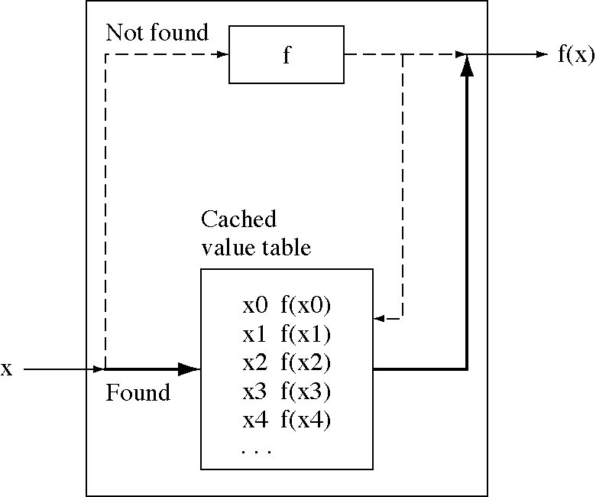
Generalized caching

Slide 5
OS examples of caching
Virtual memory
TLB
File descriptor table
Disk block cache
Pathname lookup cache

Slide 6
CS examples of caching
Hardware caching
  in memory systems
  in processors: modern processors have several caches
Memoizing a function
  a general Lisp and Scheme technique for speeding up a function

Slide 7
Caching issues
Dynamic programming: a form of caching
Minimal hashing: often saving one or two answers will get most of the speedup
Cache invalidation: we need to know when the answers become invalid
  sometimes this is difficult
Hooks: register procedures to be called when something changes
  an ideal way to keep caches valid

Slide 8
Optimizing
We can:
  speed up every instance of an operation
    e.g. faster hardware, better algorithm
  speed up some instances of the operation
    e.g. caching
Remembering previous results
  caching: remembered results are always correct
    assuming we do cache invalidation correctly
  hinting: remembered results are often correct
    and we have a fast way to check their correctness

Slide 9
Hinting examples
Remember the machine that a network service was on the last time you used it
  if it has moved your request will return an error
Remember the last location and size of a user window
  if they want it changed they can do it

Slide 10
Hierarchical names
A name space is a collection of names where each name is mapped to an object
The object mapped to can be another name space which allows general graphs of name spaces
  the most interesting special case is when the name space form a tree
  this is a hierarchical naming system, like file system names where each directory is a name space

Slide 11
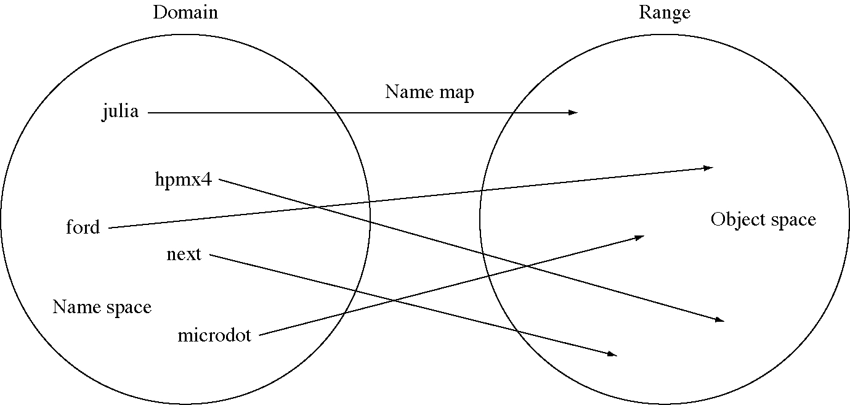
Name space

Slide 12
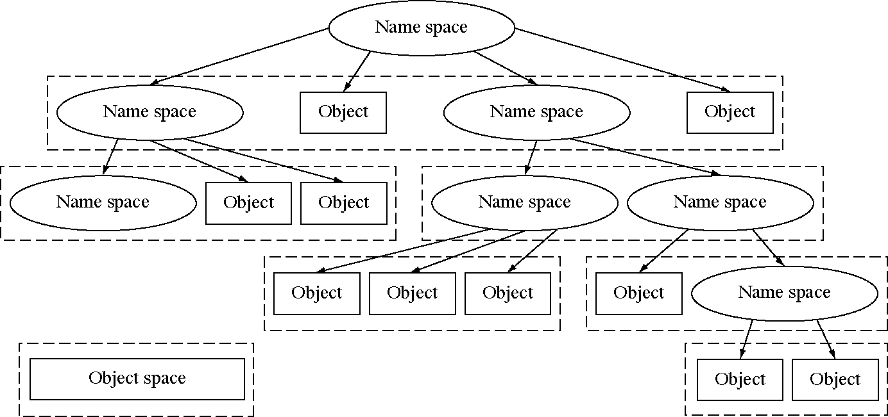
A hierarchy of name spaces

Slide 13
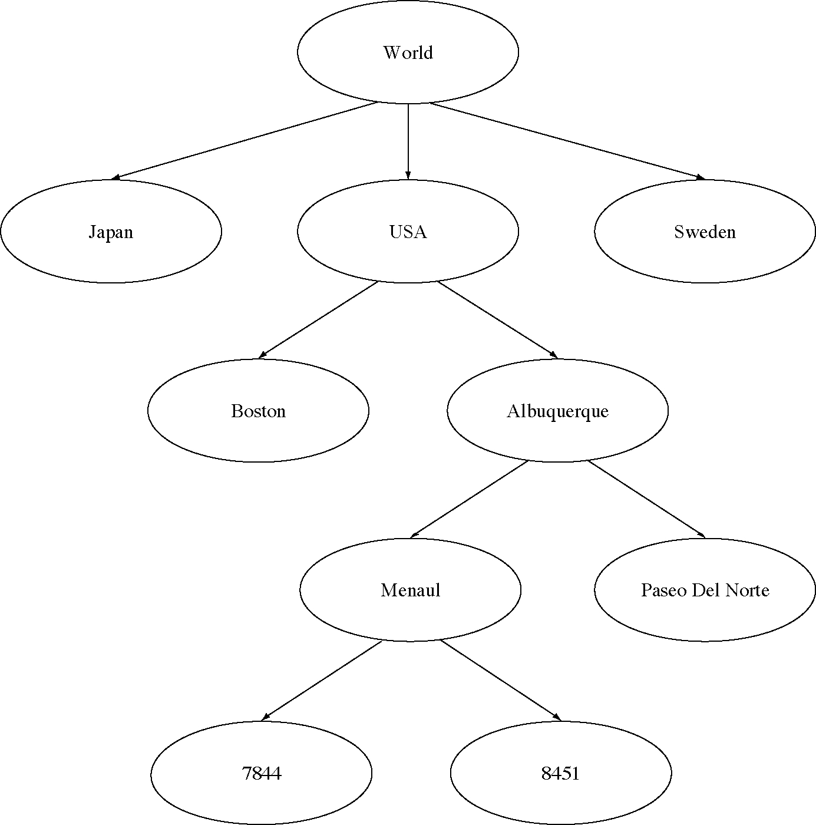
Address name space hierarchy

Slide 14
Hierarchical naming examples
File path names: /u1/crowley/book/ch16
IP addresses: 230.45.67.7
Internet domain addresses: www.unm.edu
Programming language names: owner.name

Slide 15
Naming issues
Flat name space: all names are unique, there is no hierarchy
Generating unique name (two methods)
  a central authority checks proposed names for uniqueness
  a central authority generates unique names
Adjoining name spaces
  another way to combine name spaces
  search the name space, in order, for a name

Slide 16
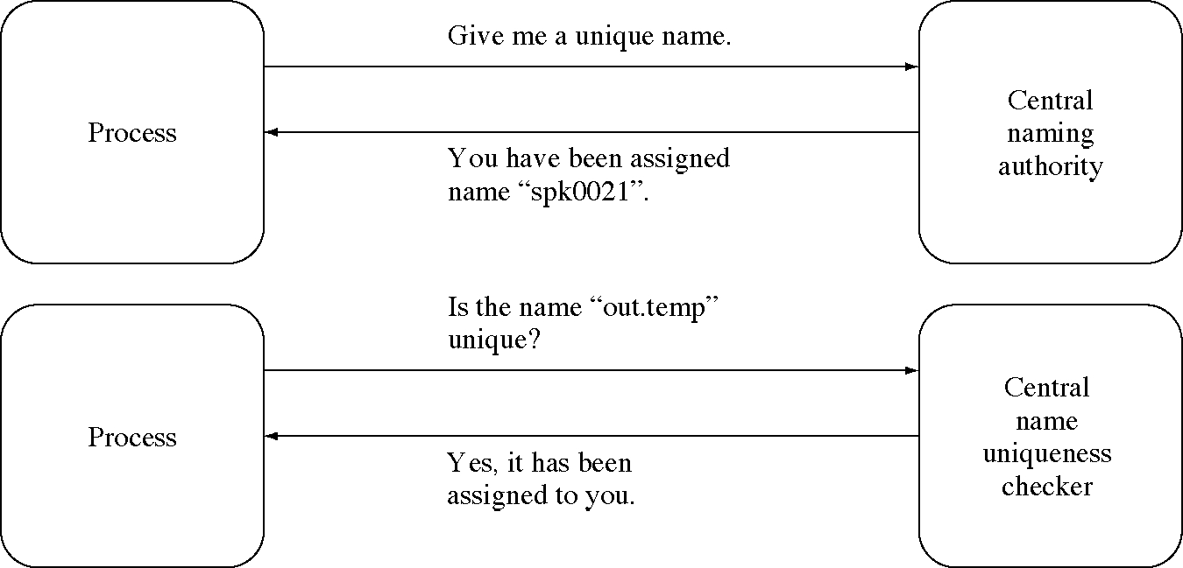
Generating unique names

Slide 17
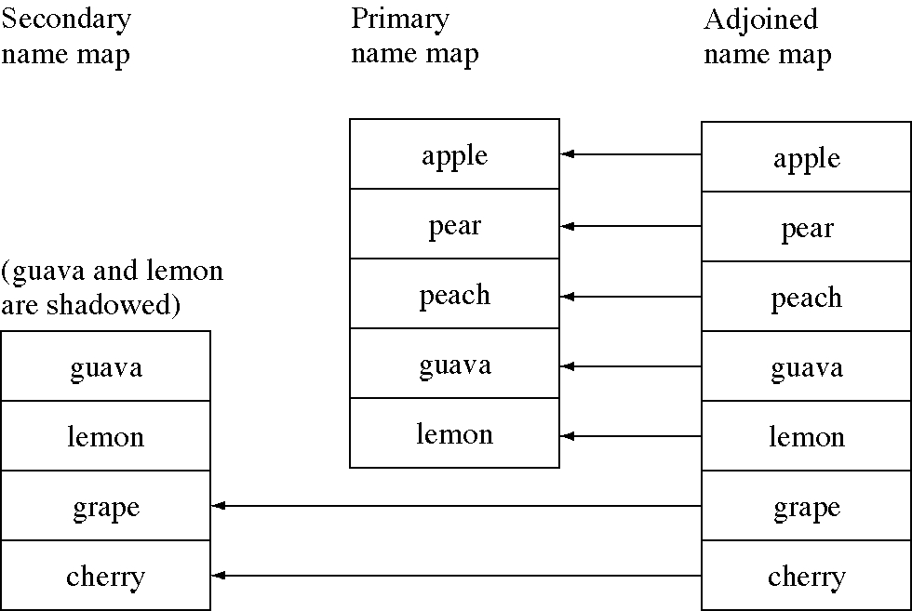
Adjoining name maps

Slide 18
Creating a unique name
// generate a unique file name
char * name = "tempaaaa”;
char * end = &name[7];
while( 1 ) {
// Does the file exist?
if( access(name,F_OK) != 0 )
break; // No, it is unique.
while( 1 ) {
if( *end < 'z' ) {
++(*end);
} else {
*end = 'a';
--end;
// try the next position to the left
}
}
}
// "name" does not exist
fid = creat( name, MODE );

Slide 19
Creating a unique name safely
// generate a unique file name
char * name = "tempaaaa”;
while( 1 ) {
fid = open( name, O_CREAT | O_EXCL, MODE );
if( fid >= 0 )
break;
char * end = &name[7];
while( 1 ) {
if( *end < 'z' ) {
++(*end);
break;
else {
*end = 'a';
--end;
// try the next position to the left
}
}
}
// file with unique file name "name" has been created

Slide 20
Design technique:
Unification of concepts
Simplify a system by combining two concepts that are similar
  the resulting system is simpler
Example: combine the device and file name spaces and unify the interface to devices and files

Slide 21
Examples of unifying concepts
OS examples
  unifying the file and device access interfaces
  the device driver interface unifies device access
  pipes unify file access and IPC
  mapped files unify virtual memory and I/O
CS examples
  procedures unify common code sections
  super classes unify two child classes
    this is a basic theme of object-oriented programming

