Slide 1
Resource Management
Chapter 19

Slide 2
Key concepts in chapter 19
Resource management and scheduling
  Queuing models
Real-time operating systems
Protection of resources
  threats
  authorization
  authentication
  access control lists and capabilities
  crypography

Slide 3
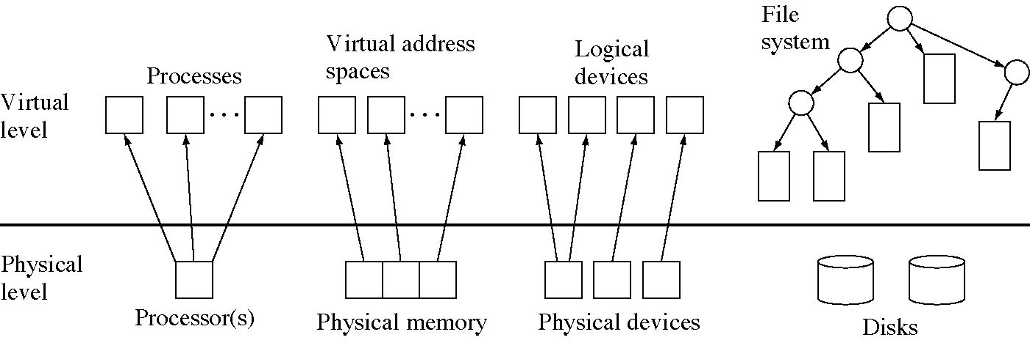
Physical and virtual OS resources

Slide 4
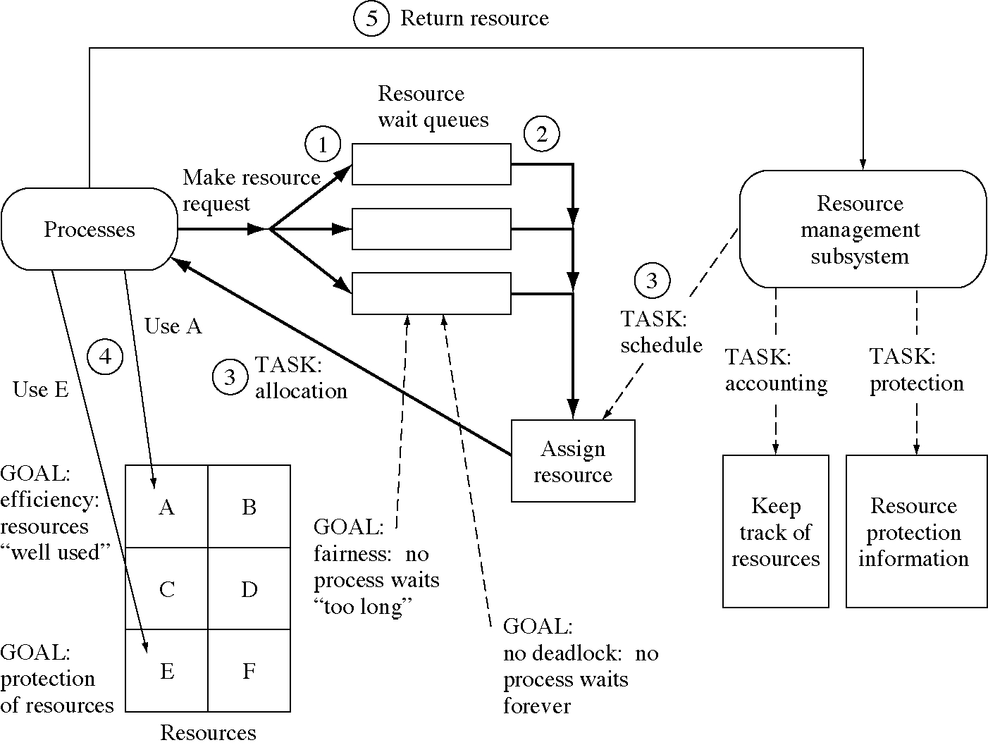
OS resource management

Slide 5
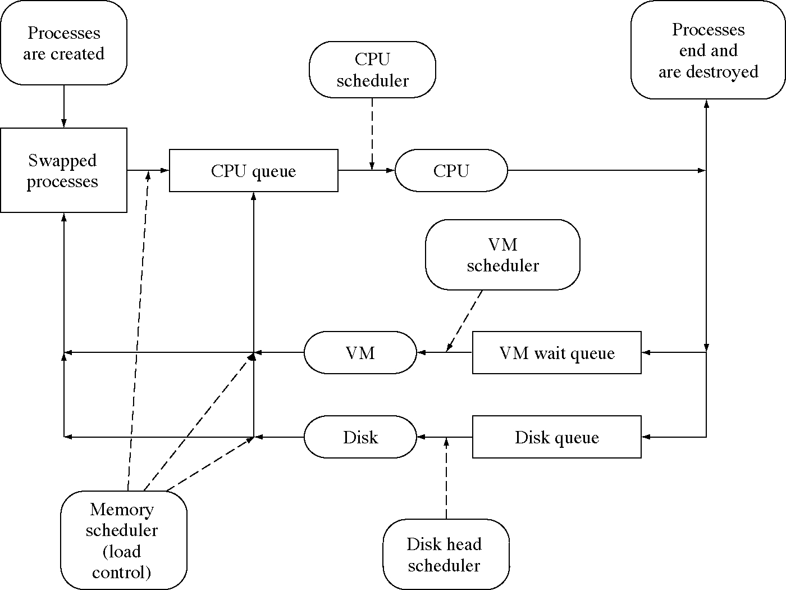
Schedulers in an OS

Slide 6
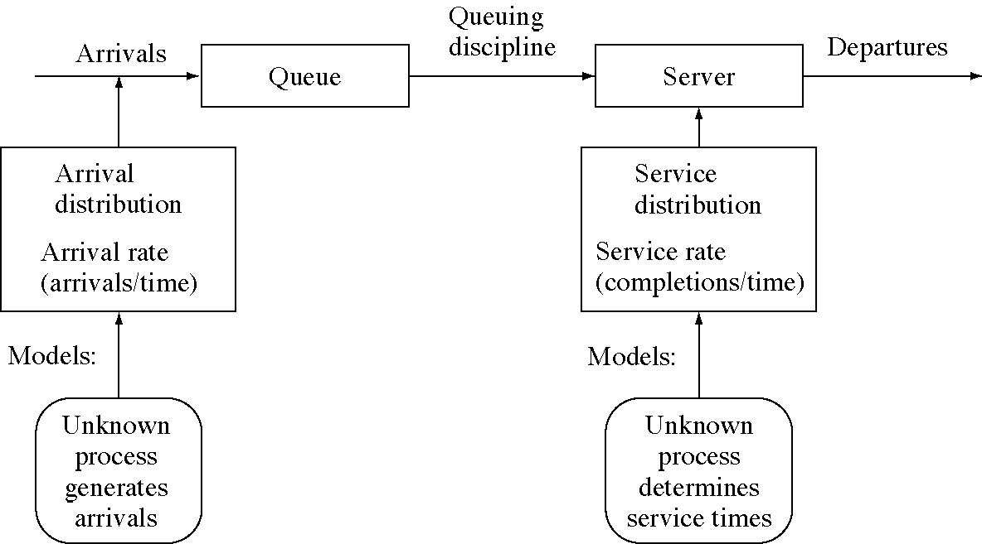
A queuing system model

Slide 7
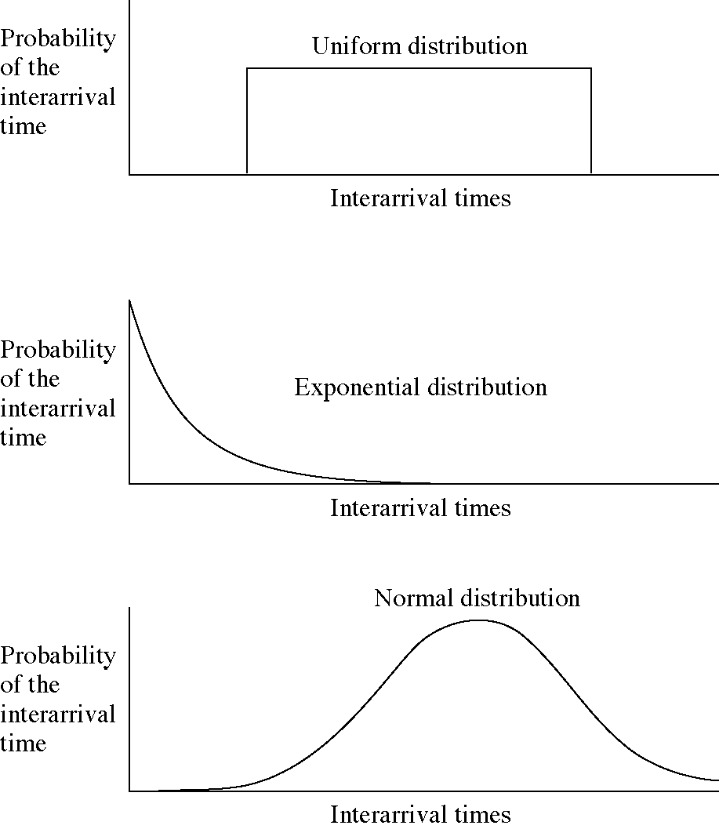
Three probability distributions

Slide 8
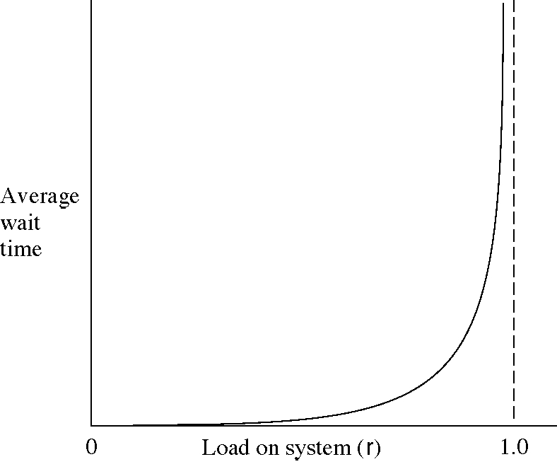
Waiting time versus load

Slide 9
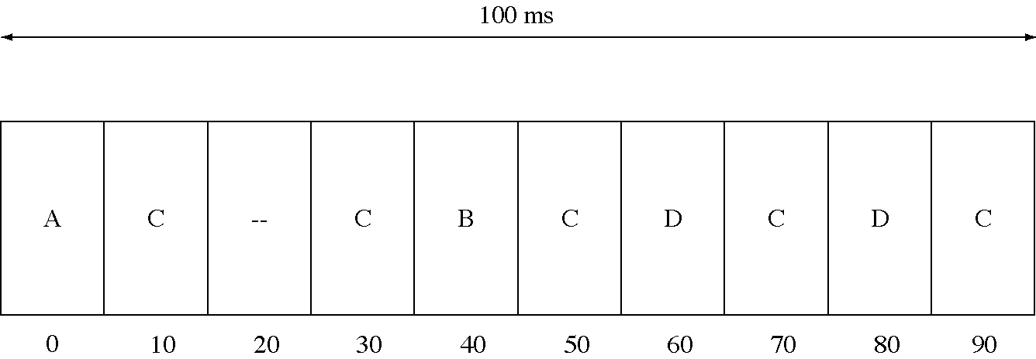
Deterministic scheduling in real-time OSs

Slide 10
Protection of resources
Processes act for users which have the authority to perform operations on resources
We need to protect both hardware and software resources
Authorization: each user is authorized to perform certain actions (possibly none) on each resource
Authentication: verifying that a process is acting for the user it says it is acting for

Slide 11
Threats to protect against
Unauthorized disclosure of information
Unauthorized modification of information
Denial of service
Unauthorized use of services

Slide 12
User authentication
Three types of authentication:
  Something a user knows
    e.g. a password, a combination, answers to personal questions
  Something a user has
    e.g. a badge, a smart card, a key
  Something a user is
    e.g. fingerprint, signature, voice print, hand geometry, retinal blood vessel pattern

Slide 13
Hardware protection mechanisms
Processor modes and privileged instructions only valid in system mode
Memory protection
Devices, and in particular disks, are protected with processor modes and/or memory protection

Slide 14
Representation of protection data
A protection database indicating what operations are allowed for each <user,object> pair.
Access control lists: kept with the object
  each record has a user (or user group) and the allowed operations
Capabilities: kept with the user process
  indicating which object it can access and what operation it can perform on that object

Slide 15
Protection domains
A protection domain is a set of capabilities to perform certain actions on certain objects
A process can move from protection domain to protection domain so, at any point, it has exactly the capabilities it needs for the current job (the principle of least privilege)
This is more flexible than associating capabilities directly with a process

Slide 16
Software protection mechanisms
Hardware resources are protected by hardware protection mechanisms
Logical resources are only accessed through system calls
All system calls must be authorized by a protection monitor
  The protection monitor accesses the protection database to make decisions

Slide 17
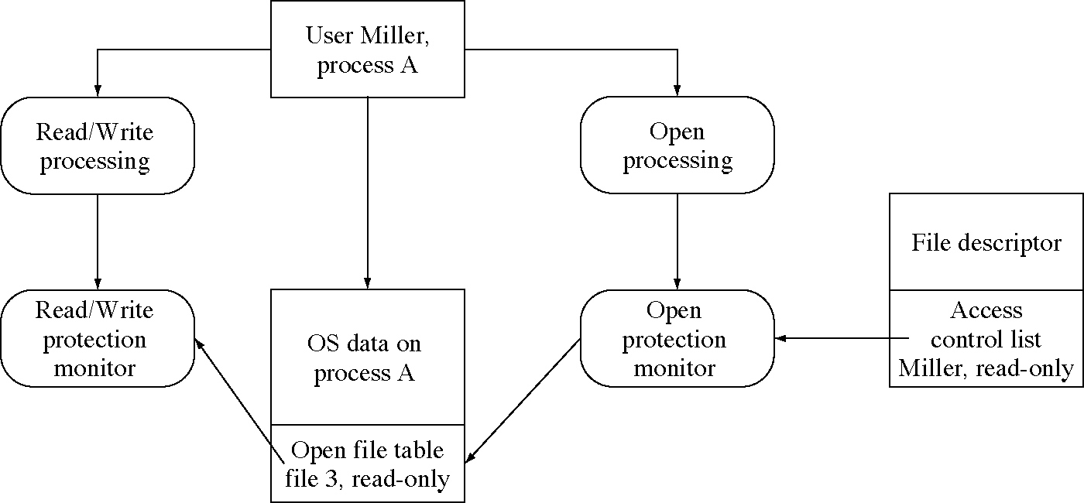
Protection monitors for file access

Slide 18
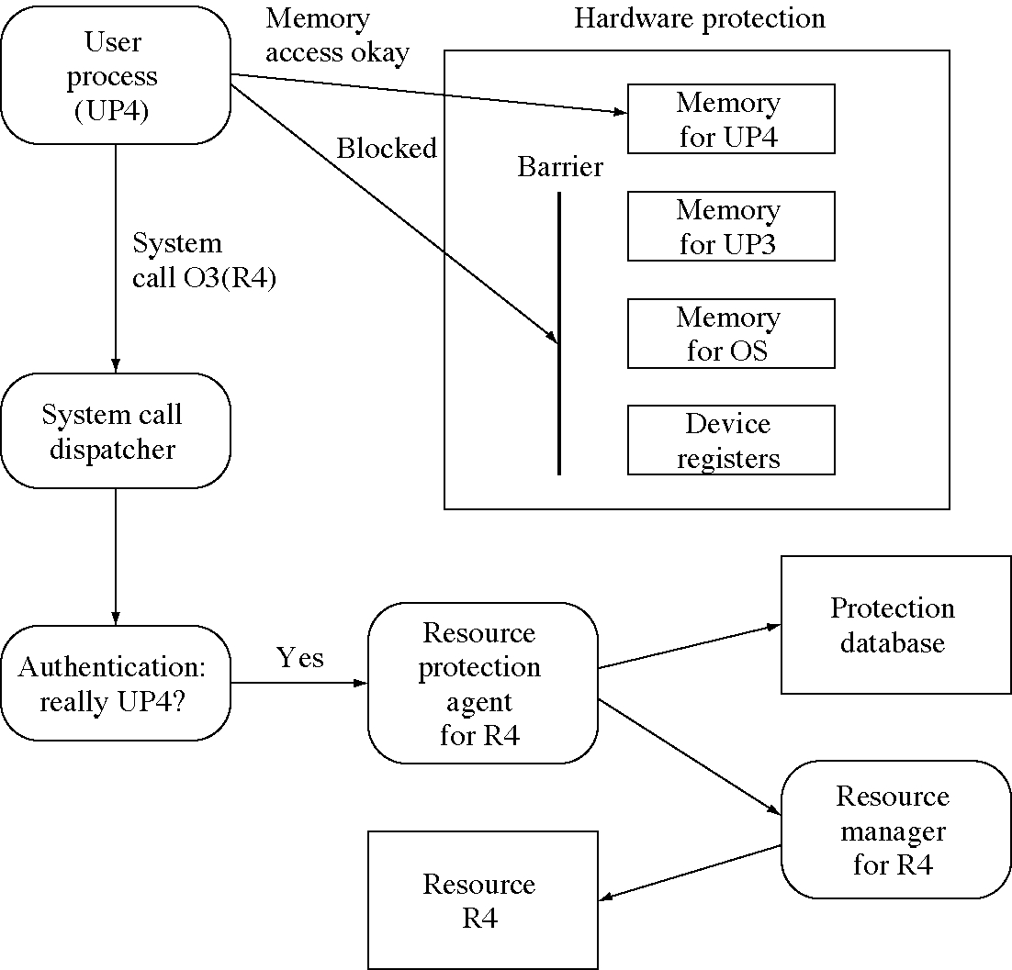
Protection monitors in an OS

Slide 19
Protection attacks
Browsing for information
Wiretapping
Trial and error password attacks
Password guessing
Searching trash
Trap doors in programs
Trojan horse programs
Covert channels

Slide 20
The confinement problem
How do we prevent a program from leaking information to others?
It is not as simple as preventing IPC and I/O
A covert channel is a hidden means of communication information
  e.g. sending bits by manipulating the CPU load

Slide 21
Cryptography
Cryptography means “secret writing”
  it is a way to prevent other people from seeing information you are sending on a public channel
Modern cryptography can also be used for authentication
  in fact this is the most important use of cryptography in operating systems
Public key cryptography allows encrypted communication and authentication without prior agreement between the parties

Slide 22
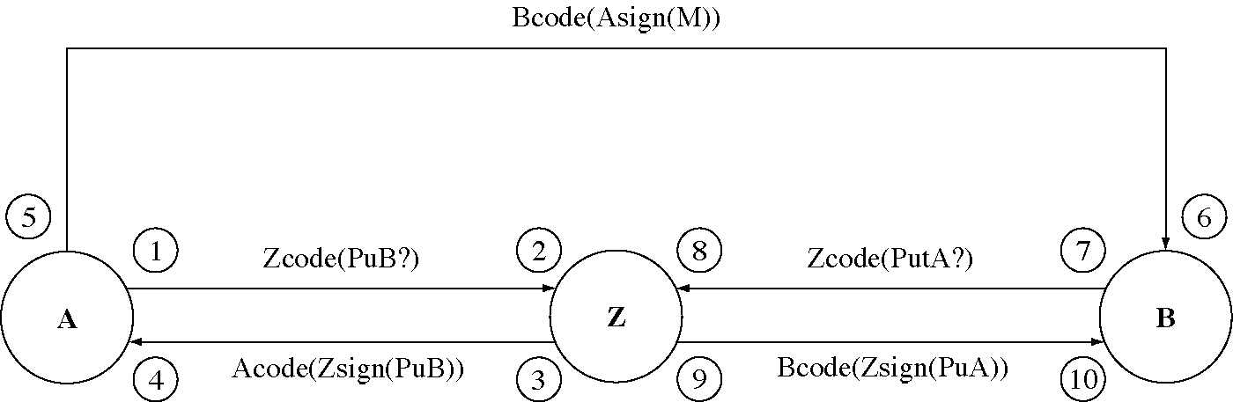
Authentication of public keys

