Slide 1
The Client-Server Model
Chapter 20

Slide 2
Key concepts in chapter 20
System processes
Micro-kernel operating systems
Client-server model
Network operating systems
Distributed operating systems

Slide 3
Process communication
Processes use three different modes of communication
  procedure calls: within the process
  system calls: to the OS
  messages: to other processes
We can use syntactic tricks to make these look similar
  system calls look like procedure calls
  RPCs look like procedure call
But they are fundamentally different

Slide 4
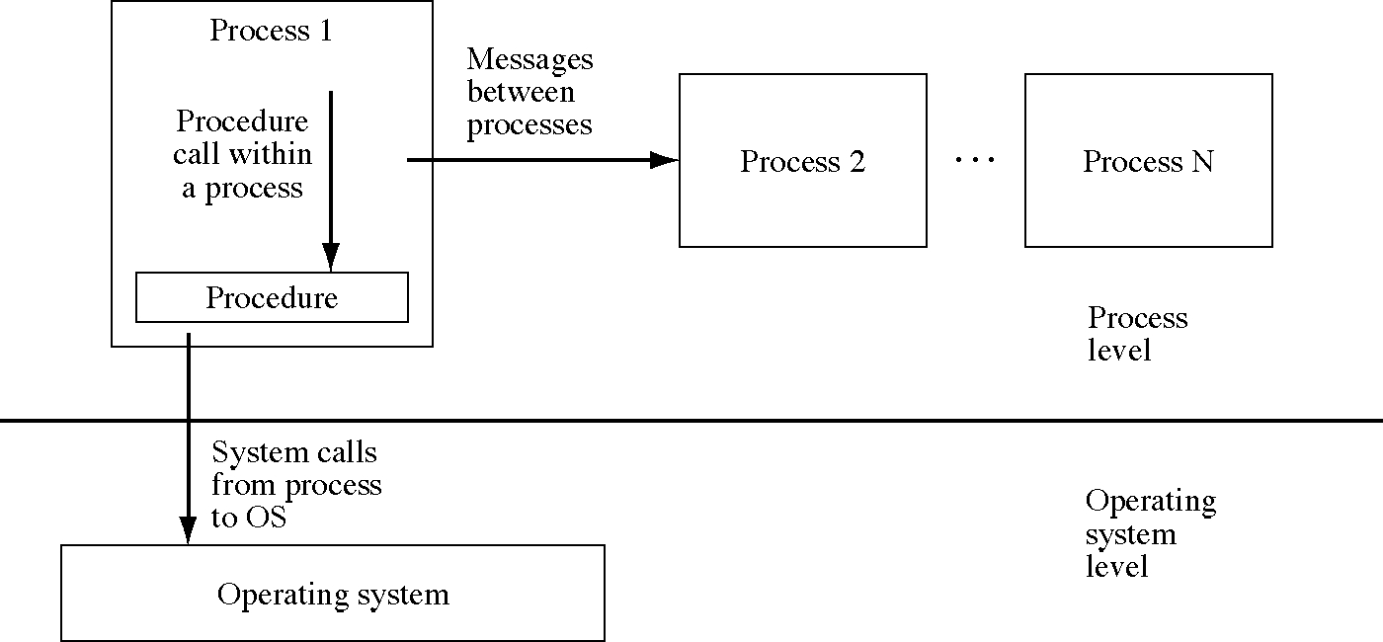
Three modes of communication

Slide 5
System processes
We will change the simple OS to unify communication outside the process
Most of the OS will exist in system processes that do what the OS kernel used to do
We will replace system calls with messages to the operating system
This will unify system calls with messages

Slide 6
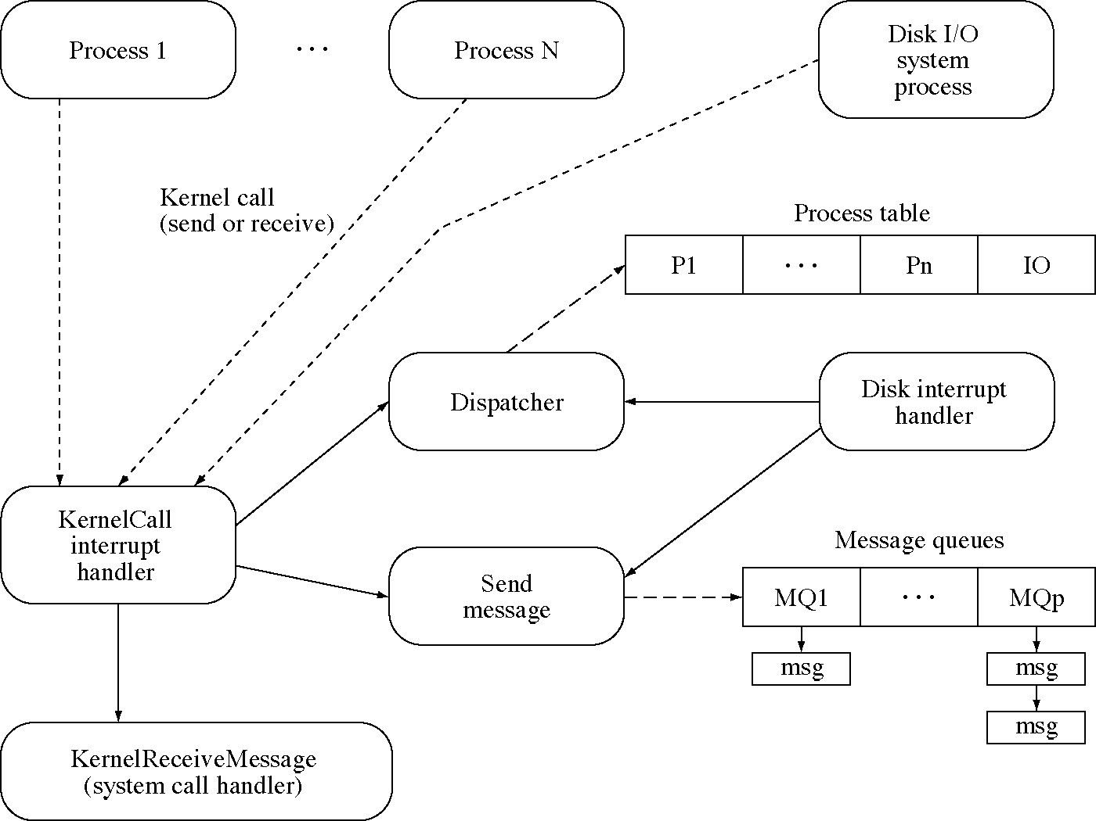
SOS with system processes

Slide 7
The initial process
void main() {
// start the disk driver process
(void)CreateProcess(
DiskDriverProcessBlock, DiskDriverProcessSize);
// ... the rest is the same as in the simple OS
}

Slide 8
System constants
// all the same constants as the simple OS
// plus …
// kernel call call numbers
static final int SendMessageKernelCall = 1;
static final int ReceiveMessageKernelCall = 2;
// message type numbers
static final int CreateProcessSystemCall = 1;
static final int ExitProcessSystemCall = 2;
static final int DiskReadSystemCall = 3;
static final int DiskWriteSystemCall = 4;
static final int ReadDeviceRegisters = 5;
static final int WriteDeviceRegisters = 6;
static final int SystemCallComplete = 7;
// fixed message queue numbers
static final int SystemCallMessageQueue = 0;
static final int DiskDriverMessageQueue = 1;

Slide 9
System initialization
int main( void ) {
// ... same as before
// Create message queues 0 (for the OS
// and 1 (for the IOP)
for( i = 0; i < 2; ++i ) {
message_queue_allocated[i] = True;
message_queue[i] = new Queue<MessageBuffer *>;
wait_queue[i] = new Queue<WaitQueueItem *>;
}
// The other message queues start out unallocated.
for( i = 2; i < NumberOfMessageQueues; ++i )
message_queue_allocated[i] = False;
// Let's go!
Dispatcher();
}

Slide 10
Send message kernel call
void KernelCallInterruptHandler( void ) {
case SendMessageKernelCall:
int * user_msg; asm { store r9,user_msg }
int to_q; asm { store r10,to_q }
// check for an invalid queue identifier
if( !message_queue_allocated[to_q] ) {
pd[current_process].sa.reg[1] = -1;
break;
}
int msg_no = GetMessageBuffer();
// Have we have not run out of message buffers?
if( msg_no == EndOfFreeList ) {
pd[current_process].sa.reg[1] = -2;
break;
}
CopyToSystemSpace( current_process, user_msg,
message_buffer[msg_no], MessageSize );
SendMessageFromOS( to_q, msg_no );
pd[current_process].sa.reg[1] = 0;
if( to_q == SystemCallMessageQueue )
KernelReceiveMessage();
break;

Slide 11
Receive message kernel call
case ReceiveMessageKernelCall:
int * user_msg; asm { store r9,user_msg }
int from_q; asm { store r10,from_q }
// check for an invalid queue identifier
if( !message_queue_allocated[from_q] ) {
pd[current_process].sa.reg[1] = -1;
break;
}
if( message_queue[from_q].Empty() ) {
pd[current_process].state = Blocked;
WaitQueueItem item;
item.pid = current_process;
item.buffer = user_msg;
wait_queue[from_q].Insert( item );
} else {
int msg_no = message_queue[from_q].Remove();
TransferMessage( msg_no, user_msg );
}
pd[current_process].sa.reg[1] = 0;
break;
}
Dispatcher();
}

Slide 12
Send message from OS
void SendMessageFromOS( int to_q, int msg_no ) {
if( !wait_queue[to_q].Empty() ) {
// some process is waiting for a message,
// deliver it immediately
WaitQueueItem item = wait_queue.Remove();
TransferMessage( msg_no, item.buffer );
pd[item.pid].state = Ready;
} else {
// otherwise put it on the queue
message_queue[to_q].Insert( msg_no );
}
}

Slide 13
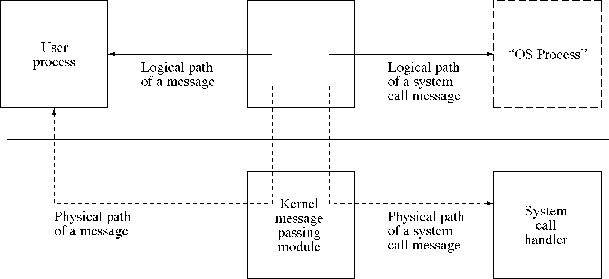
The “OS process”

Slide 14
Kernel receive message (1 of 3)
void KernelReceiveMessage( int msg_no ) {
int msg_no = message_queue[from_q].Remove();
int * msg = message_buffer[msg_no];
switch( msg[0] ) {
case CreateProcessSystemCall:
// Message format:
// msg[0] = CreateProcessSystemCall
// msg[1] = starting block number of executable
// msg[2] = number of blocks in the executable
// msg[3] = message queue to reply to
msg[1] = CreateProcess( msg[1], msg[2] );
// reuse the same message buffer for the reply
msg[0] = SystemCallComplete;
SendMessageFromOS( msg[3], msg_no );
break;
case ExitProcessSystemCall:
// Message format:
// msg[0] = ExitProcessSystemCall
pd[current_process].state = UnusedProcessSlot;
FreeMessageBuffer( msg );
break;

Slide 15
Kernel receive message (2 of 3)
case DiskReadSystemCall:
case DiskWriteSystemCall:
// Message format:
// msg[0] = DiskReadSystemCall
// or DiskWriteSystemCall
// msg[1] = block number
// msg[2] = address of buffer in user process
// msg[3] = message queue to reply to
// forward message to the disk I/O system process
// convert to physical address
msg[2] += pd[current_process].sa.base;
SendMessageFromOS(IOSystemMessageQueue, msg_no);
break;

Slide 16
Kernel receive message (3 of 3)
case ReadDeviceRegisters:
// Message format:
// msg[0] = ReadDeviceRegisters
// msg[1] = message queue to reply to
DiskCommandRegister reg2 = *disk_reg2;
msg[0] = SystemCallComplete;
msg[1] = (int)reg2;
SendMessageFromOS( msg[1], msg_no );
break;
case WriteDeviceRegisters:
// Message format:
// msg[0] = WriteDeviceRegisters
// msg[1] = control register
// msg[2] = memory address register
// store the control words in control register
*Disk_memory_addr = msg[2];
*Disk_control = msg[1]; // Load this last
break;
}
}

Slide 17
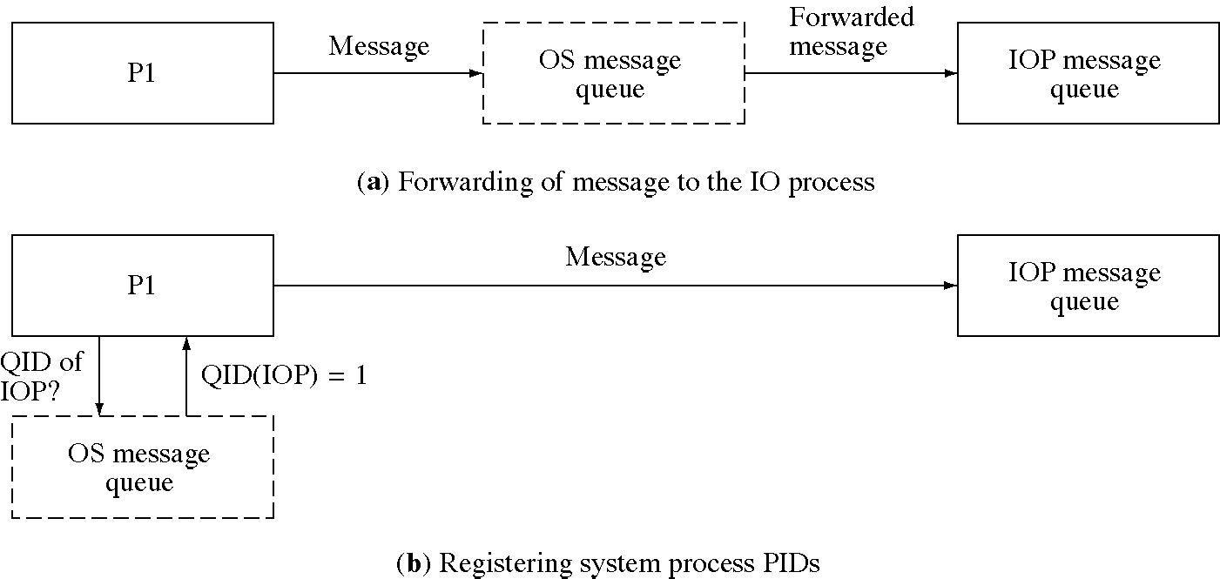
Sending messages to the IO process (two methods)

Slide 18
Disk interrupt handler
void DiskInterruptHandler( void ) {
if( current_process > 0 ) {
// was there a running process?
// Save the processor state of the system caller.
// ...as before
}
// send the message on
// to the disk I/O system process
int msg_no = GetMessageBuffer();
int * msg = message_buffer[msg_no];
msg[0] = DiskInterrupt;
SendMessageFromOS( IOSystemMessageQueue, msg_no );
Dispatcher();
}

Slide 19
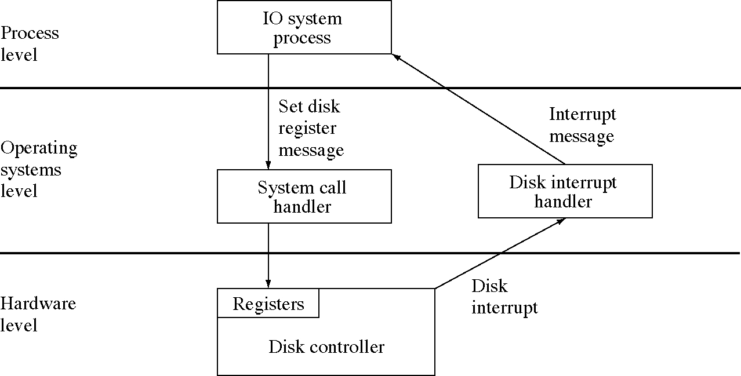
Logical levels of I/O processing

Slide 20
Disk I/O system process (1 of 3)
int message_queue_for_reply;
int DiskIsBusy = False; // initially false
struct IORequest {
int operation;
int disk_block;
int buffer_address;
int reply_queue;
IORequest( int op, int db, int ba, int rq ) {
operation = op; disk_block = db;
buffer_address = ba; reply_queue = rq;
}
};
Queue<IORequest *> * DiskQueue=new Queue<IORequest>;

Slide 21
Disk I/O system process (2 of 3)
void main() {
int msg[8];
// Begin a server loop
while( 1 ) {
ReceiveMessage( IOSystemMessageQueue, msg );
switch( msg[0] ) {
case DiskReadSystemCall:
case DiskWriteSystemCall:
// Message format:
// msg[0] = DiskReadSystemCall or
// DiskWriteSystemCall
// msg[1] = disk block number
// msg[2] = buffer memory address
// msg[3] = message queue to reply to
DiskQueue->Insert(
new IORequest(msg[0],msg[1],msg[2],msg[3]);
break;

Slide 22
Disk I/O system process (3 of 3)
case DiskInterrupt:
DiskIsBusy = False;
msg[0] = SystemCallComplete;
SendMessage( message_queue_for_reply, msg );
ScheduleDisk();
break;
}
if( !DiskIsBusy && !DiskQueue->Empty() ) {
IORequest * ior = DiskQueue->Remove();
DiskIO(ior->operation, ior->disk_block,
ior->buffer_address );
message_queue_for_reply = ior->reply_queue;
delete ior;
}
}
}

Slide 23
Disk I/O functions
int DiskBusy( void ) { return DiskIsBusy; }
void IssueDiskCommand(
int rw_cmd, int block_number, char * buffer) {
DiskSectorRegister reg0;
DiskCommandRegister reg2;
int cylinder, track, sector, msg[8];
DiskAddress(block_number,cylinder,track,sector);
reg0.sector = sector;
reg0.track = track;
reg0.cylinder = cylinder;
reg0.disk = 0;
reg2.command = rw_cmd;
reg2.interrupt_enable = 1;
msg[0] = WriteDeviceRegisters;
msg[1] = reg0;
msg[2] = buffer;
msg[3] = reg2;
SendMessage( SystemCallMessageQueue, msg );
DiskIsBusy = True;
}

Slide 24
Micro-kernel OSs
Micro-kernel: contains only the basic OS services which must run in system mode
  process dispatching
  message passing
  paging
  protection
The rest of the OS services are provided by system processes
  they are OS service servers
  this used the client-server model

Slide 25
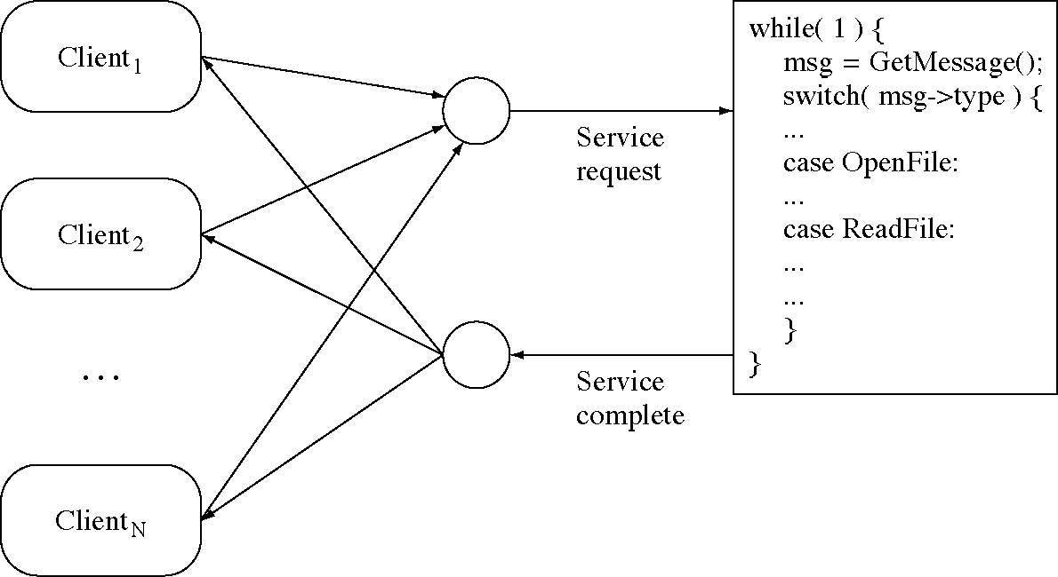
Communication with a server

Slide 26
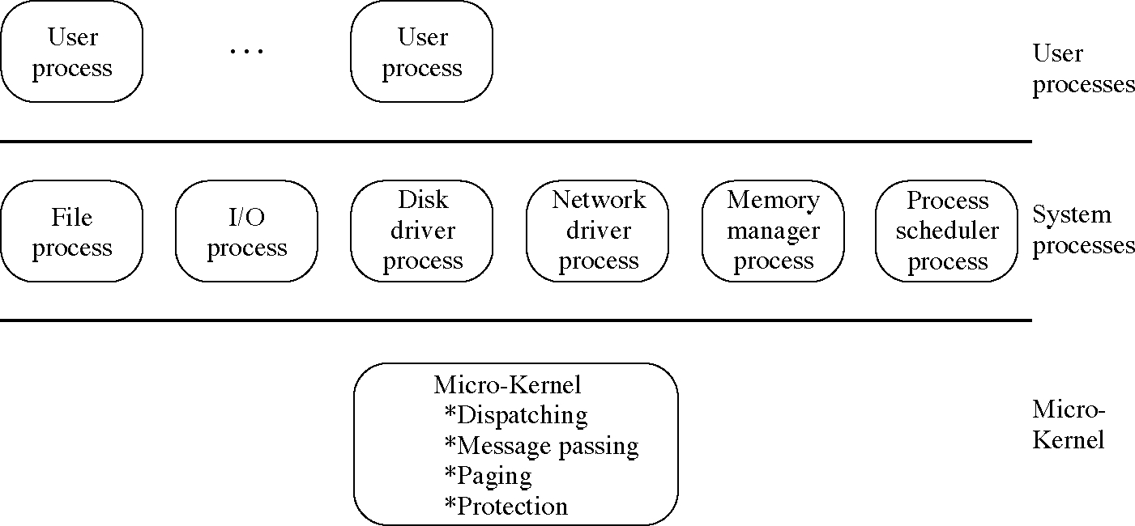
Micro-kernel-based OS

Slide 27
Advantages of micro-kernel OSs
More than one server can provide a service
  e.g. we can have multiple file systems
  we can test new versions of system services
  or just to provide alternate versions of the services
The OS can be easily distributed to multiple processors
The system is more modular
Main disadvantage: it is slower

Slide 28
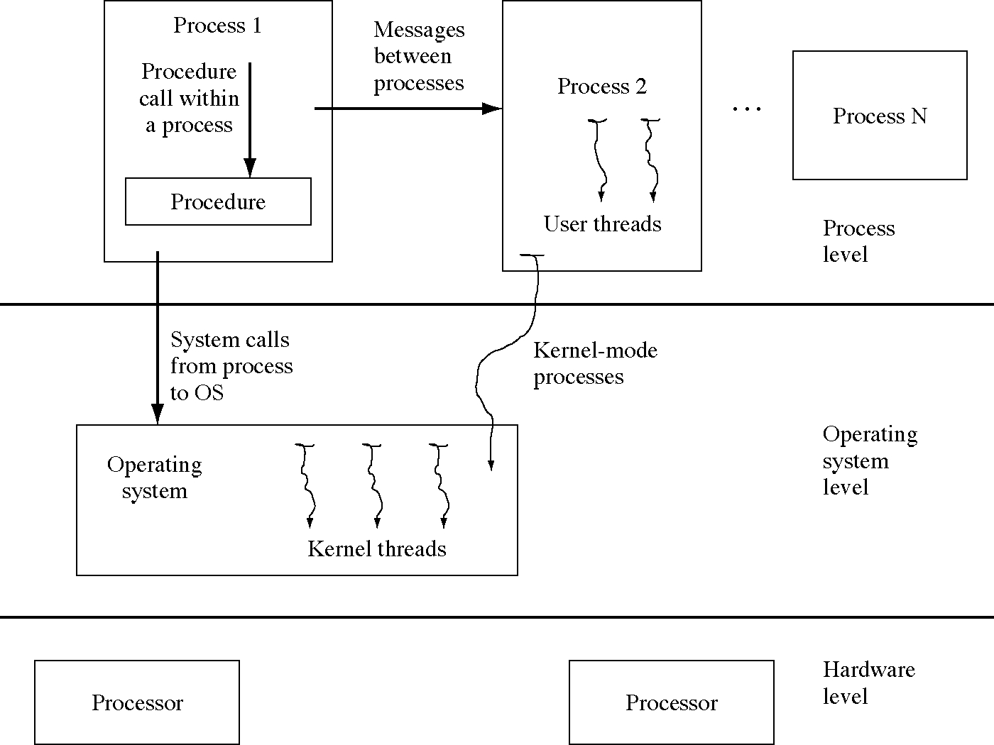
Expanded OS model

Slide 29
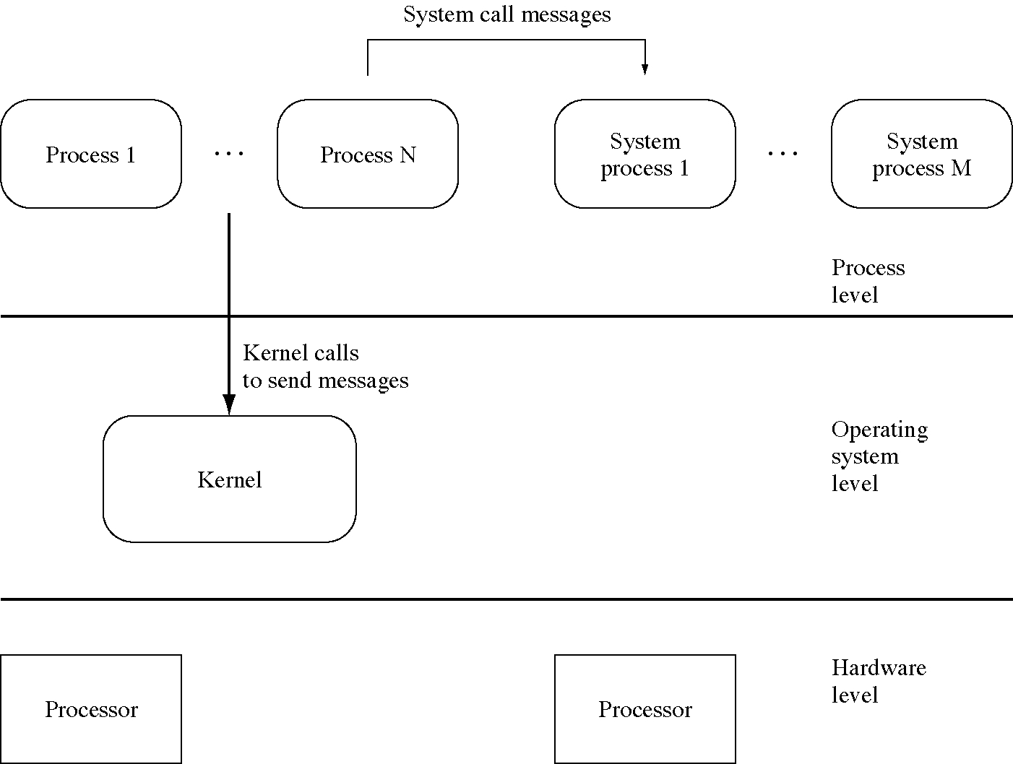
System process OS model

Slide 30
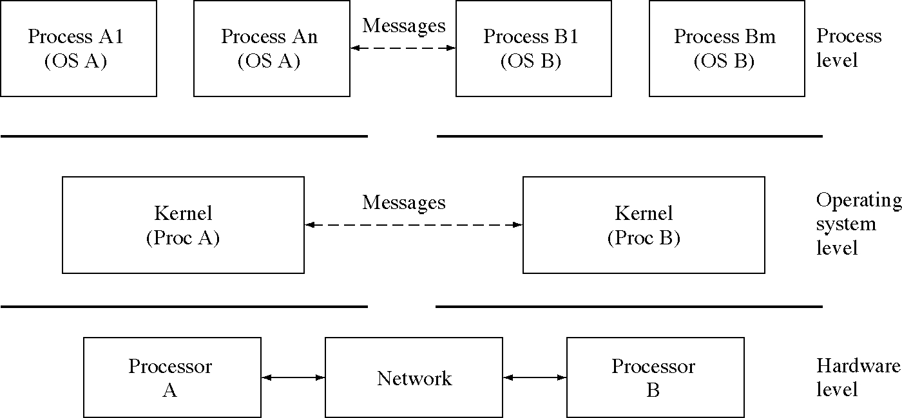
Networked OS model

Slide 31
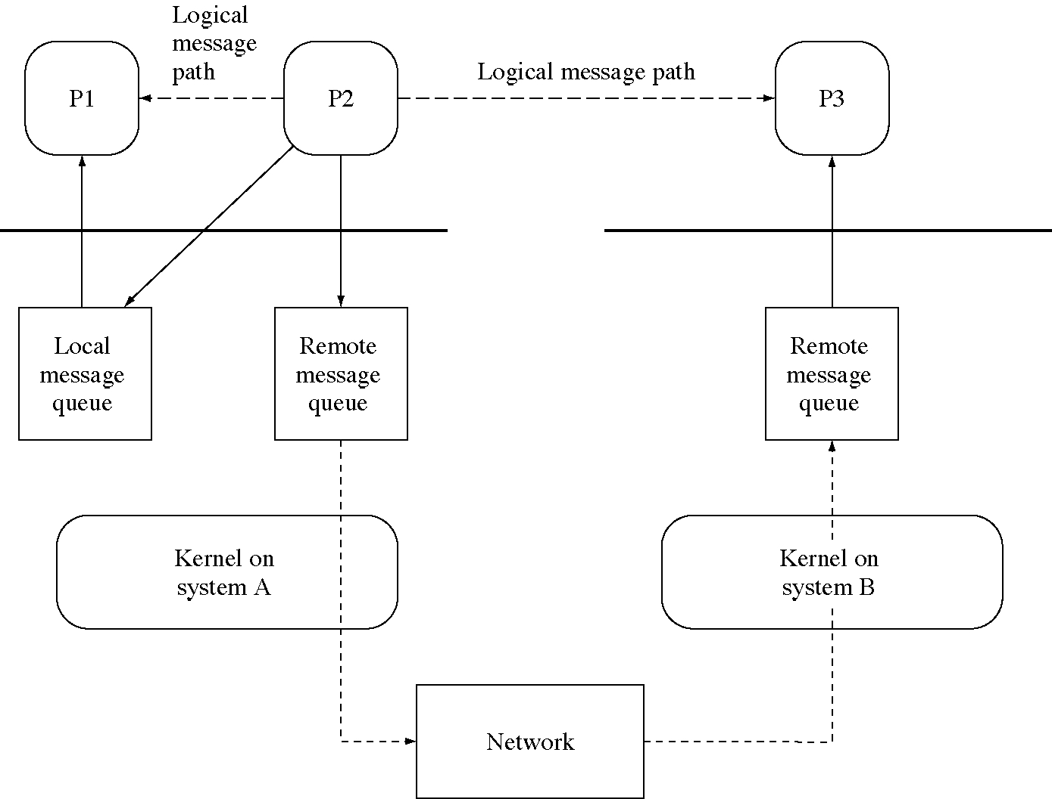
Networked OS

Slide 32
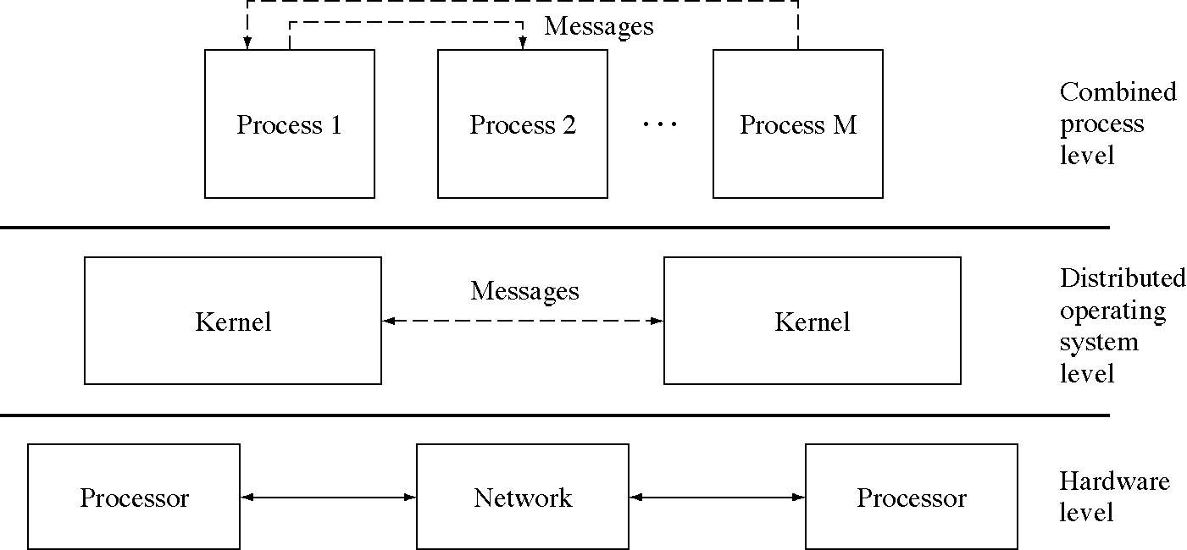
Distributed OS

