Slide 1
Streaming Platform User Behavior Analysis
Key insights and strategic recommendations

Slide 2
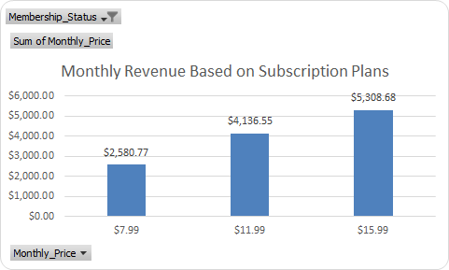
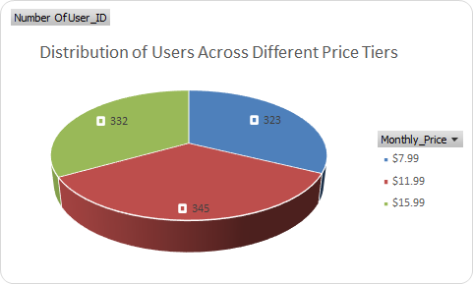
1. Subscription & Revenue
- Most users fall into the $7.99 and $11.99 tiers
- Active members drive majority of monthly revenue
- Opportunity: upsell high engagement users to premium plans

Slide 3
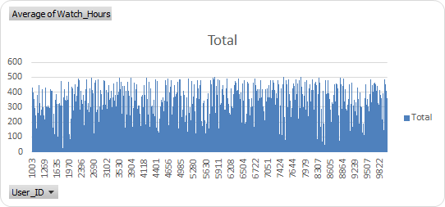
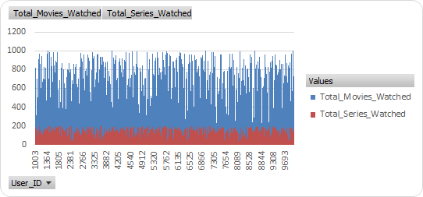
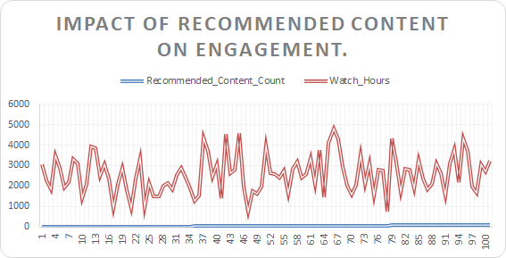
2. User Engagement Metrics
- Average watch time per user is healthy, especially for series
- Movies vs. Series ratio favors series for long-term engagement
- Recommended content boosts watch time for top 30% users

Slide 4
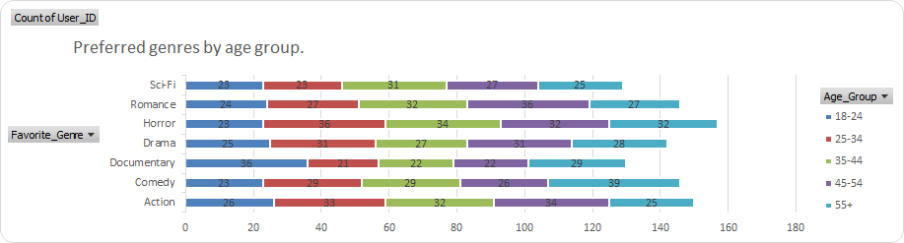
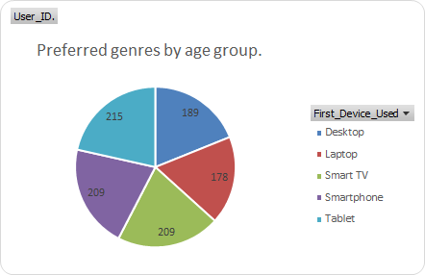
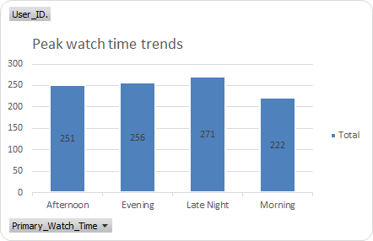
3. Demographic & Behavioural Insights:
- Age 25-34 leads in usage and loyalty
- Sci-Fi & Drama preferred by 25-34 and 35-44 segments
- Desktop and mobile dominate device usage, with Smart TVs rising
- Evening and Late Night are peak hours

Slide 5
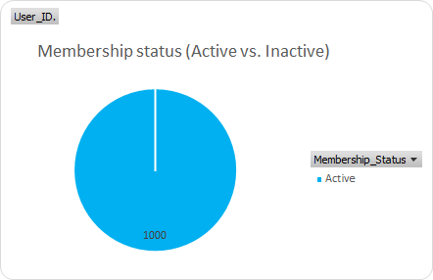
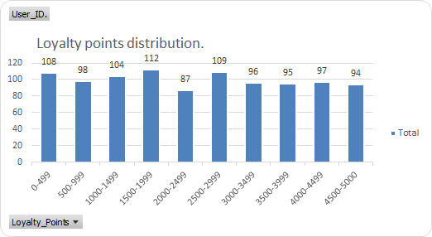
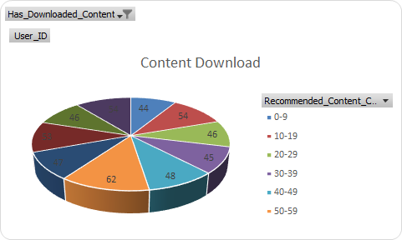
5. Retention & Loyalty
- 100% users are currently Active
- Loyalty points are under-leveraged across middle tiers

Slide 6
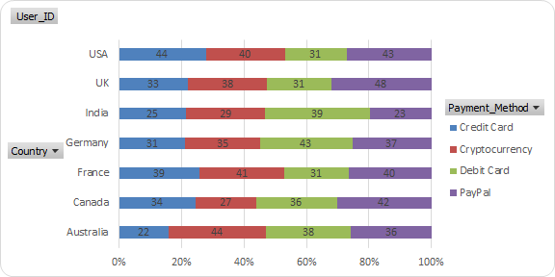
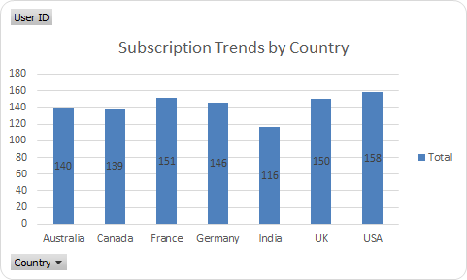
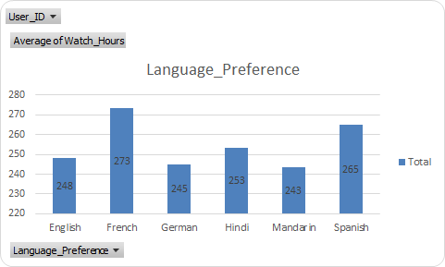
6. Payment Preferences & Regional Trends
- PayPal has the highest contribution in payment method.
- USA trends at no.1 position in subscription.
- 16% of watch hours observed in all language.

Slide 7
Strategic Recommendations
- Introduce flexible micro-subscriptions or weekend-only passes
- Age-personalized genre and UI experiences
- Improve predictive recommendations using watch history & loyalty

