Slide 1
ITP 120 Java Programming I Lecture 9.2B Problem Decomposition II
Professor Sheehan
Information and Engineering Technology
Northern Virginia Community College
tsheehan@nvcc.edu
ITP120-1; lecture starts at 9:35 am M/W
ITP120-2; lecture starts at 2:20 pm M/W
ITP120-3; lecture starts at 10:30 am Tu/Th
ITP120-4; lecture starts at 1:00 pm Tu/Th
© Thomas T. Sheehan

Slide 2
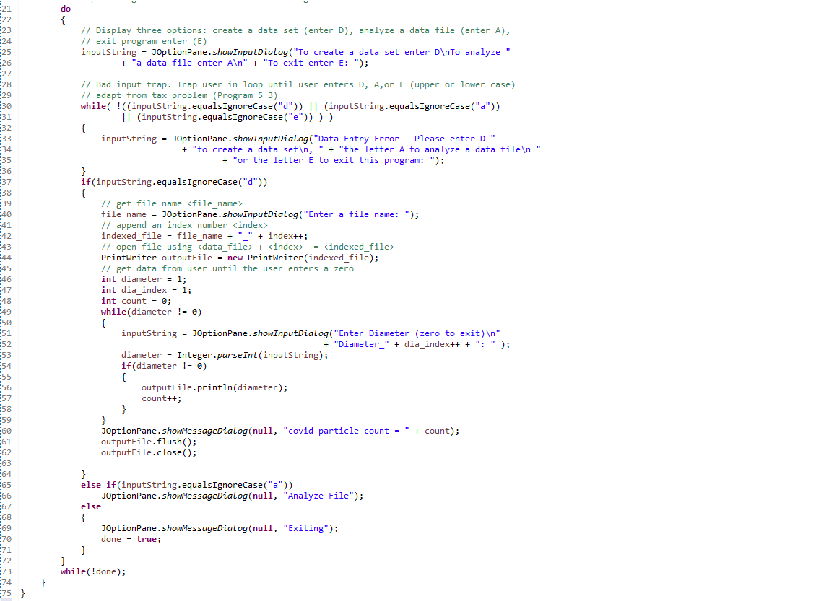

Slide 4
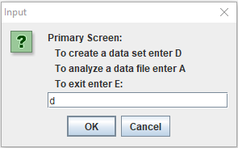
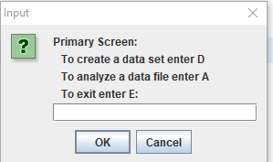

Slide 5
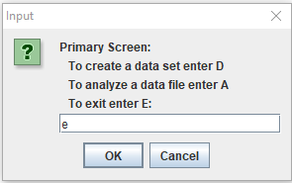

Slide 6
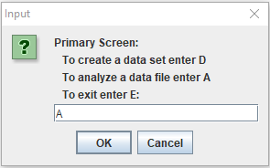

Slide 7
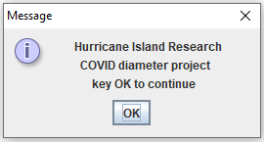
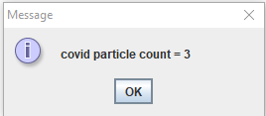
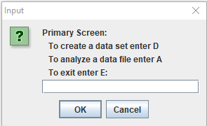
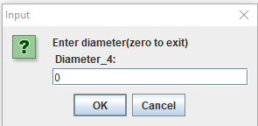
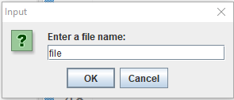
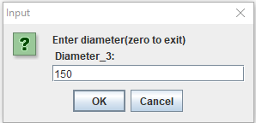
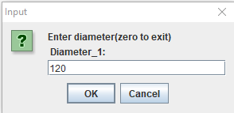
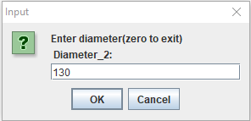
Test Case 1
Test Case 1

Slide 8
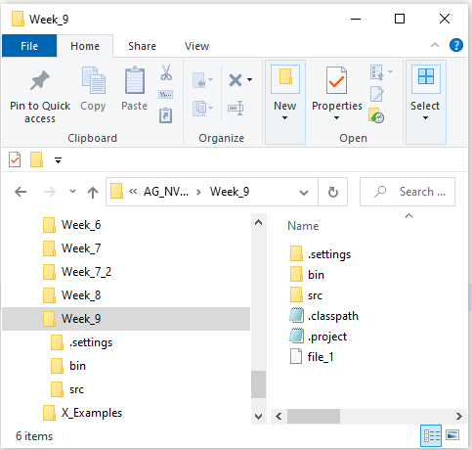
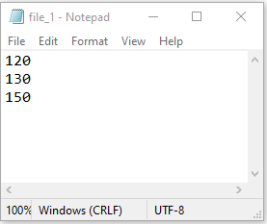
Test Case 1
Test Case 1

Slide 9
Test Case 1
Test Case 1

Slide 10

Test Case 2

Slide 11
Test Case 2

Slide 12
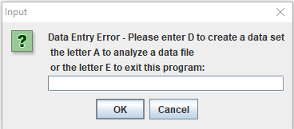
Test Case 2

Slide 13
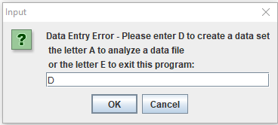
Test Case 2

Slide 14
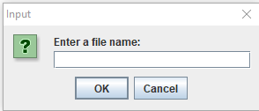
Test Case 2

Slide 15
Test Case 3

Slide 16
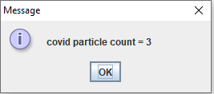
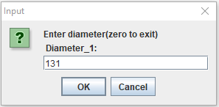
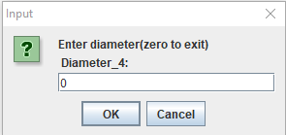

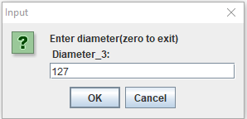
Test Case 3

Slide 17
Test Case 3

Slide 18
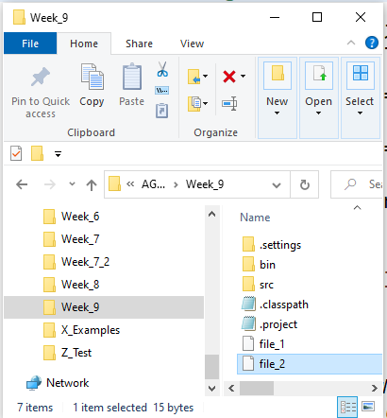
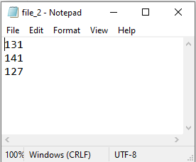
Test Case 3

Slide 19
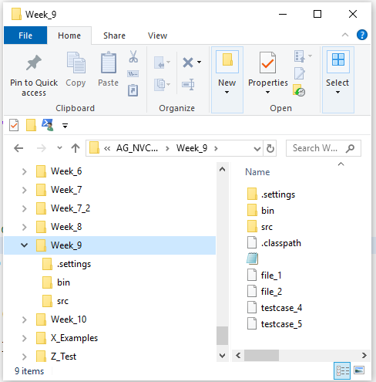
Test Case 3

Slide 20
Test Case 3

Slide 21
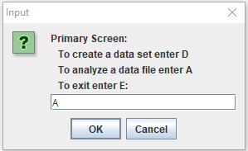
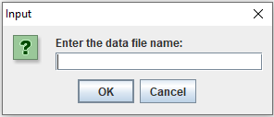
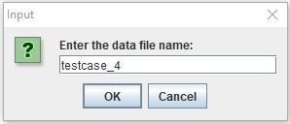
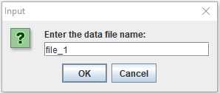
Test Case 4

Slide 22
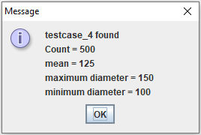
Test Case 4

Slide 23
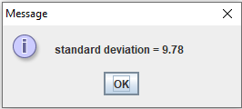
Test Case 4

Slide 24
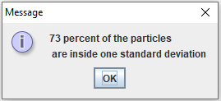
Test Case 4

Slide 25
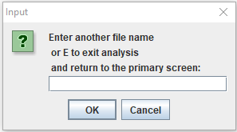
Test Case 4

Slide 26
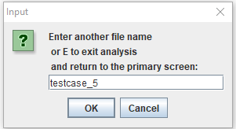
Test Case 5

Slide 27
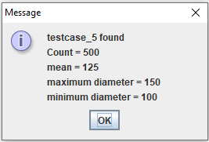
Test Case 5

Slide 28
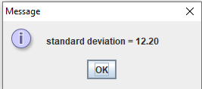
Test Case 5

Slide 29
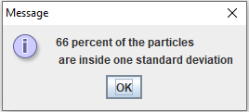
Test Case 5

Slide 30
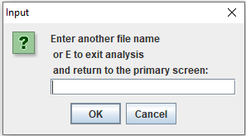
Test Case 5

Slide 31
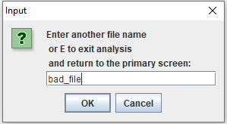
Test Case 6

Slide 32
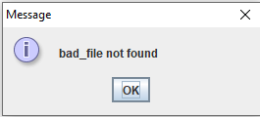
Test Case 6

Slide 33
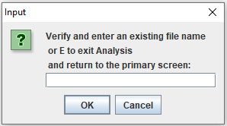
Test Case 6

Slide 34
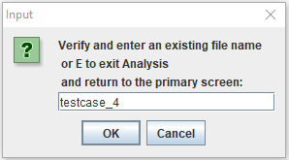
Test Case 6

Slide 35
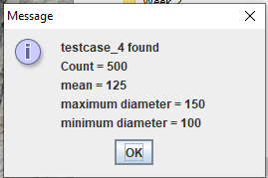
Test Case 6

Slide 36
Test Case 6

Slide 37
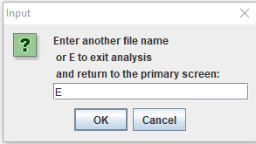
Test Case 6

Slide 38

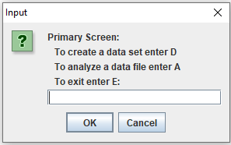
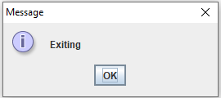
Test Case 6

Slide 39
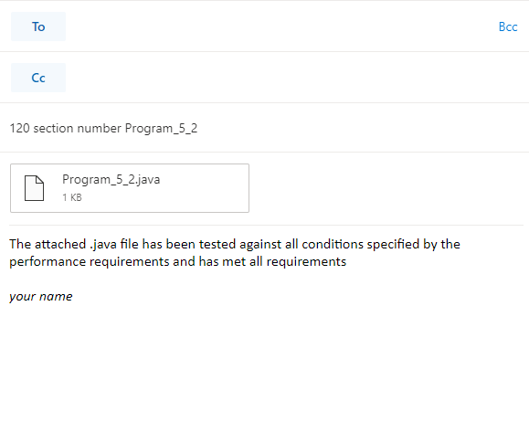
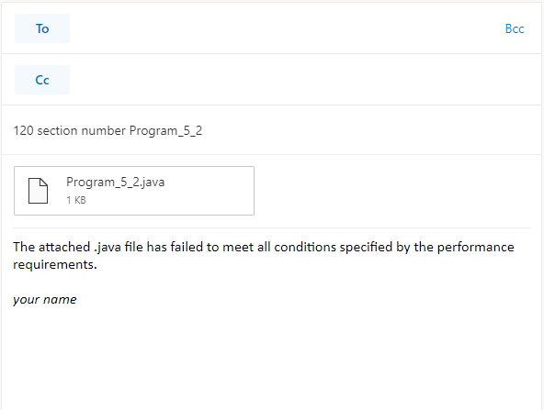
Program_9_2 is due by noon Sunday
Email your Program_9_2.java file to:
tsheehan@nvcc.edu
120 section number Program_9_2
Program_9_2.java
Subject line on your email must read
120 – section number – Program_9_2
120 section number Program_9_2
Program_9_2.java
MW 9:35 AM - 11:35 AM section number = 1
MW 2:20 PM - 4:20 PM section number = 2
TuTh 10:30 AM - 12:30 PM section number = 3
TuTh 1:00 PM - 3:00 PM section number = 4

Slide 40
Program_9_2 is due by midnight tomorrow
Email your Program_9_2.java file to:
tsheehan@nvcc.edu
120 section number Program_9_2
Program_9_2.java
Subject line on your email must read
120 – section number – Program_9_2
If your program does not come in attached to one of these two emails, with the wording as shown, and the correct subject line, the grade will be zero
120 section number Program_9_2
Program_9_2.java
MW 9:35 AM - 11:35 AM section number = 1
MW 2:20 PM - 4:20 PM section number = 2
TuTh 10:30 AM - 12:30 PM section number = 3
TuTh 1:00 PM - 3:00 PM section number = 4

Slide 41
Program_9_2 is due by midnight tomorrow
Email your Program_9_1.java file to:
tsheehan@nvcc.edu
120 section number Program_9_2
Program_9_2.java
Subject line on your email must read
120 – section number – Program_9_2
If your program comes in attached to the blue bordered email you are certifying that “the attached .java file has been tested against all conditions specified by the performance requirements and has met all requirements.” If your code comes in with that certification I will run it against the 6 test cases just outlined. If it fails at any point in any of those four tests the grade is zero
120 section number Program_9_1
Program_9_1.java
MW 9:35 AM - 11:35 AM section number = 1
MW 2:20 PM - 4:20 PM section number = 2
TuTh 10:30 AM - 12:30 PM section number = 3
TuTh 1:00 PM - 3:00 PM section number = 4

Slide 42
120 section number Program_9_2
Program_9_2.java

Slide 43
120 section number Program_9_2
Program_9_2.java

Slide 44
Bonus Points for Program _9_2
If you score 10/10 on Program_9_2 three points will be added to your final calculated grade. They won’t be averaged in, they will just be added to your final grade. If 60% of your program grade (the sum of all your programs divided by the number of programs) plus 20% of your midterm plus 20% of your final come to 87.2 then the three bonus points will raise your grade to 90.2
But to get a 10/10 you have to certify that that “the attached .java file has been tested against all conditions specified by the performance requirements and has met all requirements.” If it fails at any point in any of those tests the grade is zero and there is no bonus.

