Slide 1
MICRO CREDIT DEFAULTER PROJECT
Submitted By:
RAVIKUMAR S

Slide 2
Content
Problem Statement
Data Review
Data Cleaning
Problem Solving
Visualizations
Conclusions
References

Slide 3
PROBLEM STATEMENT
MFI is an organization which provides financial services to low income families.
Project is based on reality basis
Our client is a Telecom Industry in Indonesia
They collaborate with MFI to provide micro credit on mobile balances
There are two loan amounts :5 and 10 Indonesian Rupiah which have to be paid back within 5 days
Paid back amounts are 6 and 12 respectively
Companies having issue selecting customers as if they can payback loan within 5 days of issuance of loan.

Slide 4
DATA REVIEW
Data consists of 209593 rows and 37 columns.
Output column is label with values 0:Defaulter and 1:non defaulter
There are no null values
Data is imbalanced with 87.5% non defaulters and 12.5% defaulters
There are presence of unrealistic values and outliers
Datatypes are integer,float,object and date

Slide 5
DATA CLEANING
Synthesizing date column
Dropping unnecessary columns like year,msisdn and pcircle
Checking for null values
Checking correlation between columns using heatmap

Slide 6
PROBLEM SOLVING
Skewness resolved by Yeo-Johnson method
Oversampler technique is used to treat imbalanced data
Standard scaler used to remove unrealistic values

Slide 7
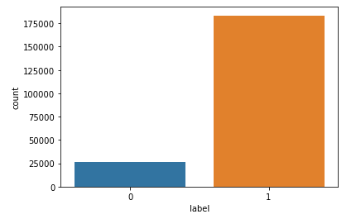
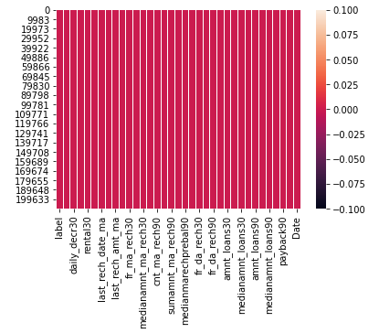
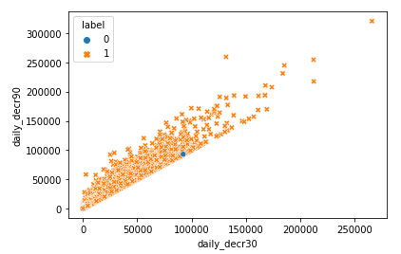
VISUALIZATIONS

Slide 8
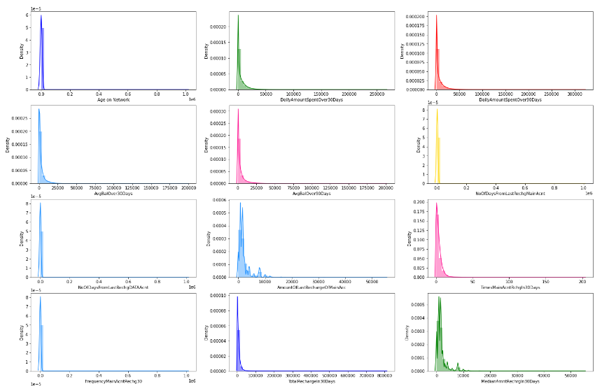

Slide 9
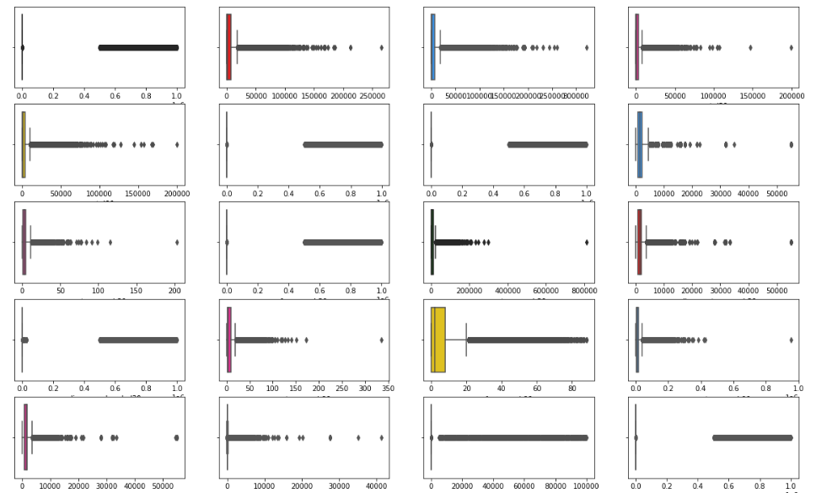

Slide 10
MODEL TESTING WITH ACCURACY SCORE
Random Forest Classifier - 0.95
Decision Tree Classifier - 0.91
LinearSVC-0.77
Logistic Regression - 0.77

Slide 11
CONCLUSION
Number of default customers are very less compared to non default customers
Above average people has taken only one or two loans and major of them opt Rs.6 category
Maximum payback time taken by defaulters is below 10 to 15 days and max.no.of loans is below 8 in a month
If MFC’s increase due date to payback loan,they may get more customers and also can reduce no.of defaulters
From my model testing Random forest classifier gives the best result and I choose this as best model and saved as pickle file.

Slide 12
REFERENCE
https://www.datatrained.com/
https://scikit-learn.org/stable/
https://towardsdatascience.com/hyperparameter-tuning-the-random-forest-in-python-using-scikit-learn-28d2aa77dd74
https://www.mdpi.com/2227-9091/9/3/50/pdf
https://github.com/amydaali/Machine-Learning-Projects

