Slide 1
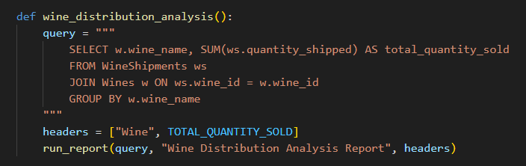
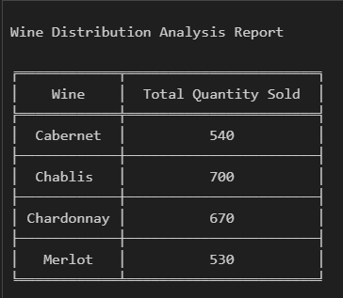
Report 2
Query # 1 - Wine Distribution Analysis Report
This report summarizes the total quantity sold for each wine

Slide 2
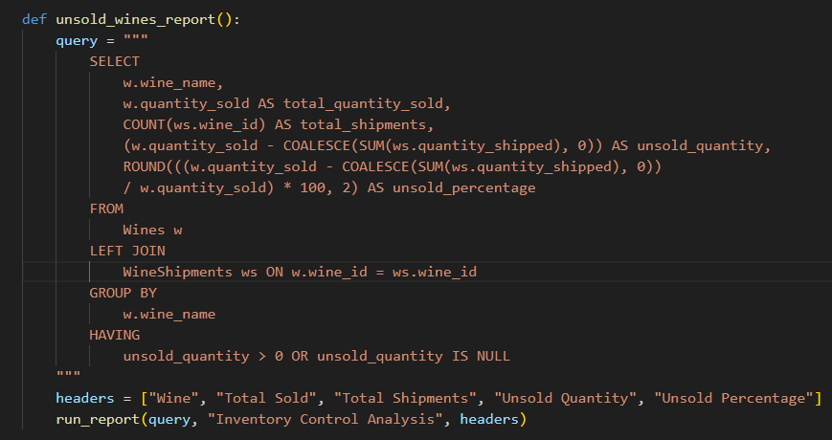
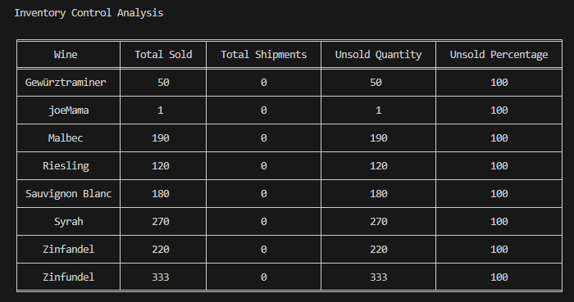
Report 2 cont.
Query #2 – Inventory Control Analysis
This report identifies which wines have not been sold and calculates the percentage of unsold wines.

Slide 3
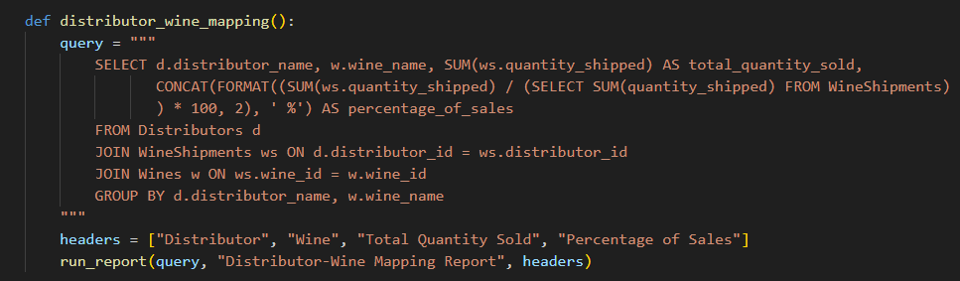
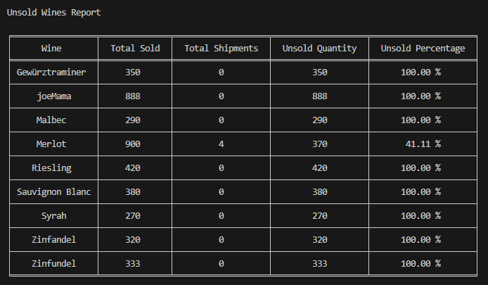
Report 2 cont.
Query # 3 - Wine Distribution Mapping
Maps distributors to the wines they distribute and shows the quantity sold and the percentage of total sales.

Slide 4
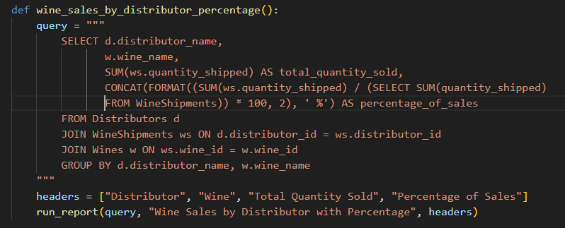
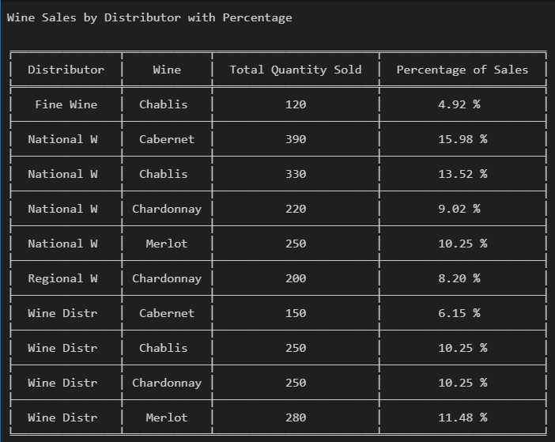
Report 2 cont.
Query # 4 – Individual Distributor Sales Report
Identifies wines , distributors, quantities , and shows unsold wine percentage.

Slide 5
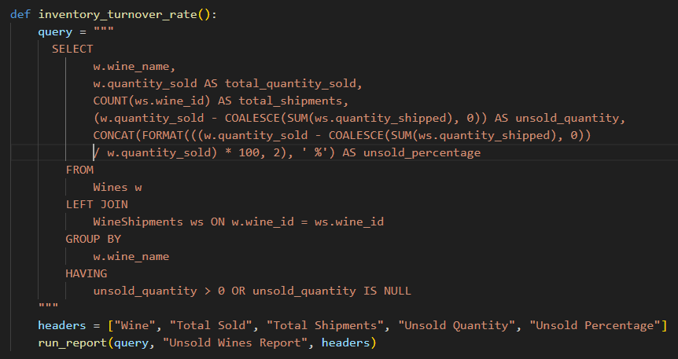
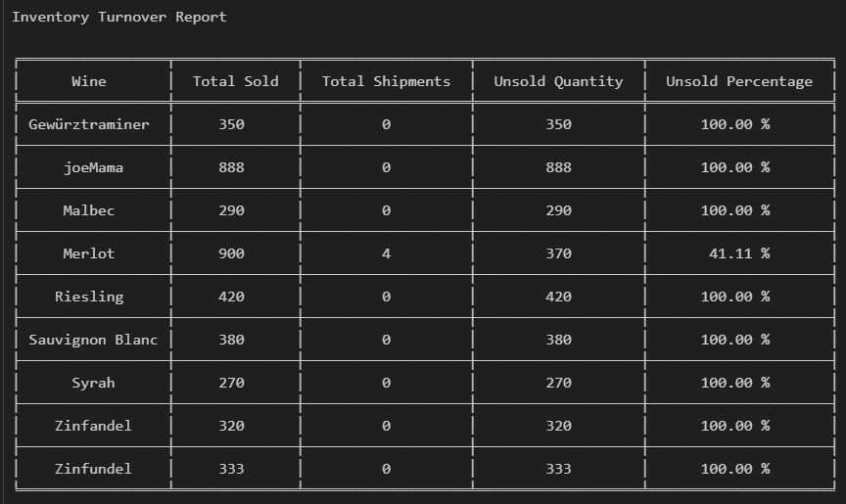
Report 2 cont.
Query # 5 – Inventory Turnover Rate
Analyzes the inventory turnover rate for each wine.

Slide 6
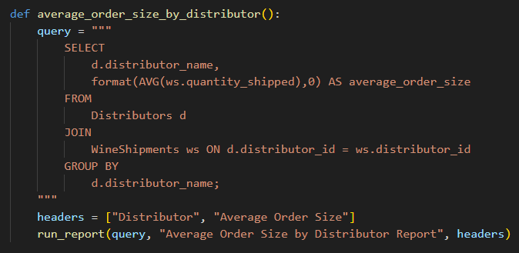
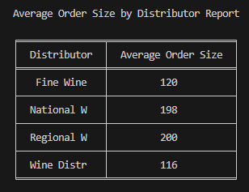
Report 2 cont.
Query # 6 – Average Distributor Order Size
Calculates the average order size for each distributor.

Slide 7
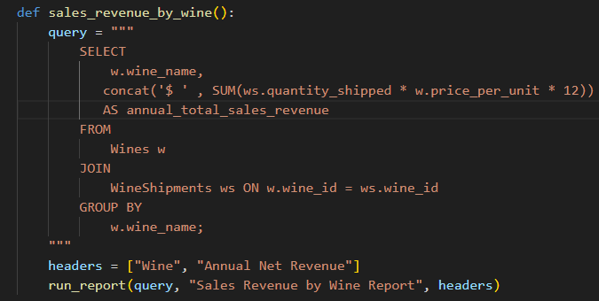
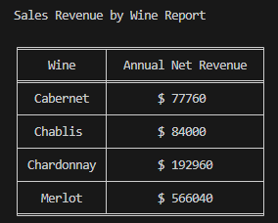
Report 2 cont.
Query # 7 – Sales Revenue by Wine
Analyzes total sales revenue generated by each wine.

Slide 8
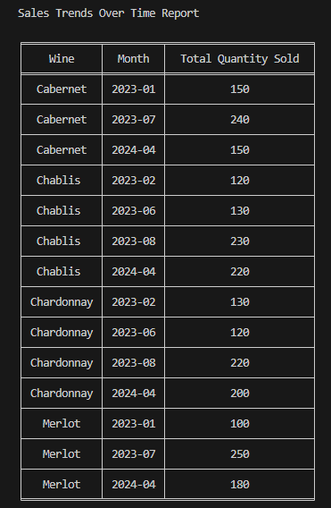
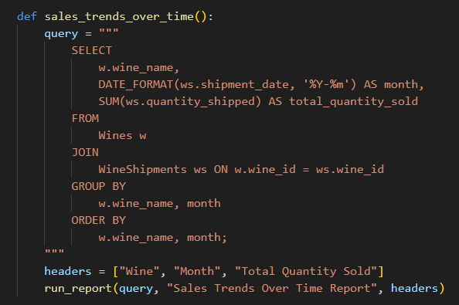
Report 2 cont.
Query # 8 – Annual Sales Trends
Analyzes sales trends over time for each wine.

Slide 9
Report 2 cont.
Query # 10 – Sales Revenue by Wine
Analyzes total net sales revenue generated by each wine.

Slide 10
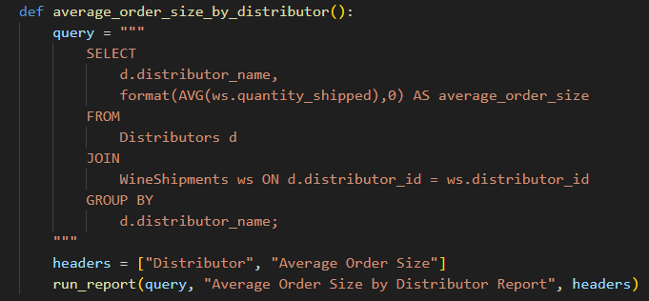
Report 2 cont.
Query # 9 – Average Order Size by Distributor
Calculates the average order size for each distributor.

