Slide 1
The Technology Value Stream
Robert Stewart 10/26/2024
Module 1.2 Assignment

Slide 2

What is the Technology Value Stream?
A technology value stream is the series of activities required to convert a business idea or request into a technology-enabled service or product, ensuring value for the customer.
The goal of the value stream is to identify and eliminate bottlenecks to optimize delivery speed and quality (Debois et al., 2021, p. 9).

Slide 3
Lead Time vs. Processing Time
Lead Time
Processing Time
The time before the request is made until it is fulfilled, including all waiting periods.
The time actively spent working on the task, excluding idle time.

Slide 4
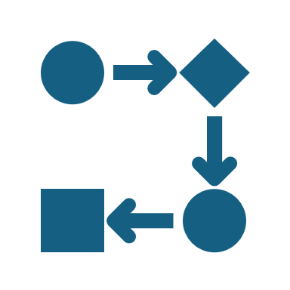
Lead Time vs. Processing Time Visualization

Slide 5
The Common Scenario: Deployment Lead Times Requiring Months
Complex, monolithic systems with long test and approval cycles.
Dependence on manual testing and scarce test environments.

Slide 6
Our DevOps Ideal: Deployment Lead Times of Minutes
Frequent, small code changes with automated testing and CI/CD pipelines.
Developers receive immediate feedback, allowing quick fixes.
Modular, loosely coupled architectures that reduce dependencies.

Slide 7
Key Elements to Achieve the DevOps Ideal
Automation Tools: Jenkins, GitHub Actions, CircleCI.
Infrastructure as code.
Continuous Feedback: Monitoring tools to track production performance and errors.

Slide 8
References
Patrick Debois, Nicole Forsgren, Jez Humble, Gene Kim, & John Willis. (2021). The DevOps Handbook, 2nd Edition. IT Revolution Press.

