Slide 1
Java

Slide 2
Features
Simple
Object oriented Programming
Robust
Secured
Platform Independent
Architecture neutral
Portable
Strongly typed language (means need to declare data type)

Slide 3
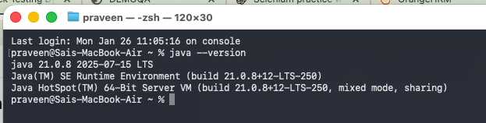
installation
https://www.oracle.com/java/technologies/downloads/
Java17 (Preferred)
Confirmation => java --version

Slide 4
JDK
lib
Bin /tools
Jre/jmods
APIs(.jar)
Collections of packages
Classes
Interfaces
variables
Methods
Fields or constants
Abstract Methods

Slide 5
Lib: library or predefined function in the form of jar files(similar to API)
Bin: Binaries or executables
Javac: it will compile a java file and create a .class file (this is byte code)
Syntax: javac file.java
Java: this will execute the .class file
Syntax: java file.class

Slide 6
JRE (java run time environment)
Pre-execution of code happens here
Collection of information about current working machine
Converts .class file(byte code) to local understandable format
Implementation of tasks for JVM

Slide 7
JVM
CLSS
Class Loader Sub system
EE
Execution Engine
GC
Garbage Collector
Interpreter
JIT Compiler

Slide 8
CLSS
CLSS: Class loader subsystem
Loading .class files or code
Initialization
Linking

Slide 9
EE : Execution engine
Byte code to machine understandable format
Interpreter : Bytecode to executable file

Slide 10
JIT Compiler
JIT Compiler: Just in time compiler (looping)

Slide 11
GC : Garbage Collector
Mark: identify
Sweep: Cleans or deallocate
By default, GC works background
Syntax:
System.gc();
Runtime.gc();

Slide 12
Java Memory Blocks

Slide 13
.class files
Static variables
Static blocks
Static methods
Class Area/ Method Area
Heap area (Dynamic memory allocation)
Objects
Arrays
Java Memory Blocks
Local declarations
Expressions
Local variables
Current running Logic /code (loops)
Java Stack area
String Constant pool Area (SCPA)
Only String Literals

Slide 14
Structure of Java Programs

Slide 15
Sections
Documentation
Package
Import
Class or interface

Slide 16
1.Documentation
Known as Comments
“ // ” used for Single line Comments
/* Multiline Comment */

Slide 17

2. package
It is similar to folder
Syntax:
Single level Package: Package package_name;
Multilevel Package: Package package1.package2;
Nameing rule: Recommended to use Lower Case
** package statement is the First & Must statement of program.

Slide 18

3. import
Used to access the external Packages or particular class or method
Syntax:
import package_name.*; => imports complete package not preferred
import package_name.class_name; => preferred
** Java.lang is default and universal package

Slide 19
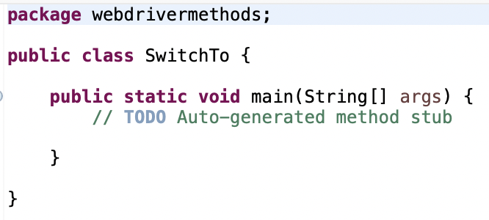
4. Class or interface
Recommendation:
one class is recommended for one file
Cannot create class data inside another class
Syntax:
Access-Specifier Access-modifier class ClassName
{ //Variable
//method. }
Access-Specifier: public, private, protected <default>
Access-Modifier: It explains about behaviour static/final/abstract/<default> or unspecified /volatile/transient

Slide 20
Main method
Compiler checks about grammatical mistakes of java program
Main method:
It is used to start execution.
One main method is required/enough to run complete Program
Syntax:
Access-specifier access-modifier return-type methodname (variable)
Only 1 main method should be allowed in class file

Slide 21


Naming Convention
packages: all alphabets be lowercase is recommended
Class & interfaces & Constructor method: Title casing is recommended.
Method & Variable & abstract Method : Camel Casing is recommended.
Constant : all letters to be Uppercase and multiple words separated by underscore. (Eg: MY_CONSTANT)

Slide 22
variables
Its is reference to given to memory block
these are used to store data for reuse the value
It used to simplify the expression
Syntax:
access-specifier access-modifier data-type variableName = value ; declaration and assignment
access-specifier access-modifier data-type variableName; declaration

Slide 23
Variables
Local variables
Instance variable
Static variable
Declaration: inside class & outside Method having Static keyword
Memory allocation: During class file loading
Memory Location: Class area /method area
Calling style: Classname.variable
Scope: Till end of program
Declaration: inside class & outside Method
Memory allocation: instance /object creation
Memory Location: Heap area
Calling style: objectname.variable
Scope: Till last usage of object
Declaration: inside Method
Memory allocation: during method call
Memory Location: java Stack area
Calling style: variable name
Scope: Till end of method
when to choose static
Note : if you have some value that is common and can be shared across

Slide 24
Primitive data types are 8 in number
1
Boolean
3
2
Primitive
float
Char
4
Floating point
double
Numeric
5
Data Types
integral
byte
6
short
Integer
7
Non-Primitive
int
8
long
Objects
Strings
Arrays etc..

Slide 25
Data Type | Size(in bytes) | Default Value | Range | Syntax | Wraper Class
byte | 1 | 0 | -128 to 127 | byte a; | Byte
Short | 2 | 0 | -32768 to 32767 | short a; | Short
int | 4 | 0 | -2147483648 to 2147483647 | int a; | Integer
long | 8 | 0 | -2^63 to 2^63 -1 | long a; | Long
float | 4 | 0.00 | Upto 8 decimal | float a; | Float
double | 8 | 0.00 | Upto 13 decimals | double a: | Double
Char | 2 | \u0000 |  | char a; | Char
boolean |  | false | true or false | boolean a; | Boolean
Sign bit
7 | 6 | 5 | 4 | 3 | 2 | 1 | 0
 | 2^6 | 2^5 | 2^4 | 2^3 | 2^2 | 2^1 | 2^0

Slide 26
Type Mismatch :
Cannot convert int to byte
Cannot convert int to short

Slide 27
methods
Contains Set of instructions to perform specific task or function
Advantages
Reusability
Code clarity
Avoids code redundancy
Length of code reduces
Easy debugging of program
Syntax
access-specifier access-modifier return-type methodName(arguments)
{
//body of method
local declarations;
statements;
return value;
}
Note : return-type should be void if there is no need of return statement

Slide 28
Non-Static/ Instance method
Static method
without static keyword (def)
while creation of objects (when memory allocated)
Heap Area (memory location)
objectName.methodName (calling style)
till the last usage of object (scope)
method with static keyword (def)
.class file loading (when memory allocated)
class Area / Method Area (memory location)
ClassName.methodName (calling style)
till the end of program (scope)
Points to remember for methods
what arguments the method need or parameters to feed
what is the return-type or what does the method returns you
what does this method overall do

Slide 29
Method classification
No Return Type & No arguments
No Return Type & Has arguments
Has Return Type & No arguments
Has Return Type & Has arguments

Slide 30
OOP Concept
Object
Class
Encapsulation
Polymorphism
Inheritance
Abstraction

Slide 31
Object: it is an instance of a class that represents an entity.
Characteristics of object: 3 in number
State: represents data or attributes of object (eg: Variables)
Behavior : Represents the operation/tasks of an object (eg: methods)
Identity: a unique id used by JVM to identify object

Slide 32
Object Creation techniques
Using new operator
ClassName objectName=new ClassName();
Using static factory method(SFM)
ClassName objectName=ClassName.methodName();
Using Non-Static factory method
ClassName1 object1=new ClassName1();
ClassName2 object2=object1.methodName();
Workbook obj1=new Workbook();
Sheet obj2=obj1.getSheet();

Slide 33
Using Cloning
ClassName object1=new ClassName();
ClassName object2=object1.clone();
Using literals
ClassName object= value ;
e.g String str="FLM";
Integer i=100;
Using deserialization
No syntax => Implicit operation by JVM

Slide 34
class
It is blueprint/template from which you can create object

Slide 35
encapsulation
Security

Slide 36
It is a mechanism of wrapping the data(variables) and code acting on the data(method) together as a single unit
Every class is encapsulated
Encapsulation = Data hiding + Abstraction
Data hiding : Tightly encapsulation using private keyword
this keyword:
It is used to replace the current calling object reference.

Slide 37
Print function
println() : print data and move cursor to next line
print(): print data and cursor stays in same line
printf(): this will give output as per string format but cursor remains in same line
public PrintStream printf(String format, Object ... args)
public PrintStream format(String format, Object ... args)
Format(): same as the printf

Slide 38
Polymorphism
Flexibility

Slide 39
polymorphism
one method is available in many forms / formats
Ex:
add(int, int)
add(float, int)
add(long, long)
add(int, int,long)

Slide 40
Static polymorphism
Compile time polymorphism
Early binding
Method overloading
Operator overloading(java not supported)
Dynamic polymorphism
Runtime
Late binding
Method overriding
Binding: linking caller and called methods

Slide 41
Method overloading
In method overloading, same class will have same method with different arguments
Showing variation in no of arguments
Difference in data types
Change in order of arguments (few cases it wont work so we don’t prefer).

Slide 42
Constructor
If a method name is same as class name, then it is called CONSTRUCTOR.
Rules:
Must match with ClassName
It may have arguments but no return type
It should not have modifier
Manual calling of constructor is not possible but constructor executes during class file loading.
Access-Specifier :
                Public or protected (preferred)
                Private or default (not preferred)

Slide 43
Constructor overloading
Same constructor name but different parameters

Slide 44
Inheritance

Slide 45
IS – a relation ship
Reusability
“extends” keyword used for inheritance.
Types of inheritance(5)
Single/Simple inheritance
Multi-Level inheritance
Hieratical inheritance
Multiple inheritance (Not Supported)
Hybrid inheritance (Not Supported)

Slide 46

Single
Multilevel
Class A
Class A
extends
Class B
extends
extends
Class B
Class C
Class B(child class) can access methods from the Class A(Parent class)
Class C(child class) can access methods from the Class B & Class A (Parent classes)
Syntax:
public ClassB extends ClassA
public ClassC extends ClassB
Class B(child class) can access methods from the Class A(Parent class)
Syntax:
public ClassB extends ClassA

Slide 47
Hierarical Inheritance
Class A
extends
extends
Class B
Class C
Class B(child class) can access methods from the Class A(Parent class)
Class C(child class) can access methods from the Class A (Parent classes) but not Class B
Syntax:
public ClassB extends ClassA
public ClassC extends ClassA

Slide 48
Multiple
Hybrid
Class D
Class A
Class C
extends
extends
extends
extends
Class B
Class C
Class B
extends
extends
Class A
Not Supported in Java

Slide 49
Method Overriding
Same method name with same signature(method name , parameter list) in different classes having relationship (inheritance)
Method calling order is based on the created object having inheritance
“super” keyword is used to refer parent class instead of child class.

Slide 50
Super keyword
If you want to refer parent variable in child class(when child class variable or method is same as parent class) then we need to use “super” keyword.
It is a non static refence
Syntax:
super.a; // to call parent variable from child class.
super.method(); //To call parent method from child class.
super(parameter); //To call the parent overloaded construction.

Slide 51
Abstraction

Slide 52
Two ways to implement abstraction
Through Class
Through Interface
If a class contains abstract method then class should be abstract
Object creation is not possible to abstract class
Child class by default will be abstract until we implement the method for the parent abstract method.

Slide 53
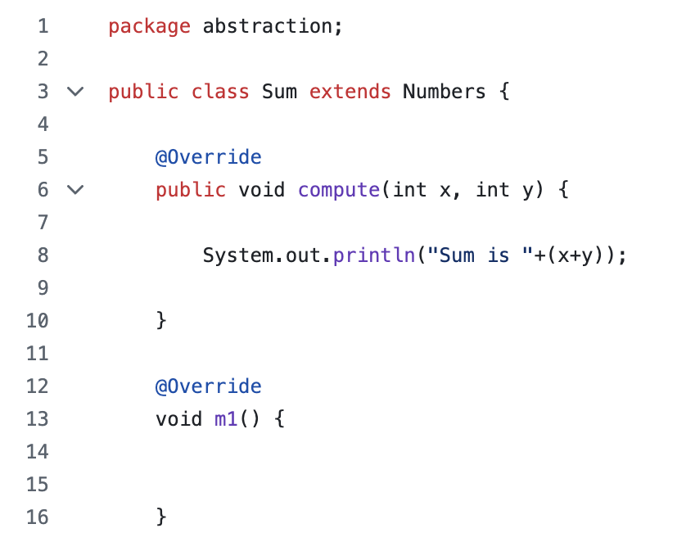
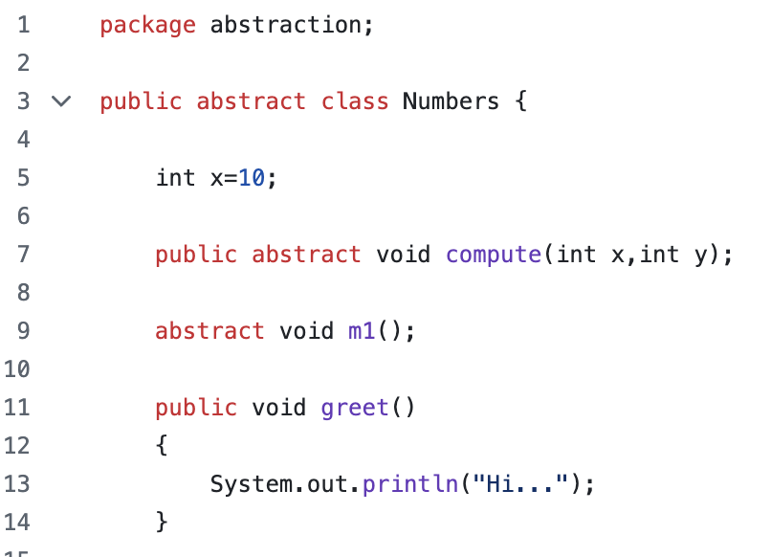
Child Class
Parent Class

Slide 54
Interface

Slide 55
By default, interfaces are abstract in nature
“implements” keyword used to access the interface in class.
”extends” keyword is used to apply inheritance btw interfaces.
Multiple inheritance allowed for interfaces but not for class in java

Slide 56
Season 2

Slide 57
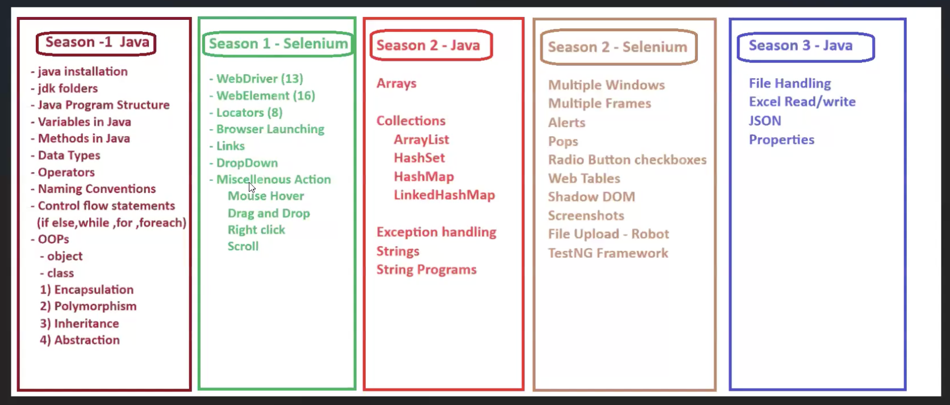

Slide 58
It is a symbol which performs action
Unary
Binary
Ternary operator
Unary operator: ++(increment),--(decrement)
Increment operator: preincrement & post increment operator
Decrement operator: predecrement operator & post decrement operator
It is operator applicable only with 1 variable

Slide 59
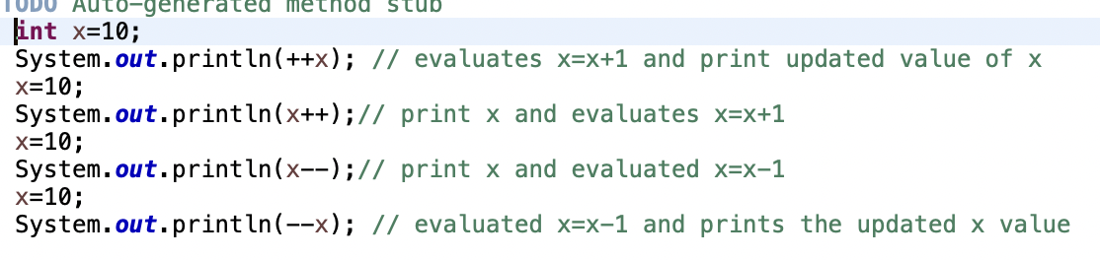
unary operator

Slide 60
Binary operator
Applies for 2 operands
Arithmentic operator:
+,-,*,%,/
Relational operator:
>,<,>=,<=,==,!=
Logical operators: between 2 comparisions
&&(and operator), ||(or operator),!
Bitwise operator
& and,|or,^xor,~ complement,>>bitwise right shift,<<bitwise left shift,>>> unary right shift
Assignment operator
=,+=,-=,%=,/=,>>=,<<=

Slide 61
Ternary operator
Known as conditional operator /decision making operator
Expression ?expression 2: expression 3
Comparision?true statement:false statement
For simple if-else statement recommended to go for ternary operator

Slide 62
Control flow statements
Decision making statements: if else,switch
Iterative : for loop,while loop, do while,for each or enhanced for loop
Jump/transfer: break,continue,return.

Slide 63
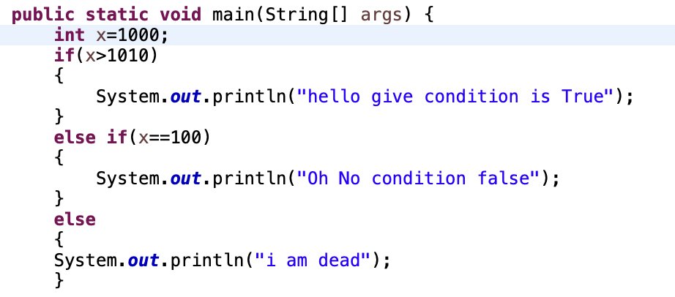
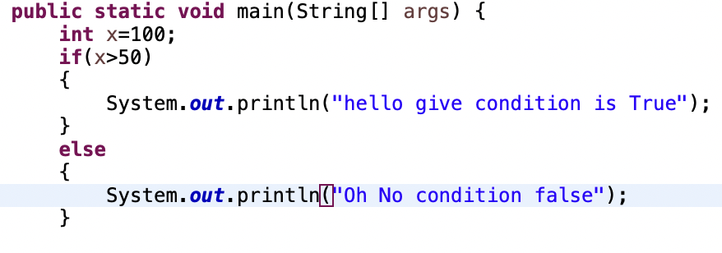
If else
Syntax:
1. If(condition)
//condition always give true or false(Boolean)
{//statements
}
Else
{ statement
}
2. If-elseif-else
Only Declaration inside if else condition is not allowed.

Slide 64
Switch case
Switch (key){
Case value: body or statement;
Break;
default: body

Slide 65
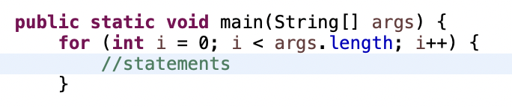
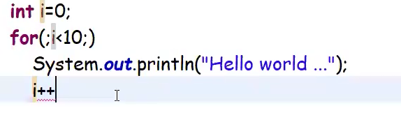
For loop
For(initialization; condition check; increment)
{statement
}

Slide 66
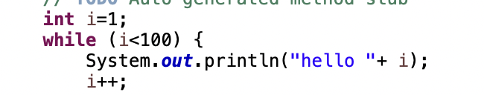
While loop

Slide 67
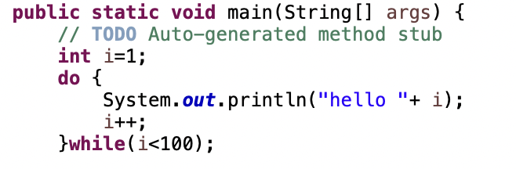
Do while

Slide 68
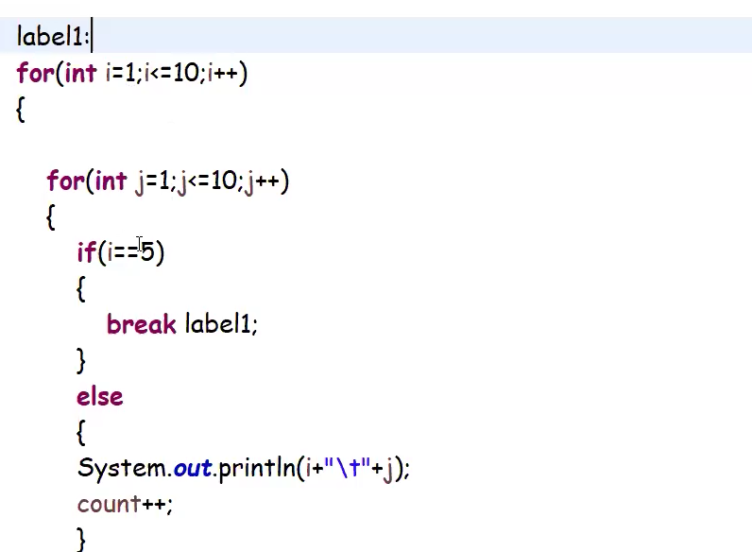
Break & continue
Break : we can particularly want to terminate the on going loop at particular condition we use break
Brak applicable in for loop,while loop,do while loop,switch statement.
Use label concept in break to terminate particulate loop instead of in going loop(refer img)

Slide 69
Continue statement is used to skip particular loop if condition meet

Slide 70
Arrays
Arrays are collection of homogeneous elements(same data type) having fixed length
Syntax:
Method 1:
Access-specifier access-modifier data-type[n] arrayName={value1,value2,….,valuen}
Array are fixed length variable and cannot be increased later
Method 2:using new operator
Access-specifier access-modifier data-type[] arrayName=new data-type[length] => mostly used
Values are stored in heap area

Slide 71

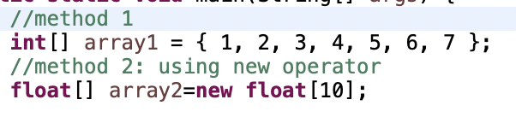
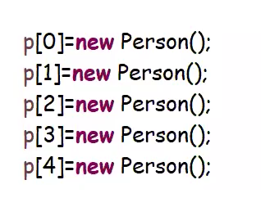
One-dimensional array
We can create array of objects. But we need to initialize object separately

Slide 72
Two-dimensional array
It is similar to matrix
Method 1:
Access-specifier access-modifier data-type[n][n] arrayName={value1,value2,….,valuen}
Array are fixed length variable and cannot be increased later
Method 2:using new operator
Access-specifier access-modifier data-type[][] arrayName=new data-type[rows][columns]

Slide 73
Disadvantages/limitations of array
It store only same data types.
Size of array cannot be changed once it declared.[fixed length]
No predefined methods or logics or data structures for arrays

Slide 74
Collections

Slide 75
Collections
Iterable(I)
Collection(I)
List(I)
Queue(I)
set(I)
ArrayList(c) =>imp
Linked list
Vector
stack
Hashset
Linkedhashset
Sorted set
Iterable(I)

Slide 76
Collection(I) menthods
add(E): Boolean =>to add an element/object of any datatype ( more used )
E => Element
addAll(Collection/,? Extends E>);Boolean => not used much
clear() : void => less used
contains(Object): Boolean => used for search operation
isEmpty() :Boolean => true if no elements in collection
remove(Object): Boolean => I will remove the object/element form Collection
size(): int => most used it returns number of elements/objects in collection.

Slide 77
List(I)
add(int,E) : void
get(int) : E => very important

Slide 78
Arraylist (c)
It creates with initial capacity of 10
Size can be increased in future
When extension need then new array list of having 3/2 times of current capacity+1 and existing data is moved to new new size

