Slide 1
Selenium

Slide 2
Introduction
Automation: Process of converting TC’s to Test scripts using Tool
Selenium:
https://www.selenium.dev/
Applicable only to Web Applications
Advantages:
Free to use, No license required
Open Source
Cross Browser Testing (chrome,firefox,edge,safari)
Cross platform/OS Testing(IOS, Windows)
TDD: Integrate Selenium with multiple frameworks (TestNG/pytest etc)
BDD: Integrate Selenium with multiple framework (cucumber etc)
Can integrate CI/CD tools with selenium (Jenkins)

Slide 3
Disadvantages:
Cannot test API/Mobile Testing
No performance Testing possible
No Security
No HW testing
Can’t automate QR codes/Captcha( Request develop team to provide single captcha),chat bots, verification, OTP (Request develop team to provide single OTP)
No Desktop Applications
Selenium is an API(.jar)

Slide 4
Selenium Architecture
Testing used Version: 4.x(4.20 and above)
Current released: 4.39(6th Dec 2025)
3.141.59(old well used version, currently not using for current projects)
org.openqa.selenium
RemoteWebDriver class is back bone of selenium

Slide 5
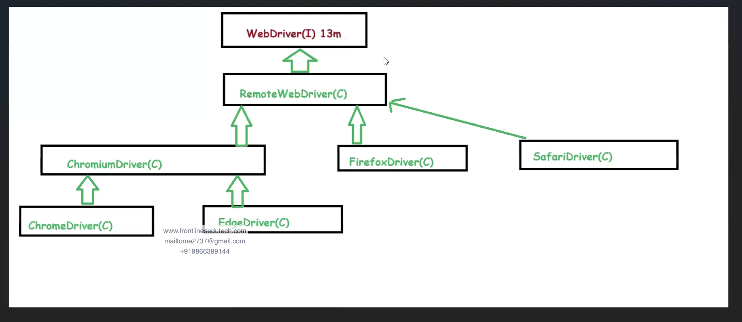
I => interface
C => Class

Slide 6
SearchContext(I)
findElement(By) => org.openqa.selenium.SearchContext.findElement(By)
findElements(By) => org.openqa.selenium.SearchContext.findElements(By)
WebDriver(I) =>org.openqa.selenium.WebDriver
Navigation (I) => org.openqa.selenium.WebDriver.Navigation
Options (I) => org.openqa.selenium.WebDriver.Options
TargetLocator (I) => org.openqa.selenium.WebDriver.TargetLocator
Timeouts (I) => org.openqa.selenium.WebDriver.Timeouts
Window (I) => org.openqa.selenium.WebDriver.Window

Slide 7
Webdriver methods
WebDriver(I)
Navigation(I)
Options(I)
TargetLocator(I)
Timeouts(I)
Window(I)
get(String): void
This will open the URL
close():void
This will close the window or tab of browser
quit():void
This will close the window /windows/ tabs are opened during the session
getCurrentUrl(): String
getTitle(): String
getPageSource(): String
getWindowHandle(): String
getWindowHandles():set <String>
https://www.selenium.dev/selenium/docs/api/java/org/openqa/selenium/WebDriver.html

Slide 8
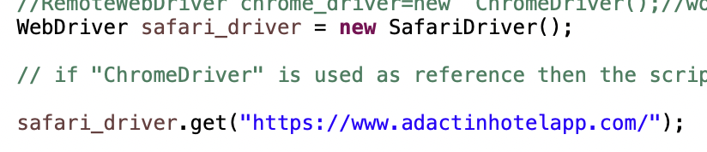
1.Get(String)
get(url)
Return Type : void
Similar to WebDriver.Navigation.to(String)

Slide 9
2.
echo "# SeleniumCourse" >> README.md
git init
git add README.md
git commit -m "first commit"
git branch -M main
git remote add origin git@github.com:rsai-praveen/SeleniumCourse.git
git push -u origin main

Slide 10
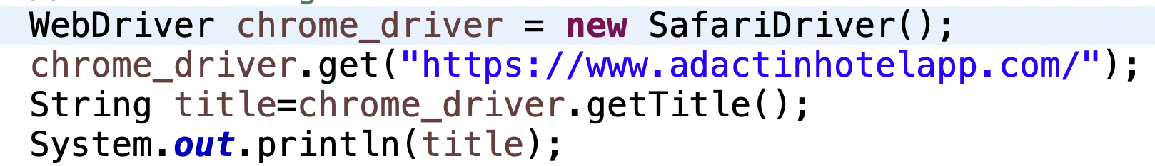
2. getTitle();
getTitle();
Return Type : String
It gives the Title of the current loaded website where the selenium driver focus exist

Slide 11
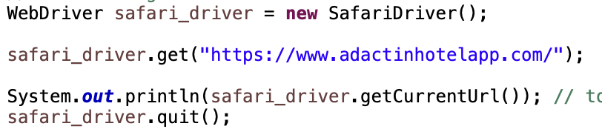
3.getcurrenturl()
getCurrentUrl();
Return Type : String
It gives the URL of the current loaded website where the selenium driver focus exist

Slide 12
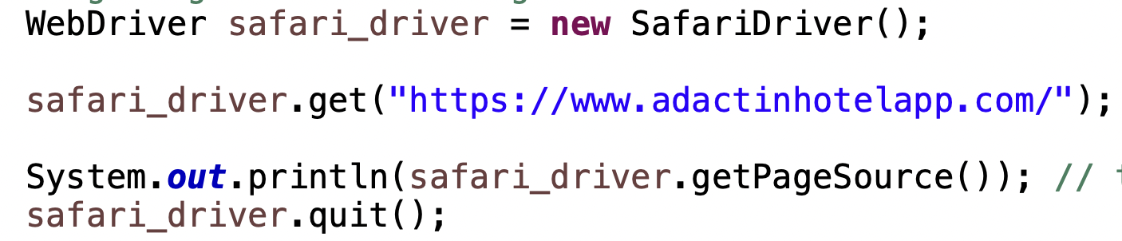
4.GetPagesource()
getPageSource();
Return Type: String
It give the current HTML page as String data

Slide 13

5.close()
close();
Return Type : Void
It closes the current running tab or window but won’t terminate the driver executable.

Slide 14
6.quit()
quit();
Return Type : Void
It closes the all running tabs or windows & terminate the driver executable also

