Slide 1
Listen Up! Using Audio to Supplement MRI Study Interpretation: A Novel Approch to Medical Image Interpretation Using Machine Learning
Raffi A. Salibian, M.D.
The University of Texas at Austin MSAI Graduate Program

Slide 2
Introduction
Machine learning (ML) methods have significantly influenced Magnetic Resonance Imaging (MRI) in both research and clinical environments.
For example, artifical intelligence algorhythms can accelerate MR image acquisition and reconstruction and can perform expert level automated image analysis.
This research paper explores integrating auditory feedback into the standard knee MRI interpretation workflow, specifically in the context of ACL tears.
Potential benefits of supplementing image analysis with auditory feedback include reducing cognitive load and fatigue and improving the speed and accuracy of diagnoses.
I detail a methodology for training a machine learning model to generate audio outputs based on model predictions to assit in the MRI interpretation process.

Slide 3
Clinical Importance
MRI and ACL Injuries
MRI is an invaluable medical imaging modality for diagnosing knee injuries, including Anterior Cruciate Ligament (ACL) tears.
Prompt and accurate diagnosis of ACL injuries is critical. Delays or errors in diagnosis can lead to severe long-term joint malfunction.
Diagnosis of knee ACL injuries relies on expertly trained medical imaging professionals, like radiologists, who visually review MRI studies.
Incorporating additional physical senses, such as hearing, into the interpretation process is a novel approach to image interpretation.

Slide 4
Clinical Importance
Automated Detection
Recent advances in machine learning (ML), particularly deep learning, have shown promise in augmenting medical image analysis.
Convolutional Neural Networks (CNNs) capture intricate image details through filters that recognize spatial hierarchies and features.
By automating the detection of ACL tears, CNNs can decrease radiologist workload and increase diagnostic accuracy.
The goal of this research project is to utilize the predictions from a CNN to introduce a auditory component to the image interpretation process.

Slide 5
Methodology
I trained my CNN using the MRNet dataset from Stanford University Medical Center. This dataset contains 1,370 knee MRI exams: 1,104 (80.6%) abnormal exams, with 319 (23.3%) ACL tears and 508 (37.1%) meniscal tears. Labels were obtained through manual extraction from clinical reports.
CNN architecture consists of three convolutional layers with ReLU activation, interspersed with max pooling layers to reduce dimensionality and dropout layers to mitigate overfitting. The network concludes with a dense output layer utilizing a sigmoid activation function to provide a probabilistic assessment of ACL injury.

Slide 6
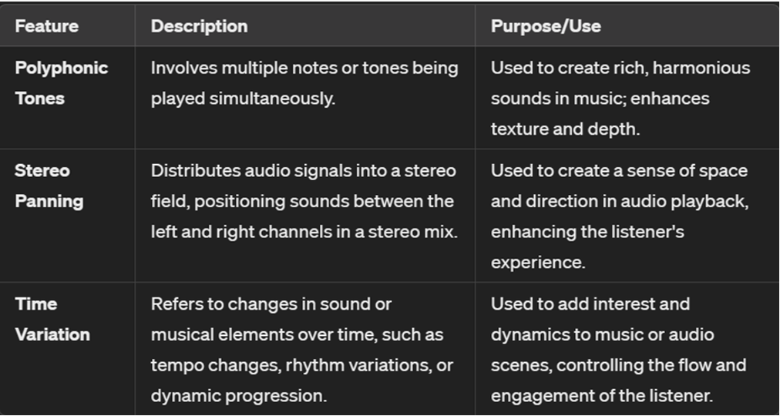

Methodology
Several audio generation methods were utilized in python to test the diagnostic utility of auditory ques.
Probability to Frequency Mapping:
Frequency of the audio wave is inversely
related to the probability: Higher probability
of ACL tear results in a lower frequency.
Normal ACL:
Abnormal ACL:

Slide 7
Methodology
Several audio generation methods were utilized in python to test the diagnostic utility of auditory ques.
Polyphonic Tones Method:
Normal ACL:
Abnormal ACL:

Slide 8
Methodology
Several audio generation methods were utilized in python to test the diagnostic utility of auditory ques.
Stereo Panning Method:
Normal ACL:
Abnormal ACL:

Slide 9
Methodology
Several audio generation methods were utilized in python to test the diagnostic utility of auditory ques.
Time Variation Method:
Normal ACL:
Abnormal ACL:

Slide 10
Results
My CNN model trained on the MRNet dataset achieved an accuracy rate of 92% in detecting ACL injuries on knee MRI studies.
Radiologists involved in the testing phase reacted positively, appreciating the additional sensory (auditory) input to enhance diagnosis.
Radiologists interpreted auditory signals differently, leading to discrepancies in image analysis and interpretation conclusions.
Many radiogists recognized the importance of dedicated training to fully benefit from the dual visual and auditory experiences.

Slide 11
Future Directions
Additional research needed to quantify the impact of supplementing MRI study interpretation with auditory information.
Developing standardized audio information corresponding with different degrees of ACL injury to ensure reproducible implementation.
Introduce this novel image interpretation methodology during radiology resident training to provide concurrent visual and auditory instruction.

