Slide 1

Project 4: Machine Learning
Team #7: Michael Herold, Ralph Samer

Slide 2
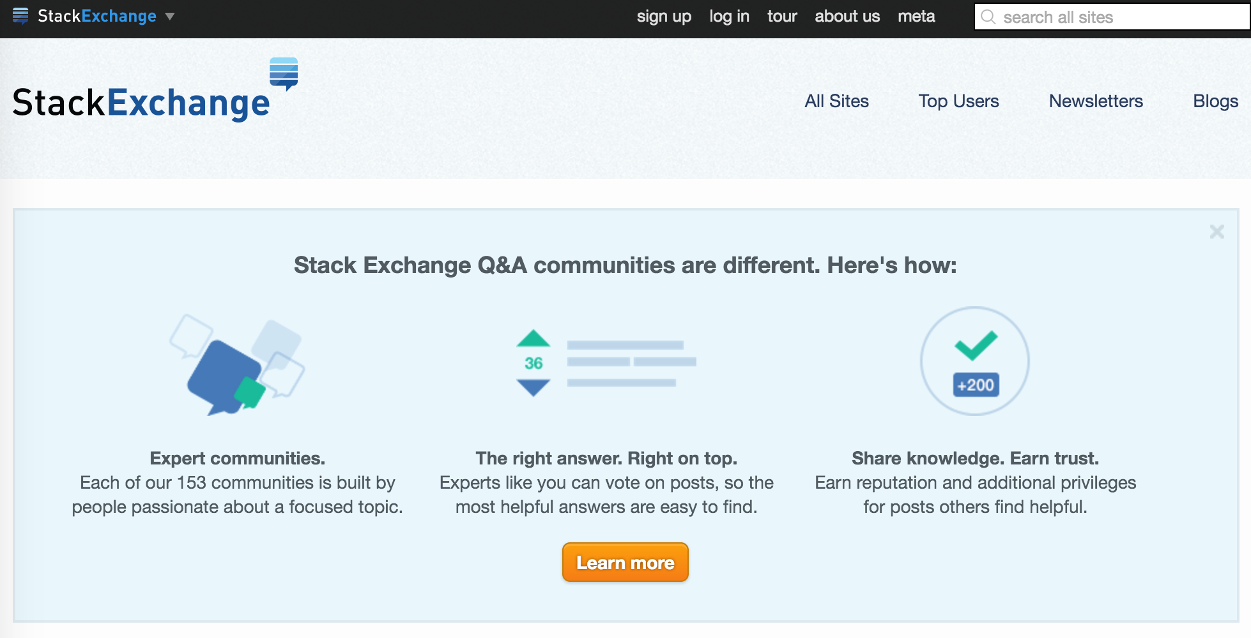
Motivation
Stack Exchange:
Experts can subscribe to tags
Mandatory to assign proper tags to questions
Users can create new or use existing tags
Manual tagging may be challenging (e.g. “.Net” and “DotNet")
Suggesting tags for new questions is crucial
Notes:
2

Slide 3
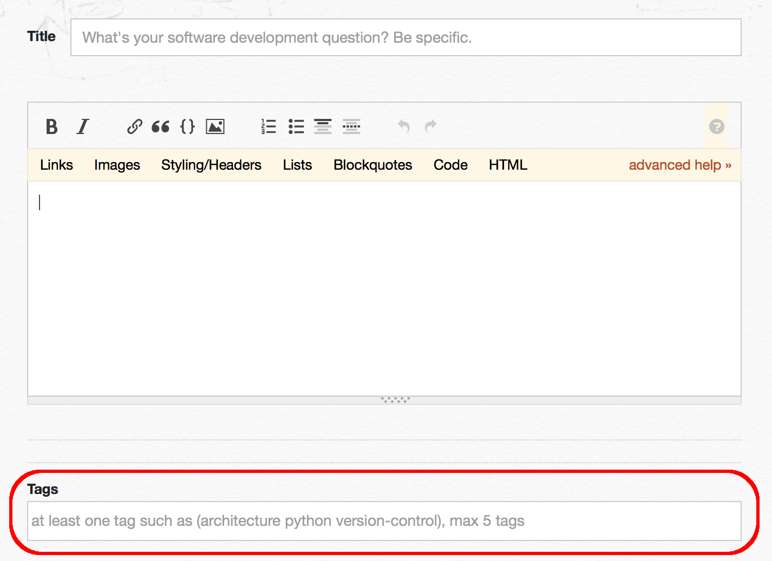
Task
Given: new question containing a title and a body
Goal: suggest/assign up to 5 tags from a limited list of tags
Analyse given data set
Supervised: Train classifier on data set
Unsupervised: Find patterns in data (e.g. groups)
Evaluate results and compare both approaches
Notes:
3

Slide 4
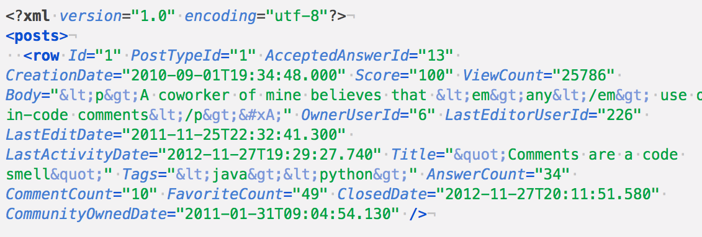
Data Set
Stack Exchange Data Dump from March 1st, 2016
Subgroup: programmers.stackexchange.com
Packed size: 179.5 MB
Post, tags and users are stored in separate XML files
Tags consist of 1-5 words separated by "." and "-"
Notes:
4

Slide 5
Characteristics of Data Set
Total number of …
Posts | 38,315
Tags | 1,614
Post length (words)
Min | 6
Max | 3,348
Average | 178.65
Tags per post
Min | 1
Max | 5
Average | 2.68
Notes:
5

Slide 6
Top 10 Tags
# | Tags
1 | java
2 | c#
3 | design
4 | design-patterns
5 | object-oriented
6 | c++
7 | php
8 | algorithms
9 | javascript
10 | architecture
Notes:
6

Slide 7
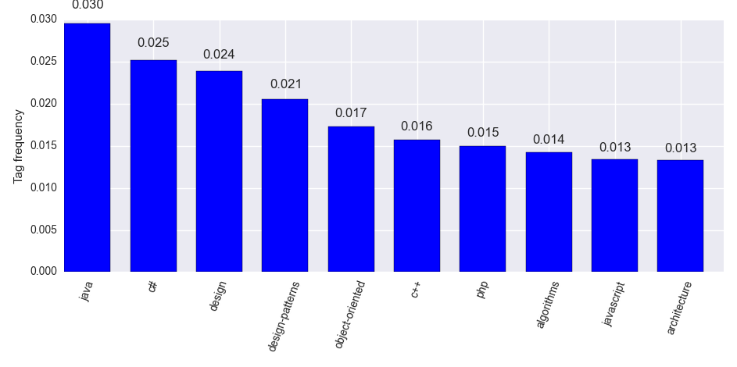
Top 10 Tags

Slide 8
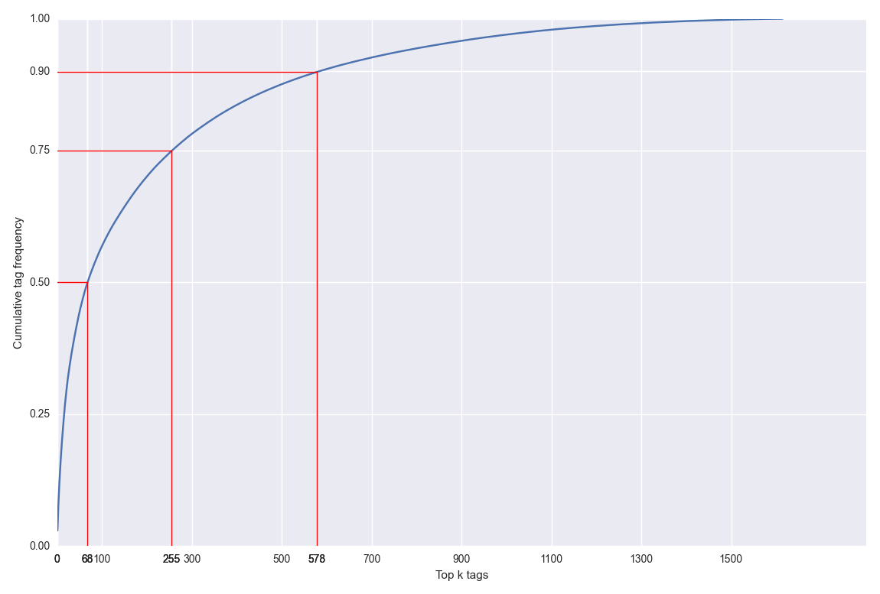
Cumulative Tag Frequency

Slide 9
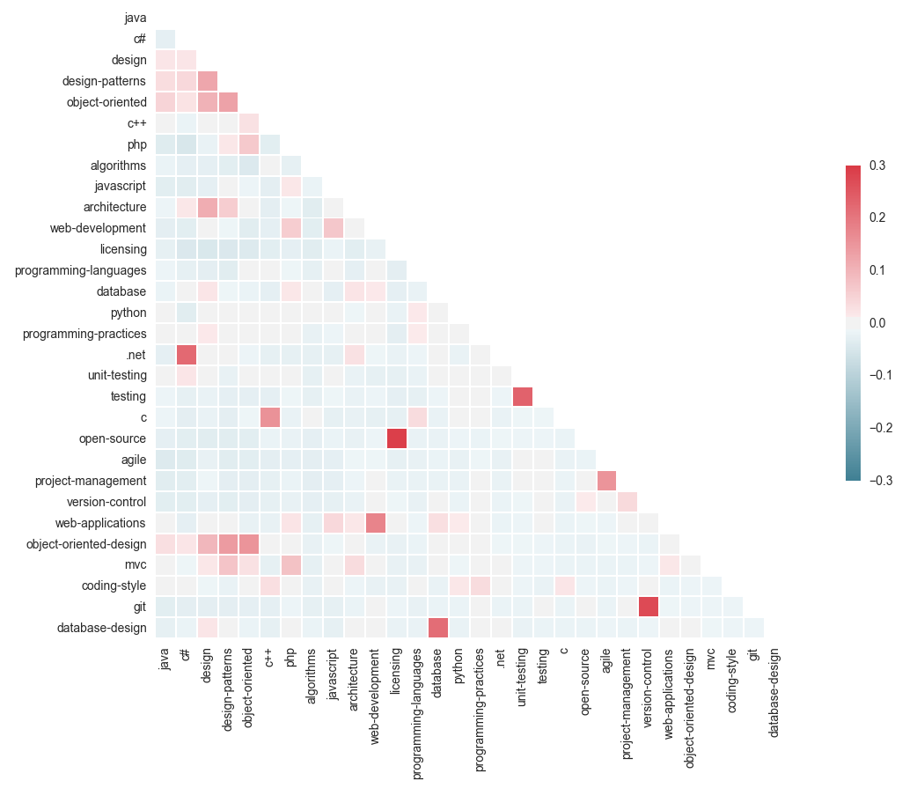
Tag Correlation

Slide 10
Outlook
1. Preprocessing
Parse XML from Stack Exchange Data Dump (title, body, tags)
Strip html code from body
Tokenize title + body (be careful: “C++” != “C” != “C#”)
Stop word removal
Stemming
Lemmatization (be careful: “Windows” (OS) != “window”)
POS-tagging
Filter “rare”/”unique” tags ➔ reduce dimensionality
Structure related tags (synonyms from Stack Exchange Data Explorer)
Content
Tags

Slide 11
Outlook
2. Supervised learning
Separate data into test & training data
Fit a supervised learning model
Naïve Bayes
Support Vector Machines (SVM)
k-Nearest Neighbors
Evaluate best model
Precision
Recall
F1 measure

Slide 12
Outlook
3. Unsupervised learning
Fit a model
k-means clustering
Hierarchical Agglomerative Clustering (HAC)
Calculate TF-­IDF (weighting)
Evaluate best model
Precision, Recall, F1 measure
Rand Index
4. Compare both approaches

Slide 13
Thank you for your attention.

Slide 14
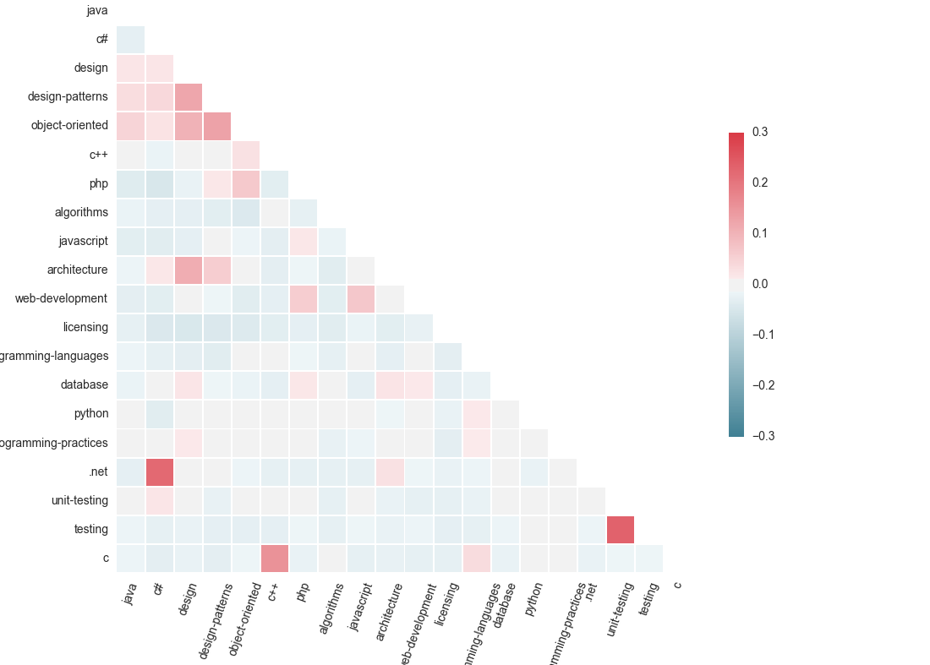
Attachment 1: Tag Correlation (zoomed)

