Slide 1

Project 4: Machine Learning
Team #7: Michael Herold, Ralph Samer

Slide 2
Recap
Task
Automatic tagging of unseen posts using both an supervised and unsupervised approach
Data set
Stack Exchange Data Dump from March, 2016
Subgroup: programmers.stackexchange.com
Tags per post
Min | 1
Max | 5
Average | 2.68
Total number of …
Posts | 38,315
Tags | 1,614
Notes:
2

Slide 3
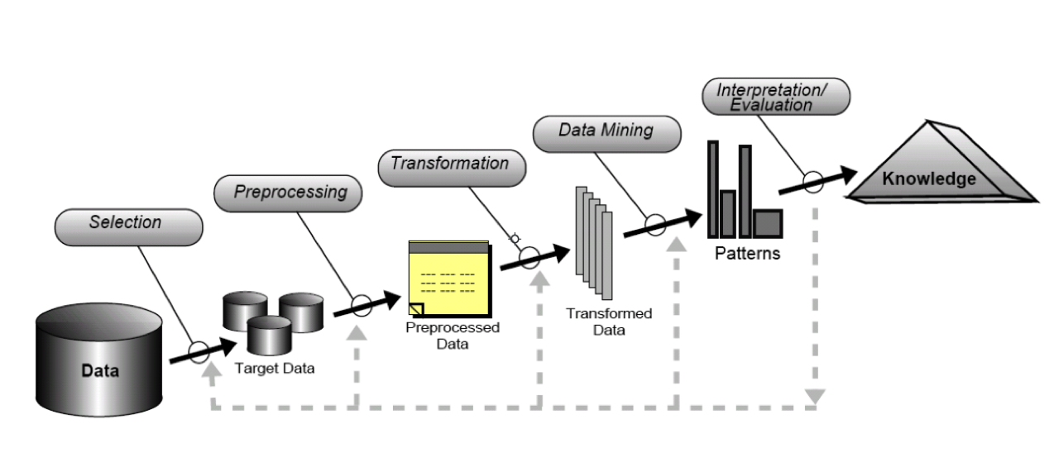
Current Approach
Source: KDDM1 – Introduction and Motivation by Denis Helic and Roman Kern (October 1st, 2015)
Notes:
3

Slide 4
Current Approach – Feature Selection and Preprocessing
Tokenized post
Ignored posts
Removed HTML and code segments
Removed URLs, emoticons, (hex-)numbers, single characters
Removed stop words
Stemming (nltk.stem.porter.PorterStemmer)
Goal: get best prediction accuracy
Body
Title
Accepted answer (if not negative score)
Score < threshold
No accepted answer
No answers and negative score
Notes:
4

Slide 5

Current Approach - Transformation
Term frequency – inverse document frequency (TFxIDF)
Goal: weighting function to give more importance to unique words within a collection
Notes:
5

Slide 6
Current Approach - Classification
Multinomial Naive Bayes classifier
Using sklearn.naive_bayes.MultinomialNB
Two approaches:
Using one binary classifier for each tag
Retrieving (positive and negative) probability for each tag
Using one classifier for all tags
Reason for choosing this model:
Notes:
6

Slide 7
Current Approach - Classification
Motivation:
Notes:
7

Slide 8
Top 10 Tags

Slide 9
Cumulative Tag Frequency

Slide 10
Tag Correlation

Slide 11
Outlook
1. Preprocessing
Parse XML from Stack Exchange Data Dump (title, body, tags)
Strip html code from body
Tokenize title + body (be careful: “C++” != “C” != “C#”)
Stop word removal
Stemming
Lemmatization (be careful: “Windows” (OS) != “window”)
POS-tagging
Filter “rare”/”unique” tags ➔ reduce dimensionality
Structure related tags (synonyms from Stack Exchange Data Explorer)
Content
Tags

Slide 12
Outlook
2. Supervised learning
Separate data into test & training data
Fit a supervised learning model
Naïve Bayes
Support Vector Machines (SVM)
k-Nearest Neighbors
Evaluate best model
Precision
Recall
F1 measure

Slide 13
Outlook
3. Unsupervised learning
Fit a model
k-means clustering
Hierarchical Agglomerative Clustering (HAC)
Calculate TF-­IDF (weighting)
Evaluate best model
Precision, Recall, F1 measure
Rand Index
4. Compare both approaches

Slide 14
Thank you for your attention.

