Slide 1

Project 4: Machine Learning
Team #7: Michael Herold, Ralph Samer

Slide 2
Recap
Task
Automatic tagging of unseen posts using both an supervised and unsupervised approach
Data set
Stack Exchange Data Dump from March, 2016
Subgroup: programmers.stackexchange.com
Tags per post
Min | 1
Max | 5
Average | 2.68
Total number of …
Posts | 38,315
Tags | 1,614
Notes:
2

Slide 3
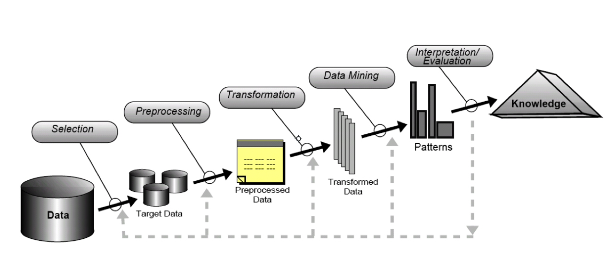
Current Approach
Source: KDDM1 – Introduction and Motivation by Denis Helic and Roman Kern (October 1st, 2015)
Notes:
3

Slide 4
Current Approach Feature Selection and Preprocessing
Tokenized post
Ignored posts
Removed HTML and code segments
Removed URLs, emoticons, (hex-)numbers, single characters
Removed stop words
Stemming (nltk.stem.porter.PorterStemmer)
Goal: get best prediction accuracy
Body
Title
Accepted answer (if not negative score)
Score < threshold
No accepted answer
No answers and negative score
Notes:
4

Slide 5

Current Approach Transformation
Term frequency – inverse document frequency (TFxIDF)
Goal: weighting function to give more importance to unique words within a collection
Notes:
5

Slide 6
Current Approach Supervised Learning
Multinomial Naive Bayes classifier
Using sklearn.naive_bayes.MultinomialNB
Two approaches:
Using one binary classifier for each tag
Retrieving (positive and negative) probability for each tag
Using one classifier for all tags (OneVsRestClassifier)
Notes:
6

Slide 7
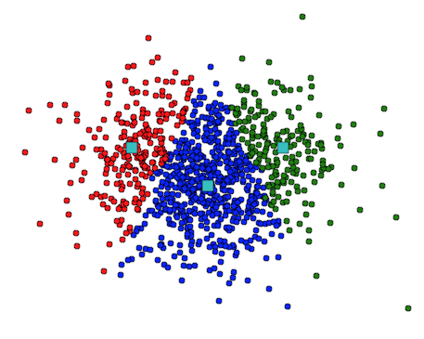
Current Approach Unsupervised Learning
Approach:
Cluster similar posts according to the TFxIDF matrix
Assign X most frequent tags of cluster to new samples of cluster
k-Means clustering
Init k centroids
Assign each post to closest centroid
Update centroids and
Repeat until convergence
Implementation and Parameters:
sklearn.cluster.Kmeans
Number of clusters: ~ #tags
Initialization: k-means++ to speed up convergence
Distance: Euclidean distance
Notes:
7

Slide 8
Current Approach Unsupervised Learning
Hierarchical Agglomerative Clustering (HAC)
Start with each post as single cluster
Merge pair of clusters with lowest distance
Update distance matrix and repeat until stop criterion
Implementation and Parameters:
sklearn.cluster.AgglomerativeClustering
Linkage (distance measure): Ward criterion (minimum variance)
Distance: Euclidean (to compute linkage)
Stop criterion: number of clusters (~ #tags)
Notes:
8

Slide 9
Evaluation
True positives: if tag found in prediction set and original set
False positives: if tag found in prediction set but not in original set
False negatives: if tag found in original set but not in prediction set
Both should be high → F1 score
Notes:
9

Slide 10
Current Approach First results
Model | Precision | Recall
MultinomialNB | 0.4 | 0.4
k-Means ¹⁾ | 0.4 | 0.4
HAC ²⁾ | 0.4 | 0.4
All results are based on two predicted tags (average tag assignment = 2.68)
¹⁾ Number of clusters = #tags ²⁾ Stop criterion = #clusters → #tag

Slide 11
Problems
Preprocessing:
Too many different words → high dimensionality → sparse matrix
POS-tagging and lemmatization not working good enough (many false positives)
Synonyms and hyypernyms
Similar tags
Learning:
Choosing proper number of clusters (k)
Finding best fitting model and parameters (exploration and evaluation)
Finding best number of tags to predict
Runtime and memory:
Too many features
HAC very intensive to compute

Slide 12
Expected results

Slide 13
Thank you for your attention.
References:
Knowledge Discovery and Data Mining 1 by Denis Helic and Roman Kern (2015)
Segaran, T. 2007. Programming Collective Intelligence: Building Smart Web 2.0 Applications. Sebastopol: O‘Really

