Slide 1

Project 4: Machine Learning
Team #7: Michael Herold, Ralph Samer

Slide 2
Recap
Task
Automatic tagging of unseen posts using both supervised & unsupervised approach
Data set
StackExchange Data Dump from March, ‘16
Subgroup: programmers.stackexchange.com
Training set: 34,500 posts (~90%)
Test set: 3,800 posts (~10%)
Total number of …
Posts | 38,315
Tags | 1,614
Tags per post
Min | 1
Max | 5
Average | 2.68
Notes:
2

Slide 3
Current Approach
Preprocessing
Body
Title
Accepted answer (if not negative score)
Posts
Tokenized content
Ignored posts
Removed HTML, code, URLs, emoticons, numbers, single letters
Removed stop words
Stemming (nltk.stem.porter.PorterStemmer)
Merge synonym words
Tags
Merge similar tags
Remove less frequent tags
Score < threshold
No accepted answer
No answers and negative score
Notes:
3

Slide 4

Current Approach
Features & Transformation
Feature Selection:
word occurences as features
remove words having little impact on performance of our models
Try additional features that improve performance (e.g. whether tag appears in title or body of a document/post or not)
Challenges:
highly depends on preprocessing (stop-word removal, merge synonyms, ...)
crucial for performance (of models)
when words are features:
important words should appear frequently
but not in every single document/post
Transformation:
e.g. TF-IDF, less frequent words occuring more often in one post are more important for that post than others
Goal:
get best prediction accuracy
Notes:
4

Slide 5
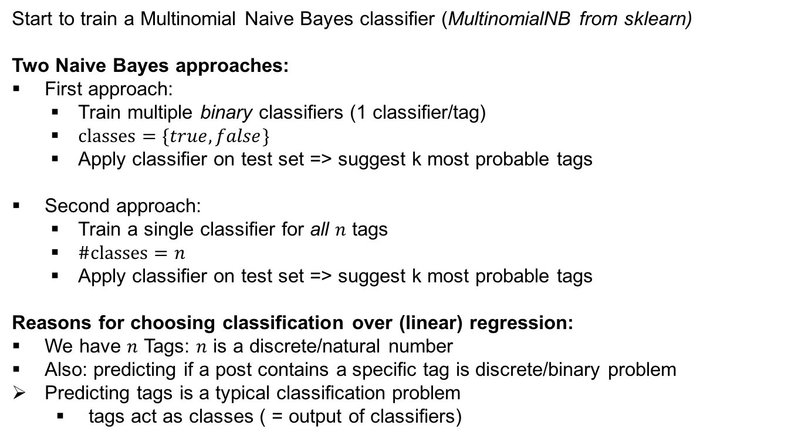
Current Approach
Supervised (I)
Start to train a Multinomial Naive Bayes classifier (MultinomialNB from sklearn)
Two Naive Bayes approaches:
First approach:
Train multiple binary classifiers (1 classifier/tag)
$classes=\{true, false\}$
Apply classifier on test set => suggest k most probable tags
Second approach:
Train a single classifier for all $n$ tags
$\#classes=n$
Apply classifier on test set => suggest k most probable tags
Reasons for choosing classification over (linear) regression:
We have $n$ Tags: $n$ is a discrete/natural number
Also: predicting if a post contains a specific tag is discrete/binary problem
Predicting tags is a typical classification problem
tags act as classes ( = output of classifiers)
Notes:
5

Slide 6
Current Approach
Supervised (II)
First tests with Naïve Bayes (full data set):
sufficient results, but still enough space left for improvements (e.g. improve preprocessing, feature selection, weight important features (user up/down-votes), …)
Compare performance of Naïve Bayes with other supervised models:
k-Nearest Neighbors:
suggest h most probable tags
probability depends on:
number of neighbors that contain these suggested tags
distance to these neighboring documents/posts
Linear SVM:
Use only a few features that represent the entire post → feature transformation, e.g.
tag occurs in title/body (true/false)
for each word and each tag in this post (scalar value):
compute product of probabilities that tag & word occur both in same post
danger: use logarithm to avoid underflow!
log of product replaced by sum of logs!
Notes:
6

Slide 7
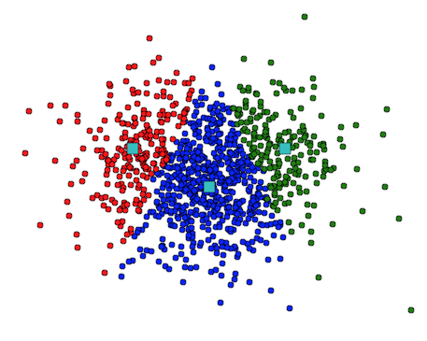
Current Approach Unsupervised (I)
Approach:
Cluster similar posts according to the TFxIDF matrix
Assign n most frequent tags of cluster to new samples of cluster
k-Means clustering
Init k centroids
Assign each post to closest centroid
Update centroids and
Repeat until convergence
Implementation and Parameters:
Kmeans from sklearn
Number of clusters: ~ #tags
Initialization: k-means++ to speed up convergence
Distance: Euclidean distance
Notes:
7

Slide 8
Current Approach Unsupervised (II)
Hierarchical Agglomerative Clustering (HAC)
Start with each post as single cluster
Merge pair of clusters with lowest distance
Update distance matrix and repeat until stop criterion
Implementation and Parameters:
AgglomerativeClustering from sklearn
Linkage (distance measure): Ward criterion (minimum variance)
Distance: Euclidean (to compute linkage)
Stop criterion: number of clusters (~ #tags)
Notes:
8

Slide 9
Evaluation
True positives: if tag found in prediction set and original set
False positives: if tag found in prediction set but not in original set
False negatives: if tag found in original set but not in prediction set
Both should be high → F1 score
Notes:
9

Slide 10
Current Approach First results
Model | Precision | Recall
MultinomialNB | 0.4 | 0.4
k-Means ¹⁾ | 0.4 | 0.4
HAC ²⁾ | 0.4 | 0.4
All results are based on two predicted tags (average tag assignment = 2.68)
¹⁾ Number of clusters = #tags ²⁾ Stop criterion = #clusters → #tag

Slide 11
Problems
Preprocessing:
Too many different words → high dimensionality → sparse matrix
POS-tagging and lemmatization not working good enough
Merge synonyms and similar tags
Learning:
Choosing proper number of clusters (k) → analyse dendrogram from HAC
Finding best fitting model and parameters (exploration and evaluation)
Finding best number of tags to predict
Runtime & memory:
Too many features for forward/backward selection
HAC very intensive to compute

Slide 12
Expected results & Outlook
Expected results:
Precision and recall not ideal but predicted tags are reasonable for humans
Precision decreases by the number of suggested tags
Recall increases by the number of suggested tags
Classification works better than clustering (but good to get overview)
Outlook:
Improve preprocessing (POS, weighting)
Use different (more independent) features for Naïves Bayes → better results expected
Evaluation of different parameters and models

Slide 13
Thank you for your attention.
References:
Knowledge Discovery and Data Mining 1 by Denis Helic and Roman Kern (2015)
Segaran, T. 2007. Programming Collective Intelligence: Building Smart Web 2.0 Applications. Sebastopol: O‘Really

