Slide 1
Part II – Classification Problem
Let's jump into some business.

Slide 2
Dream House Finance Business Needs
Pain Point: Loan Applications need to be manually reviewed based on information provided by the customer. This ties up company resources…
Solution: Company wants to implement a machine learning solution to automate the loan eligibility process based on customer detail provided while filling the online application form and give instant feedback.
Key details are Gender, Marital Status, Education, Number of Dependents, Income, Loan Amount, Credit History, and others.

Slide 3
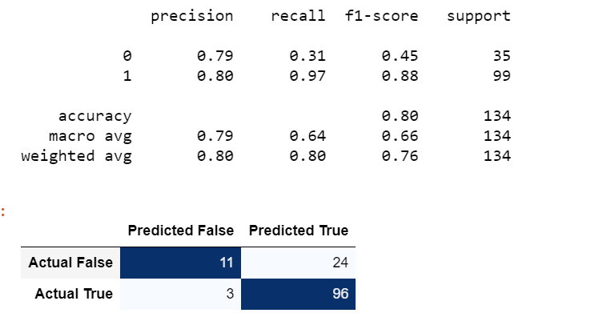
Outcome
Random Forest With Grid Search was the best solution due to its increased accuracy rate our business needs.

Slide 4
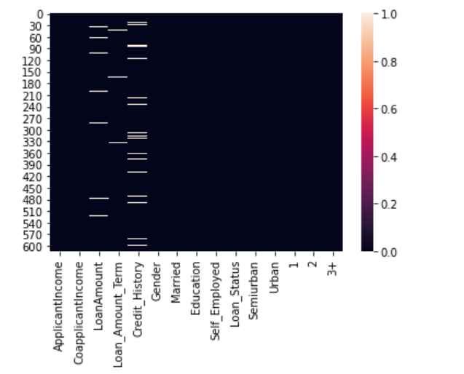
Training Data Overview
Categorical data that needed to be converted.
Missing values in the data set.
Dropped Loan ID.
Extreme outliers were found.

Slide 5
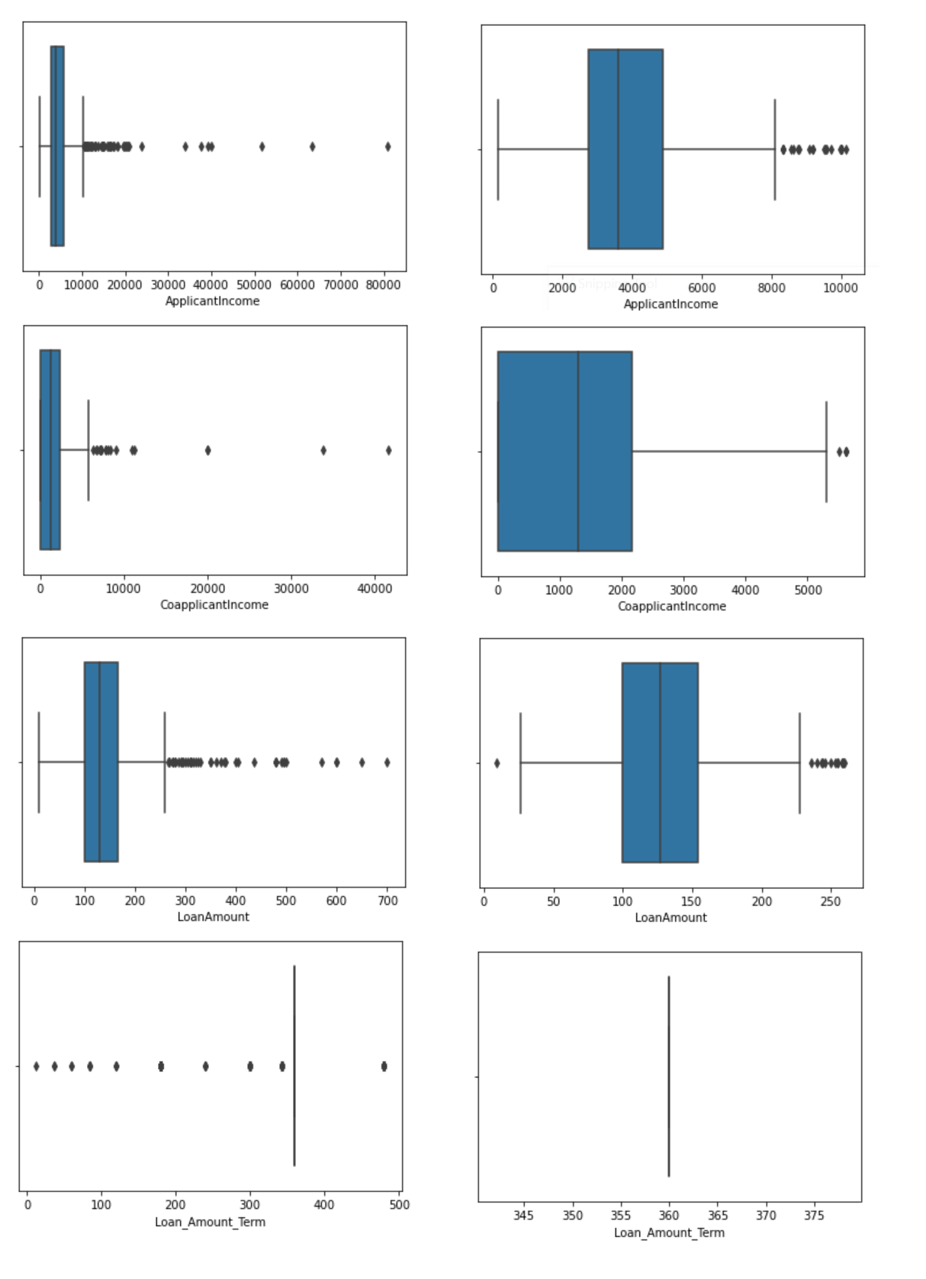
Outliers (Before and After)

Slide 6
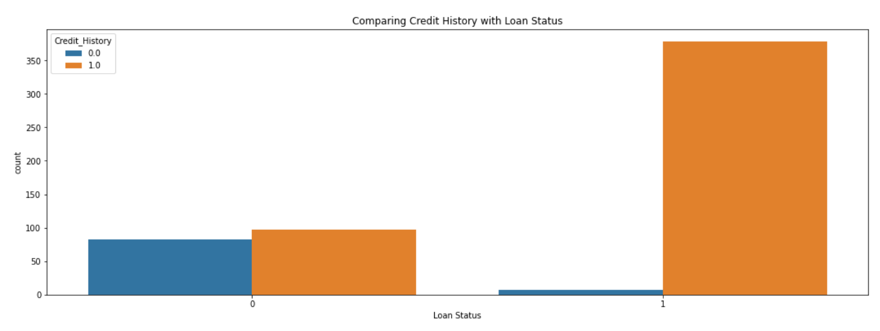
Some of the deciding factors
Credit History played a significant role in determining loan application approval.

Slide 7
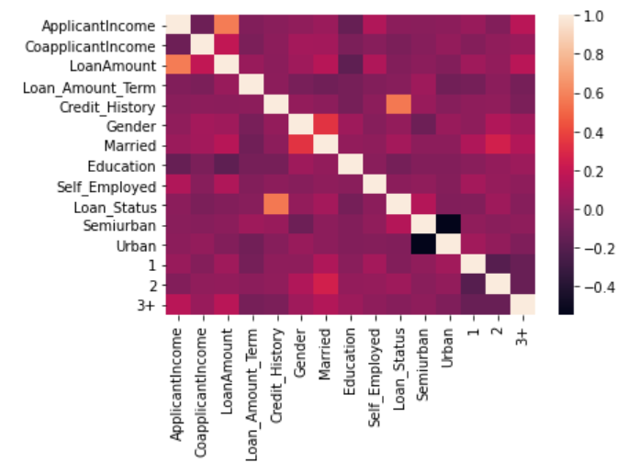
Correlation Heatmap

Slide 8
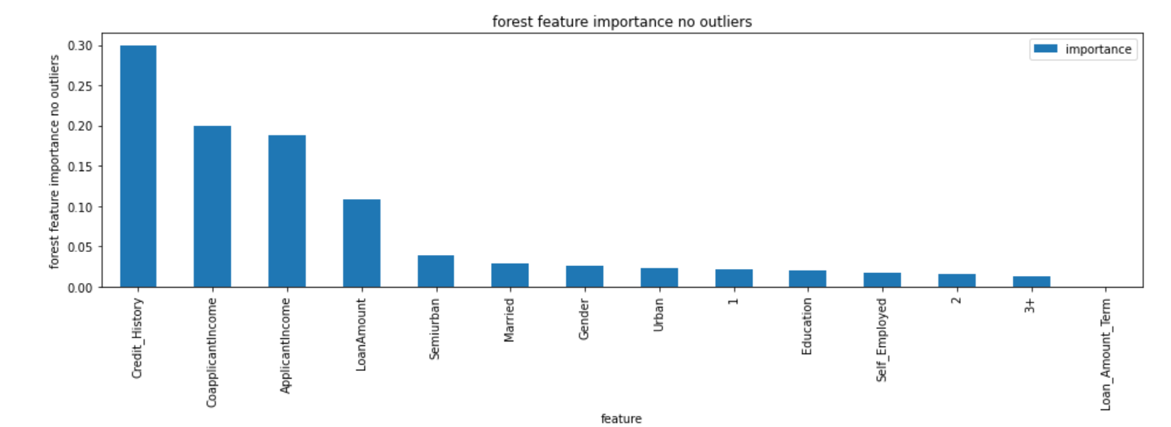
Feature Importance

Slide 9
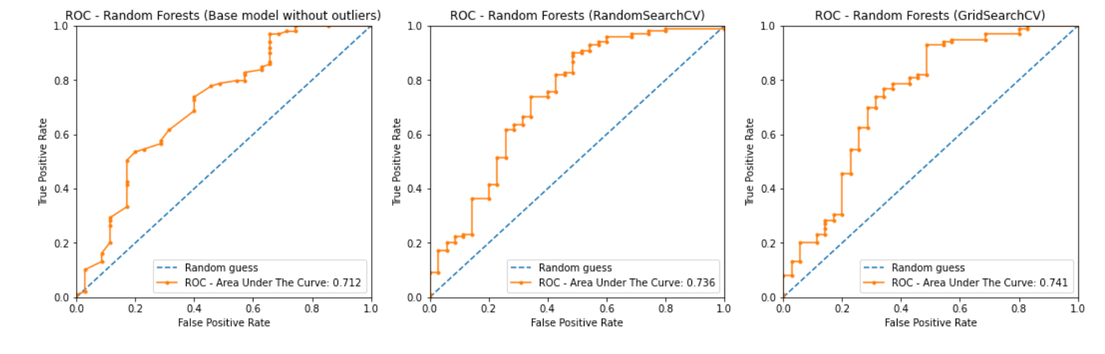
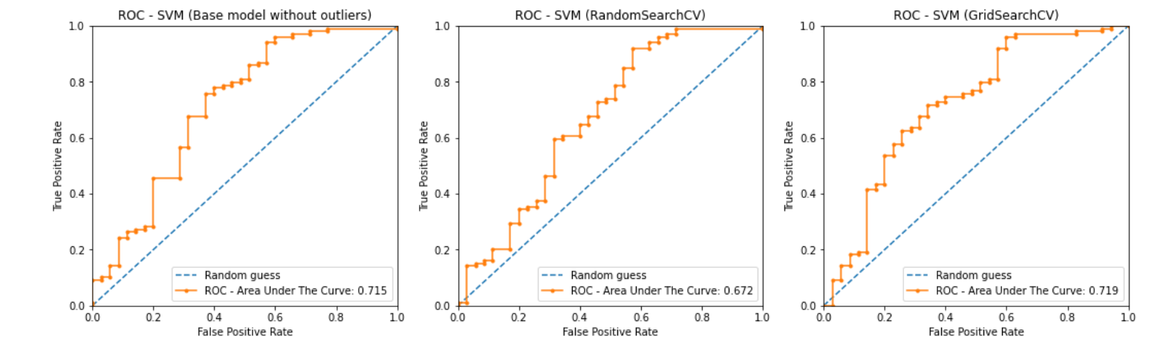
Training Models

Slide 10
Candidate Model
The Random Forest with Grid Search offers the best ROC area curve and with a training time approx. 2.5 seconds. Compared to SVM at 0.02 seconds.
Accuracy was
the deciding factor for our business needs.

Slide 11
Outcome on Provided Test Data
The candidate model has determined from the test data set that 84% of the applications are flagged to be approved while 16% of the test data was flagged to be rejected.
This machine learning solution will resolve the business’s pain point on determining loan eligibility.

Slide 12
Thank you for your time
Questions? Feedback?

