Slide 1

Introduction to

Slide 2
What is tensorflow (tf)?
“ TensorFlow™ is an open source software library for numerical computation using data flow graphs. Nodes in the graph represent mathematical operations, while the graph edges represent the multidimensional data arrays (tensors) communicated between them. The flexible architecture allows you to deploy computation to one or more CPUs or GPUs in a desktop, server, or mobile device with a single API. TensorFlow was originally developed by researchers and engineers working on the Google Brain Team within Google's Machine Intelligence research organization for the purposes of conducting machine learning and deep neural networks research, but the system is general enough to be applicable in a wide variety of other domains as well”.

Slide 3
When should I care about tf?
I need to speed up my math computations and I want to use GPU.
  Use cuda if you are brave enough
I am doing some optimization problem
  Implement gradient computation and optimizers otherwise.
I want to do big scale machine learning
  For small scale use scikit-learn, R...

Slide 4
Why to choose tf?
Multi-GPU support
Cluster/cloud systems supported
High performance, comparable to other popular frameworks (Torch, Theano)
“Easy” to deploy for production
Powerful visualization tool (tensorboard)
Python and C++ API
Supported by Google
Tons of learning resources (Udacity course, playground, tutorials…)
Easy installation (conda install, pip install...)

Slide 5
How does tf work?
You define desired operations (computation graph)
You create a session and use it to inject data and to grab results
Tf will compile your desired operations as soon as you execute your program
Tf will manage device communication and operations in a very efficient manner

Slide 6
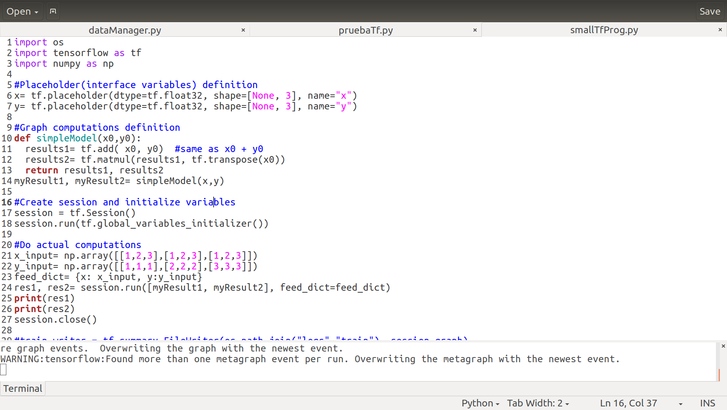
tf program structure
./1_tf_intro/examples/e1_smallProg.py

Slide 7
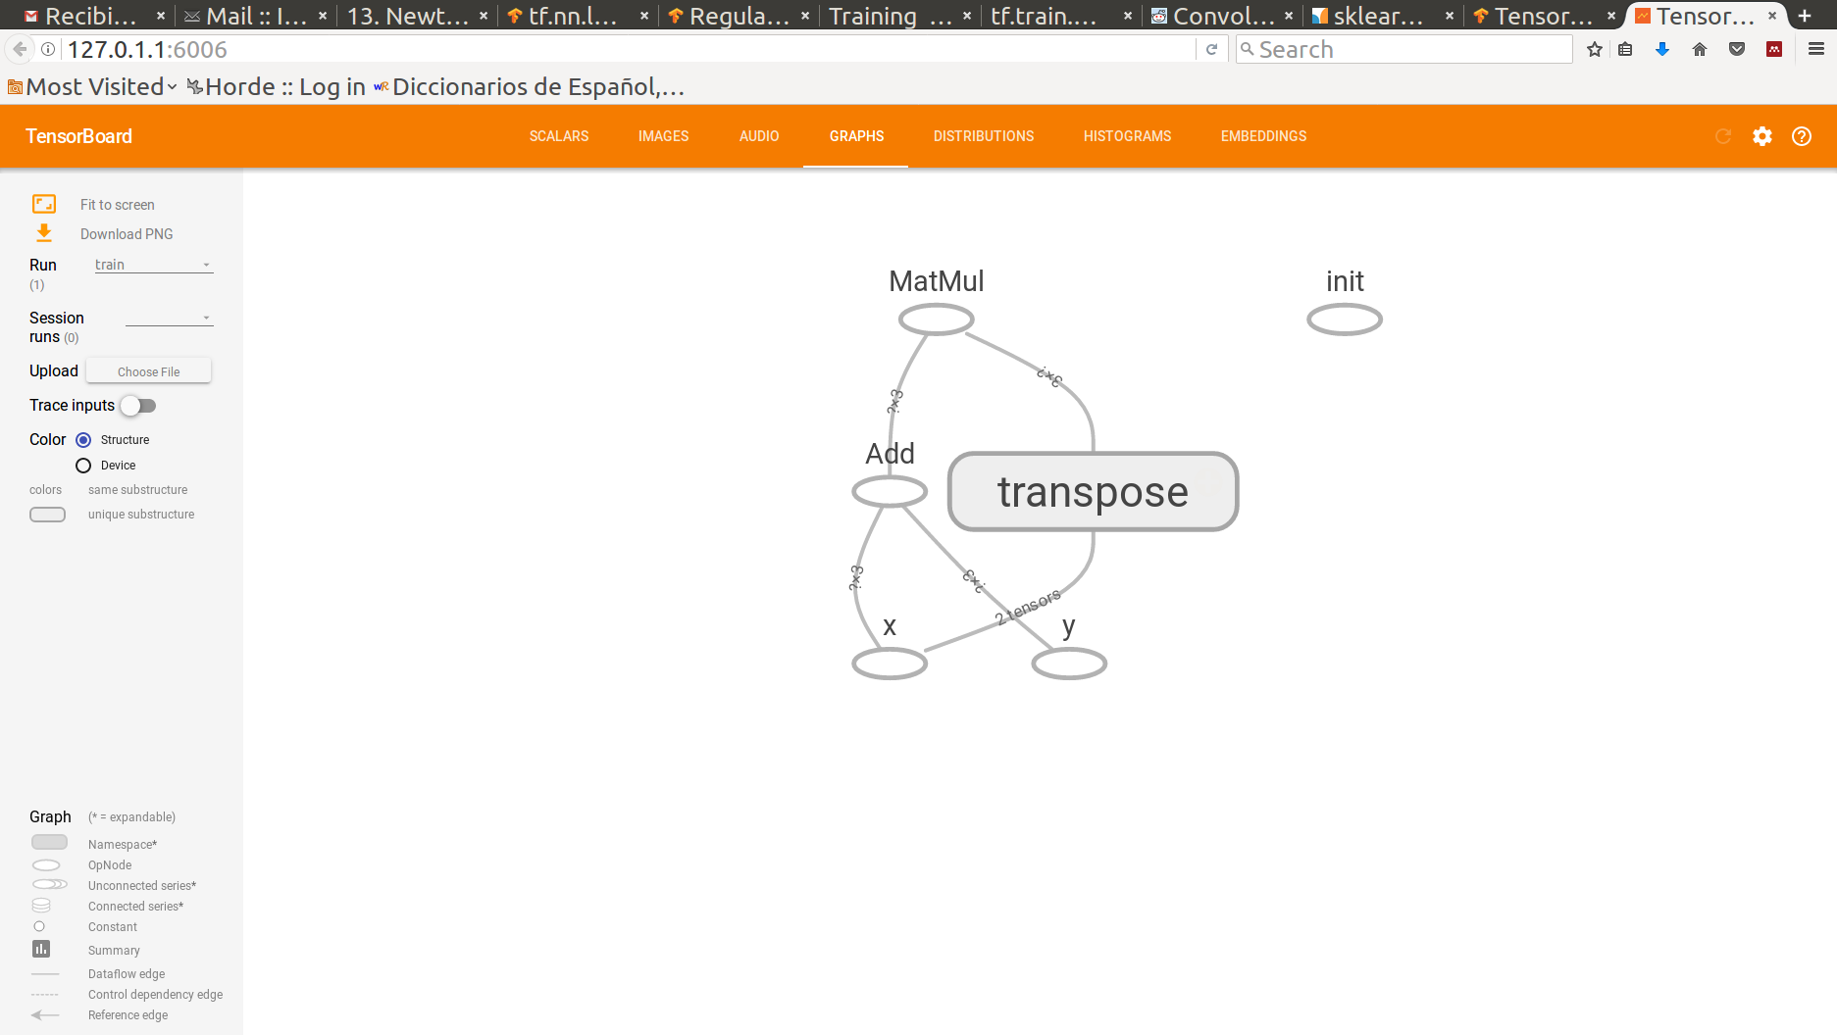
Computation graph definition
myResult2
myResult1
Data will be injected here

Slide 8
Computation graph definition (2)
Placeholders (for data injection)
tf.placeholder(...)
Constants
tf.constant(…), tf.zeros(…), tf.ones(…) ...
Variables (model parameters, several initialization schemes)
tf.get_variable(…)
Operations (can be applied to Variables, Constants and Placeholders)
tf.add(...), tf.matmul(…), tf.exp(…), tf.diag_part(…) ...
https://www.tensorflow.org/api_docs/

Slide 9
Session creation and variable initialization
By default, tf.Session() will make use of all available resources.
If several GPUs, all be allocated (although not necessarily used)
  Select GPU using environmental variable CUDA_VISIBLE_DEVICE
If no GPU all CPUs will be used (use tf.ConfigProto as argument to tf.Session() to set desired number)
Variables must be either initialized or loaded from checkpoints before being used

Slide 10
Actual computation
Graph variables we want to obtain.
Tf will do just needed computations to reach these variables.
MyResults1 and myResults2 state will be save as numpy narrays res1 and res2
WARNING: session.run is not recommended for real Deep Learning situations. See tf.data for recommended data pipelines.
Dictionary
Keys: graph placeholders
Values: np.array’s to inject into placeholders

Slide 11
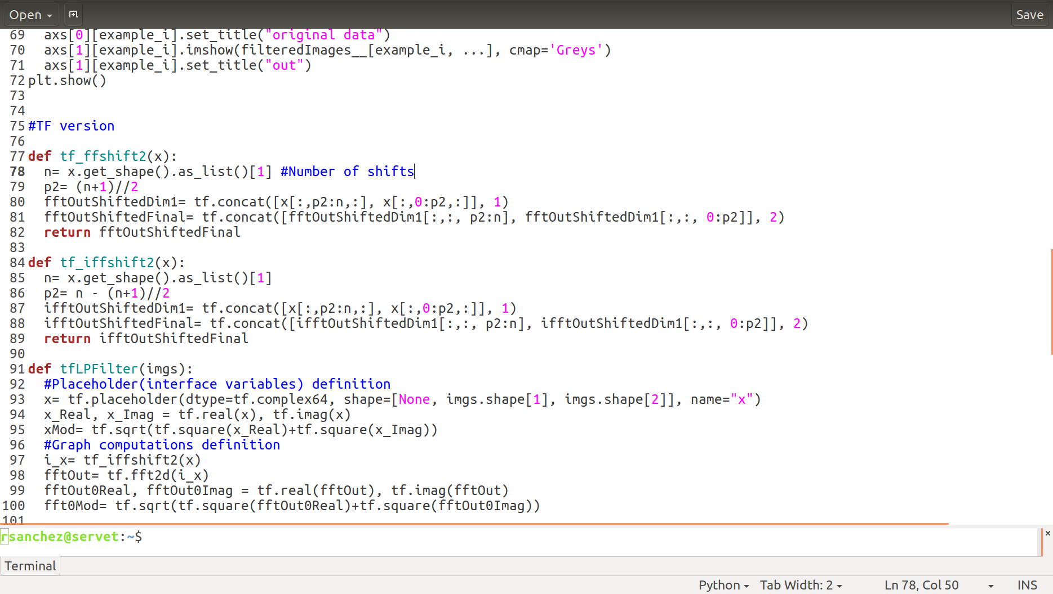
One more interesting example
FFT usage example (numpy vs tf).
Matplotlib needed for results visualization:
conda install matplotlib
./1_tf_intro/examples/e2_fftExample.py

Slide 12
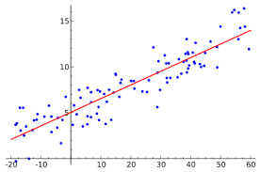
Machine Learning: linear regression
Or alternatively
./1_tf_intro/examples/e3_linRegr.py

Slide 13
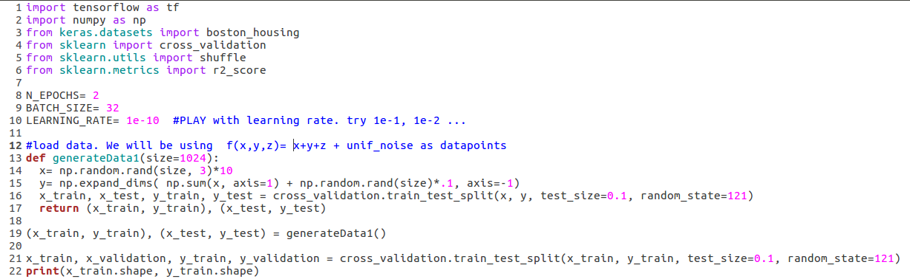
Machine Learning: linear regression
Data preparation: f(x,y,z)= x+y+z +uniform_noise
./1_tf_intro/examples/e3_linRegr.py

Slide 14
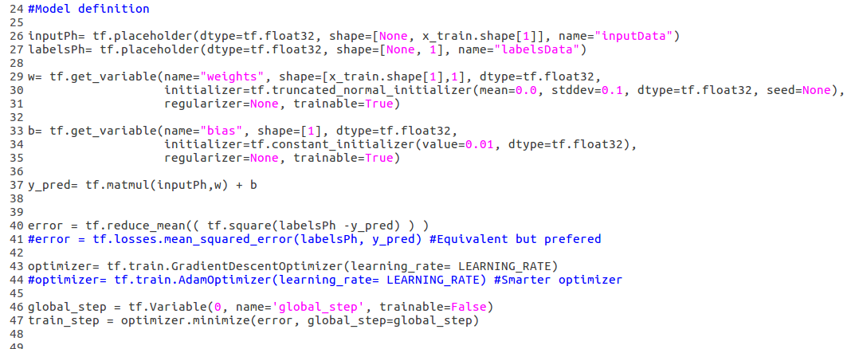
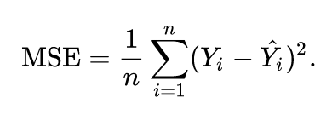
Machine Learning: linear regression
Nx3 tensor
Nx1 tensor
3x1 tensor
scalar tensor
Nx1 tensor
Optimization iteration counter
Optimization step operation. Ask tensorflow to compute it in order to update parameters
./1_tf_intro/examples/e3_linRegr.py

Slide 15
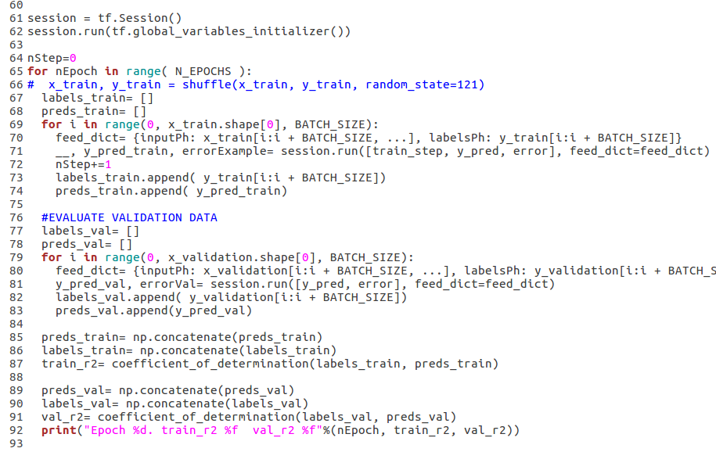
Machine Learning: linear regression
Perform training step
Validation performance is used to decide which model is best and to make changes
./1_tf_intro/examples/e3_linRegr.py

Slide 16
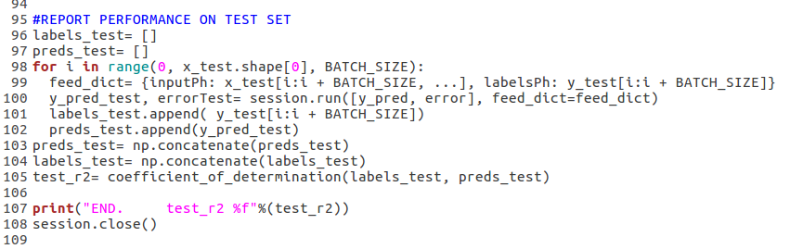
Machine Learning: linear regression
Testing set should be used just once, when reporting performance. No decision must be taken using testing set performance
./1_tf_intro/examples/e3_linRegr.py

Slide 17
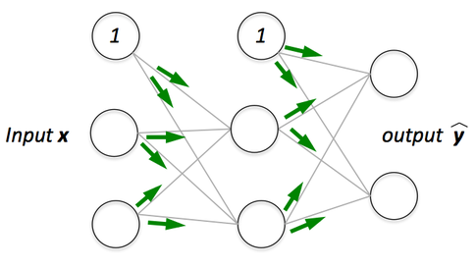
Your turn: implement Neural Network for regression
If doubts API: https://www.tensorflow.org/api_docs/python/
Try different number of layers, different number of neurons, different learning rate… See if your model is capable to overfit.
If synthetic data is too easy, try to use realistic data
  Add these 2 lines:
    from keras.datasets import boston_housing
    (x_train, y_train), (x_test, y_test) = boston_housing.load_data()
  Data scaling can be an issue
My solution: ./1_tf_intro/exercises_sol/sol1_nNetReg.py

Slide 18
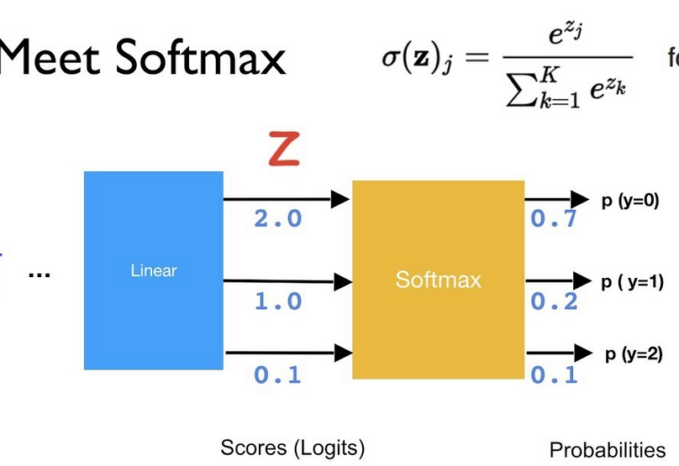
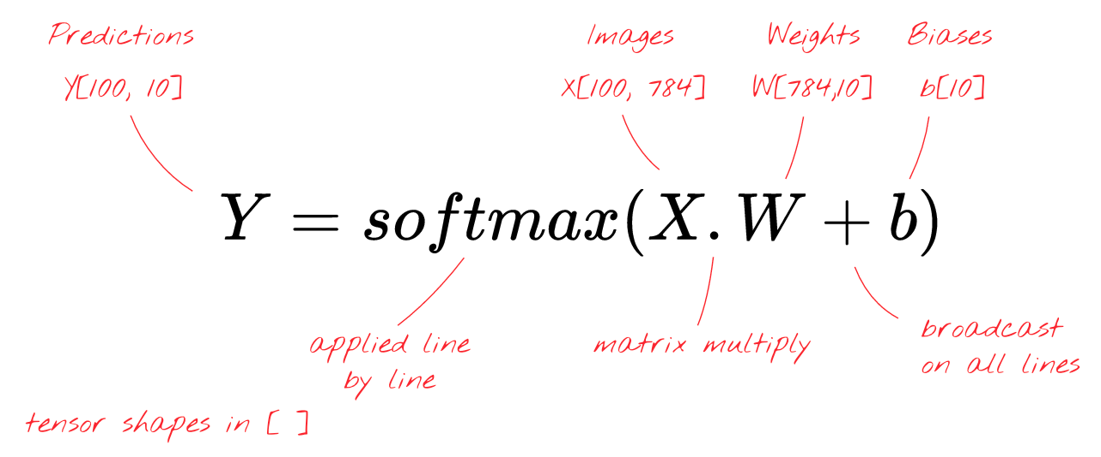
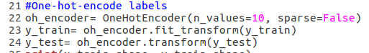
Your turn: implement logistic model for classification
tf.nn.softmax
New data set: cifar10 → 50K images of 10 categories: dog, cat, car, boat, …
  from keras.datasets import cifar10
  (x_train, y_train), (x_test, y_test) = cifar10.load_data()
Labels must be one-hot-encoded: do it automatically with:
  sklearn.preprocessing.OneHotEncoder
Data scaling can be an issue
My solution: ./1_tf_intro/exercises_sol/sol2_logRegr.py

Slide 19
Your turn: implement Neural Network for classification
You can use logistic regression script as starting point
Try other architectures
  Explore convolutional layers in API if you have finished
Help yourself using tensorboard
My solution: ./1_tf_intro/exercises_sol/sol3_nNetClas.py

Slide 20
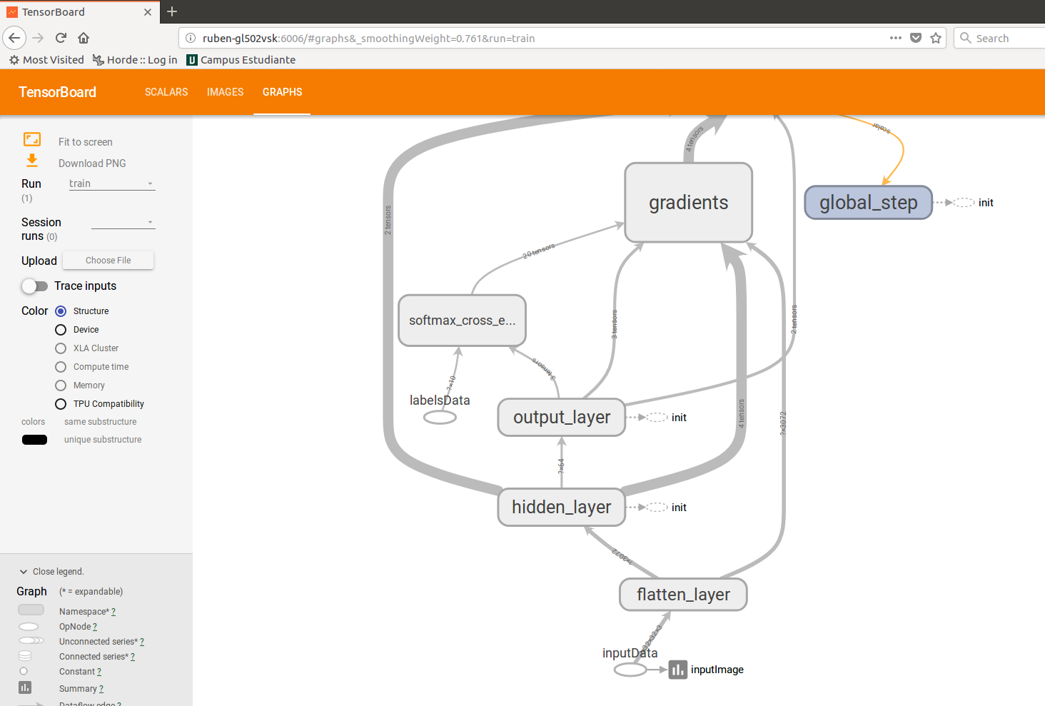
tensorboard
Choose what you want to monitor in your graph
  Scalar tensor:
    tf.summary.scalar(name, scalar_tensor)
  Images:
    tf.summary.image(name, image_tensor)
  Histograms:
    tf.summary.histogram(name, any_tensor)
Right after variables initialization
    merged_summary= tf.summary.merge_all()
    train_writer = tf.summary.FileWriter(dir/for/logs/train, session.graph)
    validation_writer = tf.summary.FileWriter(dir/for/logs/test, session.graph)
When training, ask for merged_summary and save it:
    __, m_summary= session.run([train_step, merged_summary], feed_dict=feed_dict)
    train_writer.add_summary(m_summary, nStep)
Do the same when computing validation
Launch tensorboard from command line: tensorboard --logdir dir/for/logs/test
Visualize it using your web browser and the url reported by tensorboard

Slide 21
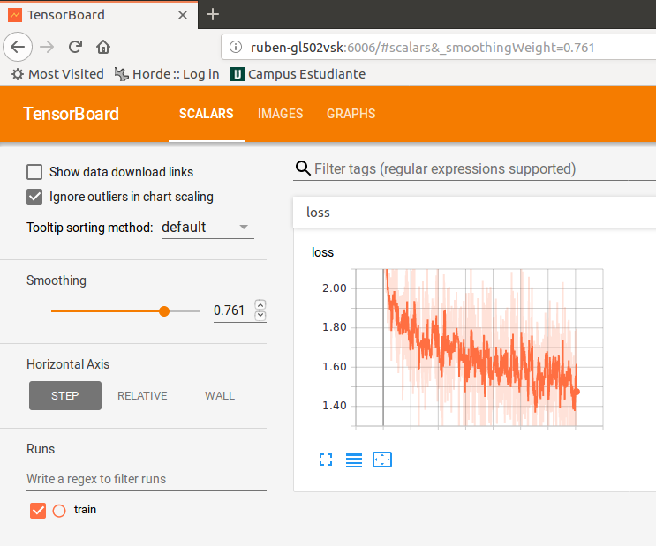
tensorboard
Choose what you want to monitor in your graph
  Scalar tensor:
    tf.summary.scalar(name, scalar_tensor)
  Images:
    tf.summary.image(name, image_tensor)
  Histograms:
    tf.summary.histogram(name, any_tensor)
Right after variables initialization
    merged_summary= tf.summary.merge_all()
    train_writer = tf.summary.FileWriter(dir/for/logs/train, session.graph)
    validation_writer = tf.summary.FileWriter(dir/for/logs/test, session.graph)
When training, ask for merged_summary and save it:
    __, m_summary= session.run([train_step, merged_summary], feed_dict=feed_dict)
    train_writer.add_summary(m_summary, nStep)
Do the same when computing validation
Launch tensorboard from command line: tensorboard --logdir dir/for/logs/test
Visualize it using your web browser and the url reported by tensorboard

Slide 22
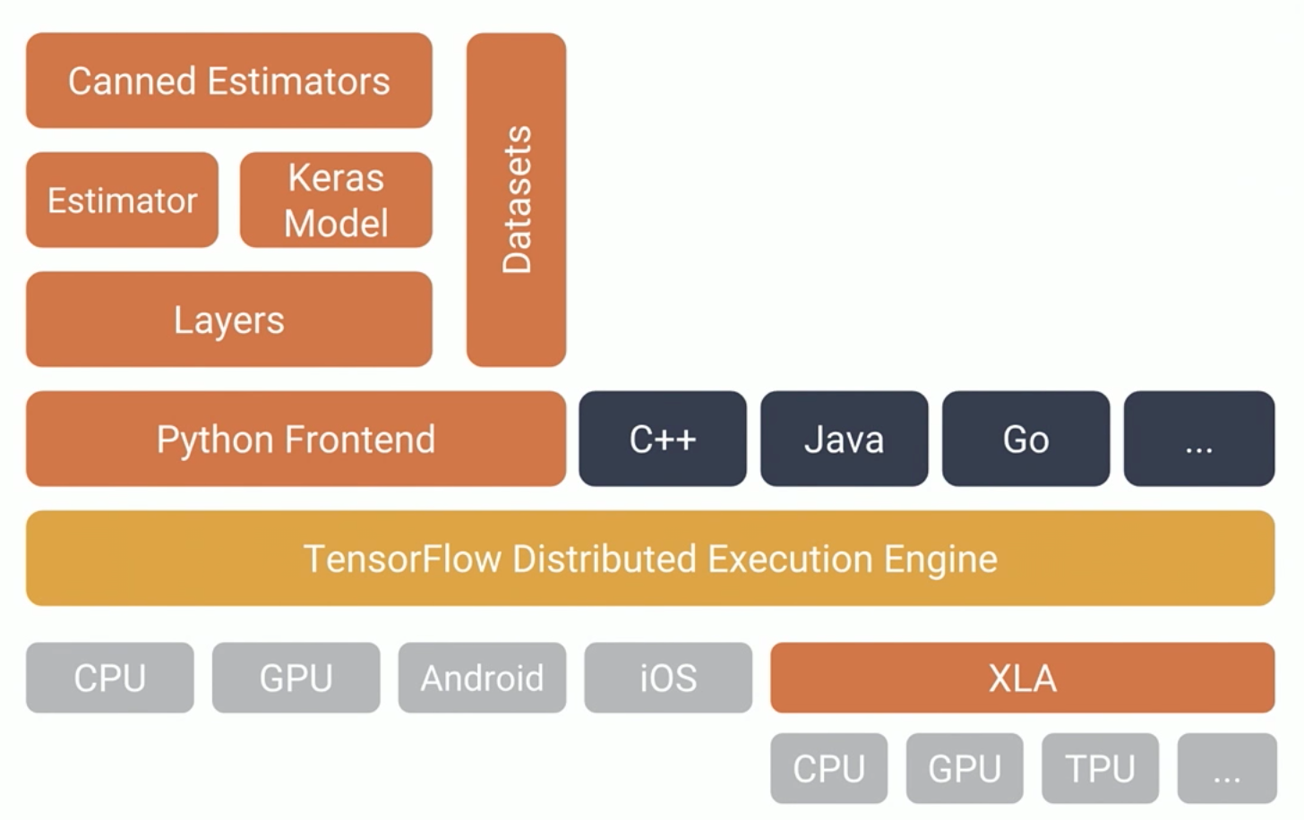
High level tf

Slide 23
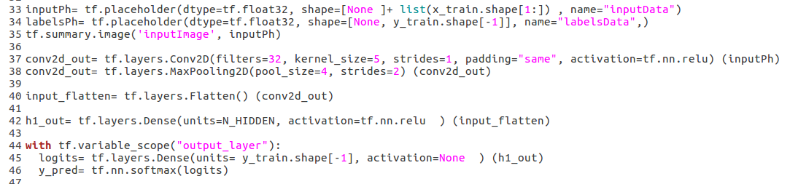
Layers level tf
No need to define weights and bias variables
No need to care about tensor shapes except for the placeholders
Training, evaluation, checkpointing, etc. it is still cumbersome
My solution: ./1_tf_intro/examples/e4_nNet_tfLayers.py

Slide 24
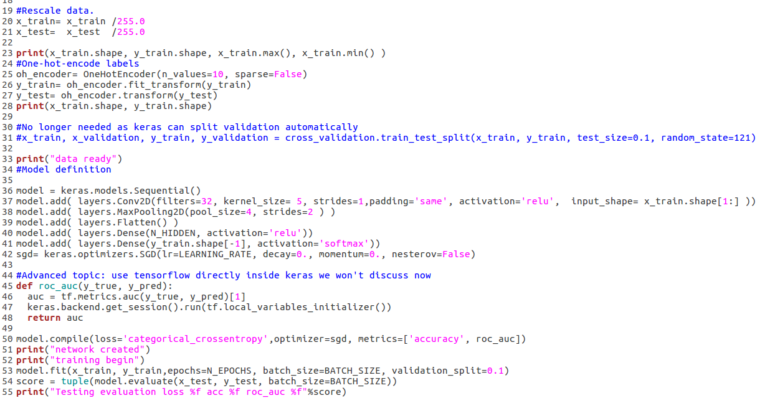
keras
Easy model definition
Easy model training, evaluation, checkpointing
My solution: ./1_tf_intro/examples/e5_nNet_keras.py

Slide 25
To be continued

