Slide 1
Advanced topics
Image segmentation
Image denoising
Image detection
Pre-training and fine tunning.
Working with sequences

Slide 2
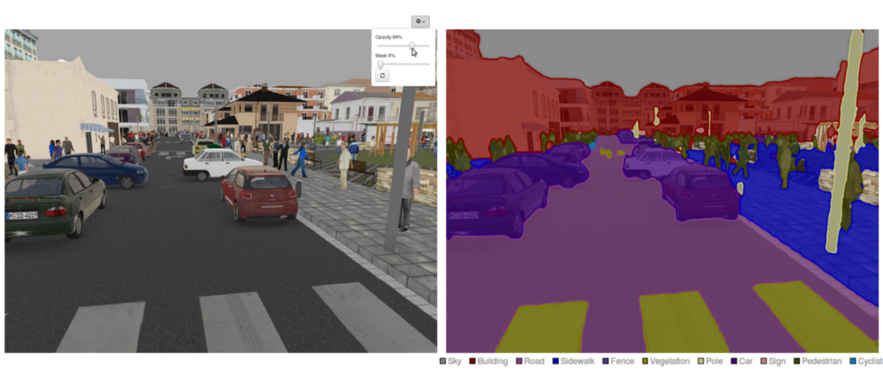
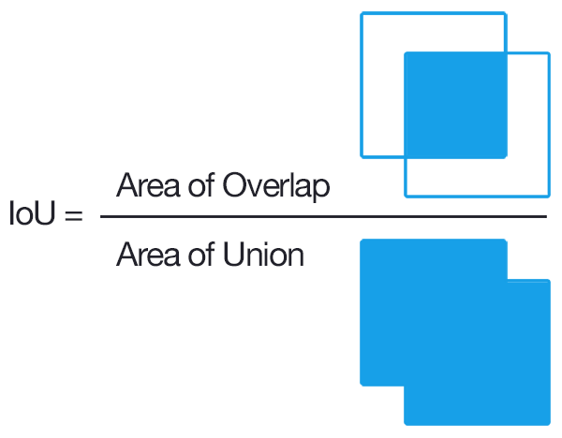
1) Image segmentation
Classification: Predict one label per image.
Detection: Predict boxes where objects are and label them
Segmentation: Predict one label per pixel
    We need images and human curated masks to perform segmentation → difficult to collect big datasets
Typical evaluation metrics: IoU

Slide 3
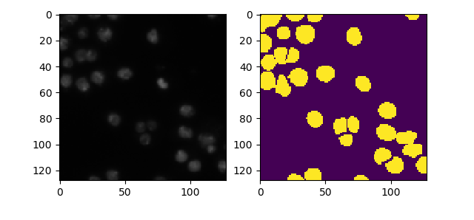
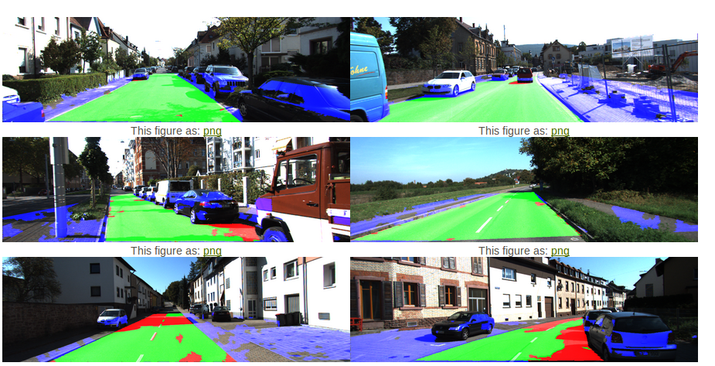
1) Image segmentation: Example
https://www.kaggle.com/c/data-science-bowl-2018
x_train
y_train
http://www.cvlibs.net/datasets/kitti/eval_road_detail.php?result=3748e213cf8e0100b7a26198114b3cdc7caa3aff

Slide 4
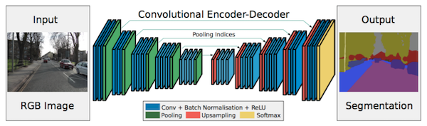
1) Image segmentation
Approaches: generally they have one encoder part and one decoder part, first part is usually pre-trained to perform classification

Slide 5
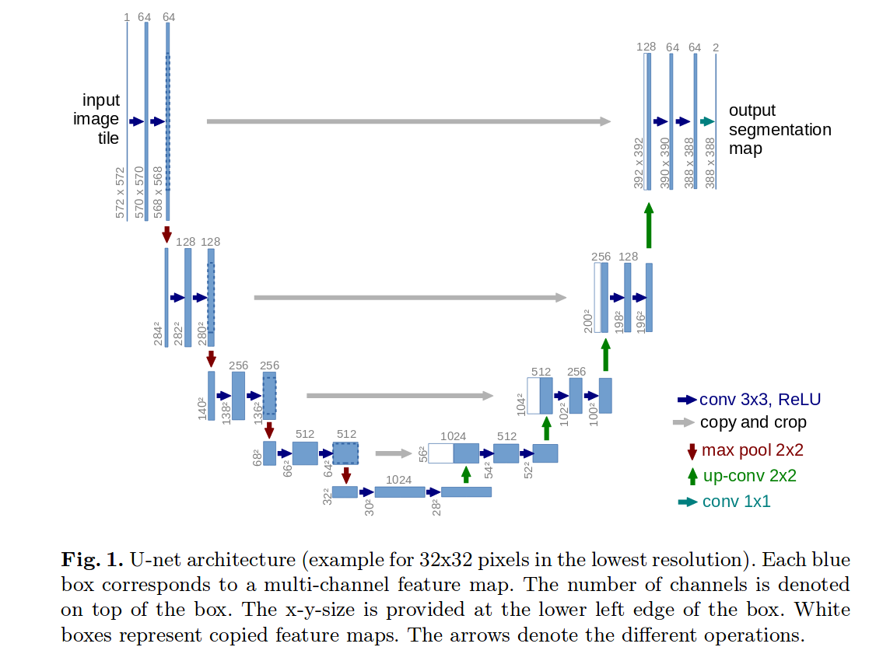
1) Image segmentation
One of the most popular architectures: U-Net
https://arxiv.org/pdf/1505.04597.pdf

Slide 6
1) Image segmentation
One of the most popular architectures: U-Net
https://arxiv.org/pdf/1505.04597.pdf
My example: ./3_advanced_topics/code_segmentation/e1_nuclei_segm.py

Slide 7

2) Image denoising

