Slide 1

Introduction to
https://keras.io/

Slide 2
What is keras?
“Keras is a high-level neural networks API, written in Python and capable of running on top of TensorFlow, CNTK, or Theano. It was developed with a focus on enabling fast experimentation. Being able to go from idea to result with the least possible delay is key to doing good research. Use Keras if you need a deep learning library that:
  Allows for easy and fast prototyping (through user friendliness, modularity, and extensibility).
  Supports both convolutional networks and recurrent networks, as well as combinations of the two.
  Runs seamlessly on CPU and GPU.”

Slide 3
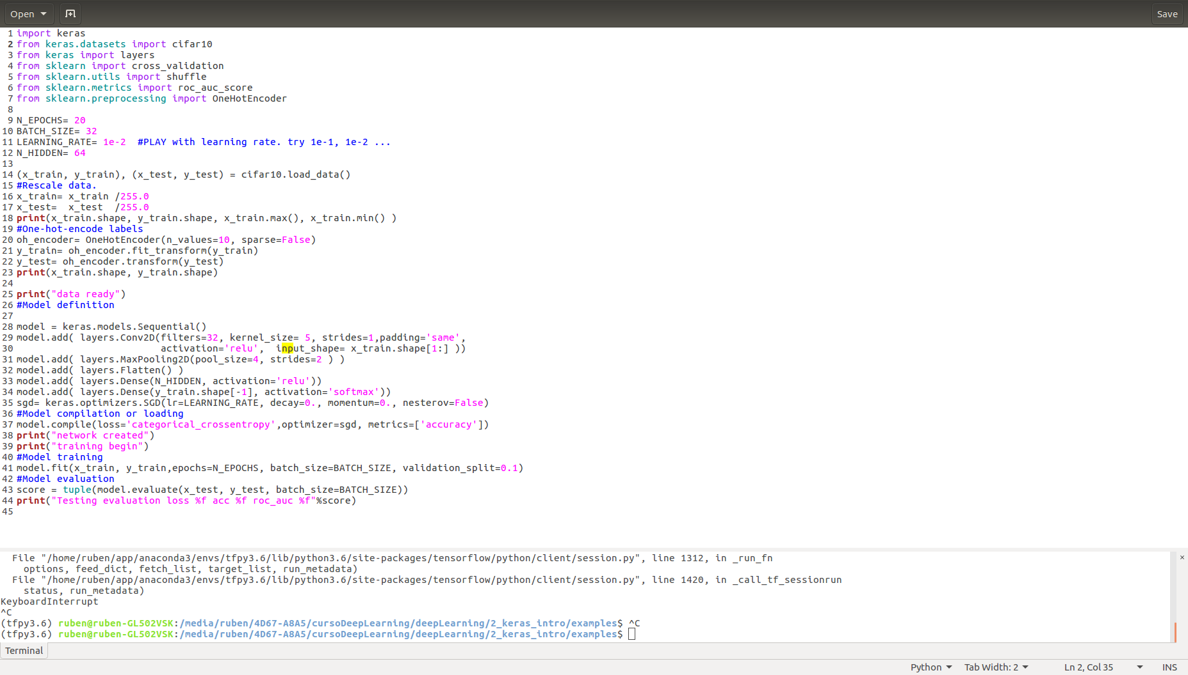
Keras program structure
./2_keras_intro/examples/e1_Sequential_keras.py
Data preparation
Model definition
training
evaluation

Slide 4
Data preparation
If data fits in memory, load it as numpy arrays and train, evaluate or use your model with model.fit(), model.evaluate(), model.predict().
Otherwise, define a python generator that produces batches or a keras.utils.Sequence class and train, evaluate or use your model with model.fit_generator(), model.evaluate_generator(), model.predict_generator().
If you want to train on batches as in tensorflow, use model.train_on_batch(), model.test_on_batch(), model.predict_on_batch()

Slide 5
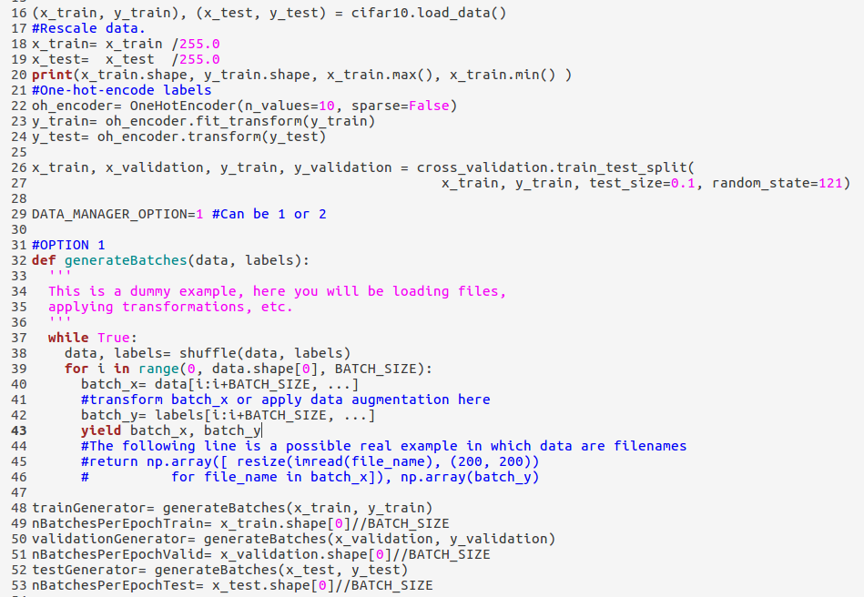
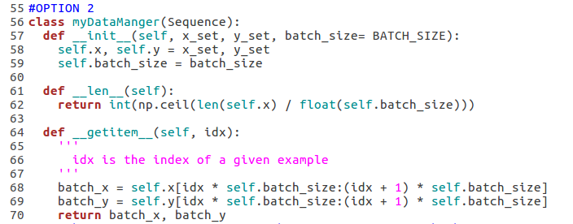
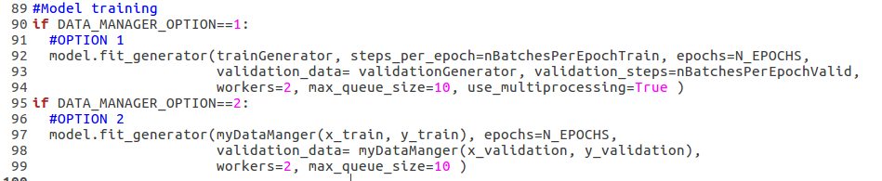
Using generators or keras.utils.Sequence
Generators, or keras.utils.Sequence are handled by keras very efficiently by means of buffers of batches and multiple CPUs
./2_keras_intro/examples/e2_a_fit_from_generator.py

Slide 6
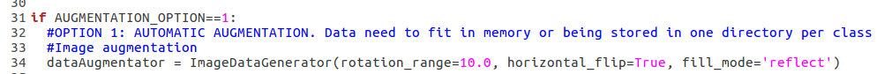
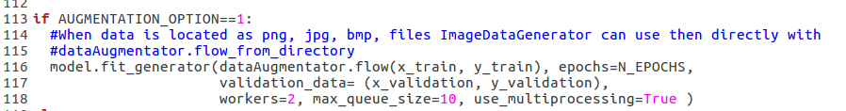
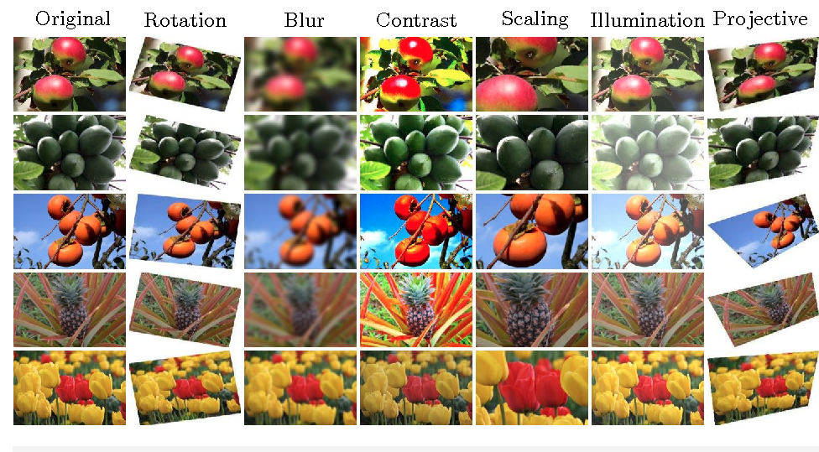
Data augmentation
./2_keras_intro/examples/e2_b_dataAugmentation.py
For images or sequences you can use built-in classes.
https://keras.io/preprocessing/image/#imagedatagenerator-methods

Slide 7
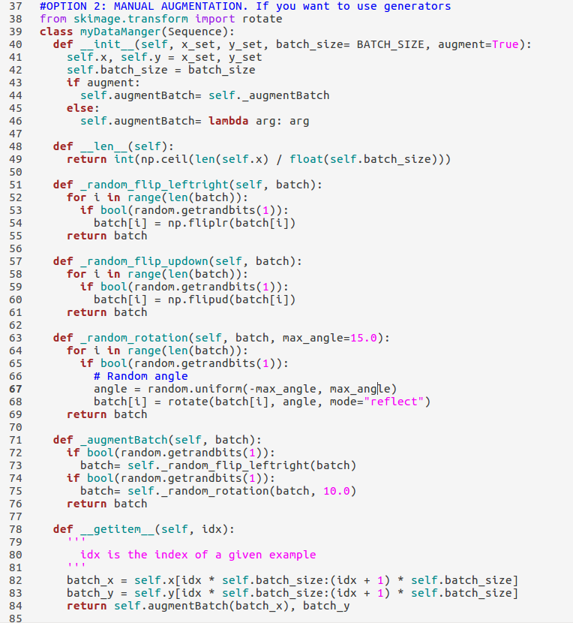
Data augmentation
For other types of data you have to handle it on your way.
  Easy when coupled with generators or keras.utils.Sequence.
./2_keras_intro/examples/e2_b_dataAugmentation.py

Slide 8
Model definition
Two alternatives:
Easy models (Feed-forward, no bifurcations, etc.)
  Use Sequential API (https://keras.io/models/sequential/)
Complicate models
  Use Functional API (https://keras.io/models/model/)

Slide 9
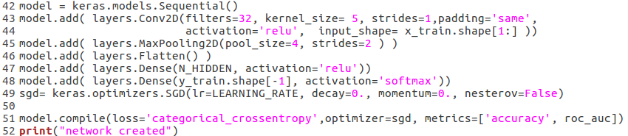
Sequential API
keras.models.Sequential class
https://keras.io/
./2_keras_intro/examples/e1_Sequential_keras.py

Slide 10
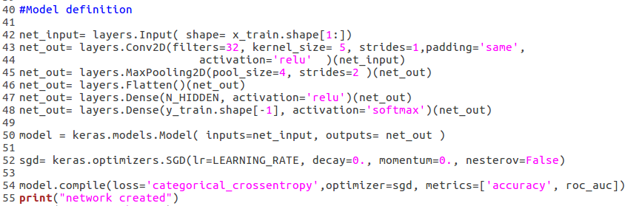
Functional API
keras.models.Model class
https://keras.io/
./2_keras_intro/examples/e3_Funtional_keras.py

Slide 11
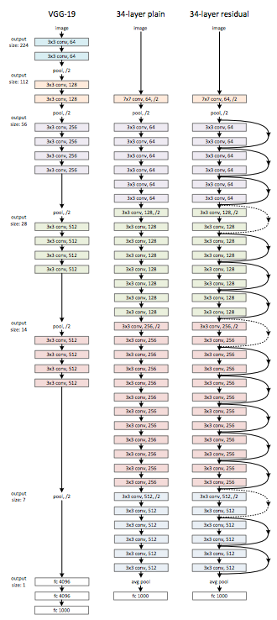
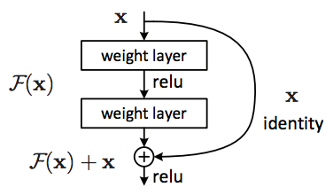
Bifurcation example: Residual Network
Naive ResNet
https://arxiv.org/pdf/1512.03385.pdf
./2_keras_intro/examples/e4_a_Residual_keras.py

Slide 12
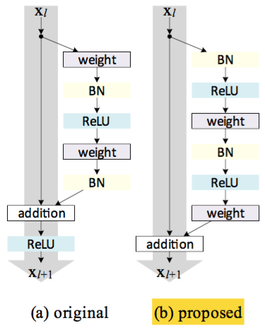
Bifurcation example: Residual Network
https://arxiv.org/pdf/1512.03385.pdf
We will be suffering overfitting:
Dropout
Regularization (l1 or l2)
Data augmentation
Batch Normalization (BN) makes training faster, and it may slightly reduce overfitting.
./2_keras_intro/examples/e4_b_Residual_keras_better.py

Slide 13
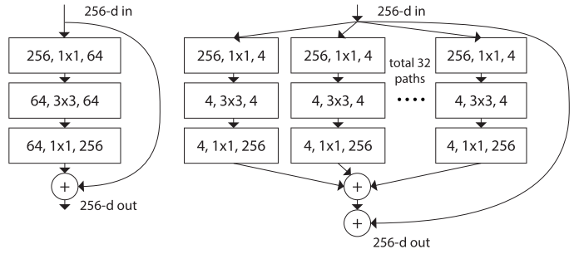
Your turn: ResNext like block
ResNext block
https://arxiv.org/pdf/1611.05431.pdf
./2_keras_intro/exercises_sol/sol1_ResNext.py

Slide 14
Several inputs and/or outputs models
features1
features 2
e.g. Micrograph
e.g. Defocus
Common part
Common part
branch1
branch2
Prediction of label 1
Prediction of label 2
e.g. Is there carbon?
e.g. number of particles on the micrograph
./2_keras_intro/examples/e5_severalInputsOutputs.py

Slide 15
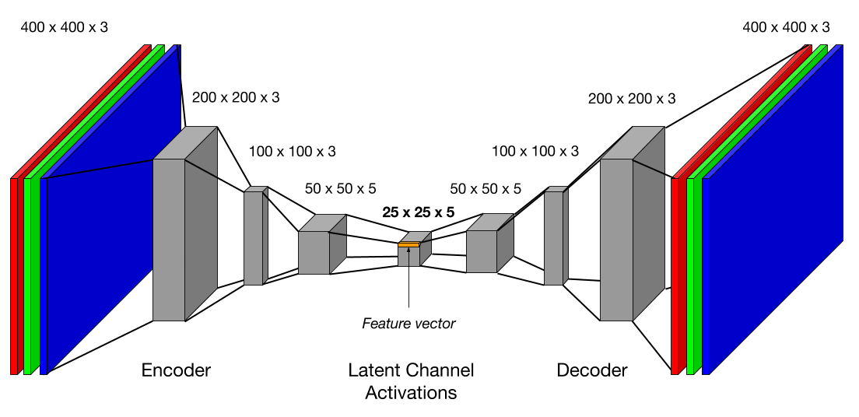
Your turn: implement autoencoder
Number of inner layer params < number of input pixels
Y: Input-like output
X: Input
Z: Compressed output
Cost= mean(X-Y)²
Denoising autoencoders add gaussian noise to X in order to force better representation
./2_keras_intro/exercises_sol/sol2_convAutoencoder.py

Slide 16
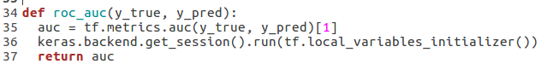
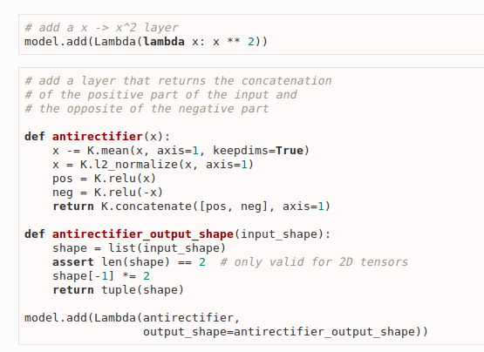
Using low level keras: keras.backend
Keras.backend is similar to tf low level calls.
Used inside Lambda layers and loss or metrics definitions.
  Direct tf calls can be done inside

Slide 17
Training tricks: callbacks
Callbacks are functions that are applied at certain stages of training, typically at the end or the beginning of a new epoch. Passed as argument to model.fit()
Very useful default callbacks:
  keras.callbacks.ModelCheckpoint.
  keras.callbacks.EarlyStopping.
  keras.callbacks.ReduceLROnPlateau
  keras.callbacks.TensorBoard
./2_keras_intro/examples/e6_model_with_callbacks.py

Slide 18
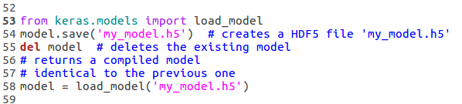
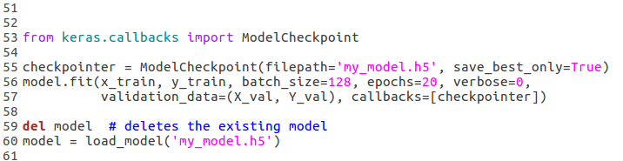
keras.callbacks.ModelCheckpoint saves keras model after epochs that have improved evaluation metric.
Save model manually
./2_keras_intro/examples/e6_model_with_callbacks.py
Checkpointer saving model
keras.callbacks.ModelCheckpoint(filepath, monitor='val_loss', verbose=0, save_best_only=False, save_weights_only=False, mode='auto', period=1)

Slide 19
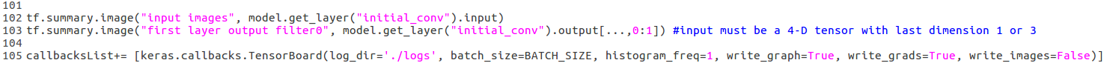
ReduceLROnPlateau helps optimizer to improve results by lowering learning rate when stuck
keras.callbacks.ReduceLROnPlateau(monitor='val_loss', factor=0.1, patience=10, verbose=0, mode='auto', min_delta=0.0001, cooldown=0, min_lr=0)
EarlyStopping prevents overfitting by stopping when error is not improving
keras.callbacks.EarlyStopping(monitor='val_loss', min_delta=0, patience=0, verbose=0, mode='auto', baseline=None)
Tensorboard usage
keras.callbacks.TensorBoard(log_dir='./logs', histogram_freq=0, batch_size=32, write_graph=True, write_grads=False, write_images=False, embeddings_freq=0, embeddings_layer_names=None, embeddings_metadata=None, embeddings_data=None)
Warning: Makes training slower specially if write_xx=True. Use only for debugging.
If True all layers will be recorded, better with tf.summary

Slide 20
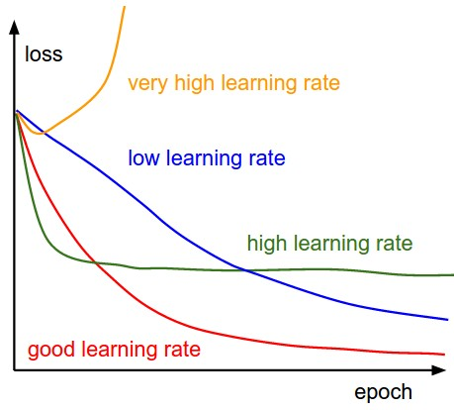
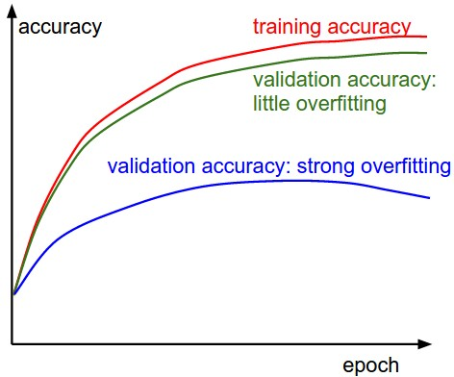
Your turn: do your best on cifar10
My advices:
Always normalize data
First try to overfit small subset of training data using big network. If you are not able to do so, there is some problem with your data or your network.
Use Adam optimizer. If loss oscillates, try smaller learning rate. If keeps vibrating, try different values of epsilon parameter. Increasing batch size also may help.
Use ReduceLROnPlateau.
Use checkpoints and employ the one with the best performance. (Sometimes using several checkpoints and averaging them works better).
Start with a well established architecture.
Monitor train and validation loss or accuracy. Diagnose weather you are suffering overfitting or underfitting and apply corrective actions (more/less regularization, data augmentation…).

Slide 21
The end

