Slide 1
Global Life Expectancy: How can the developing world catch up?
Robert Sandberg
NYC Data Science Academy

Slide 2
Outline
Research questions and stakeholders
Dataset
Exploratory data analysis
Multiple linear regression models
Conclusions
Future work

Slide 3
Stakeholders
Research questions
What features are most important in predicting the life expectancy of a country?
How have these features changed over time?
How do these features compare for developed versus developing countries?
National governments and policy makers around the world

Slide 4
World Health Organization (WHO) Dataset
193 countries
Years: 2000-2014
20 Features: Status, Life expectancy, Adult mortality, Infant deaths, Alcohol, Percentage expenditure, Hepatitis B, Measles, BMI, Under 5 deaths, Polio, Total expenditure, Diphtheria, HIV/AIDS, GDP, Population, Thinness 1-19 years, Thinness 5-9 years, Income composition of resources, Schooling

Slide 5
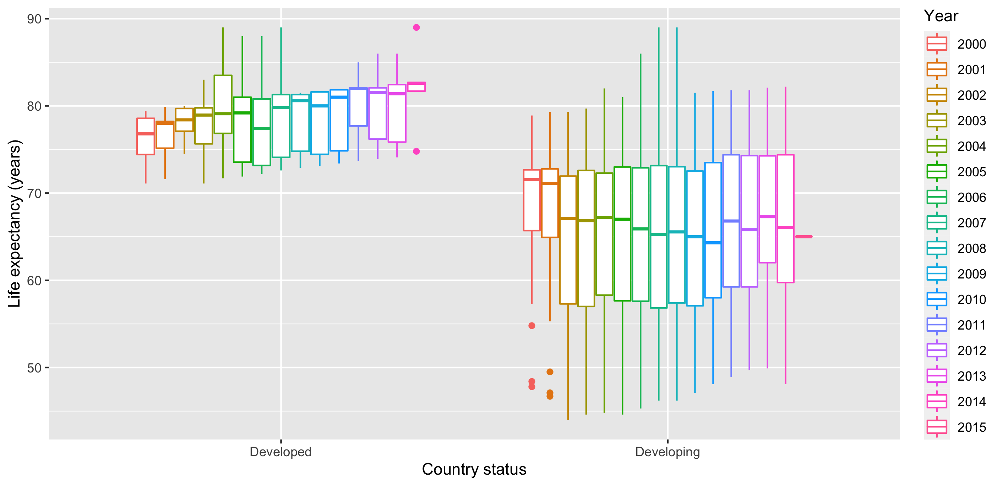
Life expectancy by Country Status

Slide 6
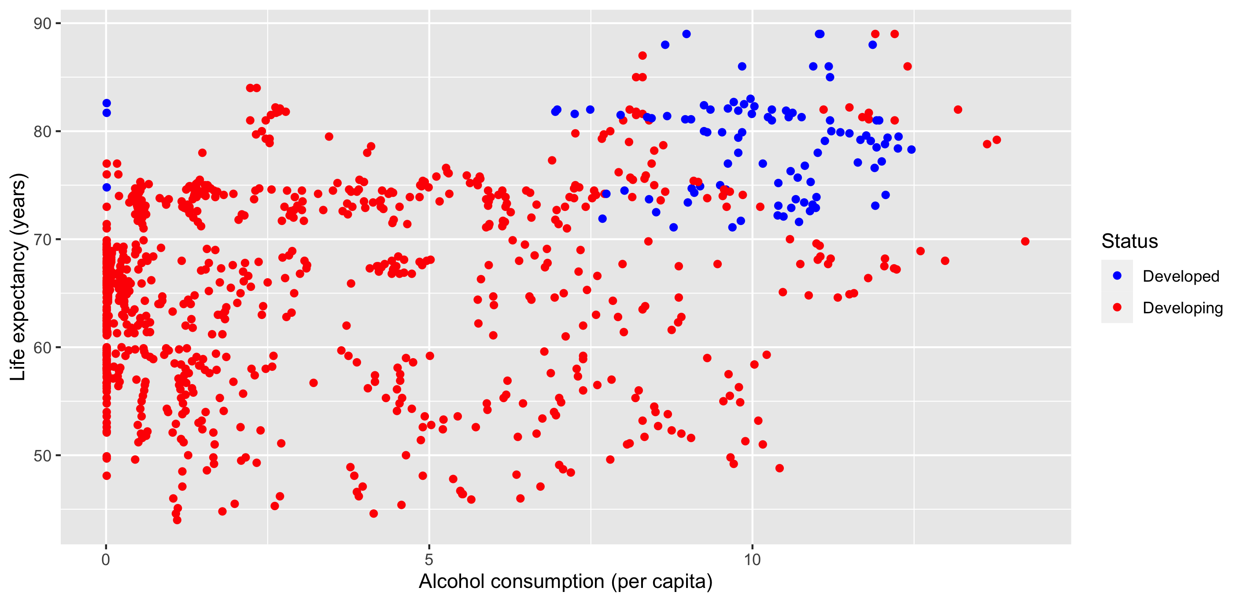
Life expectancy vs alcohol consumption

Slide 7
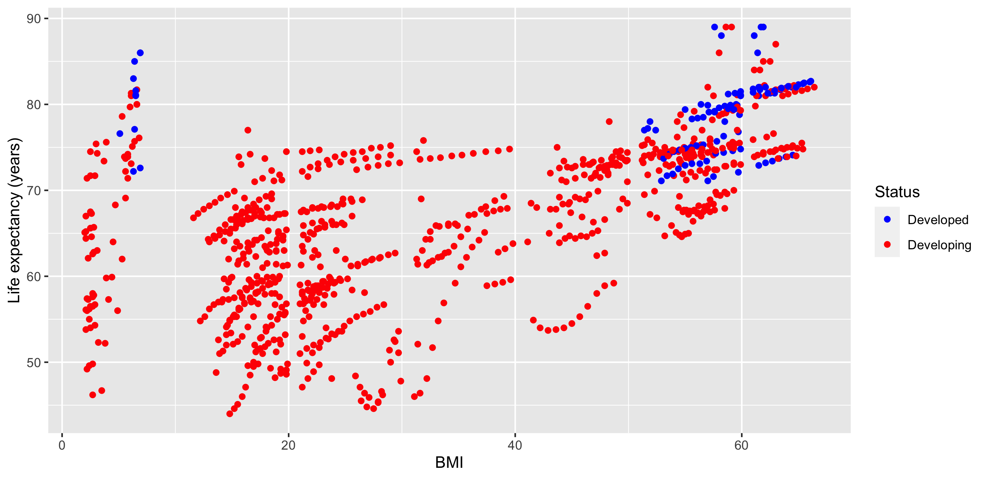
Life expectancy vs BMI

Slide 8
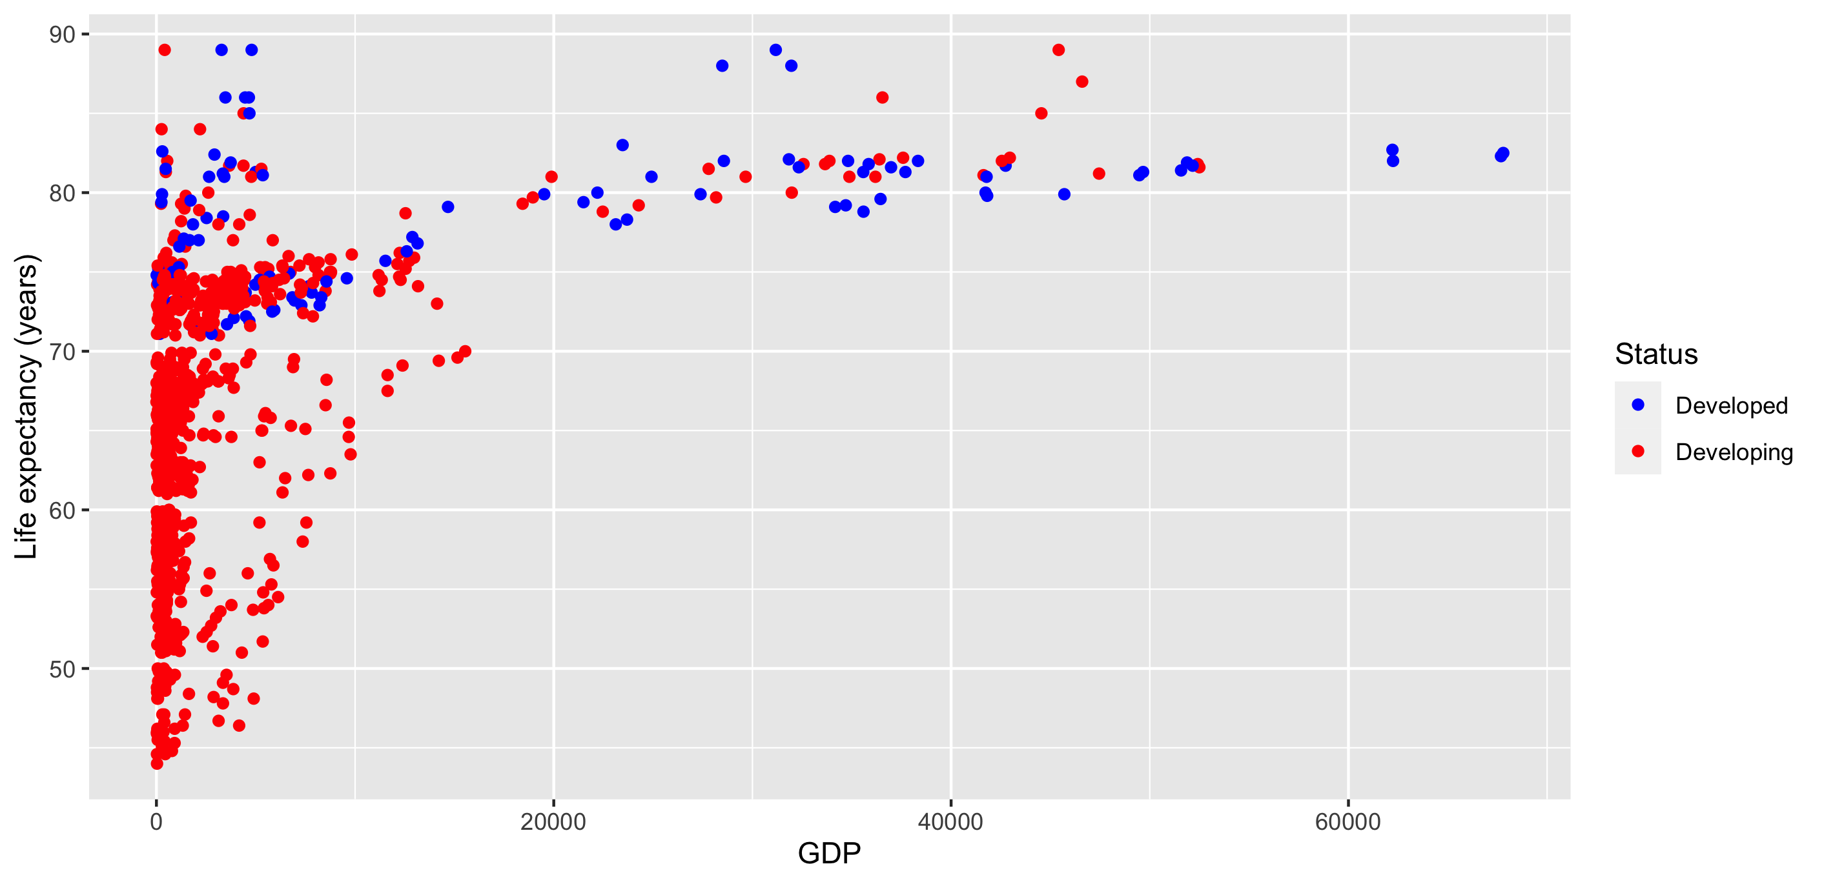
Life expectancy vs GDP

Slide 9
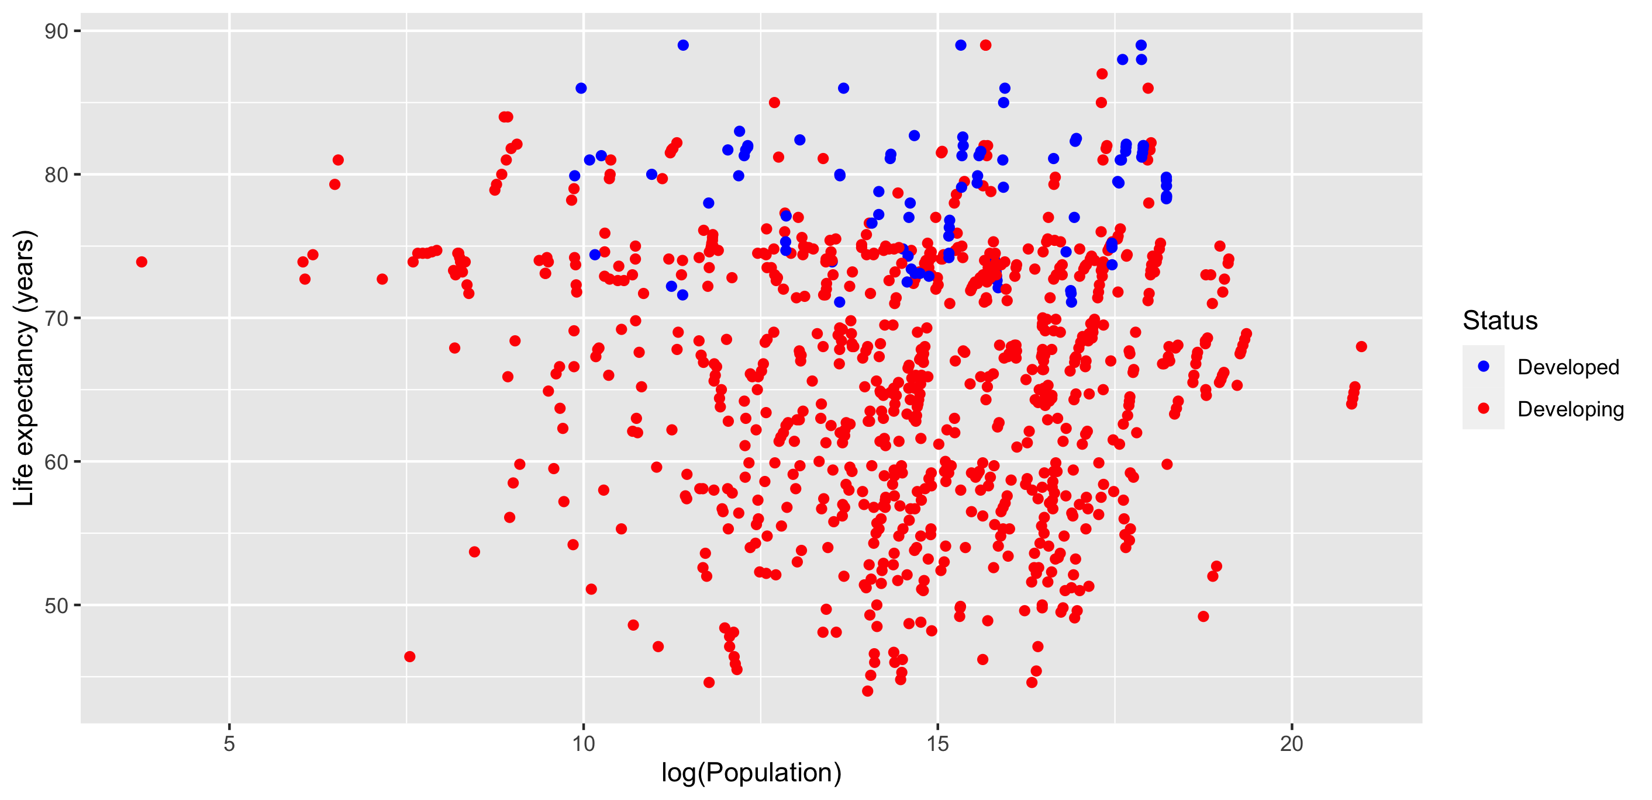
Life expectancy vs Population

Slide 10
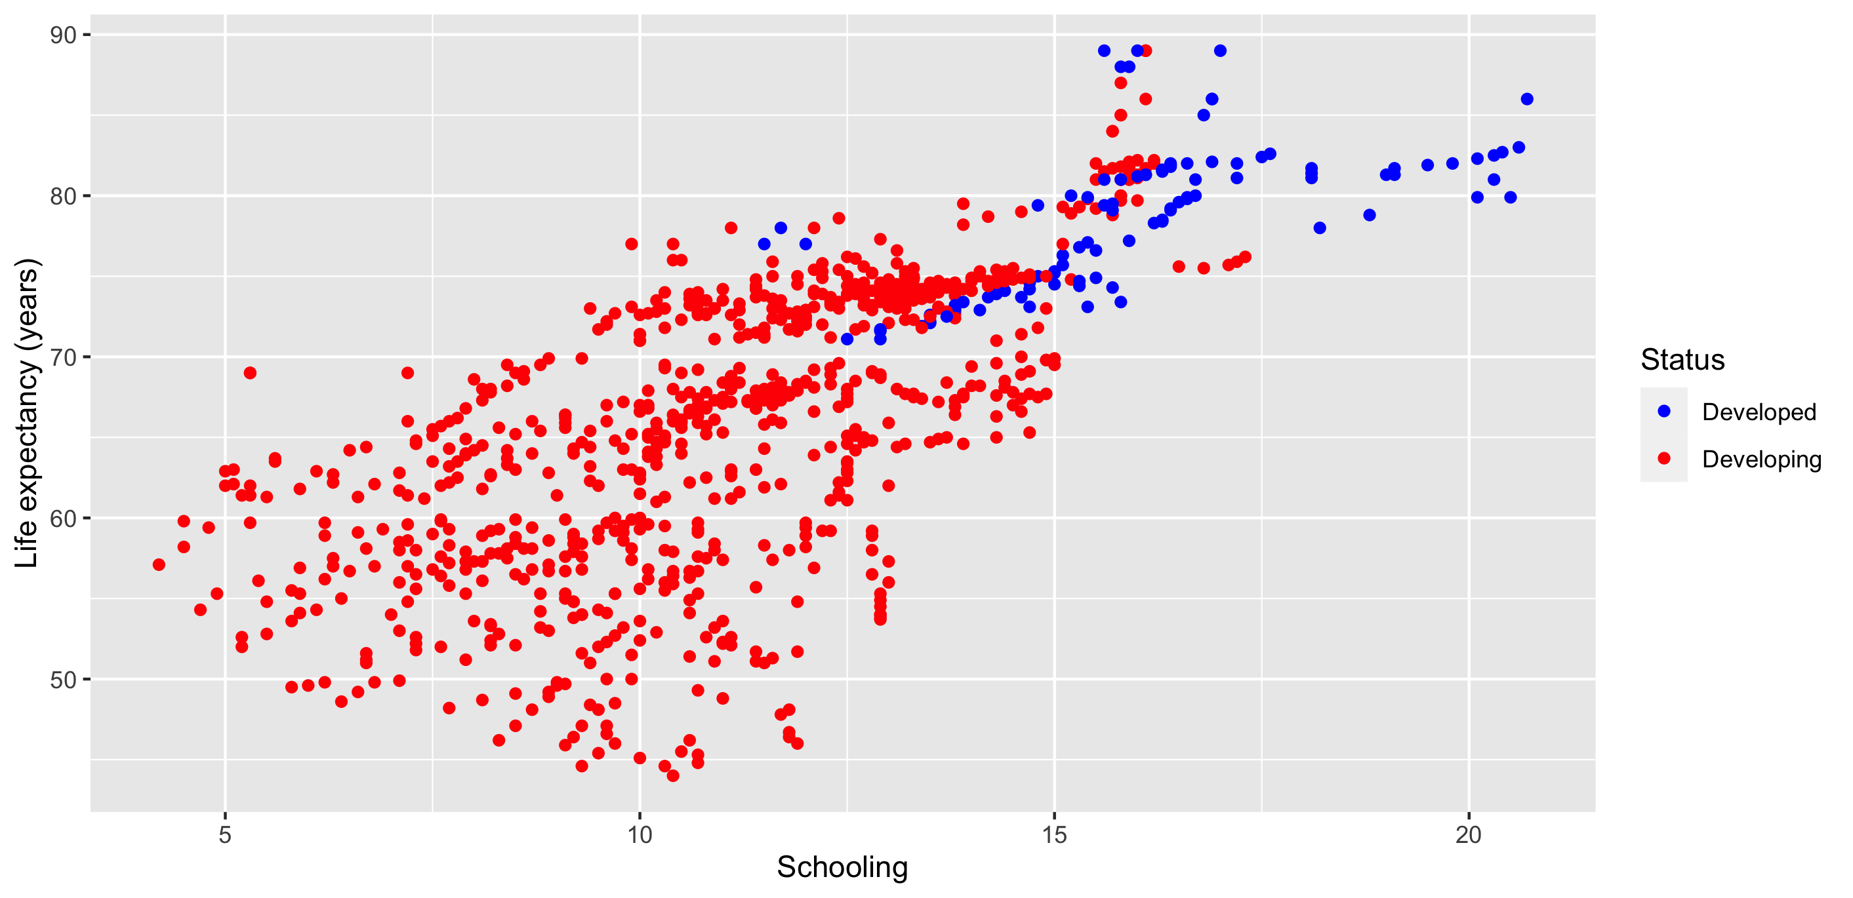
Life expectancy vs Schooling

Slide 11
Multiple Linear Regression Procedure
All countries, developed, developing
Removed countries with N/A values
Removed 3 columns due to linear dependency
Step-wise regression using AIC as the penalty criteria
Checked regression assumptions were satisfied with plots and VIF values < 5

Slide 12
Multiple Linear Regression: 2000-2014
Country Status | All | Developed | Developing
Intercept | 43.57 | 36.98 | 44.81
Income composition of resources | 49.99 | 55.10 | 47.68
HIV/AIDS | -0.327 |  | -0.327
Adult Mortality | -0.013 |  | -0.013
Alcohol | -0.214 |  | -0.289
Schooling | -0.497 |  | -0.494
Diphtheria | 0.020 |  | 0.026
GDP | 0.000042 |  | 0.000058
Total expenditure | 0.149 | 0.316
Thinness 5-9 years old |  | -1.796
Infant deaths |  | 1.409 | -0.0016
Measles |  |  | 0.000020
R² | 0.894 | 0.756 | 0.881

Slide 13
Multiple Linear Regression: 2000
Country Status | Intercept | Adult Mortality | Income composition of resources | HIV/AIDS | R²
All | 55.31 | -0.0296 | 31.035 | -0.1629 | 0.934
Developing | 56.21 | -0.0317 | 30.039 | -0.1425 | 0.941

Slide 14
Multiple Linear Regression: 2014
Country Status | Intercept | Income composition of resources | Adult Mortality | HIV/AIDS | Diphtheria | R²
All | 48.32 | 29.94 | -0.019 | -0.883 | 0.043 | 0.895
Developing | 49.66 | 27.53 | -0.019 | -0.908 | 0.044 | 0.882

Slide 15
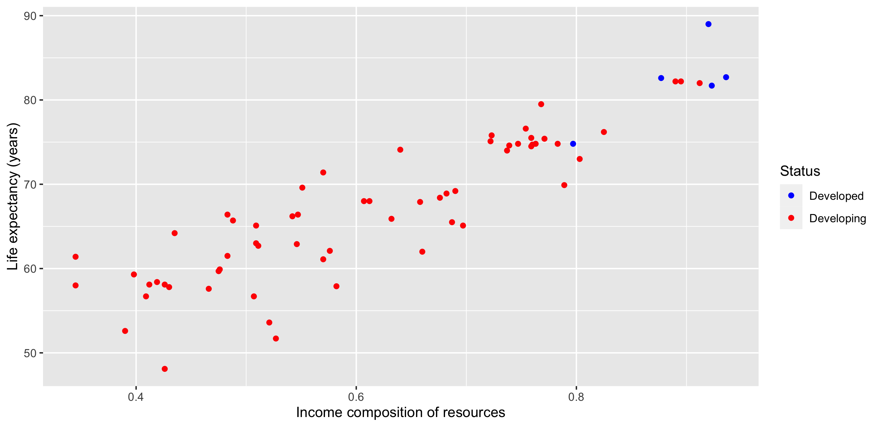
Income composition of resources

Slide 16
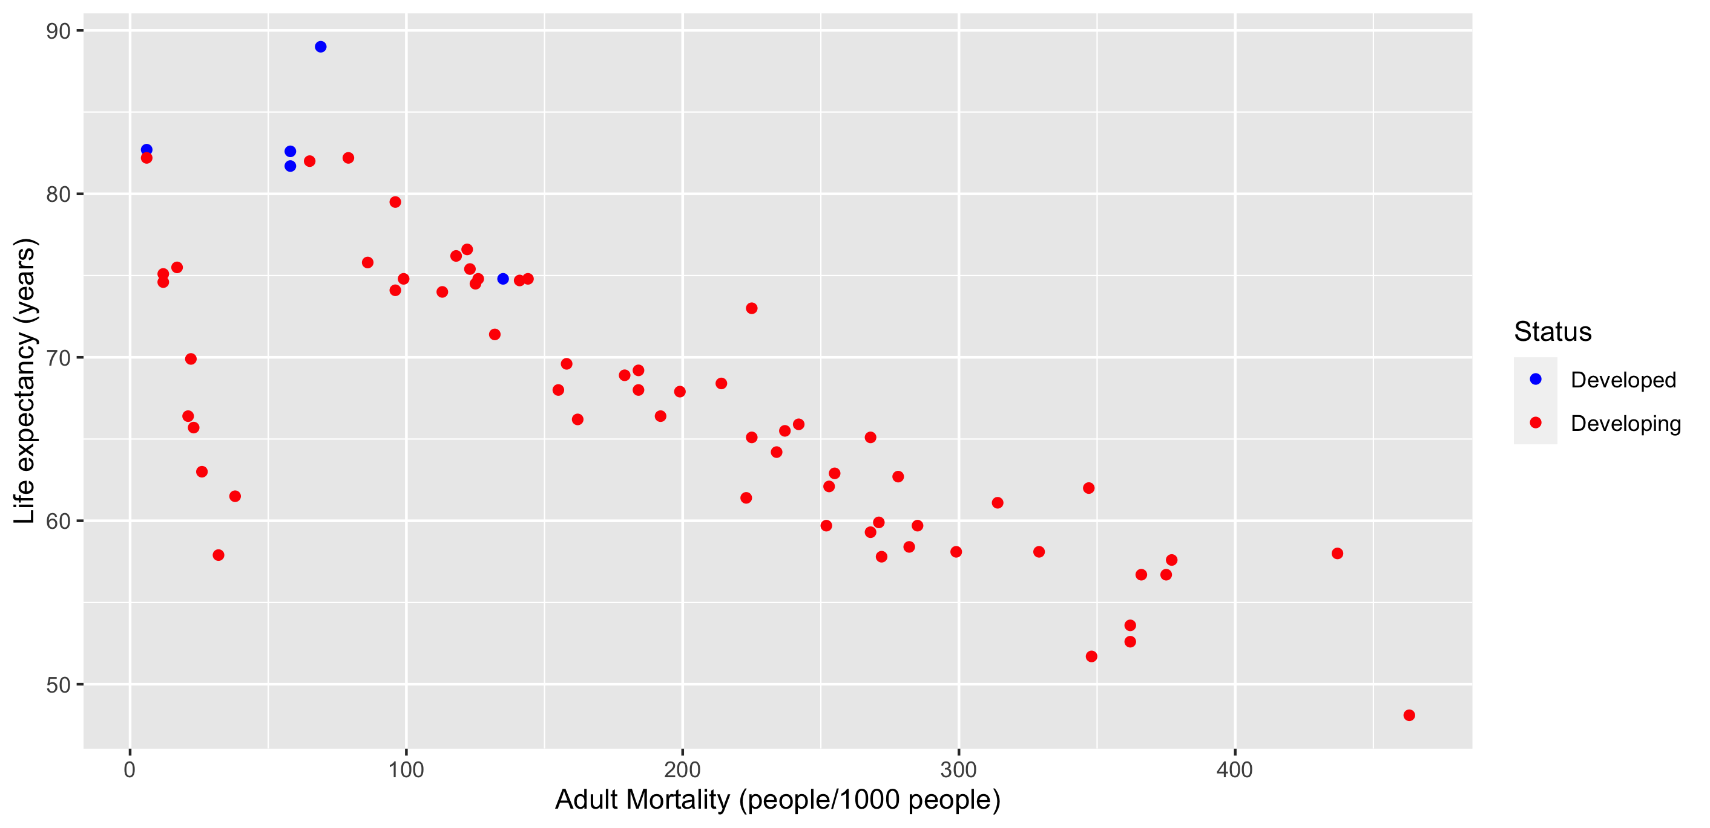
Adult mortality rate

Slide 17
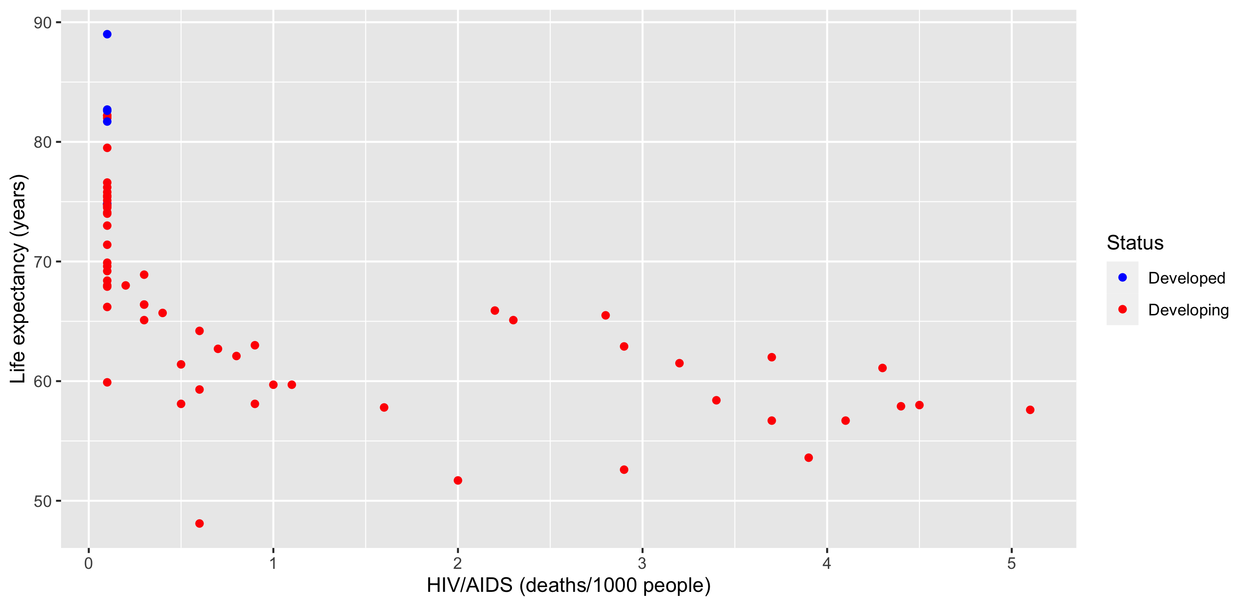
HIV/AIDS death rate

Slide 18
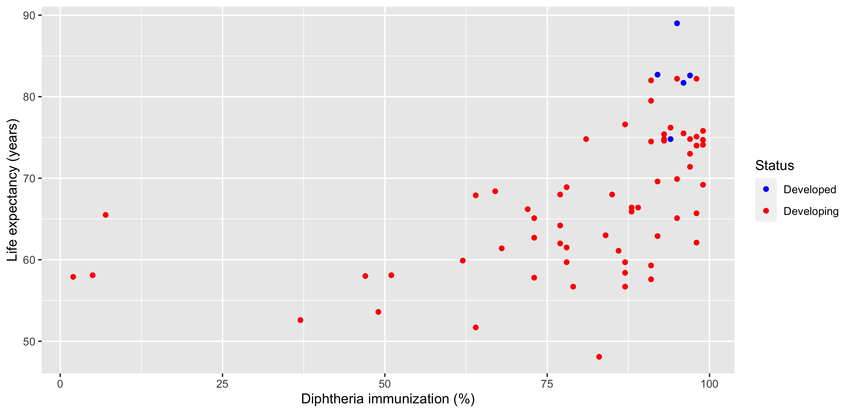
Diphtheria immunization %

Slide 19
Conclusions
Developing vs developed countries
Income composition of resources
↑ 10% utilization ⇒ ↑ 2.75-2.99 years
Adult mortality rate
↓ 100 deaths/1000 ⇒ ↑ 1.9 years
HIV/AIDS death rate (0-4 years old)
↓ 1 deaths/1000 ⇒ ↑ 0.88-0.91 years
Diphtheria immunization (1-year-olds)
↑ 10% immunization ⇒ ↑ 0.43-0.44 years

Slide 20
Future Work
Geographical data
Natural resources data
More economic data: income, minimum wage
More health data: health insurance, quality of healthcare
Larger dataset to split into training dataset and test/validation dataset to assess model accuracy

Slide 21
Questions?

Slide 22
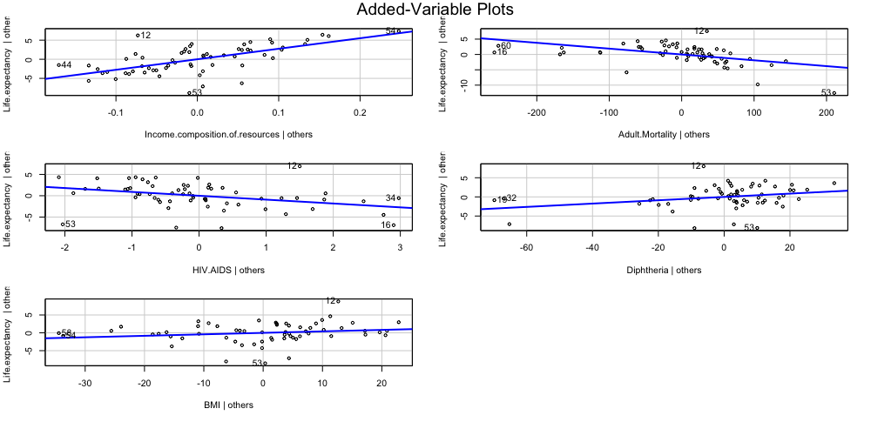
Added-Variable Plots: 2014 Developing

Slide 23
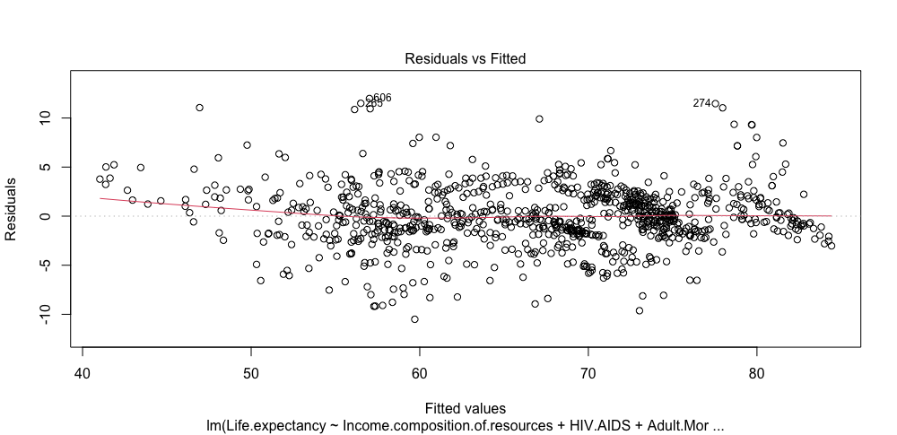
Residuals vs Fitted

Slide 24
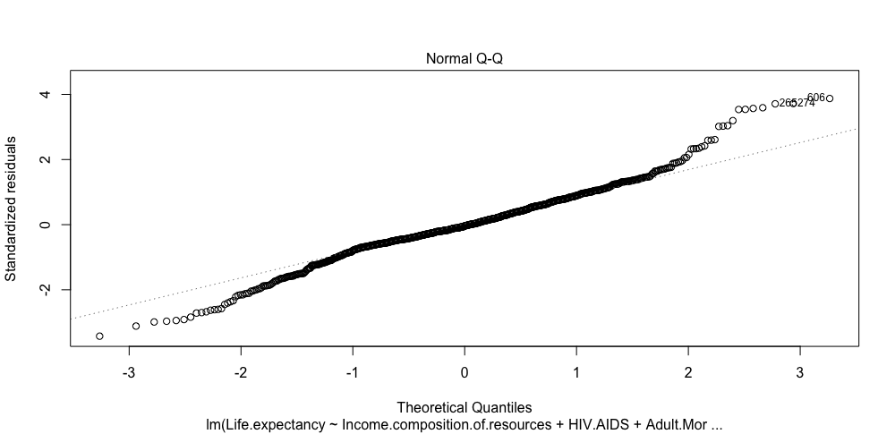
Q-Q Plot

Slide 25
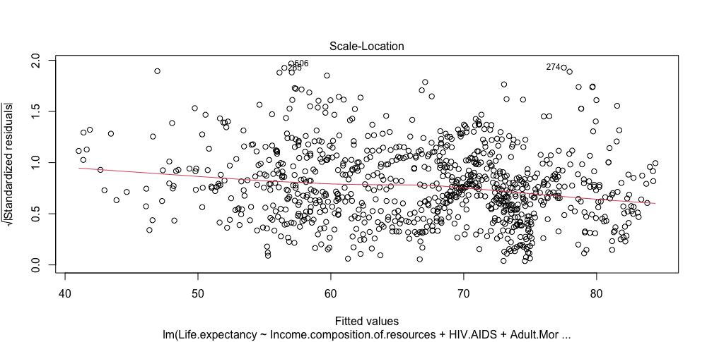
Standardized Residuals

Slide 26
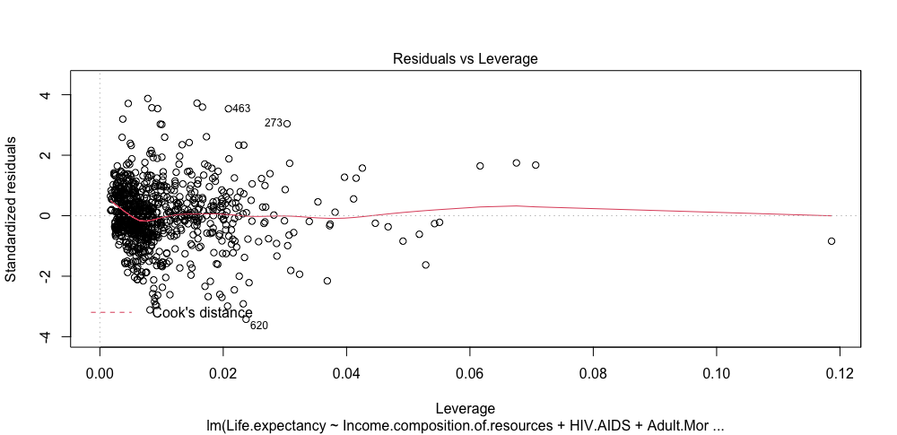
Residuals vs Leverage

