Slide 1
Global Life Expectancy: How can the developing world catch up?
Robert Sandberg
NYC Data Science Academy

Slide 2
Stakeholders
Research questions
What features are most important in predicting the life expectancy of a country?
How have these features changed over time?
How do these features compare for developed versus developing countries?
National governments and policy makers around the world

Slide 3
Dataset

Slide 4
Exploratory data analysis

Slide 5
Multiple Linear Regression: 2000-2014
Country Status | All | Developed | Developing
Intercept | 43.57 | 36.98 | 44.81
Income composition of resources | 49.99 | 55.10 | 47.68
HIV/AIDS | -0.327 |  | -0.327
Adult Mortality | -0.013 |  | -0.013
Alcohol | -0.214 |  | -0.289
Schooling | -0.497 |  | -0.494
Diphtheria | 0.020 |  | 0.026
GDP | 0.000042 |  | 0.000058
Total expenditure | 0.149 | 0.316
Thinness 5-9 years old |  | -1.796
Infant deaths |  | 1.409 | -0.0016
Measles |  |  | 0.000020
R² | 0.894 | 0.756 | 0.881

Slide 6
Multiple Linear Regression: 2000
Country Status | All | Developing
Intercept | 55.31 | 56.21
Adult Mortality | -0.0296 | -0.0317
Income composition of resources | 31.035 | 30.039
HIV/AIDS | -0.1629 | -0.1425
R² | 0.934 | 0.9411

Slide 7
Multiple Linear Regression: 2014
Country Status | All | Developing
Intercept | 48.32 | 49.66
Income composition of resources | 29.94 | 27.53
HIV/AIDS | -0.8829 | -0.9082
Diphtheria | 0.04289 | 0.0436
Adult Mortality |  | -0.0190
R² | 0.895 | 0.882

Slide 12
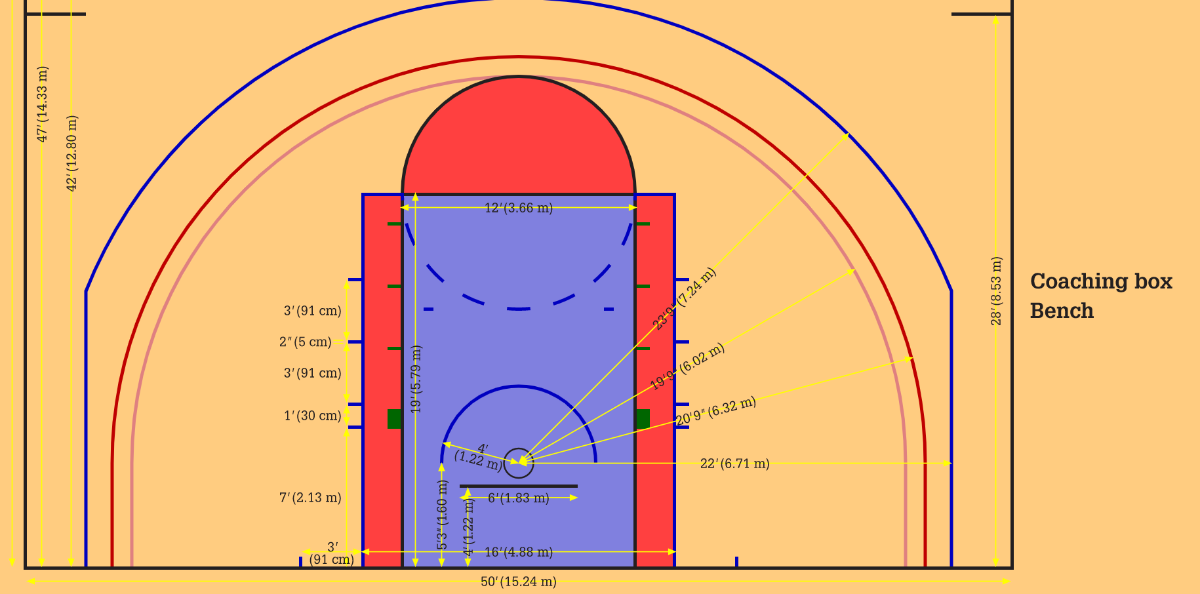
NBA 3-Point Measurements

Slide 13
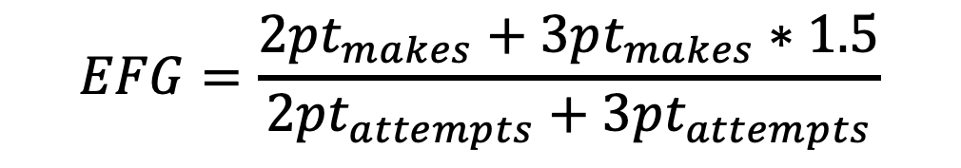
Effective Field Goal (EFG) %
Weighted average of 2-point shots and 3-point shots (expected value)
$$EFG=\frac{2pt_{makes}+3pt_{makes}∗1.5}{2pt_{attempts}+3pt_{attempts}}$$

Slide 14
Frequency of 3-Point Attempts

Slide 15
Distribution of Shot Attempts: 2019-20

Slide 16
Distribution of Field Goal %

Slide 17
Distribution of Effective Field Goal %

Slide 18
3PT % Correlation with Wins: 2019-20

Slide 19
3PT % Correlation with Wins: 2019-20

Slide 20
EFG % Correlation with Wins: 2019-20

Slide 21
EFG % Correlation with Wins: 2019-20

Slide 22
3PT % Correlation with Wins: 2018-19

Slide 23
3PT % Correlation with Wins: 2018-19

Slide 24
EFG % Correlation with Wins: 2018-19

Slide 25
EFG % Correlation with Wins: 2018-19

Slide 26
Conclusions
Shots at or near the rim (2 feet or less) are the most efficient shot
Otherwise, 3-pointers offer a better return
3PT% does not correlate well with wins
EFG% does correlate with wins, especially at the extreme values

Slide 27
Future Work
This dataset
Include other statistical categories (turnovers, FT%, rebounds, etc.) in correlations with wins
Analyze individual players’ shooting abilities/tendencies, especially at the end of games (using time and score)
Additional datasets
Location of shot attempts and nearest defender
Predictive model of FG% (on an individual and team basis) as a function of location and nearest defender

Slide 28
Questions?

Slide 29
Data and Methods
Datasets: csv files for every NBA season, each containing every play
Pandas DataFrame
Text parsing (RegEx, e.g.)

Slide 30
Distribution of Shot Attempts: 2019-20 Playoffs

Slide 31
Distribution of Field Goal %: 2019-20 Playoffs

Slide 32
Distribution of EFG %: 2019-20 Playoffs

