Slide 1
The 3-point shot in the NBA: Analysis of Trends and Correlations with Team Success
Robert Sandberg
NYC Data Science Academy

Slide 2
Stakeholders
Research questions
What types of shots are most efficient?
What shot making strategies are correlated with more wins?
Team owners/General Managers/Scouts: Decision making on players to acquire
Coaches: Decision making on offensive and defensive strategies
Players: Decision making on what types of shots to practice and improve

Slide 3
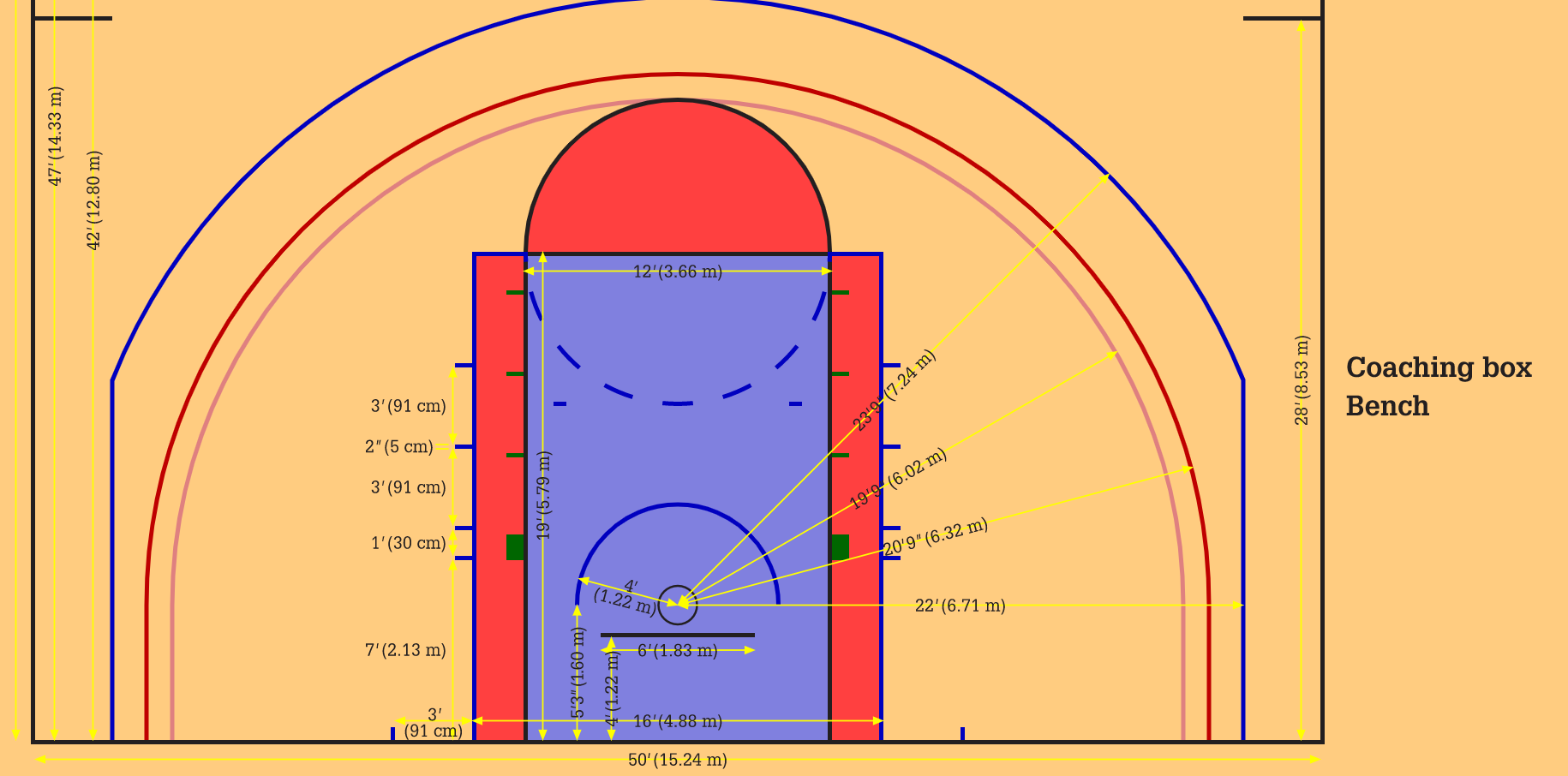
NBA 3-Point Measurements

Slide 4
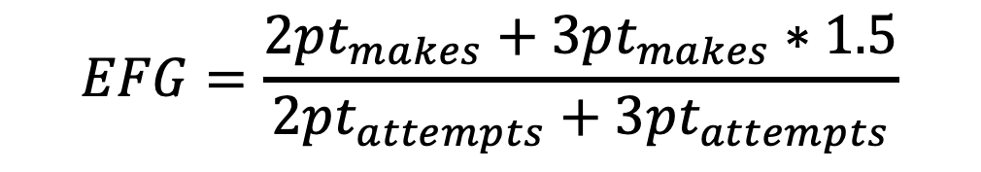
Effective Field Goal (EFG) %
Weighted average of 2-point shots and 3-point shots (expected value)
$$EFG=\frac{2pt_{makes}+3pt_{makes}∗1.5}{2pt_{attempts}+3pt_{attempts}}$$

Slide 5
Frequency of 3-Point Attempts

Slide 6
Distribution of Shot Attempts: 2019-20

Slide 7
Distribution of Field Goal %

Slide 8
Distribution of Effective Field Goal %

Slide 9
3PT % Correlation with Wins: 2019-20

Slide 10
3PT % Correlation with Wins: 2019-20

Slide 11
EFG % Correlation with Wins: 2019-20

Slide 12
EFG % Correlation with Wins: 2019-20

Slide 13
3PT % Correlation with Wins: 2018-19

Slide 14
3PT % Correlation with Wins: 2018-19

Slide 15
EFG % Correlation with Wins: 2018-19

Slide 16
EFG % Correlation with Wins: 2018-19

Slide 17
Conclusions
Shots at or near the rim (2 feet or less) are the most efficient shot
Otherwise, 3-pointers offer a better return
3PT% does not correlate well with wins
EFG% does correlate with wins, especially at the extreme values

Slide 18
Future Work
This dataset
Include other statistical categories (turnovers, FT%, rebounds, etc.) in correlations with wins
Analyze individual players’ shooting abilities/tendencies, especially at the end of games (using time and score)
Additional datasets
Location of shot attempts and nearest defender
Predictive model of FG% (on an individual and team basis) as a function of location and nearest defender

Slide 19
Questions?

Slide 20
Data and Methods
Datasets: csv files for every NBA season, each containing every play
Pandas DataFrame
Text parsing (RegEx, e.g.)

Slide 21
Distribution of Shot Attempts: 2019-20 Playoffs

Slide 22
Distribution of Field Goal %: 2019-20 Playoffs

Slide 23
Distribution of EFG %: 2019-20 Playoffs

