Slide 1
2048 (3D)
By: Sandeep Raghunandhan and Yash Sinha

Slide 2
Rules
During each round of play, the player hits an arrow key which causes certain pieces on the board to shift a certain direction
A tile is spawned during most rounds
When two tiles join, one disappears and the number on the other doubles
Keep playing until you have created a 2048 tile or until you get bored

Slide 3
Project details
Project Manager: Sandeep Raghunandhan
Status Reports: Yash Sinha
Classes: Tile (abstract), Tile3D, ThreeD2048Graphics, Driver2048

Slide 4
Distribution of work
Sandeep:
Movement (Vector math/Matrices)
Collision cases (majority)
Tile design
JUnit tests
Program testing
3DTile
Yash:
Animation
Driver
Some collision cases
Tile abstract class
Web design

Slide 5
Rules of the 3-D Version
Pretty much the same as those of 2D with a few changes
64 possible tiles in 3-Dimensions, stacked in 4 planes of 16 tiles
3 axes of movements (x-axis, y-axis, z-axis)
spawns a tile on every move

Slide 6
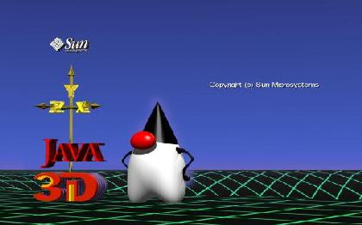
Java3D Fundamentals
SimpleUniverse - gets the basics
ready for the programmer
Canvas3D - your place to draw
BranchGroup - what objects you want to draw and how to draw them
TransformGroup - what objects to move and how to move them
Transform3D - how to move your objects in 3-D space
Alpha - converts time to a floating point value [0.0, 1.0] used for animation
Interpolator - allows you to do a certain kind of animation (translating, scaling, rotation, color changing, transparency changing, etc). Uses the following: TransformGroup, Transform3D, Alpha.

Slide 7
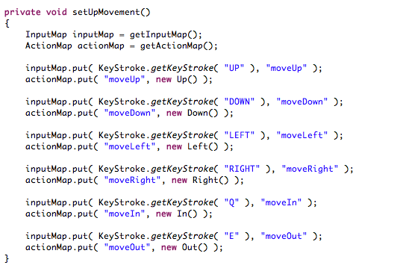
Key Binding Data Structure
Associates a key (an input) with a specific action (an output), a simple form of mapping. A class called Movement extends AbstractAction, and each of the 6-directional movements in 3-D extend Movement.

Slide 8
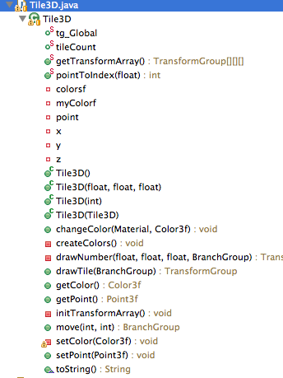
Tile3D extends Tile
Holds the concept of a tile in 3-D space. The color of the tile is specified using a 3 tuple floating point code (Color3f from Java3D)
Has methods to “draw” and “move” the tile into a BranchGroup.
Stores a public static TransformGroup[ ] [ ] [ ] array to keep track of the active tiles. Made public for easy access. Each tile has a unique TransformGroup so that it can be scaled and placed in the right position in 3-D space.

Slide 9
Data Structure:3-Dimensional Arrays
We had three different 3-D arrays which all needed to be in sync with one another.
BranchGroup[ ][ ][ ] graphicTiles; // Keeps track of tiles of screen
TransformGroup[ ][ ][ ] tg_Global; // Keeps track of positions and size of each tile
Tile3D[ ][ ][ ] activeTiles; //Keeps track of tiles “behind the scenes”

Slide 10
Our 3-D 2048 Tile Movement/Collision Algorithm
Let’s say you have four spaces for tiles. How many ways can you place 1,2,3, or 4 tiles in these empty spaces?
₄C₁ + ₄C₂ + ₄C₃ + ₄C₄= 15
Based on how many tiles there are, what numbers the tiles hold, and how the tiles are arranged, we can determine how tiles collide and move.

Slide 11
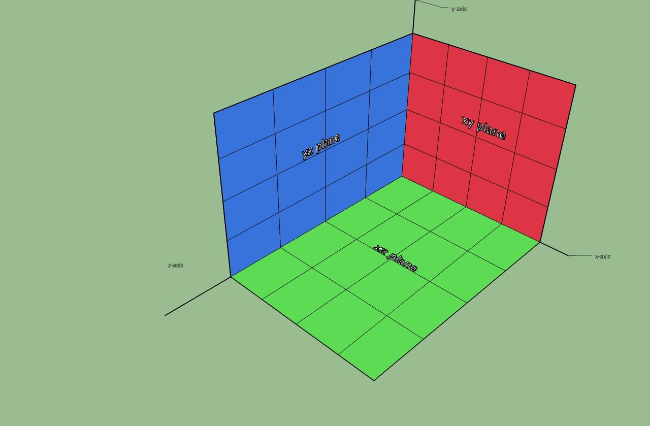
Multivariable calculus helps for this
Let activeTiles[x][y][z] represent a Tile at position (x,y,z)
UP and DOWN hold the y-index to constant 0 and 3, and look at all tiles above and below that given index respectively.
LEFT and RIGHT, hold x-index constant to 0 and 3 and look at tiles to the left and right of that given index
IN and OUT hold z-index constant to 0 and 3 and look at tiles behind and infront of that given index

Slide 12
Why?
Looking for the arrangement of tiles allows us to pattern match to given specific tile collision handling method.
In a given group of 4 spaces, you can have 1, 2, 3, 4 or no tiles. So we wrote collision cases for each of these possibilities. (Ended up with 90 if-else statements and 3000 lines of code)

Slide 13
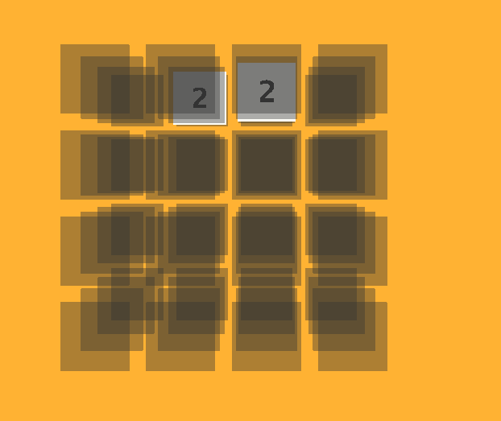
Clean Slate
Two tiles are placed on the board in the beginning
Click and drag on the board to change your view
Board is translucent so you can see most of the tiles
Controls: use arrow keys to shift the tiles up, down, left, and right. Use Q to move the tiles into the screen and E to move the tiles toward you
A tile is spawned on each move

Slide 14
Demonstration of 3D Game

