Slide 1
IoT Alljoyn Research

Slide 2
Purpose
Study IoT theory and framework
Alljoyn
Thethingsystem
ThingSpeak
Define a common framework for IoT development

Slide 3
Planning
Phase 1: Alljoyn
Phase 1.5: MQTT
Phase 2: Thethingsystem
Phase 3: ThingSpeak

Slide 4
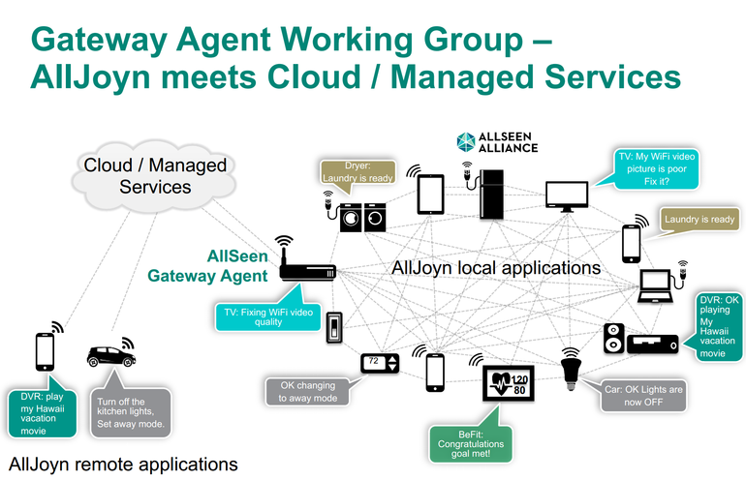
Vision

Slide 5
Architecture Overview
AJ Client
Linux Machine
Android / iOS
AJ Client
AJ lib
AJ lib
AJ Bus
Arduino/Raspberry PI
AJ Service
AJ Service
Beaglebone
AJ Service
DIRECTV STB
AJ lib
AJ lib
AJ lib
Device
Device
Sensor
Sensor

Slide 6
Architecture Overview
Client
An application run on Linux and/or Android
Detect service running on AJ bus
Connect to service running on AJ bus
Receive data from service
Send control command to service
Service
Arduino / Raspberry PI
Broadcast its service to AJ bus: service is to allow control its managed device
Receive control command from client
Send it to device using GPIO or other controlling method
Beaglebone
Receive data from sensor or other devices
Broadcast its service to AJ bus: service is to allow query and provide sensor data

Slide 7
Teaming
Client
Linux
Minh QT + Ly + Son Dang + Dat
Android
Hoang + Thanh + Tan
Service
Beaglebone + Sensor
Khanh + An + Hai
Beaglebone + CEC
Minh Dam + Hung + Lieu
Arduino / Raspberry PI
Tung + Son
DIRECTV STB
Notes:
----- Meeting Notes (1/12/15 17:30) -----
Task assignment to be detail later
Sensor:

Slide 8
Communication
Project Management & Tracking
GCS JIRA
Source Control
GitHub
Chat
Skype/HipChat
Notes:
----- Meeting Notes (1/12/15 17:30) -----
HipChat

Slide 9
Reference
https://allseenalliance.org
http://iot.eclipse.org
http://mqtt.org

